Slide 1
DEPARTMENT OF DEFENCE
Presentation to the PCD&MV
18 August 2021

Slide 2
Aim
Information brief
to the
Portfolio Committee on Defence and Military Veterans
on
FY2020/21 | DOD QPR4 DOD Annual Pre-Audited
FY2021/22 | DOD QPR1 (including BRRR and Vote 23 progress)

Slide 3
Presentation Structure
Departmental Performance for FY2020/21 – Q4
DOD Results-Based Management Dashboard
Performance Status on Targets per Quarter

Slide 4
Presentation Structure
Departmental Performance for FY2020/21 – Annual Pre-Audited Performance
DOD Results-Based Management Dashboard
DOD Pre-Audited Annual Degree of Non-Achievement
DOD Annual Performance Targets NOT Achieved
DOD Degree of Non-Achievement
Year-on-Year Performance Comparison

Slide 5
Presentation Structure
Departmental Performance for FY2021/22 – Q1
Analysis of DOD Performance Indicators
DOD Results-Based Model & Dashboard
Corporate Human Resource Status
Force Employment
Selected Performance Indicators
Financial Performance
Progress against the Budgetary Review and Recommendation Report
Progress against the Report of the PCD&MV on Budget Vote 23

Slide 6
Departmental Performance
FY2020/21
Q4

Slide 7
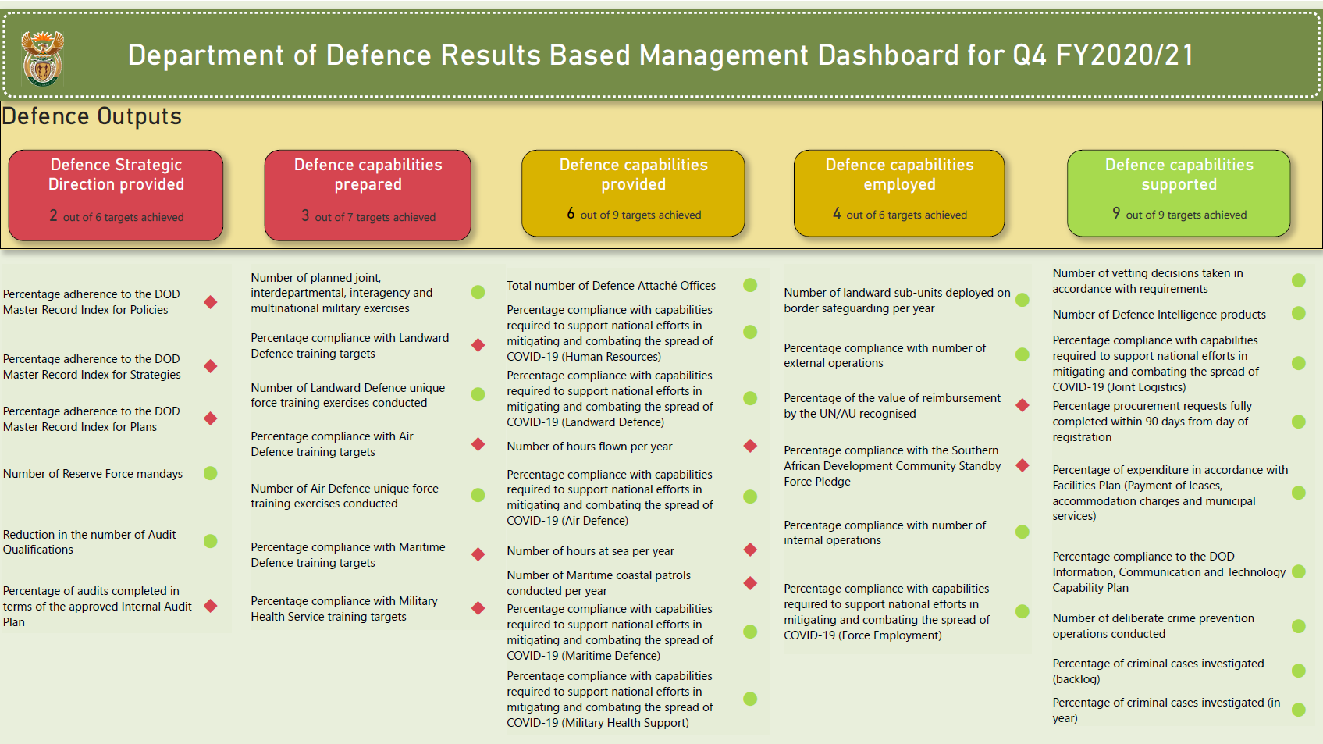
DOD RBM Dashboard – Q4 Achievement

Slide 8
Performance Status on Targets per Quarter
 | Q1 | Q2 | Q3 | Q4
Achieved | 11 (73%) | 7 (50%) | 8 (62%) | 24 (65%)
Not Achieved | 4 (27%) | 7 (50%) | 5 (38%) | 13 (35%)
Total | 15 | 14 | 13 | 37
8

Slide 9
Departmental Performance
FY2020/21
Annual Pre-Audited

Slide 10
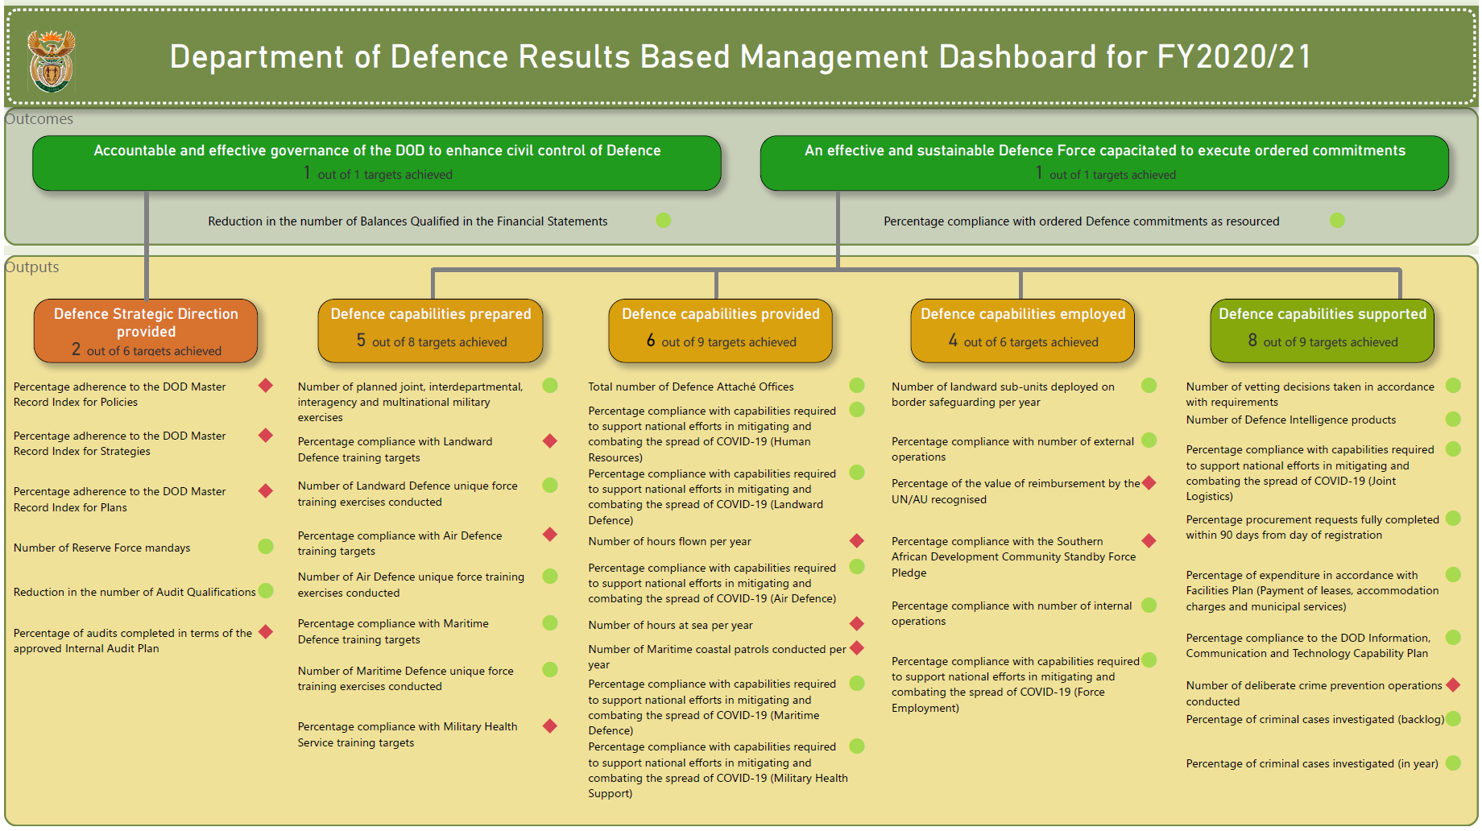
DOD RBM Dashboard –
Annual Pre-Audited Achievement

Slide 11
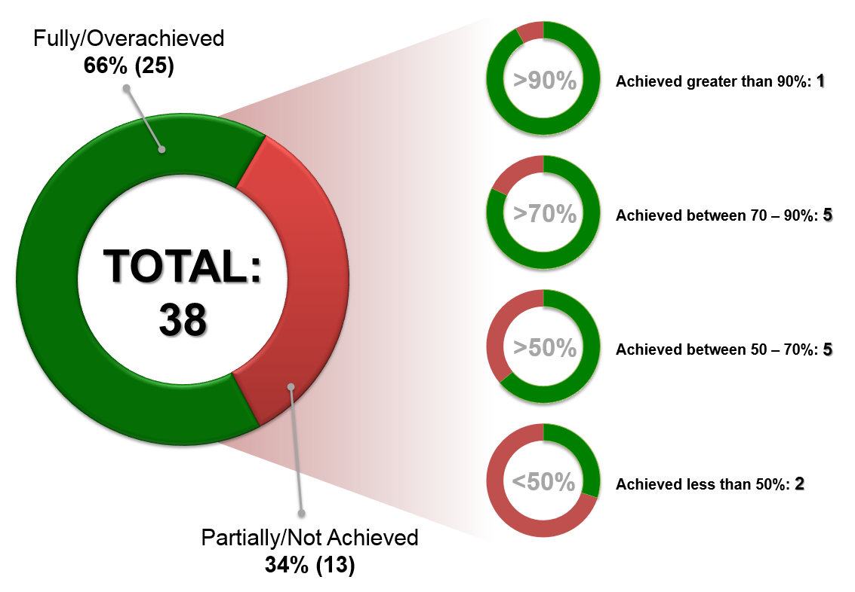
DOD Pre-Audited Annual
Degree of Non-Achievement

Slide 12
DOD Annual Performance Targets NOT Achieved
Programme | Output Indicator | Annual Target | Degree of Achievement
General Support | Number of deliberate crime prevention operations conducted | 124 | 91.9%
Force Employment | Percentage compliance with the Southern African Development Community Standby Force Pledge | 100% | 87.5%
Administration | Percentage adherence to the DOD Master Record Index for Plans | 90% | 84.2%
Administration | Percentage of audits completed in terms of the approved Internal Audit Plan | 100% | 83.3%
Air Defence | Number of hours flown per year | 17 200 | 80.3%
Maritime Defence | Number of Maritime coastal patrols conducted per year | 4 | 75%
Landward Defence | Percentage compliance with Landward Defence training targets | 80% (2 813) | 69.85%
Maritime Defence | Number of hours at sea per year | 10 000 | 68.2%
Administration | Percentage adherence to the DOD Master Record Index for Policies | ≥80% | 66.2%
Air Defence | Percentage compliance with Air Defence training targets | 80% (687) | 63.35%
Force Employment | Percentage of the value of reimbursement by the UN/AU recognised | 70% | 52%
Military Health Support | Percentage compliance with Military Health Service training targets | 80% (648) | 29.14%
Administration | Percentage adherence to the DOD Master Record Index for Strategies | 50% | 0%

Slide 13
Year-on-Year Performance Comparison
 | FY2017/18 | FY2018/19 | FY2019/20 | FY2020/21
Achieved | 64 (64%) | 67 (69%) | 57 (73%) | 25 (66%)
Not Achieved | 36 (36%) | 30 (31%) | 21 (27%) | 13 (34%)
Total | 100 | 97 | 78 | 38

Slide 14
Departmental Performance
FY2021/22
Q1

Slide 15
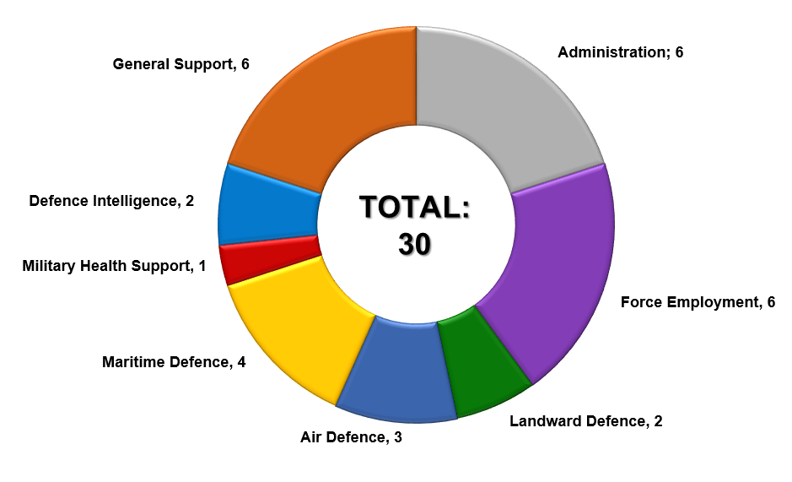
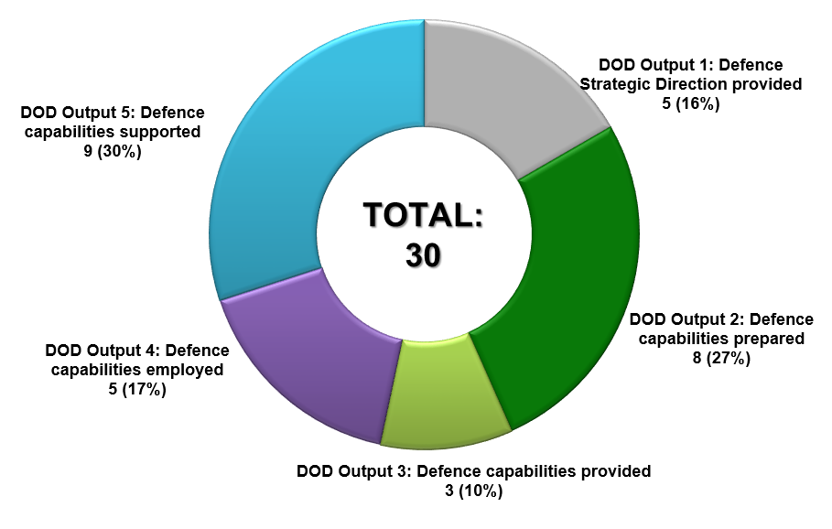
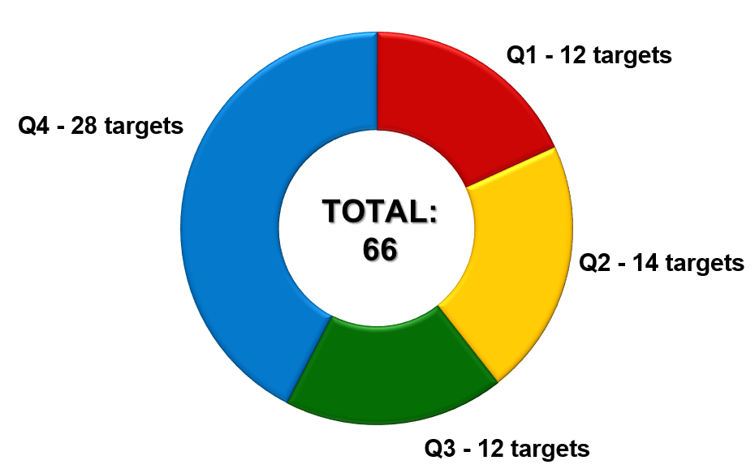
Analysis of DOD Performance Indicators
The DOD reports against 30 Output Indicators, consisting of 66 targets, in FY2021/22.

Slide 16
DOD Results-Based Model
The DOD institutionalised the Results-Based Management Framework as prescribed in the Revised Framework with effect from FY2020/21 as a tool to ensure that the Department fulfils its Constitutional mandate as expressed in terms of the intended impact, outcomes and outputs.

Slide 17
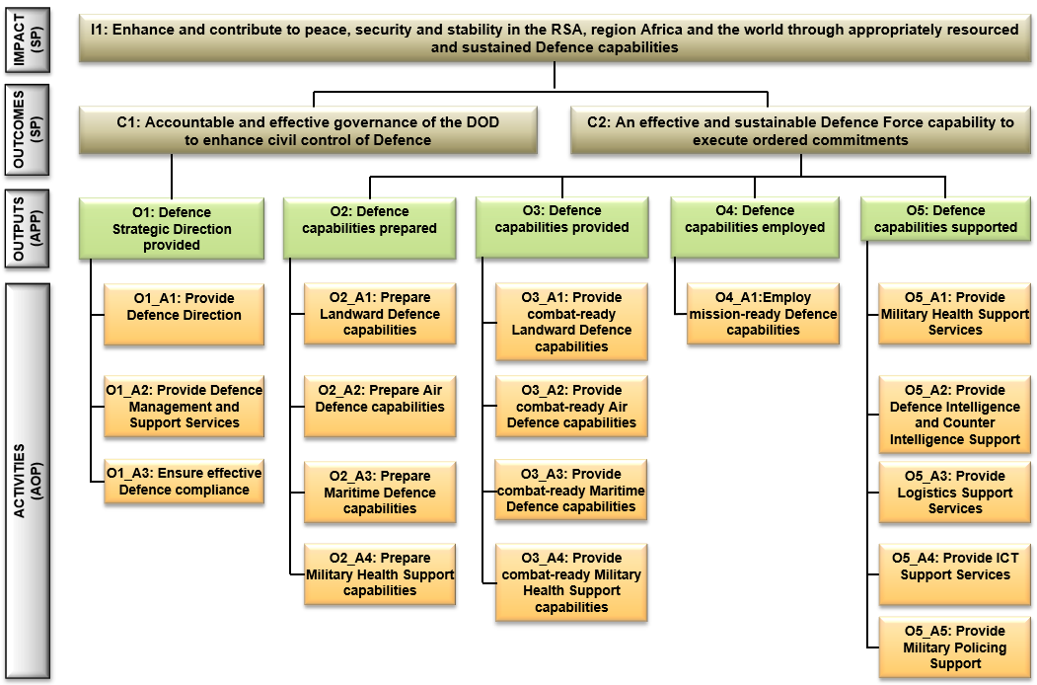
DOD Results-Based Model

Slide 18
DOD RBM Dashboard – Q1 Achievement

Slide 19
Corporate Human Resource
Status

Slide 20
Corporate Human Resource Status
Projected HR Strength and Expenditure
The Department plans to maintain a planned average regular personnel strength of 73 153 for the FY2021/22.
A projected shortfall of R2,270 billion is expected for FY2021/22.

Slide 21
Force Employment

Slide 22
MTSF 2019 – 2024 Priorities
During the period under review, the SANDF supported the following MTSF Priorities:
Priority 6: “Social Cohesion and Safer Communities”
MTSF Indicators:
Number of landward subunits deployed on border safeguarding per year
Number of maritime coastal patrols conducted
Priority 7: “A Better Africa and a Better World”
MTSF Indicator: Percentage compliance with external peace missions, rescue operations and humanitarian assistance operations.
Countries assisted with: Development assistance and Humanitarian assistance.

Slide 23
Command of Forces – Priority 6
In terms of Support to the People, the SANDF deployed 15 sub-units to execute Op CORONA (Border Safeguarding) in Limpopo, Mpumalanga, KwaZulu-Natal, Free State, Eastern Cape, Northern Cape and North-West Provinces.
Two Op CORONA maritime patrols were executed of the KwaZulu-Natal coast and South Coast of the Western Cape Province respectively.
The submarine SAS MANTHATISI deployed off the KwaZulu-Natal coast from 05 to 27 May 2021.
The Maritime Reaction Squadron (a Reaction Force Platoon, an Operational Diving Team and an Operational Boats Element) deployed in the Overberg region of the Western Cape Province from 26 Apr to 25 May 2021.

Slide 24
Op CORONA Operational Successes
Operational Successes | Q1 | Q2 | Q3 | Q4 | YTD
Weapons Recovered | 23 | - | - | - | 23
Illegal Foreigners Apprehended | 4 233 | - | - | - | 4 233
Criminals Arrested | 204 | - | - | - | 204
Stolen Vehicles Recovered | 65 | - | - | - | 65
Dagga Confiscated | 3 336kg | - | - | - | 3 336kg
Live-stock Recovered | 513 | - | - | - | 513
Contraband Goods Confiscated | Rm18,350 | - | - | - | Rm18,350
Precious Metals Confiscated | - | - | - | - | -

Slide 25
Command of Forces – Priority 7
In terms of Regional Security the SANDF continued to provide Force Structure Elements to the United Nations PSO in the DRC (Op MISTRAL). These included:
SANDF Specialist Contingent (SANDFSPECC) in Kinshasa
Force Intervention Battalion Group in Sake Base
Composite Helicopter Unit in Goma
No Op COPPER long range patrol was conducted during Q1.

Slide 26
Command of Forces – Op PROSPER
In support to Government Departments (Op PROSPER), the SANDF operational concept for Safety and Security Support is to employ multi-rolled military capabilities on request and according to the prescripts of the Defence Act 42 of 2002.
The SANDF was not requested to provide assistance during Q1.

Slide 27
Command of Forces – Op CHARIOT
In terms of Disaster Aid and Relief (Op CHARIOT), the SANDF assisted:
The SAAF provided assistance to the Department of Health by providing fixed wing air transport for the transportation of COVID-19 vaccines throughout the Country from 01 April 2021 to date.
During the last weeks of April, 22 Squadron Oryx helicopters assisted the City of Cape Town with a serious fire that broke out on Table Mountain. Apart from assisting in extinguishing fires, hikers trapped by the flames were also rescued. Additional firefighting was also performed in the first week of May with the extinguishing of the fire that broke out in Simons Town.
Op VIMBA. SANDF support to the Department of Health in the provision of tertiary medical care in the Gauteng Province from 23 Jun 2021 to 30 Sep 2021.

Slide 28
Command of Forces – Op ARABELLA
In terms of Search and Rescue (Op ARABELLA), the SANDF was not requested to provide assistance during Q1.

Slide 29
Selected Performance Indicators
(included in the ENE)

Slide 30
Selected Performance Indicator Summary
The following 10 selected performance indicators are published in the 2021 Estimates of National Expenditure for Vote 23.
Performance Indicator | Target | Q1 | Q2 | Q3 | Q4 | YTD
Number of Reserve Force mandays | 2 601 591 | 776 886 | - | - | - | 29.9%
Total number of Defence Attaché offices | 44 | 44 | - | - | - | 100%
Percentage compliance with the Southern African Development Community Standby Force | 100% | 87.5% | - | - | - | 87.5%
Percentage compliance with number of external operations | 100% | 100% | - | - | - | 100%
Note:
SA Navy SADC compliance = 50%. Total SANDF compliance = 87.5%.

Slide 31
Selected Performance Indicator Summary
Performance Indicator | Target | Q1 | Q2 | Q3 | Q4 | YTD
Percentage compliance with number of internal operations | 100% | 100% | - | - | - | 100%
Number of planned joint, interdepartmental, interagency and multinational military exercises | 2 | 0 | - | - | - | 0%
Number of landward sub-units deployed on border safeguarding per year | 15 | 15 | - | - | - | 100%
Number of hours flown per year | 17 100 | 3 560.80 | - | - | - | 20.8%
Number of hours at sea per year | 8 000 | 1 453.85 | - | - | - | 18%
Number of Maritime coastal patrols conducted per year | 4 | 2 | - | - | - | 50%

Slide 32
Performance Status on Targets per Quarter
 | Q1 | Q2 | Q3 | Q4
Achieved | 7 (58.3%) | - | - | -
Not Achieved | 5 (41.7%) | - | - | -
Total | 12 | 14 | 12 | 28
32

Slide 33
Financial Performance Information

Slide 34
Summary of State of Expenditure: 30 June 2021
DOD Planned Expenditure: 24.0%
 | R’000
Budget Allocation | 46 268 680
Less: Expenditure | 10 339 041
Total Amount Available | 35 929 639
% Expenditure (Paid) | 22.3%
34

Slide 35
Comments on of State of Expenditure per
Programme: 30 June 2021
Programme | 2021/22 ENE | Adjust-ments | Available Funds | Approved Drawing | Approved Drawing | Actual Expenditure | Actual Expenditure | Variance | Variance
 | R'000 | R'000 | R'000 | R'000 | % | R'000 | % | R'000 | %
a | b | c | d | e | f=(e/d) | g | h=(g/d) | i=(e-g) | j=(i/e)
Administration | 5 514 148 | 0 | 5 514 148 | 1 228 153 | 22,3% | 915 581 | 16,6% | 312 572 | 25,5%
Force Employment | 3 596 521 | 0 | 3 596 521 | 791 860 | 22,0% | 714 481 | 19,9% | 77 379 | 9,8%
Landward Defence | 14 523 440 | 0 | 14 523 440 | 3 811 556 | 26,2% | 3 789 373 | 26,1% | 22 183 | 0,6%
Air Defence | 5 969 203 | 0 | 5 969 203 | 1 420 551 | 23,8% | 1 201 353 | 20,1% | 219 198 | 15,4%
Maritime Defence | 4 278 120 | 0 | 4 278 120 | 1 045 867 | 24,4% | 916 089 | 21,4% | 129 778 | 12,4%
Military Health Support | 5 306 124 | 0 | 5 306 124 | 1 300 218 | 24,5% | 1 276 852 | 24,1% | 23 366 | 1,8%
Defence Intelligence | 758 045 | 0 | 758 045 | 192 948 | 25,5% | 181 165 | 23,9% | 11 783 | 6,1%
General Support | 6 323 079 | 0 | 6 323 079 | 1 323 473 | 20,9% | 1 344 147 | 21,3% | -20 674 | -1,6%
Total | 46 268 680 | 0 | 46 268 680 | 11 114 626 | 24,0% | 10 339 041 | 22,3% | 775 585 | 7,0%

Slide 36
Summary of State of Expenditure per
Economic Classification: 30 June 2021
Economic Classification | 2021/22 ENE | Adjust-ments | Available Funds | Approved Drawing | Approved Drawing | Actual Expen-diture | Actual Expen-diture | Variance | Variance
 | R'000 | R'000 | R'000 | R'000 | % | R'000 | % | R'000 | %
a | b | c | d | e | f=(e/d) | g | h=(g/d) | i=(e-g) | j=(i/e)
Compensation of Employees | 29 346 642 | 0 | 29 346 642 | 7 865 195 | 26,8% | 7 871 746 | 26,8% | -6 551 | -0,1%
Goods and Services | 13 618 592 | 0 | 13 618 592 | 2 497 205 | 18,3% | 1 660 621 | 12,2% | 836 584 | 33,5%
Transfers and Subsidies | 2 697 697 | 0 | 2 697 697 | 699 370 | 25,9% | 710 226 | 26,3% | -10 856 | -1,6%
Payments for Capital Assets | 605 749 | 0 | 605 749 | 52 856 | 8,7% | 96 177 | 15,9% | -43 321 | -82,0%
Payments for Financial Assets | 0 | 0 | 0 | 0 | 0,0% | 271 | 100,0% | -271 | 100,0%
Total Expenditure | 46 268 680 | 0 | 46 268 680 | 11 114 626 | 24,0% | 10 339 041 | 22,3% | 775 585 | 7,0%

Slide 37
Contributing Factors to Deviations
Programme 1: Administration
Rm312,572 (25.5%)
The lower spending against the approved cash flow was mainly within the Office Accommodation sub-programme, this was due to the payment of the Q1 accommodation charges for FY2021/22, to the National Department of Public Works and Infrastructure, being finalised at the end of Mar 2021.
Programme 2: Force Employment
Rm77,379 (9.8%)
The lower than planned cash flow was mainly due to the outstanding invoices and delayed payments for the satellite communication (C-Band), the C130 systems, vehicular spares and the procurement of vehicles for rotation of deployed members.

Slide 38
Contributing Factors to Deviations
Programme 4: Air Defence
Rm219,198 (15.4%)
The negotiations regarding the placement of new aircraft system contracts for the Gripen and Hawk airframes and engines are still ongoing due to hight fixed costs.
Delayed and late activation of new Aircraft System contracts for the Oryx, Rooivalk and C130 Aircraft systems due to the current status of Denel SOC Ltd.
Programme 5: Maritime Defence
Rm129,778 (12.4%)
Delivery dates of spares were shifted to the right by contractors. This negatively affected availability of spares required for the M&R of vessels, which in turn had a direct impact on the availability and readiness of Navy Platforms.
Reduction in Op COPPER deployments resulted in the lower expenditure within the Maritime Security Strategy during Q1 of FY2020/21. The SA Navy intend to reprioritize the funding to maintain and repair naval platforms required for Op VIKELA deployments.

Slide 39
Additional Contributing Factors to Deviations
Payments for Capital Assets
Rm43,321 (82.0%)
The higher than planned cash flow was as a result of invoices received and paid for the new Military Health Hospital being build in Gqeberha. The project are being managed by the National Department of Public Works and Infrastructure and is currently 12 months ahead of schedule.
Payments for Financial Assets
Rm0,271 (100.0%)
Over expenditure was mainly due to transactions that create or increase outstanding debtors’ amounts as well as foreign exchange losses, thefts and other losses, etc. It should be noted that the Department does not make provision during the budget allocation for unforeseen expenditure such as foreign exchange losses, thefts and other losses, etc. However, funds are reserved to clear these transactions at financial year-end.

Slide 40
Budgetary Review & Recommendation Report Progress

Slide 41
Analysis of Recommendations
Progress against 22 Recommendations are categorised as follows:
*Refer to App F to the DOD QPR1 dated 11 August 2021 for detailed Q1 progress.

Slide 42
Report of the PCD&MV on Budget Vote 23 Progress

Slide 43
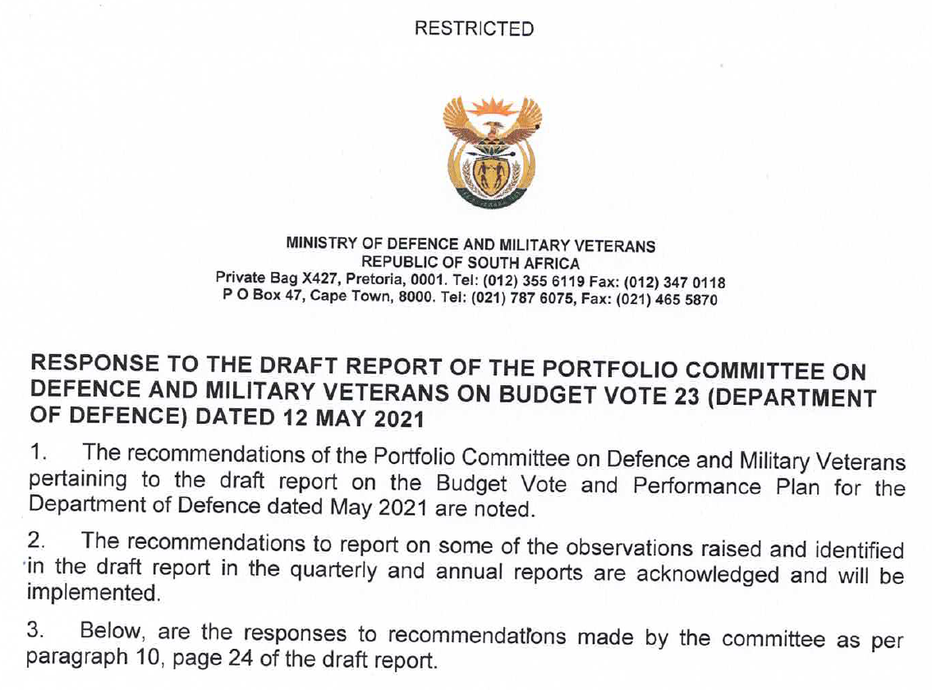
Report of the PCD&MV on Budget Vote 23
In addition to an extract of below response dated 02 July 2021, refer to App G to the DOD QPR1 dated 11 August 2021 for detailed Q1 progress.

Slide 44
Thank you…

