Slide 1
2020/21 Third & Fourth Quarter Performance and Expenditure report
Presentation to Portfolio Committee
17 August 2021

Slide 2
Strategic Focus
Impact statement:
Accelerated use of digital technologies to improve quality of life
Vision: A world class innovative Skills Institute to ensure an empowered South African citizenry with 4IR capabilities.

Slide 3
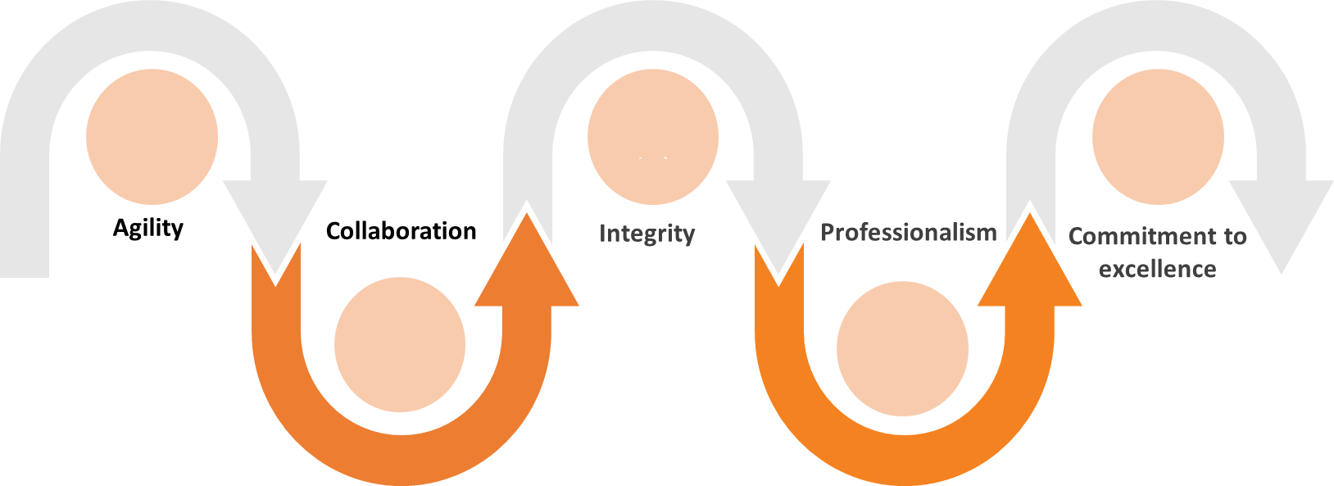
Values

Slide 4
Achievements and Challenges
Achievements
The launch of the NEMISA learning management system
3 Day NEMISA 2021 National Data Science Innovation Hackathon hosted across all nine (9) provinces
Over 800 people registered to participate in the Hackathon
The NEMISA Over the Top (OTT) media platform went live in March 2021
Challenges
COVID 19 had a negative impact on face-to-face training interventions, a Performance Recovery Plan was put in place at the beginning of quarter 3 to mitigate the challenges imposed by the pandemic. The plan encompassed online training and virtual training interventions. NEMISA managed to improve steadily and achieved 90% for the year compared to the 36% achievement in quarter 2.
Continues monitoring of the environment by implementing actions in the audit action plan.

Slide 5
Overall performance summary
NEMISA achieved 7 of the 8 planned targets set for the fourth quarter. This translates to an overall achievement of 87,5%, compared to quarter 3 which had an achievement of 45%.

Slide 6
Programme 1:Administration
Programme 1: Administration
No | Annual Target | Q3 Target | Achievement | Q4 Target | Achievement
1.1 | Approved Transformation and Change Strategy | Transformation and change strategy approved by the board | Transformation and Change Strategy has been finalized and submitted to the Board for approval | No planned target | Transformation and Change Strategy has been finalized and approved by the Board
1.2 | Multi-Media Production house business plan submitted to board for approval and online interface launched | Business plan finalized and submitted to board for approval | Business plan finalized and submitted to board for approval | Multi-Media Production house (MMPH) online interface launched | The online interface of the OTT (Over-The-Top) was launched.

Slide 7
Programme 2:Multi Stakeholder Collaboration
Programme 2: Multi-stakeholder Collaboration
No | Annual Target | Q3 Target | Achievements | Q4 Target | Achievements
2.1 | 2 MoUs | 1 MoU with Technology Institution | 1 MoU with a Technology institution has been secured and has been submitted to the Board for approval | No planned target | 2 MoU’s have been signed. One with a Technology institution and one with a Government department.

Slide 8
Programme 3: e-Astuteness Development
Programme 3: e-Astuteness Development
No | Annual Targets | Q3 Targets | Actual Achievement | Q4 Targets | Actual Achievement
3.1 | 30 000 citizens trained in basic digital literacy | 10 000 | 5070 | 15 000 | 12 319
3.2 | 114 learners trained in creative media courses | 68 | 114 | 46 | 140
3.3 | 1 creative media course developed | Creative media course developed and piloted | Creative media course developed and piloted | No planned target | -

Slide 9
Programme 3: e-Astuteness Development
Programme 3: e-Astuteness Development
No | Annual Targets | Q3 Targets | Actual Achievement | Q4 Targets | Actual Achievement
3.4 | 800 citizens trained on specialist technologies | 250 | 64 | 400 | 1027
3.5 | 500 employees within government departments and institutions participating in digital transformation advocacy and awareness campaigns | 150 | 0 | 250 | 689
3.6 | Learning management system (LMS) integrated onto cloud platform with 10000 registered users | Web services interface development 3500 registered users on the cloud platform | Web services interface development has been completed and piloted Registration of users awaits Board approval The delays from Q1 has had a domino effect on this target and hence 3500 users could not be registered onto the LMS. | LMS and web services integrated 5000 registered users on the cloud platform | The LMS was approved on 15 January 2021. There are 10 492 users on the system.

Slide 10
Programme 4:Knowledge for innovation
Programme 4: Knowledge for Innovation
No | Annual Target | Q3 Target | Achievement | Q4 Target | Achievement
4.1 | 1 Hackathon hosted | Preparation for hosting of Hackathon conducted Hackathon marketed | Preparation for hosting of Hackathon conducted Hackathon has been marketed | Hackathon Hosted Hackathon outcomes report developed | A virtual 3 - day Data Science Innovation hackathon was hosted across all nine provinces. An outcomes report has been developed.

Slide 11
Programme 5: Aggregation Framework
Programme 5: Aggregation Framework
No | Annual Target | Q3 Target | Actual Achievement | Q4 Target | Actual Achievement
5.1 | Monitoring and evaluation framework implemented | Data collected | Monitoring and Evaluation Plan has been submitted to the Board for approval. Procurement process for an impact assessment service provider in underway | Evaluation and impact report developed | An impact assessment study focusing on NEMISA’s 3 training programmes has been conducted and a report thereof has been developed.

Slide 12
Overall performance on AGSA audit findings
The below graph indicates the total Audit findings, Audit Action Plans with progress made as per AGSA audit findings:

Slide 13
Financial Information overview
NEMISA made a surplus Q4:R1.1million (deficit Q3: R1.6million)
NEMISA is in a good financial health situation.
The company liquid and solvent.
NEMISA current ratio is 1:1
Total debt to total assets ratio: 0.9:1,
Appropriation funding in Q3 R24.8 million and Q4 R23 million
Other income Q3 R 530 898.81 and Q4 R665 566.81
Notes:
Total debt to total assets ratio -which indicates NEMISA cashflow is sufficient to fund long and short-term liabilities.

Slide 14
BUDGET VS ACTUAL EXPENDITURE
QUARTER 3
QUARTER 4

Slide 15
Thank you

