Slide 1

Q3 &4
FY 2020/21 REPORTS
Portfolio Committee Presentation
By
Chair of the Board
17 Aug 2021

Slide 2
Performance Information
The report covers both Q3 and Q4. The information in the overview below is based on Q4. For the quarter under review, 15 of the 19 targets were achieved. Of the four targets not achieved, three of these pertained to financial sustainability, and one to resilient network targets. The summary below outlines the Company’s performance against the strategic objectives for the year as provided in the APP:
The Areas of Significant Achievement
Four Financial Sustainability targets were met:
A gearing ratio of 11% was achieved against a target of 154%.
An R88 million positive cash balance was maintained against a target of R15 million.
Small, Micro, and Medium Enterprises (SMME) invoices were paid within 15 days against a target of 30 days.
Debtors’ days were at 45 days against a target of 60 days.
Two Resilient Network targets were met:
Core network faults were restored within 6:70 hours against a target of 7:5 hours.
713 SA Connect Sites were connected to Broadband Infraco’s (BBI) network are maintained against a set target of maintaining 713 sites.
Six Economic Transformation targets were met:
Six SMMEs were identified and allocated work against a target to allocate installation work to three SMMEs.
A discretionary spend of 127% on Broad-Based Black Economic Empowerment (B-BBEE) was achieved against a target of 70%.
A spend of 83% on Black-Owned Entities (BOE) was achieved against a target of 40%.
A 62% spend was achieved on Black Women-Owned Entities (BWOE) against a target of 10%.

Slide 3
Performance Information
Six Economic Transformation targets were met (continued):
The final B-BBEE certificate was issued, and BBI is declared a Level 4 contributor. This meets the target set to obtain a Level 4 status.
Telematics training was provided to teachers and leaners and connectivity provided.
One Organisational Enablement target was met:
An integration strategic plan has been submitted for review to the Department of Communication Digital Technologies (DCDT). A target was set for the submission of an integration plan, and as such this requirement has been met.
One Human Resource Development target was met:
During the quarter under review, 1.44% of the salary bill was spent on training. This not only met but exceeded the target of 0.35% that was set.
One Governance target was met:
The follow-up report of the external audit findings to resolve external audit findings was submitted against a target of resolving external audit findings.

Slide 4
Performance Information
Areas of Under-Achievement
Three Financial Sustainability targets were not met:
A total of R34,887 million in new sales contracts were concluded during the quarter 3 and R7 million in quarter 4 against a target of R100 million in each quarter. Whilst there was an increase in the demand for the services offered by BBI, the Company was unable to take advantage of the business potential due to the challenges experienced with the OEM supplier of core network equipment. From June 2020 to March 2021 whilst this challenge was being addressed, the Sales and Engineering team were unable to provide delivery times to customers who had requested quotations.
A 1% year-on-year decrease in revenue was noted when compared to the same period of the previous financial year, which yielded a 10% year-on-year increase in revenue. The delays caused by the inability to access sites, due to restrictions imposed under the COVID-19 lockdown, was a significant contributor to the decline in revenue, as the Company was not able to roll out the anticipated Layer 3 professional services and the remaining SA Connect sites.
Furthermore, COVID-19 contributed to long sales to billing cycles. BBI was also unable to raise the required funds during this year to procure new equipment to provision services to customers and to settle amounts outstanding to the OEM for core network equipment. This, as described above, resulted in lower sales.
An operating profit target was set for an improvement of R15 million, but the operating profit (before depreciation, and after interest) had reduced by R31 million. The greatest contributing factor to this decline, is the IFRS16 adjustments made during March 2020, which resulted in positive results for quarter 4 of 2020.

Slide 5
Performance Information
One Resilient Network target was not met:
0.60% of gross revenue was provided for the payment of network performance rebates. This is against a target of ≤0.3%. The final figure may change once the actual pay out to customers is realised. The fibre breaks were mainly on route 7 of the network, the Liquid Telecom fibre route between Johannesburg (JHB), Oberholzer, and the East London (EL) – Pembroke and Bisho. Power failures are caused by Eskom load shedding.

Slide 6
FINANCIAL CAPITAL
Slide 6

Slide 7
Sales Performance illustrated
QUARTER 3 SALES PERFORMANCE
QUERTER 4 SALES PERFORMANCE
Sales volumes in Q3 were 65% behind budget
As illustrated the sales achievement for the quarter is 13% of the target for whilst the previous financial year it was an over-achievement by 18%.

Slide 8
Sales to revenue conversion cycle
2
Analysis
Total Contract Value (TCV)
The TCV sold for quarter 4 is coming from multiple ISPs and this is due to bigger capacities usually demanded by MNO or FNO not available due to the vendor issue.
The challenge remains of the business not able to activate or provision all the service within the quarter they were sold thus revenue conversion is much slower.
The single 100Gbps service sold contributed ±R12m over 36 months with the possibility of renewal after the period.
TCV (Sales) R7m
Activated 26%
Maximum Capacity sold 10Gbps
Highest Deal R1,6m for 100Gbps
Challenges
Non availability of timeliness for service activation

Slide 9
Sales Pipeline
50% to 79% Probability |  |  |  | 80% to 100% Probability
SALES PIPELINE |  |  |  | SALES PIPELINE
Priority | Bandwith in Mbps | Total Contract Value (TCV) |  | Priority | Bandwith in Mbps | Total Contract Value (TCV)
Content Providers |  |  |  | Content Providers
FTTx |  |  |  | FTTx
High Data SOC | 2500 | R3 752 991 |  | High Data SOC | 2000 | R184 023 955
Infrastructure Players | 52600 | R44 894 766 |  | Infrastructure Players | 152100 | R35 566 092
International Players | 55300 | R11 343 851 |  | International Players | 80000 | R14 472 420
ISP Tier 1 |  |  |  | ISP Tier 1
ISP Tier 2 | 30000 | R24 053 668 |  | ISP Tier 2 | 1000 | R20 977 408
ISP Tier 3 | 25550 | R19 647 964 |  | ISP Tier 3 | 156450 | R36 032 270
Metros & Municipalities |  |  |  | Metros & Municipalities
MNO-1 | 50000 | R12 300 000 |  | MNO-1 | 20000 | R1 727 835
MNO-2 |  |  |  | MNO-2
Local / Provincial Government |  |  |  | Local / Provincial Government
Regional Player | 5000 | R4 444 753 |  | Regional Player | 1000 | R5 627 334
Reseller | 20000 | R3 409 2901 |  | Reseller
WACS |  |  |  | WACS
Total | 240950 | R123 847 283 |  | Total | 412550 | R298 427 314

Slide 10
Financial Position
Cash now excludes advance payment from DCDT, which is shown separately and R69 million
Cash resources down to R18 million
Debtors days decreased to 45 days
Shareholders’ Loans now reflected as equity
Deferred revenue decreased YoY as no new IRUs was received
Capex only R16 million for the year to date
No medium or long term funding received during the year
Slide 10

Slide 11
Financial Performance
Revenue R93 mil (17%) below budget.
Cost of sales increases year-on-year by 3%, mainly due to ANP costs
OPEX is 8% lower than previous year and 14% below budget mainly due to low travel, repairs and maintenance and employee expenses, off the back of increase in outsource costs
Slide 11

Slide 12
Statement of Cash Flow
Cash generated by operations positive for 4th consecutive year
Capex spend of only R16 million
Loans repaid are for Eskom and TFR
Slide 12

Slide 13
Irregular Expenditure
R’000 | Audited March 2018 | Audited March 2019 | Audited March 2020 | Unaudited March 2021
Opening balance | 0 | 1 603 | 53 935 | 82 747
Incurred and identified in current year
Continued to utilise services after contract expired |  |  |  | 133
Contract renewal not approved by NT |  |  |  | 51
Incurred in previous years incurred in the current year
Non-compliance to cost containment instructions issued by National Treasury | 202
Non-compliance to a provision of legislation (Co Act) | 1 401
Continued to utilise services after contract negotiations failed |  | 6 398
Website Hosting |  | 31
Tender not advertised for 21 working days |  | 5 974 | 15 095 | 5 874
Continued to utilise services after contract expired |  | 874 | 858 | 793
Contract renewal not approved by NT |  | 0 | 5 467 | 4984
Carried forward | 1 603 | 14 879 | 75 355 | 94 582
Slide 13

Slide 14
Irregular Expenditure
R’000 | Audited March 2018 | Audited March 2019 | Audited March 2020 | Unaudited December 2020
Brought forward | 1 603 | 14 879 | 75 355 | 94 582
Incurred in prior year, identified in the current year
Continued to utilise services after contract negotiations failed |  | 26 324
Tender not advertised for 21 working days |  | 3 885 | 7 392
Continued to utilise services after contract expired |  | 9 049
Removal from register |  | (202) |  | (38 220)
Condoned during the year
Amount not condoned carried over* | R1 603 | R53 935 | R82 747 | R56 361
*Internal processes in progress
Note that the irregular expenditure relating to the tender that was not advertised for 21 days has now been removed from the register. We received confirmation from the AG in terms of the new framework on irregular expenditure, transgressions of own policies are still a non-compliance, but no longer seen to be irregular expenditure.
We are in process of requesting condonation through the process for the rest of the irregular expenditure.
Slide 14

Slide 15
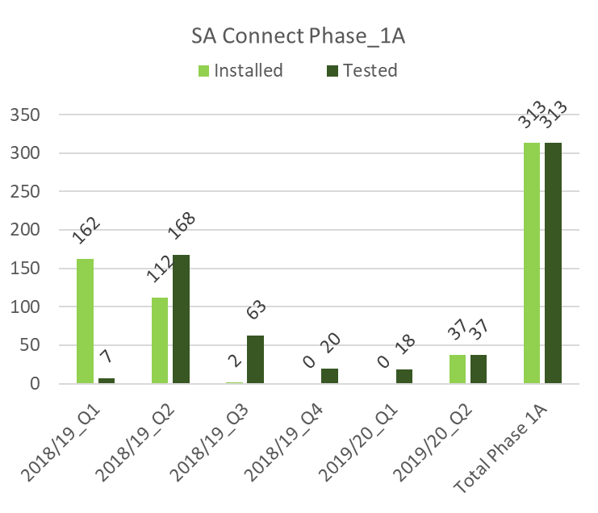
SA Connect Phase 1A and 1B

Slide 16
Targeted Procurement
 | BBI BBBEE Scorecard
 | Areas | Total Procurement Spend | Target/s | Actual %
SCM Performance Compact | BBBEE Spend | R 57 701 282.55
 | BBBEE Multiplier | R 71 830 273.92 | 70% | 124%
 | BOE | R 40 366 936.31 | 40% | 70%
 | BWO | R 25 969 243.33 | 10% | 64%
 | PWD | R 304 444.41 | 1% | 1%
 | BYO | R 6 589 783.56 | 5% | 16%
Verification Compact | Value Adding | R 43 755 095.31 | 80% | 76%
 | Generic | R 5 839 007.40 | N/A | 10%
 | QSE | R 10 062 269.24 | 15% | 17%
 | EME | R 28 208 138.21 | 15% | 49%
 | > 51% Black Owned | R 41 249 128.69 | 51% | 71%
 | > 30% Black Women Owned | R 35 803 520.63 | 30% | 62%
The Value Adding spend was not achieved year to date at 76%
Exempted Micro Enterprises (EME) was achieved for the year
Qualifying Small Enterprises (QSE’s) was also achieved for the year
Spend on Suppliers that are >51% Black Owned and Spend on Suppliers that are > 30% Black Women Owned were achieved for the year
Slide 16

Slide 17
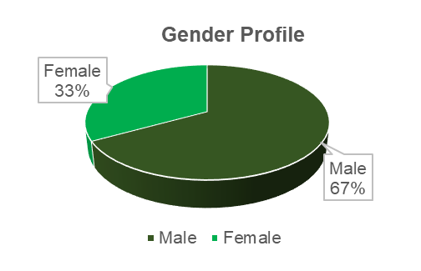
Employment Equity Demographic profile
Job Levels | Male |  |  |  | Female |  |  |  | Foreign Nationals |  | Sub Totals |  | Total
 | A | C | I | W | A | C | I | W | M | F | M | F
Executives | 3 | 0 | 0 | 1 | 1 | 0 | 0 | 0 | 0 | 0 | 4 | 1 | 5
 | 60% | 0% | 0% | 20% | 20% | 0% | 0% | 0% | 0% | 0% | 80% | 20% | 100%
Senior Management | 5 | 1 | 0 | 1 | 2 | 0 | 0 | 0 | 1 | 1 | 8 | 3 | 11
 | 45% | 9% | 0% | 9% | 18% | 0% | 0% | 0% | 9% | 9% | 73% | 27% | 100%
Professional Specialist & Middle Management | 24 | 1 | 2 | 4 | 12 | 1 | 0 | 0 | 0 | 0 | 31 | 13 | 44
 | 55% | 2% | 5% | 9% | 27% | 2% | 0% | 0% | 0% | 0% | 70% | 30% | 100%
Supervisory & Junior Management | 11 | 0 | 0 | 2 | 4 | 0 | 0 | 0 | 0 | 0 | 13 | 4 | 17
 | 65% | 0% | 0% | 12% | 24% | 0% | 0% | 0% | 0% | 0% | 76% | 24% | 100%
Operational | 26 | 0 | 1 | 0 | 14 | 0 | 0 | 0 | 0 | 0 | 27 | 14 | 41
 | 63% | 0% | 2% | 0% | 34% | 0% | 0% | 0% | 0% | 0% | 66% | 34% | 100%
Support | 0 | 0 | 0 | 0 | 5 | 0 | 0 | 1 | 0 | 0 | 0 | 6 | 6
 | 0% | 0% | 0% | 0% | 83% | 0% | 0% | 17% | 0% | 0% | 0% | 100% | 100%
Total Permanent and fixed term contracts | 69 | 2 | 3 | 8 | 38 | 1 | 0 | 1 | 1 | 1 | 83 | 41 | 124
 | 56% | 2% | 2% | 6% | 31% | 1% | 0% | 1% | 1% | 1% | 67% | 33% | 100%
GRAND TOTAL | 69 | 2 | 3 | 8 | 38 | 1 | 0 | 1 | 1 | 1 | 83 | 41 | 124

Slide 18
COVID-19 Status

Slide 19
Strategic Risks
NO | RISK DESCRIPTION | Q 1 RESIDUAL | Q 2 RESIDUAL | Q 3 RESIDUAL | Q 4 RESIDUAL | Movement
1 | Cyber security risk | Level 1 | Level 1 | Level 1 | Level 2 | Improvement
2 | Delays in conversion of the Shareholder loan to Equity | Level 1 | Level 1 | Level 1 | Level 3 | Improvement
3 | Moratorium on filling of vacancies | Level 1 | Level 1 | Level 1 | Level 1 | No Change
4 | Difficulty to raise Funds | Level 1 | Level 1 | Level 1 | Level 1 | No Change
5 | Inability for the organisation to respond to rapid changes in market and technology | Level 2 | Level 2 | Level 2 | Level 2 | No Change
6 | Lack of access to state-owned fibre infrastructure. | Level 2 | Level 2 | Level 2 | Level 2 | No Change
7 | Commercialisation of fibre infrastructure | Level 2 | Level 2 | Level 2 | Level 2 | No Change
8 | Outbreak of Covid_19 | Level 2 | Level 2 | Level 2 | Level 3 | Improvement
9 | Failure to innovate/ embrace innovation | Level 2 | Level 2 | Level 2 | Level 2 | No Change
10 | Possible failure to continue as a going concern | Level 2 | Level 2 | Level 2 | Level 2 | No Change
11 | Margin pressure | Level 2 | Level 2 | Level 2 | Level 2 | No Change
12 | Regulatory constraints impeding organisational agility. | Level 2 | Level 2 | Level 2 | Level 2 | No Change
13 | Inadequate stakeholder management | Level 3 | Level 3 | Level 3 | Level 3 | No Change
Level 1 | Very High Risk
Level 2 | High Risk
Level 3 | Medium Risk
Level 4 | Low Risk

Slide 20
External Audit Findings
2018/19 | Follow up on Audit findings
Description | Number | %
Findings addressed | 11 | 84%
Findings partially addressed (Going concern) | 1 | 7%
Findings not yet due | 0 | 0%
Finding Not Addressed (Contract Management) | 1 | 7%
Total Findings | 13 | 100%
2019/20 | Follow up on Audit findings
Description | Number | %
Findings addressed | 12 | 80%
Findings partially addressed (Going concern, creditors not paid within 30 days and assets not verified) | 3 | 20%
Findings not yet due | 0 | 0%
Findings not addressed | 0 | 0%
Total Findings | 15 | 100%

Slide 21

Thank You

