Slide 1
BRIEFING TO - PARLIAMENT’S PORTFOLIO COMMMITEE ON COOPERATIVE GOVERNANCE AND TRADITIONAL AFFAIRS
on: SARAH BAARTMAN DISTRICT MUNICIPALITY AND LOCALS
Zoom Virtual Platform
Date: 01 June 2021

Slide 2
TABLE OF CONTENT
Part 1
PURPOSE & LEGISLATIVE MANDATE
Part 2
PROVINCIAL TREASURY STRUCTURE - MFG
Part 3
NON-COMPLIANCE PER MUNICIPALITY & SUPPORT PROVIDED
Part 5
DISCUSSION
Part 4
ANNUAL STRUCTURED SUPPORT
Part 5
INFRASTRUCTURE PERFORMANCE

Slide 3
BRIEFING TO - PARLIAMENT’S PORTFOLIO COMMMITEE ON COOPERATIVE GOVERNANCE AND TRADITIONAL AFFAIRS – SARAH BAARTMAN DISTRICT
Part 1: PURPOSE AND LEGISLATIVE MANDATE

Slide 4

PURPOSE AND LEGISLATIVE MANDATE
Purpose:
The purpose is to:
  Present support provided to Sarah Baartman District Municipality and the local municipalities within the district area; and
  Report on municipality’s compliance with the Municipal Finance and Management Act (MFMA) and assistance provided to assist with compliance.
Legislative Mandate:
Chapter 13 of RSA Constitution, Section 216 – to support National Treasury in enforcing compliance with set measures of treasury norms and standards;
Section 154 of the Constitution of RSA – to support and strengthen capacity of municipalities to manage their own affairs and perform their duties; and
MFMA sec 5(3) – to fulfil and promote object of MFMA Act; and
Assist National Treasury in enforcing compliance with the MFMA Act and sec 216 of Constitution.

Slide 5
BRIEFING TO - PARLIAMENT’S PORTFOLIO COMMMITEE ON COOPERATIVE GOVERNANCE AND TRADITIONAL AFFAIRS – SARAH BAARTMAN DISTRICT
Part 2: PROVINCIAL TREASURY STRUCTURE - MFG

Slide 6
PROVINCIAL TREASURY STRUCTURE and MFG – Prog 5 (Municipal Financial Governance)
Provincial Treasury has a standalone Programme 5 Structure responsible solely for Local Govt.
Prog 5 has two Chief Directorates and six District Offices closer to municipalities;
National Treasury Support Programme where Technical Advisors are deployed to both municipalities and ECPT and
Prog 5 structure is internally supported by Prog 3 and 4 on compliance issue as outlined below:
Chief Directorate - Accounting, SCM and Asset Management
Summary Functions:
Accounting and Reporting
SCM Regulations;
mSCOA implementation
Asset Management
Financial Management Capability Maturity Model (FMCMM);
Norms and Standards
Revenue, Assets & Liabilities Management
Prog 5 Internal Support Structure
Prog 3: Assets and Liability Management:
Assist Prog 5 on:
Tracking Employees doing business with state
Prog 4 – Financial Governance:
  Assist Prog 5 on:
  Norms and Standards;
  Internal Audit Quality Assurance Reviews
  Risk Management.
  Above Programmes provides additional support listed to Prog 5. this assist in ensuring support to LG is continuous.
Chief Directorate - Budget and Institutional Arrangements
Summary Functions:
Budget preparation and Implementation;
Risk management;
Internal Audit support
Governance
Infrastructure and Conditional Grants management;
Municipal Financial Recovery Services;
NT MFIPIII - Technical Advisors to support Programme Prog 5 on:
Supply Chain Management
Asset Management
Accounting & Audit Support
mSCOA Implementation
Advisors Deployed in the Districts:
Chris Hani District – (Chris Hani, Enoch Mgijima & Sakhisizwe);
Amathole District – Amathole, Amahlathi & Great Kei)
OR Tambo District – (KSD, PSJ & Ingquza Hill).
GIZ – support two selected Districts: Amathole & Chris Hani)
EU FMISD Support to PT & three municipalities in SARA Baartman District.

Slide 7
BRIEFING TO - PARLIAMENT’S PORTFOLIO COMMMITEE ON COOPERATIVE GOVERNANCE AND TRADITIONAL AFFAIRS – SARAH BAARTMAN DISTRICT
PART 3 - SUPPORT TO SARAH BAARTMAN DISTRICT MUNICIPALITIES

Slide 8
PILLARS OF LOCAL GOVERNMENT SUSTAINABILITY AND GOVERNANCE
BACK TO BASICS PREMISED AROUND
Putting People First
Delivering Basic Services;
Good Governance;
Sound Financial Management; and
Capacity Building
National Treasury institutionalised:
  Local Government Accountability Cycle; and
  Pillars of Local Government Sustainability.
Above are at the core of strengthening Local Government Back to Basics primarily on:
  Good Governance;
  Sound Financial Management; and
  Capacity building to deliver Services.
The Pillars of sustainability is crucial for overall ideal municipality’s functional machinery;
Political and Administrative protocols in line with separation of responsibilities is centre to municipal good corporate image; and
Sustainable local government is central to satisfactory Service Delivery and stakeholder good relations.

Slide 9
NON - COMPLIANCE WITH MFMA PRESCRIPTS – SARAH BAARTMAN DISTRICT MUNICIPALITY
NON-COMPLIANCE ON:
MFMA sec 71 MFMA submission of data strings
  Non-compliance with full implementation of the mSCOA modules – Went out on tender and Asset module and IDP module included in tender.
Establishment of Municipal Disciplinary Boards (DC Board)
  Letter issued to municipality to establish DC Boards; which is not yet established. This municipality does have a committee that investigates irregular expenditure but it is not established in terms of the Regulations on Financial Misconduct Procedures
SCM Regulations - Irregular expenditure is ordinarily determined by A-G but PT also regularly issues advice where there are practices that it deems could lead to IE. This applies to all municipalities
SUPPORT – PROVIDED ON:
  The municipality had regular session with PT in respect of their system challenges, extensive advice including sessions with system vendors were facilitated by PT.
  Regular mSCOA engagements with the district municipality, particularly with the CFO and BTO team. This is coordinated by the district mSCoA champion and the MFIP advisor.
  Provide monthly feedback reports on the analysis of Sec 71 reports on the performance and quality of reports to identify red flags.
  Formal response letters sent to the municipality for specific SCM support requests/queries. This is over and above the participation of the district municipality in the SBD SCM forum.

Slide 10
NON - COMPLIANCE WITH MFMA PRESCRIPTS - MAKANA
NON-COMPLIANCE ON:
MFMA sec 71 MFMA submission of data strings
  Non-compliance with full implementation of the mSCoA modules - Asset Register has been migrated but still being reconciled before being fully utilised
SCM Regulations - Irregular expenditure is ordinarily determined by A-G but PT also regularly issues advice where there are practices that it deems could lead to IE. This applies to all municipalities
The Municipality was under Sec139 (5) intervention in May 2019. In terms of this a Financial Recovery Plan is being developed with NT, PT, CoGTA through the Municipal Financial Recovery Services.
Non payment of Creditors within 30 days i.t.o MFMA sec 65(2)(e)
  Water Board - R49 173 661
  ESKOM - R 22 732 026
Contravention of DoRA. Spending on some of the conditional Grants not in alignment with DoRA conditions. Details on this to be provided in later slides
SUPPORT – PROVIDED ON:
  Provide monthly feedback reports on the analysis of Sec 71 reports on the performance and quality of reports to identify red flags.
  Regular mSCOA engagements with the municipality, particularly with the CFO and BTO team. This is coordinated by the district mSCoA champion and the MFIP advisor
  Training offered on DC Board Establishment. PT has a member in the municipal DC Board
  Extensive support provided on SCM queries from the municipality. SCM forum held to assist with addressing Irregular, Fruitless & Wasteful Exp.
NT, PT and CoGTA currently assisted with the development of a Financial Recovery Plan, and report on the progress of the Implementation Plan. Hands-on support provided two days per week during the intervention.
Arrangement of payment plan with ESKOM and attending the engagement meetings when required
DORA workshop conducted to outline the conditions of the grants as well as the requirements of the project plans

Slide 11
NON - COMPLIANCE WITH MFMA PRESCRIPTS – BLUE CRANE ROUTE LM
NON-COMPLIANCE WITH:
MFMA sec 71 MFMA submission of data strings
  Non-compliance with full implementation of the mSCoA modules:
  - SCM Module: In Process of being install - Budget needed to implement properly
  - Asset Module - Excell spreadsheet is used - Not budgeted for Implementation of system
SCM Regulations - Irregular expenditure is ordinarily determined by A-G but PT also regularly issues advice where there are practices that it deems could lead to IE. This applies to all municipalities
Contravention of DoRA. Spending on some of the conditional Grants not in alignment with DoRA conditions. Details on this to be provided in later slides
SUPPORT – PROVIDED ON:
  Provide monthly feedback reports on the analysis of Sec 71 reports on the performance and quality of reports to identify red flags.
  Regular mSCOA engagements with the municipality, particularly with the CFO and BTO team. This is coordinated by the district mSCoA champion and the MFIP advisor
  PT has an active member in the municipal DC Board
  Detailed support provided on SCM queries from the municipality. SCM forum held to assist with addressing Irregular, Fruitless & Wasteful Exp.
The municipality has been identified as a participant in the Financial Management for Improved Service Delivery programme which is EU funded and will be facilitated through NT and PT.
DORA workshop conducted to outline the conditions of the grants as well as the requirements of the project plans

Slide 12
NON - COMPLIANCE WITH MFMA PRESCRIPTS – NDLAMBE LM
NON-COMPLIANCE WITH:
MFMA sec 71 MFMA submission of data strings
  Non-compliance with full implementation of the mSCoA modules:
  - Asset Module not yet active
SCM Regulations - Irregular expenditure is ordinarily determined by A-G but PT also regularly issues advice where there are practices that it deems could lead to IE. This applies to all municipalities
SUPPORT – PROVIDED ON:
  Provide monthly feedback reports on the analysis of Sec 71 reports on the performance and quality of reports to identify red flags.
  Regular mSCOA engagements with the municipality, particularly with the CFO and BTO team. This is coordinated by the district mSCoA champion and the MFIP advisor
  PT has an active member in the municipal DC Board
  Extensive support to assist the municipality to analyse/investigate its very high Irregular Expenditure. Significant write-off of irregular expenditure in line with prescribed processes.
The municipality has been identified as a participant in the Financial Management for Improved Service Delivery programme which is EU funded and will be facilitated through NT and PT.
DORA workshop conducted to outline the conditions of the grants as well as the requirements of the project plans

Slide 13
NON - COMPLIANCE WITH MFMA PRESCRIPTS – SUNDAYS RIVER VALLEY LM
NON-COMPLIANCE WITH:
Unfunded Budget – main and adjusted budgets
Non-submission of the FMCMM Action Plan – non compliance letter issued to the municipality
MFMA sec 71 MFMA submission of data strings
  Non-compliance with full implementation of the mSCoA modules: The municipality is in the process of acquiring a new system due to the pervasive non-compliance issues and incorrect data which it says emanate from the current system
SCM Regulations - Irregular expenditure is ordinarily determined by A-G but PT also regularly issues advice where there are practices that it deems could lead to IE. This applies to all municipalities
SUPPORT – PROVIDED ON:
  Provide monthly feedback reports on the analysis of Sec 71 reports on the performance and quality of reports to identify red flags.
  Regular mSCOA engagements with the municipality, This is coordinated by the district mSCoA champion and the MFIP advisor.
  A District Task Team led by the District municipality was formed and PT is a member. The task team is providing much needed support to the municipality. The District municipality has gone tohe extent of seconding the MM of the District to the municipality.
The municipality has been identified as a participant in the Financial Management for Improved Service Delivery programme which is EU funded and will be facilitated through NT and PT.
PT together with FMISD advisors are currently preparing a support plan aimed at improving financial viability and governace.This plan will be tabled to the municipality in later June
A Review of the revenue enhancement strategy of the municipality is also underway, a draft strategy is currently being finalized.

Slide 14
NON - COMPLIANCE WITH MFMA PRESCRIPTS – KOUGA LM
NON-COMPLIANCE WITH:
Non-submission of the FMCMM Action Plan – non compliance letter issued to the municipality
MFMA sec 71 MFMA submission of data strings
  Non-compliance with full implementation of the mSCoA modules:
  - The municipality is still in the process of implementing the SCM/HR and Payroll modules
SCM Regulations - Irregular expenditure is ordinarily determined by A-G but PT also regularly issues advice where there are practices that it deems could lead to IE. This applies to all municipalities
SUPPORT – PROVIDED ON:
  Provide monthly feedback reports on the analysis of Sec 71 reports on the performance and quality of reports to identify red flags.
  Regular mSCOA engagements with the municipality, particularly with the CFO and BTO team. This is coordinated by the district mSCoA champion and the MFIP advisor
The municipality has been identified as a participant in the Financial Management for Improved Service Delivery programme which is EU funded and will be facilitated through NT and PT.
SCM and Risk Management support provided to the municipality through their active participation in the forums that are facilitated by PT
DORA workshop conducted to outline the conditions of the grants as well as the requirements of the project plans

Slide 15
NON - COMPLIANCE WITH MFMA PRESCRIPTS – DR BEYERS NAUDE LM
NON-COMPLIANCE WITH:
Unfunded Budget
MFMA sec 71 MFMA submission of data strings
  Non-compliance with full implementation of the mSCoA modules:
  - Asset Module not functioning,
  - Three other modules are partially utilised (IDP, Budget, Payroll)
SCM Regulations - Irregular expenditure is ordinarily determined by A-G but PT also regularly issues advice where there are practices that it deems could lead to IE. This applies to all municipalities
  Eskom R 155 461 099
  Pensions R 22 099 644
  SARS – PAYE R 7 596 239
Contravention of DoRA. Spending on some of the conditional Grants not in alignment with DoRA conditions. Details on this to be provided in later slides
.
SUPPORT – PROVIDED ON:
  mSCOA workshop and facilitation with system vendors undertaken with NT MFIP Advisor
  Provide monthly feedback reports on the analysis of Sec 71 reports on the performance and quality of reports to identify red flags.
  Regular mSCOA engagements with the municipality, particularly with the CFO and BTO team. This is coordinated by the district mSCoA champion and the MFIP advisor
  PT has an active member in the municipal DC Board, it is represented by the district director
  Support to assist the municipality to analyse/investigate its high Irregular Expenditure. Significant write-off of irregular expenditure in line with prescribed processes was achieved.
SCM and Risk Management support provided to the municipality through their active participation in the forums that are facilitated by PT
PT assisted in the Review of the Financial Recovery Plan and monitored the implementation monthly.
Support provided to the municipality to agree on a Repayment Plan with ESKOM and other creditors.

Slide 16
NON - COMPLIANCE WITH MFMA PRESCRIPTS – KOUKAMMA LM
NON-COMPLIANCE WITH:
MFMA sec 71 MFMA submission of data strings
  Non-compliance with full implementation of the mSCOA modules – Inventory module not used, considered impractical by the municipality
Establishment of Municipal Disciplinary Boards (DC Board)
  Letter issued to municipality to establish DC Boards; which is not yet established. These municipality does have a committee that investigates irregular expenditure but it is not established in terms of the Regulations on Financial Misconduct Procedures
SCM Regulations - Irregular expenditure is ordinarily determined by A-G but PT also regularly issues advice where there are practices that it deems could lead to IE. This applies to all municipalities
Non payment of Creditors within 30 days i.t.o MFMA sec 65(2)(e)
  Auditor-General (R5 443 152).
Underspending of Conditional Grant i.t.o DoRA.
SUPPORT – PROVIDED ON:
  mSCOA workshop and facilitation with system vendors undertaken with NT MFIP Advisor
  Budget Engagements (main and follow-up) to ensure that the municipality tables a funded budget.
  SCM, and Fraud and Risk workshops held to assist with addressing Irregular, Fruitless & Wasteful Exp, as well as to assist the municipality
Participated in the Revenue Completion Steering Committee set-up by the District Municipality aimed at helping municipalities to maximize their revenue.
Prepare conditional grant expenditure analysis and advise municipalities on their implementation status as well as the possible implications of poor performance.

Slide 17
THREE YEAR –TREND ON AUDIT OUTCOMES (2016/17 to 2018/19 FY)

Slide 18
THREE YEAR –TREND ON AUDIT OUTCOMES
Top 3 transversal ‘problem’ areas (2019/20 FY):
Property, Plant & Equipment : Material Misstatements due to incorrect asset costs used. Asset Register not properly maintained The municipalities do not record all of its assets in the fixed asset register and financial statements.
Revenue from Exchange Transactions: Municipalities made errors in the calculation of meter readings for service charges, prepaid electricity misstatements. Verification of Bulk purchases a challenge for some
Unauthorised, Irregular & Fruitless and Wasteful Expenditure: Unauthorized expenditure as a result of incorrect estimation of non-cash items such as impairments and provisions (reasons for overspending include poorly prepared budgets, inadequate budget control and lack of monitoring and oversight). Irregular expenditure due to poor Contract Management, Deviation processes not properly followed Lack of consequence management for transgressions; Lack of monitoring and oversight of compliance with SCM regulations;
SUPPORT – PROVIDED ON:
Provides support on monitoring the implementation of Audit Improvement Plan and provides feedback.
Roll-out capacity building on preparation of GRAP compliant AFS in partnering with NT & ASB.
PT developed tools to assess AFS readiness in the preparation of submission of AFS & Audit File.
Provided Technical Review of the Annual Financial Statements before submission to AG
Participation in the Municipal Audit Steering Committee Meetings.
Conducted working sessions with members of MPAC on process to deal with UIFWE (investigations, recovery & write off). Ndlambe and Makana were the main targeted municipalities

Slide 19
THREE YEAR –TREND ON AUDIT OUTCOMES, continued…
Top 3 transversal ‘problem’ areas (2019/20 FY):
Audit of Performance Information: Municipalities still having challenges to prepare SMART performance measures. Reporting on performance information is inconsistent with the annual performance plan.
SUPPORT – PROVIDED ON:
Established District SCM forum which is held quarterly to discuss issues of non-compliance and conducts review of SCM policies.
District Internal Audit and Risk Management Forum held quarterly. All district internal auditors and risk officers participate in this session so as to ensure sharing of best practice as well as the latest reforms.

Slide 20
IRREGULAR EXPENDITURE
Main Take Aways i.r.o Irregular Expenditure Trends
Ndlambe, Makana and SRV make up 79% of the District Irregular Expenditure as at 30 June 2020
Ndlambe – R389m (30%), Makana – R339m (26%), SRV – R298m (23%)
Major Reasons Include:
  Non-compliance with specific SCM prescripts
  Deviations
  Contract Management.
  Employees in the Service of the State
  Sundays River Valley has a significant
SUPPORT – PROVIDED ON:
A dedicated team was sent to Ndlambe to specifically assist the municipality to investigate and recommend on the irregular expenditure.
Regular advice provided to Makana iro deviations and bid committee matters (evaluation and adjudication).
PT is scheduled to present in the next CFO forum on issues related to Employees in the Service of the State, i.e. MBD4 issues.

Slide 21
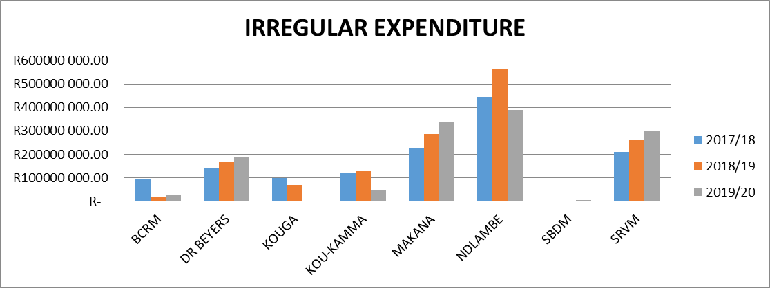
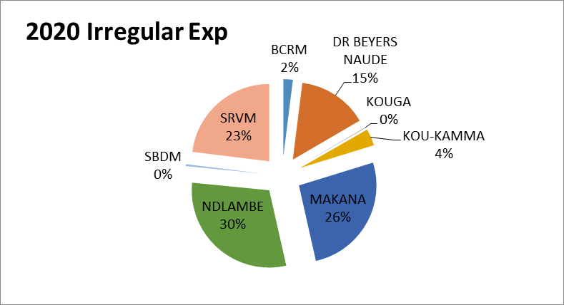
IRREGULAR EXPENDITURE, continued…

Slide 22
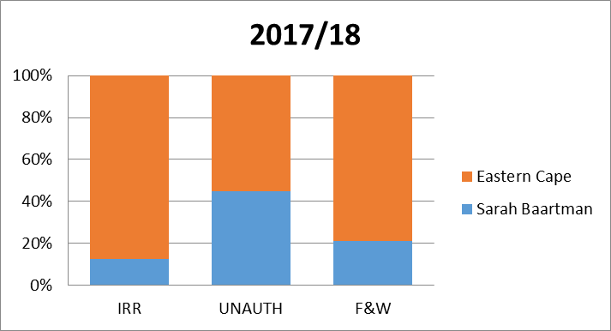
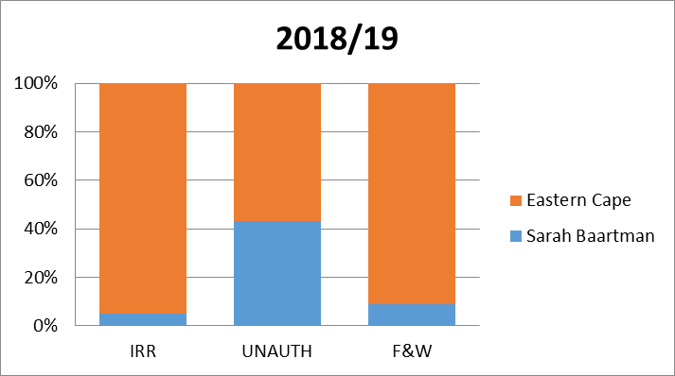
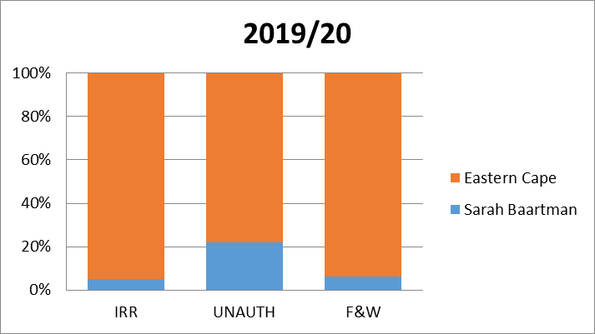
IRREGULAR EXPENDITURE, continued…

Slide 23
Financial Misconduct DC Boards -
Both Sarah Baartman and Koukamma have committees that investigate and recommend on irregular expenditure. However these boards are not established in accordance with the Regulations on Financial Misconduct Procedures and Criminal Proceedings.
The rest of the municipalities in the district have established the Boards however there are still functionality issues with some of them, e.g. appointment letters, vetting, regularity of meetings

Slide 24
INFRASTRUCTURE PERFORMANCE
PART 4 – INFRASTRUCTURE PERFORMANCE

Slide 25
MUNICIPAL INFRASTRUCTURE GRANT (MIG) - (ADM)

Slide 26
INTEGRATED NATIONAL ELECTRIFICATION PROGRAMME GRANT (INEP) - SARAH BAARTMAN

Slide 27
BRIEFING TO - PARLIAMENT’S PORTFOLIO COMMMITEE ON COOPERATIVE GOVERNANCE AND TRADITIONAL AFFAIRS – SARAH BAARTMAN DISTRICT
PART 5 – ANNUAL STRUCTURED SUPPORT

Slide 28
BRIEFING TO - PARLIAMENT’S PORTFOLIO COMMMITEE ON COOPERATIVE GOVERNANCE AND TRADITIONAL AFFAIRS – SARAH BAARTMAN DISTRICT
ADDITIONAL STRUCTURED SUPPORT ACTIVITIES TO EC-MUNICIPALITIES:
Annual Mid year and IDP/Budget engagements to improve performance and funded budgets;
Annual Medium Term Budget Policy Statement to inform LG policy making;
Annual DoRA workshops for Councillors and Officials per District, Chaired by Mayors;
Governance MPAC and Disciplinary Boards;
Implementation of the Financial Management for Improved Service Delivery (FMISD) Programme
Value for money project visit and support on grant spending and rollover applications sessions;
Roll out capacity building on Accounting & Reporting, Supply Chain Management, LG Infrastructure Delivery and Procurement Management.
mSCOA technical support and mediate between municipalities and system vendors;
Conduct Annual Financial Statement readiness support sessions with municipalities
Implementation of the project to reduce Irregular Expenditure

Slide 29
BRIEFING TO - PARLIAMENT’S PORTFOLIO COMMMITEE ON COOPERATIVE GOVERNANCE AND TRADITIONAL AFFAIRS – SARAH BAARTMAN DISTRICT
POSITIVES FROM THE MUNICIPALITIES WITHIN SARAH BAARTMAN DISTRICT:
All Municipal Managers, CFO’s and other Senior Managers complies with the municipal regulations on minimum competency levels issued by National Treasury;
Audit Improvement Plans in place to address Auditor General Findings; and
Regular meetings of oversight structures, i.e. DMAFO, MM and CFO Forum.
SCM Procurement Plans in place – attainment of the plans still require improvement.
Active participation of municipalities in the relevant technical and governance forums organized within the district and by Province

Slide 30
BRIEFING TO - PARLIAMENT’S PORTFOLIO COMMMITEE ON COOPERATIVE GOVERNANCE AND TRADITIONAL AFFAIRS – SARAH BAARTMAN DISTRICT
DISCUSSION

