Slide 1
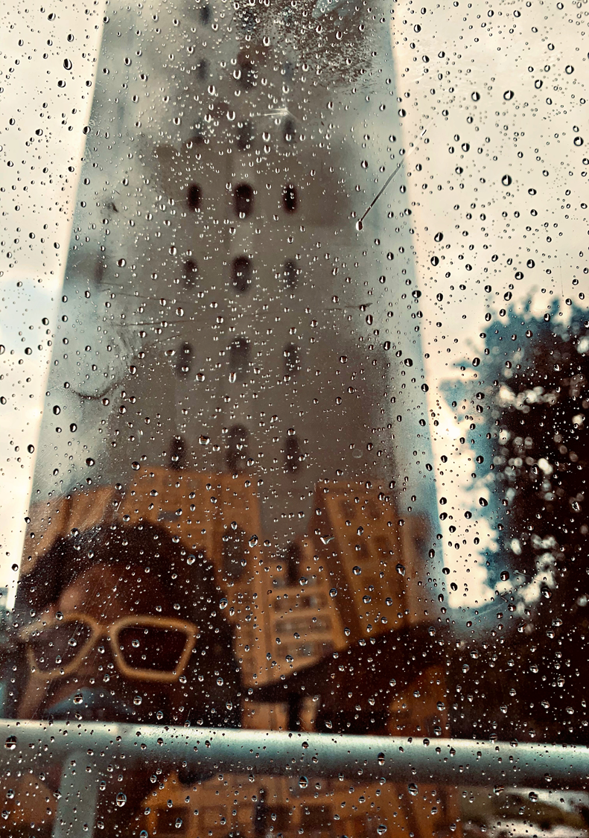
12 AUGUST 2021

Slide 2
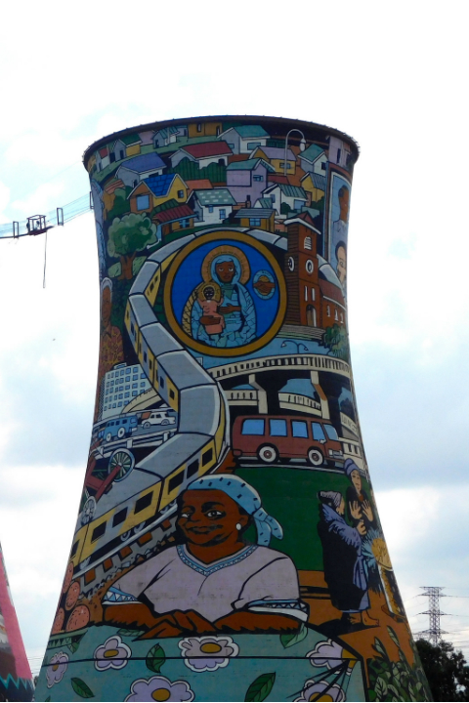
SAMRO’s primary mandate is limited to the administration of the rights afforded to authors and copyright owners in terms of section 2(1)(b) read with section 6 of the Copyright Act 98 of 1978 (Act) which relate specifically to musical works.
SAMRO represents approximately 18 000 composers, publishers and authors
Licences users in order to pay royalties to its members
INTRODUCTION

Slide 3
Tantamount to “free use”
Will limit the ability to license users
Will cause uncertainty and expensive litigation
No “built-in” statutory damages
Onus is on creator to prove copyright infringement
FAIR USE

Slide 4
Sections 12B – 12D, 19B and 19C:
constitute an arbitrary deprivation of property;
violate the right of freedom of trade, occupation and profession;
Are in conflict with the WIPO Internet treaties (the WCT and the WPPT) and
Are in breach of the three-step test.
EXCEPTIONS

Slide 5
Sections 12B – 12D, 19B and 19C:
constitute an arbitrary deprivation of property;
violate the right of freedom of trade, occupation and profession;
Are in conflict with the WIPO Internet treaties (the WCT and the WPPT) and
Are in breach of the three-step test.
EXCEPTIONS

Slide 6
Limitations and exceptions cannot be overly broad and must be applied in certain special cases
Limitations and exceptions cannot deprive rights holders of a source of income by conflicting with normal exploitation of a work
Limitations and exceptions cannot prejudice legitimate interests of rights holders
EXCEPTIONS (3 STEP TEST)

Slide 7
Conduct Impact Assessment Study to ascertain how exceptions will impact CCI’s.
Utilise advice from the experts appointed by the previous PC.
Engage copyright specialists who have also practiced in the field.
RECOMMENDATIONS

Slide 8
BACK COVER
THANK YOU

