Slide 1

NEW SCHOOLS PLANNED FOR MOSSEL BAY
WCED: Physical Resource Planning Directorate
August 2021

Slide 2
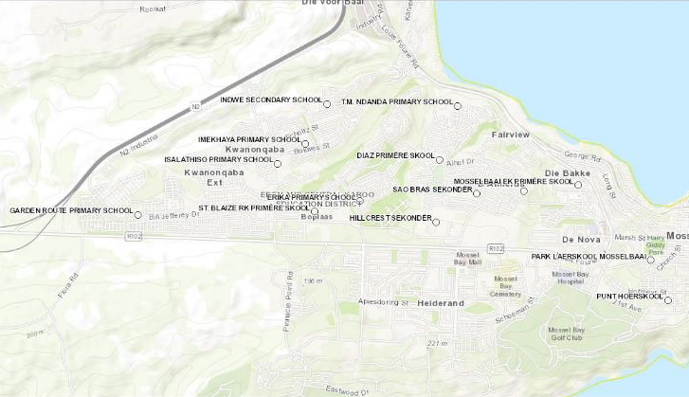
Existing schools in the Mossel Bay area
MOSSEL BAY
Erf 2510
ASLA PARK
RIDGEVIEW PRIMARY SCHOOL
Erf 4464
Erf 5287
MILKWOOD PRIMARY SCHOOL
N

Slide 3
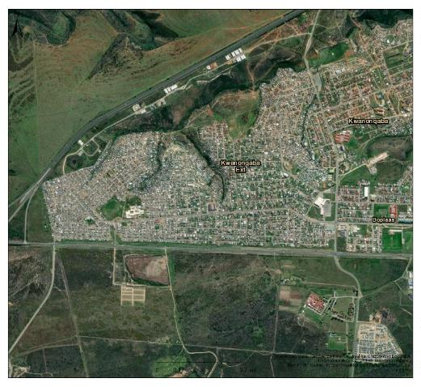
Property identified in the ASLA park area for future Primary School
Erf 2510
Erf 4464
ASLA Park

Slide 4
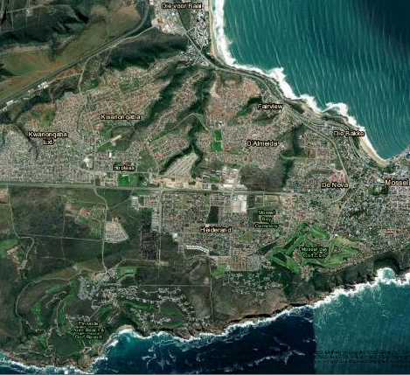
Property identified in Heiderand for Technical High School
ASLA Park
Erf 5287

Slide 5
Existing schools in the Mossel Bay area
SCHOOL NAME | TYPE | EXDEPT | QUIN-TILE | MOI | FEE_STATUS | ENROLMENT TOTAL
DIAZ PRIMÊRE SKOOL | Primary School | HOR | NQ4 | Afrikaans | No Fee | 967
ERIKA PRIMARY SCHOOL | Primary School | HOR | NQ4 | Par: Afr/Eng | No Fee | 1,268
GARDEN ROUTE PRIMARY SCHOOL | Primary School | HOR | NQ1 | Afr/Eng/Xhosa | No Fee | 1,519
HILLCREST SEKONDÊR | Secondary School | HOR | NQ4 | Dual Afr/Eng | Fee charging | 1,336
IMEKHAYA PRIMARY SCHOOL | Primary School | DET | NQ1 | Par: Xhosa/Eng | No Fee | 998
INDWE SECONDARY SCHOOL | Secondary School | DET | NQ1 | English | No Fee | 1,667
ISALATHISO PRIMARY SCHOOL | Primary School | DET | NQ2 | Par: Xhosa/Eng | No Fee | 1,298
MILKWOOD PRIMARY SCHOOL | Primary School | CED | NQ5 | English | Fee charging | 739
MOSSELBAAI EK PRIMÊRE SKOOL | Primary School | HOR | NQ4 | Afrikaans | No Fee | 137
PARK LAERSKOOL MOSSELBAAI | Primary School | CED | NQ5 | Afrikaans | Fee charging | 733
PUNT HOËRSKOOL | Secondary School | CED | NQ5 | Par: Afr/Eng | Fee charging | 1,212
RIDGEVIEW PRIMARY SCHOOL | Primary School | HOR | NQ4 | Par: Afr/Eng | No Fee | 936
SAO BRAS SEKONDÊR | Secondary School | HOR | NQ4 | Afrikaans | No Fee | 1,385
ST. BLAIZE RK PRIMÊRE SKOOL | Primary School | HOR | NQ4 | Afrikaans | No Fee | 605
T.M. NDANDA PRIMARY SCHOOL | Primary School | WCE | NQ2 | Par: Xhosa/Eng | No Fee | 317

Slide 6
Land acquisition and location of projects
Erf 5287 has been identified as the site to construct a new Technical High School in the Mossel Bay area. Erf 5287 is zoned educational and approximately 4.7ha. It is currently owned by the municipality and in process of being acquired by DTPW. Planning will only commence once the acquisition of the property is finalized.
This property is located in the Heiderand area of Mossel Bay and is accessible to the broader Mossel Bay community and is considered an ideal site for the development of a school of specialization. This property is located approximately 3km from the ASLA Park community.
Erven 4464 and 2510 has been identified as possible options to construct the future Primary school in the ASLA Park area of Mossel Bay. Both properties are zoned education and are 2.9ha & 2.3ha respectively. Further investigations will ultimately determine the final location of this future primary school.

Slide 7
Thank you

