Slide 1
BRIEFING ON CABINET DECISIONS ON STATE OF LOCAL GOVERNMENT REPORT
NORTH-WEST INTERVENTIONS
BRIEFING TO COGTA PORTFOLIO COMMITTEE 03 AUGUST 2021

Slide 2
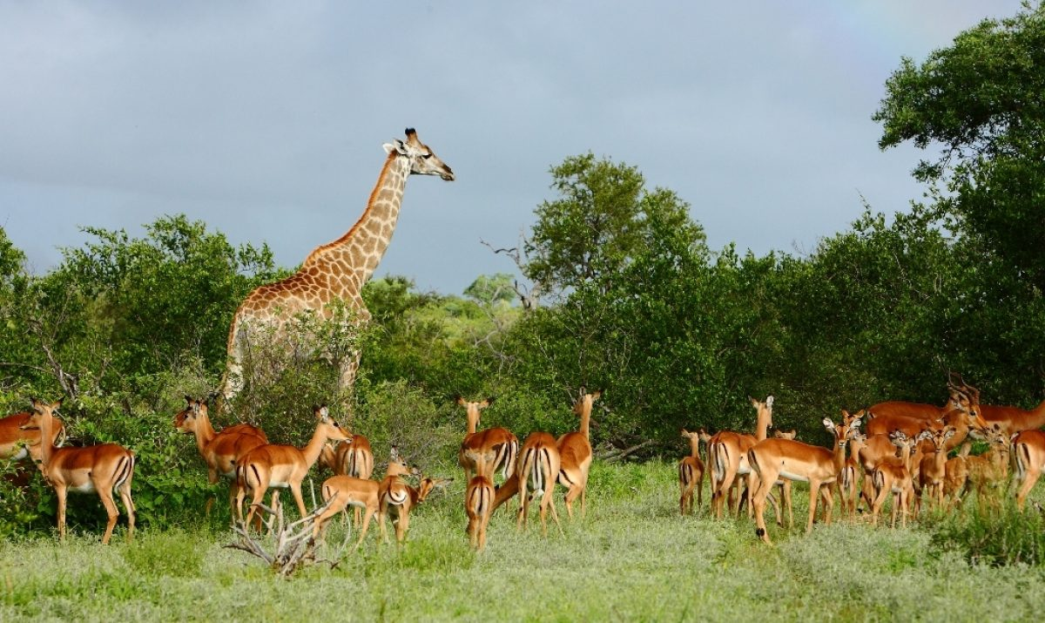
NW
It’s your North west province enjoy it

Slide 3
Purpose
To provide COGTA Portfolio Committee with progress on the implementation of the Cabinet resolutions pertaining to the State of local government report.
SECRET

Slide 4
INTRODUCTION & Background
The State of Local Government Report was presented to Cabinet and the following resolutions were taken:
That COGTA and NT should lead the process of the development of the municipal support plans in collaboration with sector departments, provinces and municipalities; and
That COGTA and NT identify candidates for Interventions and propose the relevant mode of intervention that should be applied. This should include municipalities that need to be taken over by National in terms of section 139 (7) of the Constitution

Slide 5
Challenges facing municipalities
Political
Governance
Administration
Financial Management
Service Delivery
Inappropriate political/ Admin & business interface Infighting, faction leadership resulting in 2 mayors & or speakers sometimes Lack of consequence management such that Sec 139 not yielding results Poor communications with communities by councillors Characterised by motions of no confidence, dual administrations, infighting at times with tender gangsters or aggressive local business forums | Inadequate monitoring & oversight leading to failure to identify administrative flaws Poor control environment non-compliance, lack of consequence management Litigation Dysfunctional Oversight Committees, Poor Audit outcomes, Inability to pay salaries, Failure to adopt budgets and IDPs on time, Confirmed fraud, corruption & maladministration and Limited service delivery | Vacancies in critical positions especially CFOs, engineers Systematic Maladministration, fraud, nepotism & corruption Internal as well horizontal and vertical planning and implementation silos Failure to implement Municipal Systems Act regulations leading to irregular appointments Characterised by: High vacancy rates (snr management: 21%, MM: 27%, CFO: 28%), Labour disputes, Employee costs (above norm of 25 - 40%), Senior managers are remunerated above upper limits, Bloated organisational structures, Lengthy suspensions, Non-compliance to competency regulations, No utilization of Performance Management systems, High staff turnover | Poor audit outcomes: irregular expenditure Av 2% spent on Repairs & Maintenance (8% std). Controls over fixed asset register not adequate; missing inventory, no plan for procurement of goods and services 163 municipalities are facing financial distress which includes 30 municipalities under administration | Whereas 89% of Hh have access to water only 44,9 piped in dwelling, 28,5% water on site, 12,2% communal tap, 3,4 water carrier, 2,5 neighbours tap, 1,7% stream/river & 1 098 661 Hh backlog. 46% have reliability 46% of households with water do not have reliable water Nonrevenue Water Losses from 50% in EC to 20% in WC nearly R9,9 billion a year lost in Non revenue Water R5billion lost in Non Revenue Electricity because of poor maintenance and theft Debt to municipalities R203,5billion (20% actually written off = R47,2 billion) Debt by municipalities: R67,2 up to Jan 2021

Slide 6
State of Local Government : Indicators
Political
Governance
Administrative
Financial Management
Service
Delivery
HIGH RISK DYSFUNCTIONAL | In-fighting in councils Intra-political party divisions in council Divisions in caucuses External political interference in councils Persistent & frequent section 139 interventions (esp. on dissolution of councils) | Council not meeting as regulated Committees of council not meeting Council taking wrongful decisions No oversight by council on administration Poor and weak decision-making by council Councilors unduly interfering in administration No consequence management on corruption, maladministration, nepotism & poor performance Frequent Labour disputes and disruptions Poor public participation processes | Vacancies in key positions Bloated structures Poor performance management and lack of consequence management Non-compliance: legislation, regulations and policies | Unfunded budget Incapacitated and incompetent Budget & Treasury Offices (BTO) Excessive salary bills Non submission or late submission of annual financial statements Disclaimer & adverse audit outcomes High debt to utilities and statutory obligations Flouted SCM processes Poor collection of revenue | High basic services backlogs High number of informal settlements No maintenance of infrastructure resulting in water and electricity supply interruptions and poor water quality No technical capacity Glaring service delivery issues Perennial poor infrastructure grant expenditure Persistent service delivery protests Poor response: service delivery complaints Court actions by interest groups on poor service delivery
Med RISK | Minimal in-fighting in council Elements of factionalism Regular Section 139 interventions | Council meeting as scheduled with some external interruptions Reports on maladministration identified but not acted on by council Oversight conducted not fully effective Public participation not fully effective | Vacancies in some key positions Structure not fully respondent to municipal needs Compliance to applicable legislation, regulations and policies not fully met | BTO not fully capacitated – vacancies in some positions Financial management policies in place, not fully implemented Weak revenue collection Debt owed to utilities & statutory obligations not fully services Annual financial statements late Qualified audit outcomes | Basic services backlogs not fully met Repairs and maintenance not fully executed due to capacity and budget Infrastructure grants not fully spent Frequent service delivery protests Inadequate response to service delivery complaints
LOW RISK | Robust and functional Council No intra-party political divisions | Council meeting as scheduled with no undue external influence Reports on maladministration identified | Vacancies in key positions Structure not respondent to municipal needs Compliance to applicable legislation, regulations and policies not fully met | Weak revenue collection Debt owed to utilities & statutory obligations not fully services Reliance on consultants for Annual financial statements | Repairs and maintenance not fully executed due to capacity and budget Incapacity to response to service delivery complaints
STABLE | Cohesion in council Functional caucus No intra-party political divisions No section 139 interventions over 5 year period | Council meeting regularly, as regulated Council adopts IDP, budget, policies, annual financial statements on an informed and efficient basis Council provides effective oversight over administration | Structure fully respondent to municipal needs No vacancies in key and senior positions (positions occupied by competent individuals) Full compliance with legislation, regulations and policies | Fully funded budget Functional BTO Effective application of credit control and debt collection policies No or minimal outstanding debt to utilities & statutory obligations | Community consultation on service delivery priorities Well capacitated and efficient infrastructure services department Uninterrupted delivery of services due to well maintained infrastructure Quick response and turnaround time to service delivery complaints Infrequent service delivery protests

Slide 7
State of Local Government Barometer
PROVINCE | Number of municipalities | Dysfunctional (Red) | Medium Risk (Orange) | Low Risk (Yellow) | Stable (Green)
Eastern Cape | 39 | 11 | 14 | 14 | 0
Free State | 23 | 11 | 11 | 1 | 0
Gauteng | 11 | 2 | 7 | 1 | 1
KwaZulu Natal | 54 | 11 | 20 | 22 | 1
Limpopo | 27 | 3 | 21 | 3 | 0
Mpumalanga | 20 | 6 | 9 | 4 | 1
North West | 22 | 10 | 7 | 5 | 0
Northern Cape | 31 | 9 | 16 | 5 | 1
Western Cape | 30 | 1 | 7 | 10 | 12
Total | 257 | 64 | 111 | 66 | 16
SECRET

Slide 8
List of dysfunctional municipalities per province
Demarcation Code | Name
NMA | Nelson Mandela Bay
EC104 | Makana
EC124 | Amahlathi
EC129 | Raymond Mhlaba
DC12 | Amathole
EC138 | Sakhisizwe
EC139 | Enoch Mgijima
DC13 | Chris Hani
EC145 | Walter Sisulu
EC153 | Ngquza Hills
DC15 | O R Tambo
MAN | Mangaung
FS162 | Kopanong
FS181 | Masilonyana
FS182 | Tokologo
FS183 | Tswelopele
FS184 | Matjhabeng
FS185 | Nala
FS194 | Maluti-a-Phofung
FS201 | Moqhaka
FS204 | Metsimaholo
FS205 | Mafube
GT421 | Emfuleni
GT484 | Merafong City
DC21 | Ugu
KZN223 | Mpofana
KZN225 | Msunduzi
KZN237 | Inkosi Langalibalele
DC23 | Uthukela
KZN242 | Nquthu
DC24 | Umzinyathi
KZN253 | Emadlangeni
KZN263 | Abaqulusi
KZN275 | Mtubatuba
DC27 | Umkhanyakude
LIM355 | Lepelle-Nkumpi
LIM367 | Mogalakwena
LIM368 | Modimolle-Mookgopong
MP302 | Msukaligwa
MP305 | Lekwa
MP306 | Dipaleseng
MP307 | Govan Mbeki
MP316 | Dr J.S. Moroka
MP321 | Thaba Chweu
NC071 | Ubuntu
NC075 | Renosterberg
NC078 | Siyancuma
NC082 | !Kai! Garib
NC085 | Tsantsabane
NC091 | Sol Plaatje
NC094 | Phokwane
NC451 | Joe Morolong
NC453 | Gamagara
NW372 | Madibeng
NW374 | Kgetlengrivier
NW381 | Ratlou
NW382 | Tswaing
NW383 | Mafikeng
NW384 | Ditsobotla
NW385 | Ramotshere Moiloa
DC39 | Dr Ruth Segomotsi Mompati
NW403 | City of Matlosana
NW405 | J B Marks
WC041 | Kannaland

Slide 9
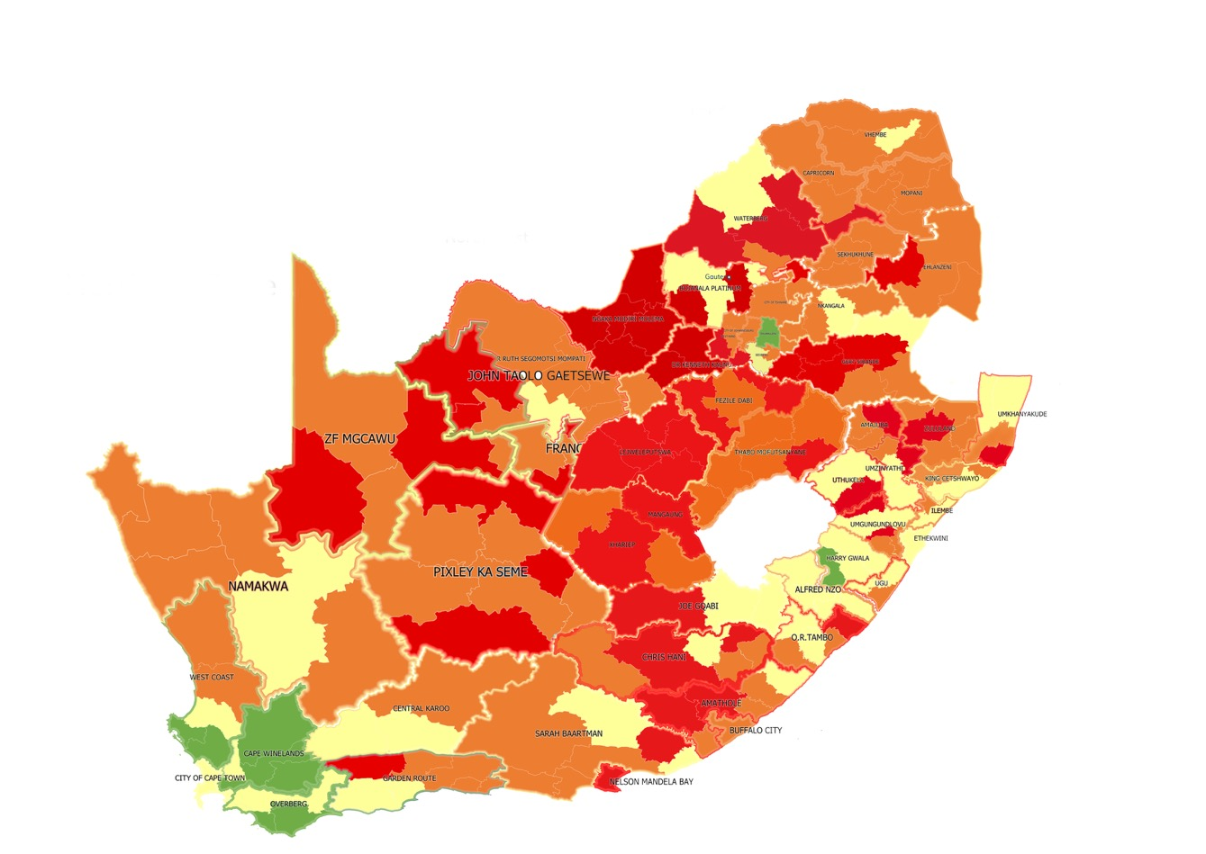
State of Local Government Barometer
Dysfunctional (Red) | Medium Risk (Orange) | Low Risk (Yellow) | Stable (Green)
64 | 111 | 66 | 16
24,51% | 44,36% | 25,68% | 5,45%
Municipalities under Financial Distress
Municipalities under Financial Distress | 163
Municipalities with unfunded budgets | 108
Dysfunctional Municipalities | 63
Muni under administration (sec 139) | 28
SECRET

Slide 10
NW MUNICIPAL CLASSIFICATION

Slide 11
STATE OF NORTH WEST MUNICIPALITIES
Since invocation of 100(1)(b) in July 2018 to provincial CoGTA directives were issued by the Minister key amongst those was the organisational structure of provincial CoGTA that is not fit for purpose to support municipalities.
A district based organisational structure has been reviewed but it lacks funding, CDWs are being migrated from the Premier’s Office to prov. CoGTA.
Directives on Service Delivery, Governance and Administration and Financial Management directed at municipalities no tangible progress registered since 2018.
According to recent categorisation, 5 Municipalities are fairly stable but still at low risk, which require section 154 support, 7 Municipalities are at risk and require close monitoring and support and 10 Municipalities are dysfunctional.
Financial distressed municipalities are 19 (86%), 17 (77%) adopted unfunded budgets. Equitable Share for all municipalities is R6.7 billion and MSIG is R11 million.

Slide 12
STATE OF NORTH WEST MUNICIPALITIES
Out of the 4 districts, 1 district have finalised its Economic Recovery Plan (strategy) and the remaining 3 districts are still at draft stages.
Political infighting and instability has led to 4 Municipalities with 2 Mayors and 2 Speakers in some instances 2 Municipal Managers, 1 municipalities is faced with litigations by Rate Payers Association and 2 municipalities have been taken to court by Rate Payers Association in respect of service delivery failures. 2 Municipalities are under section 139(1)(b) of the Constitution.
There are strained relationships between WSA / WSP this include Waterboards due to lack of sound Service Level Agreements that are not backed by Business Plans for delivering water and Sanitation programs.
Lack of Operations and Maintenance of service delivery infrastructure in particular water and sanitation which leads to sewer spillages in some instances. This is compounded by vandalisation and theft of service delivery infrastructure, some projects being blocked by Business Forums.
As at end May, debt owed to ESKOM amounts to R2.9 billion.

Slide 13
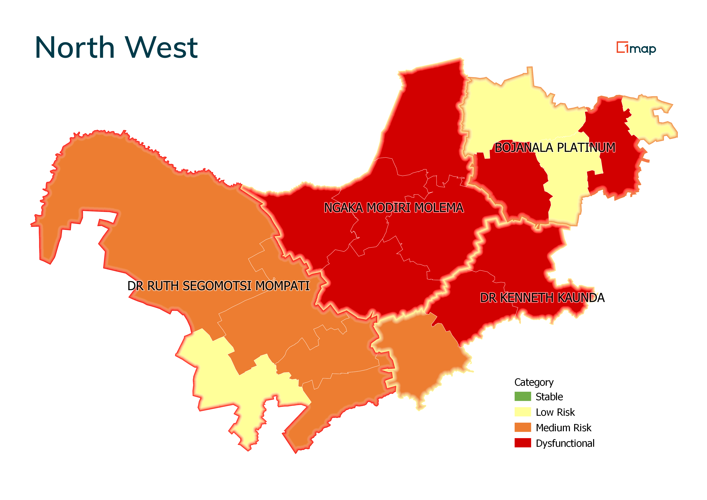
No province has perfect municipalities in any part of the country. The North-West is the worst.
Instability over 3 years with 3 different MECs and 2 National Ministers.
Out of the 22 municipalities in the province:
5 Municipalities are fairly stable but still at low risk, which require section 154 support.
7 Municipalities are at risk and require close monitoring and support. (orange)
10 Municipalities are dysfunctional (red)
Audit outcomes: 1 unqualified, 8 qualified, 5 disclaimer and 8 outstanding
19 (86%)municipalities are financial distress
17(77%) adopted unfunded budget
Equitable share allocation: R6.7billion
21 out of 22 Municipalities have adopted their LED Strategies, 1 Municipality does not have an LED Strategy.
136 informal settlements within the province.
2 Municipalities under section 139 (1) (b).
3 Municipalities with 2 Mayors and 2 Speakers in some instances 2 Municipal Managers.
The NW Eskom debt was estimated at R2.9bn as end May 2021.
There are Hawks and SIU investigations in 2 municipalities.(Madibeng and JB Marks)
Economy recovery plans and LG institutional stabilisation plans in respect of section 154 support plans are developed and will be intergrated in draft DDM One Plans. LED strategies have been developed but lack funding for implementation.
Immediate Service Delivery actions “quick wins” (patching of potholes, refuse removal, sewer spillages, fixing of pot holes, cleaning of the towns, fixing of street lights and robots are integrated in the draft DDM One Plans.
The unemployment rate is 27,6% which is up from the 25% registered in 2008.
Poverty line of R1 227 per person per month, 37,5% of the population is poor.
State of Local Government
It’s your North west province enjoy it

Slide 14
Overview: Bojanala
District Champion: Minister Gwede Mantashe
Political
Governance
Administrative
Financial Management
Service Delivery
Kgetleng Rivier | Opposition parties citing collapse of council, recently closed municipality. | There was no improvement from Section 139 In 2018. Instability, poor planning on Infrastructure grants, court battles with Rate Payers Assoc. MEC agreed on dissolution. Plenary type not effective i.t.o oversight. Number of Litigations: 6 | Vacancies in key positions. Poor performance management and lack of consequence management. Non-compliance with legislation, regulations and policies | Financial distress Disclaimer past 2 fin years,2016/17 unqualified Outstanding audit due to late submission of AFS- 2019/20 Statements quality: poor, Post Audit Action Plan not fully implemented. Adopted unfunded 2021 budget Eskom: R 167 765 775 Bankrupt: mismanagement. MIG: spent 55% of R 51,259m, an additional allocation of R16m was given to the municipality. RBIG: spent 100% of R11m. Cash Coverage not favourable in -line with Sec 140 of the MFMA Escalation of UIF&W expenditure Ineffective Revenue Management System Low collection rate of 60% as per MFMA Circular 71 Creditors not paid within 30 days’ time frame as per Sec 65 (2)(e) of the MFMA Rate Payers Association Court order Persistent non-compliance | Municipality has been taken to court by community Lack of Capacity, reliant on MISA broadly. LED Strategy in place and prioritises the Development of the Koster Dam and Agriculture Programme. High number of informal settlement - 13 Insufficient budget to conduct operation and maintenance. Municipality has outsourced this function to Magalies Water Board. There is poor water quality. Poor road maintenance Solid Waste Management – is in a poor state. The landfills are not compiling. No maintenance on the electrical substations (Koster and Swartruggens Substations) Poor technical capacity in the electrical department (need for technicians to be appointed) Poor electricity revenue collection ( Electricity and Water losses = Not reported Energy Backlog: 30% Mostly in Eskom supplied areas (Reagile, Borolelo)
It’s your North west province enjoy it

Slide 15
Overview: Ngaka Modiri Molema
District Champion: DM Obed Bapela
Political
Governance
Administrative
Financial Management
Service Delivery
Ramotshere Moiloa | The issue of 2 Mayors, 2 Speakers was recently resolved after party intervention. | Previously placed 139 until Aug 2020. Gains achieved by previous Administrator reversed. Administrator locked out. MPAC not functional. | Vacancies at senior management level. | Financial distress Disclaimer: 3 years. Eskom: R 30 588 822 Adopted unfunded 2021 budget Recurrence of irregular expenditure due to noncompliance with SCM Poor revenue collection which result in more than 50% of debt impairment | Roads in Zeerust CBD and Sandvlagte developed potholes. Unreliable water supply to Reagile and CBD due to stressed borehole and continous pumping Unreliable water supply in Rietvlei. The boreholes are yielding very low and cannot meet the demand. Unreliable water supply to the community of Dinokana resulting on constant protest. Informal Settlements – 4 LED Strategy in place prioritizing SMME Support and Trade. MIG Exp: Spent 41%, lost R10.2m MIG funds. INEP: Spent 100% Persistent service delivery protest. Energy Backlog is 10 563HH (22%), mostly informal settlements and Ikageleng infills. Energy losses 25%
It’s your North west province enjoy it

Slide 16
Overview: Ngaka Modiri Molema
District Champion: DM Obed Bapela
Political
Governance
Administrative
Financial Management
Service Delivery
Tswaing | 2 Mayors, 2 Speaker after vote of no confidence. Ward committees dysfunctional. | Portfolio committees resuscitated and functional. MPAC has also been resuscitated | MM no access to offices locks changed. 2 MMs. Fraud cases unresolved. | Financial distress Qualified: 3 previous yrs Adopted unfunded budget Cash Coverage not favourable in -line with Sec 140 of the MFMA Escalation of UIF&W expenditure Ineffective Revenue Management System Low collection rate of 49% as per MFMA Circular 71 Creditors not paid within 30 days’ time frame as per Sec 65 (2)(e) of the MFMA Backlog on Statutory payments Persistent non-compliance | The clarifier for Delaryville is dysfunctional due to lack of process controllers. Pollution to the environment due to spillages from Atamelang pump station. There is lack of maintenace on the pump and motors Discharging of untreated effluent from the Delaryville WWTW due to lack of process controllers. Unreliable water supply to the RDP section in Delaryville. No proper reticulation to supply the area with water. Energy losses 42% Energy Backlog is 3 420HH.(9.4%), infills in Delareyville, Ottosdal and Sannieshof. CBD roads have potholes and need resurfacing. The maintenance is being neglected due to funding. Technical Director position vacant. Poor spending in INEP grant, Municipality lost R3m of INEP MIG Exp: Spent 49%, received extra R6m reallocated funds. Persistent service delivery protests from poor water services in RDP section . Informal Settlements – 11 LED Strategy in place prioritizing Agriculture, Tourism and Manufacturing Programmes.
It’s your North west province enjoy it

Slide 17
Overview: Ngaka Modiri Molema
District Champion: DM Obed Bapela
Political
Governance
Administrative
Financial Management
Service Delivery
Ratlou | 2 Mayors, 2 Excos, 2 Speakers, council and snr officials divided | Previously placed 139 Under administration (Jun 2019). MPAC Partially functional. MPAC not receiving sufficient support | Administration is also unstable, officials divided among factions in council. Gangs are disrupting Administration | Financial distress Disclaimer: 2 years; Qual 2017/18 & 2016/17 Regresses from Unqualified finding 2014/15. Adopted funded budget. Recurrence of irregular expenditure due to noncompliance with SCM Poor revenue collection which result in more than 40% of debt impairment | Poorly maintained roads in Madibogo and Setlagole. Technical Director position vacant. MIG Exp: Spent 14%, lost funds R8.7m MIG funds. Persistent service delivery protest LED Strategy in place prioritizing SMME Support and Agriculture Development. Lack of Town Planning Capacity and Non Existence of Planning Units/Departments
It’s your North west province enjoy it

Slide 18
Issues requiring Intervention
A package of interventions is being implemented by National & Provincial COGTAs with Treasuries to address and assist the municipalities. The issues that require urgent intervention at municipalities include:
Parallel councils, 2 Mayors, 2 Speakers exist in some municipalities;
Maladministration and corruption;
Defiance of provincial government interventions;
Private ratepayers' organisations withholding revenue and taking over municipal services;
Failing water and sanitation systems;
Vandalism and theft of infrastructure;
Gangsterism and criminal attacks on officials;
Debts to Eskom & Water Boards threaten continuation of essential services.

Slide 19
State of local government: Interventions
Service delivery:
MISA, Provincial COGTA and DWS team done comprehensive action plan & identified key projects:
Short term: patching of potholes; refuse collection; repair of street and traffic lights; addressing sewer spillages and water leakages
Medium term: completion of water projects; completion of road projects; electricity substations
Long term: bulk water and sanitation projects
Resourcing of the plan of action:
Service delivery plan of action requires an estimated R3bn, some sourced from municipal budgets; Municipal Infrastructure Grant; Water Services Infrastructure Grant; Regional Bulk Infrastructure Grant
Submission made to National Treasury to process proposal to convert a portion of the MIG to be directly managed by national government (appointment of implementing agents to deliver some of the strategic projects)
DBSA made commitment to support the plan of action and will establish a Program Management Unit for municipal support
Mining houses in the Bojanala District have made commitments to fund some of the key infrastructure led by the DDM Champion

Slide 20
State of local government: Interventions
The progress made thus far is as follows:
Detailed plan of action developed. Highlights immediate, medium-term and long-term interventions
Service delivery plan of action completed and costed
Relevant sector depts at national and provincial level made inputs to the plan of action (Department of Water & Sanitation (DWS), Provincial Department of Transport, Department of Environment, Forestry and Fisheries) –
COGTA, Through MISA already on the ground.
DWS already on the ground on the priority water projects;
Department of Environment commence cleaning & greening projects in July 2021)
DWS committed to fast-track water projects incomplete for years which will provide access to underserved communities (i.e. Taung Dam; Moretele bulk water; Brits WTW; Maquassi Hills bulk water pipeline)
Joint National and Provincial Teams (Cogta, NT, PT Cogsta, SALGA) are finalising the municipal specific support and intervention package and agree on the appropriate mode of intervention within the hierarchy of Constitutional and Legislative interventions measures; (139 (1) (a), 139 (1) (b), 139 (1) (c), 139 (5), 139 (7), section 106 of the MSA

Slide 21
Recommendations to Cabinet for the Immediate
1.1 Notes the 64 high risk municipalities which are in crisis.
1.2 Agrees on decisive steps which include disbanding some municipalities.
1.3 Agrees on the deployment of rapid response teams constituted by former Ministers and DGs
amongst others.
1.4 Agrees on technical support teams.
1.5 Agrees on political champions to work closely with provincial administration.
1.6 Agrees that the President with Ministers of COGTA and Finance approve the national interventions.
1.7 Support the hosting of a Local Government Indaba by the Ministers of COGTA and Finance to implement the solutions proposed.

Slide 22
Recommendations to Cabinet
THAT CABINET FURTHER:
2.1 Notes the report on the State of Local Government
2.2 Supports the following proposed key interventions:
2.2.1 Governance and administration Invocation of interventions in terms of Section 139 of the Constitution: (139(1)(b) 139(1)(c) and 139(7); as well as application of section 106 of the Municipal Systems Act (accelerate and conclude on investigations).
2.2.2 Service delivery Conversion of a component of the Municipal Infrastructure Grant (MIG) from a schedule 5B (direct grant) to a schedule 6B (indirect grant), apply provisions of section 20 of DORA and appoint capacitated Implementing Agents to support the most challenged municipalities.
2.3 Notes and supports the Local Government Support and proposed Intervention Packages
of which details are reflected in the SoLG Annexure.

Slide 23
Cross-Cutting Interventions
Issues / Challenges | Recommended Intervention
Theft vandalism of infrastructure and blockage of projects by Business Forum | A National Task Team led by SAPS, State Security Agency, Hawks and Provincial Departments of Community Safety to develop a response strategy to safeguard infrastructure and corrective take action through Law Enforcement Agencies and NPA
2. Filling of vacant senior positions prior to the LG elections | COGTA, NATIONAL TREASURY, PROVINCES AND SALGA to issue a Circular guiding municipalities on managing transitional matters pre and post LG elections
3. Districts that are not Water Services Authorities and not extensively supporting the local municipalities | A decision to be taken on all non WSA districts to enter into Service Level Agreements with the under-capacitated Local Municipalities on specific functions such as water services and other shared services e.g. shared audit committee services, water testing laboratories, municipal health services, etc.
4. Escalating debt owed by municipalities to ESKOM and Water Boards | The IMC on Debt owed to ESKOM and Waterboards to be provided with viable options for a sustainable solution through DWS, COGTA, SALGA and National Treasury

Slide 24
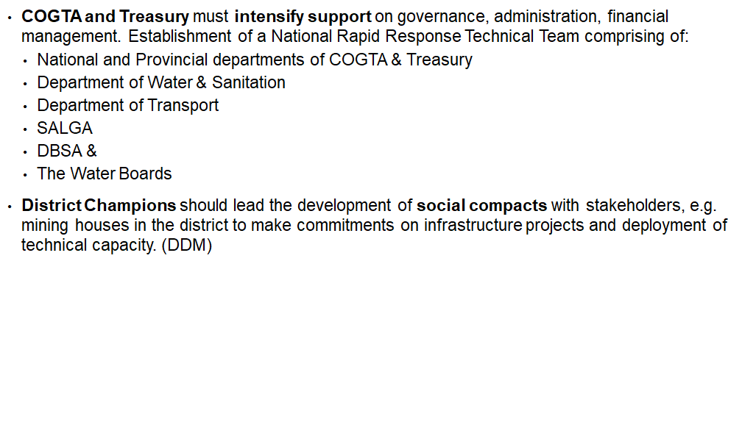
Recommendations

Slide 25
TIME FRAMES for the development of the municipal support and intervention package
NO | MILESTONES | OBJECTIVE | RESPONSIBILITY | TIMELINES
1. | Key national sector departments through the DDM approach | Ensure a multi-sectoral approach to support and interventions | National COGTA & National Treasury | 6 August 2021
2. | Development and finalisation of Municipal Specific Support Plans | Identify unblocking actions for each of the key performance areas outlined in the template and finalise Municipal Specific Support Plans | COGTA, National Treasury, National & Provincial Sector Departments, Provincial CoGTA Departments, SALGA and municipalities | 16 August 2021
3. | Identify candidates for interventions and define the correct mode of the intervention to be applied (from the 64 dysfunctional municipalities) | Ensure that municipalities in crisis are prioritised for urgent interventions | COGTA , NT Provincial COGTA and Treasuries | 16 August 2021
4. | Provincial Executive Councils and Municipal Councils to approve the Municipal Support Plans for the 64 dysfunctional municipalities | Approval & Monitoring of implementation of Municipal Specific Support Plans | Provincial Executive Councils & Municipal Councils | 31 August 2021
5. | Provincial Executive Councils and Municipal Councils to approve the Municipal Support Plans for the rest of municipalities | Approval of the | Provincial Executive Councils & Municipal Councils | 15 September 2021
6. | Political roadshows by Deputy Ministers of COGTA and NT | To communication Cabinet decisions to Premiers and MECS for COGTAs and Treasuries | Deputy Ministers of COGTA and NT | July-September 2021

