Slide 1
Presentation to BUDGET committee PROVINCIAL PRELIMINARY BUDGET PERFORMANCE 2020/21 FINANCIAL YEAR
Provincial Treasury and Department of the Premier
23 July 2021

Slide 2
Overview
Departmental Preliminary Budget Performance: 2020/21 Financial year- 98.2 per cent of budget spent
Departmental Preliminary Infrastructure Performance 2020/21 Financial Year – 95.5 per cent of budget spent
Departmental Validated Non-Financial Performance: 2020/21 – 77 per cent of targets achieved

Slide 3
Departmental Preliminary Budget Performance: 2020/21 Financial Year

Slide 4
Provincial Preliminary Expenditure as at 31 March 2021

Slide 5
Provincial Preliminary Expenditure as at 31 March 2021
The preliminary under spending of R1.305 billion (1.8 per cent) mainly relates to the three largest Votes – Education R547.548 million, Health R361.535 million and Transport and Public Works R230.969 million.
Preliminary March 2021 outcomes per Economic Classification, reflects;
Underspending on Compensation of Employees (CoE), and Goods and Services.
Overspending is reported against Transfers and Subsidies, Payments for capital assets and Payments for financial assets.
The respective overspending will be off-set by way of year-end entries, as well as the application of virements and shifts where applicable and will be reflected as part of the final audited reporting.

Slide 6
Provincial Preliminary Expenditure as at 31 March 2021
The votes contributing to the net under spending include:
Health: preliminary net under spending of R361.535 million, or 1.3 per cent of the adjusted budget of R27.214 billion. The underspending is largely in Goods and services R166.634million, Compensation of employees R118.091 million, Non-Profit Institutions R60.900 million and Buildings and other fixed structures R38.711 million
Education: preliminary net under spending amounted to R547.548 million consisting of Goods and Services R433.366 million, Buildings and other Fixed structures R258.544 million and a preliminary overspending on Non-Profit Institutions R214.897 million.
Under spending within Goods and Services and Buildings and other Fixed structure relates to projects and activities that were adversely impacted by the COVID-19 pandemic.
Overspending on the Non-Profit R266 million due to advanced payments made in respect of the 2021/22 Norms and Standards paid in the month of March 2021.

Slide 7
Provincial Preliminary Expenditure as at 31 March 2021
Transport and Public Works: The preliminary under spending amounts to R230.969 million due to the impact of COVID-19 and the resultant lockdown :
R44.378 million Compensation of Employees - later than anticipated appointment of staff due to;
R79.295 million Goods and Services mainly due to delays in contracted maintenance;
R37.710 million Transfers and Subsidies due to outstanding rates and taxes accounts not received and due to several municipalities, that did not claim their subsidies for construction and maintenance work on road infrastructure; and
R70.549 million Payments for Capital Assets due to delayed construction work.
Human Settlements: The preliminary net under spending amounted to R76.920 million, relating to the Provincial Emergency Housing Grant R70.800 million to address permanent housing solutions for households affected by the fire and storm damage in the Masiphumelelele settlement in the Metro.

Slide 8
Provincial Preliminary Expenditure as at 31 March 2021
Provincial Parliament: The preliminary net under spending amounting to R14.478 million mainly relates to the Compensation of Employees R9.070 million
due to vacancies not filled as planned which will be requested for rollover and reallocation in terms of the Financial Management of Parliament Act, Act 10 of 2009 (FMPPLA). Furthermore,
CoE under spending amounting to R5.408 million, in terms of Direct Charges, is mainly due to the members’ salary increases not implemented, as determined by the Presidency’s proclamation notice 17 of 2021.

Slide 9
Public Entity Preliminary Expenditure as at 31 March 2021

Slide 10
Public Entity Preliminary Expenditure as at 31 March 2021[1]
Provincial Public Entities recorded preliminary spending of R717.490 million or 89.6 per cent of the R800.554 million adjusted budget. The aggregate net preliminary under spending of R83.064 million mainly relates to Wesgro, Western Cape Liquor Authority, Western Cape Gambling and Racing Board and Casidra and include the following:
Western Cape Tourism, Trade and Investment promotion Agency (Wesgro): Wesgro preliminary spending amounting to R130.896 million or 83.5 per cent of the R156.768 million adjusted budget, reflecting a net preliminary under spending of R25.872 million at the end of March 2021.
The under spending is mainly related to Compensation of Employees as a result of vacant positions that were not filled as planned due to the impact of the COVID-19 lockdown regulations; under spending in in Goods and Services (R14.114 million), mainly due to postponement of planned events as a result of COVID-19 lock down regulations;

Slide 11
Public Entity Preliminary Expenditure as at 31 March 2021[2]
Western Cape Liquor Authority: The preliminary spending amounting to R47.948 million or 67.4 per cent of its R71.186 million adjusted budget and translating to under spending of R23.238 million, mainly related to Compensation of Employees as well as Goods and Services on activities adversely impacted by the COVID-19 pandemic.
Western Cape Gambling and Racing Board (WCGRB): Preliminary spending of R53.822 million or 76.9 per cent of its adjusted budget amounting to R69.971 million at the end of the March 2021. The preliminary under spending amounting to R16.149 million, prior to final book entries, mainly relates Compensation of Employees 5.642 million due vacant posts; Goods and Services R9.641 million due to savings realised on travel and subsistence, administrative and legal fees impacted by the lockdown.
Casidra: Recorded preliminary spending amounting R38.476 million or 77.2 per cent of the adjusted budget with a net under spending of R11.346 million. The net under spending is observed within CoE R6.984 million and Goods and Services amounting to R2.875 million.

Slide 12
Departmental Preliminary Infrastructure Performance 2020/21 Financial Year

Slide 13
Infrastructure Preliminary Expenditure as at 31 March 2021
Infrastructure preliminary expenditure (maintenance and capital) at the end of March 2021 amounted to R7.821 billion or 95.5 per cent against the R8.186 billion adjusted budget.

Slide 14
INFRASTRUCTURE PERFORMANCE END QUARTER 4 2020/21
Infrastructure Expenditure
Preliminary infrastructure spending by the Province at the end of Quarter 4 amounted to R7.822 billion or 95.5 per cent against the 2nd adjusted budget allocation of R8.187 billion.
Impact of Covid-19
WCGH had to implemented several unforeseen Priority Infrastructure Projects in order to respond to COVID-19.
Reprioritisation, away from infrastructure occurred in order to respond to COVID-19.
Some projects in planning were delayed.
Some projects on tender, or ready for tender have been delayed, pending budget availability and certainty over the 2021 MTEF.

Slide 15
Provincial Preliminary Receipts as at 31 March 2021

Slide 16
Provincial Preliminary Receipts as at 31 March 2021
Provincial departmental own revenue collections at the end of March 2021 amounts to R2.582 billion, or 106.6 per cent of the adjusted budget amounting to R2.423 billion.
Tax receipts consists of gambling taxes and liquor licence fees:
In 2020/21, gambling taxes receipts were R455.893 million or 121.4 per cent of the R375.520 million adjusted budget;
Liquor licence fees receipts were R39.713 million, against an adjusted estimate of R35.292 million.
Departmental Revenue includes the following:
Transport and Public Works recorded own revenue collections of R1.967 billion or 103.7 per cent of the adjusted budget at the end of March 2021. The Department’s own revenue is mainly derived from Motor Vehicle Licence (MVL) fees, which recorded collections of R1.839 billion at the end of March 2021, compared to R1.804 billion collected during 2019/20. Own revenue collections for MVL fees was mostly recovered by the end of the 2020/21 financial year as motorists paid outstanding motor vehicle licence fees which was payable during the lockdown period.

Slide 17
Provincial Preliminary Receipts as at 31 March 2021
Departmental Revenue includes the following:
Health’s own revenue collected at the end of March 2021 amounted to R411.006 million, lower than the R686.092 million collected in 2019/20. Lower collections reported in 2020/21 are attributed to the national lockdown which resulting in lower hospital patient fees, reduced collections from the Road Accident Fund and a decrease in the submission of medical scheme claims.
Human Settlements’ own revenue collections amounted to R114.119 million or 170.7 per cent of the R66.845 million adjusted budget and mainly include returned subsidies from municipalities remitted to the Department, the sale of property assets and rental income.

Slide 18
Validated Non-financial Quarter 4 performance data
2020/21 financial year for all departments and public entities

Slide 19
Departments: Achievement against performance indicator targets
KEY: Achieved = 100 per cent or more of target achieved; Partially Achieved = 50 per cent or more but less than 100 per cent; Not Achieved = below 50 per cent.
NOTE: Health uses 95 per cent and above to reflect “achieved” due to many of the indicators being demand driven and therefore unpredictable
Due to rounding, percentages do not always add up to 100.
*The targets reflected as” 0” were not taken into account

Slide 20
Departments: Results against the WCG departments average
Includes all performance indicator targets

Slide 21
Public Entities: Achievement against performance indicator targets
KEY: Achieved = 100 per cent or more of target achieved; Partially Achieved = 50 per cent or more but less than 100 per cent; Not Achieved = below 50 per cent.
*The targets reflected as” 0” were not taken into account

Slide 22
Public Entities: Results against the WCG public entity average
Includes all performance indicator targets

Slide 23
Departments and Public Entities:
New COVID-19 Interventions Implemented (Quarter 4)and Progress on C-19 Interventions (Quarters 1, 2 & 3)

Slide 24
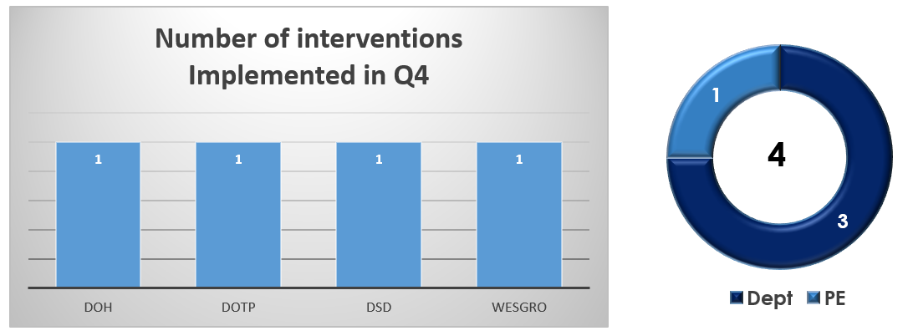
C-19 interventions by departments and public entities
The survey confirmed a total of 4 new interventions implemented across the WCG by departments and public entities as summarised in the graph below.

Slide 25
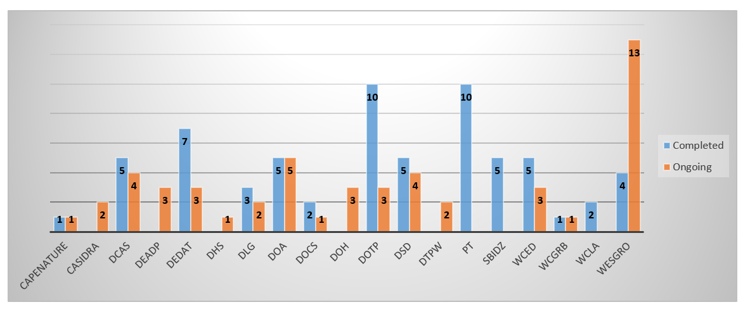
C-19 progress interventions by departments and public entities
The graph below shows the progress of 116 interventions implemented by institutions during all quarters of 2020/21.
As reported by institutions, above graph shows 65 (or 56 per cent) interventions completed and 51 (or 44 per cent) will continue in the next financial year.
Provincial Treasury, Western Cape Liquor Authority and SBIDZ completed 100 per cent of their C-19 interventions.

