Slide 1
Adhoc Committee on Covid - 19
Health Update
Dr K Cloete

Slide 2
Overview
Surveillance & Response Update
Expectations for the 3rd wave
The triggered third wave response
Vaccine Implementation update
Conclusions

Slide 3
Surveillance & Response Update

Slide 4
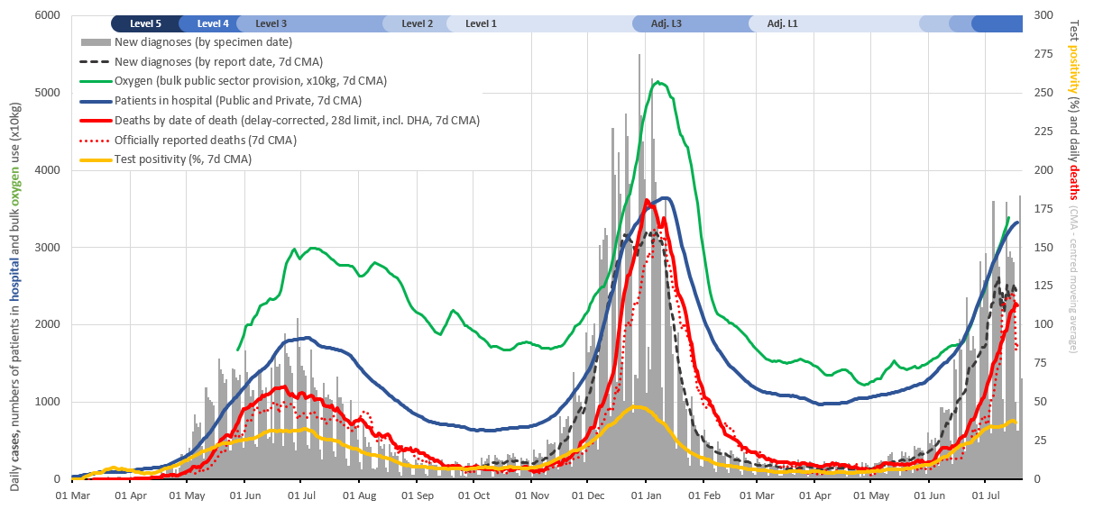
Integrated testing, case, hospitalisation and mortality trends

Slide 5
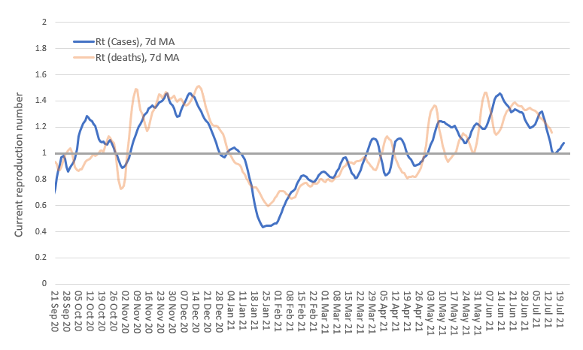
Current reproduction number (Western Cape)
Reproduction number based on cases currently ~1.1
Approximated based on smoothed doubling times, cases by date of reporting

Slide 6
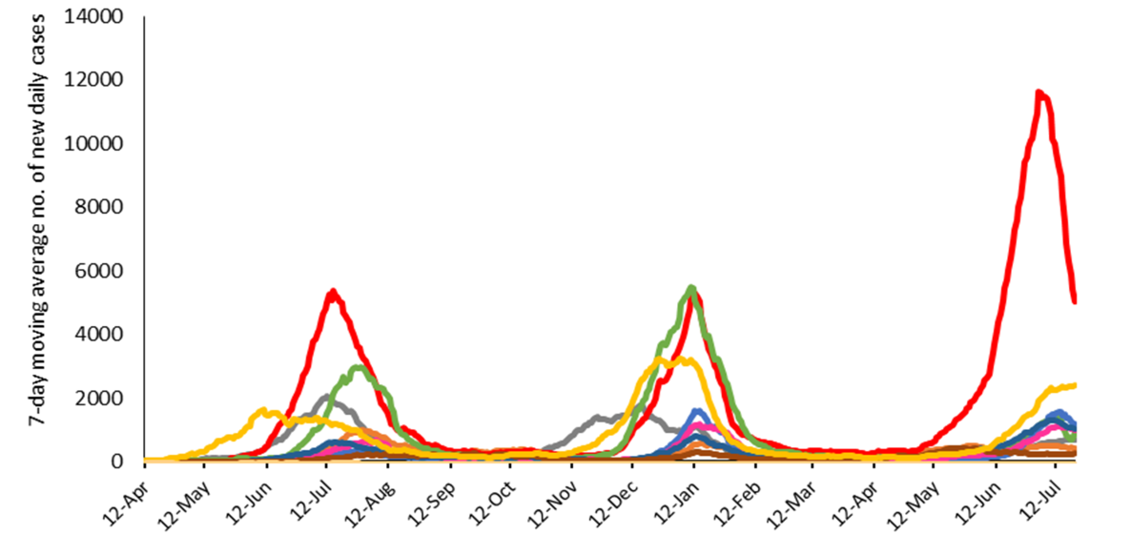
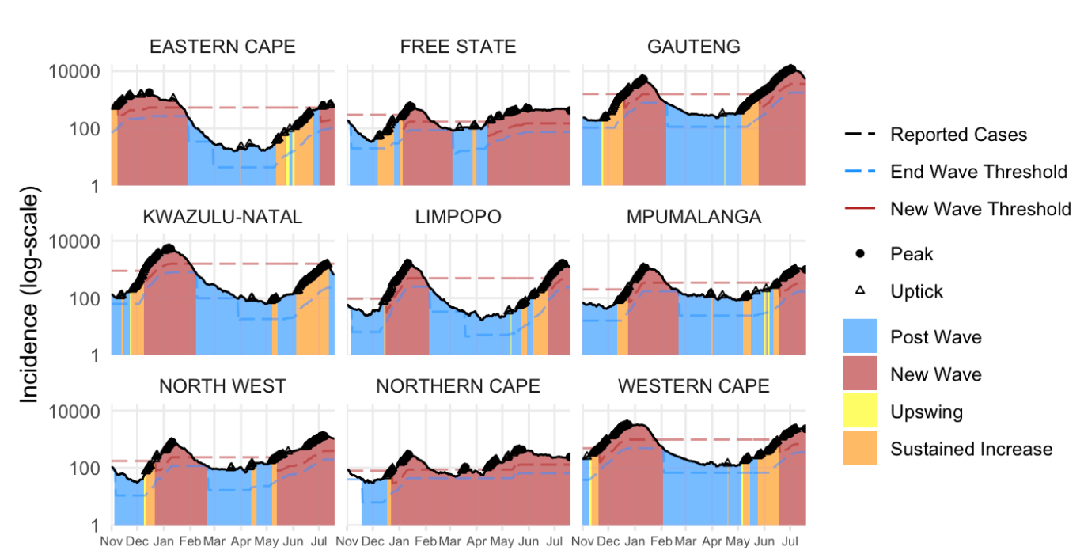
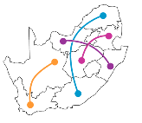
National trends
Several provinces showing early signs of plateauing including WC.
Gauteng: Steep decreases in Gauteng continue.
7-day moving average of new cases by province

Slide 7
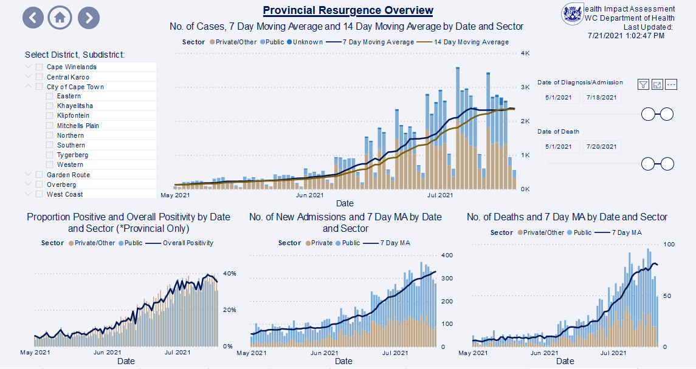
Provincial Overview
3.2% in last wk (11 July – 18 July 2021)
10 % in last wk (11 July – 18 July 2021)
11 % in last wk (11 July – 18 July 2021)
Case numbers appear to have flattened; case numbers in last week similar to week before. The proportion positive has, however, continued to increase, reaching 39% last week.
The concern is that testing has decreased, due to a range of factors, including taxi violence, so unclear whether we have reached the peak of this wave.
We are currently seeing an average of 2345 new diagnoses each day. Admissions are increasing with an average of 330 new admissions per day. Deaths have also increased, with around 82 deaths each day.

Slide 8
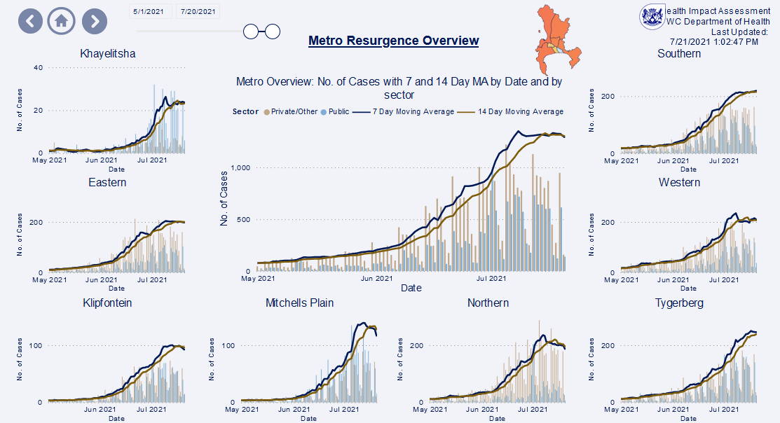
Metro Overview
17%
4%
4% in last wk (11 July – 18 July 2021)
-0.5%
9%
3%
-3%
-3%
14%
Overall, there is a 4% week on week increase in cases in the Metro.
Most sub-districts are seeing a plateau in case numbers this last week, which may be artificial, and due to a range of factors including restricted testing criteria and the recent taxi violence.
An increasing proportion of cases in Metro are from the public sector.

Slide 9
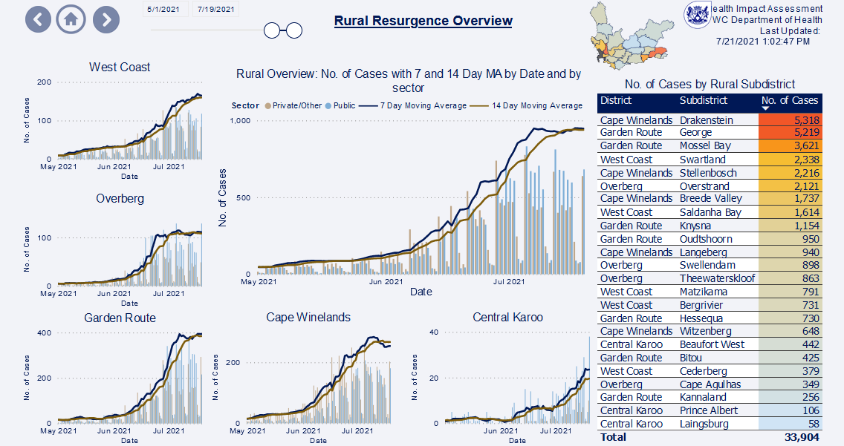
Rural Overview
8%
1 % in last wk (11 July – 18 July 2021)
5%
5%
-10%
55%
A similar plateau in case numbers is being seen in the rural districts as well.
The exception is Central Karoo, which is having a high percent increase in case numbers, although the absolute numbers there are small.

Slide 10
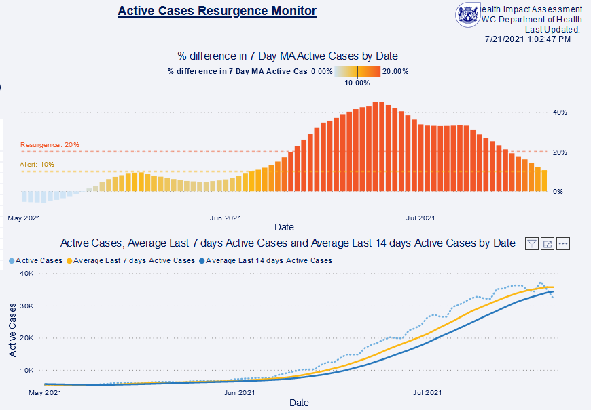
There are currently 32 730 active infectious cases. This is 1 358 more active cases (4.3%) in the last week.

Slide 11
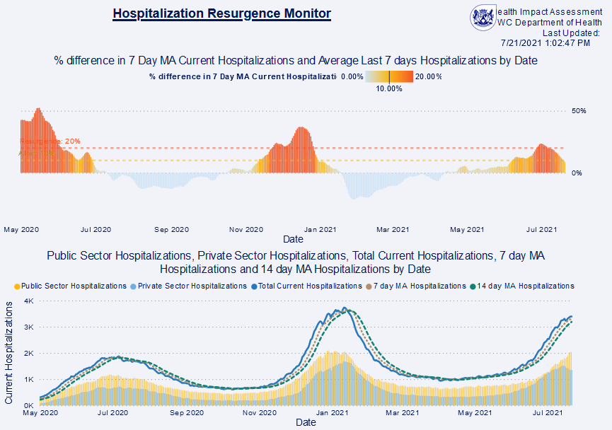
Currently admitted patients
Hospitalisations continue to increase in both the public and private sectors but the percent increases are smaller.
Currently 3 010 patients are admitted with COVID-19.

Slide 12
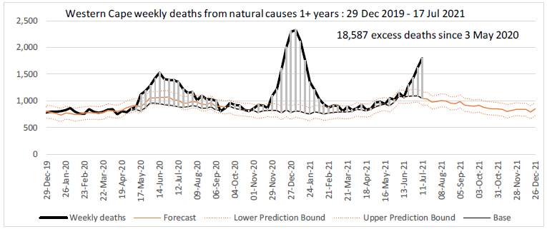
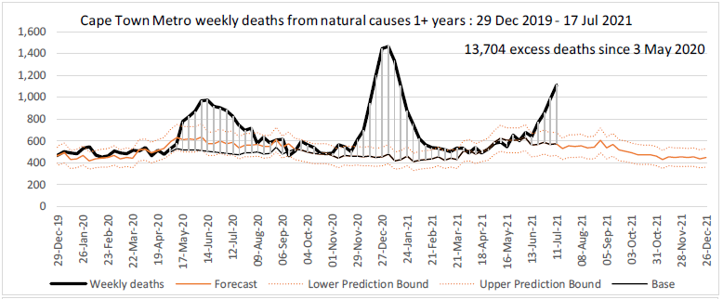
Western Cape and Cape Town Metro excess deaths continue increasing steeply and have exceeded first wave peak.

Slide 13
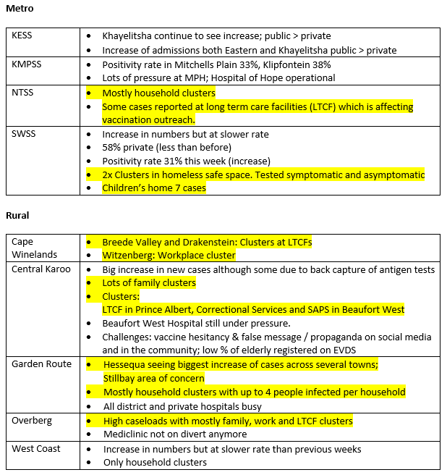
20 July 2021
Surveillance Huddle Notes
Increasing case numbers, and now admissions and deaths across the province.
Remain in the phase of widespread community transmission and mitigation.
Household, workplace and LTCF / congregate residential clusters.

Slide 14
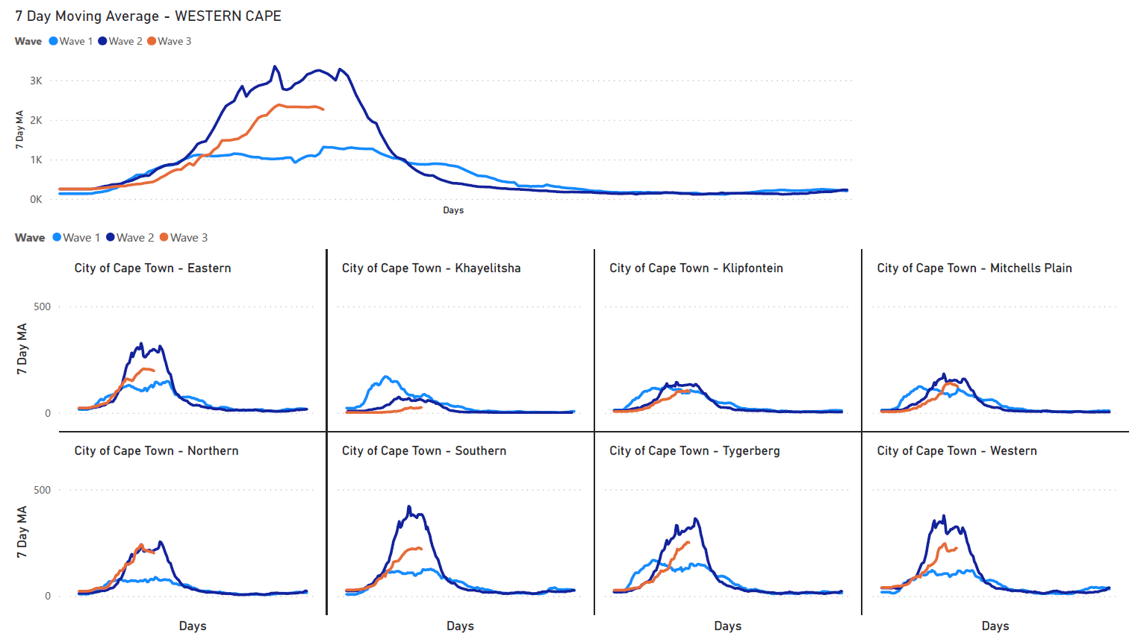
Comparing the 3 waves
3rd wave appears to be plateauing slightly lower than 2nd wave but could still be due to limited testing.
Northern case incidence same as 2nd wave peak.
Klipfontein, Mitchells Plain similar to 2nd wave.

Slide 15
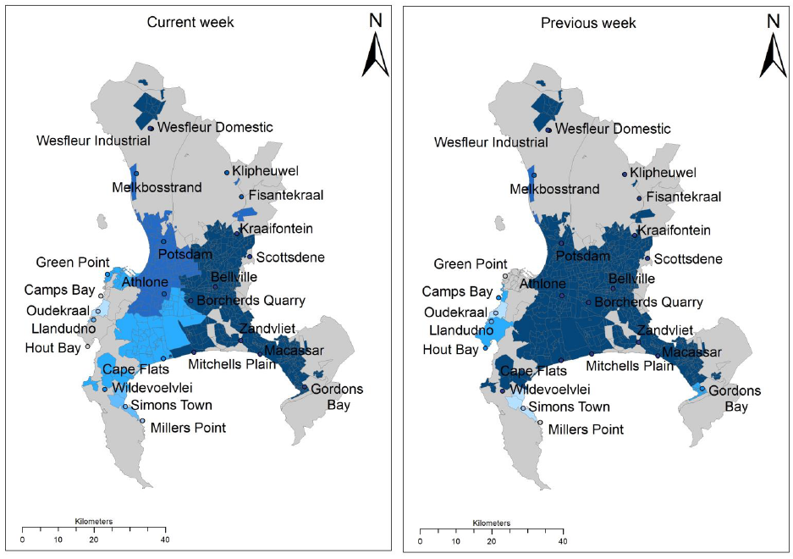
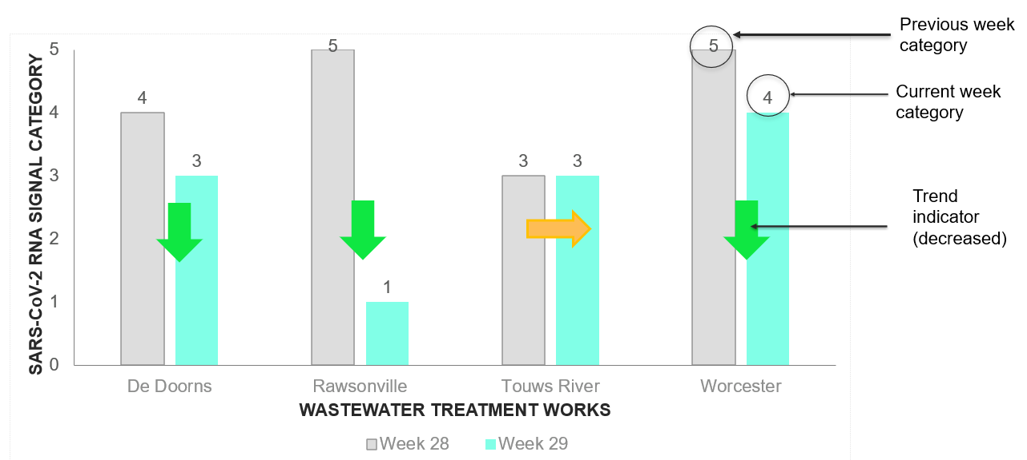
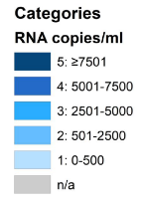
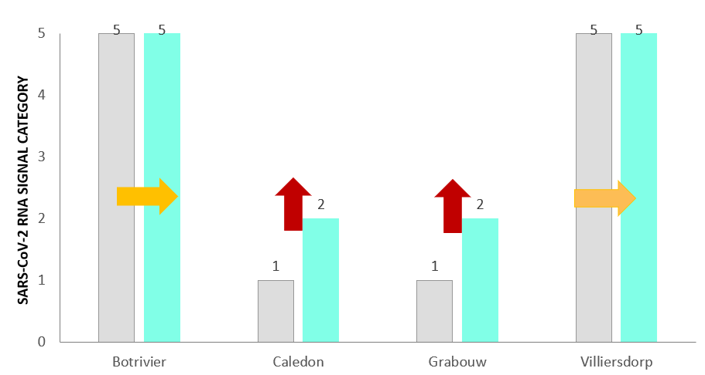
Triangulating with wastewater
WEEK 29 2021
SAMRC COVID- 19 AND WASTEWATER EARLY WARNING SYSTEM
City of Cape Town, Breede Valley AND Overberg
Breede Valley: SARS-CoV-2 ↓ at all treatment plants except Touwsriver; Large ↓ in Rawsonville.
Metro:
SARS-CoV-2 >2500 copies/ml (category 3 or higher) at 82% of treatment plants and category 5 at 45% of plants (↓ from 68% in previous week).
Notable increase from category 3 to 5 at Gordon’s Bay.
Theewaterskloof:
Botrivier and Villiersdorp remain in category 5 ↑ to category 2 at Caledon & Grabouw

Slide 16
Update on delta variant in WC
Delta remains overwhelmingly dominant variant in WC from mid-June onwards.
Notes:
Suggest omitting – there is really not much new data and remains predominantly delta

Slide 17
Expectations for the Third Wave

Slide 18
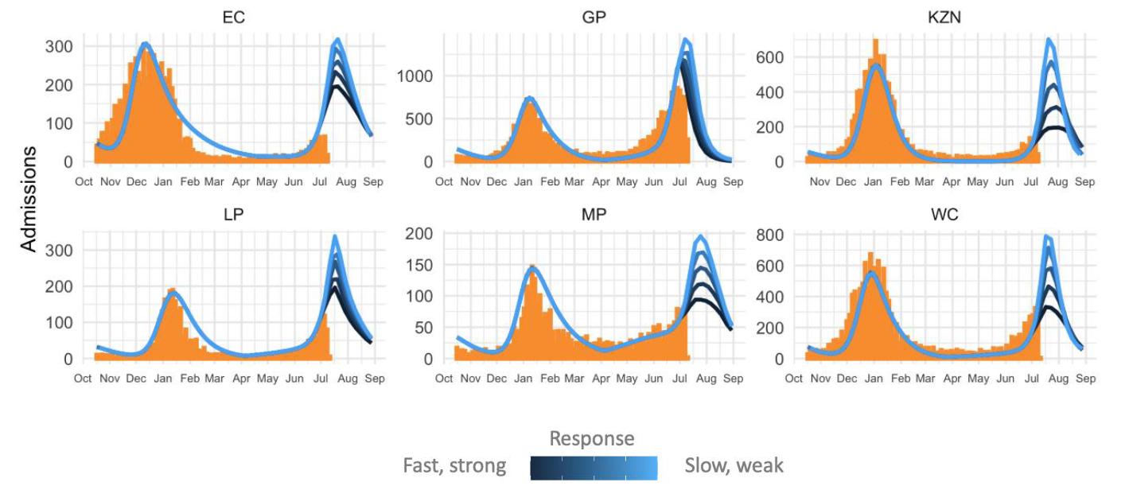
SA COVID-19 Modelling consortium scenarios for new admissions
Orange bars represent actual admissions (2nd wave and current);
Blue curves are model projections for different speed and strength of NPI response
Third wave in WC could peak with similar or fewer admissions than 2nd wave
Expected timing of peak: mid-July to early August

Slide 19
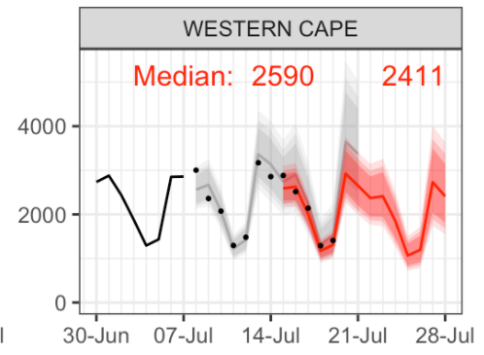
Short term predictions from SACMC – new cases
Forecasting similar numbers of cases for the next week
Black line: previous cases
Grey line: forecast for this week
Dots:
actual cases
Red line: Prediction for next week

Slide 20
Probability that provinces in 3rd wave have passed peak by 17 July 2021
All provinces in 3rd wave have >50% probability of having passed peak
BUT uncertainty as civil unrest and related service disruptions may impact testing and data integrity, as well as transmission.

Slide 21
The triggered Third Wave Response

Slide 22
Western Cape 3rd wave advisory
Principle: Transparent pre-defined triggers for whole of society response to reduce transmission and prepare health services. Note: Metrics in bold met
Indicator | Example of Resurgence Metric
First warning: ↑ health service demand in 14-21d | Large ↑ daily cases (increase for ≥ 1 week of ≥ 20%) Overall test positivity >7% for ≥1 week >15% of hospitals have >10% of beds occupied by COVID-19 patients >50% ↑ in pre-COVID-19 hospital O₂ use
Second warning: ↑ health service demand in 7-14d | Overall test positivity 10-15% for ≥1 week >15% week-on-week increase in 7dma of current admissions >40% of hospitals have >10% of beds occupied by COVID-19 patients >75% ↑ in pre-COVID-19 hospital O₂ use
Third warning: ↑ health service demand in 2-7d | >20% week-on-week increase in 7dma of current admissions (20.6% ↓ to 8.8%) >50% of hospitals have >20% of beds occupied by COVID-19 patients (57%) >50% of high care, intensive care & HFNO₂ COVID-19 beds occupied (101%) >100% ↑ in pre-COVID-19 hospital O₂ use (currently at >25T/day or >100%)
Health service capacity threatened | >2800 current COVID-19 inpatients (currently at 3402 admissions) Note: This is across both public and private sector. >80% of high care, intensive care & HFNO₂ COVID-19 beds occupied (101%) >200% ↑ in pre-COVID-19 hospital O₂ use (currently <200%)

Slide 23
3rd warning indicator
Indicator | Recommended action
First warning indicator. ↑ in health service demand in 14-21 days. | Strong public messaging about ↑ cases and need for stricter NPI adherence Publish ceilings of 2nd warning indicators with restriction expectations ↑ testing capacity, contact tracing, isolation Prepare to mobilize resources for a substantial surge ↑ vaccination Targeted sequencing of virus Recommend restrictions: gatherings, travel
Second warning indicator. ↑ in health service demand in 7-14 days. | Continue public messaging, vaccination, viral sequencing as above Publish ceilings of 3rd warning indicators with restriction expectations Limit testing not absolutely necessary Mobilize resources to support a substantial surge within 7 to 14 days Recommend further restrictions: gatherings, curfew
Third warning indicator. ↑ in health service demand in 2-7 days. | Continue public messaging, vaccination, viral sequencing, testing limits as above Publish potential increase of restriction expectations if systems overwhelmed Further mobilize resources to support a substantial surge within 2-7 days Recommend restrictions: gatherings, curfew, alcohol

Slide 24
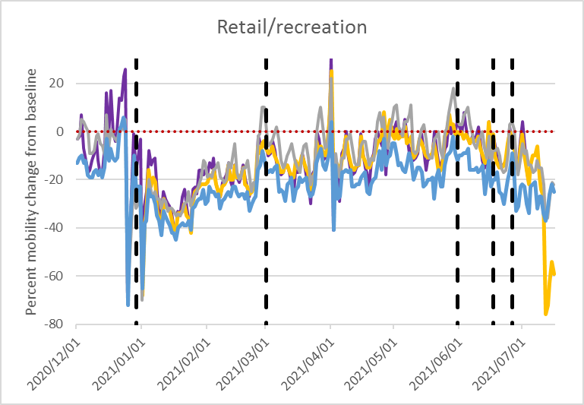
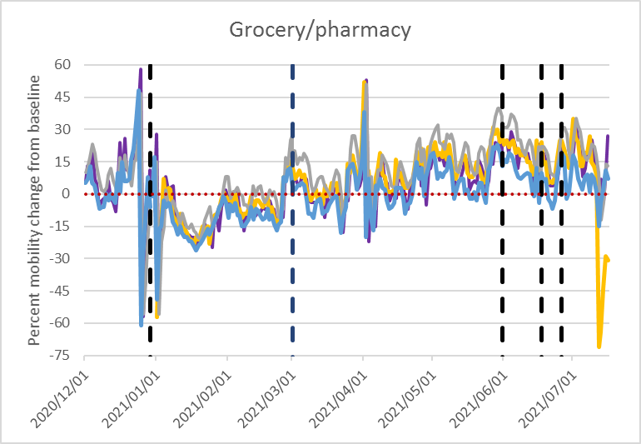
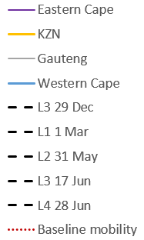
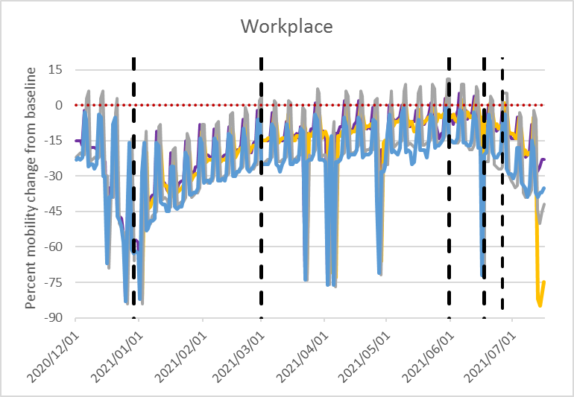
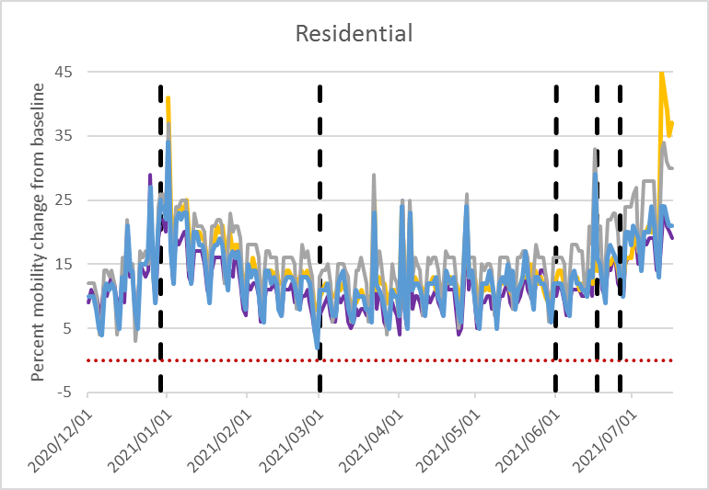
Google mobility data – percentage change in mobility in relation to restrictions
Now clear evidence of change in mobility patterns in response to L4.
Impact of civil disruption in KZN in last week on mobility patterns.

Slide 25
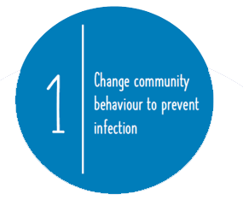
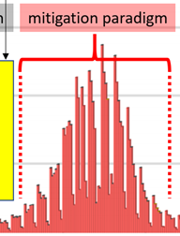
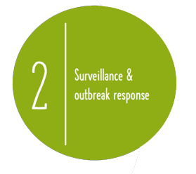
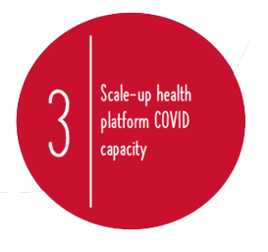
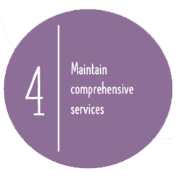
In the midst of the Mitigation Paradigm
Community Behaviour, at this point, becomes even more important as individual risk increases.
This will inevitably translate into how the wave progresses and whether we, as a collective, can flatten the height of it.
Trigger Points for titrating response
Outbreak response shifts focus to protecting high risk COVID-19 patients
Note: Trigger Points are actively monitored in order to titrate the response to the COVID-19 wave and achieve balance for COVID-19 and comprehensive service capacity.
During the wave 3 period we will be asking of our staff to manage increasing COVID-19 cases and a Phase 2 vaccine programme over and above their normal clinical duties. This additional burden will stretch our staff.

Slide 26
Acute service platform – scaling up COVID capacity
De-escalation of non-COVID services – in both PHC and hospitals, to maintain only essential care.
Acute Hospitals – progressive demarcation of PUI, COVID ward and COVID critical care capacity, to a full planned capacity of 2 300 Public Sector COVID beds (inclusive of a proportion of the field hospital capacity).
Field Hospital capacity – stepwise full commissioning of field hospital capacity in Brackengate (336 beds), Mitchells Plain Hospital of Hope (200 beds), Freesia & Ward 99 (75 beds), WCRC (26 beds), Sonstraal Hospital (68 beds) and at rural hospitals.
Co-ordinated platform response – co-ordinated movement of patients from ECs to acute and critical care beds to field hospital beds, and streamlined discharges.
Staffing – additional staff employed and retained from the 2nd wave, with flexible deployment.
Oxygen capacity – daily huddles for co-ordinated of uninterrupted oxygen supply and distribution, in line with oxygen utilisation needs.
Notes:
The 795 beds are included in the IC and Acute care bed numbers

Slide 27
Acute service platform – current picture
Currently 3 010 COVID patients in our acute hospitals (1 517 in public hospitals & 1 493) in private hospitals). This excludes PUIs and cases in specialised hospital settings.
The Metro hospitals have an average occupancy rate of 91%; George drainage area hospitals at 70%; Paarl drainage area hospitals at 78% & Worcester drainage area hospitals at 68%.
COVID & PUI cases currently make up 24% of all available acute general hospital capacity in both Metro and Rural Regional Hospital drainage areas.
COVID inter-mediate care – the Brackengate Hospital of Hope currently has 253 patients (4 441 cumulative patients), Freesia & Ward 99 have 0 patients, Mitchell Plain Hospital of Hope has 40 patients (an additional ward had been opened) and Sonstraal currently has 59 patients.
The Metro mass fatality centre has capacity for 240 bodies; currently 36 decedents (cumulative total of 1 635 bodies) admitted. The overall capacity has been successfully managed across the province.
Notes:
The 795 beds are included in the IC and Acute care bed numbers

Slide 28
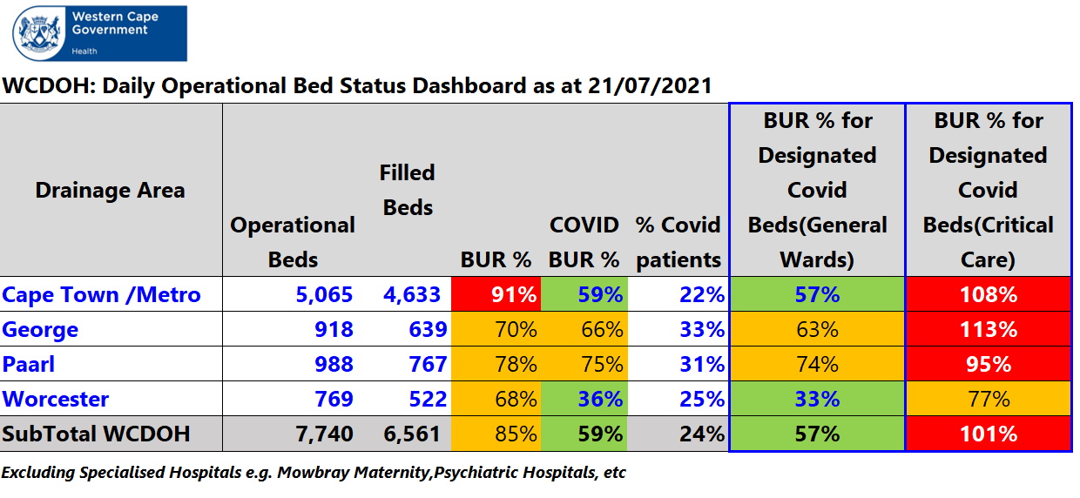
Current Public Sector Acute Bed Utilisation per
Drainage Area
Operational Bed = an inpatient bed available for inpatient use that is staffed and equipped.

Slide 29
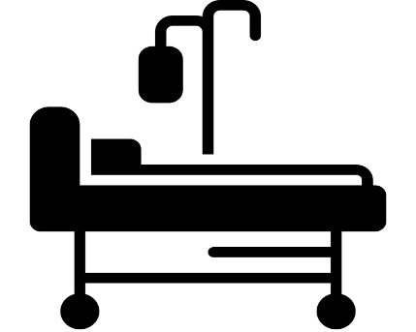
COVID-19 Bed Capacity (Public Sector)
Wave 2:
Wave 3:
Wave 1:
1681 (acute and intermediate care beds)
2330 (acute and intermediate care beds)
2690 (+/-90) (acute and intermediate care beds)

Slide 30
Oxygen Delivery Capacity (Public Sector)
Wave 2:
Wave 3:
Wave 1:
266 (Ventilation + HFNO)
378 (Ventilation + HFNO)
420 (Ventilation + HFNO)

Slide 31
Oxygen utilisation – general comments
The combined public-private utilisation is now 63.43 tons/day or 90.6 % of the maximal production capacity (70 tons/day) at the Afrox Western Cape plant.
The public sector total average bulk oxygen consumption is 33.95 tons/day. This equates to around 48.95 % of the daily bulk consumption of the Afrox WC plant for the 7-day period ending 16 July 2021. This is compared to 51 tons/day in the first week of January.
Both public and private sectors are addressing some of the capacity challenges at facility level, as identified during the 2nd wave, in preparation for the 3rd wave.
We will continue to monitor the utilisation of oxygen over the coming weeks and have started the regular oxygen huddles with Afrox to be able to scale up the provision as required for a 3rd wave.
Notes:
The 795 beds are included in the IC and Acute care bed numbers

Slide 32
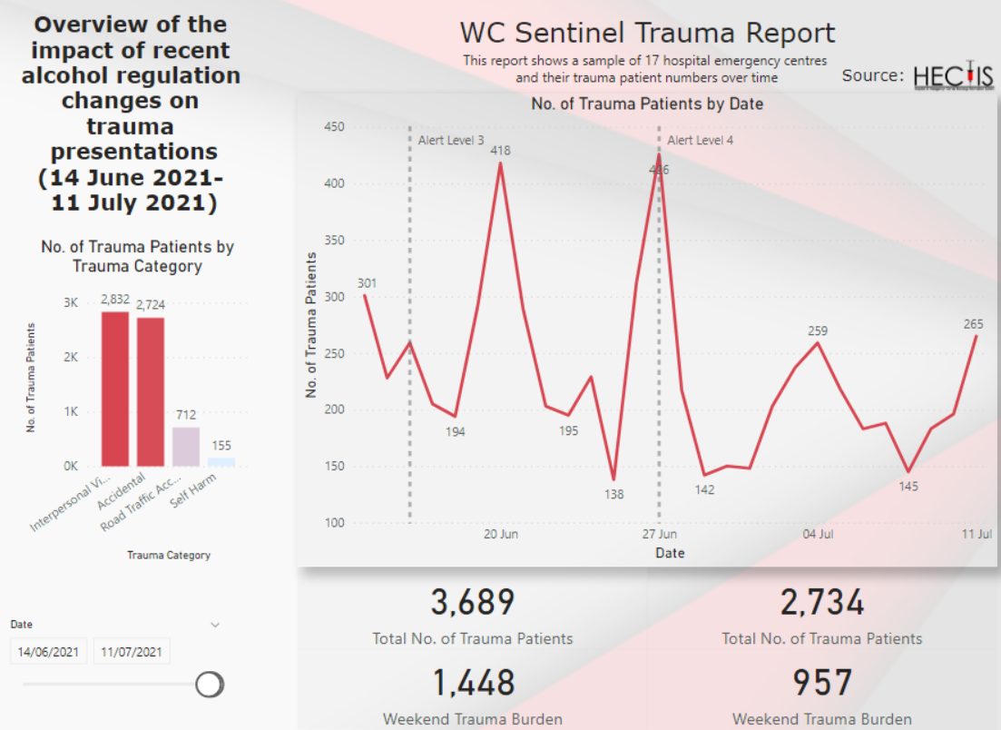
 | Date Period | Lockdown Level | Alcohol Regulation | Curfew
 | 16 June -27 June 2021 | Adjusted Level 3 | Offsite sale restriction Mon-Thurs 10-00-18:00 | 22:00-04:00
 | >28 June 2021 | Adjusted Level 4 | Complete prohibition of sale | 21:00-04:00
During the second week following the complete alcohol ban from a partial alcohol ban we see trauma presentations decrease by ~25.8% and weekend trauma burden decrease by ~33.9% (relative to 2 weeks prior to the ban).
This is in the context of a baseline restricted alcohol availability, initial remaining stock on hand and expected end-of-month increase in trauma presentations.
-25.8%
-33.9%
14-06-2021 to 27-06-2021
28-06-2021 to 11-07-2021

Slide 33
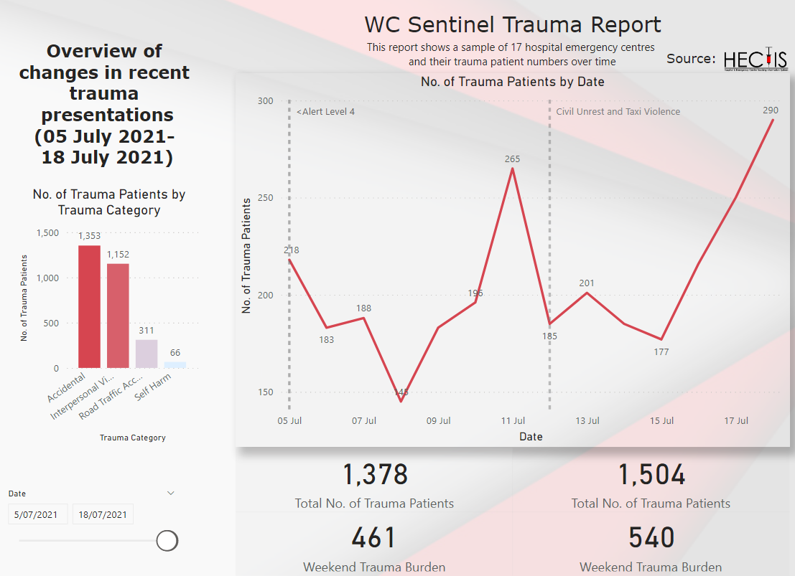
 | Date Period | Lockdown Level | Alcohol Regulation | Curfew
 | >28 June 2021 | Adjusted Level 4 | Complete prohibition of sale | 21:00-04:00
 | 12 July 2021 | Civil Unrest and Taxi Violence | As above | As above
The recent civil unrest and taxi violence, within the context of a baseline restricted alcohol availability and level 4 lockdown, has resulted in a 9.1% increase in total trauma presentations (week on week) to our hospital emergency centres.
Baseline weekend trauma presentations were small but also saw an increase of 17.1% week on week post the recent civil unrest and taxi violence.
+9.1%
+17.1%
05-07-2021 to 11-07-2021
12-07-2021 to 18-07-2021

Slide 34
Preparing and Caring for our People – 3rd Wave
Workforce Planning:
To date, appointed 777 staff additional for COVID
Appointed 827 HCW and support staff as well as 359 interns for the Vaccination Drive
Contract extensions until end of Sept
CTICC appointments finalised
765 applicants can still be appointed, if needed
Staffing for Athlone Mass Vaccine Site:
Status | PNs | SNs | NAs | MOs | Pharm | Pharm Assist | Admin | Interns
In progress | 21 | 50 | 6 | 2 | 1 | 2 | 42 | 94
 | General Workers
 | 4
Vaccination Training:
6 063 registered vaccinators on health platform
4 013 trained vaccinators to date
13 new registered vaccinators
9 additionally trained vaccinators
Well-being and Safety:
Increased advocacy and activation of Onsite Counselling Clinics (Employee Wellbeing Programme)
PPE provision and improving OHS Practices
Communicating practical ways for our staff to be safe at work
Continued training on PPE use
68.13% vaccine coverage
Resilience and Hope:
Stories of Hope and engagements to encourage vaccine uptake amongst HCWs
Internal Health Comms Series to motivate staff during 3rd wave(mitigate anxiety)
Fostering a Culture of Healing (Story of Hope) & Collaborative Learning

Slide 35
Additional Staff Capacity (Public Sector)
Wave 2:
Wave 3:
Wave 1:
844 (Additional staff capacity)
1117 (Additional staff capacity)
Wave 2 capacity retained
775 added, with 765 still available for appointment if required)

Slide 36
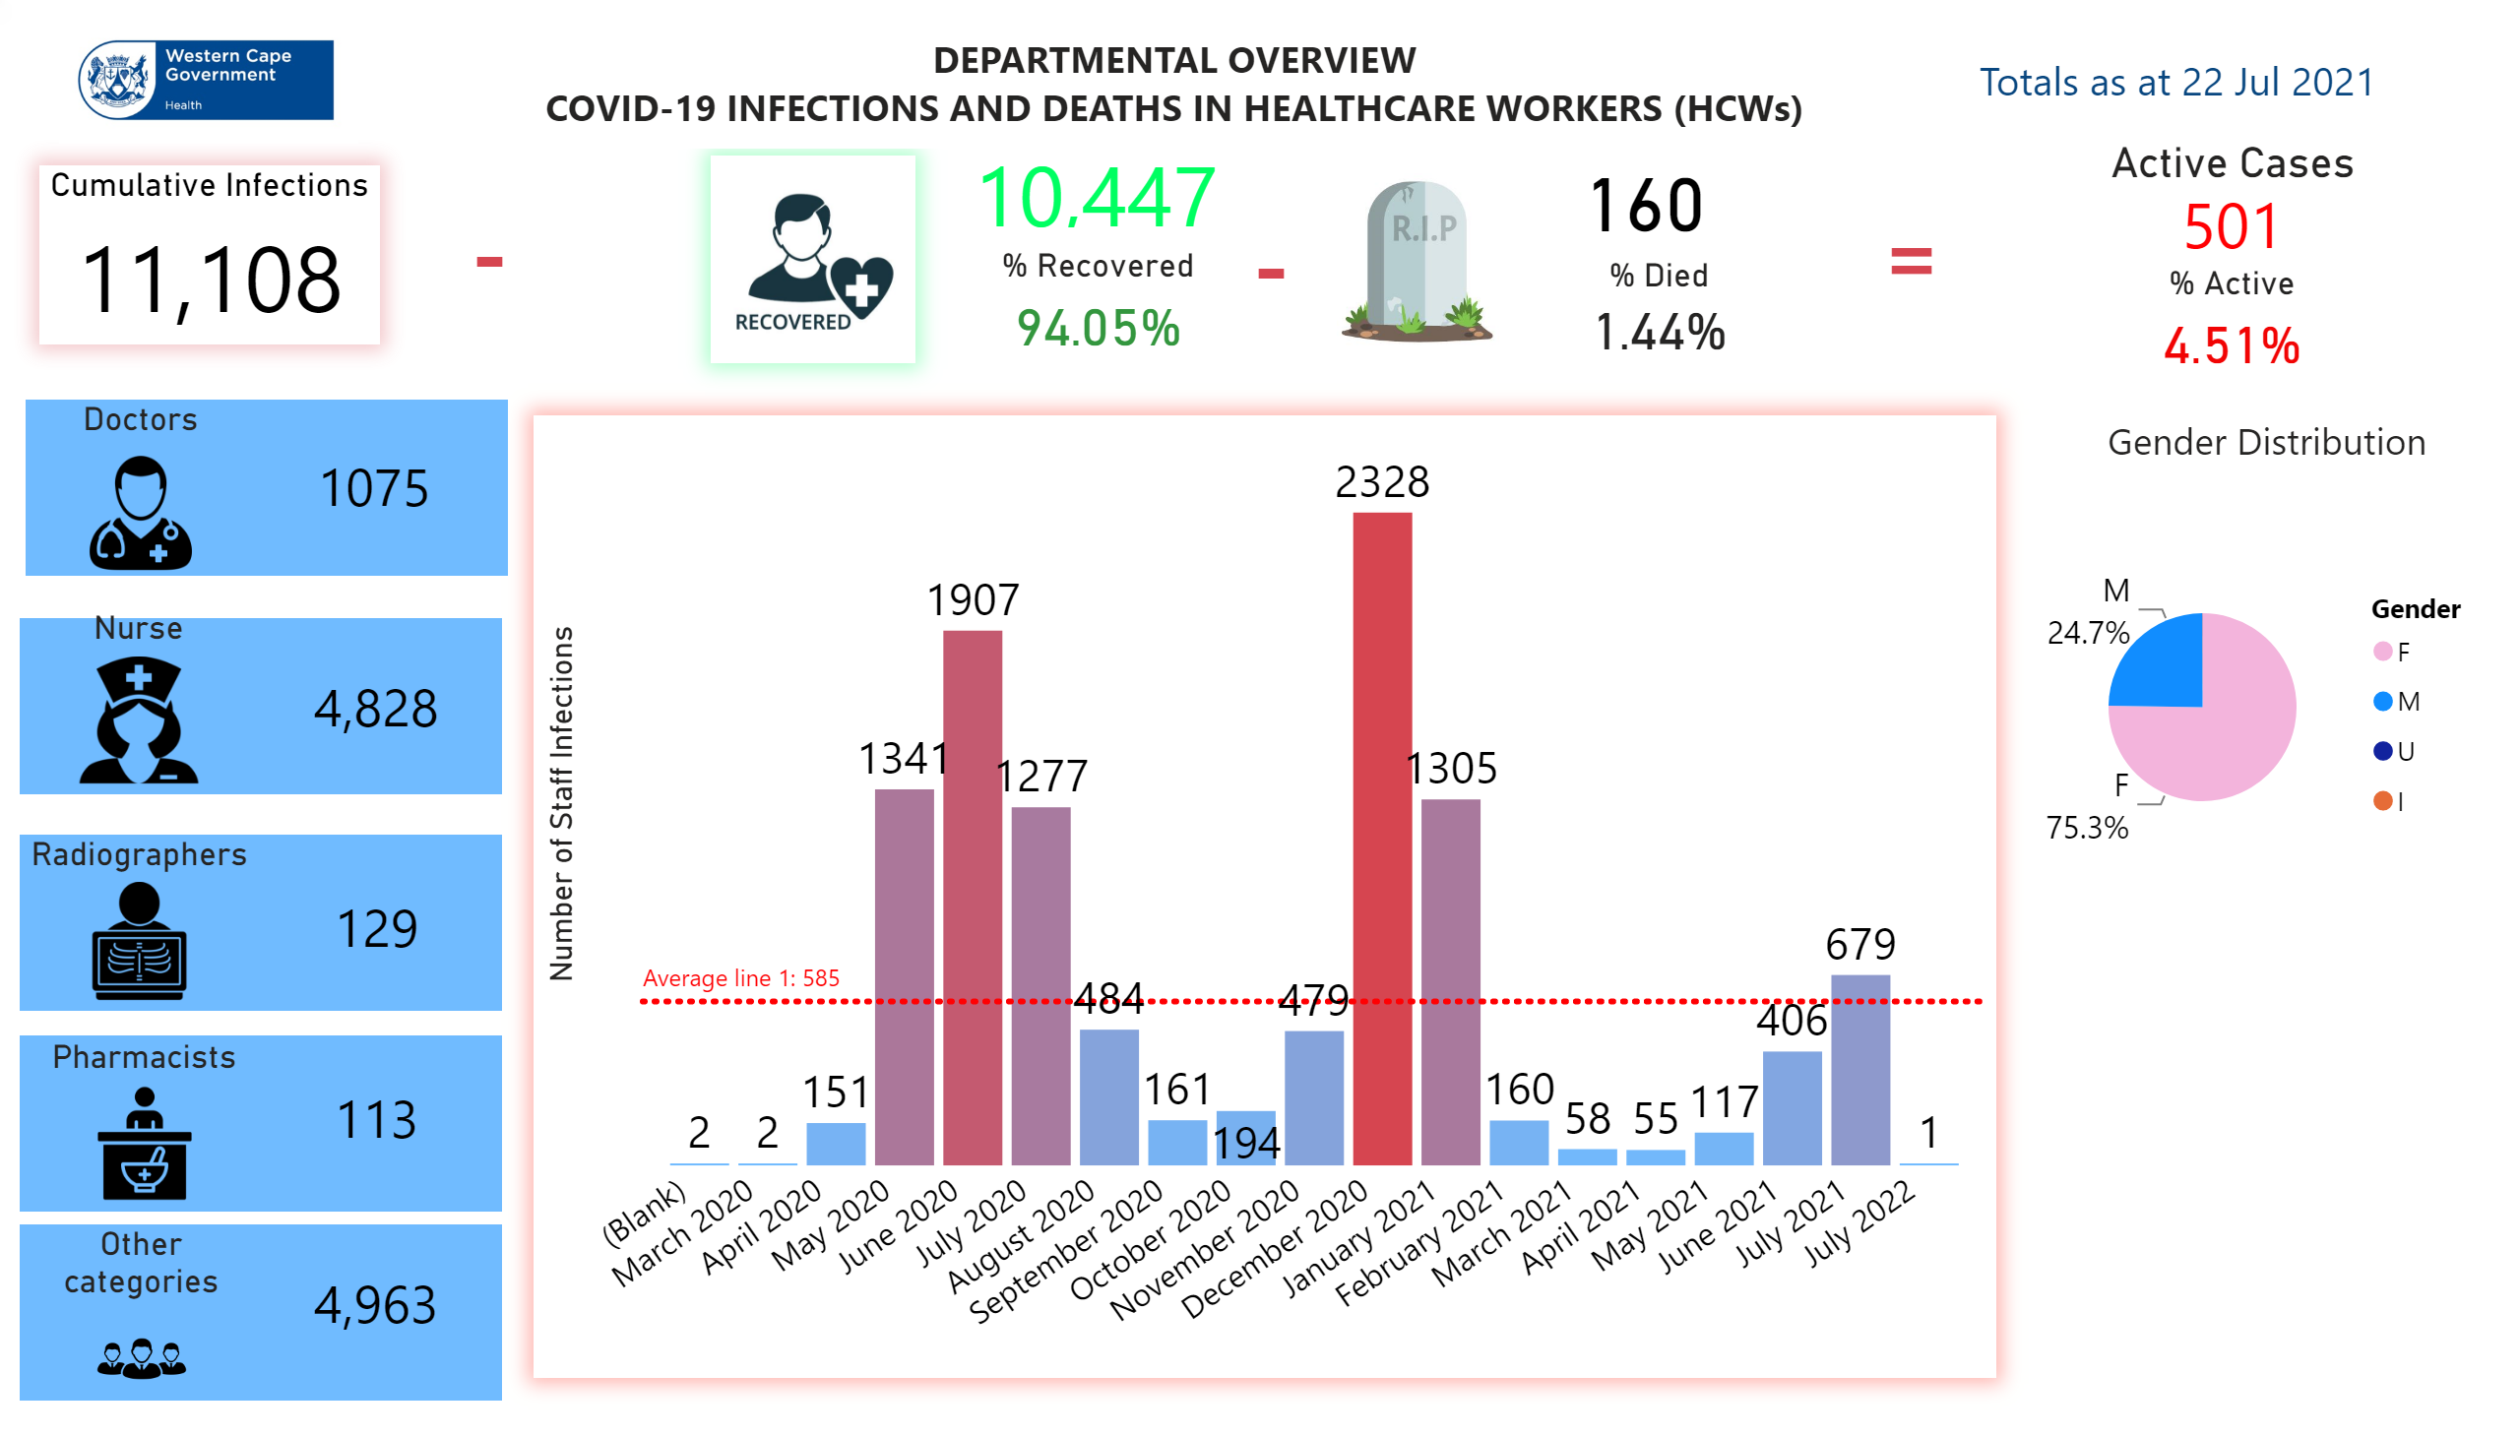
Departmental
Notes:
textbox
No alt text provided.
textbox
No alt text provided.
textbox
No alt text provided.
textbox
No alt text provided.
textbox
No alt text provided.
% Recovered
No alt text provided.
% Died
No alt text provided.
% Active
No alt text provided.
Doctors
No alt text provided.
Nurse
No alt text provided.
Radiographers
No alt text provided.
Pharmacists
No alt text provided.
Other categories
No alt text provided.
textbox
No alt text provided.
textbox
No alt text provided.
textbox
No alt text provided.
Gender Distribution
No alt text provided.
image
No alt text provided.
card
No alt text provided.
card
No alt text provided.
card
No alt text provided.
Cumulative Infections
No alt text provided.
card
No alt text provided.
card
No alt text provided.
image
No alt text provided.
card
No alt text provided.
image
No alt text provided.
card
No alt text provided.
card
No alt text provided.
clusteredColumnChart
No alt text provided.
textbox
No alt text provided.
Active Cases
No alt text provided.

Slide 37
Vaccine Implementation update

Slide 38
Western Cape Timeline to date
17 Feb 2021
16 April 2021
16 May 2021
17 May 2021
23 June 2021
01 July 2021
14 July 2021
Sisonke Programme
Sisonke Programme Concludes
Rollout of Educator Vaccination Programme
Vaccinations up to 14 July 2021
Rollout for Healthcare Workers
91 732 HWCs vaccinated
708 258
EVDS Registration Opens
Educators offered vaccination at designated sites in the province
EVDS Registration
Rollout of National Vaccination Programme
Registration opens for >50 years
Registration opens for >60 years

Slide 39
Western Cape Timeline going forward
12 July 2021
15 July 2021
19 July – 10 Aug 2021 (tbc)
tbc
Registration
Of DCS Staff
On EVDS via bulk upload by NDoH
Social Development Sector
EVDS Registration
NDoH to confirm implementation arrangements for vaccination of workers in Social Development Sector
EVDS Registration
DCS Staff to access vaccination at public or private sites (regardless of age)
Registration opens for >35 years
Access opened for vaccinations
Registration opens for >18 years

Slide 40
Vaccine update: Phases and Prioritisation Groups
Phase I
Health Care Workers :
Care Workers
CHWs
Health Science students
Estimated target:
Public & Private Health Sectors
132 000
Traditional Healers
Age in years | 60+ | 50 - 59 | 35 - 49 | 18 - 34
70+ | 285 399
65 to 69 | 186 971
60 to 64 | 247 332
55 to 59 |  | 311 886
50 to 54 |  | 370 664
45 to 49 |  |  | 428 598
40 to 44 |  |  | 481 305
35 to 39 |  |  | 602 279
18 to 34 |  |  |  | 2 065 372
TOTAL | 719 702 | 682 550 | 1 512 182
 | 2 914 434 |  |  | 2 065 372
Phase 2
Phase 3

Slide 41
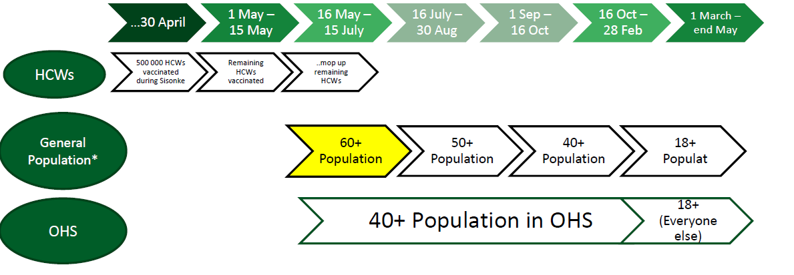
Phase 2 and Phase 3: NDoH Timelines and Target Population
Timeframe adjusted due to rapid expansion of age band eligibility

Slide 42
Strategy
Updated W Cape Public Sector Vaccine Supply Pipeline
Date Received | Number of doses Received | Type of Vaccine Received | Provincial Cumulative Total
14-May-21 | 33 930 | Pfizer | 33 930
22-May-21 | 35 100 | Pfizer | 69 030
24-May-21 | 29 250 | Pfizer | 98 280
27-May-21 | 25 740 | Pfizer | 124 020
03-Jun-21 | 72 540 | Pfizer | 196 560
10-Jun-21 | 49 140 | Pfizer | 245 700
18-Jun-21 | 49 140 | Pfizer | 294 840
22-Jun-21 | 26 400 | J&J (for educators only) | 321 240
25-Jun-21 | 121 680 | Pfizer | 442 920
28-Jun-21 | 70 200 | Pfizer | 513 120
30-Jun-21 | 28 800 | J&J (for educators only) | 541 920
05-Jul-21 | 58 500 | Pfizer | 600 420
06-Jul-21 | 26 400 | J&J (for educators and designated groups only) | 626 820
08-Jul-21 | 63 060 | Pfizer | 689 880
15-Jul-21 | 16 800 | J&J (for designated groups only) | 706 680
16-Jul-21 | 73 650 | Pfizer | 780 330
23-Jul-21 | 93 600 | Pfizer | 873 930

Slide 43
Planned Public Sector Sites: Metro & Rural for Phase 2
District | Sub-structure | # of Planned Vaccination Sites | # of Active Sites 19 – 23 July 2021
City of Cape Town | Southern/Western | 21 | 19
 | Klipfontein/Mitchell’s Plain | 15 | 13
 | Khayelitsha/Eastern | 28 | 25
 | Northern/Tygerberg | 18 | 15
Sub-total: Metro |  | 82 | 72
Rural Districts | Overberg District | 44 | 28
 | Garden Route District | 37 | 35
 | West Coast District | 60 | 18
 | Cape Winelands District | 53 | 51
 | Central Karoo District | 13 | 12
Sub-total: Rural |  | 207 | 144
TOTAL |  | 290 | 216
Public Sector Sites have come on line in a phased manner from 17 May onwards.
118 Private sector sites (85 Metro, 33 Rural) and Workplace sites are added sequentially.
There are weekly updates on active sites per geographic area.
Roving teams will visit satellite clinics. Members of the public to check with local health contacts to confirm days of operation.

Slide 44
Private Sector Sites as at 20 July 2021
Private sector sites are coming on board in a phased manner.
The majority of private sector sites are Clicks Pharmacies (76).
As at 20 July 2021, there were 85 active private sites in Metro and 33 in rural districts.
Private sites also include a limited number of private sector hospitals, independent pharmacies and other retail pharmacies, e.g. Dis-Chem, etc.
District | # of private sector sites
Metro | 85
Cape Winelands | 12
Central Karoo | 1
Garden Route | 8
Overberg | 7
West Coast | 5
TOTAL | 118
58
Active Sites
(44 in Metro; 14 in Rural)

Slide 45
Vaccines Administered: Phase 1b and Phase 2
Cumulative Total = 884 917 (including Sisonke and back-captured data)
Source: NDoH Dashboard (Microsoft Power BI) accessed on 21 July 2021 @19:25.
[Disclaimer: Data displayed in these graphs and tables only contains records captured on EVDS. Totals will be adjusted as back-capturing and data validation is done.]

Slide 46
Vaccinations Administered Against Weekly Targets
Note: Targets are informed by available vaccine supply.
[Disclaimer: Data displayed in all tables, graphs and dashboards only contains records captured on EVDS and excludes vaccination records captured on paper. Totals will be adjusted as back-capturing and data validation is done.]

Slide 47
Fully Vaccinated as at 21 July 2021
Programme | Cumulative total as at 21 July 2021
Healthcare Workers (Sisonke) (J&J Vaccine) | 92 167
National Programme (J&J Vaccine) | 48 140
National Programme (2nd dose Pfizer) | 131 982
TOTAL | 272 289
Source: NDoH Dashboard (Microsoft Power BI) accessed on 21 July 2021 @19:25.

Slide 48
Rollout of Essential Worker Programme in the Public Sector
Sector | Process
Basic Education Sector | Process concluded on 15 July 2021 A total of 47 536 Educators were vaccinated as part of this programme (87% of the target of 54 400).
Department of Correctional Services (DCS), Department of Home Affairs, Department of Justice and NPA, | Provincial Department of Health Bulk registration uploads onto EVDS by NDoH on 12 July 2021 DCS, DHA, NPA & Justice employees to access vaccination at any vaccination site (public or private) as a walk-in
South African Revenue Service (SARS) | Provincial Department of Health Bulk registration uploads onto EVDS by NDoH on 21 July 2021 SARS employees (>35 years) to access vaccination at any vaccination site (public or private) as a walk-in
Social Development Sector (incl. ECD/SASSA), Traffic Officers | Provincial Department of Health Bulk registration uploads onto EVDS by NDoH Separate booking/scheduling system to be utilised Vaccination at designated sites only Will commence from 21July 2021
Department of Defence and Military Veterans | South African Military Health Services (SAMHS) will take responsibility
South African Police Service | SAPS sites – Service provided by Wellness Odyssey on behalf of Polmed
Remaining public sector employees will be required to access vaccination via the programme for the general public

Slide 49
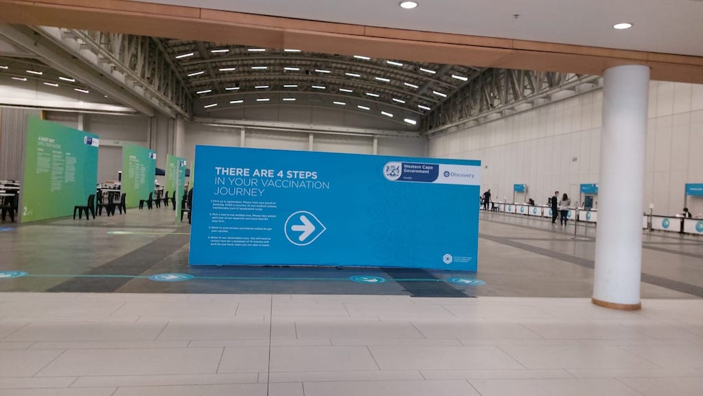
CTICC Vaccination Centre of Hope
The Western Cape Government, in partnership with the City of Cape Town and Discovery opened the CTICC Vaccination Centre of Hope on 07 July 2021.
The site is currently operating 29 vaccination stations and will increase as vaccine supply increase.
Up to close of business on 21 July 2021, this site had administered 12 205 vaccinations.
Notes:
The 795 beds are included in the IC and Acute care bed numbers

Slide 50
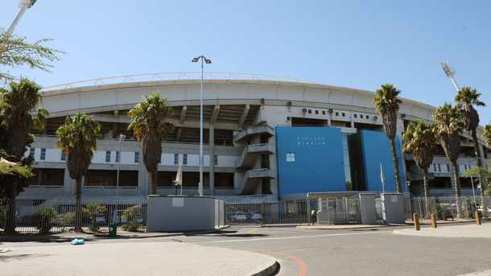
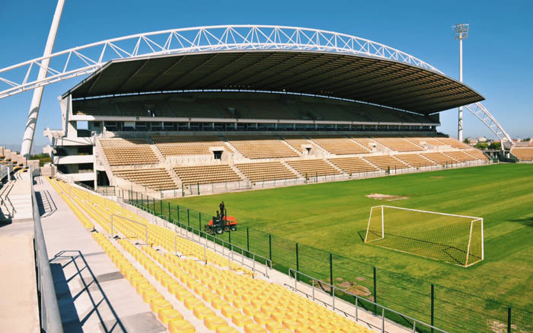
Mass vaccination at Athlone Stadium
The Western Cape Government Health will partner with the City of Cape Town to introduce the first drive-through and walk-through mass vaccination site at the Athlone Stadium.
The aim is for the walk-in facility to be operational mid August and the drive through facility, two weeks later.
The drive-through will follow the same steps as a walk-through, where clients are successfully screened, registered and vaccinated.
Notes:
The 795 beds are included in the IC and Acute care bed numbers

Slide 51
Overall Vaccine Cascade
Vaccines Ordered
Vaccines Received
Vaccines Issued
Vaccines Ordered
Vaccines Received
Vaccines Issued
Supply Pipeline
Public Sector
Private Sector
Insured
Individual Vaccinee Cascade
Population registered
Actual Vaccinations administered
By age cohort and subdistrict
Vaccine Coverage of Population
Absolute Population
By age cohort and subdistrict
By age cohort and subdistrict
By age cohort and subdistrict
Uninsured
Predicted Daily Vaccine Throughput
Total Vaccine Stations
Total Sites
Operational
Vaccination
Capacity
Total Sites
Active
Inactive
Notes:
The 795 beds are included in the IC and Acute care bed numbers

Slide 59
Key Lessons from the first 9 weeks
The importance of equity:
Access in the Metro versus rural districts and towns
Public sector versus private sector sites and access
Access for insured versus uninsured people
Access for >60yrs versus other age groups
The importance of having a differentiated and targeted strategy:
Metro – targeted outreach into low uptake areas
Rural – increase private sites & targeted outreach
The importance of communication:
What to expect – simplifying the process
Importance of being vaccinated – counter misinformation & hesitancy
Notes:
The 795 beds are included in the IC and Acute care bed numbers

Slide 60
EVDS Registrations

Slide 61
EVDS Registrations: >35 years as at 21 July 2021
Western Cape: 36.99% (1 078 181)
23.67% (35yrs to 49yrs) 39.38% (50yrs to 59yrs) and 62.72% (60yrs+)
RURAL
District | Total | 35yrs to 49yrs | 50yrs to 59yrs | 60yrs+ | 35yrs+
Cape Winelands | 123893 | 19,9% | 37,6% | 59,8% | 33,2%
Central Karoo | 8356 | 15,3% | 31,6% | 45,1% | 29,4%
Garden Route | 110621 | 23,3% | 40,1% | 71,0% | 42,2%
Overberg | 53139 | 20,4% | 39,9% | 90,6% | 43,4%
West Coast | 56983 | 15,5% | 32,9% | 71,1% | 31,8%
METRO
Sub-District | Total | 35yrs to 49yrs | 50yrs to 59yrs | 60yrs+ | 35yrs+
Eastern | 118222 | 27,2% | 41,8% | 59,9% | 38,6%
Khayelitsha | 36309 | 13,0% | 31,9% | 43,6% | 21,1%
Klipfontein | 60883 | 22,4% | 40,7% | 71,6% | 36,9%
Mitchells Plain | 51263 | 14,5% | 23,2% | 38,7% | 21,2%
Northern | 97861 | 35,8% | 45,2% | 53,9% | 43,5%
Southern | 132603 | 30,0% | 44,9% | 70,4% | 44,8%
Tygerberg | 100147 | 22,2% | 36,3% | 52,8% | 33,1%
Western | 127390 | 40,0% | 55,9% | 73,9% | 53,1%

Slide 62
Low registration communities in Mitchells Plan and Khayelitsha 21 July 2021
Mitchells Plain Sub-places | 35 to 49yrs | 50 to 59yrs | 60yrs+ | 35yrs+ | Total registered | Population 35yrs+
Browns Farms | 7,3% | 11,9% | 9,7% | 8,5% | 2846 | 33400
Tafelsig | 10,6% | 18,2% | 29,3% | 17,0% | 4857 | 28616
Philippi East | 5,8% | 10,8% | 9,6% | 7,3% | 1578 | 21572
Weltevreden Valley North 1 | 1,4% | 2,0% | 1,8% | 1,6% | 287 | 17905
Crossroads SP | 10,1% | 15,6% | 23,9% | 13,1% | 1231 | 9366
Kosovo Informal | 1,7% | 3,8% | 1,5% | 2,1% | 127 | 6113
Heinz Park | 3,6% | 6,8% | 10,6% | 5,8% | 242 | 4185
Sweet Home | 1,6% | 2,1% | 1,7% | 1,7% | 70 | 4031
Khayelitsha Sub-places | 35 to 49yrs | 50 to 59yrs | 60yrs+ | 35yrs+ | Total registered | Population 35yrs+
Ikwezi Park | 1,8% | 4,5% | 6,0% | 3,0% | 660 | 22323
Village V3 North | 3,0% | 5,8% | 17,6% | 5,7% | 902 | 15906
Khayelitsha T3-V5 | 2,3% | 5,6% | 3,5% | 3,1% | 410 | 13221
Khayelitsha T3-V2 | 2,7% | 5,7% | 9,6% | 4,3% | 485 | 11274
Victoria Merge | 1,5% | 2,7% | 7,3% | 2,5% | 260 | 10202
Khayelitsha T2-V2b | 4,9% | 16,7% | 27,0% | 10,4% | 1053 | 10144
Khayelitsha T3-V3 | 5,3% | 21,3% | 19,2% | 10,4% | 1024 | 9857
Town 3 | 3,8% | 5,4% | 7,4% | 4,7% | 322 | 6914
Village V1 South | 2,2% | 3,8% | 2,9% | 2,6% | 173 | 6712
Village V2 North | 1,6% | 3,6% | 5,5% | 2,6% | 170 | 6640
Village V1 North | 2,2% | 5,2% | 8,7% | 3,7% | 244 | 6542
Village V4 North | 1,3% | 3,2% | 2,8% | 1,9% | 89 | 4767

Slide 63
Communications

Slide 64
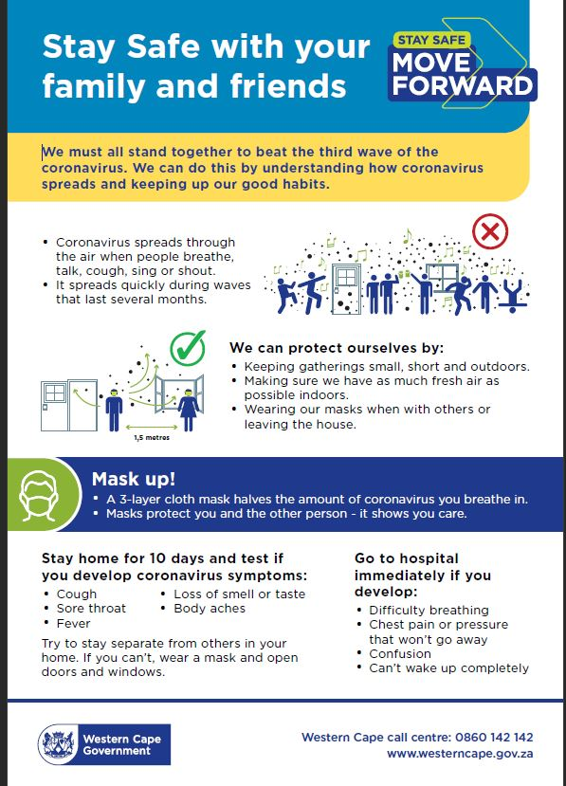
Keeping Safe Messaging

Slide 65
Vaccination messaging: Walk-in priority groups

Slide 66
Stories about expanding access

Slide 67
Keeping communities informed

Slide 68
Message for 35yr to 49yr olds
The EVDS system is accepting registration of over 35 year old citizens from 15th July.
Vaccinations of this age band are being scheduled on EVDS.
Should over 35-year-olds present at sites with legitimate EVDS appointments – these appointments will be honoured.
We discourage 35 – 49 year old citizens from presenting for walk ins at sites, but will accept, based on available capacity.
Our current priority for walk-ins remains the same :
Priority 1 - people >60 years requiring their 1st dose of Pfizer vaccine
Priority 2 - people >60 years requiring their 2nd dose of Pfizer vaccine
Priority 3 - people aged 50 -59 years requiring their 1st dose of Pfizer vaccine.
Priority 4 – people aged 35-49 years

Slide 69
Conclusions

Slide 70
Concluding remarks
We are experiencing a flattening of the 3rd wave, but urge everyone to adhere strictly to protective behaviours, as a key drive to contain it. We will monitor the 3rd wave over the coming weeks.
We have revised our response for the 3rd wave, with clearly identified trigger points for an appropriate health platform and societal response.
We continue to require a concerted whole of government and whole of society response to flatten the 3rd wave, to protect the health system.
We have scaled up our Phase 2 vaccination capacity to administer vaccines over the past 9 weeks, in a sequential manner in each geographic area. We have the capacity to scale up rapidly, as we receive more vaccines.
We need to continue to mobilise and assist everyone >35 years to be registered on the EVDS for Phase 2, and to be vaccinated.

Slide 71
Thank you

