Slide 1
PORTFOLIO COMMITTEE
COVID-19 VACCINATION UPDATE
21 July 2021

Slide 2
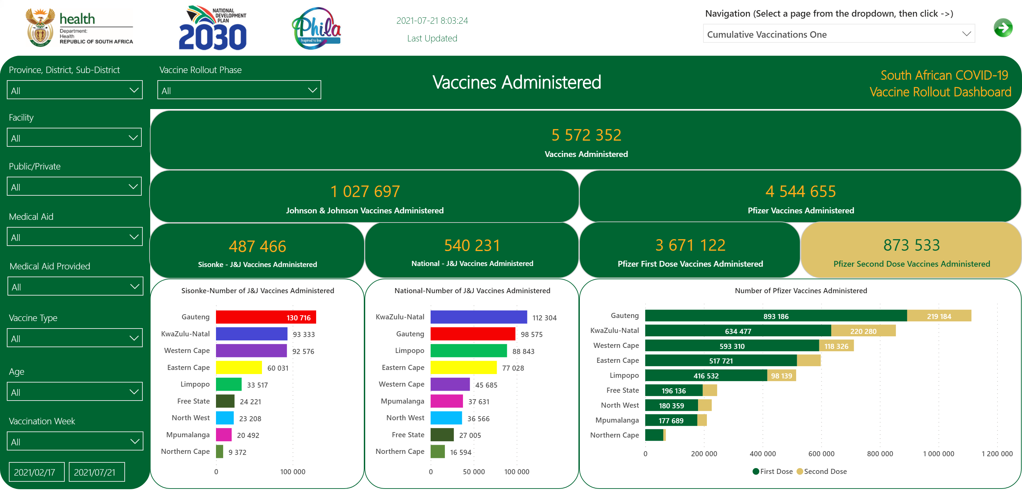
Vaccines Administered 1/5
Notes:
Date
No alt text provided.
slicer
No alt text provided.
slicer
No alt text provided.
slicer
No alt text provided.
slicer
No alt text provided.
slicer
No alt text provided.
slicer
No alt text provided.
slicer
No alt text provided.
slicer
No alt text provided.
slicer
No alt text provided.
textbox
No alt text provided.
textbox
No alt text provided.
card
No alt text provided.
card
No alt text provided.
card
No alt text provided.
card
No alt text provided.
card
No alt text provided.
Number of Pfizer Vaccines Administered
No alt text provided.
Sisonke-Number of J&J Vaccines Administered
No alt text provided.
National-Number of J&J Vaccines Administered
No alt text provided.
card
No alt text provided.
card
No alt text provided.
card
No alt text provided.
textbox
No alt text provided.
slicer
No alt text provided.
image
No alt text provided.
image
No alt text provided.
image
No alt text provided.
image
No alt text provided.

Slide 3
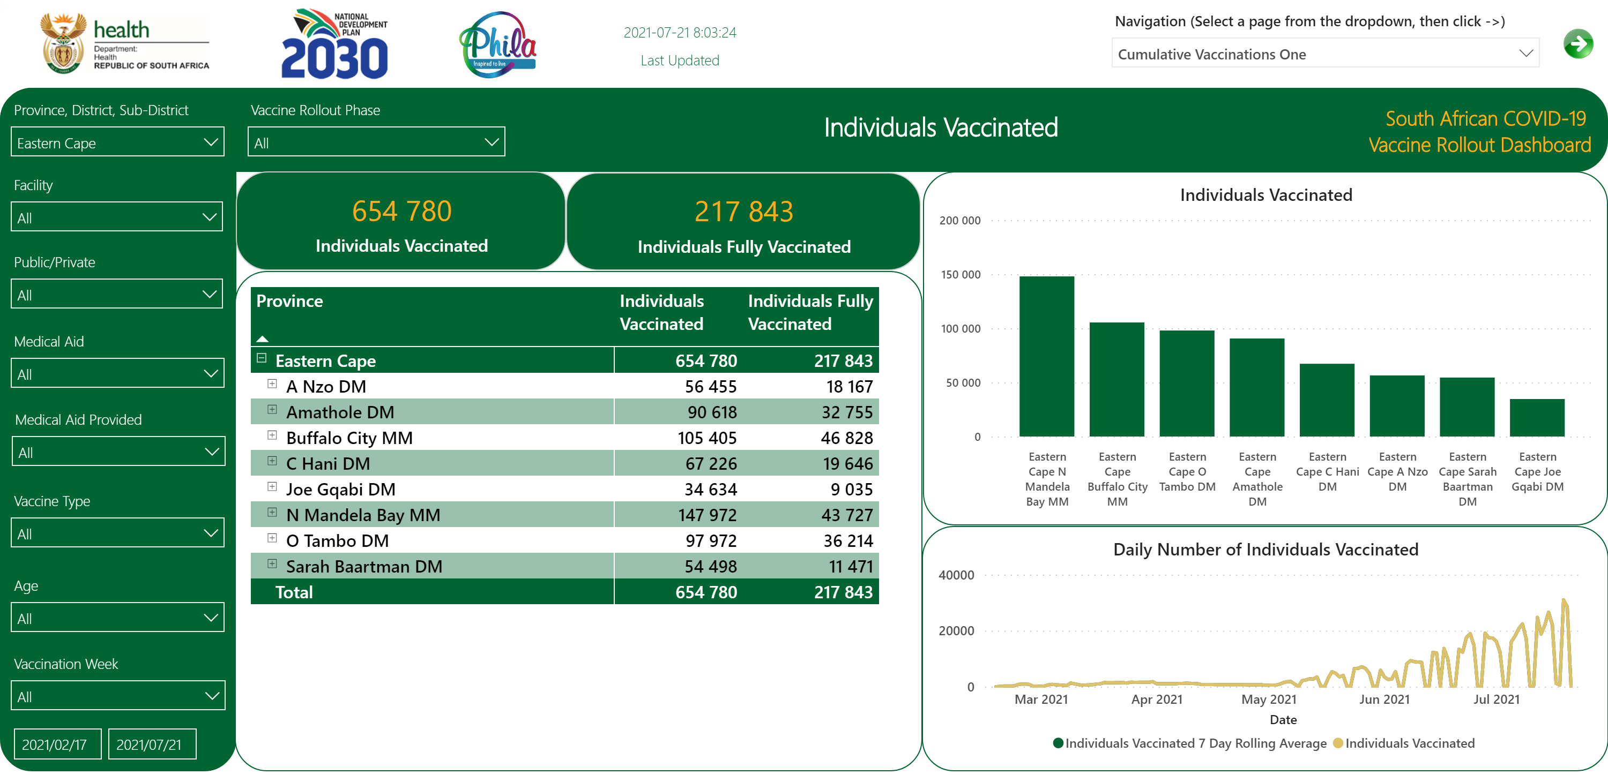
Individuals Vaccinated 1/6
Notes:
slicer
No alt text provided.
textbox
No alt text provided.
textbox
No alt text provided.
card
No alt text provided.
slicer
No alt text provided.
slicer
No alt text provided.
card
No alt text provided.
textbox
No alt text provided.
slicer
No alt text provided.
slicer
No alt text provided.
slicer
No alt text provided.
slicer
No alt text provided.
slicer
No alt text provided.
slicer
No alt text provided.
slicer
No alt text provided.
image
No alt text provided.
image
No alt text provided.
image
No alt text provided.
image
No alt text provided.
Date
No alt text provided.
card
No alt text provided.
Individuals Vaccinated
No alt text provided.
pivotTable
No alt text provided.
Daily Number of Individuals Vaccinated
No alt text provided.

Slide 4
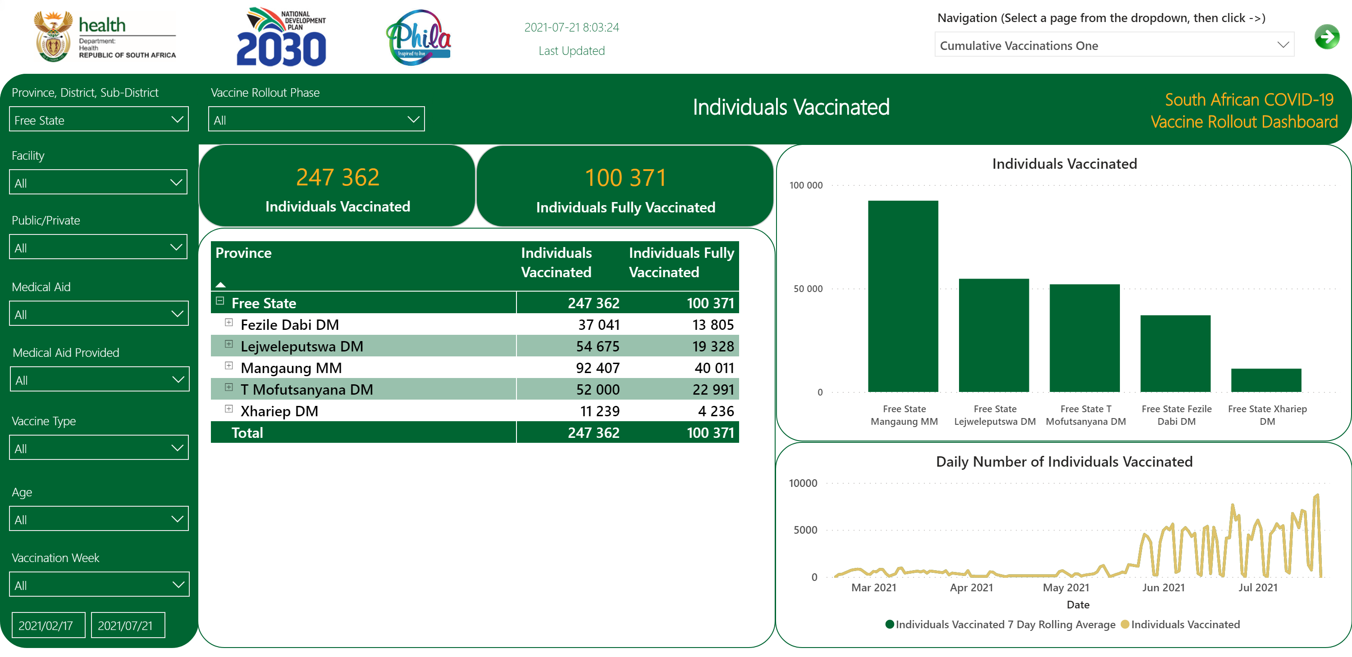
Individuals Vaccinated 1/6
Notes:
slicer
No alt text provided.
textbox
No alt text provided.
textbox
No alt text provided.
card
No alt text provided.
slicer
No alt text provided.
slicer
No alt text provided.
card
No alt text provided.
textbox
No alt text provided.
slicer
No alt text provided.
slicer
No alt text provided.
slicer
No alt text provided.
slicer
No alt text provided.
slicer
No alt text provided.
slicer
No alt text provided.
slicer
No alt text provided.
image
No alt text provided.
image
No alt text provided.
image
No alt text provided.
image
No alt text provided.
Date
No alt text provided.
card
No alt text provided.
Individuals Vaccinated
No alt text provided.
pivotTable
No alt text provided.
Daily Number of Individuals Vaccinated
No alt text provided.

Slide 5
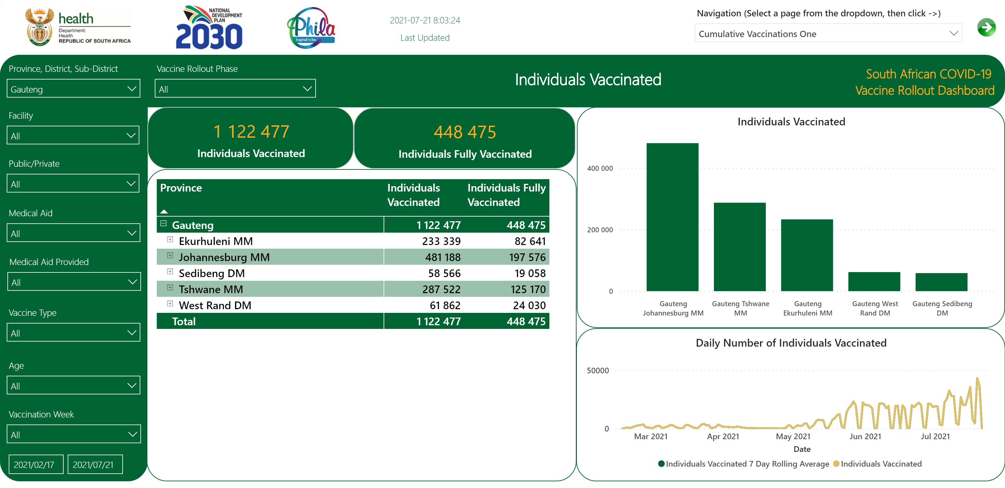
Individuals Vaccinated 1/6
Notes:
slicer
No alt text provided.
textbox
No alt text provided.
textbox
No alt text provided.
card
No alt text provided.
slicer
No alt text provided.
slicer
No alt text provided.
card
No alt text provided.
textbox
No alt text provided.
slicer
No alt text provided.
slicer
No alt text provided.
slicer
No alt text provided.
slicer
No alt text provided.
slicer
No alt text provided.
slicer
No alt text provided.
slicer
No alt text provided.
image
No alt text provided.
image
No alt text provided.
image
No alt text provided.
image
No alt text provided.
Date
No alt text provided.
card
No alt text provided.
Individuals Vaccinated
No alt text provided.
pivotTable
No alt text provided.
Daily Number of Individuals Vaccinated
No alt text provided.

Slide 6
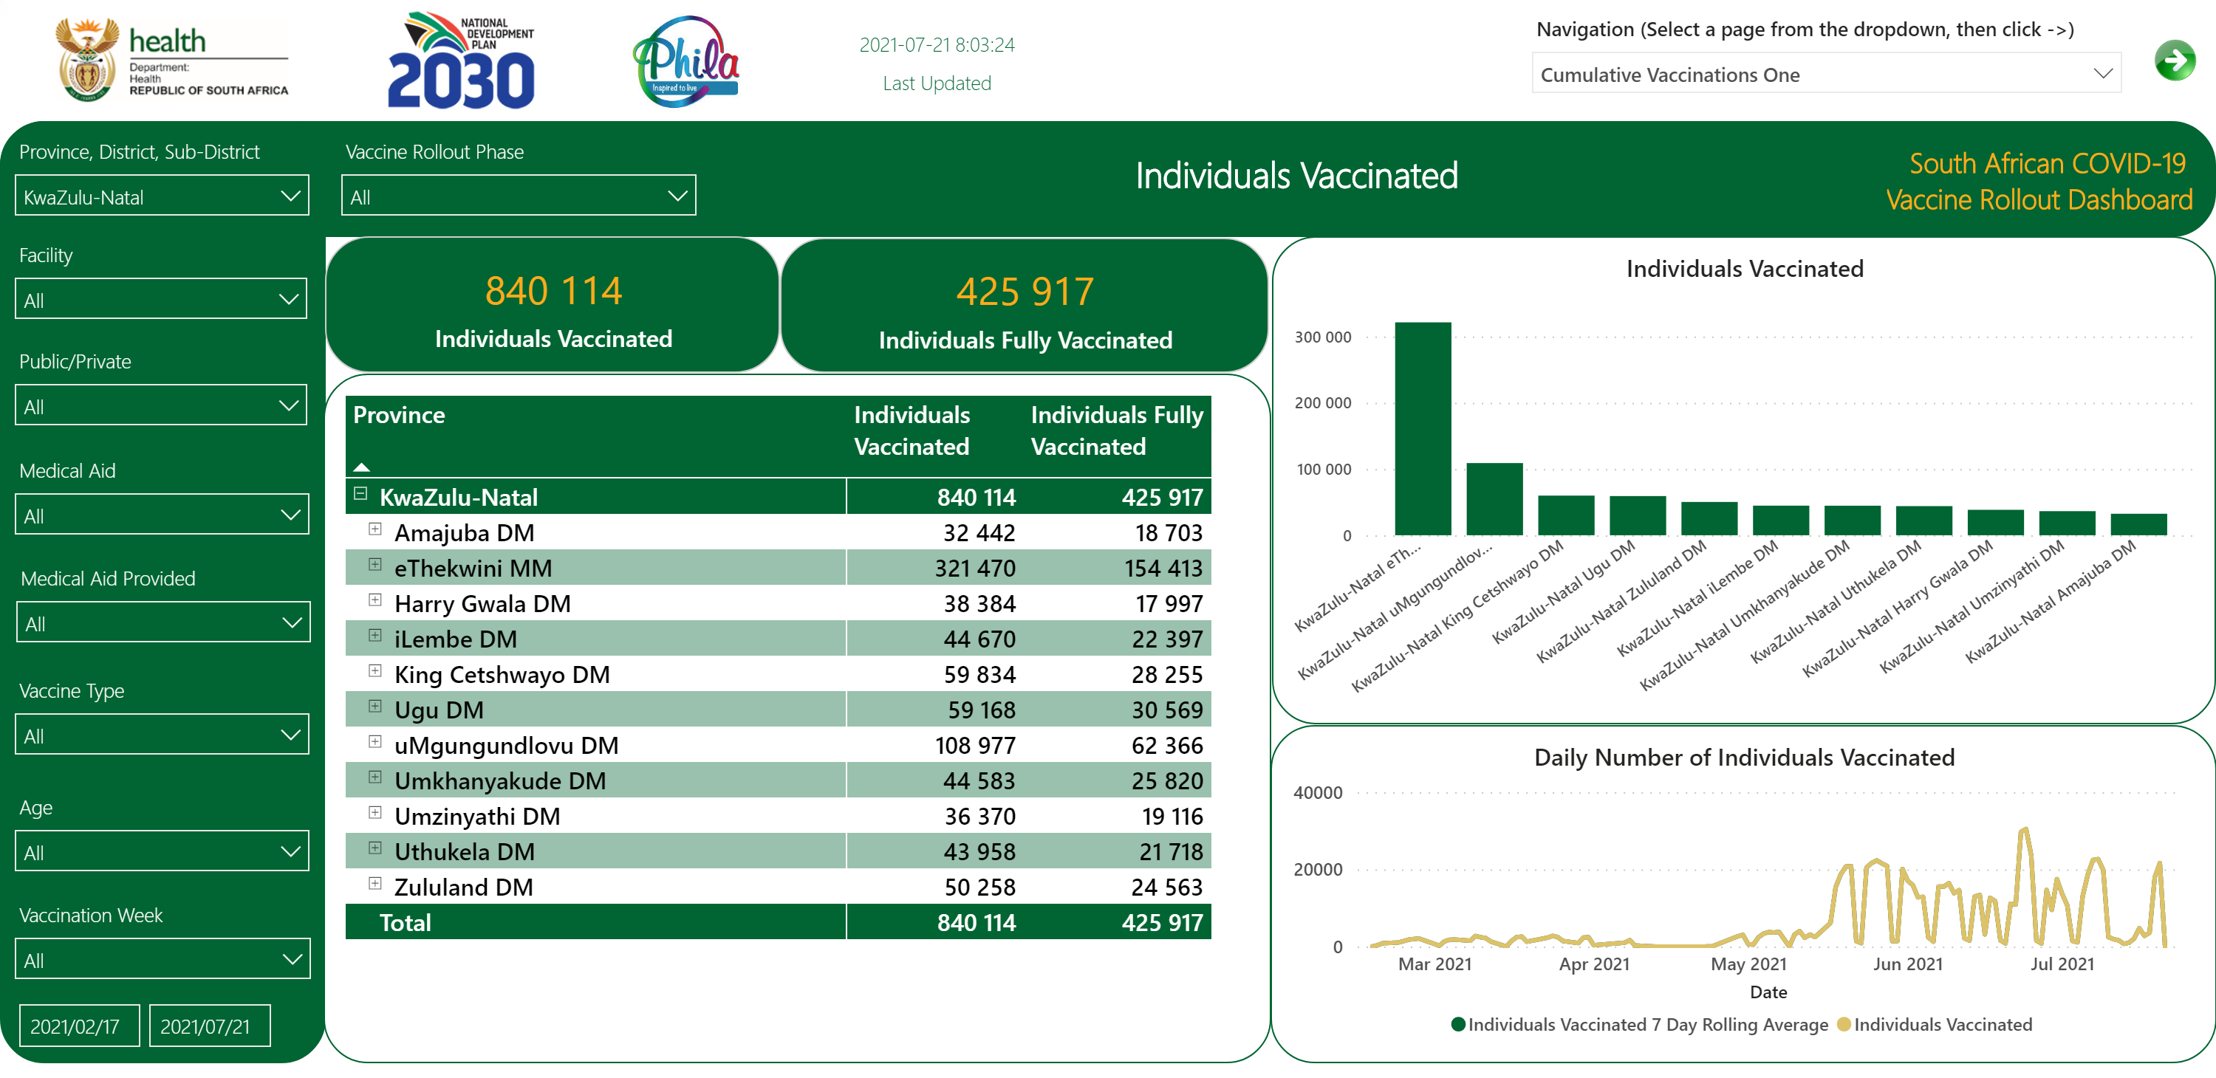
Individuals Vaccinated 1/6
Notes:
slicer
No alt text provided.
textbox
No alt text provided.
textbox
No alt text provided.
card
No alt text provided.
slicer
No alt text provided.
slicer
No alt text provided.
card
No alt text provided.
textbox
No alt text provided.
slicer
No alt text provided.
slicer
No alt text provided.
slicer
No alt text provided.
slicer
No alt text provided.
slicer
No alt text provided.
slicer
No alt text provided.
slicer
No alt text provided.
image
No alt text provided.
image
No alt text provided.
image
No alt text provided.
image
No alt text provided.
Date
No alt text provided.
card
No alt text provided.
Individuals Vaccinated
No alt text provided.
pivotTable
No alt text provided.
Daily Number of Individuals Vaccinated
No alt text provided.

Slide 7
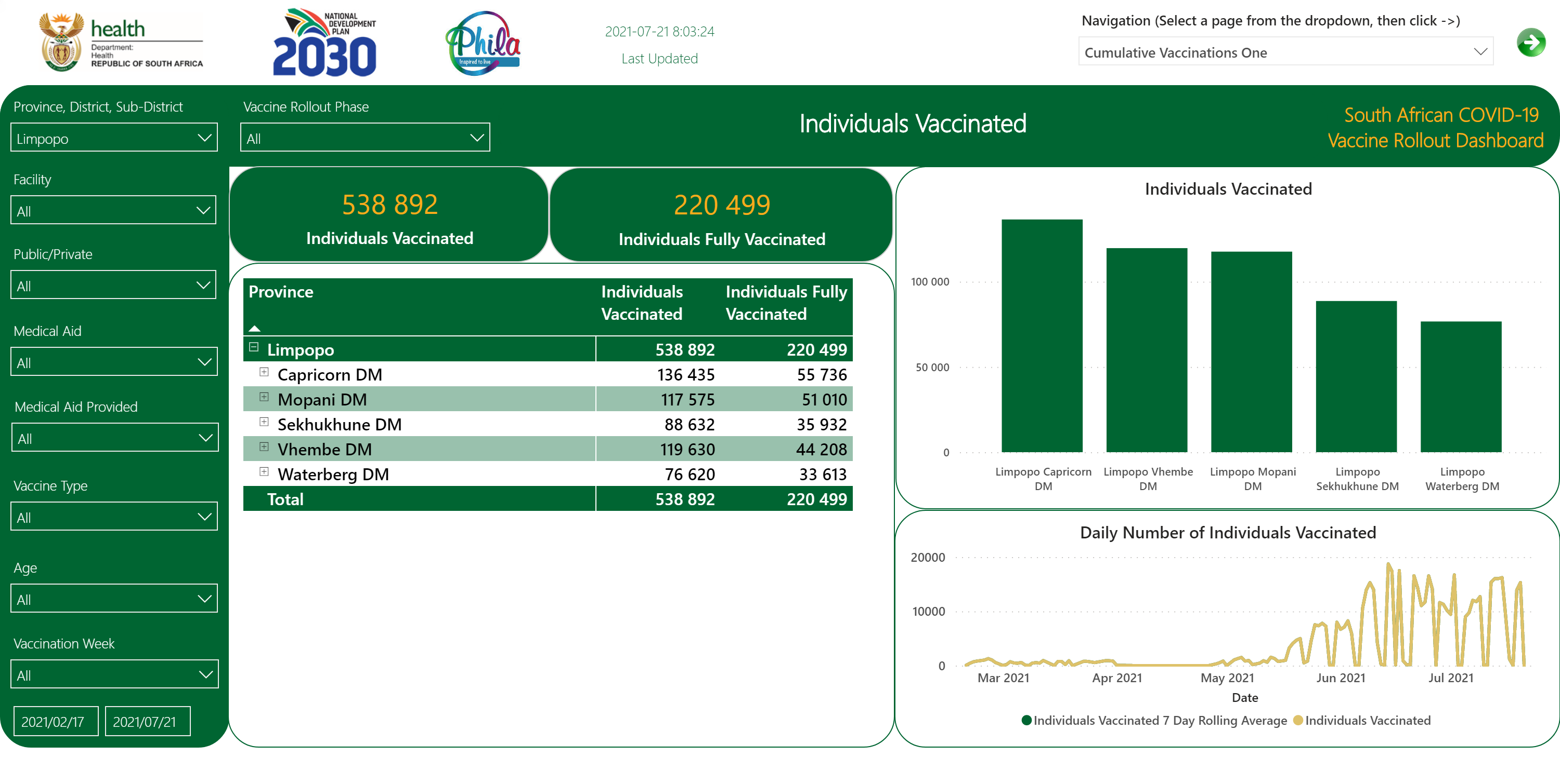
Individuals Vaccinated 1/6
Notes:
slicer
No alt text provided.
textbox
No alt text provided.
textbox
No alt text provided.
card
No alt text provided.
slicer
No alt text provided.
slicer
No alt text provided.
card
No alt text provided.
textbox
No alt text provided.
slicer
No alt text provided.
slicer
No alt text provided.
slicer
No alt text provided.
slicer
No alt text provided.
slicer
No alt text provided.
slicer
No alt text provided.
slicer
No alt text provided.
image
No alt text provided.
image
No alt text provided.
image
No alt text provided.
image
No alt text provided.
Date
No alt text provided.
card
No alt text provided.
Individuals Vaccinated
No alt text provided.
pivotTable
No alt text provided.
Daily Number of Individuals Vaccinated
No alt text provided.

Slide 8
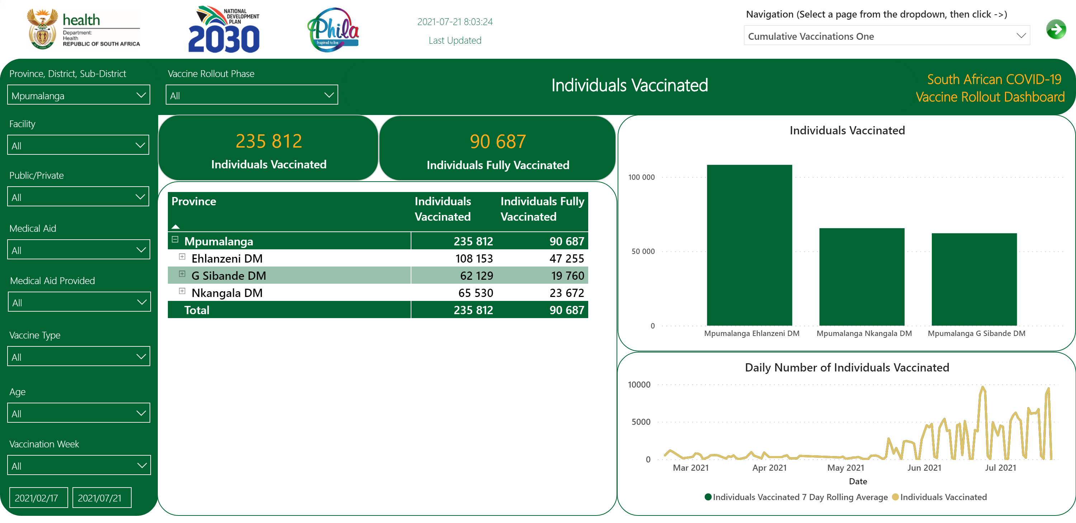
Individuals Vaccinated 1/6
Notes:
slicer
No alt text provided.
textbox
No alt text provided.
textbox
No alt text provided.
card
No alt text provided.
slicer
No alt text provided.
slicer
No alt text provided.
card
No alt text provided.
textbox
No alt text provided.
slicer
No alt text provided.
slicer
No alt text provided.
slicer
No alt text provided.
slicer
No alt text provided.
slicer
No alt text provided.
slicer
No alt text provided.
slicer
No alt text provided.
image
No alt text provided.
image
No alt text provided.
image
No alt text provided.
image
No alt text provided.
Date
No alt text provided.
card
No alt text provided.
Individuals Vaccinated
No alt text provided.
pivotTable
No alt text provided.
Daily Number of Individuals Vaccinated
No alt text provided.

Slide 9
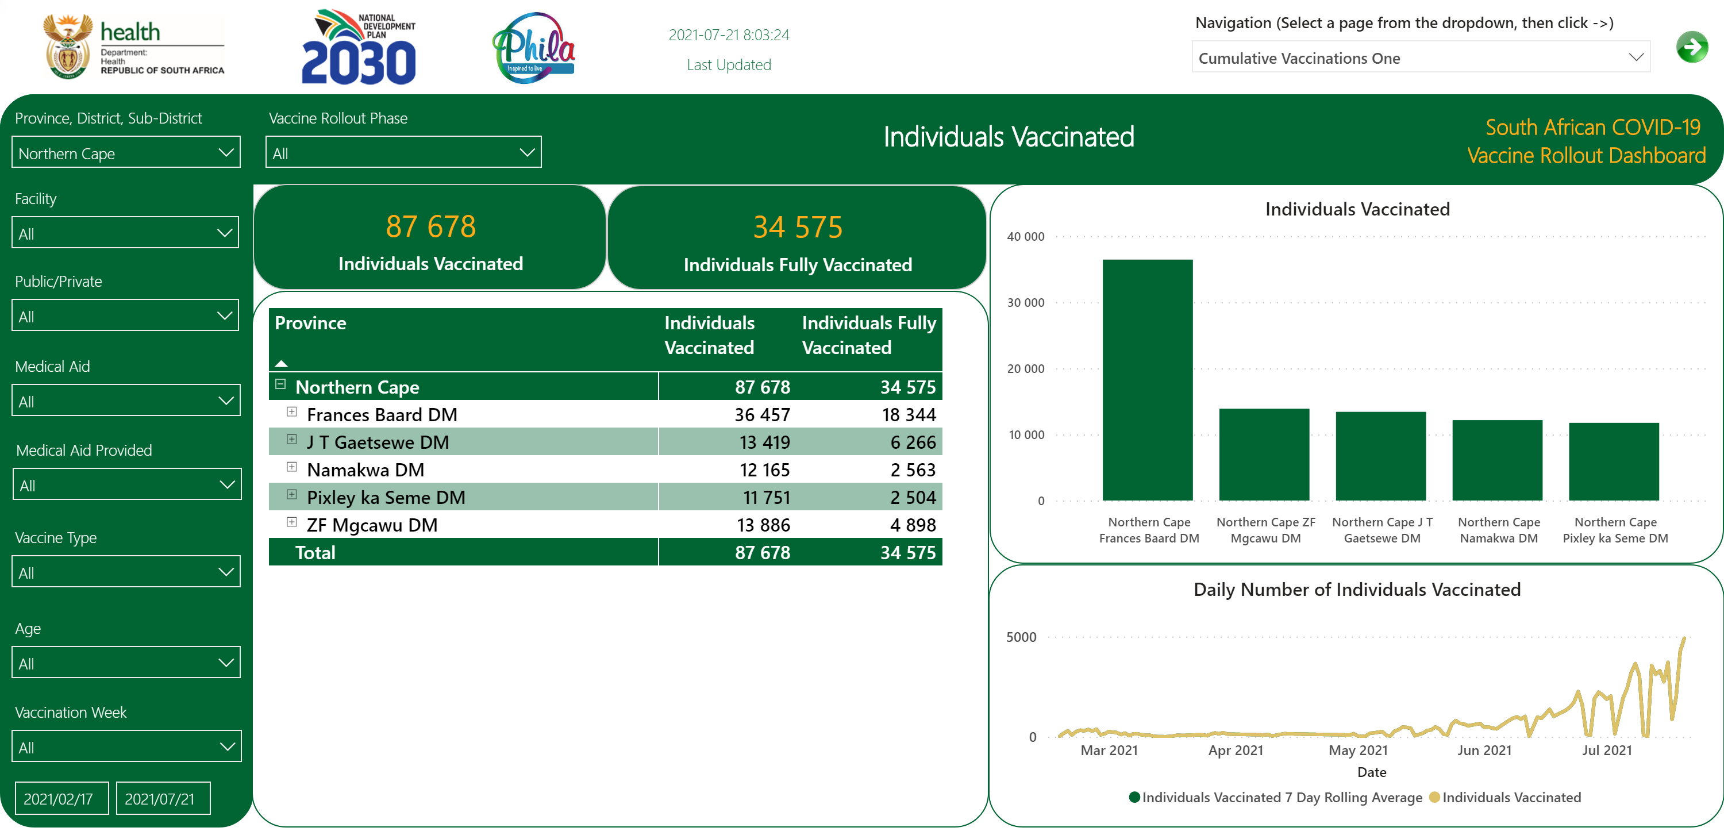
Individuals Vaccinated 1/6
Notes:
slicer
No alt text provided.
textbox
No alt text provided.
textbox
No alt text provided.
card
No alt text provided.
slicer
No alt text provided.
slicer
No alt text provided.
card
No alt text provided.
textbox
No alt text provided.
slicer
No alt text provided.
slicer
No alt text provided.
slicer
No alt text provided.
slicer
No alt text provided.
slicer
No alt text provided.
slicer
No alt text provided.
slicer
No alt text provided.
image
No alt text provided.
image
No alt text provided.
image
No alt text provided.
image
No alt text provided.
Date
No alt text provided.
card
No alt text provided.
Individuals Vaccinated
No alt text provided.
pivotTable
No alt text provided.
Daily Number of Individuals Vaccinated
No alt text provided.

Slide 10
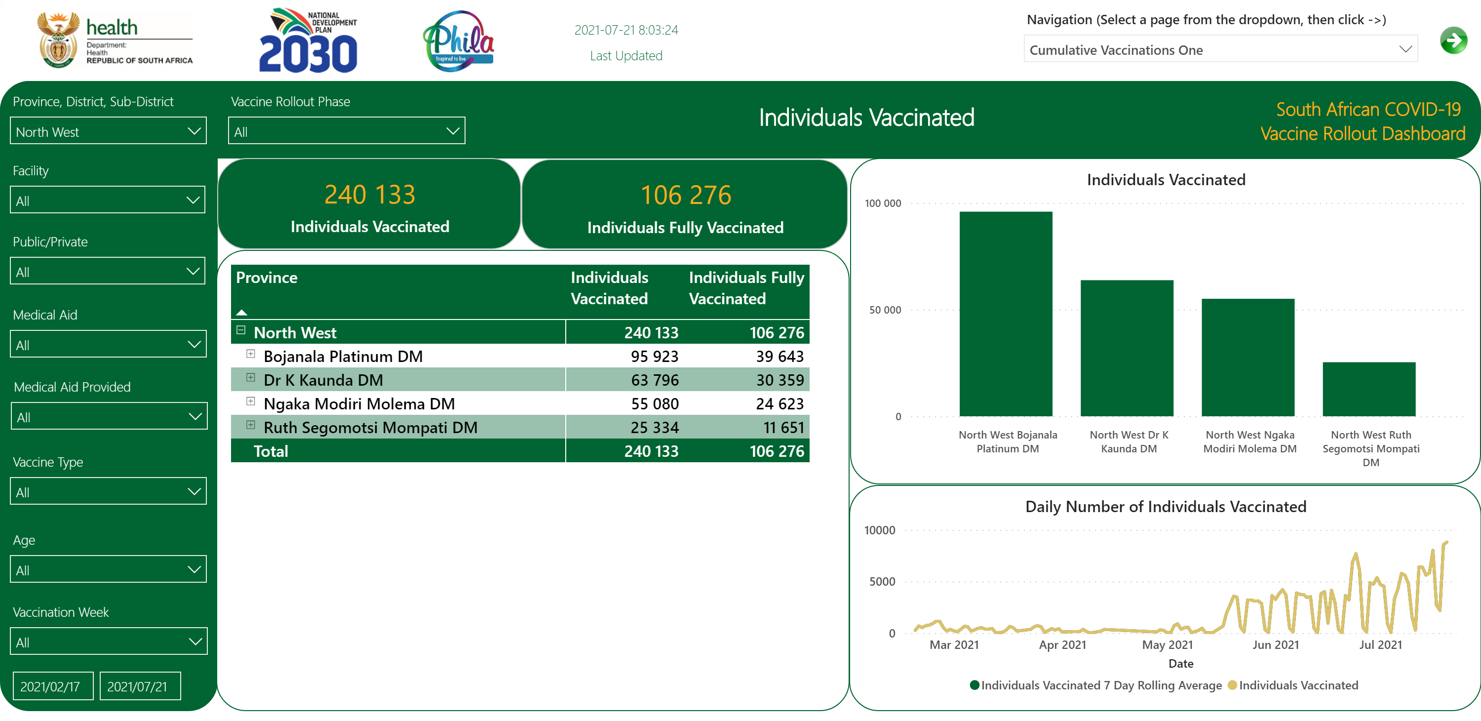
Individuals Vaccinated 1/6
Notes:
slicer
No alt text provided.
textbox
No alt text provided.
textbox
No alt text provided.
card
No alt text provided.
slicer
No alt text provided.
slicer
No alt text provided.
card
No alt text provided.
textbox
No alt text provided.
slicer
No alt text provided.
slicer
No alt text provided.
slicer
No alt text provided.
slicer
No alt text provided.
slicer
No alt text provided.
slicer
No alt text provided.
slicer
No alt text provided.
image
No alt text provided.
image
No alt text provided.
image
No alt text provided.
image
No alt text provided.
Date
No alt text provided.
card
No alt text provided.
Individuals Vaccinated
No alt text provided.
pivotTable
No alt text provided.
Daily Number of Individuals Vaccinated
No alt text provided.

Slide 11
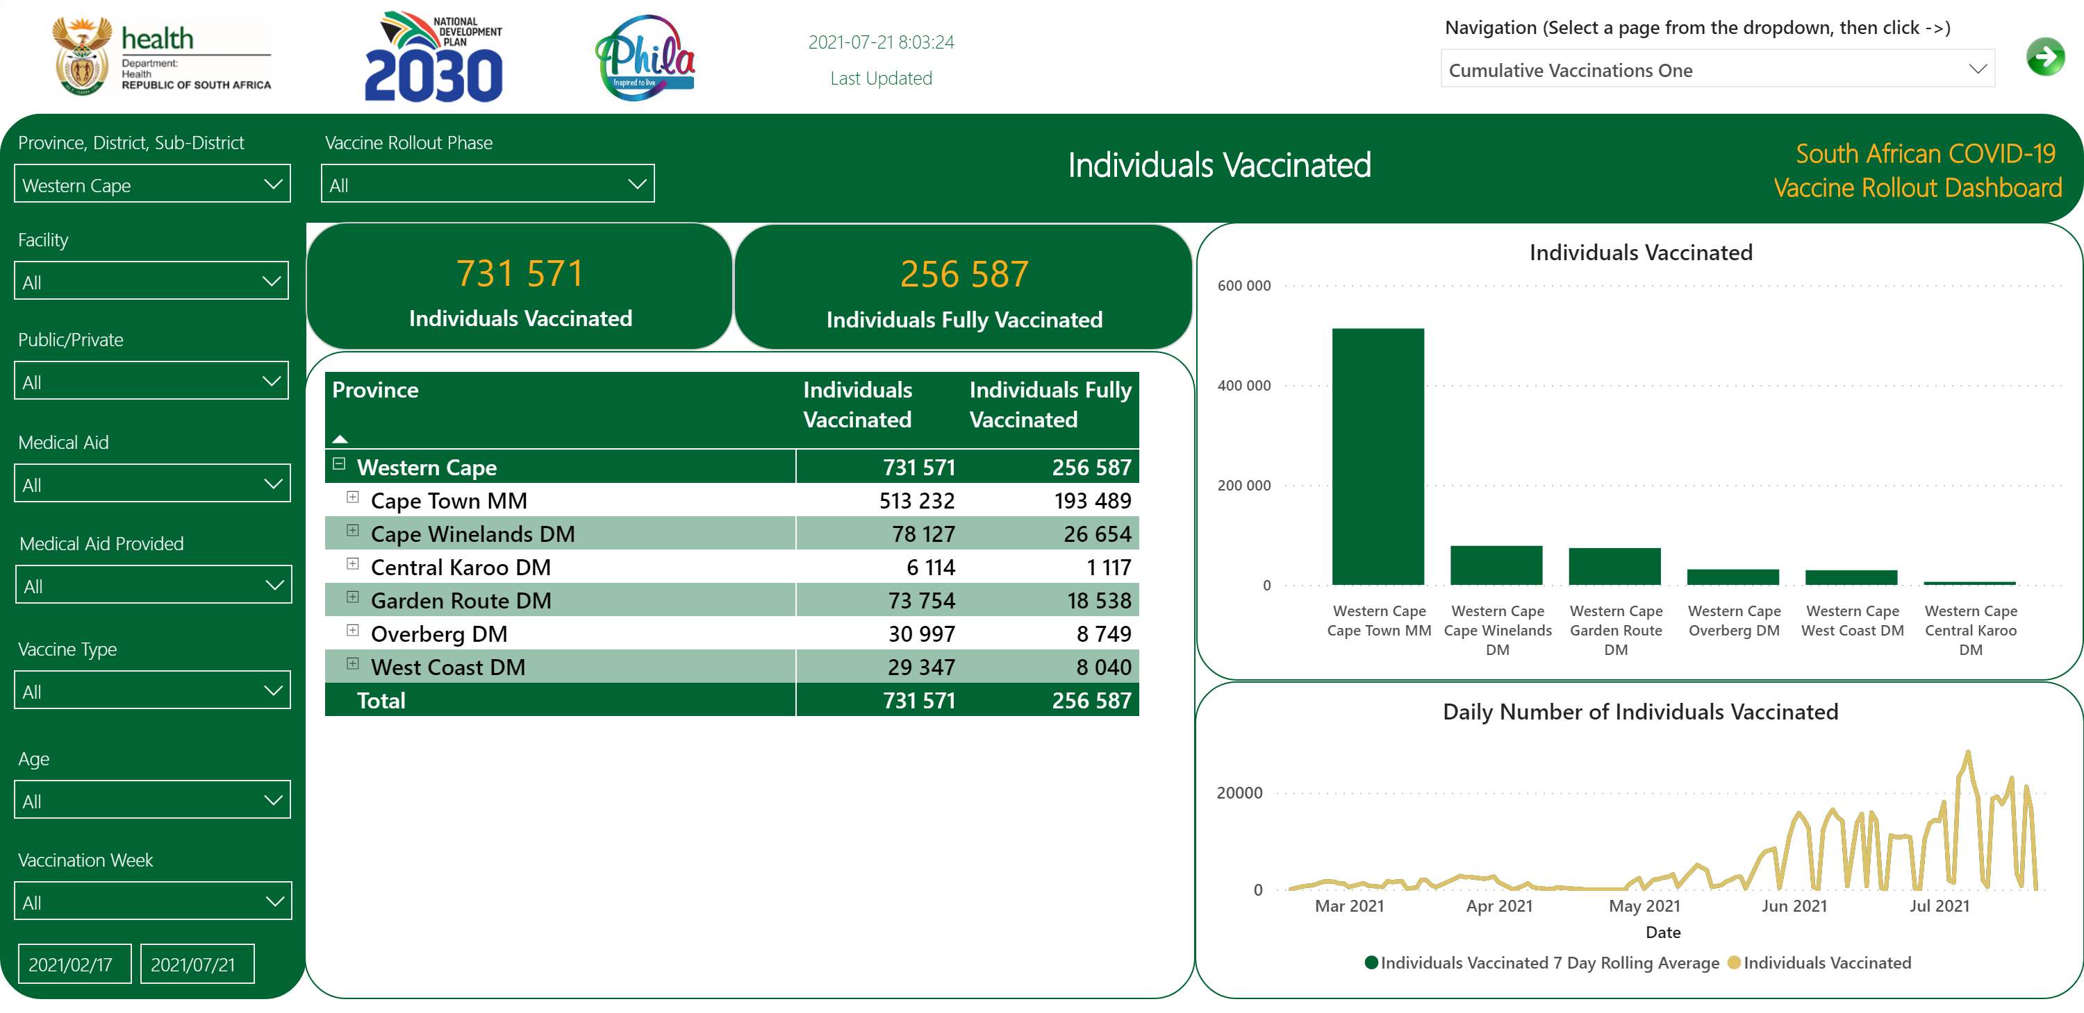
Individuals Vaccinated 1/6
Notes:
slicer
No alt text provided.
textbox
No alt text provided.
textbox
No alt text provided.
card
No alt text provided.
slicer
No alt text provided.
slicer
No alt text provided.
card
No alt text provided.
textbox
No alt text provided.
slicer
No alt text provided.
slicer
No alt text provided.
slicer
No alt text provided.
slicer
No alt text provided.
slicer
No alt text provided.
slicer
No alt text provided.
slicer
No alt text provided.
image
No alt text provided.
image
No alt text provided.
image
No alt text provided.
image
No alt text provided.
Date
No alt text provided.
card
No alt text provided.
Individuals Vaccinated
No alt text provided.
pivotTable
No alt text provided.
Daily Number of Individuals Vaccinated
No alt text provided.

Slide 12
Individuals Vaccinated 6/6
Notes:
textbox
No alt text provided.
textbox
No alt text provided.
slicer
No alt text provided.
slicer
No alt text provided.
COVID-19 Vaccinations Daily Totals
No alt text provided.
card
No alt text provided.
textbox
No alt text provided.
slicer
No alt text provided.
image
No alt text provided.
image
No alt text provided.
image
No alt text provided.
image
No alt text provided.

Slide 13
Public Healthcare Workers
Notes:
slicer
No alt text provided.
textbox
No alt text provided.
textbox
No alt text provided.
slicer
No alt text provided.
slicer
No alt text provided.
slicer
No alt text provided.
slicer
No alt text provided.
slicer
No alt text provided.
slicer
No alt text provided.
slicer
No alt text provided.
slicer
No alt text provided.
slicer
No alt text provided.
slicer
No alt text provided.
slicer
No alt text provided.
card
No alt text provided.
textbox
No alt text provided.
slicer
No alt text provided.
image
No alt text provided.
image
No alt text provided.
image
No alt text provided.
image
No alt text provided.
textbox
No alt text provided.
Numbers of Vaccinated Public Health Care Workers (HCW) out of Total Registered Public HCW
No alt text provided.

Slide 14
Education Sector
Notes:
slicer
No alt text provided.
textbox
No alt text provided.
slicer
No alt text provided.
slicer
No alt text provided.
textbox
No alt text provided.
slicer
No alt text provided.
slicer
No alt text provided.
slicer
No alt text provided.
slicer
No alt text provided.
slicer
No alt text provided.
slicer
No alt text provided.
slicer
No alt text provided.
slicer
No alt text provided.
card
No alt text provided.
textbox
No alt text provided.
Numbers of Vaccinated Individuals in Education Sector out of Total Registered Individuals Registered in Education Sector
No alt text provided.
textbox
No alt text provided.
slicer
No alt text provided.
image
No alt text provided.
image
No alt text provided.
image
No alt text provided.
image
No alt text provided.

Slide 15
SANDF
Notes:
slicer
No alt text provided.
textbox
No alt text provided.
textbox
No alt text provided.
slicer
No alt text provided.
slicer
No alt text provided.
slicer
No alt text provided.
slicer
No alt text provided.
slicer
No alt text provided.
slicer
No alt text provided.
slicer
No alt text provided.
slicer
No alt text provided.
slicer
No alt text provided.
card
No alt text provided.
textbox
No alt text provided.
Numbers of Vaccinated Individuals in the South African National Defence Force (SANDF) out of Total Registered Individuals Registered in SANDF
No alt text provided.
slicer
No alt text provided.
image
No alt text provided.
image
No alt text provided.
image
No alt text provided.
image
No alt text provided.

Slide 16
SAPS
Notes:
slicer
No alt text provided.
textbox
No alt text provided.
textbox
No alt text provided.
slicer
No alt text provided.
slicer
No alt text provided.
slicer
No alt text provided.
slicer
No alt text provided.
slicer
No alt text provided.
slicer
No alt text provided.
slicer
No alt text provided.
slicer
No alt text provided.
slicer
No alt text provided.
card
No alt text provided.
textbox
No alt text provided.
Numbers of Vaccinated Individuals in the South African Police Service (SAPS) out of Total Registered Individuals Registered in SAPS
No alt text provided.
slicer
No alt text provided.
image
No alt text provided.
image
No alt text provided.
image
No alt text provided.
image
No alt text provided.

