Slide 1
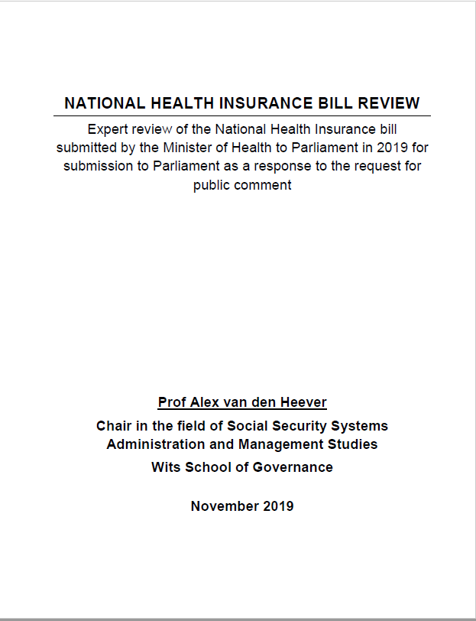
Review of the National Health Insurance Bill
Presentation to the Health Portfolio Committee
21 July 2021
Prof (adj) Alex van den Heever
Chair in the Field of Social Security Systems Administration and Management Studies
Alex.vandenheever@wits.ac.za
Available at:
https://www.researchgate.net/publication/338717425_NATIONAL_HEALTH_INSURANCE_BILL_REVIEW

Slide 2
Some terminology
State health service versus Public health service
Service versus System
National Health Insurance versus Universal Health Coverage
National Health Insurance versus Social Health Insurance
Incremental versus non-incremental policy change

Slide 3
“… while there is a wide consensus among the authors defining the NHI-model as a single fund and single-payer system with universal coverage, several countries name their health insurance schemes, a national public institution or a specific national health program “National Health Insurance”, regardless the health financing system of the country …
“For example, Israel names “National Health Insurance” their country SHI-model based on a multi-insurance system.
“Japan uses “National Health Insurance” to refer to one of the two major types of health insurance schemes in the country, which targets the population not eligible for insurance provided by the employee, in the context of a SHI-model. “
Several African countries such as Ghana, Kenya or Tanzania have insurance schemes denominated “National Health Insurance”. Nevertheless, these schemes are not universal, as they cover only a small percentage of the population (11 - 35%) - mainly formal sector employees …
“These uses of the term NHI have probably contributed to some confusion in the literature.”
(Cuadrado, Crispi, Libuy, Marchildon, & Cid, 2019, pp. 624-625)
Classification of country health systems

Slide 4
In an open democracy society, how should policy be made?
Identification of what needs to change
Appraisal of policy change options
Adoption
The more “radical” the proposed policy change, the greater the need for careful appraisal and review
Learning
Learning
Evaluation
Implementation/What is
Research
Social engagement
Meaningful consultation

Slide 5
The NHI process?
Identification of what needs to change
Appraisal of policy change options
Adoption
None of the learning features of a policy reform process were engaged
Evaluation
Implementation/What is
A narrow top-down “political” process framed the policy end-point and sought to pressure role-players and stakeholders to legitimise it and offer technical content to make it feasible

Slide 6
You do not diagnose complex problems that require systemic responses
You do not identify and implement needed systemic reforms timeously
The gap between social needs and the required social responses widen
Multi-faceted crises emerge with increased frequency
Policy responses consistently take the form of short-term fixes and drain resources
Consequences of poor process?

Slide 7
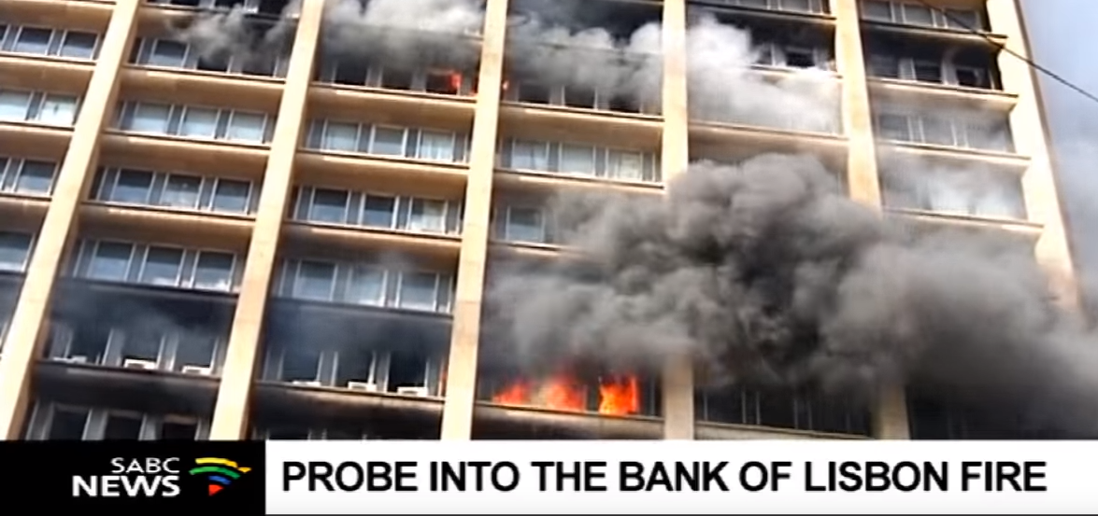
Identifying what needs to change?
Our public sector
Our private sector
TWO SIDES OF THE SAME COIN?

Slide 8
COVID-19 admissions in the public and private systems
What would have happened if we only relied on the public hospital system?
Source: NICD Datcov system

Slide 9
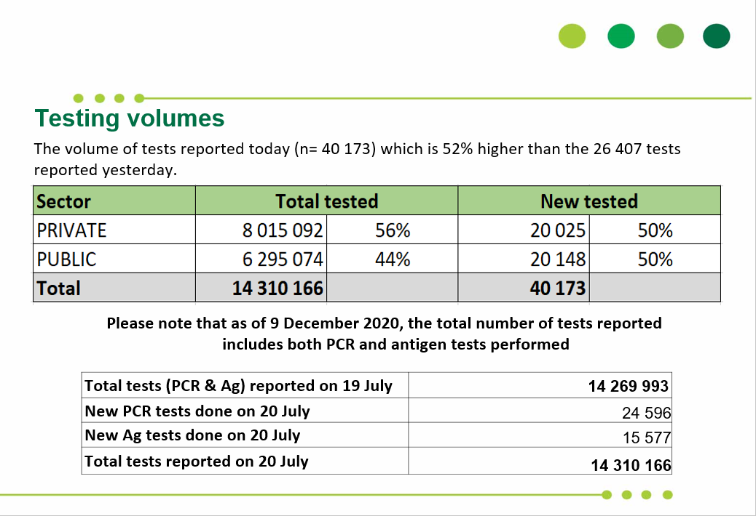
COVID-19 tests in the public and private systems to 20 July 2021
Source: NICD

Slide 10
As a quick diagnostic lets look at a five to ten year scenario?
Public sector
Medical scheme system
Institutionalised corruption will continue to drive failures of efficient quality care provision – particularly for major medical and hospital-related services - which will therefore incrementally decline in scope and access relative to the population in need
Poor risks for catastrophic health care will drift incrementally to the state
Systemic de-insurance will continue, resulting in the failure of financial risk protection for poor risks (pensioners and people with pre-existing conditions) and the exit of private hospital beds due to the elimination of lifetime insurance coverage for many
Fiscal pressures result in budget growth below the growth in the catchment population
The question is whether any of the NHI proposals address this scenario
Out-of-pocket market for primary care continues to expand

Slide 11
Three distinct elements to the NHI proposals
Pooling
Each of these aspects should be supported by a diagnostic assessment indicating why they are necessary and which rational and reasonable interventions are required to address any problems
Purchaser Provider Split
Monopoly purchaser

Slide 12
List of “problems” and their relationship to the possible rationale
Problem as specified | Source | Relationship to reform proposal |  |  | Evidence provided in the form of research and analysis
 |  | Pooling | Purchaser-provider split | Monopoly purchaser
Two-tier system generates inequity, inequitable health financing arrangements, financing systems that punish the poor | Green Paper White Paper 1 White Paper 2 | Yes | None | None | None
Fragmentation in funding pools | White Paper 1 White Paper 2 NHI Bill | Yes | None | None | None
Quadruple burden of disease, social determinants of health | Green Paper White Paper 2 | None | None | None | None
Under-performing institutions in the public sector attributed to poor management, underfunding and deteriorating infrastructure | Green Paper | None | None | None | None
Quality of care poor in the public sector which is a barrier to access | Green Paper White Paper 1 White Paper 2 | None | Unclear, but possible | Unclear, but possible | None

Slide 13
List of “problems” and their relationship to the possible rationale
Problem as specified | Source | Relationship to reform proposal |  |  | Evidence provided in the form of research and analysis
 |  | Pooling | Purchaser-provider split | Monopoly purchaser
Curative hospi-centric focus of the health system | Green Paper White Paper 1 | None | None | None | None
Private health sector costs | Green Paper White Paper 1 White Paper 2 | Yes | Already exists in the private sector | Yes | None
Cost drivers in the public health sector | White Paper 1 | None | None | Yes | None
Mal-distribution and inadequate human resources, Health workforce challenges, health professionals concentrated in the private sector | White Paper 1 White Paper 2 | Yes | None | None | None
Out-of-pocket payments | Mentioned in the Green Paper, but not in its problem statement White Paper 1 White Paper 2 | Yes | None | None | None

Slide 14
List of “problems” and their relationship to the possible rationale
Problem as specified | Source | Relationship to reform proposal |  |  | Evidence provided in the form of research and analysis
 |  | Pooling | Purchaser-provider split | Monopoly purchaser
Leadership and governance | White Paper 2 | None | None | None | None
Service delivery challenges | White Paper 2 | None | None | None | None
Availability of medical products and technologies | White Paper 2 | Yes | None | None | None
Weak purchasing and financing systems that punish the poor | White Paper 2 | None | Yes | Yes | None

Slide 15
Current UHC framework
General tax revenue appropriated to health
Contribution
Tax credit
Pooling of health finances
National tier of government
Benefit and access guarantees
Medical schemes purchasing of health care
Conditional grants
Provincial equitable share formula
Provision of health care
33% of provincial revenue
Transfers
Organisation and financing of health care
Provincial Revenue appropriated by provinces to the health function
Provincial tier of government
Provision of health care

Slide 16
Proposed UHC framework
General tax revenue appropriated to health
Contribution
Tax credit
Pooling of health finances
National tier of government
Benefit and access guarantees
Medical schemes purchasing of health care
Conditional grants
Provincial equitable share formula
Private sector provision of health care
X
Transfers
Organisation and financing of health care
Provincial Revenue appropriated by provinces to the health function
Provincial tier of government
Provision of health care

Slide 17
Proposed UHC framework
General tax revenue appropriated to health
Contribution
Pooling of health finances
National tier of government
Medical schemes purchasing of health care
NHI Fund organises and purchases all healthcare in SA
Private sector provision of health care
Contracts with facilities
Provinces lose 33% of their revenue
Provincial tier of government
Provision of health care

Slide 18
Why will the policy endpoint either not be achieved, or will fail to achieve public value goals?
Financial feasibility
Institutional feasibility
General tax revenue is behaviourally not a substitute for medical scheme contributions
The proposed tax increases to achieve the policy end-point are not feasible
Health systems are extremely complex, with the “purchasing” function decentralised, not centralised to achieve efficiencies
The proposed involvement of the executive in appointments to all aspects of the proposed system will reinforce systems of patronage that have harmed performance of the state-run health system to date

Slide 19
“The large degree of uncertainty and lack of common understanding of how the NHI will be implemented and operate is of concern, given the magnitude of the proposed reform.” (Davis Tax Commission, 2017, p. 42)
“Given the considerable size of projected funding shortfalls, substantial increases in VAT or PIT and/or the introduction of a new social security tax would be required to fund the NHI.” (Davis Tax Commission, 2017, p. 44)
“The magnitudes of the proposed NHI fiscal requirement are so large that they might require trade-offs with other laudable NDP programmes such as expansion of access to post school education or social security reform.” (Davis Tax Commission, 2017, p. 44)
“Given the current costing parameters outlined in the White Paper, the proposed NHI, in its current format, is unlikely to be sustainable unless there is sustained economic growth.” (Davis Tax Commission, 2017, p. 44)
Davis Tax Commission (2017)

Slide 20
“The National Health Insurance (NHI) option, even with a minimum benefit costed at the lowest level feasible, appears not to be affordable in the medium-term. Overall health expenditure would rise to exceed 11.3% of GDP.
“Were minimum benefits to be more comprehensive, the increases in overall health expenditure would be significantly in excess of this figure.” (Ministerial Task Team on Social Health Insurance, 2005, p. 50)
Ministerial Task team on Social Health Insurance (2005)

Slide 21
“He added that the budget for the NHI has yet to be confirmed, and that initial estimates of R256 billion were a thumb-suck by a local accounting firm.
“We made a mistake on the figures. I then went to the World Bank and the World Health Organisation and they asked why am I trying to do this, it can’t be quantified by any human being because the costs are so variable.” (Staff reporter, 2018)
Minister of Health (2018)

Slide 22
Achievable UHC framework
General tax revenue appropriated to health
Corporate governance reform of regulators to remove interference from the executive
Pooling of member contributions
RA + Social reinsurance
Explicit UHC per capita subsidy
Pooling of health finances raised from taxes
National tier of government
Benefit and access guarantees
Medical schemes purchasing of health care
Specific purpose conditional grants
Provincial equitable share formula
Provision of health care
33% of provincial revenue
Transfers
Organisation and financing of health care
Provincial Revenue appropriated by provinces to the health function
Revised governance framework
Provincial tier of government
Provision of health care

Slide 23
Summary

Slide 24
First, they have not been thought through
Second, they are lacking in evidence of their public purpose
Third, they are not based on a coherent rationale
Fourth, they have not been evaluated for feasibility despite nearly 11 years of apparent work
Fifth, they pose significant risks to the public and private health systems without any evidence of advantage to the general public
Sixth, they do not expressly address the actual problems that exist in the health system
Seventh, they ignore viable and easier to implement reforms that are already identified, and that relate to actual problems in the health system
General concerns with the proposals

Slide 25
First, the institutional framework, which implies the complete replacement of the provincial and private sector functions of financing, planning, organising and purchasing health, is plainly too ambitious for the current capabilities of the health system
Second, the fiscal requirements for the substitution of medical schemes contributions with general tax increases is plainly unachievable. It is quite evident that the failure of the NDOH and National Treasury to produce a financial feasibility study results from this realisation
Third, the inclusion of a corporate governance model for the NHIF and related organisations, based on political appointments, condemns any version of the proposals to failure. This governance approach has driven institutionalised under-performance throughout the public sector and all state-owned enterprises, which will be no different in this instance
Feasibility

Slide 26
Taking this into account, there are three key features of the NHI proposals that, on review, require substantiation through the elaboration of a clear and reasoned evidence-based rationale:
First, the extent of required pooling, together with the institutional mechanisms by which pooling will be achieved
Second, the need for the entire health system to be converted into a purchaser-provider split
Third, the need for a monopoly purchaser
As things stand, despite over ten years of apparent constant work on the NHI framework, and up to R3.8 billion spent on NHI pilot projects, no evidence has been generated that clarifies what problem the NHI proposals are seeking to solve and why the proposed interventions are the most effective way forward
Rationale

Slide 27
A further feature of the NHI reform framework is that it relies on an apparent misdiagnosis of the current failures of the public and private health systems
Were these failures properly considered, a coherent set of reforms could feasibly have resulted
There are, in fact, no diagnostic studies of any form performed by the NDOH on any part of the health system over the past 11 years relating to the NHI process and framework
As the public sector failures are plainly attributable to weaknesses in the governance framework, and the private sector failures attributable to weaknesses of the regulatory framework (Competition Commission, 2019), there appears to be no imperative to address any actual problems in the health system
The various references made to other country reforms appear deliberately framed to imply that they are in some way equivalent versions of what is proposed in South Africa through the NHIB
This is not true
While many countries are pursuing UHC reforms, continuously, there are no proposals equivalent to what is suggested for South Africa
No support can be drawn from international experience for the specific NHI framework proposed
Rationale

Slide 28
The re-direction of the PES to the national level of government
The circumvention of the powers of provinces, which reduce the health function to that of an agent for the NHIF
The establishment of government components without the requisite powers or permissions to do so
The prohibition of medical scheme and related social insurance coverage for benefits offered through the NHIF
The elimination of social protections offered to medical scheme members through the Medical Schemes Act
The removal of the tax credit regime for contributions to medical schemes, which is an existing legitimate entitlement for a population that cannot in any way be accommodated in the public sector
In an attempt to avoid any arbitrary limitation of any protected right in the Bill of Rights, Section 36 introduces strong qualifications to any restrictions imposed on any protected right in the Bill of Rights
Not only must the restriction be rational, but it must also be reasonable and justifiable in an open democratic society
Constitutional and legal challenges

Slide 29
For noting:
The effectiveness of the purchasing function is subordinate to the governance framework
Efficient forms of planning, organising, procuring and delivering healthcare invariably arise from the incentives resulting from how decision-makers are held to account within organisational hierarchies and, directly and indirectly, to users
All the institutional features that drive incentives to perform therefore arise from the governance framework
Purchaser-provider splits therefore arise organically when they make sense to a particular health authority within their context
Efficiencies do not occur magically through imposed purchaser-provider splits, particularly when they are configured within bad governance structures (i.e. the current framework proposed in the NHIB)
Less onerous approaches to the achievement of UHC

Slide 30
The implementation and institutionalisation of a more coherent system of health transfers at the national level of government
The establishment of a national framework of regional and district authorities to operate at the provincial level of government (This would in fact be a legitimate use of national legislation)
This framework of decentralised authorities should involve a combination of decentralisation, supportive accountability structures (that, inter alia, separate political appointments from delivery structures) and a supportive framework of national transfers to ensure equity goals are achieved
As part of the decentralisation approach, all major facilities should become autonomous, but subject to oversight and supervision by independent supervisory boards and related structures
A unified system of critical care should be implemented to ensure universal equal access to emergency care for all residents of South Africa (The Inter-departmental Task Team on Social Security has assessed this proposal, together with a provisional feasibility analysis)
Less onerous approaches to the achievement of UHC

Slide 31
Two considerations flow from the HMI report:
First, the system of medical schemes can be made to work more efficiently without the need for government to take over the purchasing functions of the private health system
Second, the fragmentation of the medical scheme system can be addressed through the recommended pooling regimes, i.e. the risk adjustment scheme together with social reinsurance and the mandatory minimum package
Reasonable alternatives: Medical schemes

Slide 32
Thank you

