Slide 2
Representatives
Dr Nkhensani Mukoki (National President of SPNP)
Mrs Gertrude Nare (Immediate Past President)
Mrs Debbie Regensberg (Honorary Secretary / Treasurer)

Slide 3
The Society of Private Nurse Practitioners of South Africa
We represent nurse practitioners who practice independently and interdependently throughout South Africa
Support the call to provide affordable and accessible health care in line with Article 12 of the United Nations Covenant, the African Charter on Human and People’s Rights, and our Constitution, as noted in the preamble to this Bill.
We choose to work as self employed nurses as it give us the privilege of providing a level of quality care which puts our patients and their needs at the centre of our practice

Slide 4
Who is a Private Nurse Practitioner (PNP)?
Professional Nurses and Midwives
Registered by the South African Nursing Council
Provide nursing care on a fee for service basis, Reimbursed directly or indirectly by the patient or NGOs.
Does not include practitioners who are salaried, eg. Agencies (duty nurses), doctors consulting rooms, pharmacy nurses or occupational health clinics nurses on salaries.
But these practitioners also contribute toward reduction of cost of care & face most challenges being presented

Slide 5
Practice Models
Independent practitioners – sole proprietor, partnership, private companies
Health centres, Midwifery units & Pharmacy-based clinics
Franchise-type model – Unjani & Owethu / Sha’p Left primary health clinics
Reimbursement
Fee-for-service
Direct or 3rd party funding
Registered as NPOs / PBOs

Slide 6
SERVICES PROVIDED BY PNPs Consultation, not shift based including
General – frail care, home visits
Wound care – Basic & Advanced
Psychiatry
Lymphoedema manag’t
Stomatherapy
Dermatology
Palliative care / end of life
Education
Childbirth education
Midwifery – ANC, PNC, Births
Lactation consultants
Immunization and Well Baby clinics
School nursing
Occupational health / wellness
Renal dialysis

Slide 7
PRACTICE SETTINGS
Rural
Informal settlements
Industrial areas
Urban Business & Residential areas
City Centres
Patients homes
Hospitals
Workplaces
Consulting rooms
Pharmacies
Gauteng: 150
Mpumulanga: 19
North West : 21
Limpopo: 32
KZN: 81
Western Cape 118
Eastern Cape 22
Other (including Free State, N.Cape, other etc) 12
Group practices 22
Corporate members: 14
Notes:
Clips of practices to be added here -

Slide 8
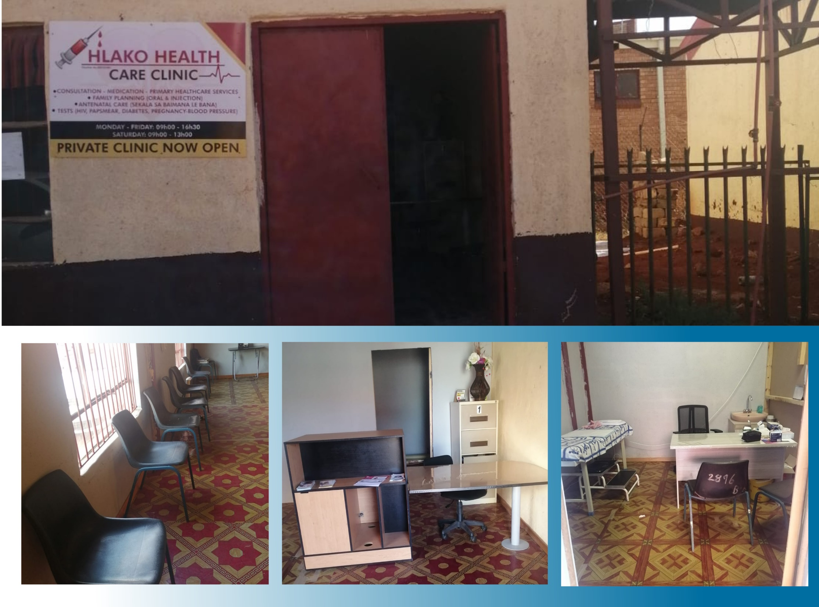
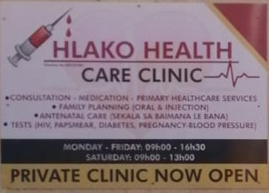

Slide 9
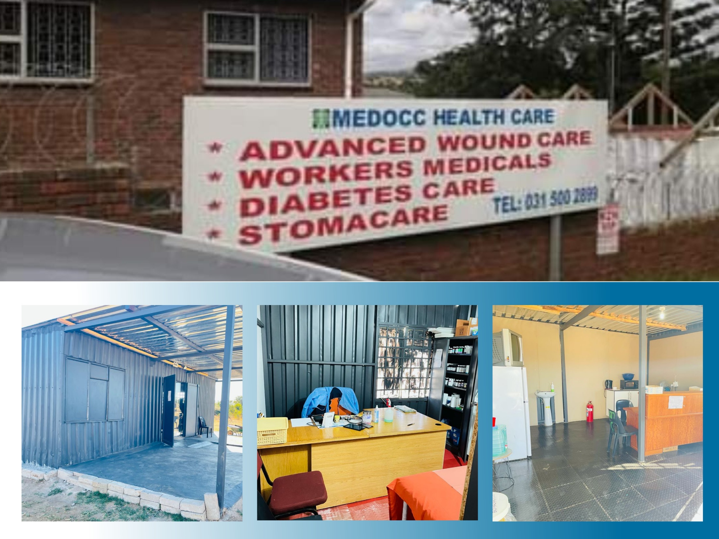

Slide 10
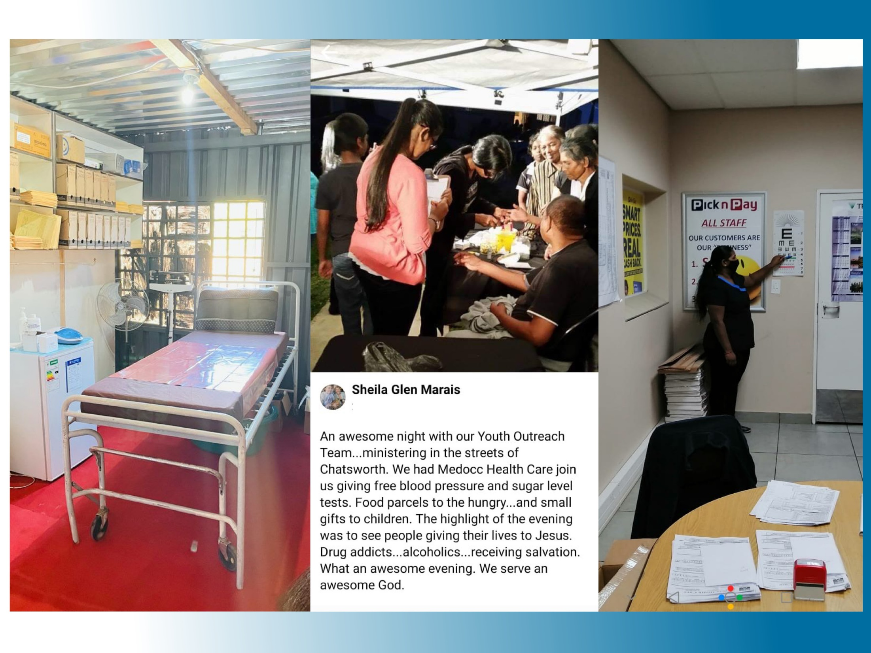

Slide 14
Nursing challenges
Nursing legislation continues to restrict recognition of expertise and skills of critically skilled practitioners eg Primary health care – prescribing of EDL, issuing sick certificate
Recognition of nurses as independent practitioners and employers, not only employees
Inclusion in NHS / NHI / PMB policy setting processes limited to SANC or DOH, limiting perspectives and recognition of different challenges & practice contexts

Slide 15
Regulatory challenges
Challenges of conflicting legislation, often due to outdated information
Focus is on facilities not services
Acts:
Nursing Act, particularly S56 (6)
Medicines & Related Substances Act
Regulations:
Certificate of Need (in comment phase)
Office of Health Standards Compliance
Various Nursing regulations in process

Slide 16
Technological challenges
Advances in health services and health care provided by nurses not recognised / reimbursed by funders, not available in public sector
Clinic facilities not aligned to draft regulations but approved for services – Ideal Clinic standards: outreach units, eg. Mobile clinics, Portable prefabricated containers
Telehealth – providing referral pathways

Slide 17
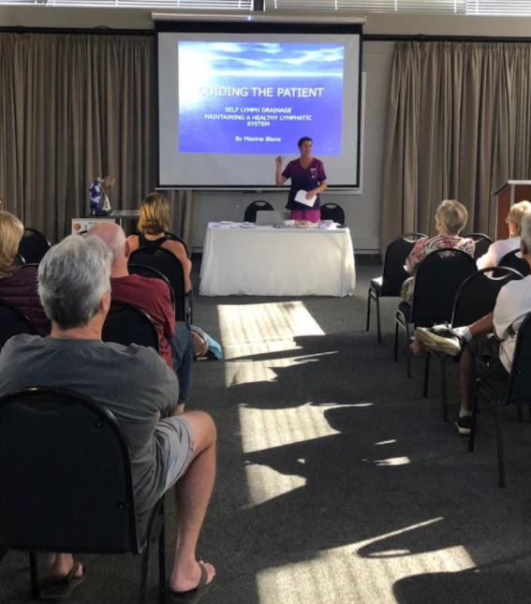
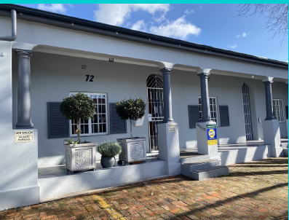
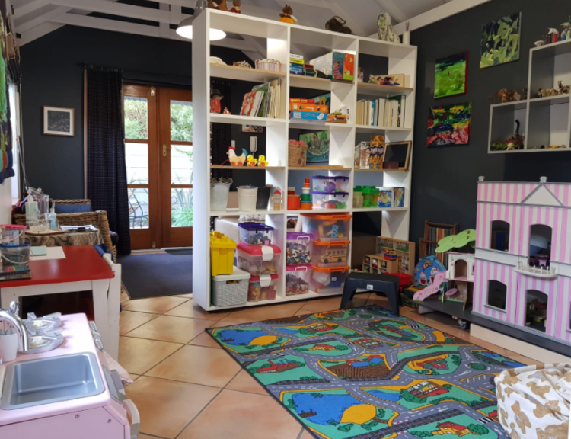
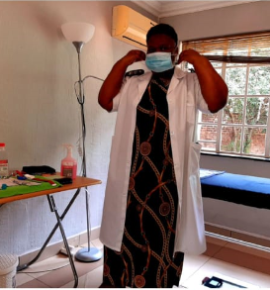
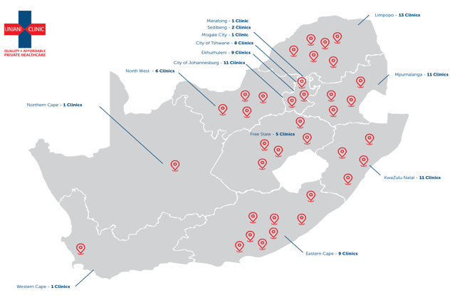
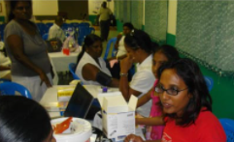

Slide 18
Representation
5. The Fund must –
(c ) design health care services as advised by the relevant committee
Composition of Ministerial Committees
Registered Nurses, who provide “the backbone” of healthcare had one representative across all committees through the SANC
We do not believe that this one person on their own could represent the healthcare needs of all the different patients
We therefore question the value of the nomination and selection processes

Slide 19
Prices / Fee structures
(f) determine prices annually after consultation with health care providers, health establishments and suppliers in the prescribed manner and in accordance with the provisions of this Act;
(k) ensure that health care providers, health establishments and suppliers are paid in accordance with the quality and value of the service provided to users at every level of care;
Our experience has shown that fees have been set against public sector salaries, not taking into account overhead costs of business. (NHRPL, BHF prior to 2008)
Omission of nursing representatives on the relevant Ministerial Committees.
Differentiation between levels of care – Generalists vs Specialists, if based on SANC criteria, will exclude services such as Advanced wound care, Stomatherapy, Lactation Consulting, and similar which are not linked to academic requirements for registration as specialists

Slide 20
Payment of providers
S39 refers to the payment of “primary service providers at health establishments must be funded on a risk adjusted capitation basis”..
The provision of homebased (domiciliary) nursing service in the public sector is critical to reduction in in-patient admissions, facilitation of early discharges and provision of appropriate levels of community based care.
Our public health services do not provide these nursing services, particularly for more advanced nursing needs. The range of PMBs published to date have very limited reference to nursing care

Slide 21
Payment of providers (2)
Many rural areas do not have access to or are not serviced by medical practitioners, and public clinic services are provided once or twice weekly.
The Society seeks clarity on the proposed capitation structures and who would qualify as the “primary service provider” , and the allocation of services against this capitation fee in areas where nurses currently practice.
This appears to be in contrast to the content of S52 (2) (b) which requires the Minister to make regulations for “mechanisms to enable the payment of individual health care workers and health professionals”

Slide 22
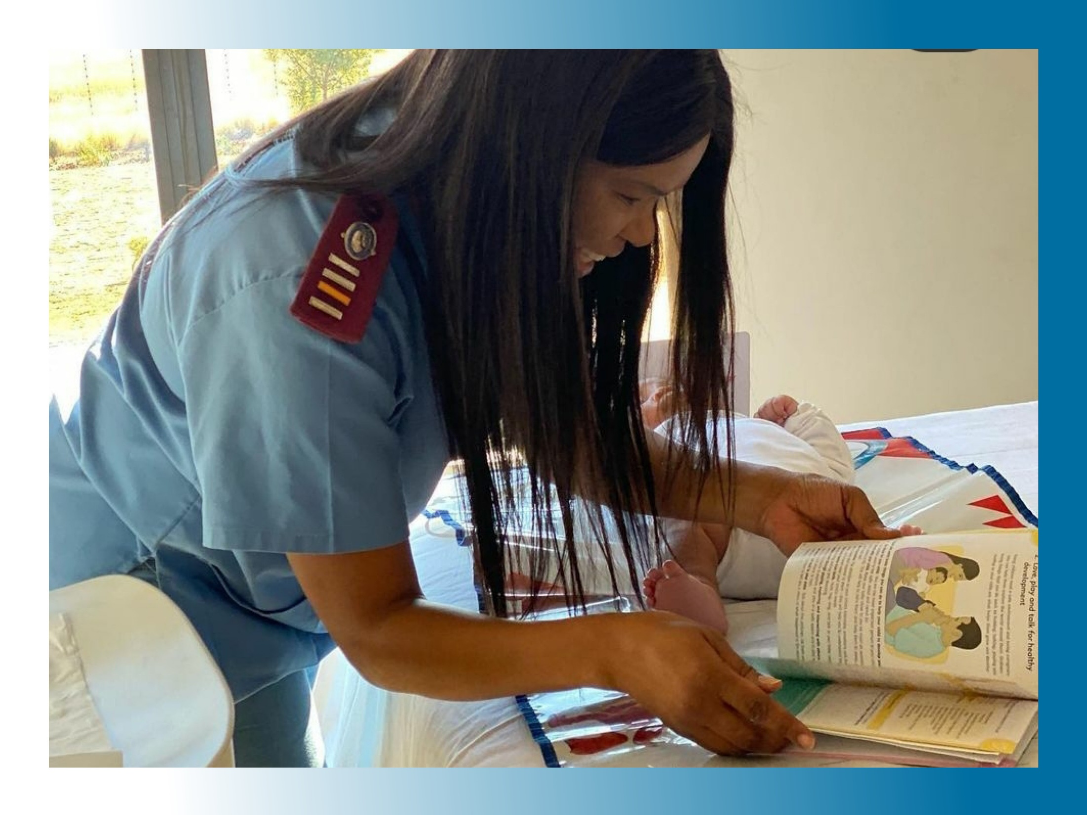

Slide 24
Registration, licensing or accreditation
(l) monitor the registration, license or accreditation status, as the case may be, of health care providers, health establishments and suppliers;
Current Nursing Act (2005) and supporting regulations do not recognize or enable appropriately skilled nurses outside public sector to diagnose and prescribe in terms of S56(6) of the Act .
S11 (5) & S33(1) of this proposed legislation states that treatment protocols and guidelines will be developed and must be followed.
Will this requirement be accepted by the SANC, the SAPC and NDOH to recognize the role of private practitioners, and an environment in which licenses to practice in terms of S56(6) may be granted? Particular areas of concern are Reproductive health, Primary Health Care including maternal and child health, NIMART and Palliative Care

Slide 25
Right to health care
S7 (3) acknowledges the right of access to NH services for various categories of users who are registered with the provider, subject to having an official identity document, birth certificate, or valid documentation from Dept of Home Affairs, or be a dependent.
The Society is deeply concerned that there is no recognition of children or other persons without valid birth certificates.
While we do not have the figures for this group, experience has shown that these children will be at risk if excluded.

Slide 26
Composition of the Board & Committees
The Society has reservations and expresses concern at the composition of various structures:
S14(5) There appears to be no requirement that the Board should have an appropriately qualified / registered Health Care professional at the highest level of the Fund.
S25(2) The Benefit Advisory Committee includes two representatives of the private hospital sector, but no representative of private community based professional organisations.
This has the potential to continue to embed the focus of private health care in curative milieu, without due consideration for preventive, rehabilitative and community based curative and palliative needs.

Slide 27
Composition of Committees
The WHO defines health as a state of “complete physical, mental and social well-being and not merely the absence of disease or infirmity.”
The Society believes that it is an extreme oversight to have omitted representation of the South African Council for Social Service Professions (SACSSP) as one of the professional councils from the Stakeholder Advisory Committee (S27).
The broad range of services which Social Workers provide within the healthcare team, particularly for the most vulnerable members of society must be recognised through their inclusion in this Act.

Slide 28
Accredited service providers
S38(2) The omission of Social Workers from the potential list of accredited services providers is a further concern, given their role in the provision of health care and prevention of disease and infirmity.

Slide 29
Amendment to National Health Act (2003)
The amended definition of “health agency” is commended.
The provision of community based health care for the disabled, elderly and infirm is dependent on the caregivers who are currently not formally recognised is a concern due to the wide range of training and skills, often resulting in abuse of both the clients and the carers.
The lack of recognition results in minimal reimbursement for these services, with dire consequences to the wellbeing of the patients in most instance.
The Society will welcome an opportunity to develop the cadre of workers so that they can be included in the National Health services and funding.

Slide 30
Transitional arrangments
The Society wishes to see an expansion of the inclusion of Private Nurse Practitioners in Phase 2 (S54) to complement the services provided as is currently practiced in selected provinces and local authorities to ensure that affordable and effective health care can reach every member of the community.

Slide 32
