Slide 1
GREATER TZANEEN MUNICIPALITY ELECTRICAL INFRASTRUCTURE

Slide 2
TABLE OF CONTENT
BACKGROUND
STAKEHOLDERS
PROJECT STEERING COMMITTEE
PROGRESS ON DBSA CAPITAL PROJECTS
REVENUE ENHANCEMENT PROGRAM
HAMSA REPORT
VEGETATION CONTROL

Slide 3
GREATER TZANEEN MUNICIPALITY ELECTRICAL INFRASTRUCTURE
1. BACKGROUND
The GTM is a licensed service provider for electricity within the proclaimed towns and townships of Tzaneen, Letsitele, Haenertsburg, Lenyenye and Nkowankowa and is one of the largest non-Eskom distributors of electricity in the country. The municipality presently distributes power to an area of approximately 3 500 km² in extent and which serves more than 14,000 customers.
The distribution area does not correspond with the Municipality’s jurisdiction area, with the two main areas of difference being (1) the townships of Nkowankowa, Lenyenye and southernmost areas, which are serviced by Eskom, but fall within the Tzaneen Municipal area, and (2) Letsitele, Eiland and Gravelotte, which form part of the Ba-Phalaborwa Municipality, but are supplied by the Greater Tzaneen Municipality.

Slide 4
GREATER TZANEEN MUNICIPALITY ELECTRICAL INFRASTRUCTURE
The National Energy Regulator of South Africa (NERSA) conducted a compliance audit on the Greater Tzaneen Municipality’s electrical networks on 27th - 29th of February 2012 in order to determine their level of compliance with the electricity distributor’s license conditions. During the audit NERSA found that the latest master plan that was done in 2006 was outdated and had to be reviewed to assist the municipality in forecasting demand. NERSA recommended that GTM allocate sufficient funding for a reviewed master plan in their 2013/14 budget year (NERSA: 2013). NERSA also observed that there was a lack of recapitalization of the network electrical plant (i.e. continuous replacement of existing infrastructure as it reaches the end of its useful life), such as the replacement of the old transformers at the existing Letsitele Substation, the Tzaneen Main Substation, and the replacement of overhead line networks (NERSA: 2013).

Slide 5
GREATER TZANEEN MUNICIPALITY ELECTRICAL INFRASTRUCTURE
2. STAKEHOLDERS – ELECTRICITY FORUM
Agri Letaba
Business Community
Farm owners
Domestic Households
NERSA
Greater Tzaneen Municipality

Slide 6
GREATER TZANEEN MUNICIPALITY ELECTRICAL INFRASTRUCTURE
3. PROJECT STEERING COMMITTEE
A Project Steering Committee was established at the onset of the projects planning phase after the loan from DBSA was secured.
Regular monthly meetings were held where reports was produced on a technical and financial level
The members of the Steering Committee is:
GTM
NERSA
DBSA
DMRE
ESKOM

Slide 7
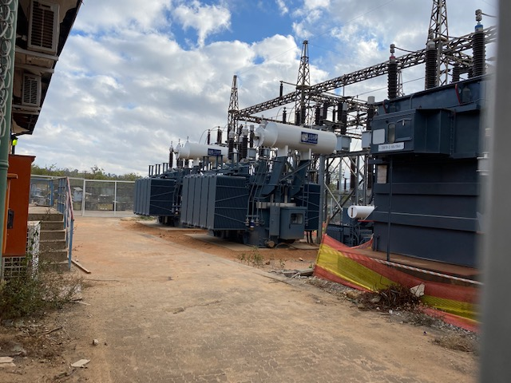
GREATER TZANEEN MUNICIPALITY ELECTRICAL INFRASTRUCTURE
FUNDING R100 MILLION
DBSA LOAN = R90 MILLION (APPROVED)
2018/19 FINANCIAL YEAR = R40M (Received)
2019/20 FINANCIAL YEAR = R20M (Received)
2020/21 FINANCIAL YEAR = R30M (Received)
IIPSA GRANT = R10 MILLION
2019/20 = R10M (Received)

Slide 8
GREATER TZANEEN MUNICIPALITY DBSA FUNDED CAPITAL PROJECTS
DBSA R90 Million loan Incomplete Projects for 1st year 2018/19
Project Description | Original Budgeted Amount VAT excl
 |  |  | Project Expenditure | Date Completed
 |  |  | Vat Incl.
Streetlights R36 | R 1 100 000.00 |  | R933 485.53 | 31/08/2019
Area Lighting at Tarentaal rand Crossing | R400 000.000 |  | R443 803.11 | 28/06/2019
Replace 2 x 20 MVA 66/11 kV at Tzaneen main sub (+R4 Million from STD) Phase 1 | R6 550 000.000 |  | R7 504 722.90 | Multi-year project 3 years
Prepaid Meters | R300 000.000 |  | R480 230.23 | 28/06/2020
Replacing 11kv cables (Old SAR to SS1 sub) | R1 200 000.000 |  | R1 965 827.37 | 28/06/2020
Substation Tripping Batteries (Item B53 6/14) | R400 000.000 |  | R855 116.92 | 17/12/2019
Replace Minisubs: Tzaneen | R1 000 000.000 |  | R1 099 422.78 | 21/04/2019
Provision of Capital Tools (Customer and Retail Services) | R200 000.000 |  | R129 921.25 | Acquired
Provision of Capital tools (Operations and Maintenance) | R200 000.000 |  | R124 688.83 | Acquired
Replacement of Existing Air Conditioners | R250 000.000 |  | R286 585.75 | 31/07/2019
Rebuilding of lines – Letsitele Valley substation – Bosbou and all T offs (2.5km) | R500 000.000 |  | R509 145.47 | 28/06/2019

Slide 9
GREATER TZANEEN MUNICIPALITY DBSA FUNDED CAPITAL PROJECTS
Project Description | Original Budgeted Amount VAT excl
 |  |  | Project Expenditure | Date Completed
 |  |  | Vat Incl.
Rebuilding of Lushof South 11kv lines (2.2km) | R500 000.000 |  | R514 454.47 | 28/06/2019
Rebuilding of Mabiet 11kv lines (4.9km) | R1 000 000.000 |  | R1 046 087.13 | 30/08/2019
Rebuilding of Haenertsburg 11kv line (4.6km) | R1 000 000.000 |  | R818 181.84 | 28/06/2019
Rebuilding of Campsies Glen 11kv lines (3km) | R1 000 000.000 |  | R731 818.22 | 28/06/2019
Rebuilding of CP Minnaar 11kv lines (1.9km) | R400 000.000 |  | R405 634.05 | 28/06/2019
Rebuilding of Mieliekloof / Deerpark 11kv lines (2.3km) | R500 000.000 |  | R522 727.24 | 30/08/2019
Houtbosdorp 11KV Ring (4.1km) | R1 500 000.000 |  | R1 463 755.03 | 30/08/2019
Substation Fencing: Tarentaalrand Main | R1 000 000.000 |  | R1 505 137.25 | 31/05/2019
Refurbishment of the Ebenezer 33kV Feeder (4.5km) | R1 000 000.000 |  | R1 281 353.20 | 28/06/2019
Replacing of old SS1 electrical substation circuit breakers with compact switchgear | R10 000 000.000 |  | R10 681 557.62 | 28/06/2019
Replace 11 kV and 33 kV Auto reclosers per annum (Item B53 6/14) (5x Auto Reclosers) | R3 000 000.000 |  | R3 638 103.50 | 25/05/2020
Upgrading of Waterbok 33/11KV Substation | R2 000 000.000 |  | R1 982 320.38 | 28/06/2020
Upgrading of Blacknoll 33/11KV Substation | R2 000 000.000 |  | R2 017 884.93 | 28/06/2020

Slide 10
GREATER TZANEEN MUNICIPALITY DBSA FUNDED CAPITAL PROJECTS
Project Description | Original Budgeted Amount VAT excl
 |  | Project Expenditure | Date Completed
 |  | Vat Incl.
Rebuilding of Rooikoppies 11kv lines (4.8km) | R1 000 000.000 | R946 025.51 | 18/062021
Rebuilding of Politsi Valley 11kv lines (4.8km) | R1 000 000.000 | R1 045 454.57 | Physical Construction at 99%.
Total | R 39 000 000.00 | R42 933 445.08

Slide 11
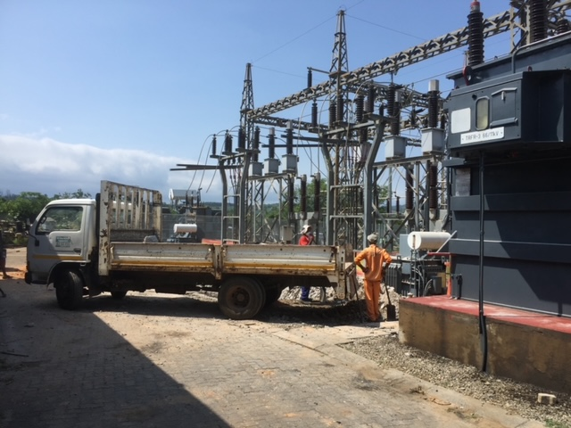
GREATER TZANEEN MUNICIPALITY DBSA FUNDED CAPITAL PROJECTS
2nd YEAR DBSA LOAN FUNDED PROJECTS
2019/20 FINANCIAL YEAR
TOTAL BUDGET = R 20M (LOAN) +
R 10M (IIPSA GRANT)

Slide 12
GREATER TZANEEN MUNICIPALITY DBSA FUNDED CAPITAL PROJECTS
Greater Tzaneen Municipality 2019/20 Electrical Capital Projects Roll over
PROJECT / INITIATIVE | START DATE | END DATE | ORIGINAL BUDGET TOTAL 2019/20 | Total Expenditure on Project | Phisical Progress in %
R71 Streetlights and Traffic Circle (Project Cancelled – RAL have no budget) | 01-Jul-19 | 30-Jun-21 | R 104 347.83 | R 119 999.99 | Project Deferred
R71 Streetlights (Adshade bridge to Robot) | 01-Jul-19 | 30-Jun-21 | R 500 000.00 | R 472 282.01 | 100%
Area lighting at Kujwana turn off | 01-Jul-19 | 30-Jun-21 | R 300 000.00 | R 428 450.00 | 100%
Rebuilding of lines - Greenfrog to Haenertsburg (2.5km) | 01-Jul-19 | 30-Jun-21 | R1 050 000.00 | R 331 331.82 | 100%
Rebuilding of lines - Gravelotte to De Neck (2.2km) | 01-Jul-19 | 30-Jun-21 | R1 000 000.00 | R 503 636.38 | 100%
Rebuilding of 33kV lines - Lalapanzi to Waterbok (1.2km) | 01-Jul-19 | 30-Jun-21 | R 600 000.00 | R 368 045.46 | 100%

Slide 13
GREATER TZANEEN MUNICIPALITY DBSA FUNDED CAPITAL PROJECTS
Greater Tzaneen Municipality 2019/20 Electrical Capital Projects Roll over
PROJECT / INITIATIVE | START DATE | END DATE | ORIGINAL BUDGET TOTAL 2019/20 | Total Expenditure on Project | Physical Progress in %
Mashuti/Agatha 11kV line (1.3km) | 01-Jul-19 | 30-Jun-21 | R 400 000.00 | R 287 390.91 | 100%
Deeside 11kV line Ph1 (1km) | 01-Jul-19 | 30-Jun-21 | R 600 000.00 | R 234 436.37 | 100%
Yamorna/Shivurali 11kV line ph1 (1.3km) | 01-Jul-19 | 30-Jun-21 | R 600 000.00 | R 285 454.56 | 100%
Ledzee 11kV line Ph1 (2.8km) | 01-Jul-19 | 30-Jun-21 | R 1 400 000.00 | R 604 936.37 | 100%
Rooikoppies 11kV line Ph2 (1.7km) | 01-Jul-19 | 30-Jun-21 | R 500 000.00 | R 287 763.27 | 100%
Mieliekloof/Deerpark 11kV line Ph2 (1.2km) | 01-Jul-19 | 30-Jun-21 | R 500 000.00 | R 281 090.92 | 100%

Slide 14
GREATER TZANEEN MUNICIPALITY DBSA FUNDED CAPITAL PROJECTS
Greater Tzaneen Municipality 2019/20 Electrical Capital Projects Roll over
PROJECT / INITIATIVE | START DATE | END DATE | ORIGINAL BUDGET TOTAL 2019/20 | Total Expenditure on Project | Physical Progress in %
Letsitele Valley sub to Bosbou 11kV line Ph2 (1.1km) | 01-Jul-19 | 30-Jun-21 | R 500 000.00 | R 249 899.78 | 100%
Ebenheaser 33kV Ph2 (3.1km) | 01-Jul-19 | 30-Jun-21 | R1 000 000.00 | R 507 239.01 | 60%
Valencia 11kV ph2 (1km) | 01-Jul-19 | 30-Jun-21 | R500 000.00 | R 277 954.55 | 100%
Letaba 33kV Ph1( 1.9km) | 01-Jul-19 | 30-Jun-21 | R1 000 000.00 | R 667 772.74 | 100%
Substation fencing Ph2- Letsitele Main Sub | 01-Jul-19 | 30-Jun-21 | R 500 000.00 | R 509 268.30 | 100%
Prepaid Meters Ph2 | 01-Jul-19 | 30-Jun-21 | R 300 000.00 | R 297 300.00 | 100%

Slide 15
GREATER TZANEEN MUNICIPALITY DBSA FUNDED CAPITAL PROJECTS
Greater Tzaneen Municipality 2019/20 Electrical Capital Projects Roll over
PROJECT / INITIATIVE | START DATE | END DATE | ORIGINAL BUDGET TOTAL 2019/20 | Total Expenditure on Project | Physical Progress in %
Minisubs Ph2 | 01-Jul-19 | 30-Jun-21 | R 800 000.00 | R 791 534.36 | 100%
Batteries ph2 | 01-Jul-19 | 30-Jun-21 | R 100 000.00 | R 105 006.50 | 100%
Aircon Replacements Ph2 | 01-Jul-19 | 30-Jun-21 | R 150 000.00 | R 212 276.20 | 100%
Tzaneen Main Trf replacement Ph2 | 01-Jul-19 | 30-Jun-21 | R16 495 652.17 | R 17 118 815.61 | 100%
Auto Recloser Replacement (4x Auto Reclosers installed) | 01-Jul-19 | 30-Jun-21 | R1 000 000.00 | R 1 069 194.31 | 100%
Capital Tools CRS | 01-Jul-19 | 30-Jun-21 | R 50 000.00 | R 97 598.55 | 100%
Capital Tools O&M | 01-Jul-19 | 30-Jun-21 | R 50 000.00 | R 15 426.25 | 100%
TOTALS | Totals |  | R30 000 000.00 | R 26 124 104.20 | 98%

Slide 16
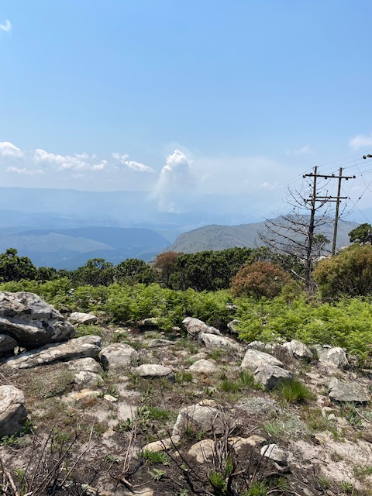
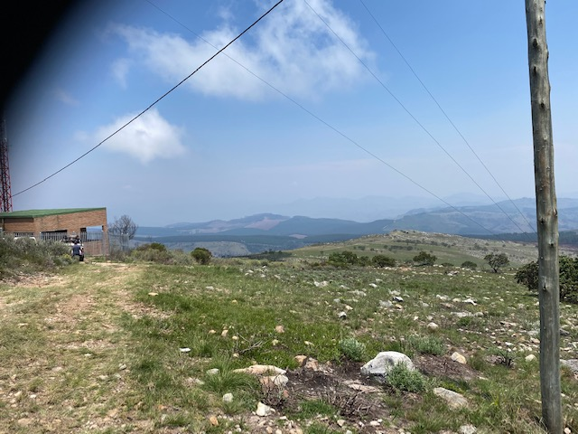
GREATER TZANEEN MUNICIPALITY DBSA FUNDED CAPITAL PROJECTS
Haenertsburg/ Iron Crown 11kV line challenge
More than 10 structures must be installed by hand – no access to machinery
Equipment and material carried by hand for more than a kilometre
New Transformer position, reachable by a crane truck
Existing Transformer position not reachable by crane truck

Slide 17
GREATER TZANEEN MUNICIPALITY DBSA FUNDED CAPITAL PROJECTS
DBSA R90 Million loan Projects 3rd year 2020/21
PROJECT NAME | BUDGET | EXPENDITURE | % OVERALL PHYSICAL CONSTRU
Replace 2 x 20 MVA 66/11 kV at Tzaneen main sub PH3 | R14 670 000.00 | R 4 947 534.95 | 62,5%
Prepaid Meters ph3 | R 300 000.00 | R 305 664.25 | 100%
Substation Tripping Batteries (Letsitele Main) (Appointed) | R 450 000.00 | R - | 100%
Provision of Capital Tools (CRS) | R 100 000.00 | R - | 5%
Provision of Capital tools (O&M) | R 100 000.00 | R 6 250.00 | 10%
Replacement of Existing Air Conditioners ph3 | R 150 000.00 | R 139 150.00 | 100%
Rebuilding of Deeside 11kv line (2.2km planned) | R 600 000.00 | R 35 573.13 | 90%
Rebuilding of Yamorna /Shivurali 11kv line ph2 ( 1.9km planned ) | R 600 000.00 | R 35 573.13 | 90%

Slide 18
GREATER TZANEEN MUNICIPALITY DBSA FUNDED CAPITAL PROJECTS
DBSA R90 Million loan Projects 3rd year 2020/21
PROJECT NAME | BUDGET | EXPENDITURE | % OVERALL PHYSICAL CONSTRU
Rebuilding of Ledzee 11kv lines ph2 (2km planned) | R 500 000.00 | R 29 644.26 | 95%
Rebuilding of Waterbok 11kv lines (3.3km planned towards Prieska) | R 700 000.00 | R 41 501.98 | 95%
Rebuilding of Letaba Feeder 33KV line ph2 (4.2km planned) | R 1 500 000.00 | R 88 932.81 | 85%
Replace 11 kV and 33 kV Auto reclosers per annum (Item B53 6/14) ph3 (3x AR installed) | R 1 500 000.00 | R 202 341.35 | 100%
Refurbishment of the Ebenezer 33kV Feeder ph3 – (3.3km planned – Incl. Increasing conductor size) | R 1 500 000.00 | R - | 25%
Install 33kV voltage regulator on the 33kV Haenertsburg ring (This project will address the voltage drop experience in Haenertsburg area) | R 2 500 000.00 | R 118 577.08 | 10%
Rebuilding of California 11kV line – (3km planned) | R 830 000.00 | R - | 35%
Totals | R26 000 000.00 | R 5 950 742.94 | 66.8%

Slide 19
GREATER TZANEEN MUNICIPALITY DBSA FUNDED CAPITAL PROJECTS
DBSA R90 Million loan Projects 3rd year 2020/21
Ledzee 11kV line, Letaba 33kV line, Deeside 11kV and Waterbok 11kV line are handed over and construction started in May.
Appointments are done for Yamorna 11kV line and Battery replacement for Substations.
Ebenhezer 33kV line Ph3, - Contractor appointed
33kV Voltage Regulator – Contractor appointed

Slide 20
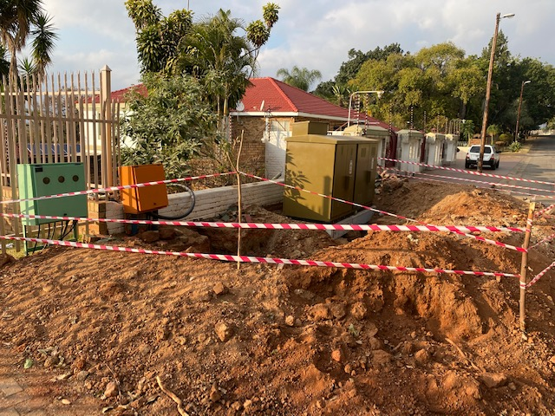
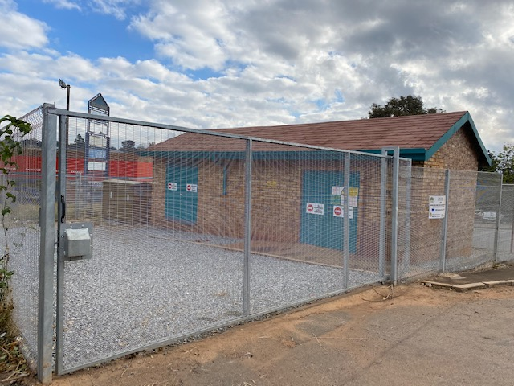
GREATER TZANEEN MUNICIPALITY DBSA FUNDED CAPITAL PROJECTS Photo wall
Minisub Replacement
SS1 Sub after completion

Slide 21
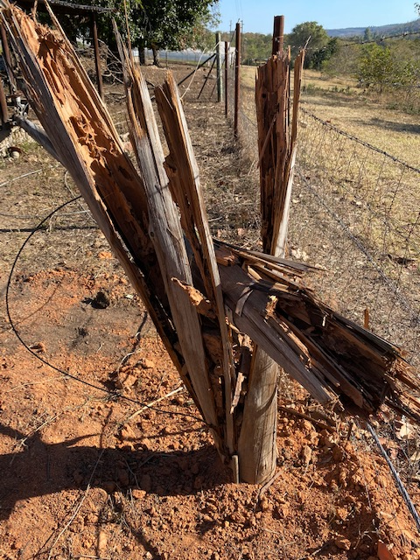
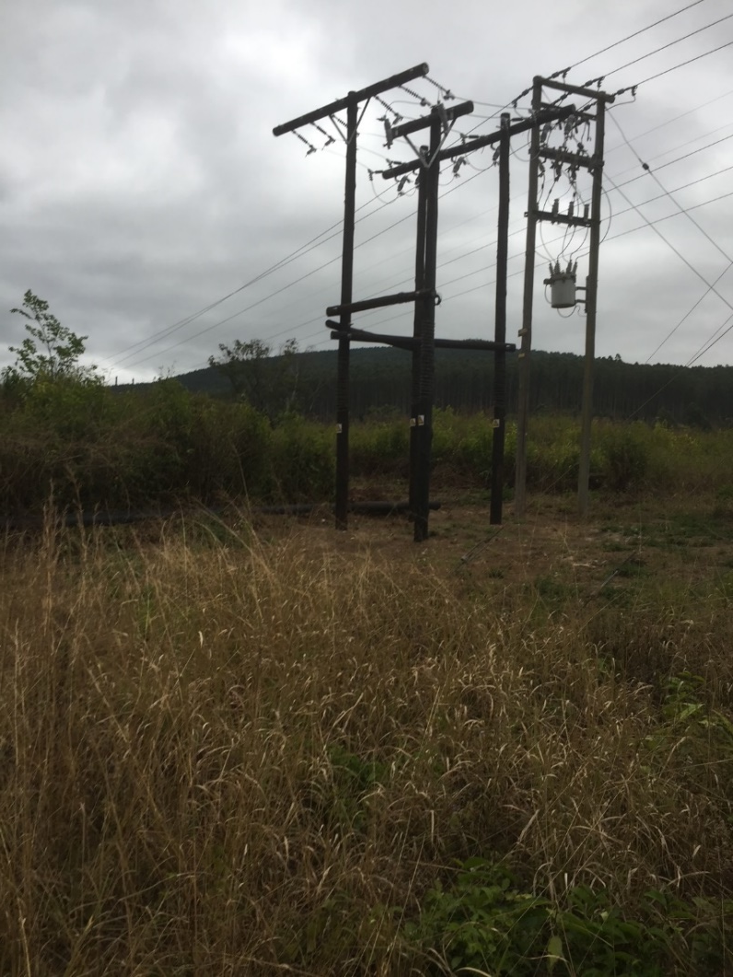
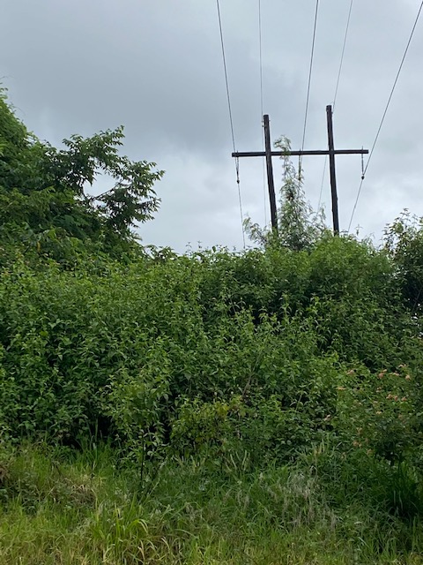
GREATER TZANEEN MUNICIPALITY DBSA FUNDED CAPITAL PROJECTS Photo wall
Rotten poles
Auto Recloser Installation
Vegetation

Slide 22
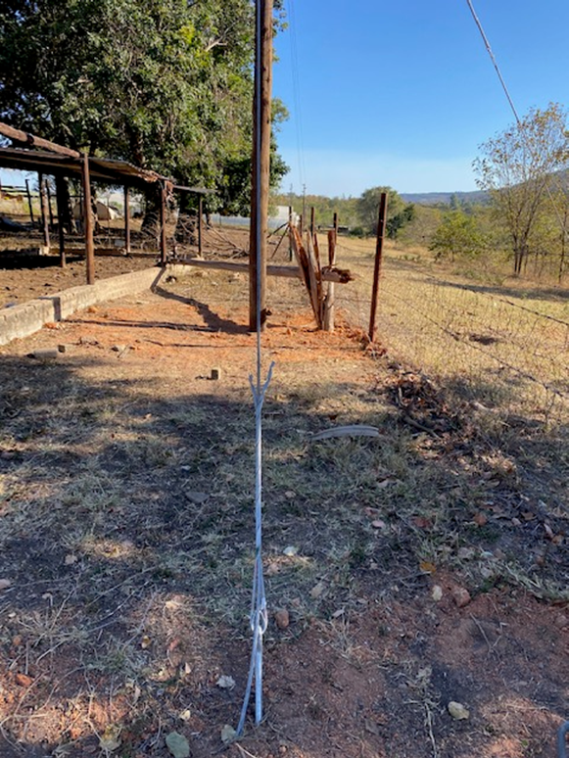
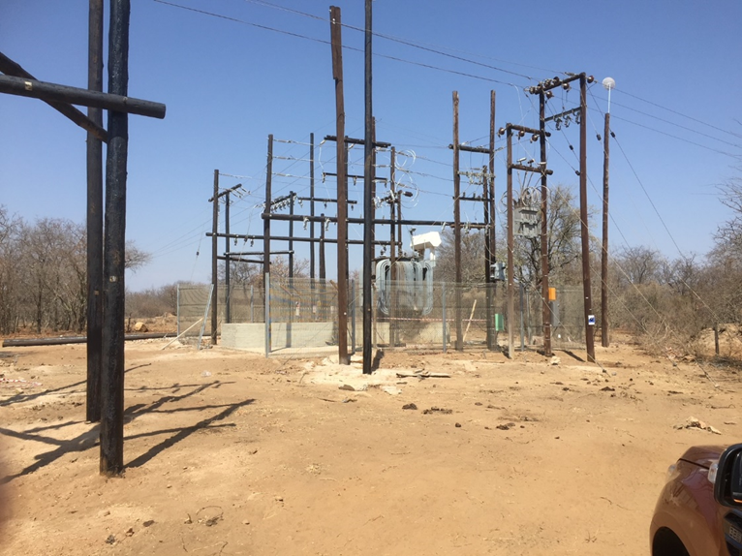
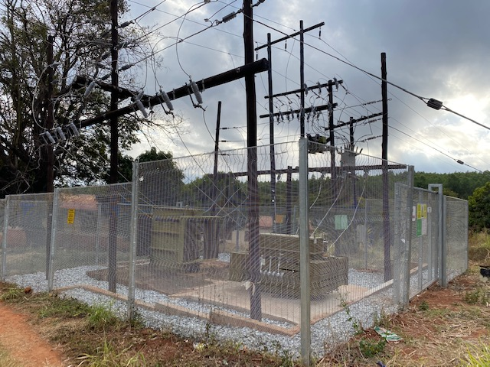
GREATER TZANEEN MUNICIPALITY DBSA FUNDED CAPITAL PROJECTS Photo wall
Rotten poles
Line rebuild in progress
Waterbok Sub Upgrade before final completion
Blacknoll Sub Upgrade completed
Vegetation

Slide 23
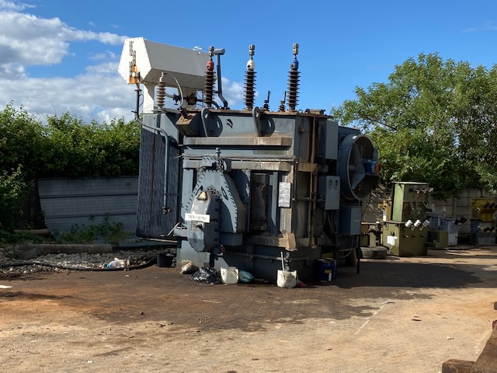
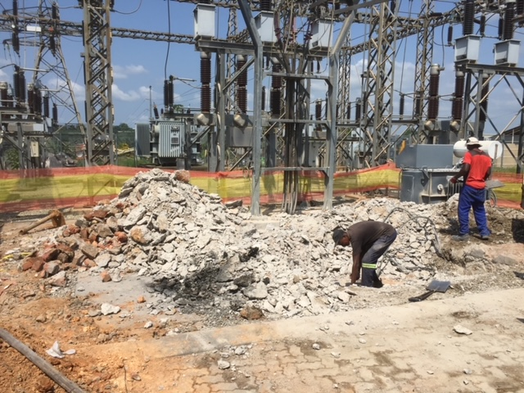
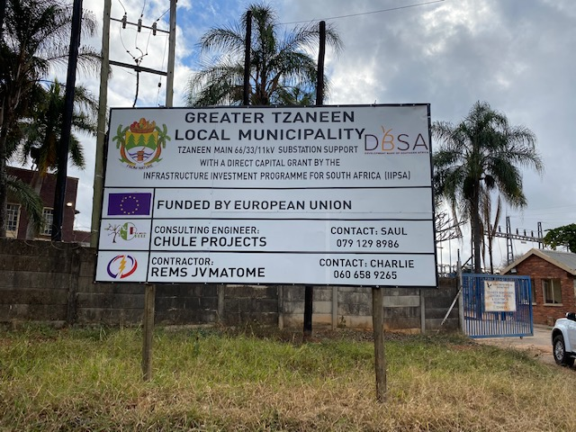
GREATER TZANEEN MUNICIPALITY DBSA FUNDED CAPITAL PROJECTS Photo wall
Tzn Main old Tfr
Tzn Main Earth works
Tzn Main Project sign board

Slide 24
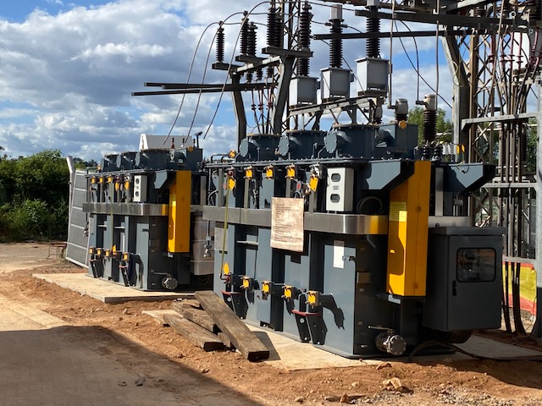
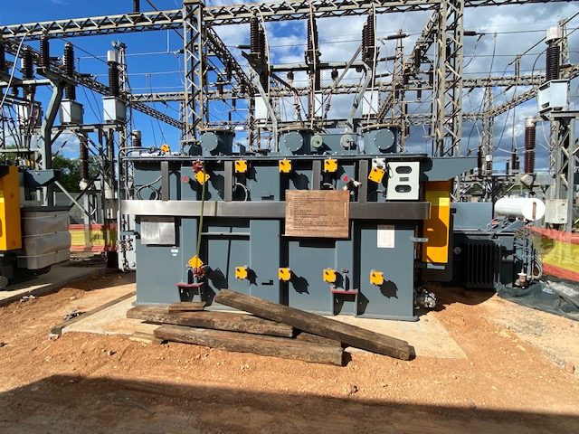
GREATER TZANEEN MUNICIPALITY DBSA FUNDED CAPITAL PROJECTS Photo wall
Tzn Main 2x New TFR’s on the plinth

Slide 25
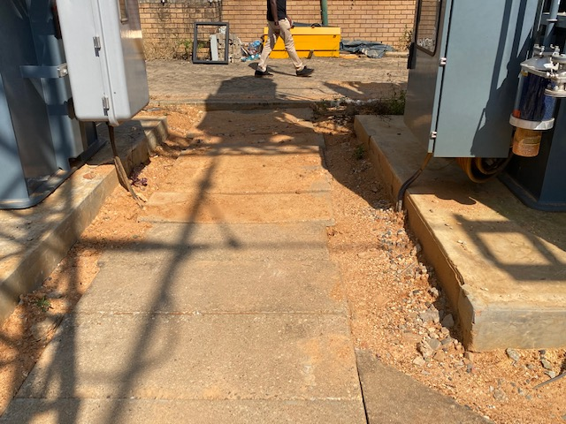
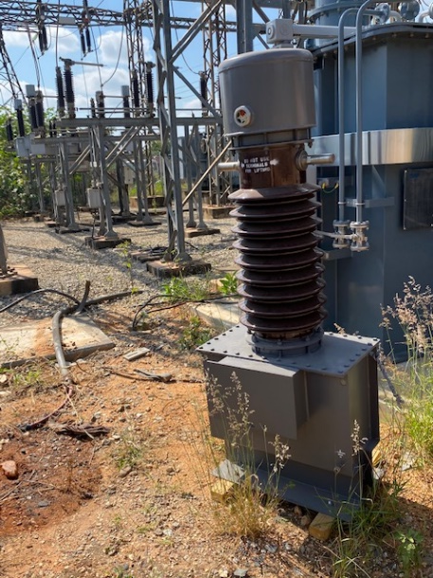
GREATER TZANEEN MUNICIPALITY DBSA FUNDED CAPITAL PROJECTS
More of the long lead items will arrive in May 2021
New long lead material for Tzn Main start arriving
Most of the earth works at Tzn Main are done

Slide 26
2. REVENUE ENHANCEMENT PROGRAM
Purpose: Supporting Greater Tzaneen Municipality, focussing on revenue generating and lost pertaining to electricity.
The Program Entailed
Review existing situational assessment.
Auditing of customer billing data.
Electricity Tariff Review and Structuring.
Engineering Contribution policy.
Cost of Supply and Single Line Diagrams
Electricity/ Water Meter Audits

Slide 27
REVENUE ENHANCEMENT PROGRAM
Detailed “road map” and revenue enhancement program
Revenue Enhancement Road Map has been developed.
The Road Map includes a number of strategies and projects that have been identified.
The Municipality is currently in the process of implementing some of projects: Replacement of old meters, Setting Automated Meter reading system for LPU, Power Factor Correction Analysis.

Slide 28
3. HAMSA ELECTRICITY METER AUDITS
Purpose: Determine the causes of electricity and revenue losses and come up with a loss minimization and revenue recovery plan.
Determine the sources of the losses.
Audits of electrical infrastructure, commercial process, billing system, tariff structure.
Revenue recovery plan.
Asset register
Process flow to determine data integrity.

Slide 29
3. HAMSA ELECTRICITY METER AUDITS
Issues Identified and Progress to date.
Issues Identified | Comments
Installation Tempered. | Addressed during replacement, but progress not satisfactory.
Inaccurate reading Meters | Verification data before running of billing system
Meters Not on Database. | Data cleansing required
Incorrect Tariff | Data cleansing required
Defective Meters | LPU: 96 Meters Replaced AMR: 86 Meters reading remotely
Meter Inaccuracy | Addressed during replacement, but progress not satisfactory

Slide 30
4. VEGETATION CONTROL
Purpose: Clearing of vegetation encroaching of overhead lines, to reduce number of power interruptions and improve availability of supply.
Overhead lines | Km of line cleared
Ebenezer 33kV | 19.7km
Politsi 11kV | 5.8km
Letsitele Valley 11kV | 12.2km
Granshoek 11kV | 10.1km
Tzaneen 66kV | 14.9km
Haenerstburg | 6.8km
Waterbok 11kV | 17.2km

Slide 31
4. VEGETATION CONTROL
Purpose: Clearing of vegetation encroaching of overhead lines, to reduce number of power interruptions and improve availability of supply.
Overhead lines | Km of line cleared
Deerpark 11kV | 6.23km
Henley 11kV | 3.9km
Ledzee 11kV | 4.3km
Lacote 11kV | 4.6km
Laborie 11kV | 1,82km
As Guard 11kV | 3.5km
The Plein11kV | 1.2km
Total km Cleared | 185,2km

Slide 32
7. VEHICLES
Purpose: The vehicles used by the Electricians were in a very bad state incurring more down time than operational.
9 x Vehicles were bought in stages with Council own funds to replace the old ones the Electricians were using. This potentially increased the operating capacity of the Electrical Department.

Slide 33
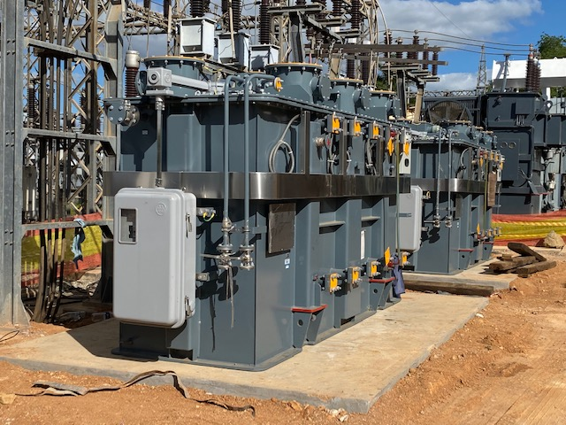
GREATER TZANEEN MUNICIPALITY ELECTRICAL INFRASTRUCTURE
THE
END
THANK YOU

