Slide 1
CWP Presentation to Portfolio Committee
June 2021
Mr P Matomela / Mr S Nyoka / Ms F Makhubu

Slide 2
OVERVIEW OF THE PROGRAMME

Slide 3
Overview of community work program
CWP is the outcome of the Second Economy Strategy process that was commissioned by the Presidency in 2008. Purpose was to review why government strategies targeting poor and economically marginalised groups were not delivering the impacts intended.
CWP is part of the Public Employment Programmes (PEPs) designed to mitigate the triple challenge of poverty, unemployment and inequality.
CWP is based on the recognition that the impact of policies intended to address unemployment and create sustainable jobs will take time to reach people living in marginalised and impoverished areas.
CWP is targeted at unemployed and underemployed women and men of working age and aims to give those willing and able to work the opportunity to do so:
Participants can work 2 days per week up to a maximum of 8 days per month
Daily stipend (R97.60) is determined in terms of the Expanded Public Works Programme
Supervisors and store managers work 5 days per week – stipend is R127.00 per day
Training is an important component of the CWP. The aim of training at site level is assist participants with respect to skills development to allow them to exit the programme into more sustainable employment.

Slide 4
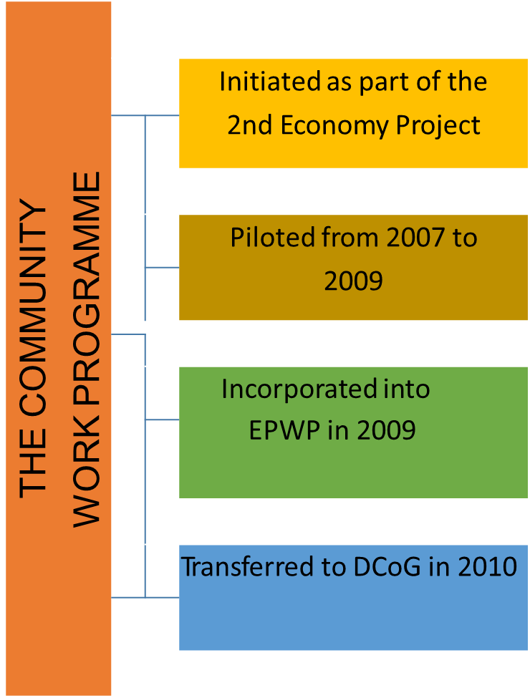
The Evolution of CWP

Slide 5
Overview of community work program
The Useful Work to be undertaken is decided through participatory community processes (Public Participation)
The CWP is based on the recognition that policies to address unemployment and create sustainable jobs will take time to reach people living in marginalised areas.
There is no shortage of work to be undertaken in poor communities.
Communities know best what Useful Work is needed to improve the quality of their lives.
Through this process, community agency to contribute to development is unlocked.
This approach leads to a multi-sectoral mix of Useful Work at each site.
The site activities must be ‘Useful work’: creating community assets and services that improve the quality of life in the community.

Slide 6
Overview of community work program
CWP is a Ward-based programme
Being Ward based allows CWP to target the poorest areas.
It also means that the CWP becomes institutionalised at a local level.
Making an ongoing local contribution – and building local networks, partnerships, capacities.
Assets and services are ‘sustainable’ in the sense that they can be maintained on an ongoing basis by participants from the same community.

Slide 7
BUDGET AND INVOICES

Slide 8
BUDGET CONTRACT PERIOD : 2014 – 2018 & 2019 – 2021
Three-year cycle plus current interim Six month Budget
CWP NPO Budgets for 3 Consecutive years
NPO Name | 2018/19 | 2019/20 | 2020/21 | 2021
Thembalethu Development | 140,109,194.00 | 156,890,819.00 | 167,867,442.12 | 105,784,823.20
Insika Foundation | 126,205,933.00 | 144,705,519.00 | 107,415,500.59 | 68,186,704.60
Joubert Park | 74,945,346.00 | 103,378,673.00 | 77,088,760.21 | 48,158,383.53
Seboka Training and Support Network | 74,437,816.00 | 83,189,408.00 | 60,338,882.93 | 38,304,931.35
South African Youth Movement | 59,980,884.00 | 106,118,178.00 | 78,590,473.34 | 49,892,414.60
3L Development | 67,363,147.00 | 74,209,696.00 | 53,825,724.49 | 34,167,434.70
Beulah Africa | 64,287,204.00 | 70,821,126.00 | 51,367,928.85 | 32,609,012.10
NPO Iketsetse up to Q1 2020 | 63,979,610.00 | 66,077,127.00 | - | -
AIDS Foundation | 27,375,891.00 | 30,158,278.00 | 21,874,381.18 | 13,884,371.90
Icembe Foundation up to Q1 2019 | 24,761,339.00 | 2,234,756.00 | - | -
Out the Box up to Q1 2019 | 13,226,554.00 | 1,209,559.00 | - | -
Total | 736,672,918.00 | 838,993,139.00 | 618,369,093.70 | 390,988,076

Slide 9
Participation Rates : Contract Period 2014 – 2018
NPO Name | 2014/15 | 2015/16 | 2016/17 | 2017/18
Thembalethu Development | 71 228 | 20 983 | 21001 | 20 965
3L Development | 3 430 | 5 166 | 6833 | 8 781
Dhladhla Foundation | 16 833 | 85 272 | 93317 | 75 524
Humana | 5 403 | 0 | 0 | 0
JPYouth | 1 230 | 0 | 0 | 0
Lima | 4 619 | 5 402 | 5468 | 5 752
Seboka Training | 6 602 | 8 783 | 9199 | 9 700
Seriti Institute | 40 882 | 43 473 | 48000 | 51 917
Siyakholwa | 4 786 | 4 996 | 6519 | 8 545
Border Rural Committee | 0 | 7 463 | 7896 | 7971
Insika Foundation | 0 | 16 534 | 17111 | 16076
Total | 155013 | 19 8072 | 21 5344 | 20 5231

Slide 10
Participation Rates: Contract Period 2019 – 2021
Participation rates
NPO Name | 2018/19 | 2019/20 | 2020/21
Thembalethu Development | 48,538 | 46,300 | 46,150
Insika Foundation | 43,511 | 43,650 | 43,572
Joubert Park | 27,050 | 30,865 | 32,150
Seboka Training and Support Network | 24,450 | 24,550 | 24,550
South African Youth Movement | 23,200 | 32,500 | 33,056
3L Development | 21,900 | 21,900 | 21,900
Beulah Africa | 20,900 | 20,900 | 20,900
NPO Iketsetse | 19,500 | 19,500 | 20,840
AIDS Foundation | 8,904 | 8,900 | 8,900
Icembe Foundation | 9,200 | - | -
Out the Box | 4,750 | - | -
Total | 251,903 | 249,065 | 252,018

Slide 11
Current suspense account status per npo
REVISED SUSP ACCOUNT BALANCE (Original 3-year contract)
NPO | Actual Suspense as at 31 March 2021 | Add Disallowed (Duplicate Invoices) | Corrected Suspense
Thembalethu Development | (1 328 279.64) | 2 326 781.10 | 998 501.46
Insika Foundation | 11 879 663.31 | 3 278 345.47 | 15 158 008.78
Joubert Park Outreach Project | (2 140 187.59) | 2 197 006.61 | 56 819.02
Seboka Training and Network | 6 713 352.19 | 2 958 006.56 | 9 671 358.75
3L Development | (60 927.81) | 4 315 236.61 | 4 254 308.80
South African Youth Movement | 29 352 613.41 | - | 29 352 613.41
Beaulah Africa | 2 635 007.36 | 222 750.00 | 2 857 757.36
NPO Iketsetse up to Q1 2020 | 8 795 751.46 | 422 000.00 | 9 217 751.46
AIDS Foundation | 2 835 904.97 | - | 2 835 904.97
Icembe Foundation up to Q1 2019 | 2 722 730.59 | - | 2 722 730.59
Out the Box up to Q1 2019 | 1 901 611.10 | - | 1 901 611.10
TOTAL | 63 307 239.35 | 15 720 126.35 | 79 027 365.70

Slide 12
Current suspense account status per npo
REVISED SUSP ACCOUNT BALANCE (Original 3-year contract)
NPO | Corrected Suspense | Transactions since 1 April 2021 | Current suspense For period ending 31 March 2021
Thembalethu Development | 998 501.46 | (6 572 600.40) | (5 574 098.94)
Insika Foundation | 15 158 008.78 | 9 208 542.69 | 24 366 551.47
Joubert Park Outreach Project | 56 819.02 | (2 266 336.00) | (2 209 516.98)
Seboka Training and Network | 9 671 358.75 | 1 141 315.82 | 10 812 674.57
3L Development | 4 254 308.80 | - | 4 254 308.80
South African Youth Movement | 29 352 613.41 | (2 581 348.80) | 26 771 264.61
Beaulah Africa | 2 857 757.36 | - | 2 857 757.36
NPO Iketsetse | 9 217 751.46 | - | 9 217 751.46
AIDS Foundation | 2 835 904.97 | - | 2 835 904.97
Icembe Foundation | 2 722 730.59 | - | 2 722 730.59
Out the Box | 1 901 611.10 | - | 1 901 611.10
TOTAL | 79 027 365.70 | (1 070 426.69) | 77 956 939.01

Slide 13
FORENSIC INVESTIGATIONS
AND
AGSA FINDINGS

Slide 14
FORENSIC INVESTIGATIONS COMMISSION BY THE DEPARTMENT
The following are the forensic investigations commissioned by the Department into the Community Work Programme as well as the associated expenditure:
No. | Investigation name | Financial Year | Expenditure (R)
1. | Investigation into the appointment and awarding of Tenders to the Implementing Agents for the Community Work Programme (CWP) and procurement processes of goods/services procured by the Implementing Agents (Sekela-Xabiso) | 2015/16 | 821, 057.68
2. | Forensic Investigation into the Community Work Programme (CWP) (Delloitte) | 2016/17 & 2017/18 | 7, 486, 494.69
3. | Community Work Programme Forensic Investigation (MNS Attorneys) | 2019/20 | 8, 585, 976.20
 | Total |  | 16, 893, 528.57

Slide 15
Forensic investigation 1
Investigation into the appointment and awarding of Tenders to the Implementing Agents for the Community Work Programme (CWP) and procurement processes of goods/services procured by the Implementing Agents.
Investigation mandate
To investigate the procurement processes followed to select and award tenders to the Implementing Agents for the CWP and the possible irregular expenditure incurred by the appointed Implementing Agents when procuring good and services on behalf of the Department.
Outcome: The procurement process undertaken by the department was found to be in contravention of set procurement processes i.e. non-compliance with Bid Specifications, inconsistent application of pre-qualification criteria and bid committee resolutions.

Slide 16
Forensic investigation 2
Forensic Investigation into the Community Work Programme (CWP)
Investigation mandate
Perform a detailed analysis on the Project Management Fees (PM Fees) per IA with a view to identifying inconsistencies and trends by the IAs when invoicing the Department for PM Fees;
Review and analysis of payment batches and identification of irregular expenditure;
Detailed review of the CWP-MIS application–this requirement, which was added to the scope via deviation, was performed by a team of Information Technology (IT) auditors, payment specialists and data analysts;
Verify the completeness of the CWP Asset Register by performing a detailed analysis of all the payment batches for all IAs for the period 1 April 2014 to 31 March 2016

Slide 17
Forensic investigation 2…………cont.
The following is a summary of the findings raised as they relate to the mandate, recommendations as well as the current status of implementation of those recommendations.
Finding | Recommendation | Status of implementation of the Recommendation
Asset Management – no clear definition as to what constitute an asset | The Department should consider: Developing an asset policy, which should include the definition and recognition criteria. Conducting physical verification of assets with the purpose of properly documenting each asset with barcoding and identification of location as well as safeguarding and valuation. | Asset Management Policy has since been developed. The definition and recognition criteria agreed which delineates between Assets, Inventory and Accessories. Physical verification of Assets has previously been undertaken except for the 2020 financial due delay in the appointment of a service provider due to Covid 19. A service provider has recently been appointed to undertake the physical verification for this financial year.

Slide 18
Forensic investigation 2…………cont.
Finding | Recommendation | Status of implementation of the Recommendation
Processing of payments | The CWP should exercise stricter control on the verification and validation of the PM Fee claims to ensure that the IAs comply with the SLA requirement | The SLA checklist has been developed as a compliance tool. Further verification and validation process with NPOs has since been undertaken
CWP-MIS | Management should investigate internal and external (i.e. through the use of additional software) options for the automation of the balancing and reconciliation functions for the salary payments managed by CWP-MIS. The MIS system should also interface with the Home Affairs system for further verification of participants. | SITA in partnership with CWP is currently working on a project to enhance CWP MIS with effective controls and systems. Intent on ensuring interfaces with other relevant government departments including Home Affairs, DPSA, National Treasury, SASSA, SARS. There is a interim arrangement that enables verification of the CWP MIS Data against the DPSA and SASSA. The Home Affairs verification is currently undertaken through the EPWP Reporting System

Slide 19
Forensic investigation 3
Community Work Programme Forensic Investigation
Investigation mandate
Arising from the Auditor-General’s material irregularities raised in the 2018/19 audit report, the Department commissioned a legal forensic investigation on all issues directly and/ or indirectly linked to the material irregularities in respect of the CWP. The material irregularities issued by the Auditor-General covered the following areas:
Payment to deceased participants;
Payment to Persal participants;
Project Management Fees not supported, prior contract period (2014-2018);
Project Management Fees not supported, current year (2018/19).

Slide 20
Forensic investigation 3………cont.
The following is a summary of the findings raised as they relate to the mandate, recommendations as well as the current status of implementation of those recommendations.
Finding | Recommendation | Status of implementation of the Recommendation
Various findings: Overpayment on Project Management Fees; Undue Vat benefit; and Pre-payments unsupported by evidence | A total of R39 714 864.20 paid to the sighted NPOs for amongst others, overpayments on project management fees, undue VAT benefit and prepayments unsupported by evidence will be recovered. | Work is currently underway to engage NPOs with the intention to ensure compliance. NPOs have been submitting outstanding invoices to enable the reconciliation and subsequent reduction of the suspense account.
Consequence management against officials | The Accounting Officer should take disciplinary action against the sighted officials for failing to ensure that there is a system of financial management and control; prevention of fruitless and wasteful expenditure; failure to withhold retention fees. | Six officials have been suspended based on the forensic investigation reports. Disciplinary action in progress.

Slide 21
Forensic investigation 3………cont.
Finding | Recommendation | Status of implementation of the Recommendation
Payment to Deceased Participants | Institute recovery processes | Management has established interim arrangements to facilitate verification of Participants through the EPWP Reporting system Deceased and recouped from PM Fees due. Contact with DHA made and SITA assisting with the Finalisation of the Interface in MIS and later into the IMS.
Payment to Persal Participants | Institute recovery processes | Arrangements have been made with the DPSA for a monthly verification and validation process for proactive identification of participants with PERSAL numbers. Recovery processes underway.

Slide 22
Forensic investigation 3………cont.
Finding | Recommendation | Status of implementation of the Recommendation
Non-compliance with the VAT Act | DCoG must report this irregularity to SARS for non-compliance with the Vat Act | Work in progress. There is a discussion currently underway with SARS to facilitate the compliance and verification processes.
Criminal activities | Engagement with SAPS | Work in progress (See slide 23 below).

Slide 23
ALLEGATIONS OF FRAUD AND CORRUPTION
Following allegations of corruption and related offences reported to the Department on CWP matters, an investigation was instituted. SIU members who were seconded to the Department were assigned to the investigate the allegations.
Following the investigations, fourteen (14) criminal cases of fraud were opened and handed over to the Commercial Crimes Unit for further processing. The focus of the investigation was mainly on 4 of the 12 municipalities in the Northern Cape province.
The Department to consider engaging the Special Investigating Unit (SIU) with a view get a Presidential proclamation to focus specifically on CWP allegations of fraud and corruption throughout the country.

Slide 24
Forensic investigation 3………cont.
CATEGORY | AMOUT IDENTIFIED | AMOUNT CLEARED / RECOUPED / UNDER INVESTIGATION
AGSA PERSAL PARTICIPANTS | R4 711 695.50 | CLEARED * - R2 200 910.50 RECOUPED** - R2 510 785.00
AGSA DECEASED PARTICIPANTS | R581 015.00 | CLEARED - R479 669.00 RECOUPED - R101 346.00
Total | R5 292 710.50 | R5 292 710.50

Slide 25
Forensic investigation 3………cont.
CATEGORY | AMOUT IDENTIFIED | AMOUNT CLEARED / RECOUPED / UNDER INVESTIGATION
PERSAL PARTICIPANTS | R7 198 927.00 | Cleared R1, 276, 017.00 Recouped R5, 925,910.00
DECEASED PARTICIPANTS | R448 223.00 | Cleared R420, 885.00 Recouped R2,738.00
TOTAL | R7 647 150.00 | R7, 647, 150.00

Slide 26
PARTNERSHIPS

Slide 27
PARTNERSHIPS TO sUPPORT CWP
PARTNER | VALUE ADD
Department of Basic Education | Support includes related COVID19 protective clothing in identified targeted schools, purchase of electronic thermometer per school; Training to CWP Workers; Gloves; Masks; Timetable sheets; and Costs related to COVID19. The cost of the Personal Protective Equipment (PPE) required by the CWP Workers will be paid by the applicable PED(s).
Department of Environment, Forestry and Fisheries | Support includes training of youth on environmental skills i.e greening, cleaning, recycling (waste management) etc. to promote sustainable livelihoods; Youth empowerment on coastal economy and clean-up projects; provide support in the maintenance of identified existing infrastructure such as community parks. Youth with Matric are already being profiled in the CWP as a preparation for training.
DG Murray Trust | Provided training for Early Childhood Development and Playgroups in CWP sites in EC, NW, FS.

Slide 28
PARTNERSHIPS TO sUPPORT CWP
PARTNER | VALUE ADD
Majuba College | 60 CWP participants ranging from grade 10, 11 and 12 were trained on the following areas: Early Childhood Development, agriculture, cooking, plumbing. The Graduation Ceremony was attended by DCOG Minister Tsenoli. Participants are able to provide catering services at funerals and events in the community. Others are able to get additional income by providing plumbing services in the township.
Smartstart | Provide ECD training to CWP participants in NW and FS
Afrika Tikkun | Youth acceleration programme to support youth to be economically active; Job creation for youth; Bursaries; Mobilise partners on exit opportunities and placement; Support youth to start their own businesses, cooperatives, Computer programming and Robotics training; awareness on GBV.

Slide 29
PARTNERSHIPS TO sUPPORT CWP
PARTNER | VALUE ADD
Majuba College | 60 CWP participants ranging from grade 10, 11 and 12 were trained on the following areas: Early Childhood Development, agriculture, cooking, plumbing. The Graduation Ceremony was attended by DCOG Minister Tsenoli. Participants are able to provide catering services at funerals and events in the community. Others are able to get additional income by providing plumbing services in the township.
Sasol | The partnership was to train 60 youth 60 Youth were recruited into CWP. They were trained to be plumbers. 12 schools in EMbalenhle were selected for fixing leaking taps and broken toilets. Sasol donated R1.5 million to buy the infrastructure for the schools. The CWP youth were trained and they fixed the broken infrastructure at the schools. This resulted in 60% reduction in water losses. 10 of those youth were absorbed by Sasol.
Department of Small Business Development | Provided training to 50 CWP participants in Tshwane (Erasmus site and in Harrismith-white house). Supported CWP to register cooperatives for sowing, cooking, brick making, beadmaking, baking etc.

Slide 30
PARTNERSHIPS TO sUPPORT CWP
PARTNER | VALUE ADD
ITALY (REGGIO EMILIA MUNICIPALITY) | Provided training and funded a Study Tour visit to Italy on cooperatives for DCOG representatives The partnership demonstrated that cooperatives can be sustainable; Through cooperatives, the Reggio Emilia municipality was transformed from being the poorest to one of the richest municipalities.
PARTNERSHIP WITH THE CENTRE FOR THE STUDY OF VIOLENCE AND RECONCILIATION | Training on Gender based Violence was provided by the CSVR to CWP participants in Khayelitsha, Ivory Park, Tembisa and Ivory Park. The findings from the implementation of the partnership were presented in Kenya Nairobi. They show that CWP awareness raising initiatives, as well as men being involved in CWP instead of drinking the whole day, has contributed to reduce the GBV to women and children. The partnership unit was sponsored to be part of the Conference.

Slide 31
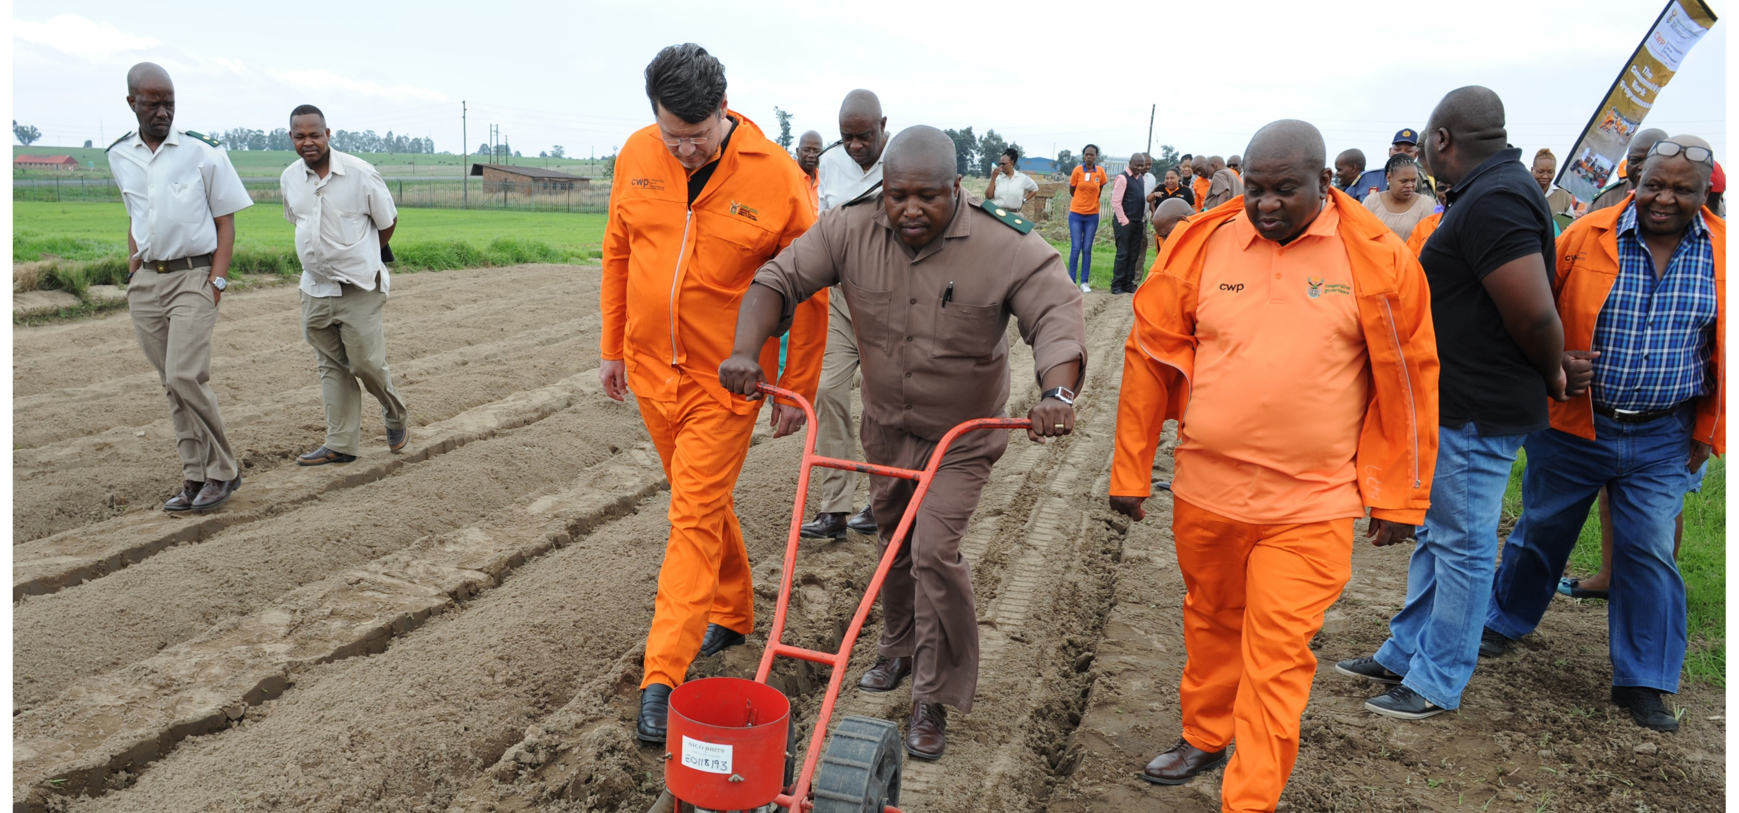
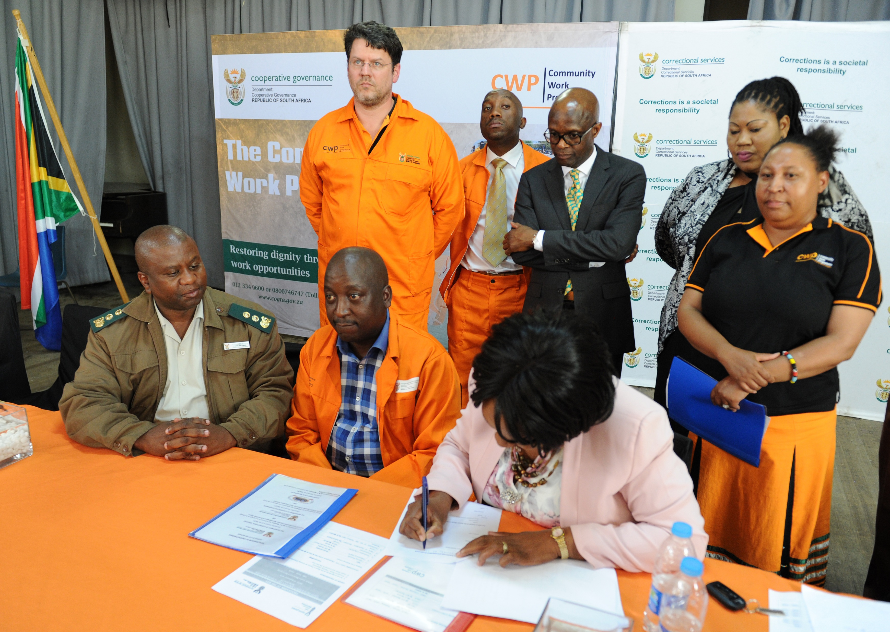
1. PARTNERSHIP WITH DEPARTMENT OF CORRECTIONAL SERVICES
The partnership with the Department of Correctional Services (Barberton and Bethal) was established to support CWP. 2.5 hectars of land is made available for CWP on both sites to cultivate and feed the vulnerable of uMjindi Local Municipalities and at Govan Mbeki Municipality. 28 Parolees have been integrated into the CWP as part of the partnership. A service level agreement has been signed between DCoG and DCS.
The partnership assists the parolees not to re-offend because they receive a stipend from CWP.
CWP participants received agricultural training from DCS

Slide 32
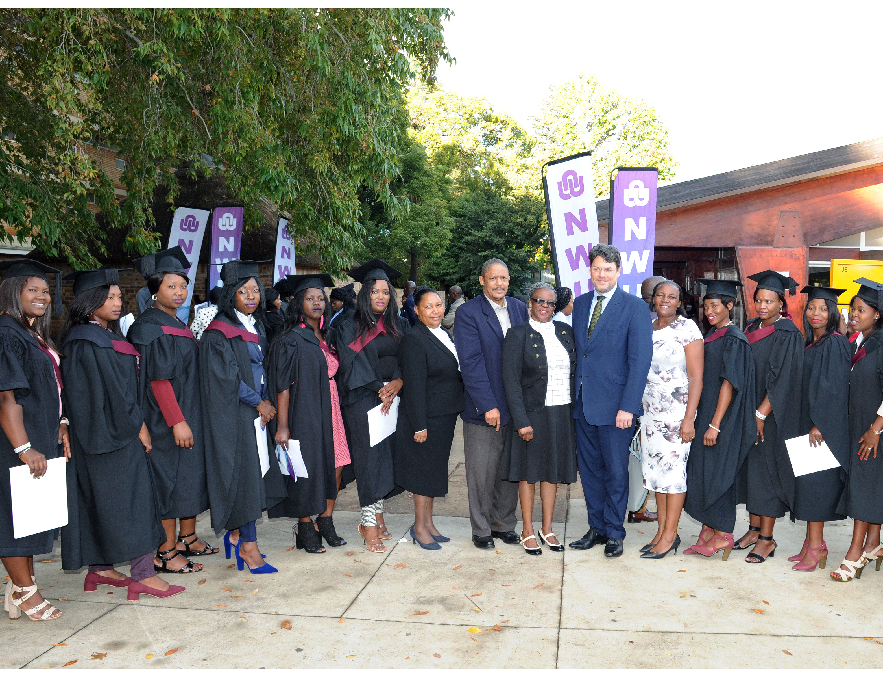
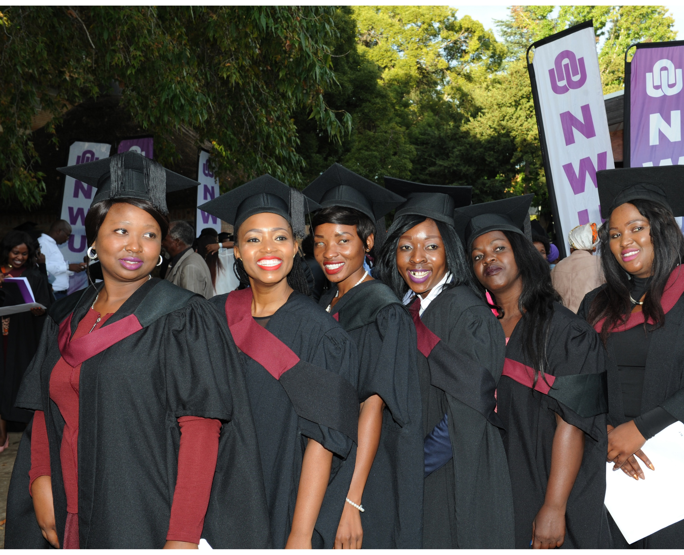
2. Cwp Partnership with north-west university
CWP participants who were cleaning and mopping classrooms in KZN, FS and NW were identified (criteria was matric).
53 participants graduated and 40 graduates have exited CWP and are working as teachers at public schools in the 3 provinces (A visit for the leadership can be organized to meet the participants at the schools to congratulate them).

Slide 33
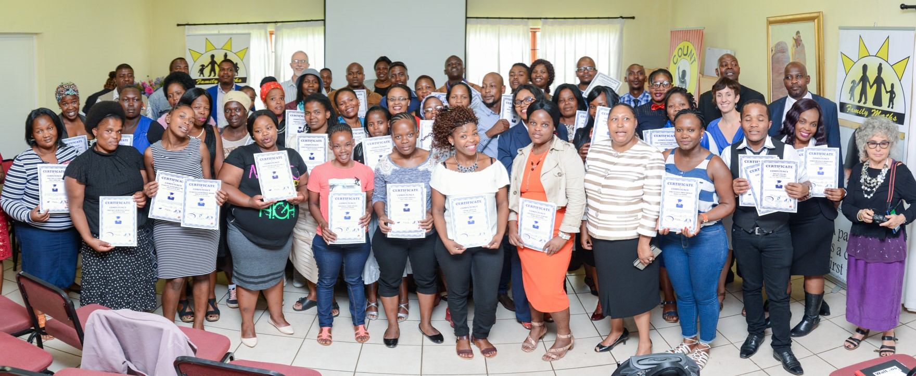
3. CWP PARTNERSHIP WITH COUNT
The partnership with COUNT provided training to 60 CWP participants with matric. The training was done through a collaboration with UNISA and it was on Maths literacy.
The CWP participants graduated and are placed at schools in Ixobo, KZN as assistant teachers. CWP officials attended the graduation.

Slide 34
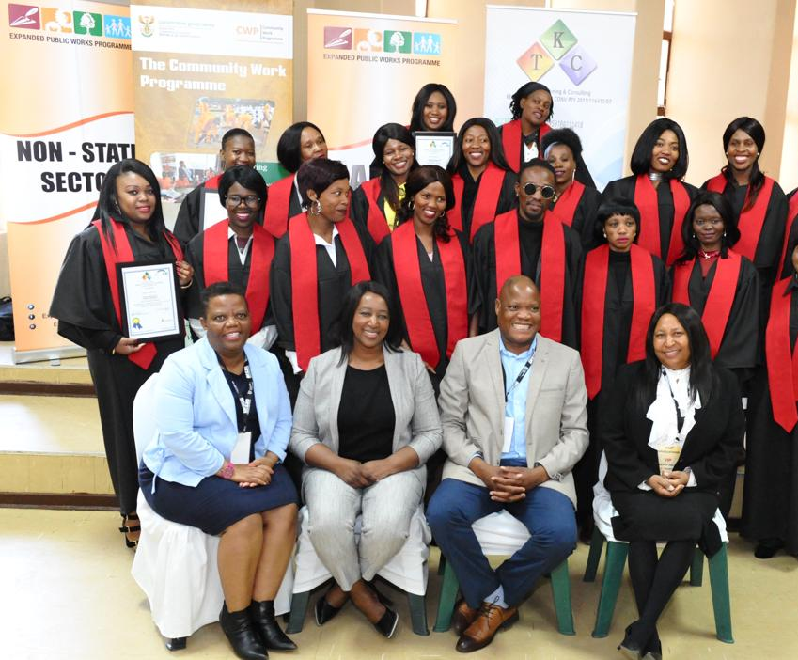
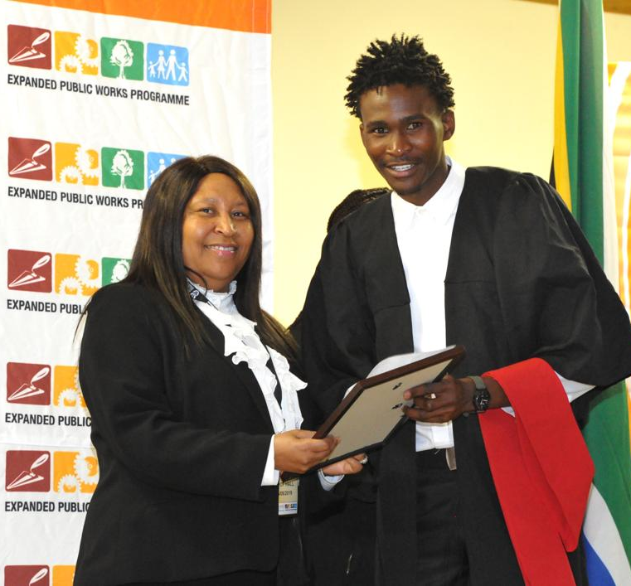
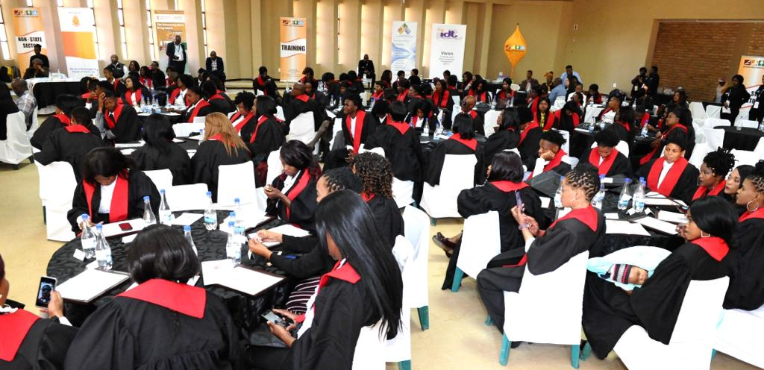
4.PARTNERSHIP WITH HWSETA
49 CWP participants graduated on Home Based Care (HBC) accredited training through a partnership with HWSETA.
The participants are able to register their own NPOs and to start their own HBC facilities.

Slide 35
5. CWP PARTNERSHIP WITH LGSETA
The partnership with LGSETA and EPWP provided training to 55 CWP participants in Mahikeng (NW).
The accredited training was on Environmental Practice NQF Level 2. This qualification will help them to start their own businesses to turn Waste into Wealth.

Slide 36
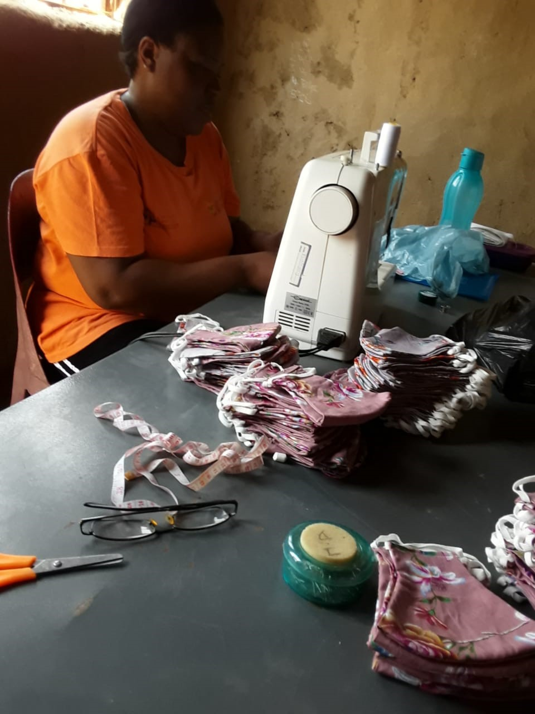
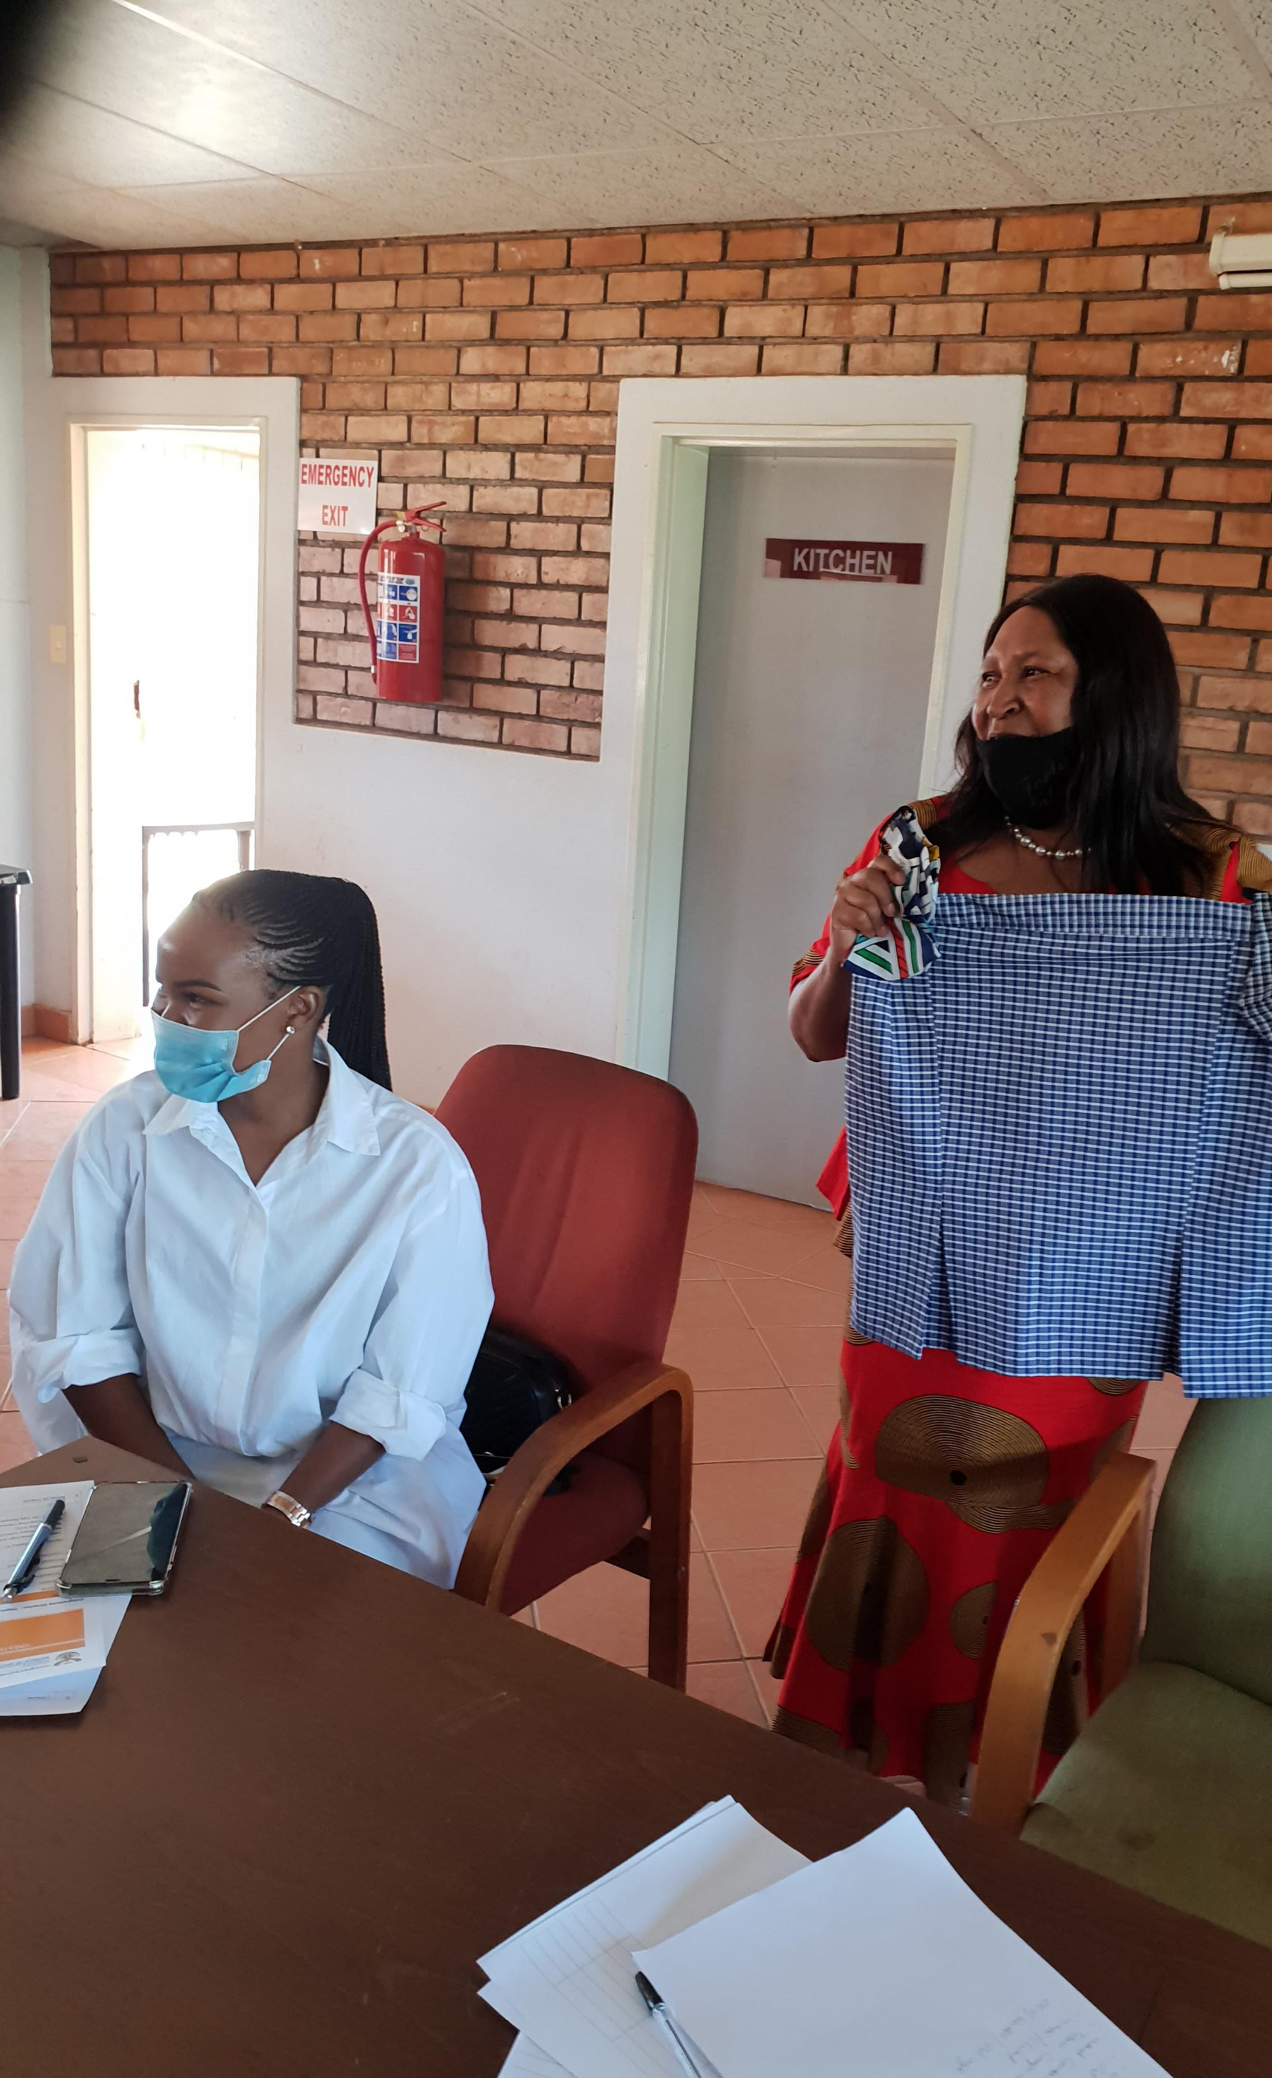
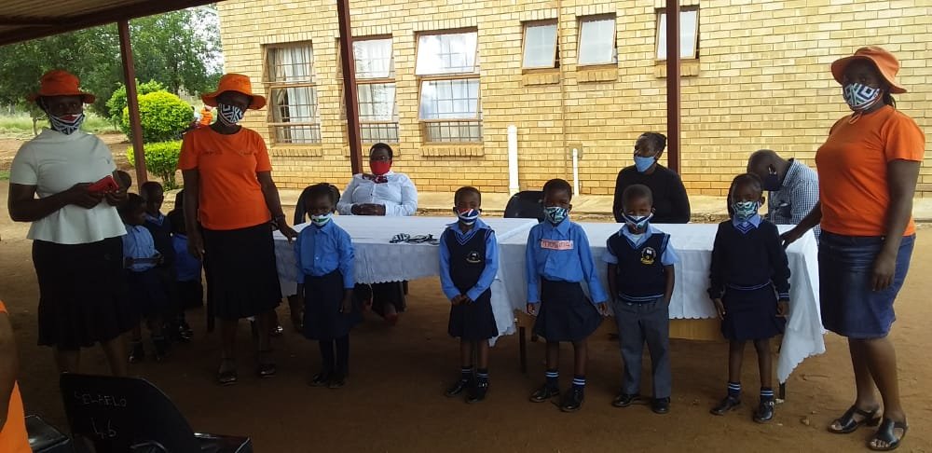
6. CWP PARTNERSHIP TO provide COVID19 support
The partnership was established with Dzunisani Consultant to provide COVID19 support to vulnerable households, schools, old age homes and CWP participants who could not afford to buy masks.
Training and technical support has been provided by the partner to CWP participants on how to manufacture cloth masks in 17 identified CWP sewing centers in Limpopo.
173 CWP participants were trained. The donation consisted of one 50 meters roll per group to the value of R32 950 for all 17 groups.
A total of 32 300 masks were sown. Uniform was also sewed and donated to Primary and High School. 50% of the masks were donated and 50% were sold by CWP cooperatives to stimulate the local economy.

Slide 37
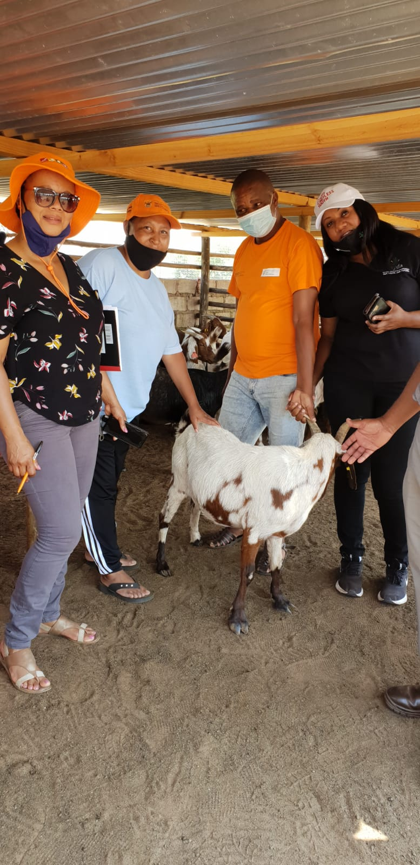
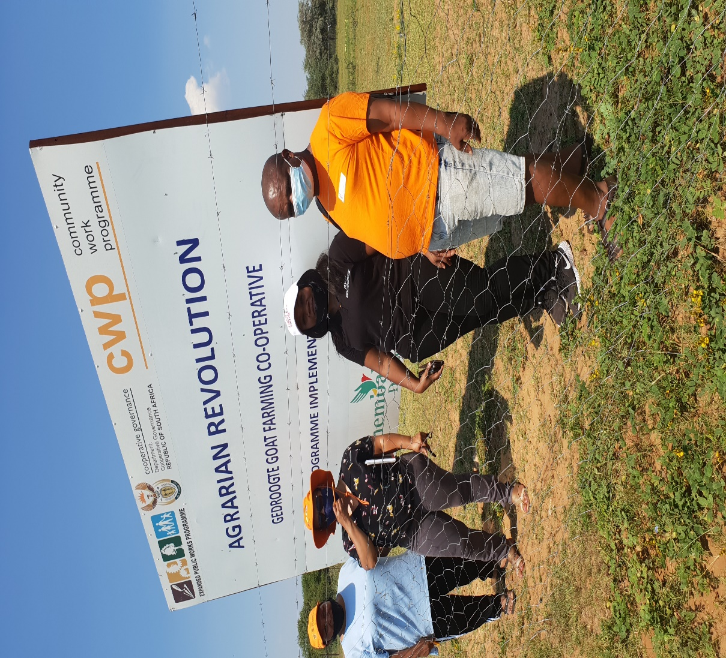
CWP Partnerships to support enterprise development
10 . Partnerships with Enterprise Development unit in
DPW
Provide Enterprise development support.
They have assisted CWP Agrarian
Revolution projects to establish
cooperatives and trained them.
They mobilized R30 000 during
COVID19 to buy vaccines and feed for
the goats not to die during lockdown.
11. Partnership with National Youth Development
Agency
They have committed R100 000 at Lepelle Nkumpi site to support a CWP youth cooperative for Agrarian Revolution project so that more goats can be purchased to stimulate the economic recovery during COVID19 pandemic.

