Slide 1



PRESENTATION TO THE PORTFOLIO COMMITTEE ON HEALTH
NHI Bill
29 JUNE 2021
NATIONAL OFFICE
61 Katherine Street,
Sandton, 2196
P.O. Box 652807, Benmore, 2010

Slide 2


Cas Coovadia
01

Slide 3


INTRODUCTION TO BUSA
BUSA is a confederation of business organisations, including chambers of commerce and industry, professional associations, corporate associations, and unisectoral organisations. It represents a cross-section of business, large and small, including health care providers, health care funders, medical manufacturers and employer groupings.
BUSA represents in excess of 350 000 employers.
In its deliberations on NHI, BUSA has sought the views of both its health sector members and its wider constituency, comprising industry bodies and employers with responsibility for workers across the whole economy.
BUSA would like to thank the Portfolio Committee on Health for the opportunity to make oral representation following its written submission dated 29 November 2019.
02

Slide 4
CONTENTS
Introductory remarks – Mr Cas Coovadia (CEO BUSA)
Research summary - Mr Stavros Nicolaou (BUSA Board)
Main points of principle – Mr Stavros Nicolaou (BUSA Board)
What Covid 19 has taught us – Dr Ayanda Ntsaluba (BUSA Member)
Specific recommendations – Mr Stavros Nicolaou
Concluding remarks – Mr Martin Kingston
Annexure: Specific drafting recommendations for ease of reference
03

Slide 5
Introductory remarks
BUSA supports Government’s policy objectives of
      Progressive universalism to address inequality
      Mandatory membership and prepayment for sustainability
      Financial risk protection to ensure access to needed care
BUSA supports the implementation of the NHI Fund and our inputs aim to highlight risks of execution, that may ultimately undermine these policy objectives
Policy needs to be implemented in a way that is inclusive, affordable and sustainable
BUSA believes that this should include:
A multi-funder dispensation
Access to a minimum package of healthcare services for all South Africans
Sharing the operational load of providing the care between the public and private health sector
Phased implementation to avoid concentration of operational risk and unintended consequences
04

Slide 6
Introductory remarks
As Business we recognize that the principles underpinning the proposed NHI give expression to the policy objective of equitable access to health care as a socioeconomic right under our Constitution.
We are mindful of the contribution of universal access to health care to fairness, human dignity and economic productivity.
This objective can be advanced in various ways, and involves health service delivery and standards of care, investment in infrastructure, human resource mobilization and financing arrangements, amongst others.
A founding assumption of our commitment to NHI is that society agrees to share the costs of providing universal access to necessary and appropriate health services, essential to the wellbeing and dignity of all. This forms part of our broader commitment to advancing comprehensive social protection.
05

Slide 7
Introductory remarks
South Africa has excellent medical and health science faculties in our universities, well-established hospitals and specialist practice in both the public and private sectors, pharmaceutical and other medical suppliers and distributors, and an extensive network of public clinics, GP practices and pharmacies for primary care delivery.
The objectives and progression of NHI will be best achieved if we adopt an inclusive approach to narrow the gaps between rural and urban areas and between public and private providers through the evolving roles of public health services, medical schemes, health administrators and private sector health service providers.
This requires an inclusive and collaborative approach, drawing on our country’s collective skills and resources.
06

Slide 8
Introductory remarks
The lack of an accompanying paper from National Treasury on the fiscal implications as well as the associated Money Bill is a cause of serious concern.
In adopting NHI as the organizing framework for financing health care, we believe that South Africa has the opportunity to incorporate its entire health infrastructure and build on the strengths, assets and capabilities of both the public and private sectors.
Government has also not yet responded to the recommendations of the Health Market Inquiry (HMI), regarding the proposed operational reforms which were developed through an extensive and robust process and have the potential to enhance efficiencies with immediate benefits in healthcare funding and delivery.
We support the NHI Bill in principle, however we have identified certain serious concerns and risks that may potentially impede successful implementation and achievement of Government’s health policy objectives. We submit several constructive drafting considerations in this regard, for the Committee’s review
07

Slide 9
Stavros Nicolaou
08

Slide 10
The context of the South African health system
Unique disease burden
Comparative health expenditure
Shortage of healthcare resources
Requires a collaborative approach to address unacceptable levels of inequality and promote investment in health system strengthening
Recognise the important role of the health system in the economy and in attracting investment
09

Slide 11
The South African context: SA health system is infinitely more complex due to high burden of disease – and this is escalating
Absolute burden of disease compared with developing countries – 2017
Disability Adjusted Life Years (DALYs) per 100 000 lives
Source: OurWorldinData.org
SA already has high communicable disease burden (especially HIV/TB)
Growth in Non-Communicable Diseases (NCD) prevalence is concerning and means significant risk of under-estimated pent up demand
Requires collaborative approach to address
10

Slide 12
Global public expenditure as % of total spend
Impact of proposals is to increase SA public expenditure to over 85% with balance OOP
Countries grouped by GDP per capita
SA public expenditure contributions compare well – not unusual for middle income countries to have 50% of healthcare spending in private sector
No low or middle income countries (LMIC) have adopted single funding approach
All of the countries reviewed in the Insight study allow private insurers to operate in conjunction with the publicly funded cover - no country has attempted to outlaw private cover
In the absence of insurance, balance from private funding sources or out of pocket (OOP) – highly regressive
11

Slide 13
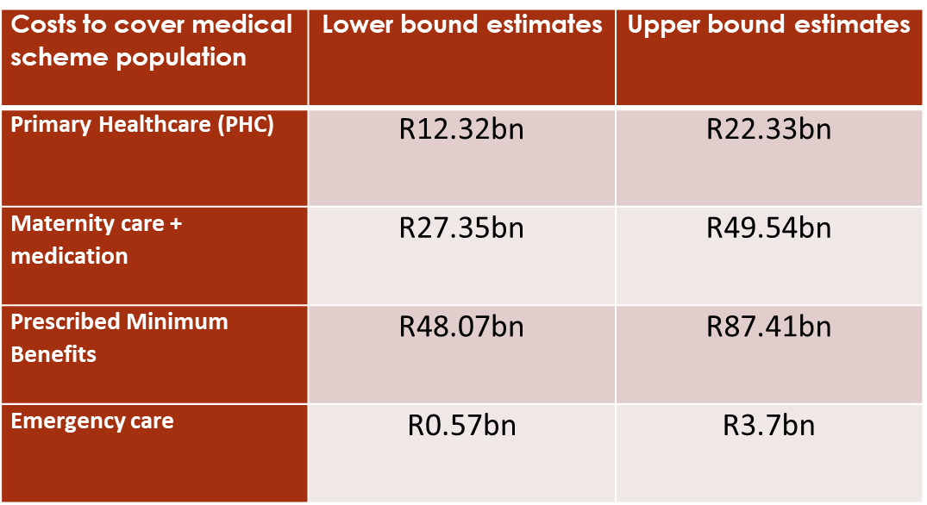


FTI Note 1: Section 33 shifts cost of medical scheme lives to public sector funds:
PHC + maternity for medical scheme lives costs more than R33bn
The Explanatory Memorandum makes reference to R33bn additional funding
PHC and maternity – R40bn to R70bn
Cost of providing care to currently covered lives would consume the R33bn additional funding
i.e. no increased cover for the most vulnerable
12

Slide 14
FTI Note 2: There is limited excess capacity in the private sector
Monopsony purchasing assumes that there is a private sector market to purchase from.
Once service providers contract with NHI Fund there is no alternative market – no competitive pressures and limited incentive for innovation to the benefit of patients.
There is a need for collaborative investment in health resources to build and strengthen the SA health system
13

Slide 15
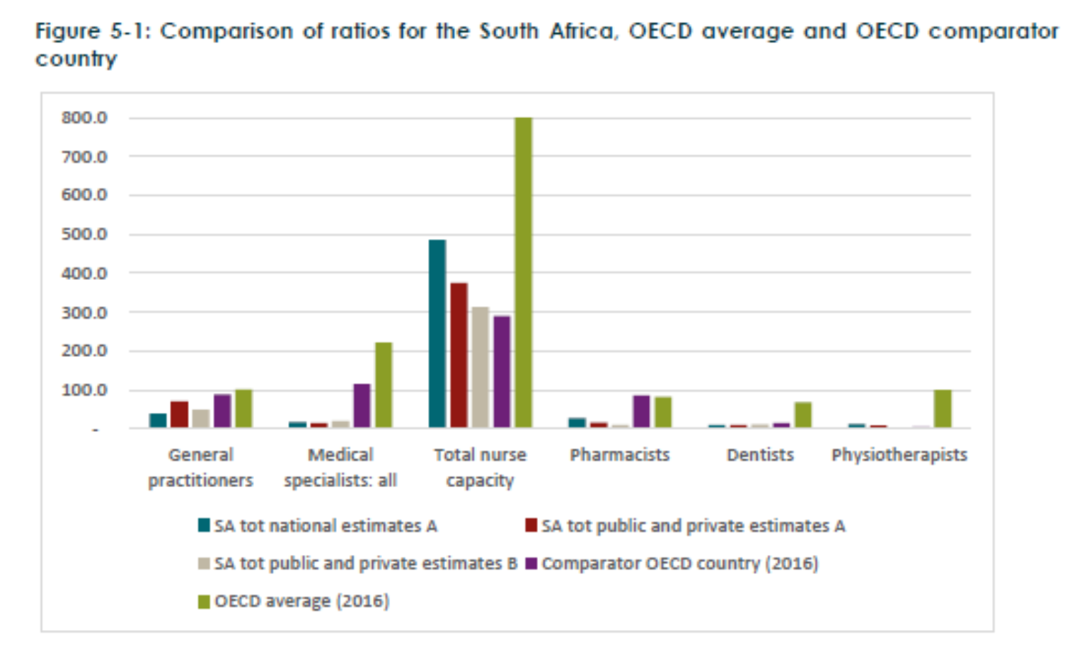
South Africa has a shortage of health professionals overall (FTI Note 2 and Percept Report)
Overall shortages compared to targets and comparator countries
The largest shortages affect the following disciplines: anaesthesiology, paediatrics, surgery. These are the disciplines most needed for maternal and child-care.
Cost of filling posts estimated at R10bn per annum
Need is for training and retaining of HRH
Limited available data – needed to combine data sources
The NHI Bill expects the monopsony power of the NHI Fund to persuade doctors to increase their workloads (caring for more patients) for equivalent or lower remuneration.
14

Slide 16
Our independent research findings:
Single payer approach
    Both high income (Germany, Netherlands, Switzerland) and middle income (Chile, Mexico) countries, have multi-fund partnerships between the public and private sectors.
    South Africa is well-suited to a multi-fund NHI, given its existing systems and capacity.
    No countries with large “single fund” approaches have legislative restrictions on private cover
    Key risk
    Drawing on international evidence, there is a clear risk that the NHI as proposed will be underfunded, leading to unintended rationing and discrimination against the vulnerable
Proposed solution
A multi-fund partnership approach is still consistent with policy objectives
If the infrastructure investment needs of the public sector (>R190 billion) are to be addressed, both public and private funding sources should be mobilized
Expanded training and provision of health professionals is needed, supported by both public and private funding streams.
15

Slide 17

A multi-fund approach – BUSA Nedlac presentation
23 February 2018
Employer funding (mandate?)
Private Sector Medical Schemes
GEMS
New NHI Fund
Government subsidises costs
Virtual Central Purchaser : Pooling of Minimum Benefit Package
Autonomous Schemes
Transitioning from “2-tiered” to integrated environment
Virtual pooling is consistent with encouraging contributions from those who can afford to pay for the benefit of the vulnerable
Appropriate approach for LMIC to achieve optimal coverage
Option to have benefits above the basic package
Services employed private sector
Services employed public sector
Services unemployed sector
16

Slide 18
Main points of principle
Governance – Chapters 4 to 7
      Robust governance and transparency are essential to public confidence across the public and private systems – needs review
                Professional, independent adjudication of appointments needs to be incorporated across the Fund’s governance arrangements
The role of medical schemes – Sections 6, 8 and 33
NHI coverage must accommodate all members and beneficiaries equally and should aim to expand the reach of coverage over time, while recognizing the right of individuals to supplementary voluntary insurance.
Notwithstanding mandatory participation in the NHI Fund, patient choice should be respected, both in the selection of service providers and between administrators and insurers
17

Slide 19
Main points of principle
The role of medical schemes (cont.)
Business is therefore concerned about the limitation of rights to insure privately, notwithstanding all solidarity objectives having been met through mandatory participation in the NHI Fund (sections 6, 8 and 33 of the Bill when read together)
This limitation will drive out of pocket funding for exclusions envisaged under section 8(2) which will be regressive in nature for most South Africans
Insurance, whether statutory or private should not undermine the rights of individuals to physiological and psychological integrity and autonomy under Section 12(2) of the Constitution
18

Slide 20
Main points of principle
Phased implementation – Section 57
Phases should be defined by milestones achieved rather than dates
A progressive realisation of cover should target the most vulnerable with an incremental approach to tax-based funding within the construct of our national social protection floor.
This includes the development of referral pathways to optimize the utilisation of resources
Legislative changes – Section 58
Legislative changes are premature and inconsistent with progressive phased approach
Risk of legislative uncertainty which will limit investment in the sector
The single payer approach – Section 2
A single payer, single purchaser system does not ensure optimal outcomes for price or supply and is not conducive to strategic purchasing
Optimal scale and diversified supply ensures best outcomes, limits systemic risk and unintended narrowing of the supply side
19

Slide 21
Specific recommendations
The NHI Bill requires review to ensure that there is a clear framework for implementing the NHI Fund and that the scope for uncertainty is limited. This includes:
      Clear definitions and consistent use of terminology throughout the Bill
      Amendments to section 6 and 8 of the Bill to ensure that the supplementary role of medical schemes is clear
      The role of medical schemes, as set out in section 33 of the NHI Bill should be amended to allow for the coexistence of the NHI and medical schemes.
      Revision of the governance framework including the process for appointments being based on required qualifications, skills and experience
      Revision of the definition of the implementation phases to incorporate clear and objectively measured metrics
      Amendments to legislation should be proposed as required to accommodate phased implementation and reduce unintended consequences
  Specific drafting recommendations respectfully submitted
20

Slide 22
Ayanda Ntsaluba
21

Slide 23
Covid 19 – An integrated approach
Working together to overwhelm the problem
            Our achievements and challenges in providing care to Covid-19 patients, ramping up testing and advisory capacity, providing PPE equipment and this year in ramping up vaccine implementation capabilities have relied on public-private collaboration
              Public / private coordination structures
                Progress has required hard work and continuous engagement – we have learnt that public / private coordination structures need dedicated capacity and constructive, in-depth engagement
              Supplies and services
              While centralised procurement and “framework”/transversal agreements have a useful role, decentralised supply and servicing contracts are essential if needs are to be met efficiently and appropriately
              Vaccine acquisition, logistics and administration, resource mobilization
              Careful planning and coordination is needed to optimize the respective roles of the national and provincial departments, private industry capacity and the contribution of medical schemes and administrators
22

Slide 24
Martin Kingston
23

Slide 25
Concluding remarks
Health policy needs to be considered within the context of priorities for the country as a whole
This includes social inclusion, affordability, sustainability and investment in services and manufacturing
Health is a fundamental necessity for business productivity and growth in the same way that it is a very personal priority for individuals
Optimal investment and innovation in the health sector is the product of vision, skill, competition, policy and regulatory certainty and a diversity of views. NHI as a single fund will not promote such an outcome.
We therefore support National Health Insurance as a necessary component of the broader social security system on an incremental, integrated multi-fund basis
We support the funding of NHI within the parameters of affordability to the fiscus
cont.
24

Slide 26
Concluding remarks
We highlight four major concerns noted above:
    Governance
    The right of persons to insure their health risks in addition to their mandatory membership of the Fund
  Risk of policy and regulatory uncertainty during the transition period, if the meaning of “fully implemented” is not clarified in the Bill
  The economic and financing impact of the NHI Fund as framed misconstrues the virtues of a public good with the necessary dynamic of investment in the sector
  Policy should promote expansion of the health sector as a whole to promote coverage and quality of care
  Policy should co-opt and support the private sector as a partner, to provide inclusionary coverage
  Policy should be aimed at attracting investment in South Africa and creating employment opportunities
  We support a strong partnership and effective NHI to the benefit of all South Africans
25

Slide 27
Drafting Consideration
26

Slide 28
Drafting considerations: Governance
Section 12: The appointment of the Board should include assurances of independence, transparency and relevant technical expertise independently adjudicated. The sheer size and significance of this fund once fully implemented warrants dual accountability to both the Minister of Health and Minister of Finance. Both Ministers should have a representative on the Board.
Section 14: The Chair of the Board should be appointed by its members
Section 25(6): The chairperson of the Benefits Advisory Committee must be appointed by the members of the Committee and not by the Minister
Section 26 (1): too much relies on the discretion of the Minister in the appointment of the Benefits Pricing Committee
Section 26(3): The singular view of a committee in determining price outcomes for the sector is vulnerable to skewed or narrow development of the health sector. The cost of capital associated with an investment should be duly considered in a price determination. National Treasury should be represented on this committee.
Section 27: there is no clear mechanism on how the deliberations of the Stakeholder Advisory Committee will be incorporated into the processes of the NHI. The intended purpose and function of the Committee is similarly omitted from the Bill as well as the influence, if any, of the representatives of the Committee on the decisions of the Board.
27

Slide 29
Drafting considerations: Governance continued
Section 31 (1 & 2): See section 12 comment above. (2) is inappropriate as an ongoing empowerment of the Minister. The policy intention here would be better captured as a specific obligation in section 57(4)(h), i.e., a duty on the Minister to propose legislation regarding the re-allocation of functions/duties in order to get NHI set up. The Minister cannot have an indefinite empowerment to propose such re-allocations of powers that are constitutionally conferred.
Section 32(1)(d): contemplates the enactment of section 36 (certificate of need) of the NHA. There are currently no regulations supporting section 36 of the NHA. Such regulations would have to be brought into effect through an appropriate public participation process and the constitutionality of section 36 would have to be determined: in so far as section 36 may cause healthcare providers to be unable to render services in a particular area where such a determination is made, pursuant to the provisions of section 36. This will, in turn, have implications pursuant to section 22 of the Constitution in respect of "the rights [of medical practitioners] to choose their trade, occupation or profession freely."
28

Slide 30
Drafting considerations: The role of medical schemes
Section 33 raises several constitutional concerns:
            When read with section 6 and section 8, it appears to reduce/abolish the existing right of citizens to acquire healthcare services from private providers, which may infringe sections 12(2)(b) and 27(2) and 28(1)(c) of the Constitution;
            When read with section 6 and section 8, it appears to reduce/abolish the existing right of citizens to insure themselves against the risk of non-coverage by the Fund, potentially infringing the same sections of the Constitution;
            It may, for reasons related to the two preceding concerns, unreasonably restrict healthcare providers’ and healthcare funders’ freedom of trade, occupation and profession in addition to the right to acquire healthcare services from private providers;
            “fully implemented” is neither defined nor clear which makes the Act vague. Further, the Minister should not have the power to “determine” when NHI is fully implemented, as there is no basis stipulated in the Bill against which to measure the legitimacy of the Minister’s determination. The Minister should have the power to “notify” or “declare” the objective achievement of that state, subject to a definition in the Bill for what constitutes that state.
29

Slide 31
Drafting considerations: Strategic purchasing
Sections 35-38: The term “strategic purchasing” has not been defined. This needs to be linked to sustainability and quality outcomes and not just the “lowest possible price” per section 11(e). Clarity is sought with regards to the nature of legal entity the CUPCs will be at district level as they are yet to be established in terms of the NHA. These entities will need to have the appropriate expertise and accountability framework to receive and manage allocations of funds as well as to implement and monitor contracting requirements.
Section 39: The proposed amendment in the NHI Bill to the Health Professions Act will prohibit registered practitioners from providing services covered by the NHI Fund if they are not accredited by and contracted to the Fund. This seems Constitutionally unjustifiable considering s12(2)(b) and 22 of the Constitution. Suggest: the limitation of rights imposed by s33 and s39 infringe on the freedoms of both patients and health professionals under the Constitution.
Section 39(8): The Fund may withdraw or refuse to renew accreditation of a provider/establishment “if it is proven that” there have been one or more failings as listed. It suggests that the Fund would need to go through a legal process (otherwise, to whom must it be “proven”?), which may frustrate legitimate striking-off of failing providers. Suggest the words “if it is proven that” be replaced with “if the [provider] …has failed”.
Section 40(3): provides that the Fund “may” use personal data for six listed functions. Proposed the wording change either to “may only” or “must” so that there is no suggestion that the Fund may use such data otherwise in its discretion. General privacy concerns need to be reviewed in section 40.
30

Slide 32
Drafting considerations: Complaints and Appeals
Section 42(1): Only an “affected natural or juristic person” may furnish a complaint. There may be partnerships or unincorporated associations which should also have this right.
Section 45: An appeal against a Fund decision must be appealed within 60 days, i.t.o. section 43, but the Appeal Tribunal has no power to condone late filing of an appeal. The power should be conferred, otherwise two interpretations arise: either there is no right of appeal at all after 60 days, or the appellant has to approach the High Court.
Section 46: contains an incorrect second reference to “the Board”: it should read “the Appeal Tribunal”.
Section 47(2): is appropriate in intent, but impractical. There are only five tribunallists, of whom only one is a lawyer, and the case load is likely to be insurmountable in any event. To then compel recusal and temporary substitution by the Minister “if it transpires that [a member] has…indirect personal interest” is inviting opportunistic frustration of process and burdening of the Minister. Strongly recommend that the whole process be amended to simply allow parties to approach the Magistrates or High Court in the ordinary course.
31

Slide 33
Drafting considerations: Funding and financing
Section 48(d): Whether or not money was “paid erroneously” is a question of law, which could only be determined by the judiciary; whether or not such money is capable of being refunded is a matter that the Bill leaves to the opinion of the Minister. Since the Minister can only exercise that opinion in respect of a matter that requires a prior legal determination, it makes sense to leave the Minister’s discretion out of the section entirely. Paragraph (d) should be deleted; although the Fund may end up acquiring assets, especially money, it receives erroneously, this cannot be characterized as a “revenue source”.
Section 49(2): these provisions are the subject of tax policy and belong in a money bill
Section 49(2)(a)(ii): this statement is factually incorrect as no medical scheme tax credits are paid to medical schemes but rather impact the amount of personal income tax paid by individual medical scheme members
Section 55(1)(m)-(n): delegates regulation of the relationships between private and state healthcare provision and state and private health funding / insurance to the Minister. Matters that are so central to the constitutionality of the Bill and the feasibility of the UHC project should be contained explicitly in the Bill itself.
Section 55(3)(b): provides for a truncated pre-regulation public consultation process if the Minister deems it to be in the public interest. The Minister is obliged first to consult with the Board. Suggest that this consultation should be with the Stakeholder Advisory Committee as well as the Board.
32

Slide 34
Drafting considerations: Phased implementation
  Section 57: Implementation phases should not be defined based on fixed dates but should be clarified through objective milestones, such as:
  Expansion of priority services (towards the package of comprehensive health services)
  Population coverage
  Reduction in out-of-pocket expenditure
  Broadly these include the following possible steps:
  Establishment of an institutional framework, including a governance framework
  Defining initial benefits and an incremental approach (affected by affordability)
  Information framework – records to facilitate delivery of care and monitoring
  Accessible delivery – existence of resources accessible to the population, appropriate ratios
  Effective delivery – people are able to access care when they need it
  Outcome measures – quality and clinical effectiveness as well as preventative coverage
  We suggest that legislative reform should only be considered once the NHI fund is practically established
  We recommend further engagement on appropriate metrics for transparent monitoring and reporting as part of implementation
  Caution on liabilities being transferred to taxpayers during transition
33

Slide 35
Drafting considerations: Legislative amendments
Repeal and amendment of related legislation included in the schedule: The Bill should not serve as an omnibus bill to compress the legislative process. There are too many contingencies that yet have to be worked through. Related legislation should be amended at the relevant stage of NHI implementation.
The immediate effects of the proposed changes include
    Coverage for advice and medication for pregnancy and terminations is no longer the business of a medical scheme under the MSA;
    “compensation” as defined in COIDA will exclude ”medical aid or payment of the cost of such medical aid”;
    The cost of a medical examination under ODMWA “shall be purchased and be paid for by the NHI Fund” (not the mine owner or DG as currently stipulated);
    The RAF’s tariff structure will be replaced by “the reimbursement strategy for health care services contemplated in the NHI Act”.
    An appropriate incremental approach should involve assessment of experience and determining legislative amendments as required.
    The legislative changes should be revised and limited only to those required for the establishment of the NHI Fund.
34

