Slide 1
Positively influencing the environment for Small Businesses in South Africa
1

Slide 2
PURPOSE OF THE PRESENTATION to parliament
Thank honourable members for inviting us
Make preliminary comments on the Ease of Doing Business Bill
2

Slide 3
Key messages from THE PRESENTATION
A first important step towards the right direction – achieving President’s aspiration
Our support is nuanced and requires consideration
Share some uncomfortable truths about pains of SMMEs
3

Slide 4
Who We Are
75 year old NPO -- apolitical
Speaking out for almost 100 business chambers & business forums (informal and informal sector SMEs)
A member of Business Unity SA and participants in the President’s Public-Private Growth Initiative & enjoy MoUs with the Franchise Association of SA and the Ethics Institute.
We’re transforming rapidly beyond the Board.
4

Slide 5
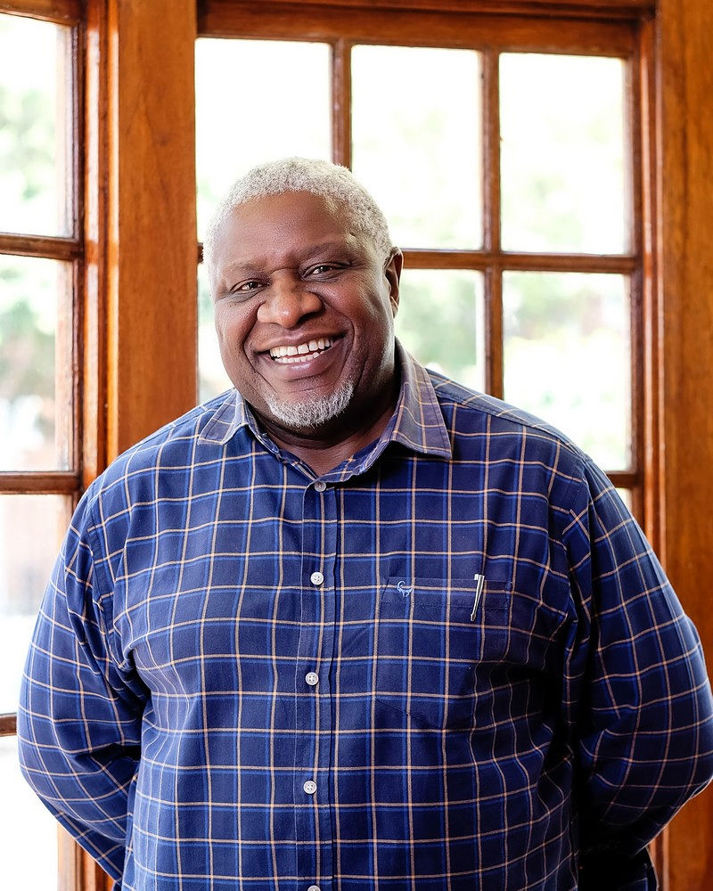
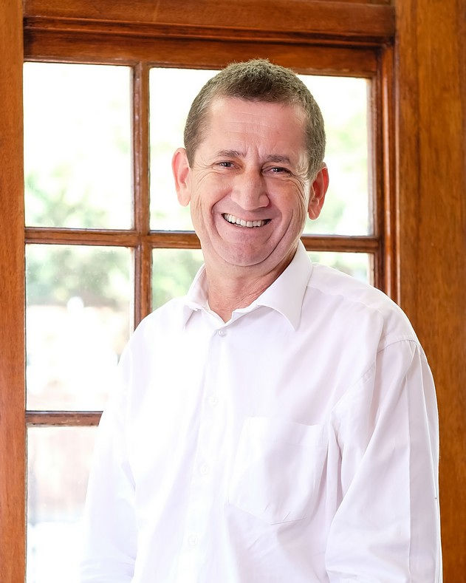
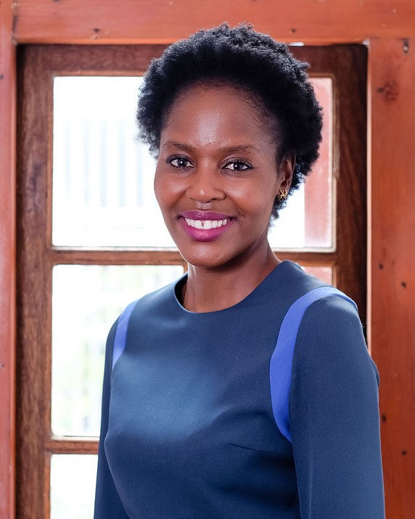
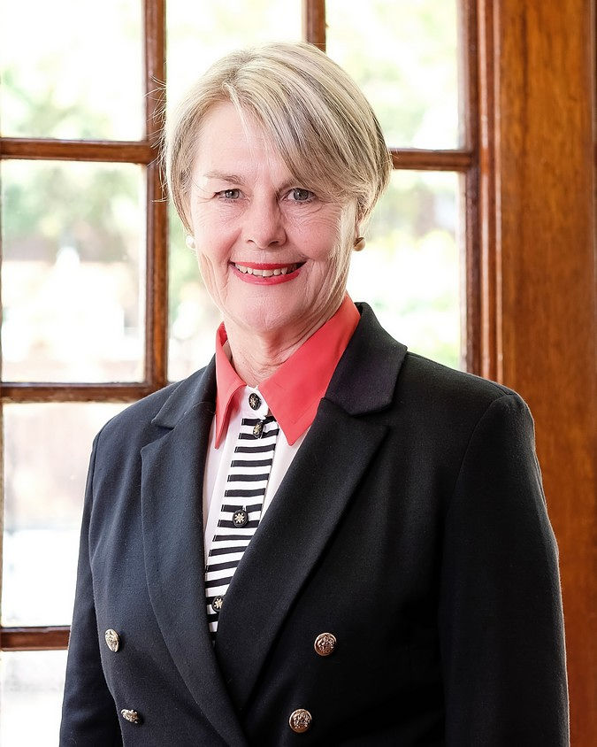
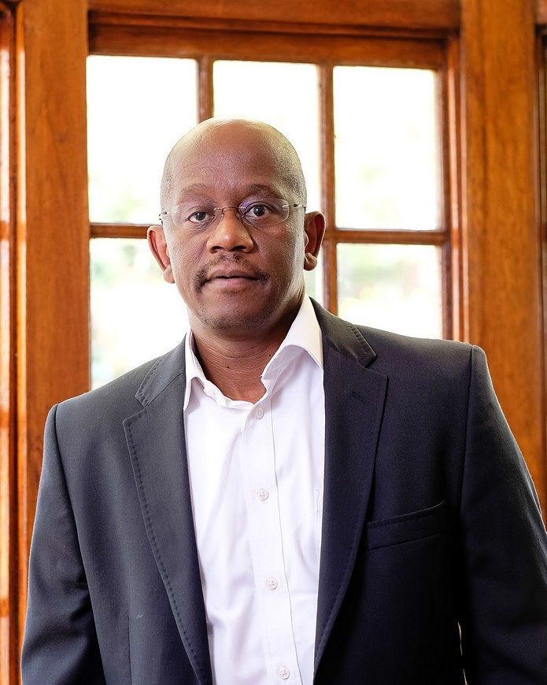
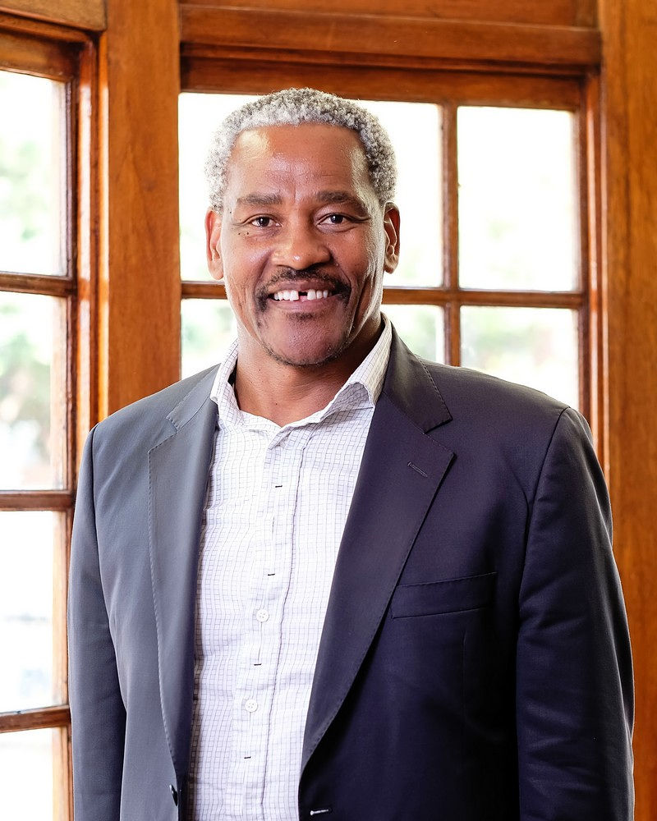
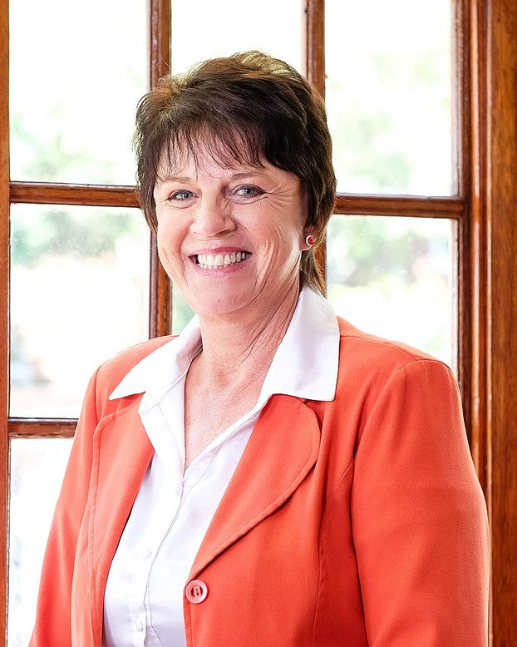
SBI Board of Directors
Bernard Swanepoel
Dr. Thabi Leoka
Hettienne von Abo Moolman
SBI Chairman: Sipho Nkosi
Joe Mwase
Dr. Lumkile Mondi
Winda Austin-Loeve
5

Slide 6
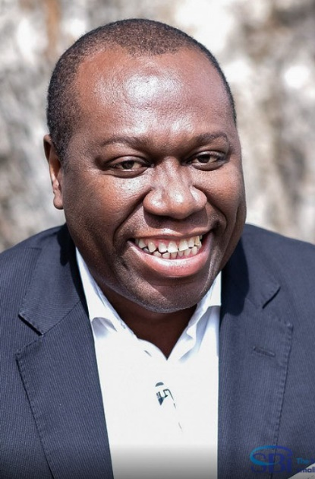
SBI Executive Team
John Dludlu Chief Executive Officer
Leandre Swart General Manager
Kenan Pardey SBI Coordinator

Slide 7
A Chamber Movement
Increasingly, the point at which the ‘takkie hits the tarmac’ is at the local government level.
SBI is at the nexus of this recommendation -- formal business chambers, emerging business forums and entrepreneurs.
We are establishing strong, regional chambers to help fulfil the President’s wishes that service delivery emanate principally from District Municipalities.

Slide 8
SBI Affiliated Business Chambers
59 Formal Chambers | 15 Informal Chambers
Representing 66 434 businesses | Representing 44 896 businesses

Slide 9
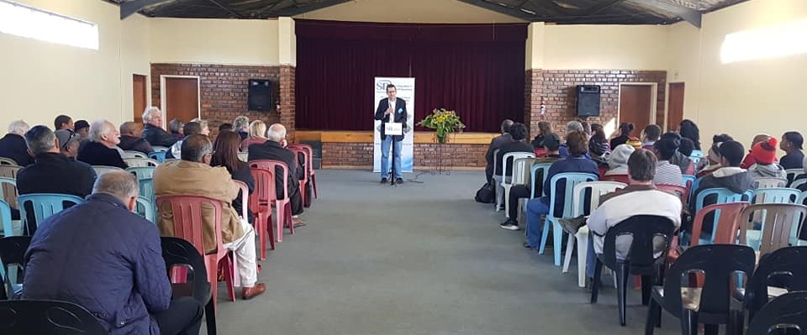
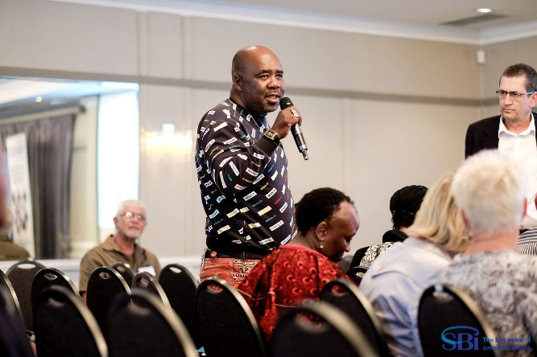
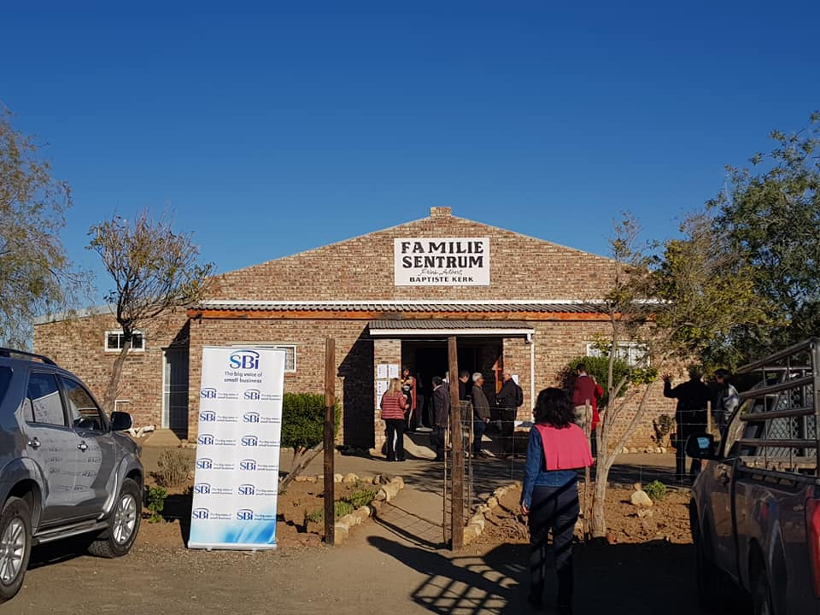
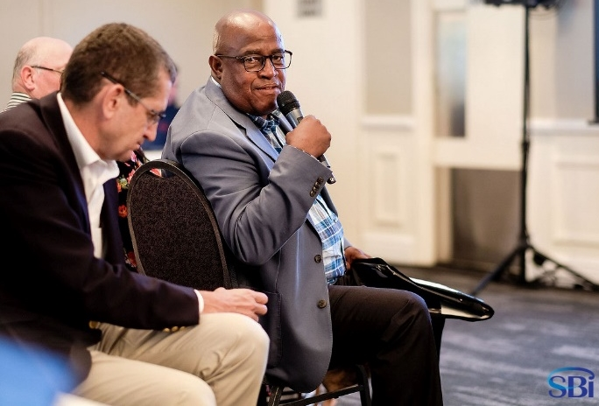
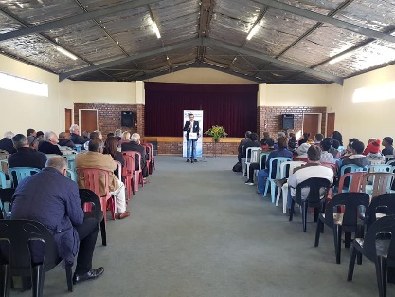
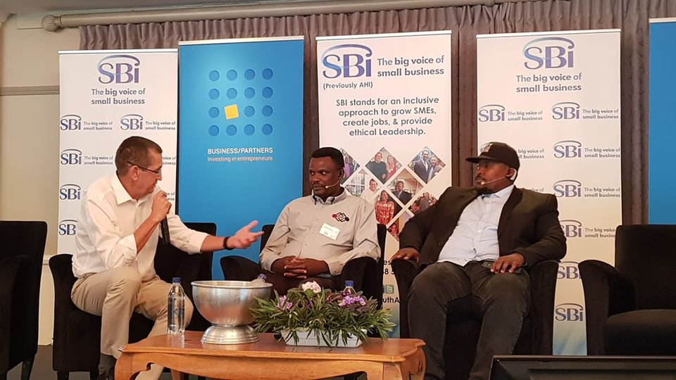
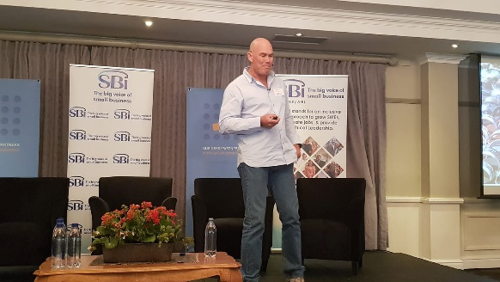
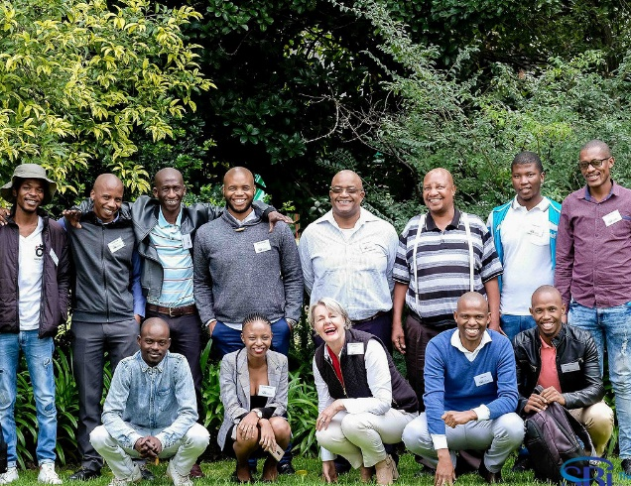
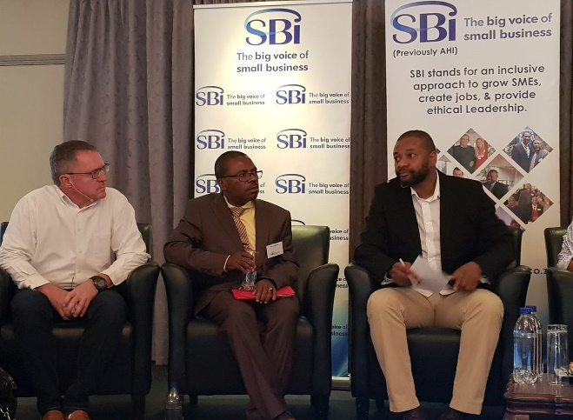
We are aggressively driving chamber formation in townships and villages and;
keeping a strong voice in the public square to influence policy makers, thinkers and journalists beyond our #SMEIndabas

Slide 10
Our work Research & Advocacy
Research – evidenced-based advocacy
Implementation of Section 18
#PaySMEsIn30Days
Mainstream the SME agenda
10

Slide 11
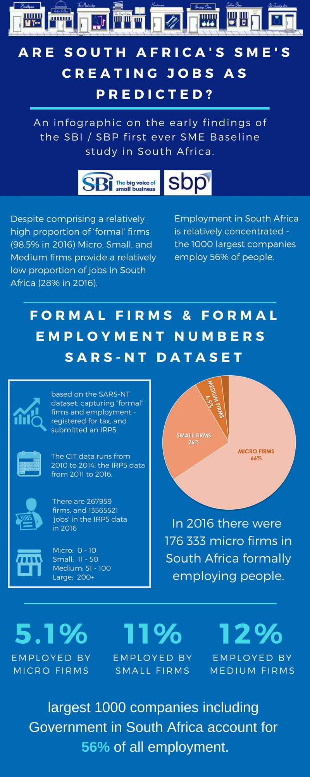
SBI SME Baseline Study
There are 263,224 formal, employing micro, small and medium enterprises in SA (plus 4,735 large and government employers)
That’s 98.5% of all formal firms in the economy (minus the thriving informal sector economy which remains unseen and uncounted)
Formal SMEs employ 3.9 million people or 28% of formally employed people in our country

Slide 12
RESEARCH 2021
Formalisation and formalism
The role of local champions
How to tackle the disabling environment
The localisation conundrum

Slide 13
Research
Keynote address: Suite release
https://www.youtube.com/watch?v=-lkt0X5_o8U
13

Slide 14
Broadly support the spirit of the Bill (in keeping with President’s aspiration of improving our ranking in Ease of Doing Business survey)
Location of the RIA Authority in Presidency needs to be such that it avoids duplication and unnecessary turf wars
Explicit focus on SMMEs as the backbone of the economy
Preference for RIA over SEIAs
Because the RIA tool emphasises stakeholder engagement early on in drafting policies and laws, some policymakers met a great deal of resistance to the policy changes they proposed. An erroneous perception was created in some parts of the state that the transparency associated with RIA and publishing policy proposals was a hindrance, as it resulted in public lobbying and delays to implementing legislation that the politicians wanted pushed through. Departments were encouraged to cut back on the publication of policy in order to speed up legislative processes…
Comments on the Bill
14

Slide 15
While SEIAs support stakeholder consultation on regulatory proposals, including with other government departments, a lack of rigour in its methodology allows for shallow or selective consultation by policymakers
Economic growth and investment – against which all regulatory proposals are assessed for impact by the SEIAs – falls only to the third priority on the list of four national objectives of the SEIA assessment: the first is ‘social cohesion’, followed by ‘security’ and ‘environmental sustainability as the last
The original RIA approach that was applied however, prior to the SEIAs in 2015, listed regulatory impact assessment of proposals measured against the national priorities of: economic growth (1st); competitiveness (2nd); employment (3rd); small business (4th); poverty and equity (5th): transformation (6th); environment (7th); and health (8th)
While listed in that order, all of these national priorities were measured in the RIA application as – combined - are factors that support an enabling environment for businesses growing our economy
Comments on the Bill continue…
13

Slide 16
SBI proposals
Red tape challenge – ask SMEs to say what their pain points are (out of 21,000 statutory rules and regulations excluding tax and national security, over 2200 were scrapped or improved in the UK in 2011-14)
New, imaginative approach to regulation – e.g. Canada requires that one regulation be removed for every new regulation introduced
Establish the National Small Business Council – institutionalise dialogue
Make RIAs mandatory (60 countries are doing them)
Revisit section 18

Slide 17
CONCLUSION
The Bill is a significant step towards creating that elusive enabling environment or tackling the disabling environment
Thanks for inviting us – but hear us
Institution building in a hollowed state is a big concern
Look into what our research says
17

Slide 18
Thank You
www.smallbusinessinstitute.co.za
012 348 5440
leandre@smallbusinessinstitute.co.za

