Slide 1

SA Nephrology Society presentation on NHI
For the Parliamentary Portfolio Committee on Health

Slide 2
Who is the South African Nephrology Society?
Founded in May 1967
Members are nephrologists, trainee nephrologists and physicians with an interest in nephrology
150+ members
The goals of the organization are
  Promote and protect the profession of nephrology
  Facilitate co-operation and contact between all interested parties in the field of nephrology and related subjects
  Provide guidelines for the optimal care of renal patients.

Slide 3
Executive committee – office bearers
Name | Region | Position
Dr Shoyab Wadee | Gauteng | President
Prof Nicola Wearne | Western Cape | Executive Secretary
Dr Julian Jacobs | Western Cape | Treasurer

Slide 4



Affiliations
SANS is a key regional member of the International Society of Nephrology (ISN)
SANS is a key/founder member of the African Society of Nephrology (AFRAN)
SANS holds a joint congress with the Renal Care Society of SA (RCCSA)
  Representing dialysis nurses and technologists

Slide 5
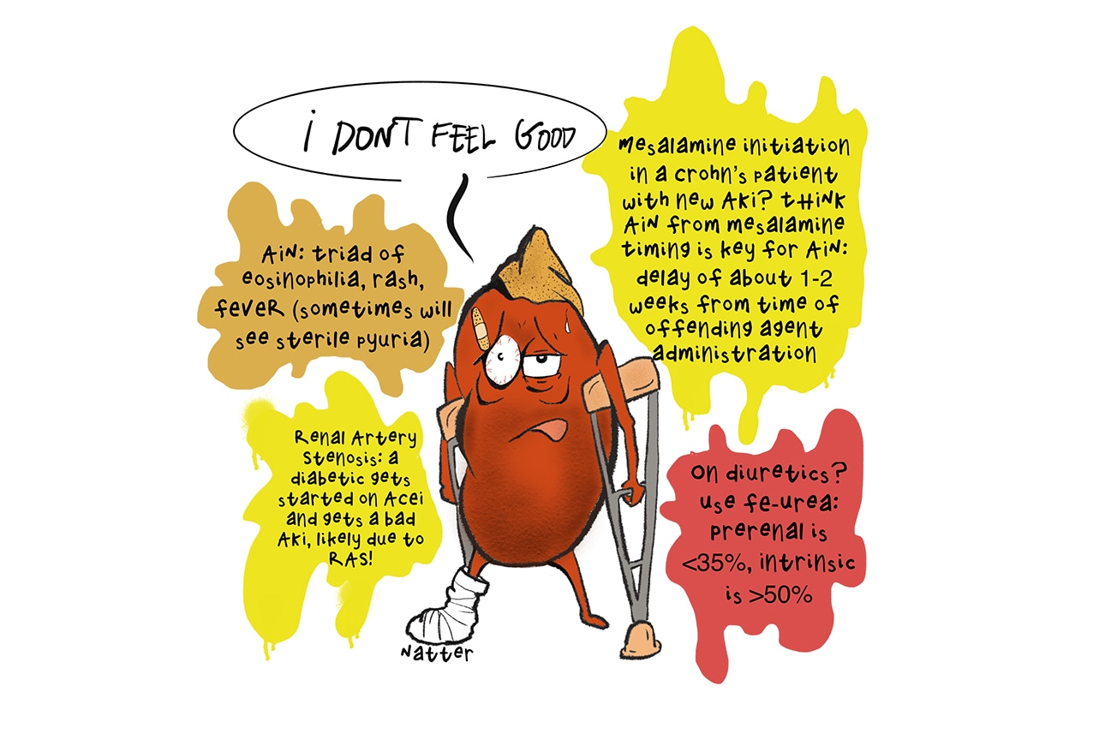
What is a nephrologist?
Medical specialist
Treats patients with various forms of kidney disease
Does research on kidney diseases
Does education on the role of the kidneys in health, disease & prevention of diseases

Slide 6
Who do we care for?
Chronic kidney disease
  Especially stage 3-5
  Chronic inflammatory/ immune diseases of the kidney
  Hypertensives, diabetics and HIV are at high risk
Acute kidney diseases
People with kidney failure requiring dialysis
People with kidney transplants

Slide 7
What is chronic kidney failure?
STAGE | DESCRIPTION | GFR ml/min/1.73m2 | ACTION
 | At increased risk | ≥ 90 (+CKD risk factors) | Screening CKD risk reduction
1 | Kid damage + N or ↑ GFR | ≥ 90 | Diagnosis & Treatment CVD risk reduction
2 | Kid damage + mild ↓GFR | 60-89 | Estimating progression
3 | Mod ↓ GFR | 30-59 | Evaluate and treat complications
4 | Severe ↓GFR | 15-29 | Prepare for renal replacement therapy (RRT)
5 | Kidney Failure | <15 or dialysis | RRT
Abnormal structure or function of the kidneys, lasting more than 3 months with implications for health.
Stages 1-5
Stage 5 – end stage kidney disease
  High risk of life-threatening complications – with the need for dialysis or transplantation

Slide 8
End stage or kidney failure causes suffering
Severe fatigue
Swelling of the body
Shortness of breath
Muscular weakness and pain
Debilitating Itching
Confusion and drowsiness
Death

Slide 9
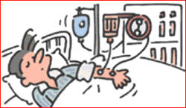

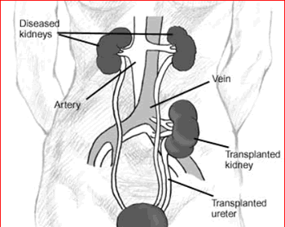
Treating kidney failure
Dialysis
Transplantation
KRT is expensive, so limited access
Palliative/supportive care

Slide 10
The South African Renal Registry: documenting the treatment of kidney failure
Razeen Davids
Stellenbosch University and Tygerberg Hospital
South African Renal registry
mrd@sun.ac.za

Slide 11
More than 850 million people,
or about one adult in ten,
have some form of kidney disease

Slide 12

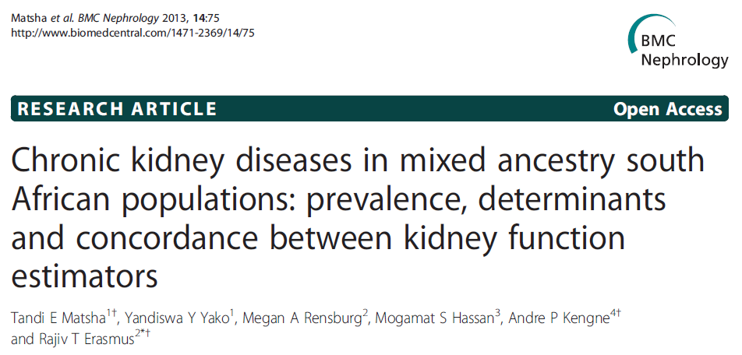
6.1%
17.3%

Slide 13
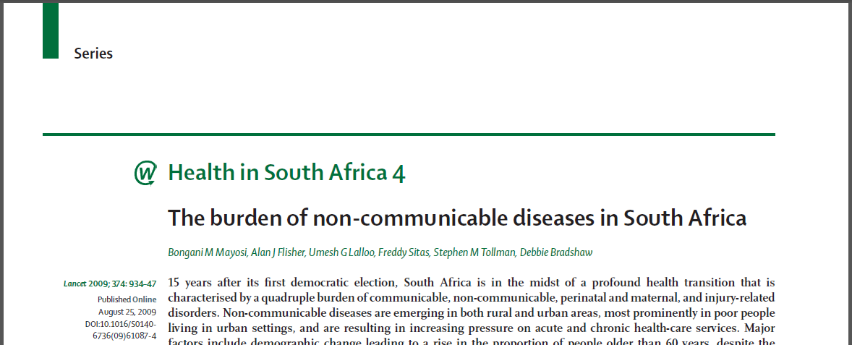
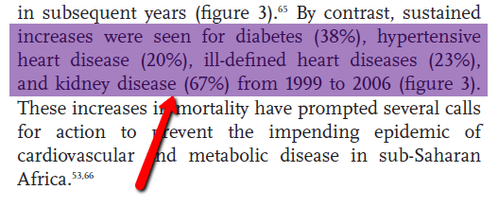
Deaths from kidney disease increased by 67% from 1999 to 2006
Notes:
13

Slide 14
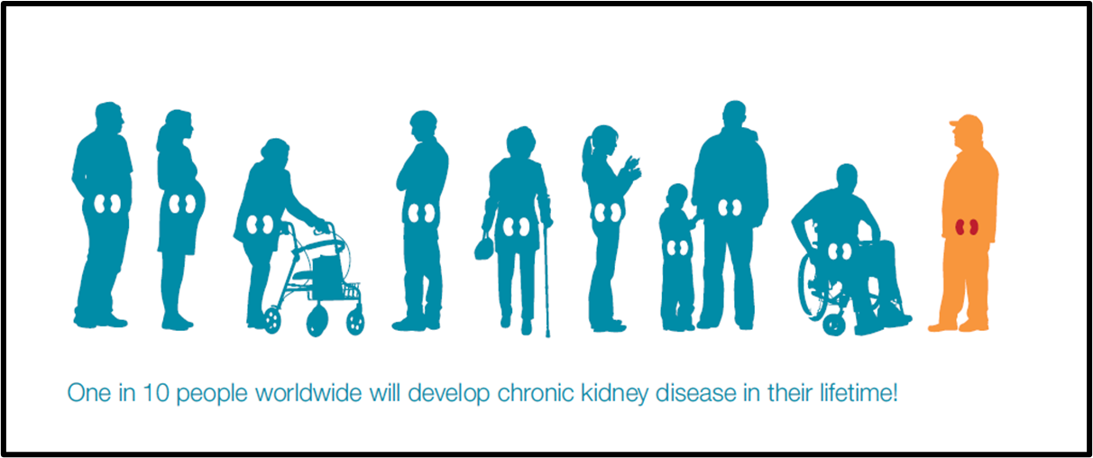
Estimated population of RSA 2020 59,62 million. Therefore 5.9 million South Africans are at risk
ISN Global Kidney Health Atlas | 2017

Slide 15
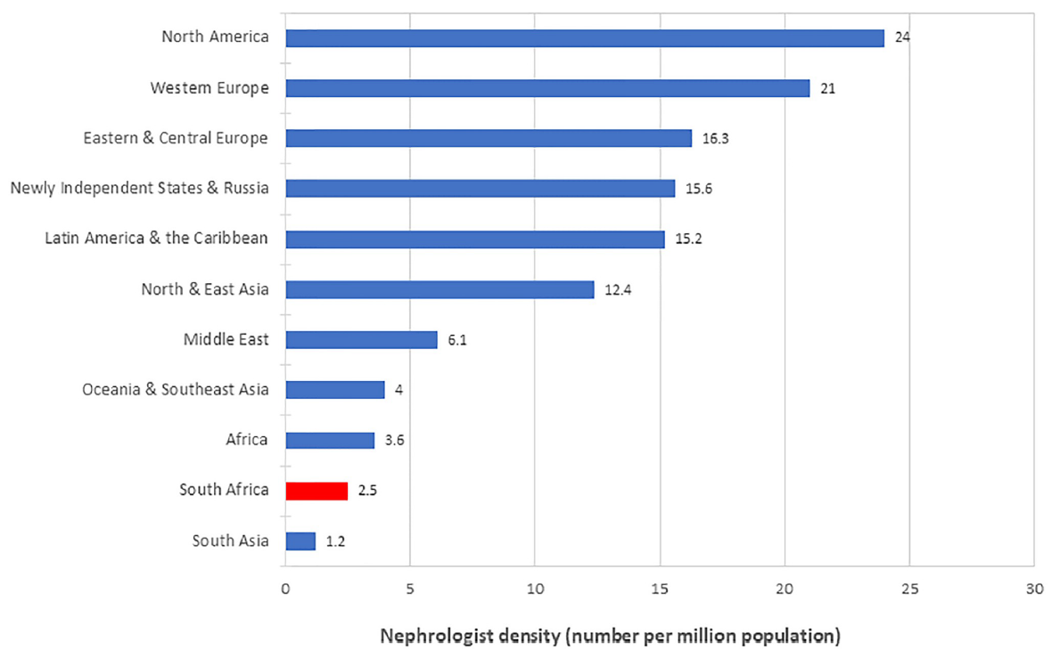
Hassen et al. PLOS ONE, 2020
Notes:
Figure 1. Provinces and major cities of South Africa

Slide 16
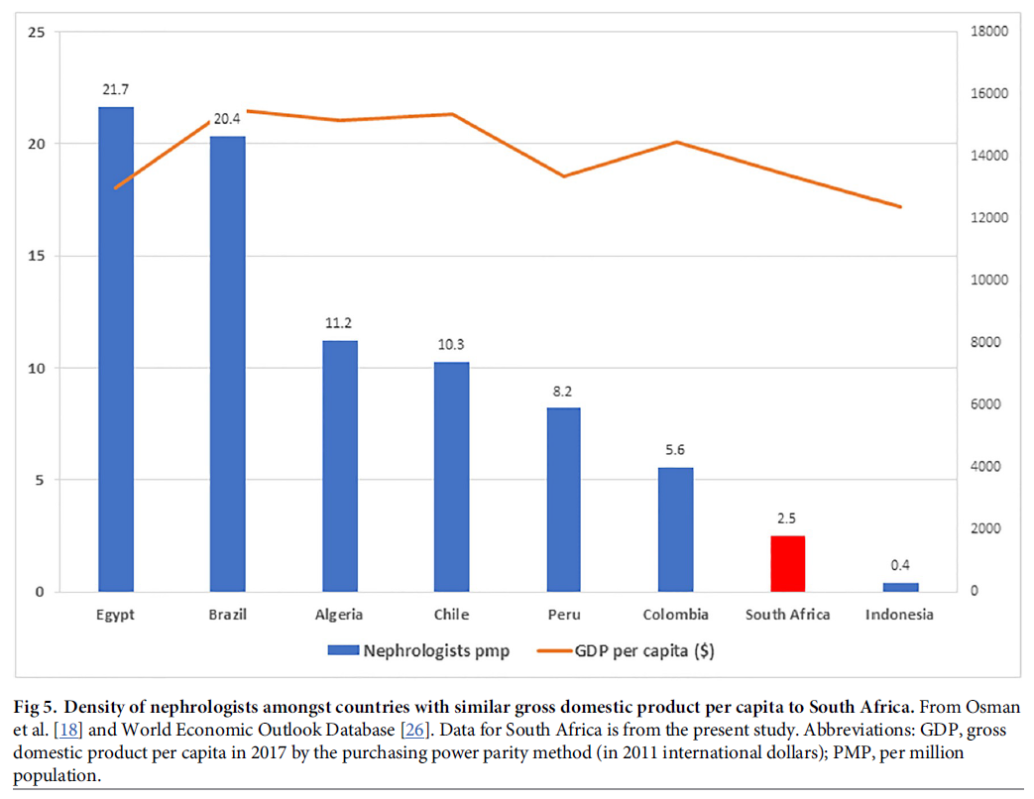
Hassen et al. PLOS ONE, 2020
Notes:
Figure 1. Provinces and major cities of South Africa

Slide 18
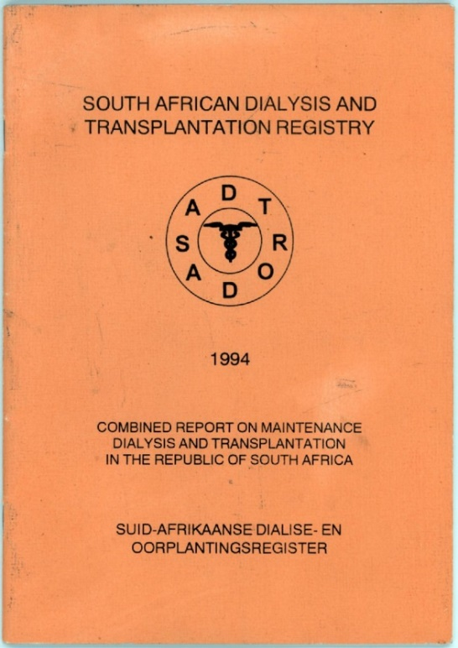
SA Dialysis and Transplant Registry
Established in 1977
Last data 1994
Two decades without data
 | 1994
Population in millions | 40.4
Patients on treatment | 2843
Treatment rate (pmp) | 70

Slide 19
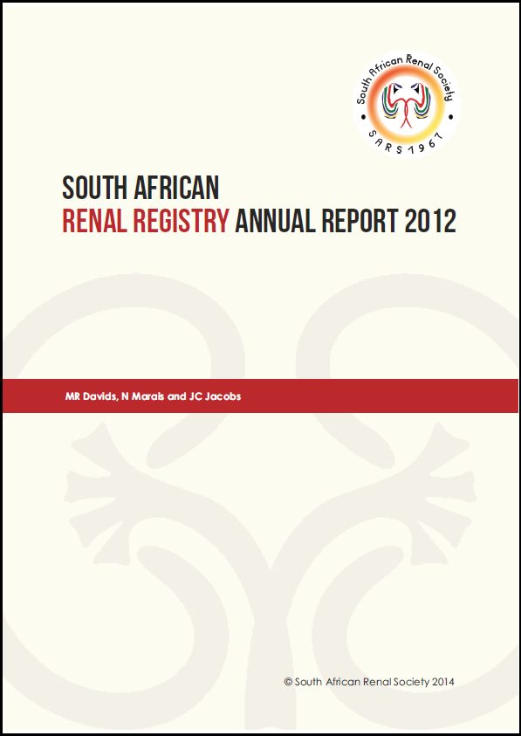
Response to release of the first SA Renal Registry Report

Slide 20
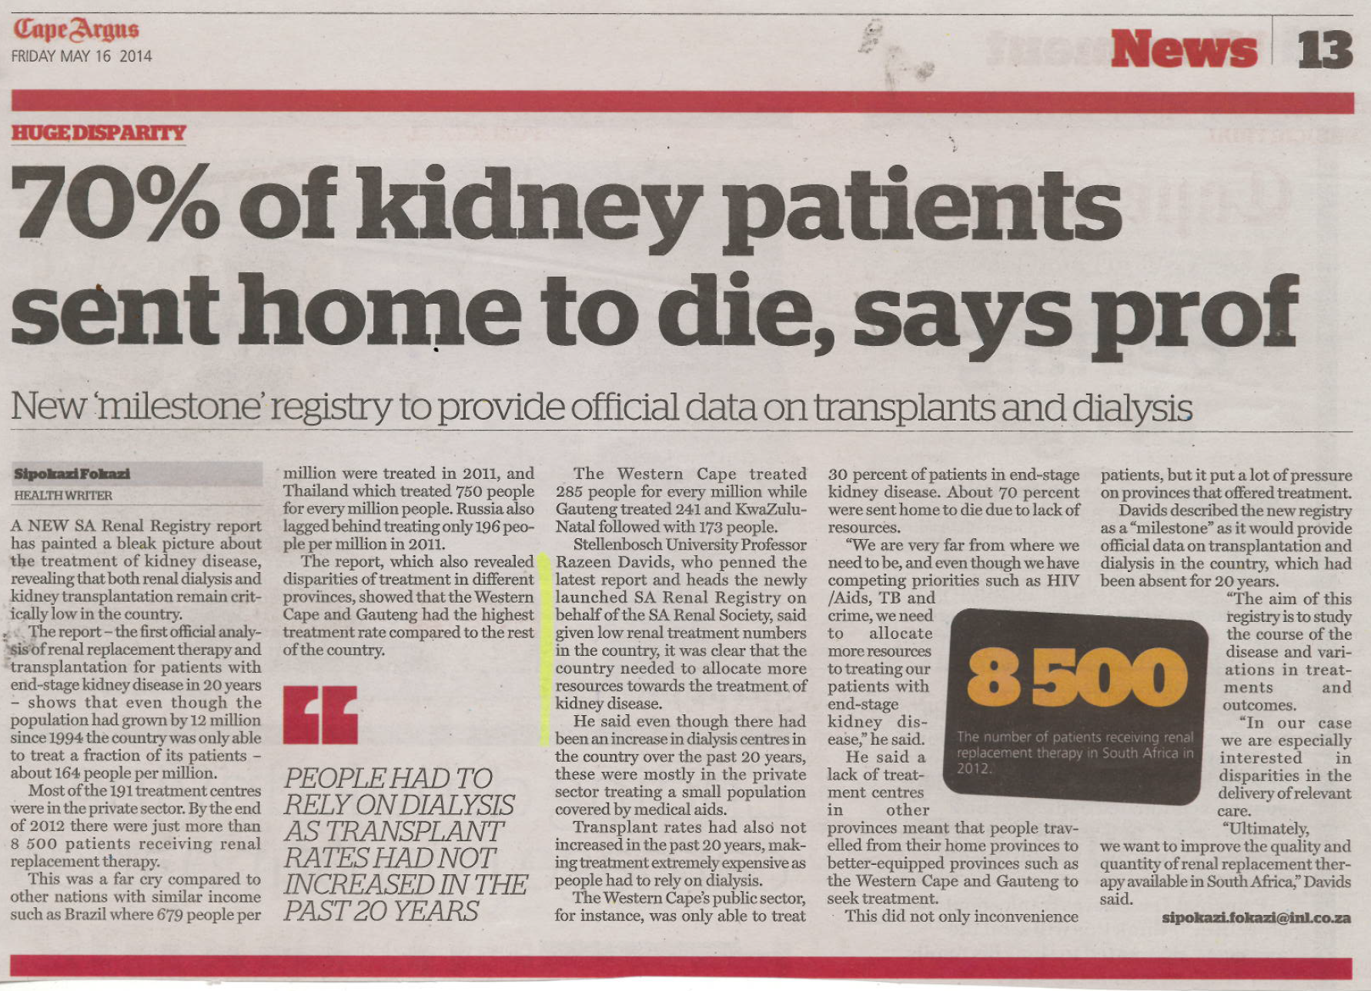

Slide 21
Moosa MR; Kidd M -2006
Moosa MR; Kidd M; The dangers of rationing dialysis treatment: The dilemma facing a developing country; Kidney International (2006) 70, 1107–1114

Slide 22
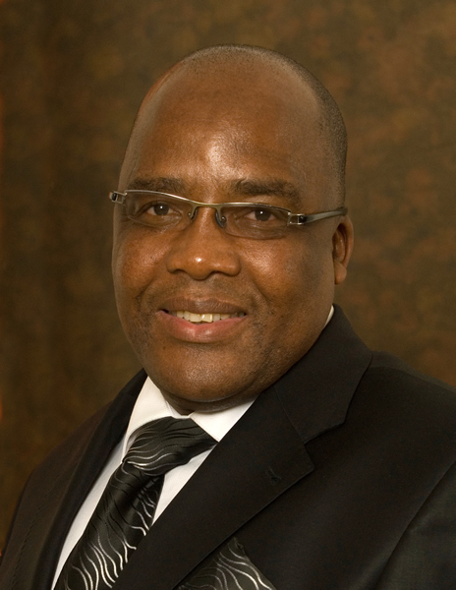
Presentation to Health Minister Aaron Motsoaledi
Summit on an effective approach to CKD

Slide 23
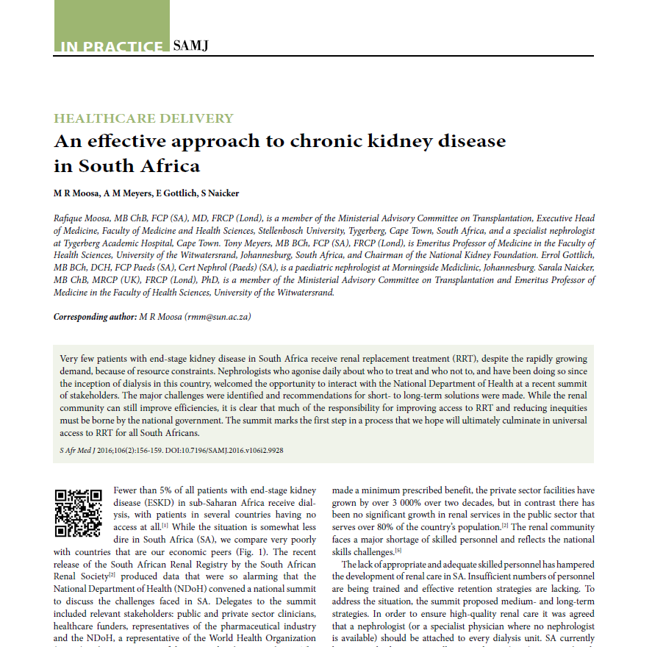

Slide 24
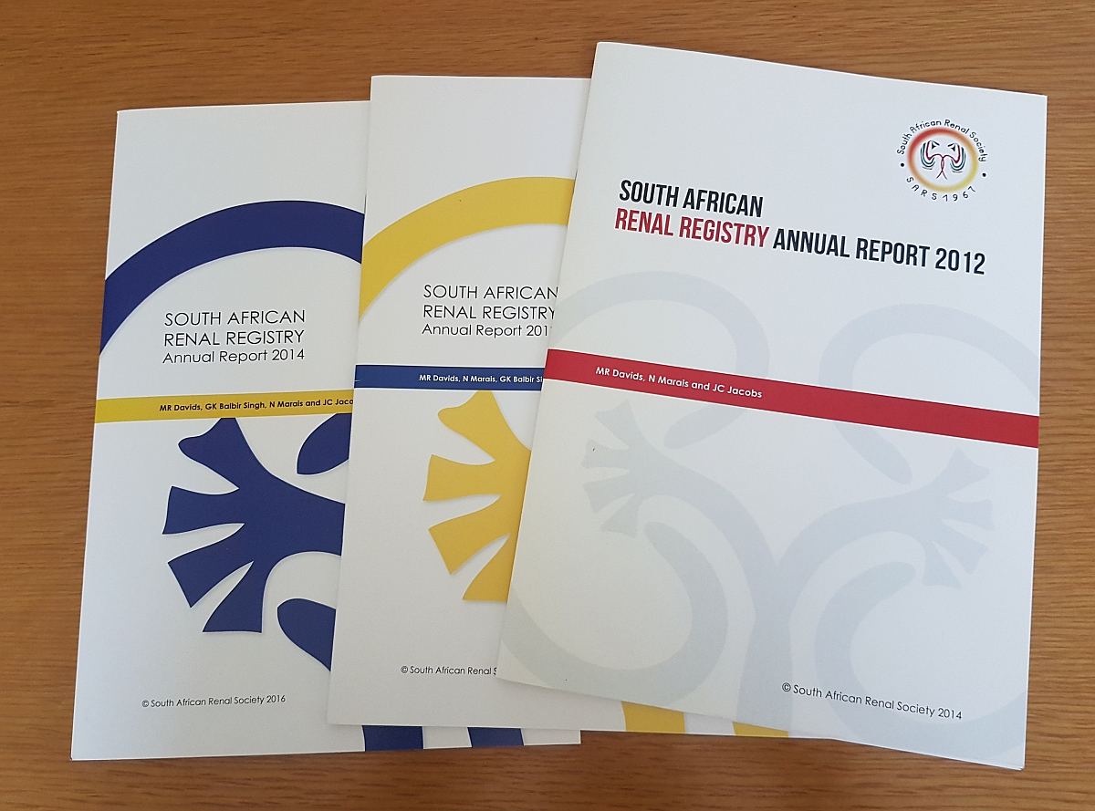
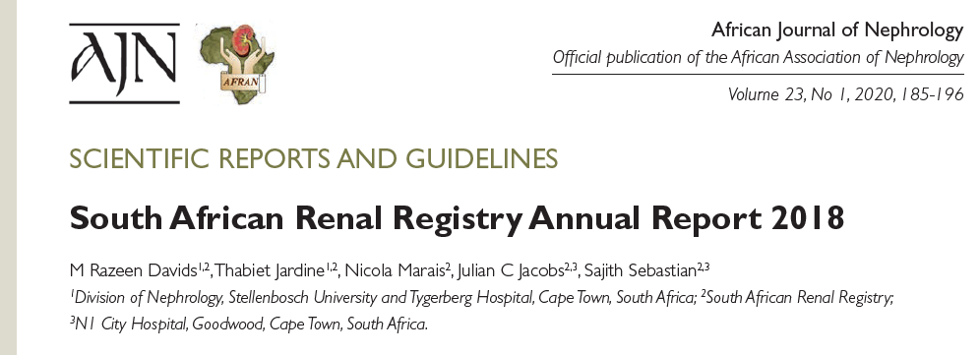

Slide 25
Treatment centres reporting data
 | 1994 | 2018 | %
Public sector | 26 | 32 | 10.6
Private sector | 5 | 269 | 89.4
Total | 31 | 301 | 100.0

Slide 26
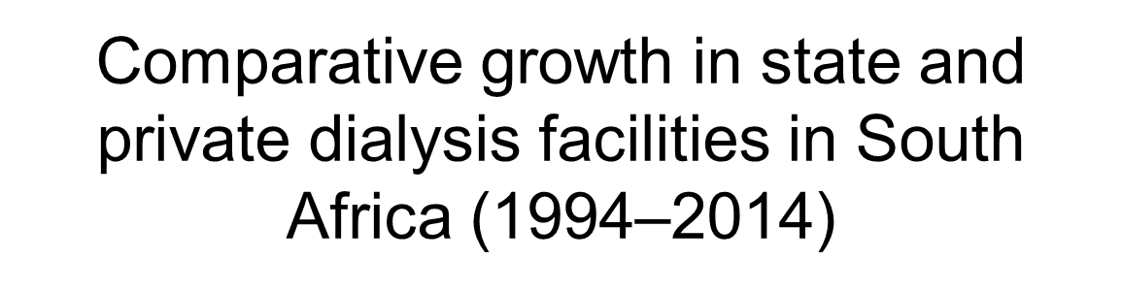
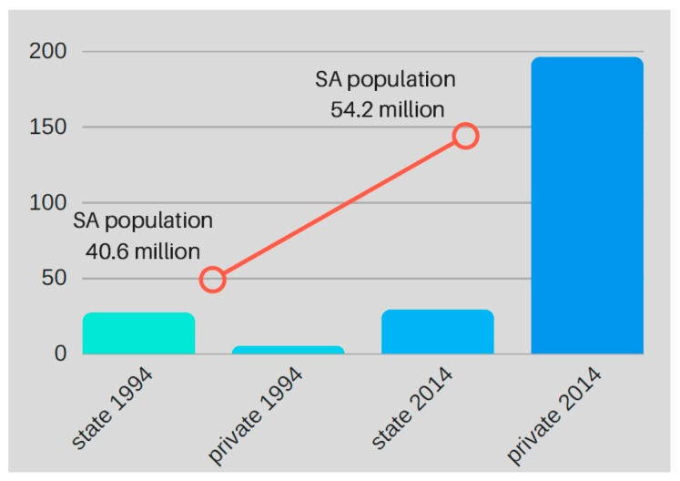


Slide 27
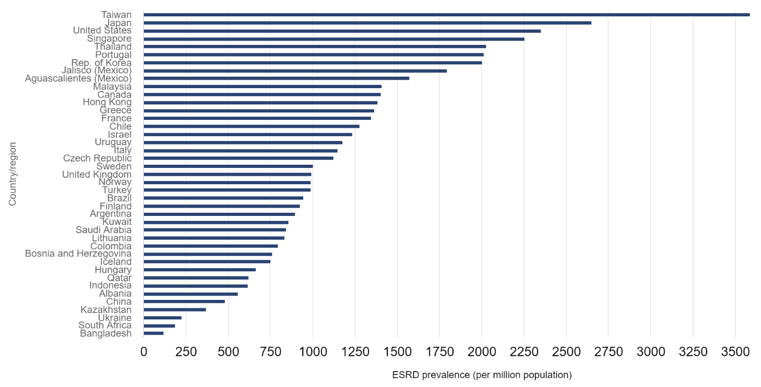
Total patients 10730
Prevalence 186 pmp
South Africa

Slide 28
South Africa: prevalence (pmp) by sector, 2018
Private
Public | Private
67 | 839
Private
Public

Slide 29
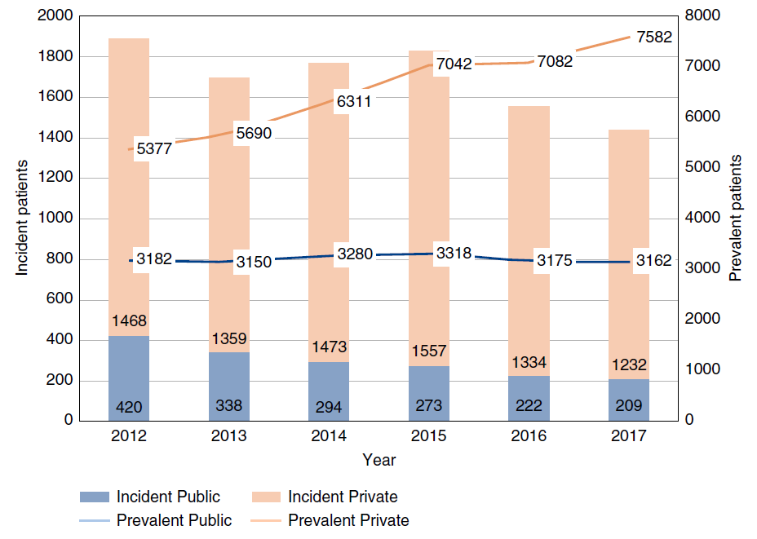
Jardine et al. Kidney360, 2020

Slide 30
Prevalence of KRT (pmp) by province and ethnicity

Slide 31
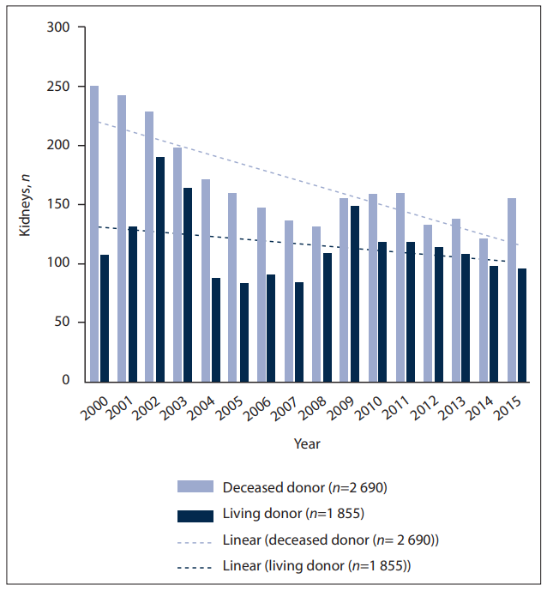
Moosa. S Afr Med J, 2019

Slide 32
Most commonly reported causes of kidney failure
 | % of total
Hypertensive kidney disease | 35.1
Cause unknown | 32.6
Diabetic nephropathy | 15.0
Glomerular disease | 10.0
Cystic kidney disease | 2.9
Obstruction and reflux | 1.8
Notes:
GN = 3235
HT = 3104
DM = 1273
CYSTIC = 282
UNKNOWN = 1228
OTHER = 331
Genitourinary causes = 138
Total = 9591

Slide 33
HIV status
No. of patients with data = 8948

Slide 34
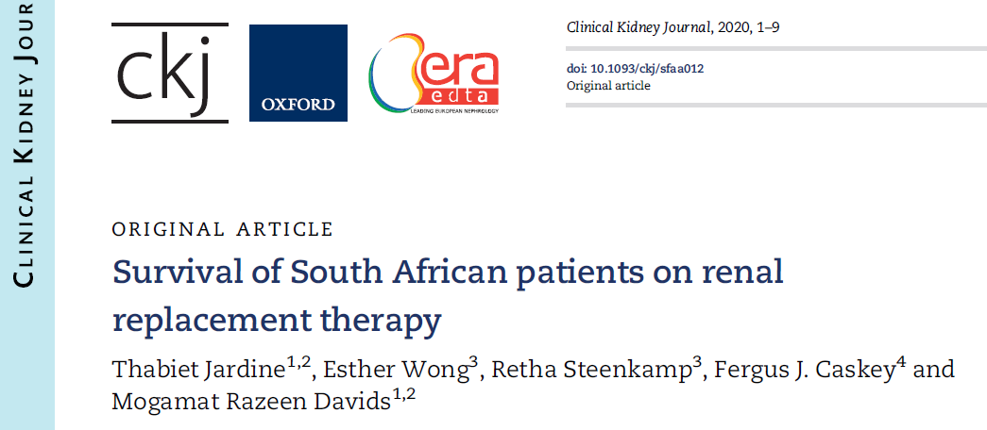

Slide 35
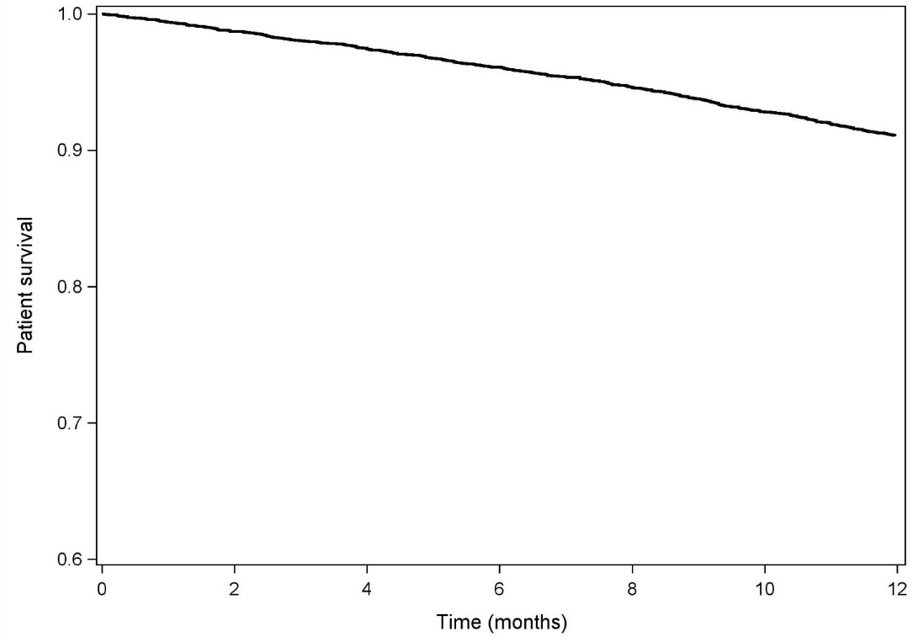
One-year patient survival
Incident patients: Overall survival 90.4%
No difference in public vs. private sectors (p = 0.18)
90.4%
Jardine et al. Clin Kidney J, 2020

Slide 36
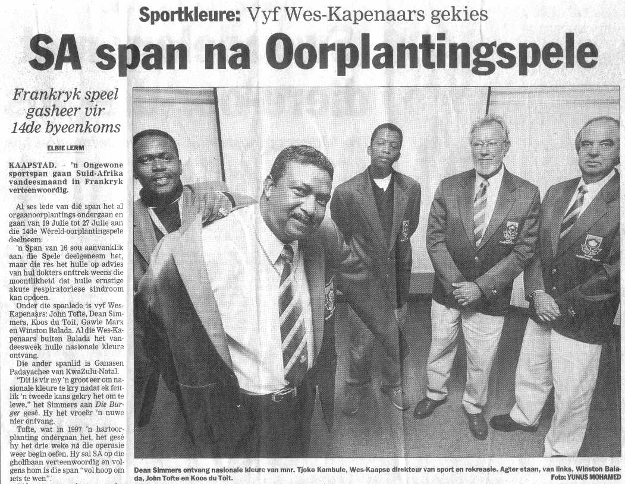

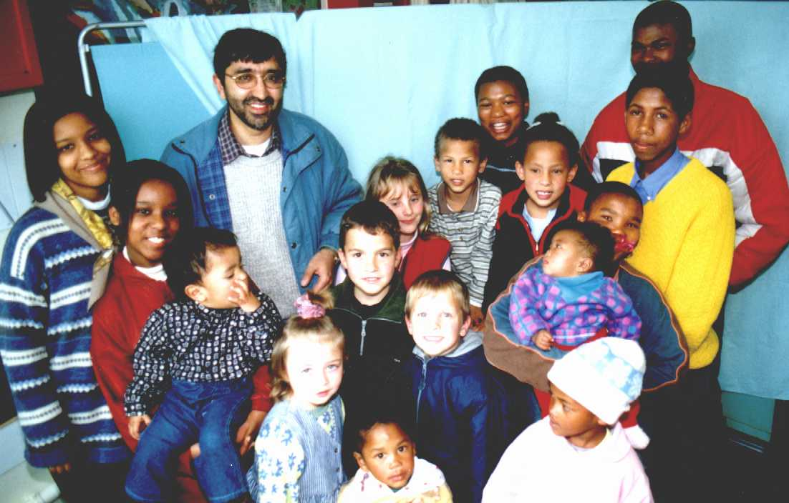

Slide 37
- commit to improving KRT access
- shortage of nephrologists
- shortage of training posts
- make data submission mandatory
- registry needs better funding
Messages
Access to treatment for kidney failure
has not improved in last two decades

Slide 38
Conservative therapy (i.e. no access to dialysis)
Significant suffering
Major burden on family
Loss of income, need for social grants
Lack of economic re-integration of the patient
Burden on healthcare system
  Frequent hospital admissions
  Need for palliative care
  Blood transfusions
  Moral distress for healthcare providers
Death

Slide 39
The current state of affairs
Inadequate prevention, detection and treatment of early stages of kidney disease.
Unequal distribution of services - affects the poorest people
  Major cities vs periphery
  Public vs private
  Racial disparities
Significant demand for dialysis and transplant services in kidney failure
  Rationed - but processes not standardised
  Severely under-resourced public sector – financial and human resources

Slide 40
The current state of affairs – Dialysis
Dialysis is:
  Effective in preserving life
  An effective bridge to transplantation
  Allows patients to return to work
Lack regulatory framework around services
  Unlicensed dialysis units
  Draft Regulation on Dialysis in SA ‘stuck’ in NDoH for 7-8 years!!
Demand likely to grow
  More diabetes
  HIV disease
  Older age of population

Slide 41
The current state of affairs - Transplantation
Maximizes quality of life for people with kidney failure
Allows people to work, have children, normalize their lives
Donors are in short supply
    Awareness
    ICU resources
    Emergency services
Waiting times / lists continue to grow
Most patients do not receive a transplant!

Slide 42

NHI bill– the perspective from SANS
Strengths
  Recognizes the need to change the current system
  Aims to equalise disparities
  Intends to promote universal health coverage
  Progressive realisation of this constitutional right
  Inclusivity of stakeholders
  Phased initiation
  Utilisation of both Public and Private sector resources for the benefit of the patients

Slide 43
NHI bill – the perspective from SANS
Weaknesses
  The bill does not address the current level of infrastructure and management failure in the state
  Funding mechanisms are vague, and critical for implementation
  Benefits are lacking detail and CRUCIAL
  The anticipated cost is not known

Slide 44
NHI - threats
Implementation concerns related to
  Corruption
  Fruitless expenditure
  Infrastructure
  Inadequate workforce
  Moral decay, poor work ethic and lack of accountability.
Further Reduction in dialysis services
  Current inadequate services in the state sector
Further Reduction in transplant services
  Needs an integrated system which includes medical, surgical and ICU care
  Needs strong multidisciplinary support and infrastructure

Slide 45
NHI - threats
Reduced interest in training in nephrology
  Inadequate remuneration
  Poor working conditions due to inability to offer life-saving therapy
  Both may discourage Nephrology as specialty choice
Transition Period
  Thousands of patients currently on dialysis in private sector will die if planning is poor
    Loss of medical aid cover without NHI funding will result in inevitable deaths within days or weeks
  Will take our country renal services backwards

Slide 46
NHI -opportunities
Improved integration and planning at all levels of kidney care
  Screening
  Prevention
  Management
  Timely referral to nephrologists
  Better dialysis initiation
Allow universal access to renal care services including dialysis and transplantation.
Using consolidated purchasing power to negotiate down costs.
Improved organ procurement for transplantation
Adequate basket of benefits and protocols developed with SANS.

Slide 47
What we would like to see
Fund raising to allow a progressive increase in services
SANS should be recognized as a key stakeholder and expert body in the planning and implementation of services for patients with kidney disease.
Fair remuneration for Nephrologists
Increased training posts for Nephrologists, dialysis nurses and technologists
Improved referral systems to access nephrology services
Correct the historical gap in access to dialysis services
  More dialysis infrastructure and staffing
  Developing a plan based on the hope offered by future technologies and partnerships rather than past failures.
  Universal dialysis for all

