Slide 1
UPDATE: HM PITJE AND ODI STADIA
PRESENTATION TO THE PORTFOLIO COMMITTEE ON SPORT, ARTS AND CULTURE
22 JUNE 2021

Slide 2
PREFACE
This a joint presentation of:
National Department of Sport, Arts and Culture
Gauteng Department of Sport, Arts, Culture and Recreation (GDSACR)
The City of Tshwane Metro Municipality (CoT)

Slide 3
CONTENTS
Purpose
Update on projects
  HM PITJE Stadium
  ODI Stadium
Funding requirements and options
Other funding models

Slide 4
PURPOSE
Purpose of this presentation is to multi-fold and include the following:
Appraise the PC on project phases for the HM Pitje & ODI projects
  Phase 1 (Demotion)
  Phase 2 ( Re-development)
Propose a way forward regarding funding and how to deal with challenges of the two facilities

Slide 5
HM PITJE STADIUM

Slide 6
Background
HM Pitje was one of the facilities earmarked as a training venue for team(s) participating in the 2010 World Cup Soccer Tournament
This necessitated a need for an upgrade, and the leading implementer was Gauteng Department of Public Transport, Roads and Works
As an implementer, the Department was responsible for procurement for consultants, professional team and the contractor
The stadium is located at Kubone Drive in Mamelodi township, East of Pretoria.
The HM Pitje stadium upgrade design had a number of shortcomings, and consequently did not comply with OHS and FIFA standards. As such, it was been abandoned and subsequently deteriorated or dilapidated.

Slide 7
Background (cont.)
In December 2018, a project initiation report was completed to assess the state of the stadium and provide recommendations for a way forward.
The project initiation deliverables included assessment report, demolition plan, demolition permit, concept design for redevelopment and BOQ
The report recommended that the stadium be condemned and should be demolished

Slide 8
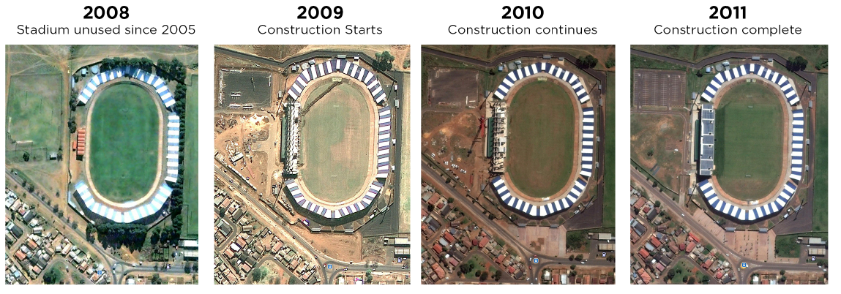
Status of the Stadium – prior to the 2010 World Cup

Slide 9
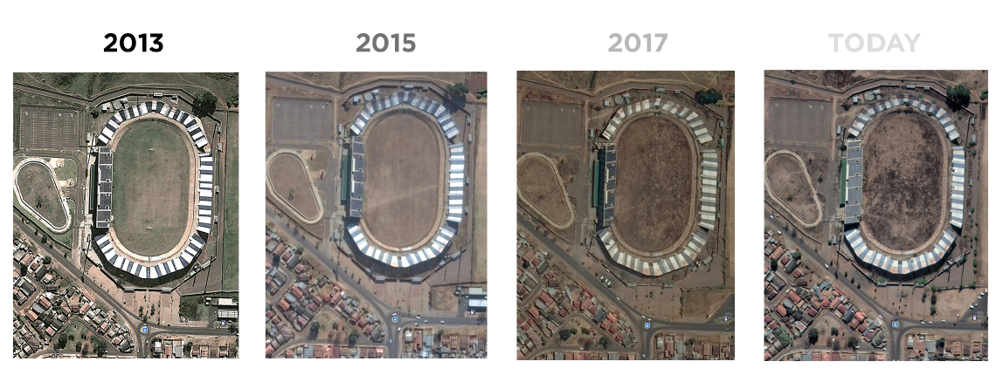
Status of the Stadium – the deterioration post refurbishment

Slide 10
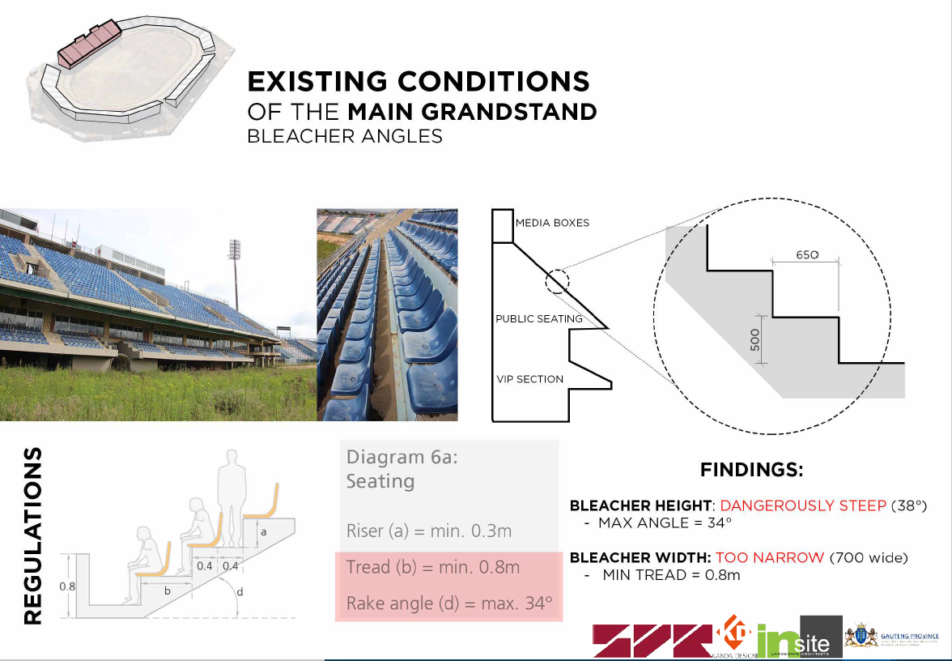
Reasons for Demolition: Non-Compliant Items

Slide 11
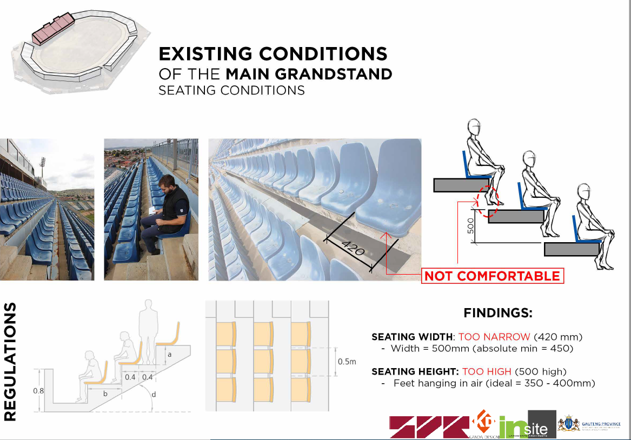
Reasons for Demolition: Non-Compliant Items

Slide 12
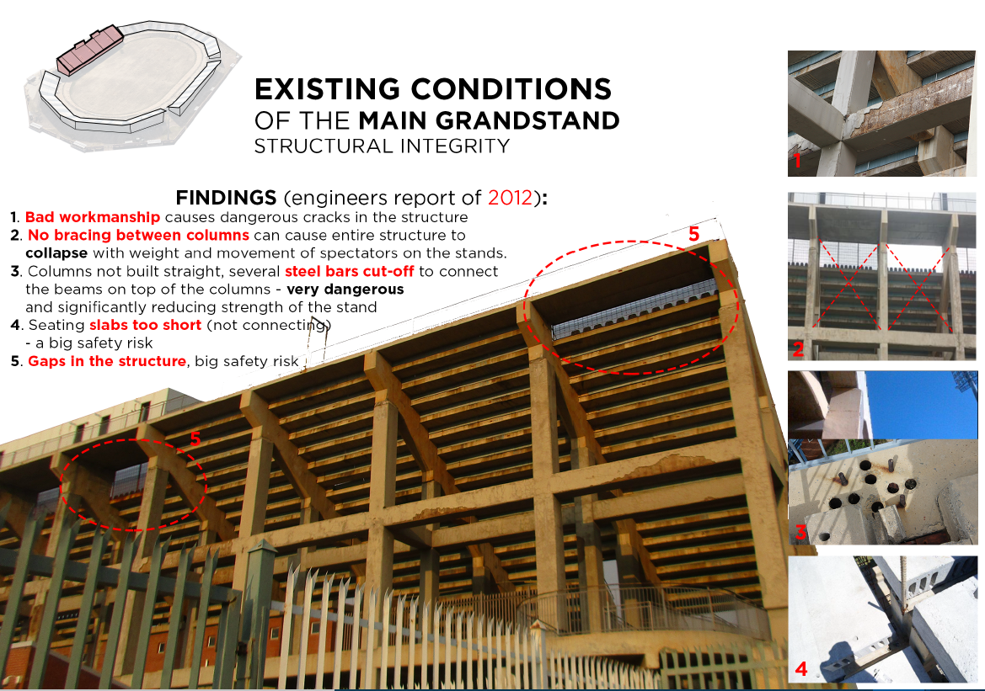
Reasons for Demolition: Non-Compliant Items

Slide 13
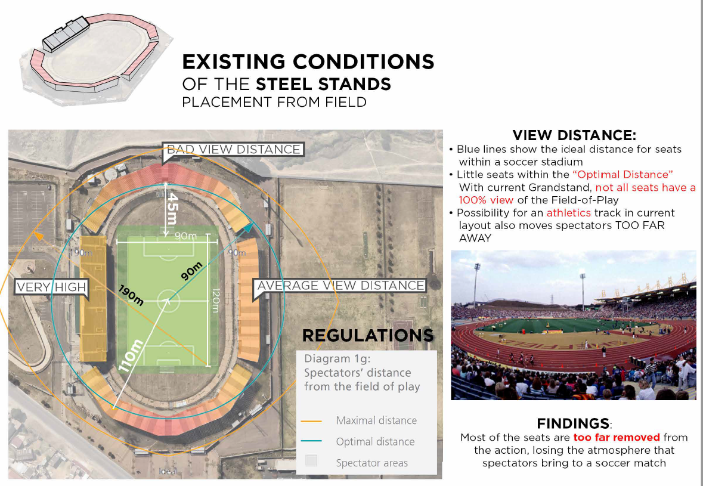
Reasons for Demolition: Non-Compliant Items

Slide 14
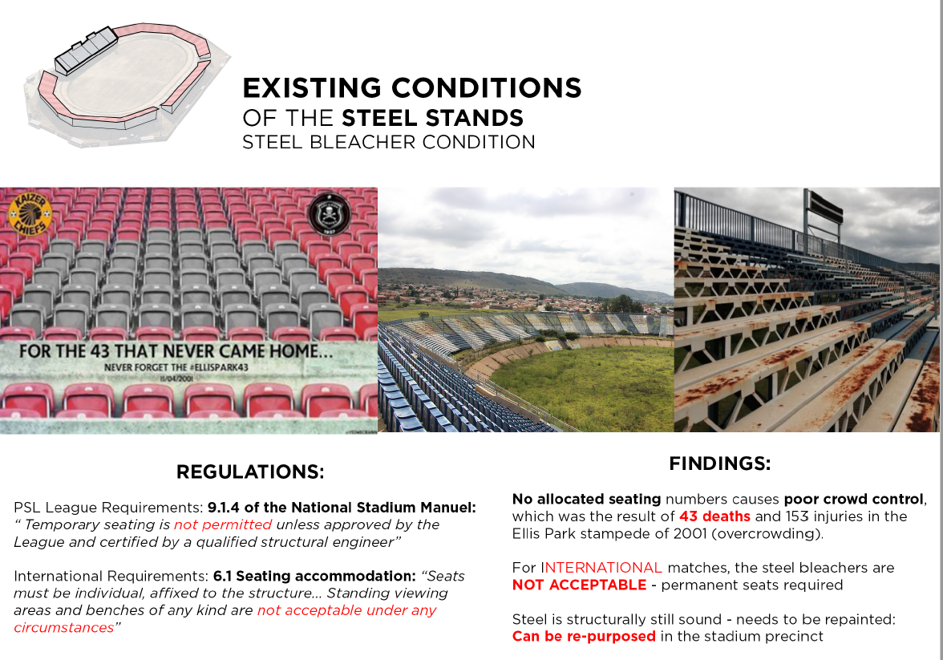
Reasons for Demolition: Non-Compliant Items

Slide 15
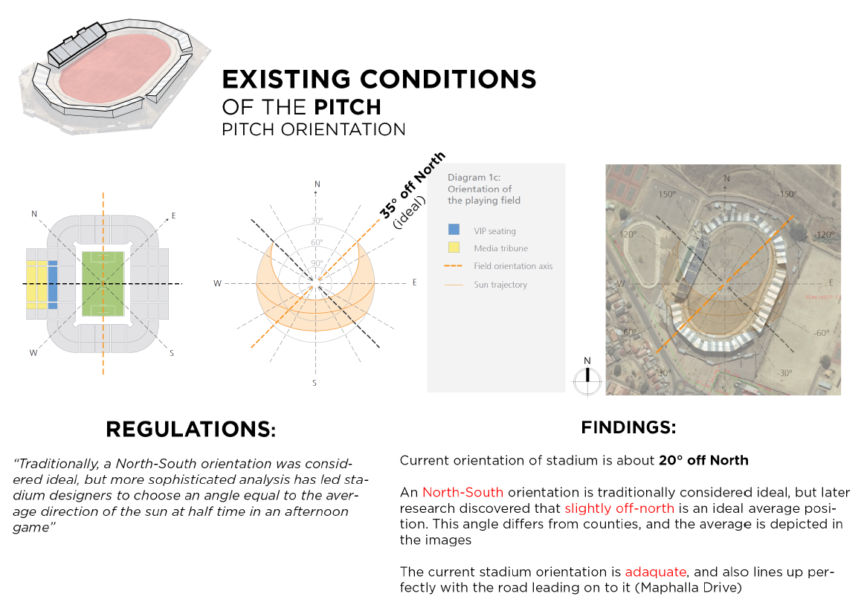
Reasons for Demolition: Non-Compliant Items

Slide 16
Actions taken to date
In June 2019, Gauteng Department of SACR submitted a business case to the Gauteng Provincial Treasury for the funding of the demolition works. The proposed demolition cost was estimated at R69 751 997.00.
The business case was approved and R22 000 000 was allocated for 2019/2020 MTEF, of which R499 751.00 was paid for the assessment report.
GDSACR has appointed GDID as an implementing agent to demolish HM Pitje Stadium.
Inception Stage - GDID, GDSACR and City of Tshwane Region 6 representatives carried out a technical inspection on 20 April 2021. This was a visual and works inspection. During the inspection it was noted that the community has dismantled some of the existing features and the status of the stadium has deteriorated.

Slide 17
Actions taken to date
The inspection findings concluded that the stadium has badly deteriorated, thus unsafe for the community in the vicinity. The findings include:
The site is covered with grass.
Some of the steel bleachers have been dismantled.
The embedded steel reinforcement on the concrete stands has corroded.
The steel bleachers have corroded.
The concrete structure is partly demolished.
Community stripping of structural steel (Collapse and OHS risk).
Health & safe risk (vagabonds occupying place).
The collapse of the structure may cause injuries & fatalities

Slide 18
Actions taken to date
A budget estimate has been submitted by GDID for the demolition works, and is estimated at R87 million (incl. VAT). The total cost will be finalised upon appointment of a contractor who will cost the project and propose a methodology for the demolition of the stadium.
The Department is in the process of appointing specialists i.e. Professional Service Providers (PSPs) who will be responsible for monitoring of the demolition phase.
The PSPs will include Project Manager, Structural Engineer, Occupational Health and Safety Specialist, Environmental specialist, and Quantity Surveyor.
The demolition plans and permit have been approved

Slide 19
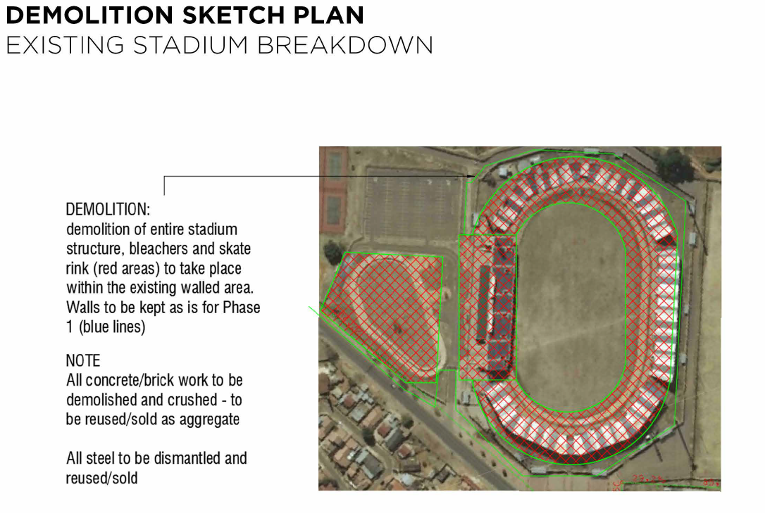
Demolition Sketch Plan

Slide 20
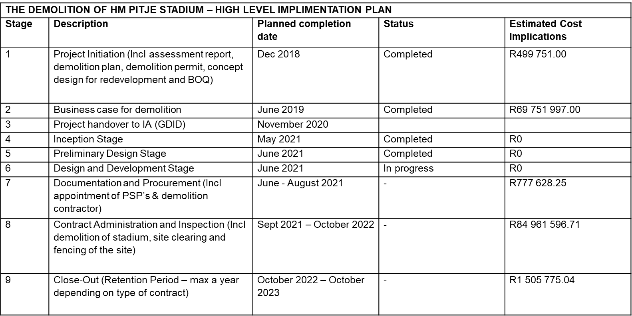
High Level Implementation Plan

Slide 21
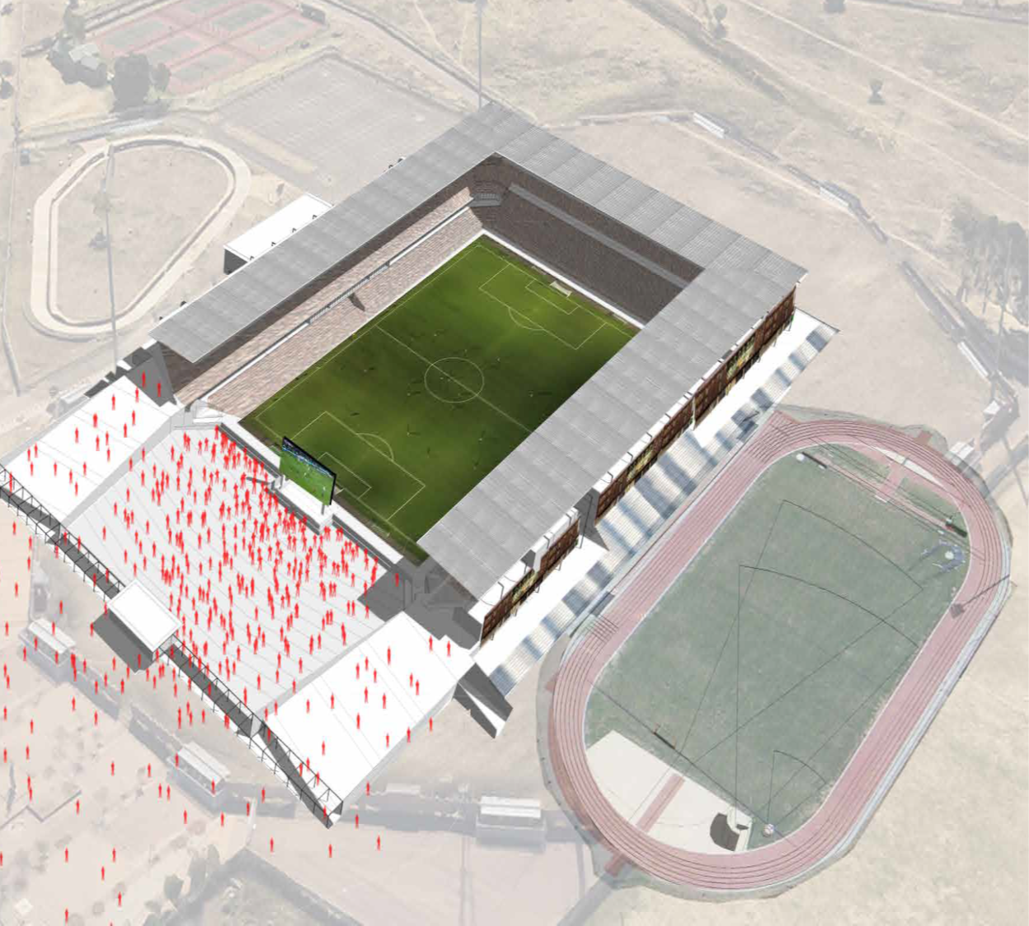
Re-Development Phase

Slide 22
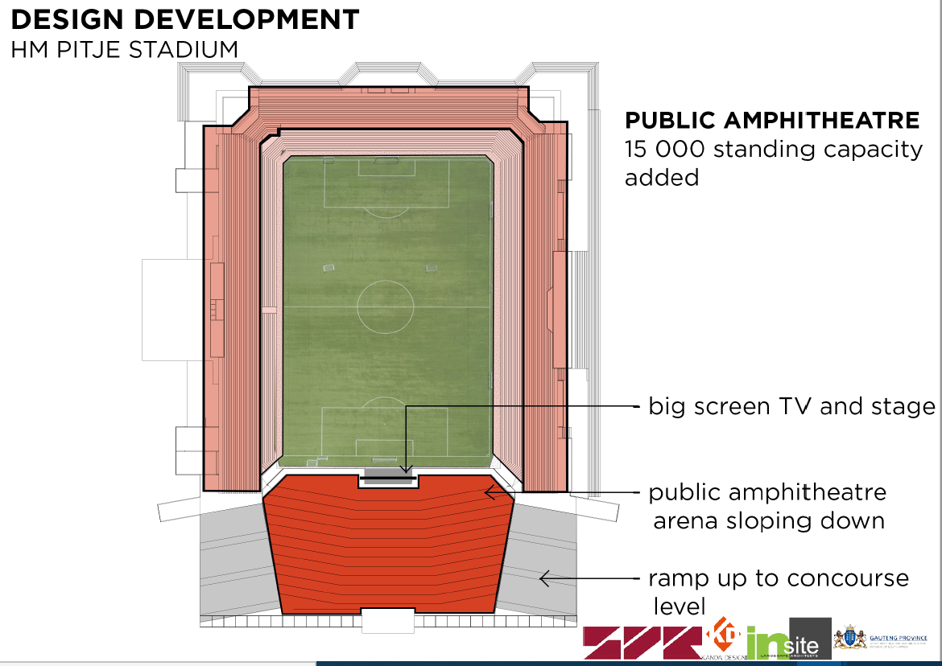
Re-Development Phase
The community consultation meetings took place in 4 October 2018 and 8 November 2018.
It was agreed that a
30 000-seater, 15 000 standing square stadium with multi purpose sports facilities is desirable.

Slide 23
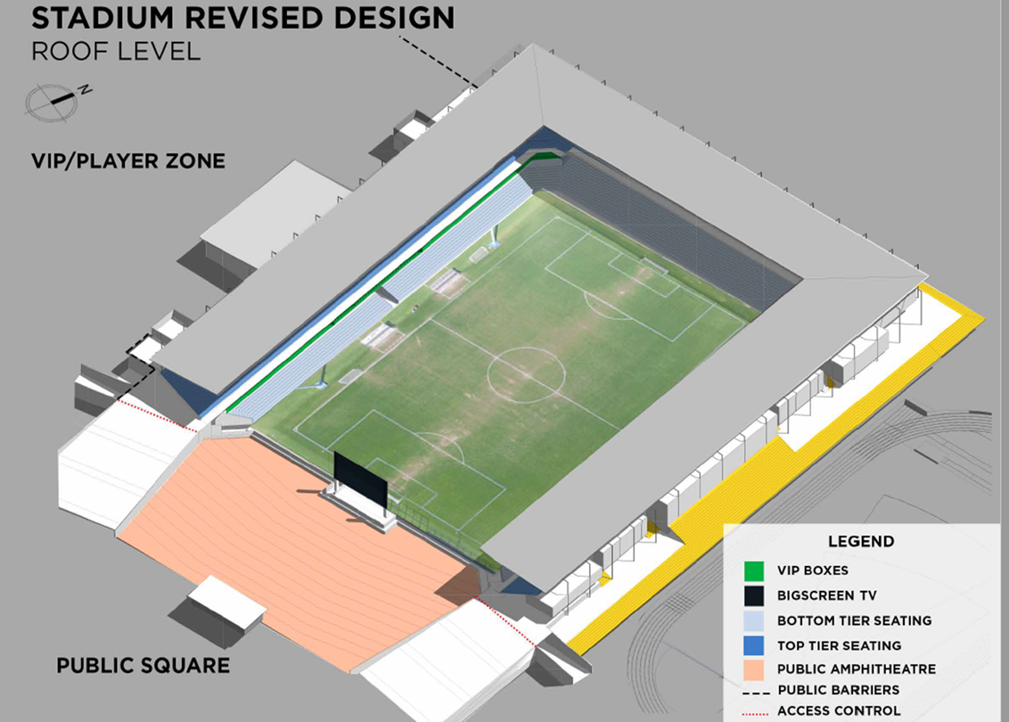
Re-Development Phase
The 30 000 seater PSL standard stadium is estimated at an average cost of R36,000 to R55,000 per seat excl. VAT
(i.e. therefore the average cost per seat is R45,500 x 30 000 = R1,365,000,000)

Slide 24
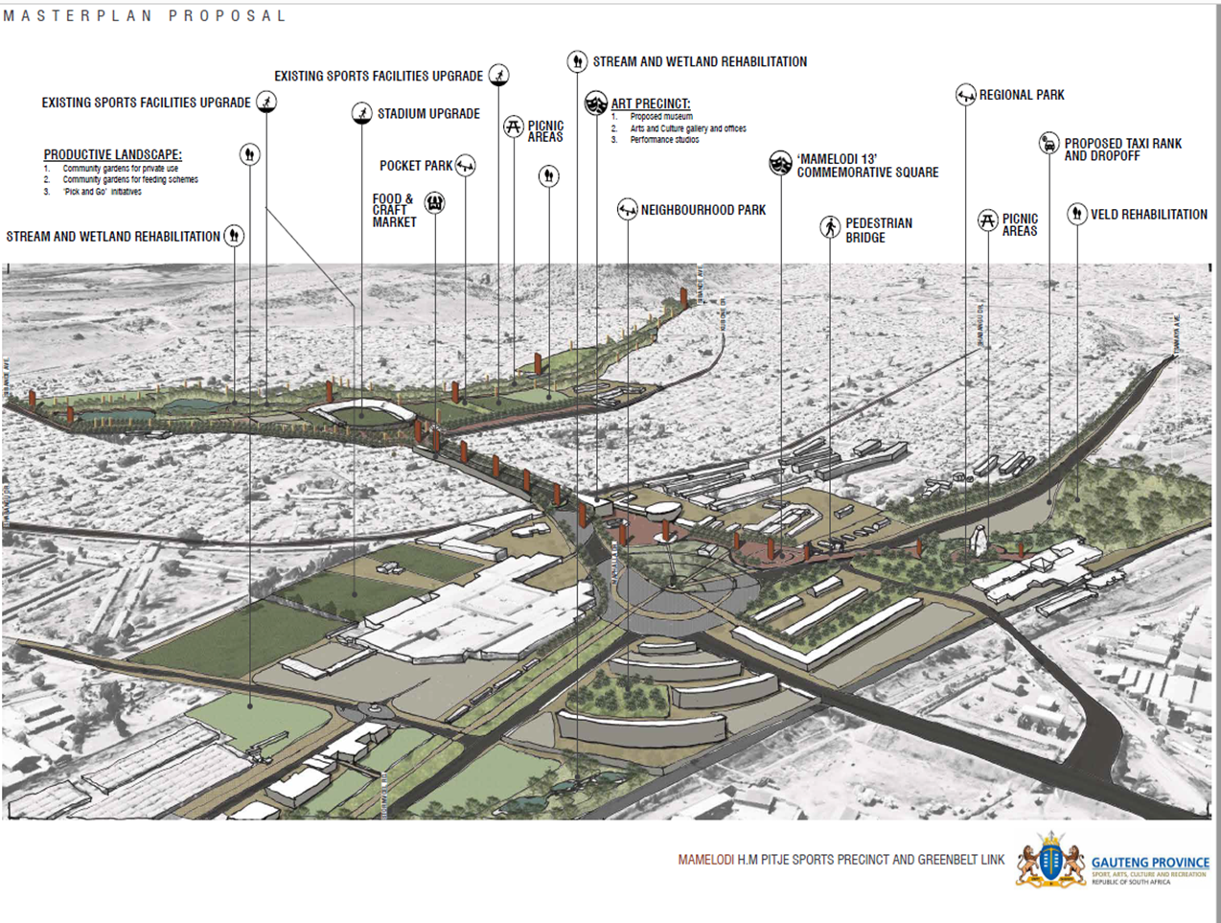
Re-Development Phase
A precinct is proposed to form part of the redevelopment phase

Slide 25
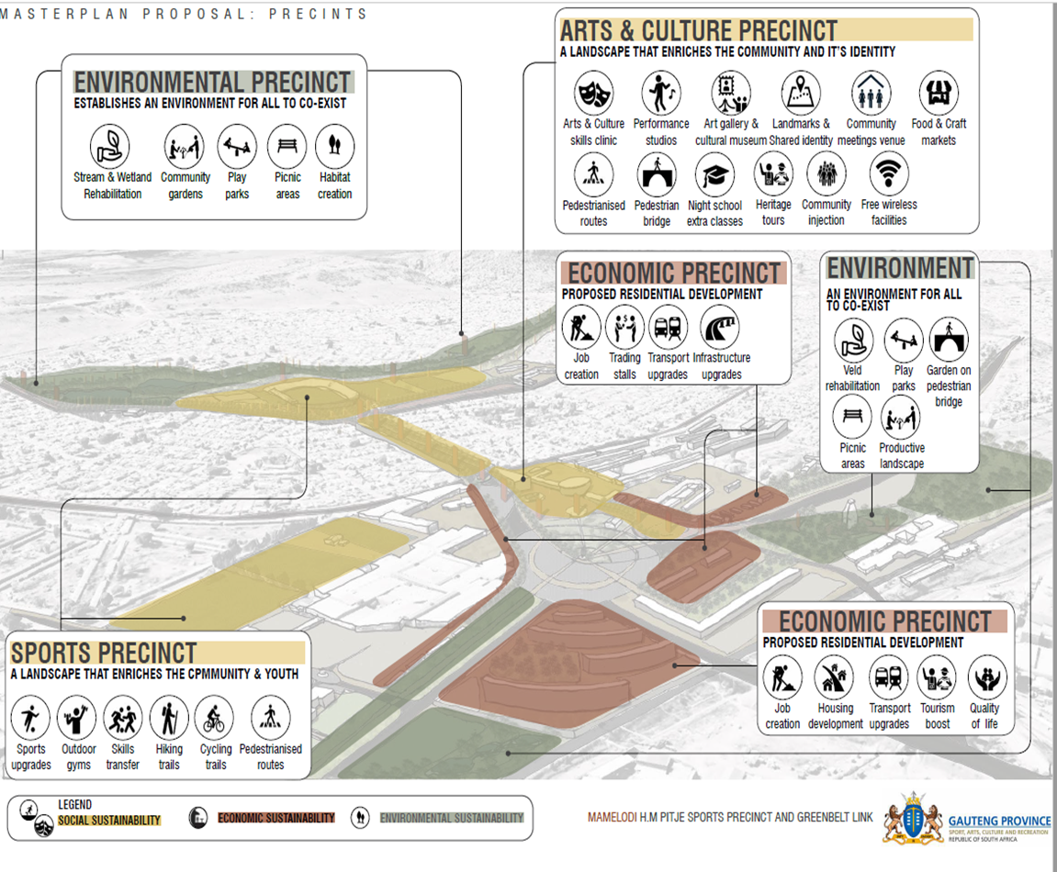
Re-Development Phase
A precinct is proposed to form part of the redevelopment phase

Slide 26
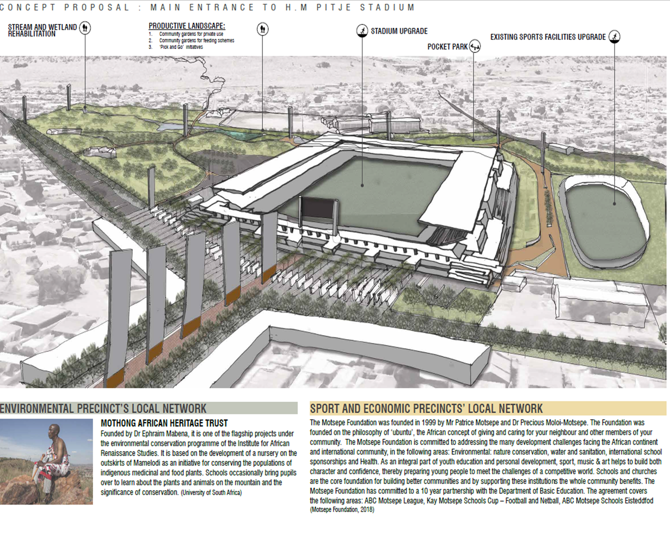

Re-Development Phase

Slide 27
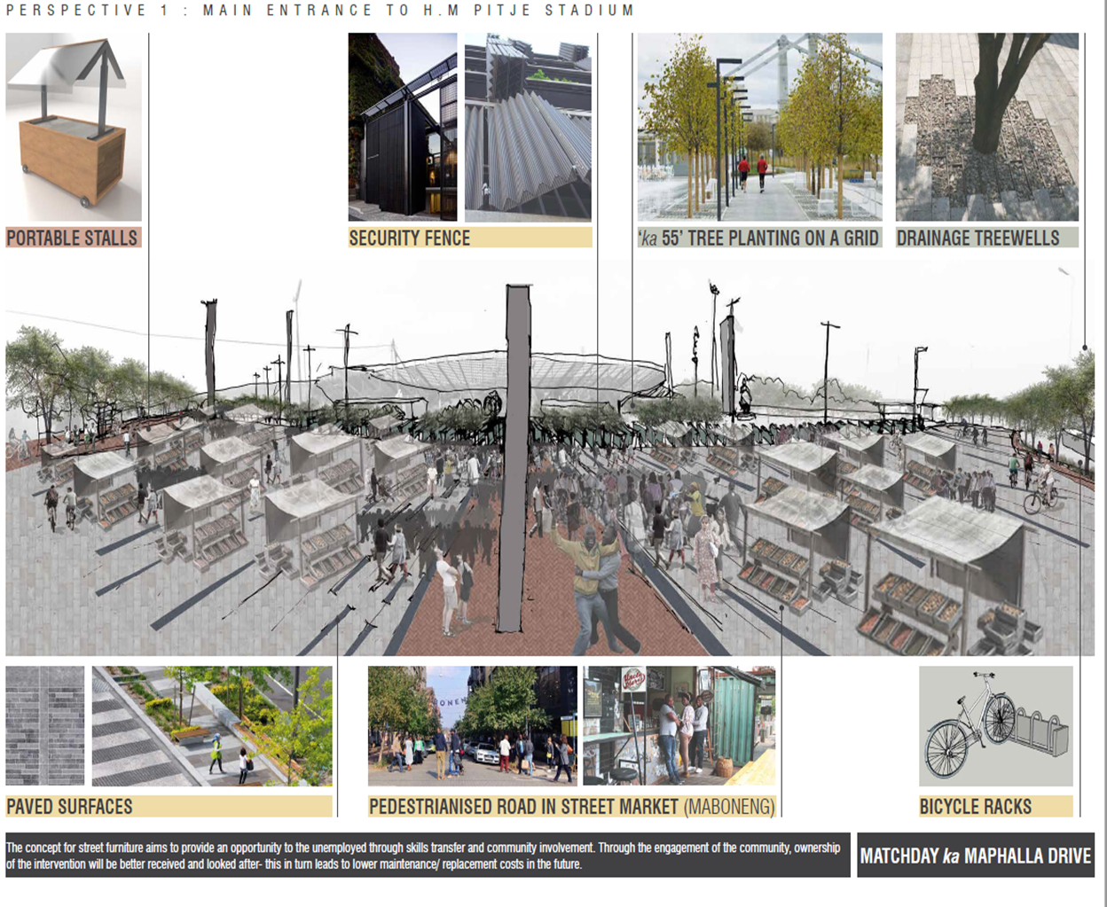
Re-Development Phase

Slide 28
ODI STADIUM

Slide 29
Background
This part of the presentation focuses on:
The demolition of the existing multi-purpose Sport and Recreation Stadium
The construction of a new multi-purpose Sport facility that will comply with OHS-Act standards and requirements as set for facilities used for public gathering and recreation.
The need for the new facility to accommodate various sporting codes.

Slide 30
Background
The stadium consists of a un-covered grand stand, secondary 4 rectangular and 2 small triangular stands, and 20 floating stands, giving the stadium a seating capacity of approximately 50,000 seats.
The stadium includes a main soccer field, tartan athletics track, tartan field events, 2 change rooms, 4 sets of male/female ablutions, 4 kiosks, VIP lounge and seating, security room, referees room, press room, control room, admin offices, generator room, stores, several indoor sporting areas, 4 high mast and 4 ticketing offices.
Other facilities outside the stadium include combi-courts for tennis, basket ball, volley ball and 2 informal soccer training grounds.

Slide 31
Background
Setting the context
The stadium was transferred to Gauteng Province at the beginning of 2008 and later transferred to the City of Tshwane. The latter had to accept an asset which was an immediate liability.
The layout of the facility is not compliant to FIFA specifications and can therefore not be used for matches.
Specific design shortfalls and lack of maintenance over several years.
The option to demolishing the stadium is based on the assessment of the structural integrity of the stadium and the inter-dependence to surrounding areas of development to compliment the existence of the stadium.

Slide 32
Background
Statuary considerations
Occupational Health and Safety Act 1993 (OHSACT)
National Building Regulations and Building Standards Act (Act 103 of 1974)
Disaster Management Act No. 57 of 2002
SABS 0400 – National Building Regulations
Municipal Fire Regulations

Slide 33
Project Description

Slide 34
Project Description

Slide 35
Community Consultation
It was recommended that a public participation process be undertaken regarding the main stadium. Consequently, a public participation meeting took place on 7 September 2013.
The three options were explained in detail to the meeting. The three options were the following:
Option 1: Demolition of the stadium and rebuilding
Option 2: Retention of the stadium and upgrading
Option 3: Demolition of the existing stadium and conversion of the stadium into a multi-purpose sport & recreational park
The Mayoral Committee of 22 January 2014 resolved on the majority decision by the community to convert the Odi Stadium into a multipurpose sport and recreational park (Option 3).
The community consultation process will need to be repeated to make sure that their wishes are implemented.

Slide 36
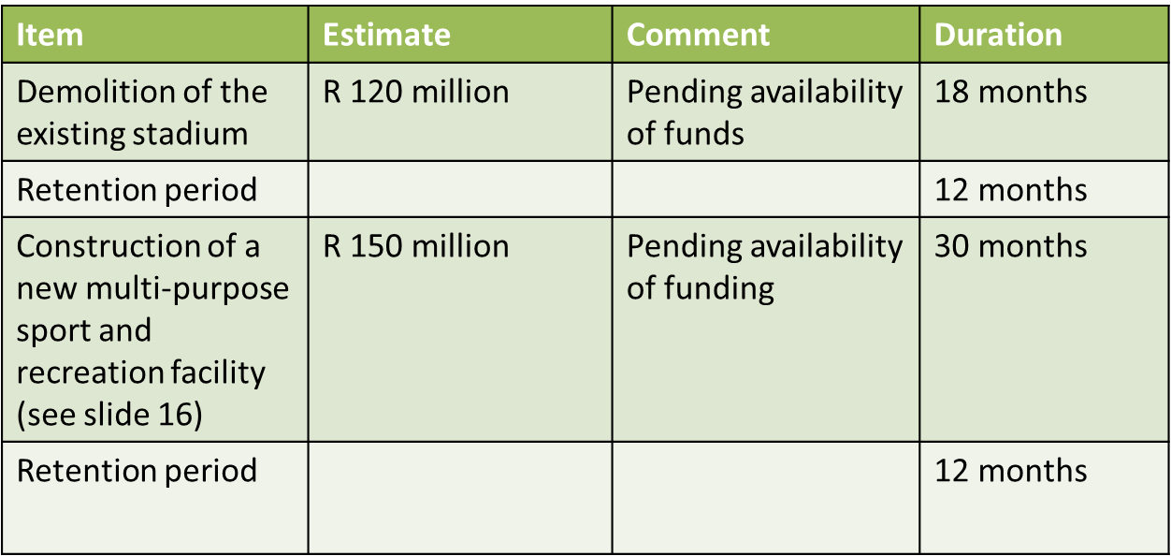
Timelines for Implementation:

Slide 37
Re-Development Elements
The proposed way forward to establish the new multi-purpose Sport and Recreation facility will include the following elements:
Demolition of the existing stadium
Newly grassed main field with floodlights, athletics track, security fencing and parking
Upgrade the existing 2 practice soccer fields in the precinct
Upgrade the existing multi-purpose courts in the precinct
Upgrade the existing indoor centre (precinct)
New public ablutions
New change rooms
New clubhouse

Slide 38
Funding Requirements and Options

Slide 39
Funding Requirements and Options
Following the PC visits, CoT engaged with DSAC and declared its intention to submit funding proposal to National Treasury (NT) under Budget Facility for Infrastructure (BFI)
By design, BFI is meant to fund projects between R1 and R3 billion, in sectors that include municipal infrastructure. In essence this means cost estimates for proposed upgrades must meet the above minimum threshold.
The current estimates are around R1,3 billion for HM Pitje and R270 million for ODI
DSAC is required to support this application through an endorsement letter. To this end, the preparation of a DG submission is underway, and a letter will be issued after consultation with CoT and approval by DG, noting the closing date of end June

Slide 40
Funding Requirements and Options
In terms of Schedule 5B, provision and maintenance of local sport facilities is a primary mandate of local government. However, the Constitution also empowers national government (in this instance DSAC) with legislative and executive authority to oversee the effective performance by municipalities of their functions in respect to, inter alia, schedule 5B.
The above clause justified the intervention in the MIG and could still be applied in the USDG to ensure that it is used accordingly to also deliver sport infrastructure, and the latter must also be included in the municipal Built Environment Performance Plans (BEPP)
It is therefore justifiable in this context that funding for sport infrastructure is made available to local government in a form of 15% of USDG

Slide 41
Funding Requirements and Options
DSAC has already engaged with NT to explore possibilities of ring-fencing 15% of Urban Settlement Development Grant (USDG), which is almost like equivalent of MIG for Metros.
The purpose of ring-fencing is to provide DSAC with some degree of control on funding mechanisms that cater for sport infrastructure to ensure that such infrastructure is actually implemented by metros
NT indicated that their data shows that metros spend more than the proposed 15% on sport infrastructure but this has not been verified by work on the ground.
NT advised DSAC to embark on process to verify these reports, and if evidence suggest otherwise and that USDG is not used to cater for sport infrastructure, then DSAC proposal may be considered, just like the proposal on ring-fencing portion of MIG for allocation was justified and supported
DSAC intends to conclude this process by no later than the end June 2021 in order to be on time for submission to relevant Budget Committees

Slide 42
Other Funding Options
National Government funding option:
- 15% USDG for Sports Infrastructure
Public Private Partnership option:
- To be explored as a commercial development and a creation of a commercial hub.

Slide 43
THANK YOU

