Slide 1
LOCAL CONTENT AND PRODUCTION
PRESENTATION TO SCOPA
N. Ebrahim

Slide 2
LEGISLATIVE FRAMEWORK
PFMA
and
MFMA
CONSTITUTION
Chapter 13: Financial Matters
(Section 216 )
Section 217 (1)
Procurement generally in terms of the 5 pillars (fair, equitable, transparent, competitive & cost-effective
Section 217 (Procurement)
Section 217 (2): an organ of state may implement a procurement policy providing for categories of preference in contracts and for protection and advancement of persons… disadvantaged by unfair discrimination
Section 217(3) National legislation must prescribe a framework for the above policy
National Treasury Regulations to PFMA & MFMA
PREFERENTIAL PROCUREMENT POLICY FRAMEWORK ACT No. 5 of 2000
Purpose:
To provide a uniform legal instrument through which government would set aside 30% of appropriate categories of state procurement for purchasing from SMMEs, cooperatives, townships and rural enterprises.
PPPFA Regulations 2017 (new)
18 SEPTEMBER 2020 PRESENTATION

Slide 3
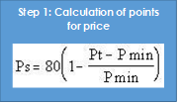
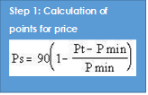
PROCESS PRESCRIBED BY THE ACT
80/20
Evaluation:
price and preference
90/10
SPLIT BETWEEN PREFERENCE AND SPECIFIC GOALS
AS DEFINED BY PROCURING ENTITIES
Step 2: Calculation of points for B-BBEE status level of contributor (preference)
Allocation of points for specific goals within the 20 or 10 points for preference (i.e. local content being defined as one of the goals of RDP)
Step 2: Calculation of points for B-BBEE status level of contributor (preference)
18 SEPTEMBER 2020 PRESENTATION

Slide 4
PROCESS PRESCRIBED BY THE 2017 REGULATIONS
Applied for all price quotations and bids above R30 000 up to R50 M (all applicable taxes included)
New thresholds i.t.o. 2017 regulations
Applied for all bids above R50 M
Other
Considerations
Functionality
Pre-qualification
Sub-Contracting
Local content
These considerations are dealt with upfront before the points system is used and often compete with each other
80/20
90/10
Evaluation:
price and preference
Step 2: Calculation of points for B-BBEE status level of contributor (preference)
Step 2: Calculation of points for B-BBEE status level of contributor (preference)
18 SEPTEMBER 2020 PRESENTATION

Slide 5
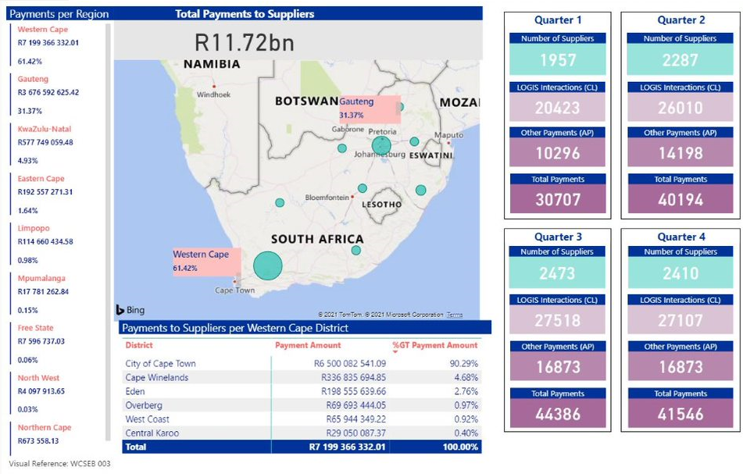
REGIONAL SPEND ANALYSIS (2020/21 financial year)

Slide 6
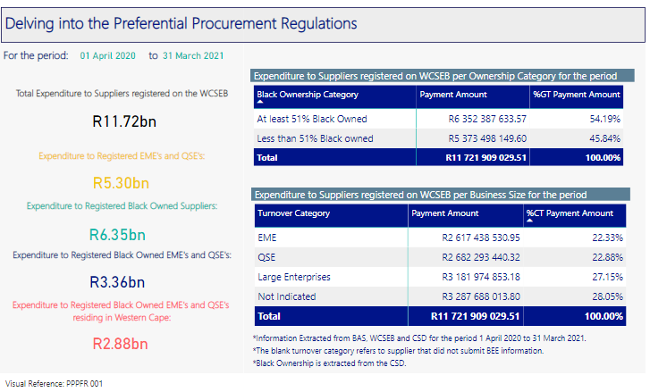
Preferential Procurement

Slide 7
Local Production and Content Procurement End to End Complexity
DEPARTMENT
Advertises Bid include Local Production and Content
Explain Exemption Requirement (DTIC Process)
Issue 6.2 Bid Document
2
1
SUPPLIER
Sees Advert
Supplier Assess
Specifications
Department assess quality of sample
5
Can
Meet Spec
Cannot Meet Spec
If Not compliant Department must take action in terms of instructions
6
12
7
3
If Threshold is met
Due Diligence Test
Indicates doing site visit / assessment according to DTIC criteria
4
3
Supplier applies to dtic for exemption
Supplier to Make / Provide SAMPLE to Department
Supplier to complete
Annexure D if materials are imported
7
4
12
BID AWARDED TO THE HIGHEST POINT SCORER
dtic has 5 days to issue an exemption / authorization letter
8
6
SUPPLIER to submit:
Bid /Quotation
WCBD 6.2
Annexures C
Annexure D (for Imported Content)
Annexure E
8
5
9
Notify the dtic
SUPPLIER to submit:
Bid
Annexures C; D; E
WCBD 6.2
Exemption Letter
Sample
dtic instructs SABS for verification
10
SABS reverts back to dtic
POST AWARD VERIFICATION
11
18 SEPTEMBER 2020 PRESENTATION

Slide 8
28 DESIGNATED SECTORS
Industry/sector/sub-sector | Minimum threshold for local content
Buses (Bus Body) | 80%
Textile, Clothing, Leather and Footwear | 100%
Steel Power Pylons, Monopole Pylons, Steel Substation Structures, Powerline Hardware, Street Light Steel Poles, Steel Lattice Towers | 100%
Canned / Processed Vegetables | 80%
Pharmaceutical Products: (MANAGED BY NT)
OSD Tender Family Planning Tender | 70% (volumes) 50% value
Rail Rolling Stock | 65%
Set Top Boxes (STB) | 30%
Furniture Products:
Office Furniture School Furniture Base and Mattress | 85% 100% 90%
Solar Water Heater Components | 70%
Electrical and telecom cables | 90%
Valves, products and actuators | 70%
Residential Electricity Meter:
Prepaid Electricity Meters Post Paid Electricity Meters SMART Meters | 70% 70% 50%
Working Vessels/Boats (All types): | 60%
Components | 10% - 100%
Conveyance Pipes | 80% - 100%
Transformers and Shunt Reactors:
Class 0 Class 1 Class 2 Class 3 Class 4 | 90% 70% 70% 45% 10%
Components and conversion activities | 50% - 100%
Solar PV Components:
Laminated PV Modules Module Frame DC Combiner Boxes Mounting Structure Inverter | 15% 65% 65% 90% 40%
Two Way Radio Terminals and Associated Equipment:
Portable Radio Mobile Radio Repeater | 60% 60% 60%
Components | 20% - 100%
Rail Signalling: | 65%
Components | 40% - 100%
Wheely Bins: | 100%
Fire Fighting Vehicle | 30%
Crew Cabin Super Structure Assembly | 100% 100% 100%
Steel Products and Component for Construction
Steel Value-added Products Fabricated Structural Steel Joining/Connecting Components Frames Roof and Cladding Fasteners Wire Products Ducting and Structural pipework Gutters, downpipes & lauders Steel Value-added Products Plates Sheets Galvanised and Colour Coated Coils Wire Rod and Drawn Wire Sections Reinforcing bars | 100% 100% 100% 100% 100% 100% 100% 100% 100% 100% 100% 100% 100% 100%
Pumps, Medium Voltage (MV) Motor and Associated Accessories | 70%
Casting or Frame Fabrication Fabrication and winding of the Rotor Core Accessories Assembly and testing of the fully-built unit | 100% 100% 100% 100%
Rail Permanent Way | 90%
Rails and rail joints Ballasts Ballastless Turnouts/switches and crossings Railway sleepers Rail fastening and accessories Railway maintenance of way plant & equipment Assembly and testing of fully build units | 100% 100% 100% 100% 100% 100% 70% 100%
Plastic Pipes | 100%
Polyvinyl chloride (PVC) pipes High density polyethylene (HDPE) pipes Polypropylene (PP) pipes Glass reinforced plastic (GRP) pipes | 100% 100% 100% 100%
Air insulated MV Switchgear | 50%
Instrument Transformers Busbars Housing Switching Devices | 15% 5% 25% 5%
Bulk Material Handling | 85%
Conveyer Idlers Structural Steel Rubber Conveyor Belt Pulleys | 70% 100% 100% 100% 60%
Industrial lead Acid Batteries | 50%
Pumps, Medium Voltage (MV) Motor and Associated Accessories
70%
Casting or Frame Fabrication
Fabrication and winding of the Rotor Core
Accessories
Assembly and testing of the fully-built unit
100%
100%
100%
100%
Rail Permanent Way
90%
Rails and rail joints
Ballasts
Ballastless
Turnouts/switches and crossings
Railway sleepers
Rail fastening and accessories
Railway maintenance of way plant & equipment
Assembly and testing of fully build units
100%
100%
100%
100%
100%
100%
70%
100%
Plastic Pipes
100%
Polyvinyl chloride (PVC) pipes
High density polyethylene (HDPE) pipes
Polypropylene (PP) pipes
Glass reinforced plastic (GRP) pipes
100%
100%
100%
100%
Air insulated MV Switchgear
50%
Instrument Transformers
Busbars
Housing
Switching Devices
15%
5%
25%
5%
Bulk Material Handling
85%
Conveyer Idlers
Structural Steel
Rubber
Conveyor Belt
Pulleys
70%
100%
100%
100%
60%
Industrial lead Acid Batteries
50%

Slide 9
28 DESIGNATED SECTORS
Designated PPE Commodities Requiring Adherence to The Local Content & Production Thresholds (NT Instruction Issued 16 July 2012) Clothing and Textiles: 3- ply Surgical Masks Clothing and Textiles: Respirators (e.g. FFP2 & FFP3; N95) Clothing and Textiles: Medical Textiles (e.g. Linen, Curtains, Gowns, Coveralls; overshoes; swap suits; etc.) Clothing and Textiles: Fabric/Public usage / consumer face masks Leather and Footwear: Hospital cleaners closed work shoes Leather and Footwear: Nurses shoes Leather and Footwear: Patient shower slippers /sandals Leather and Footwear: Service Footwear Furniture: Beds and Mattresses | 100%
Non-Designated PPE Commodities Which can be Locally Procured Using Regulation 8.4 of 2017 Preferential Procurement Regulations Goggles Face shield Disposable Aprons Gloves Body Bags Biohazard bags | 100%

Slide 10
Applicable Designated Sectors
First instruction note issued in 2012, since 2012 28 sectors were designated.
Not all designated sectors are applicable to departments and municipalities, this is however not defined by the dtic. Departments and municipalities to assess applicability and apply the requirements as needed
The pharmaceutical Products sector are managed by the National Treasury
Rail Rolling stock, set top boxes, working vessels/boats, rail signaling, bulk material handling and rail permanent way sectors are not applicable to departments and municipalities

Slide 11
Implementation Challenges Experienced
Local Content
2 pieces of enabling Laws (B-BBEEA & PPPFA
Ambiguity in process and prescripts results in various interpretations
Bidders complete bid documents and indicate compliance which is not verified
Ex post facto verification and certification
Threshold of R30 000 is problematic given red tape four compliance
Irregular expenditure is for the boos of account of procuring entities
Deviation must be done by bidder for each and every procurement
100% compliance is required to prescribed threshold
Market analysis not freely available
Certification (cost and for every tender process)
18 SEPTEMBER 2020 PRESENTATION

Slide 12
WCG Response to Challenges
WCG Position Paper on Local Content Implementation produced and made available to NT as well as issues raised at various NT fora (i.e., SCM Forum, TCF, PAG forum and in formal written comments to the commentary phases iro PPPF regulations and to Instruction Notes)
Discussions and workshops with the dtic and SABS since implementation of local content requirements post 2012 as part of previous PPPFA regulation implementation
Training interventions, workshops which the Province facilitated and dtic and /NT
Support provided to departments and municipalities by PT on interpretation issues in audit process
PT deals with queries on local and provincial implementation challenges via the PT SCM helpdesk
Formal communication provided to the National Treasury DG -end August 2019 on policy and prescript challenges, conflicts and impracticalities or red tape on financial prescripts. Local content challenges also documented and flagged as an issue in this communication
Procuring entities include LC requirements for designated goods, suppliers follow deviation process as required
WCG procured from local suppliers in its procurement process although not necessarily designated “Local content and Production”
18 SEPTEMBER 2020 PRESENTATION

Slide 13
Universal Widespread challenges
SCA ruling on the PPPFR, 2017 – decision set aside till November 2021
Market analysis that informed designations are not made available
NT does not provide on local content requirements, all enquiries must be forwarded to the dtic
Sectors are designated without consultation
Sectors are designated with immediate effect or limited notice hampering successful implementation
Forms are drafted for manufacturers and not suppliers of the goods
Where minimal fraction of a contract is a designated sector, the whole contract is subject to LC before other components of the bid are considered
Zero to limited data on local content verifications conducted by the SABS
Compliance to certain designations may be achieved by approving and availing a list of local brands - dtic is reluctant to provide a list of local brands
Bidders do not know how to complete the forms
Applicability of Regs from R30 000 but dtic requests application regardless of threshold value. (cumbersome process for low value procurement)

Slide 14
Sector Specific Challenges
Canned / Processed Vegetables
DoH: List of vetted complaint brands are not updated, which makes implementation of this instruction note problematic
Furniture Products
The list is not defined, only 11 items are mentioned in the circular under office furniture however the list is not comprehensive
Two Way Radio Terminals and Associated Equipment
Security services are procured, how to enforce the utilisation of locally manufactured radios
Steel Products and Component for Construction
Broad sector: how to apply in turnkey projects where steel is a fraction of the bid price

Slide 15
Sector Specific Challenges
Textile, Clothing, Leather and Footwear sector:
Material is not available in South Africa, in most cases imported material is used and suppliers must request for exemption as this sector has a 100% requirement
Suppliers struggle with the completion of the forms
Difficult to determine locality of materials used if not the manufacturer of the goods
Manufacturers unwilling to provide information on materials
No items list: broad sector and the dtic adds to this sector when the need arises, constant consultation with dtic in terms of the applicability of this sector to goods to be procured
Certain medical items (gauze, plasters, bedlinen, curtains, aprons) forms part of this sector, local content is the first consideration as per the dtic’s instruction however in terms of medical items other factors (SABS requirements) should be considered first
Suppliers/bidders are not always the manufacturers

Slide 16
Initiatives
Training session with municipalities
Inputs to the on amendments to Instruction No. 05 of 2020/21 (IN5). NT issued amendments to (IN5): Emergency Procurement in Response to the COVID-19 i.e., stipulated minimum threshold percentage for local production and content for the Textiles, Clothing, Leather and Footwear sector-16 July 2012)
Engagements with NT and District Municipalities, CFOs - Matrix of SCM Challenges giving a synopsis of SCM interpretation challenges faced by departments and municipalities
Letter to NT on Local production and content issues
Submitted comments to the Review of NT’s prescripts for local production and content
Summit (Local Content) PT formed part of the panel. Local content concerns raised. NT attended and the dtic
Roadshows in municipal areas to establish concerns and issues by municipalities and suppliers: DEDAT, SABS, dtic, PT presented
Sought legal opinion from legal services regarding local content threshold
Workshop arranged by PT: Departments and suppliers (training material provided to departments and suppliers)
Steel IN concerns and challenges raised with dtic and NT (no feedback received).

Slide 17
Covid-19 specific

Slide 18
CHALLENGES I.R.O. NT INSTRUCTION 5 AND CIRCULAR 102 100% local content and production required for PPE items
18 SEPTEMBER 2020 PRESENTATION
Supply and demand issues of the local market.
RT contracts e.g. for gloves specify an imported content requirement and in current circumstances these require a 100% local content compliance threshold
Exemption process with dtic has not been amended and no confirmation on a 24 hour return time and potential disruptions this may cause.
Companies listed NT preferred list- it is not known whether these are third party agents or whether/not they purchase from other companies that are importing the products
No indication by NT on whether /not the market has been tested and whether the suppliers can provide the service and comply with the LC requirements
Provincial initiatives to stimulate the local economy not taken cognisance of.
Outstanding orders on PPE items that were purchased from the preferred lists
False declarations of bidders as the verification is required ex post facto an award
Challenges in vetting and verification process under COVID-19 conditions
Inability of market to respond to the need
Proudly South African verification or certification is not a prescribed LC verification mechanism
The reference to procuring institutions may approach “any supplier” is qualified by “ provided that” or “on condition that..” they meet the stipulated minimum threshold...” This has the impact of bringing in compulsory requirements for local content and manufacture for disaster and/ emergency procurement, which in any event is a requirement if the goods have been designated.
Emergency protocols issued after lockdown did not specify compulsory local content compliance for PPE. The 2 previous Instructions / Circulars were retracted with the impact the procuring institutions were required to follow different prescripts every time that these were issued by NT making different procedures applicable with a lack of consistency in application and requirements
Cumbersome compliance procedure are required in the norm and to do this with a disaster is irrational and impractical.

Slide 19
Local Government Specific Challenges
The local content was a huge issue with audit interpretation challenges, coupled with a wide range of irregular expenditure.
Suppliers are finding it very difficult to adhere to the requirements and municipalities are complaining that it negatively impact operations and ultimately service delivery.
The City of Cape Town had to cancelled quite a significant number of bids because of non-compliance to local content.
Examples:
Tender 123Q/2017/18 - Sludge processing – Value R107m – No responsive bids due to LC on 4 valves to the value of R100 000.
Tender 367Q/2015/16 – Du Noon Library – Compliance with LC cost an additional R4m due to fire reticulation valves to the value of approx. R85k. Only 1 responsive bid. (R37m to R41m).
This had a detrimental impact on service delivery. In a special session held on the 05 Feb 2020 with the National Treasury, the COCT unpacked the unintended consequences of the non-compliance to local content.
Through the Western Cape LED/SCM Indaba’s a lot of local development projects have been spearheaded by municipalities.
The Drakenstein Municipality has a specific Contractor Development Programme that was designed to empower the local contractors. The Garden Route District has also identified through its JDA Structure, a range of projects to kick-start the local economy and empower suppliers.
18 SEPTEMBER 2020 PRESENTATION

Slide 20
Key Initiatives and mainstreaming-
PROVINCIAL GOVERNMENT
Centre led (technology led) SCM strategy that looks at uniformity and standardisation;
Procurement Planning Toolkit – empowerment impact assessments to be concluded in the planning phase to look at viability and targeting in the actual procurement process (i.e., for any socio-economic empowerment initiatives including B-BBEE . Local content and other empowerment requirements through special conditions)
Empowerment Impact Assessments
Trade-offs
How to we eliminate red tape and look at legislative/ regulatory reforms
Relationship building with dtic; SABS, NT and further work required with other role-players like Proudly SA
Linking with our municipalities through LED/ Supplier Indaba’s
LOCAL GOVERNMENT
Through the Western Cape LED/SCM Indaba’s a lot of local development projects have been spearheaded by municipalities.
The Drakenstein Municipality has a specific Contractor Development Programme that was designed to empower the local contractors. The Garden Route District has also identified through its JDA Structure, a range of projects to kick-start the local economy and empower suppliers.

Slide 21
Integrated Strategy to Unlock Value
PROPOSALS
Business Intelligence and Technology enablement
SCM Public disclosure Reporting
Performance Information (SCM Insight Reports
Procurement planning Toolkit linking to Budget and linkages to Empowerment Impact assessment enablement
Issue Management System
Commodity Focus
Cost Containment (Travel & Accom.; Catering)
DotP (Employee Health & Wellness; Communication) ;
PT ( Security Framework Contract)
DoH (Medical and PPE)
Other: Emanating out of Demand Forecasting from Departmental Procurement Plans
e-Procurement and Technology Enablement
e-Procurement System continuity to replicate and build on current model to replace current model inclusive of bids that interfaces with WCSEB and Procurement Planning Toolkit
Strategic Sourcing and Transversal Contracting
Use opportunity for alternative strategic sourcing initiative - commodity and project focused initiatives that leverages on economies of scale (transversal contracting) and value chain
SMME and job creation focus as opportunities
Local Economic Development
Empowerment focused initiatives
Relook and reconsider the economic procurement policy to focus on post disaster recovery initiates to stimulate the market differently
Supplier development and linkages to Strategic Sourcing
SCM TECHNOLOGY AND STRATEGIC SOURCING FOCUS

Slide 23
NADIA EBRAHIM
Director: Provincial Government Supply Chain Management
021-483 4748
Nadia.ebrahim@westerncape.gov.za

