Slide 1
A New Approach to Infrastructure Development and Financing SIDAFF Project Graham Paulse Head of Department: Local Government 15 June 2021

Slide 2
Infrastructure Programmes: Observations
What the Practice is showing us …
Infrastructure Development lags urbanization and existing spatial challenges, especially within secondary cities in the Western Cape
Secondary City: ’. “A secondary city’ is the same as an ‘aspiring metro’” (SA Cities Network)
There is general lack of support, skills and resources for project pipeline planning and implementation
National Government’s Fiscal Policies and budgeting practices created a dependency on grant funding

Slide 3
… A New Approach is Required
Multi-disciplinary / Multi-Sectoral / Multi-Skilled Approach….. (expanded team…. working within collaboration the municipal management teams)
New Approach comprises…
Literature review of all relevant national and provincial strategies, policies, as well as international best practices.
To identify developmental patterns, economic drivers and socio- economic realities and
To provide a holistic view of the areas and its development and infrastructure financing needs
Documents consulted, include:
Provincial Growth & Development Strategy
Provincial Economic Review and Outlook (PERO)
Municipal Economic Review and Outlook (MERO)
Provincial Strategic Plan & Municipal Integrated Development Plans (IDP)

Slide 4
New Approach (2)
Documents consulted, included: - continue
Bulk Infrastructure Plans;
Municipal Long Term Financial Plans
Selection of qualifying Secondary Cities to partake in the project and secure support. (criteria included: strong governance and clean audit track record)
Identification of Catalytic Projects that will have a direct impact on unlocking economic and social development opportunities
Explore possible innovative funding mechanisms
Package qualifying projects and take them from feasibility to bankability
Propose development/supply chain proposals (in line with MFMA and other Regulatory Frameworks)

Slide 5
2 Phase Approach Adopted
Multi disciplinary team of specialists required to supplement resident capacity in the Province and in targeted municipalities.
Phase 1
Consolidated list of all infrastructure projects
Assess and Identify catalytic projects / programmes that can be funded from other sources (using LTFS and DFI criteria)
Co-ordinate feasibility & bankability studies with non-public grant funding (financial and non-financial support from DFIs).
Phase 2
Develop a Long-Term Financial Plan model to support the project evaluation process and to guide the municipality’s funding strategy options;
Provide infrastructure financing advisory services in terms of best borrowing options and practise in terms of the MFMA; and
Providing oversight and support in the roll-out of the programs and projects and governance around “use of proceeds” which will be strictly insisted upon by funders.

Slide 6
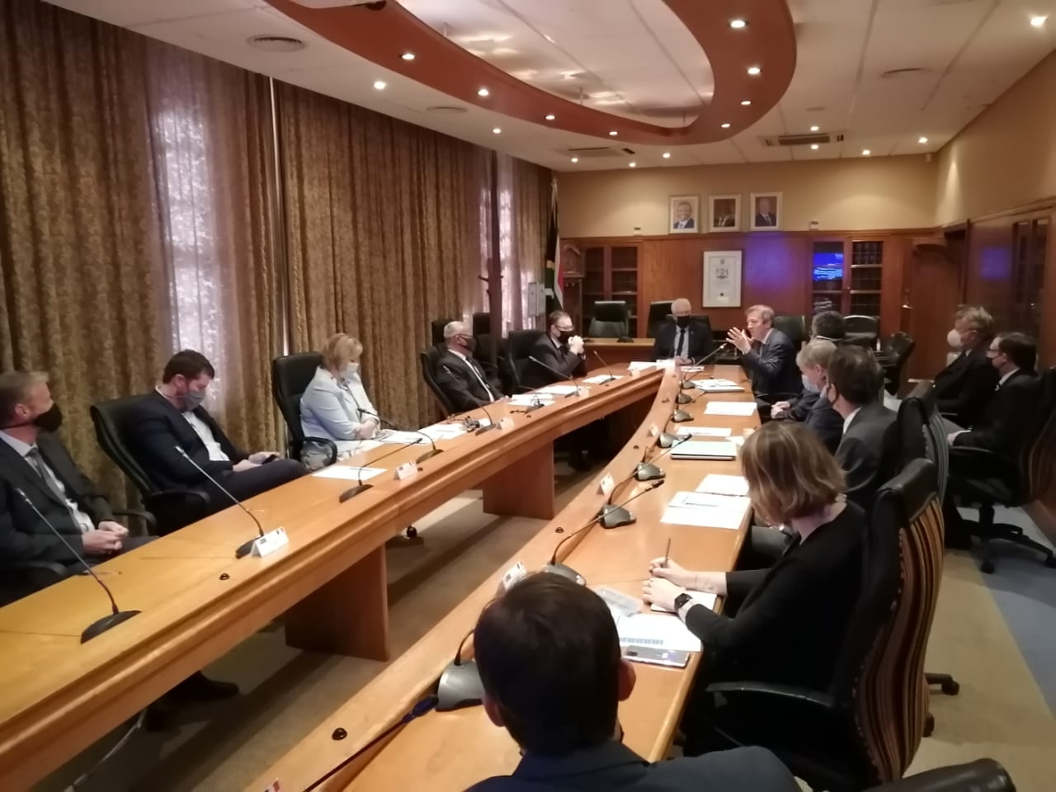
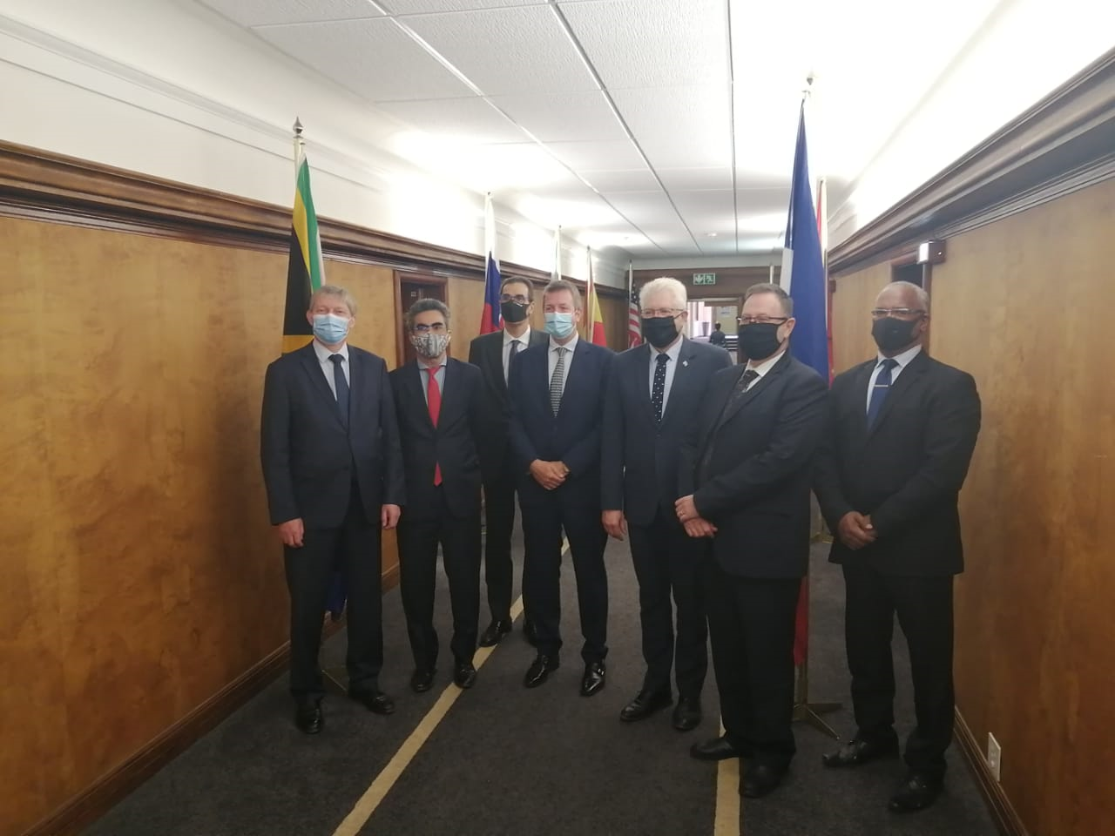
Securing a Partner…
Why an International Partner?
Grant funding to secure specialist team (Planners, Engineers, Development Financiers etc.)
Introducing International Best Practice
Access to more international development partners
Why the French Government?
The Agence Française de Développement (AFD) lead in supporting and accelerating the transition to a fairer and more sustainable world in support of the United Nation's Sustainable Development Goals.
Formalizing the Partnership
Inter-Governmental Memorandum of Understanding signed between the SA and French Governments – symbolizing the start if a era.

Slide 7
Roles and Responsibilities of DLG…
Role and responsibility of DLG in this project:
Provide Provincial Oversight and Governance of the SIDAFF programme
Identify and facilitate municipal buy-in and participation.
Create an enabling environment for effective planning and enhanced roll-out of catalytic and impactful infrastructure projects
Gateway for communication and interaction between municipalities & affected National and Provincial Departments
Guide the realisation of the deliverables as per the MOU signed between with AFD

Slide 8
Programme Initiation & Consultation
GreenCape appointed as the Service Provider by AFD for Phase 1
Project Steering committee members appointed by DLG
Municipal Coordinators nominated by representatives from the Steercom members
Roadshow concluded with the eight beneficiary municipalities, namely Saldanha Bay LM, Swartland LM, Stellenbosch LM, Breede Valley LM, Overstrand LM, Mossel Bay LM, Drakenstein LM and George LM. The Municipal Mangers indicated their overwhelming commitment to the Programme.
Municipal Infrastructure Liaison Committees established, consisting of the Administrative Leadership and Senior Mangers of the respective municipalities.
Catalytic infrastructure projects identified and confirmed with the municipalities.

Slide 9
Phase 1: Scope of Work
Step 1:
Created an enabling environment for SIDAFF
Step 2:
Consolidated pipeline of projects
Programme Initiation
Step 3:
Identified catalytic projects & programmes
Database of pipeline projects identified
(Long list)
Step 4:
Enabled process to take from feasibility to bankability
Most catalytic projects & programmes identified
(Short list)
Enable process to progress catalytic projects from feasibility to bankability

Slide 10
Project Summary: Qualifying Projects
Overstrand
Wastewater Programme | R 163m
Bulk Water Programme | R 53m
Hermanus Desalination Plant | R 94m
Overstrand Renewable Energy Project | R 160m
Mossel Bay
Wastewater Programme | R 47m
Bulk Water Programme | R 36m
Renewable Energy Project | R 78m
Renewable Energy (& storage) at informal settlements | R 19m
Total Combined Project Value:
(projects which meets international criteria):
R1,299m
Swartland
Bulk Water Programme | R 153m
George
Wastewater Conveyance Upgrade | R 236m
Wastewater Treatment Upgrade | R 117m
Bulk Water Treatment Extension | R 329m
Saldanha Bay
Wastewater Programme | R 184m
St. Helena Bay Desalination | R 20m
Smart Water Meter Project | R 90m

Slide 11
Testing the International Market: Preferences
Projects to be researched and packaged up to a “concept” or “pre-feasibility” stage before considering potential international donor/funder interest.
Strongest interest showed in water & sanitation and renewable energy projects.
Strong preference for funding of large scale packaged projects/programmes with Regional impact
Therefore: focus shift to the Province as a whole, rather then on a municipality-by-municipality basis.
Initiation consultation with participating technical directors in support of this paradigm shift

Slide 12
Phase 2: Project Scope
Revised TOR for Phase 2 based on feedback received from DFIs
Provincial wide focus based on Provincial Growth & Potential Opportunities (shifting focus from secondary cities to a provincial-wide approach)
Large scale packaged projects/programmes for maximum impact
Require recipient/participating municipalities to collaborate (MOU’s will be prepared between relevant stakeholders)
Working closely with Legal services – to ensure legal services to address potential risk factors.

Slide 13
Mr Graham Paulse
Head of Department: Department of Local Government
021 483 4449
Email: Graham.paulse@westerncape.gov.za

