Slide 1
SASCI NHI 15 June 2021 Dr Hellmuth Weich President sasci@sasci.co.za www.sasci.co.za

Slide 2
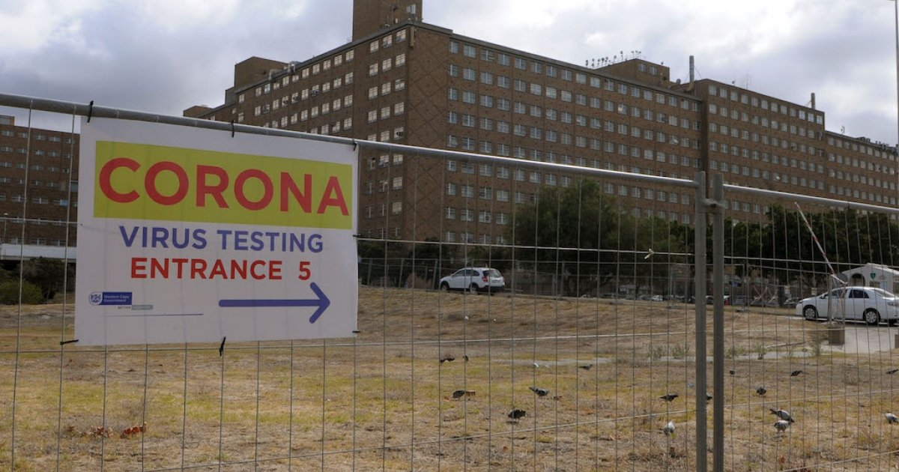
Who am I?

Slide 3
What do I do?
Tertiary hospital
Secondary hospital
Day hospital
Primary care hospital
GP

Slide 4
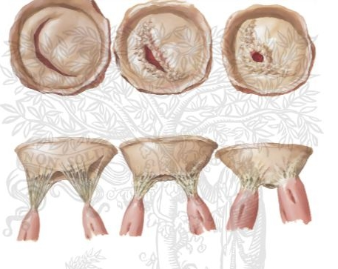
Who do I treat?

Slide 5
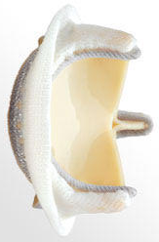
Who do I treat?

Slide 8
Is our health care system healthy?

Slide 9
The Health Market Inquiry
The HMI investigated what is “wrong” in private healthcare, and proposed reforms that would ready it for the NHI
Two of these are import for the NHI:
Health Technology Assessment [HTA] and the setting of treatment protocols, including coding (as independent body) [value for money]
A health outcomes organization(as independent body)
Are treatments leading to patients getting better?
[cheap care could be expensive care]

Slide 11
What motivates people to do better?
Money
Teach
Academic excellence
A functional environment
Provide service/care
Job security
Future security
Notes:
One of your biggest challenges is not just to provide care/finances/manage flow of funds – rather to motivate people

Slide 12
1. Money
Makes systems more efficient
Reduce this driver….reduce productivity
Potential for corruption
Governance /outcomes.

Slide 13
2. Teach
Emphasis on service
How will teaching hospitals be funded?
Specialist training, currently funded via grants from the National Treasury
Based in provinces, most trainees and lecturers co-employed by the province and the universities – how will NHI fund this?
Teaching medicine significantly slows down service

Slide 14
3. Academic excellence
Inadequate description of how research-teaching- service interaction will function.
Room for centers of excellence?
Who decides if you are excellent?

Slide 15
4. Functional environment
State burocracy / management
Cause of problem
Solution to problem?
Notes:
Example of warren in EC
Bills not paid
Corruption

Slide 16
5. Provide service/ care
160 cardiologists for 55million population= 0,3 cardio/mil
Brazil… 3/mil
Egypt… 30/mil
Tertiary hospital
Secondary hospital
Day hospital
Primary care hospital
GP
Notes:
Insert data from Brazil etc on cardiologists per m population

Slide 17
5. Provide service/ care : Evidence-Based Medicine
Section 27 of the Constitution: access to healthcare should be realized through principles of “reasonable measures”, “available resources”
Requires strict pathways, strict adherence – no room for outliers (often the most vulnerable)
To solve this: protect the principle of EBM in the Bill- [was in NHI White Paper]
Health Technologies Assessment
Outcomes
Notes:
1.5. Although the Bill recognises its roots in section 27, the application of the principles of “reasonable” measures, “available resources” and “progressive realization” is virtually absent in the text. This means that, for example, where strict adherence to a treatment pathway is required, and this limits the rights of a patient with co-morbidities, there are no criteria against which compliance with such pathways could be deemed to be acceptable and hence constitutionally defensible. Sections 8(2)(b) and 39(2)(b)(iv) requires absolute and unwavering adherence to these pathways by both providers and patients, with no criteria as to how to evaluate when such adherence may be unreasonable.

Slide 18
5. Provide care: who decides?
According to the Health Professions Act, only persons who are trained, skilled and experienced in the registration categories they are in, are allowed to “practice”, which includes making pronouncements on care
The NHI Committees must therefore include experts from specific fields, generalized experts would not work

Slide 19
6. Job security
Unclear how private specialist will contract into the NHI
Unclear how private hospitals will contract into the NHI
Notes:
Provincial and central hospitals will get a budget based on diagnosis-related groups (assuming therefore that all conditions and care are recorded so that the cost per patient can be worked out to determine these budgets
Unclear how private specialist will contract into the NHI, and unclear how private hospitals will contract into the NHI
The “payment mechanisms” to be determined as stated in the Bill is too vague
The impact of procurement decisions not clear – practices and hospitals (public and private) have equipment in place, cannot be prescribed via formularies or lists

Slide 20
7. Future security?
What will access to care be in an environment where medical schemes can only provide “complementary cover”
Medical schemes: what they could provide-is it per diagnosis, or per type of treatment, e.g.:
If NHI provides Aortic Valve Stenosis care, can a scheme provide it, or not? OR:
If NHI only provides open heart surgery, and not TAVI, can schemes provide TAVI (and would that be financially feasible?)
What will this mean for
high-end procedures?
EBM – rare diseases?

Slide 21
7. Future security: do we have the money?
The DTC found: “Given the current costing parameters outlined in the White Paper, the proposed NHI, in its current format, is unlikely to be sustainable unless there is sustained economic growth.”
Do we have a copy of this funding paper … and 15 benefits?
Does the NHI Bill, with its mention of “comprehensive care” and not incremental Implementation, not raise unrealistic expectations?
https://www.taxcom.org.za/docs/20171113%20Financing%20a%20NHI%20for%20SA%20-%20on%20website.pd; https://www.businesslive.co.za/bd/national/2019-08-26-treasury-draws-up-new-financing-paper-for-nhi/;
Notes:
The NHI is called a “Fund” in the Bill, but no financing mechanisms – yet another law would be required in our understanding
National Treasury funding paper still outstanding, we would submit that Bill cannot be finalized without that
Dennis Davis Tax Committee found that NHI unaffordable (see: https://www.taxcom.org.za/docs/20171113%20Financing%20a%20NHI%20for%20SA%20-%20on%20website.pdf)
Unclear how the constitutional mandate of provinces to render healthcare services, and receive funding, would be accommodated in the NHI, i.e. what would remain in provincial budgets, and what would depend 100% of NHI Fund allocations?

Slide 22
Conclusion
Major concerns:
Lack of governance
Academic medicine
Centres of excellence
Strict adherence to rigid pathways
How will private healthcare feature
Can we afford it?
Outstanding:
Key info from NHI pilot sites
National Treasury financing paper
Availability of basic infra-structure [e.g. ICD-10 coding]
Proposal:
Start with a limited roll-out and not as the Bill says “comprehensive care”, e.g. PHC

