Slide 1


NHI
Presentation
15 June 2021

Slide 2
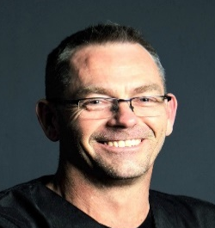
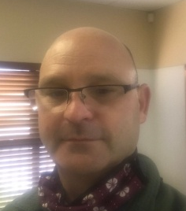
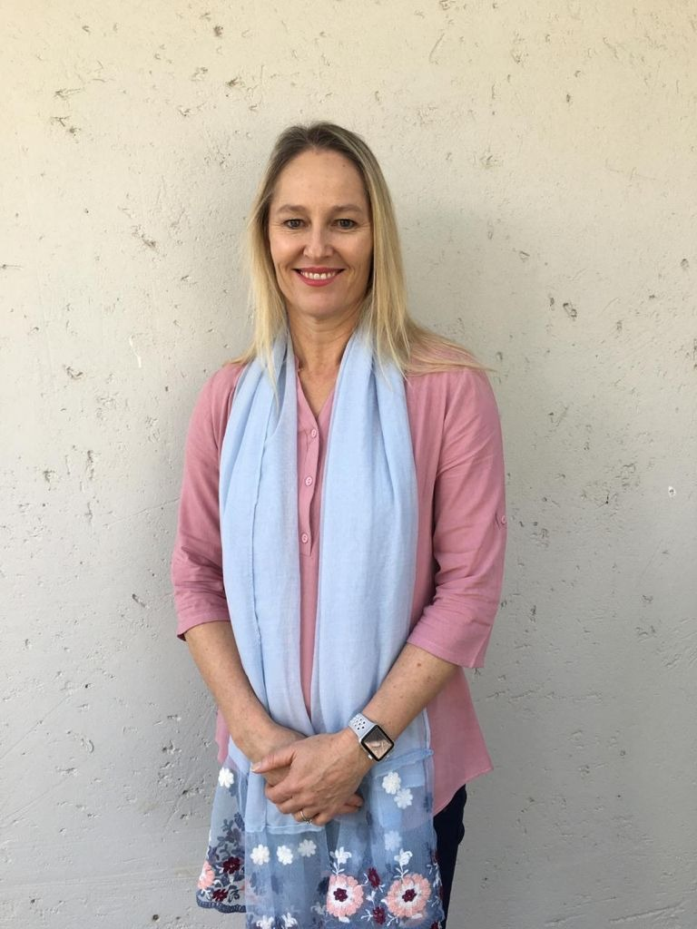
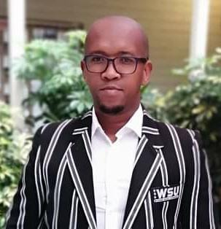
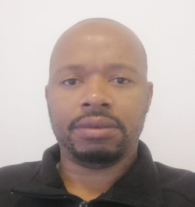
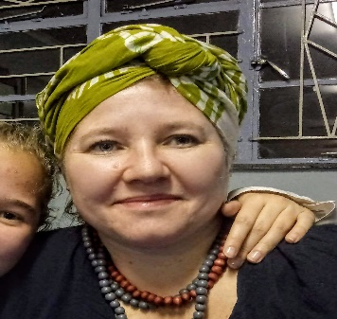
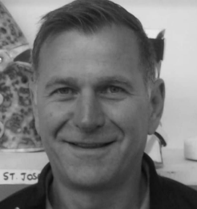
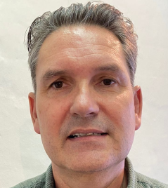
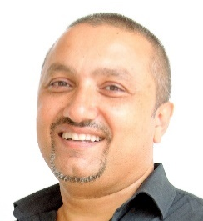
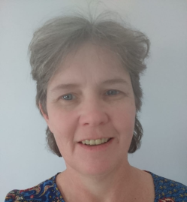
Meet the
Panelists
Bradley Beckerleg
SAOPA CHAIRMAN
Mariette Deist
Education TUT, HPCSA, ISPO
Abraham Kholwane
Government, MOPASA, HPCSA
Jan-Hendrik Swiegers
Government, Rehab Forum
Adrian Singh
Private Practitioner, SAOPA
Richard Schmidt
SAOPA NEC
Lupiwo Mduzana
Education WSU, HPCSA
Genevieve Joubert
Government, MOPASA
Riaan Knight
Private Practitioner
Heather Mc Crae
SAOPA COO

Slide 3
Introduction
OVERVIEW
EDUCATION
PUBLIC
PRIVATE SECTOR

Slide 4
Presentation
Overview of Orthotics & Prosthetics
Orthotics & Prosthetics
SAOPA Chief Operating Officer
Heather Mc Crae

Slide 5

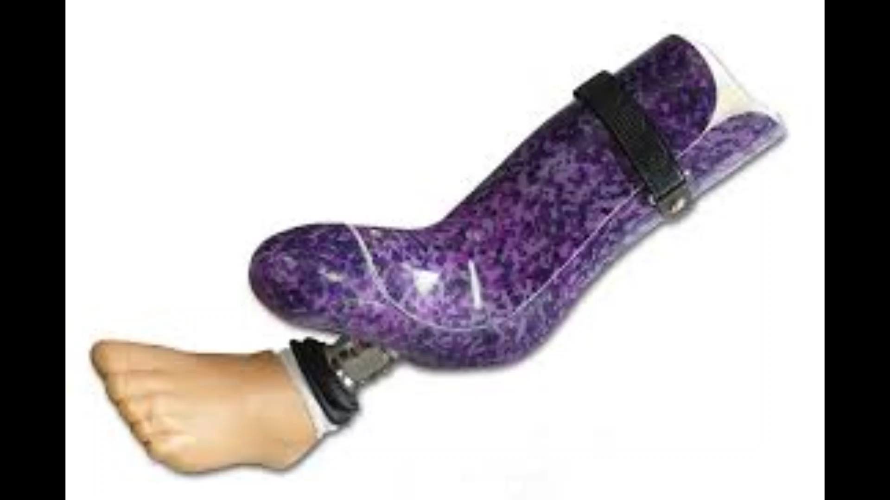

Slide 6
Presentation
Education
Education
Mariette Deist

Slide 7




Training structure: Orthotists and Prosthetists
1987 – 2021 / 2022 (phasing out)
3 year national diploma plus graduation (TUT)
then
Internship year (HPCSA)
then
Registration with HPCSA
4 year BHSc
2014 – DUT = 30 students per year
2016 – WSU = 30 students per year
2021 – TUT = 40 students per year
100 per year to graduate EXTRA
Community service??? = NO

Slide 8
Training:
Assistants (OSA)
Orthopaedic footwear Technicians (OFT)
Public service only appoint HPCSA registered persons
Orthopaedic Footwear Technicians (OFTs)
Allowed to work with patients with foot disabilities and pathologies not including the ankle
1st train as an assistant for 2 years
The 3rd year they train specifically for orthopaedic footwear related to surgical boots and foot pathologies
HPCSA Board Exam
Registration with HPCSA
Assistants (OSA)
Not allowed to work with patients
Working only in the lab
Manufacturing
2 year training in service
Registration with HPCSA
SUPERVISED PRACTICE

Slide 9
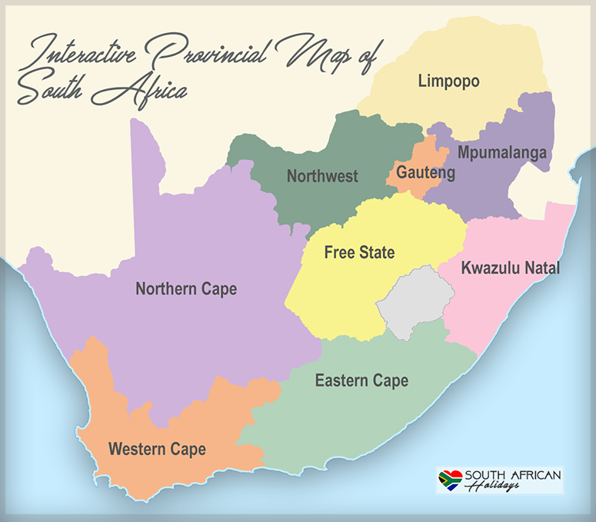
Statistics in
South Africa
&
HPCSA
29
3
6
4
42
14
1
240
12
4
5
24
5
7
3
8
Red = MOP = 704
30
4
173
1
0
Blue = OFTs = 46
Green = Assistants = 74
80
9
14
88
(Holidays, 2021)
10
8

Slide 10
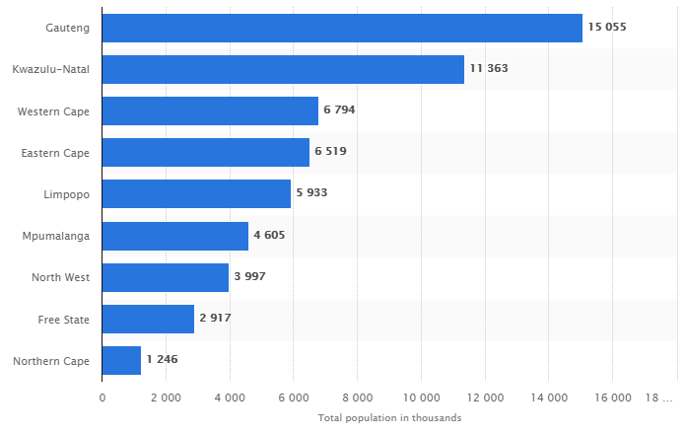
Public Hospitals linked to Provinces and Population
Public sector MOP
Gauteng | Baragwanath Tambo Memorial Dr George Mukhari Steve Biko
34
240
17
31
43
173
KZN | Wentworth & Ladysmith
14
88
Western Cape | Pinelands
12
34
80
Eastern Cape | Port Elizabeth Frere Mthatha
18
4
29
Limpopo | Polokwane St Rita’s Lethaba
6
11
42
Mpumalanga | Ermelo Rob Ferreira Mapulaneng
4
2
14
North West | Klerksdorp Mafikeng
4
13
30
2
8
1
Free State | Pelenomi Bethlehem Welkom
12
Northern Cape | Kimberley
(Statista, 2019)

Slide 11
Current situation Public vs Private
XXX
WHO recommend 5 – 10 MOP’s per million
WHO recommend 10 – 20 Technicians per million
(Each clinician is normally supported by 2 technicians)

Slide 12
Ideal Situation
Provinces selected: | Gauteng | KwaZulu Natal | Western Cape | Eastern Cape | Limpopo | Mpumalanga | North West | Free state | Northern Cape | Total
Population | 15 055 000 | 11 363 000 | 6 794 000 | 6 519 000 | 5 933 000 | 4 605 000 | 3 997 000 | 2 917 000 | 1 246 000 | 58 429 000
MOPs - 10 per million (WHO) | 151 | 114 | 68 | 65 | 59 | 46 | 40 | 29 | 12 | 584
Public MOPs | 34 | 43 | 14 | 34 | 4 | 11 | 2 | 13 | 2 | 157
HPCSA | 240 | 173 | 88 | 80 | 29 | 42 | 14 | 30 | 8 | 704
Provinces selected: | Gauteng | KwaZulu Natal | Western Cape | Eastern Cape | Limpopo | Mpumalanga | North West | Free state | Northern Cape | Total
Assistants 2 x per MOP | 301 | 227 | 136 | 130 | 119 | 92 | 80 | 58 | 25 | 1169
HPCSA | 36 | 10 | 18 | 23 | 9 | 8 | 6 | 9 | 1 | 120
Public OSAs and OFTs | 32 | 17 | 12 | 18 | 6 | 4 | 4 | 12 | 1 | 106

Slide 13
Link between NHI & Education of
Medical Orthotics & Prosthetics
Education and Health - Most important characteristics of human capital. Both education and good health make individuals more productive. (Groot and Maasen van den Brink, 2006)
Not just about tertiary training but training of all categories in our profession
Are DOH and DOE on the same page?
  Yes, on a managerial level- (Looking at policies, guidelines etc.)
  Not so much on an implementation, practical level
“ Low levels of access to (Orthotic and Prosthetic) O&P services is hampered by a broad lack of understanding of the benefits and need for these services as well as failure of infrastructure to provide appropriate services” as mentioned in the GATE concept note by the World Health Organization.
Long-term planning is also needed to encourage professional recognition and retain prosthetic and orthotic professionals for service sustainability (4). (WHO, 2013)

Slide 14
Global cooperation
(WHO & ISPO)
WHO global disability action plan 2014 – 2021 (The GATE Initiative)
Objective 1: To remove barriers and improve access to health services
Estimate that 35 – 40 million people currently require prosthetic and orthotic services. 1 out of 10 persons have access to such services (WHO, 2016)
With the rise in aging populations and the increase of non communicable diseases such as diabetes, the prediction is that more than 2 billion people will require orthotic and prosthetic services by 2050. (WHO, 2017)
The WHO also recognise that orthotic and prosthetic patients are “lifetime patients” meaning the need for ongoing evaluations, new devices and maintenance of these devices
As with other health professions such as physiotherapy and occupational therapy, an increase in the number of appropriately trained professionals in prosthetic/orthotic occupation is needed. The WHO encourages a sustainable expansion of education and training for health professionals to ensure access to appropriate quality and quantity of services

Slide 15
Challenges &
Education
Assistants / Orthopaedic footwear technicians
  Creating posts for this categories
  Appointing learners to do the in-service training
  Appoint them into the posts created
Current training – Looking at the need for SA
  Discussions with universities, and council to cap intake (This is going to be very difficult)
  Or convince universities to start train assistants
Bursaries – not linked to posts
Community service (will assist newly qualified to stay in the public sector)

Slide 16
Presentation
Public Health
Service
Public Health Service
Jan-Hendrik Swiegers

Slide 17
Orthotic and Prosthetic Challenges and Background
Current NDOH Orthotic and Prosthetic Centres
Shortage of Medical Orthotist Prosthetists in South Africa
Access to Assistive Devices Challenges
Proposed Way Forward
Western Cape Orthotic and Prosthetic Centre

Slide 18
154 MOPs in Public Sector
154 MOPs responsible for 665 Outreach Clinics

Slide 20
Backlogs in Orthotics and Prosthetics = 10,424

Slide 21
Access to Assistive Devices Challenges
SA Population of 60,041,994 vs 154 MOPs in Public Service
Skewed proportions of MOPs in private sector 549 vs 154 in public sector, this includes urban and rural areas
MOPs traveling up to 500km to service Outreach Clinics
Lack of accesses for rural patients to Outreach Centres
Inadequate Orthotic and Prosthetic facilities, consultation rooms, machinery and equipment in rural and metro areas
Lack of referral pathways to Orthotic and Prosthetic Services.
Need for a National document on the Prescribed Minimum Benefits for assistive devices in public service
Lack of National tenders for O&P and prescribed minimum standards

Slide 22
Proposed Way Forward
Staffing action plan
Implementation of MOP Community Service
Increase accessibility, the national need for more O&P Centres
Upgrade current facilities; outdated machinery, technology and assistive devices
Implement Ideal Hospital/Facility Framework for O&P Centres (IHRM-F)

Slide 23
Proposed way forward continue
SCM needs to be centralized to each facility – no longer tied to the hospital to which a facility is attached
Budgets must be individualized per facility – again separated from the hospital to which the facility is attached
85% of consumable stock should always be available
Implementation of WHO and ISPO action plan on O&P services and staffing
LEAN management implementation
DUT, TUT and WSU to assist with above mentioned feasibility study, do research and make recommendations

Slide 24
Western Cape Orthotic and Prosthetic Centre
The Orthotic and Prosthetic Centre (OPC) is the only Centre of its kind in the Western Cape providing orthotic and prosthetic services to government patients
OPC is governed by the Western Cape Rehabilitation Centre (WCRC), geographically at 2 separate locations
14 MOPs service a population of 6,794 million
92 Annual Outreach Clinics
18 Special Needs School Clinics
6 Metro weekly clinics
Annual Budget = R24 755 000,00

Slide 25
Western Cape Population and O&P Services
With a population close to 6.7 million in the WC we will have 34 000 people with disabilities in need of MOP services (estimate from the WHO World Report on Disability = 0.5% of a population)
Proposed WHO personnel estimate to provide MOP services for 6.7 million people = 190 staff
Current O&P staff in the WC = 48
WHO proposed estimate of qualified MOPs required to fulfill the Western Cape’s need in Orthotics and Prosthetics = 40
Current WC MOP staff = 14

Slide 26
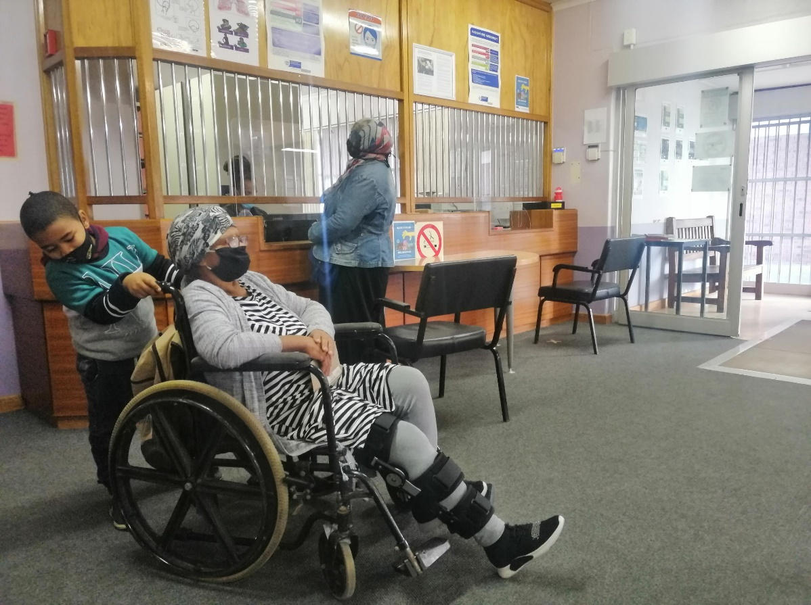
WC, only 46% of 0&P patients are treated at a Centre with sufficient machinery and equipment, where 27% of patients are seen at Outreach Clinics and 22% are children from either Special Needs Schools or Pediatric Hospitals.
WC Orthotic Clinic Locations | No. of patients | % of total activity
OPC clinics | 1119 | 34%
Rural District Outreach clinics | 906 | 27%
Special Needs Schools | 390 | 12%
Red Cross Children’s Hosp | 331 | 10%
Tygerberg Hosp | 299 | 9%
Groote Schuur Hosp | 270 | 8%
Other District hospitals (ad hoc requests) | 12 | 0.4%
Total | 3327

Slide 27
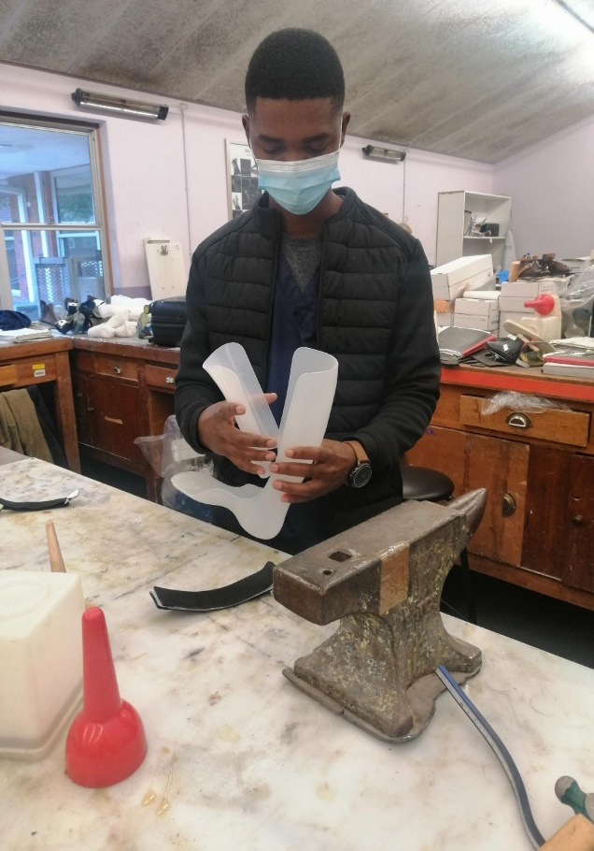
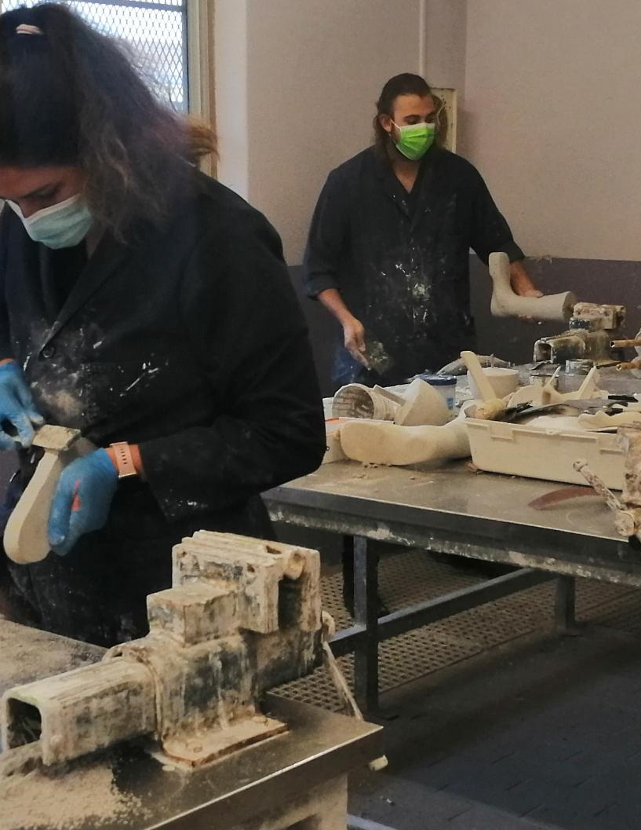
WC, considering 29% of O&P patients treated do not have a disability explaining the vast scope in the field of Orthotics and Prosthetics.
Orthotic diagnoses | No. of patients | %
Congenital | 1090 | 43%
Osteoarthritis & Knee conditions | 531 | 21%
Feet deformities | 240 | 10%
Stroke | 228 | 9%
Back pain & injury | 193 | 8%
Post-Polio | 152 | 6%
Amputations | 76 | 3%
Total | 2510

Slide 28
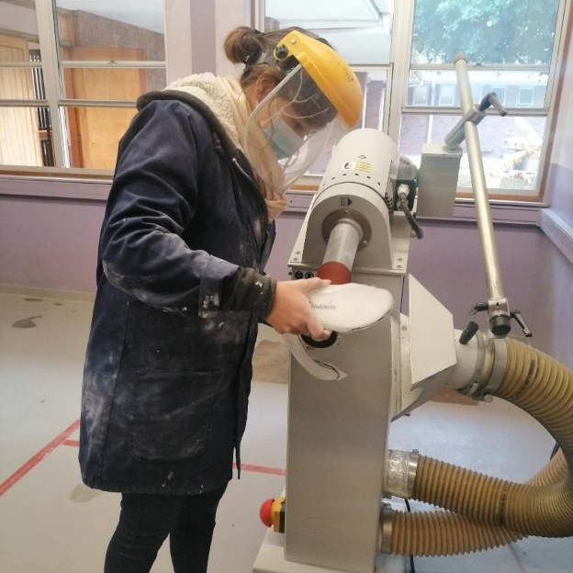
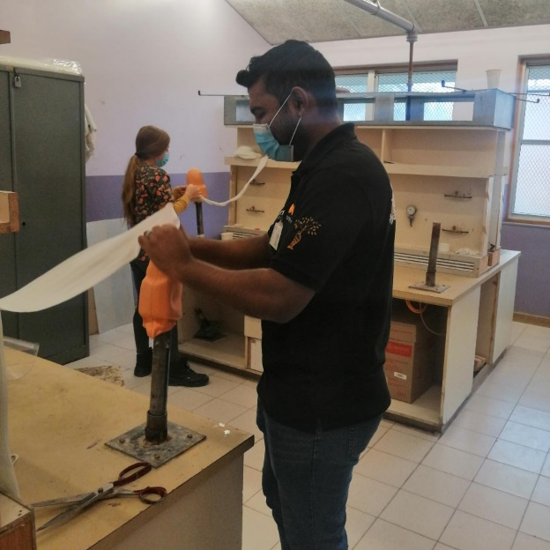
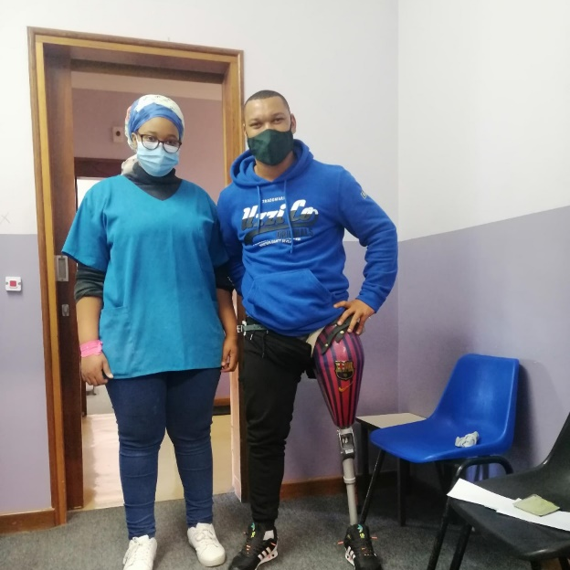
Western Cape Prosthetic Stats
Trauma = 103
Vascular related = 176
Cancer = 9
Congenital = 30
Total = 318

Slide 29
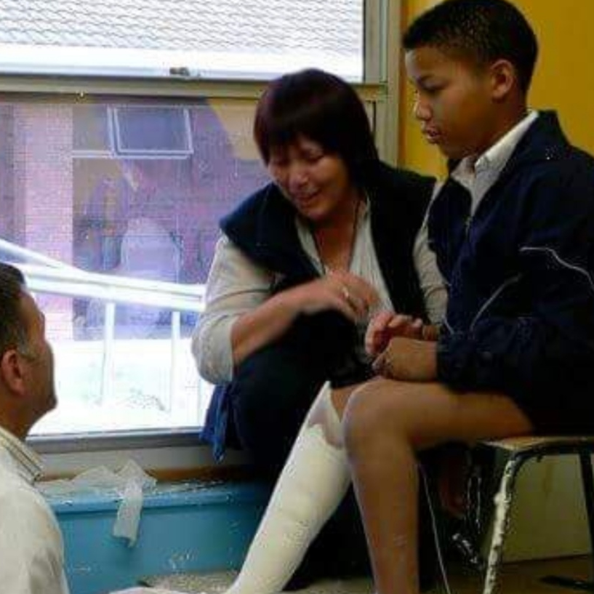
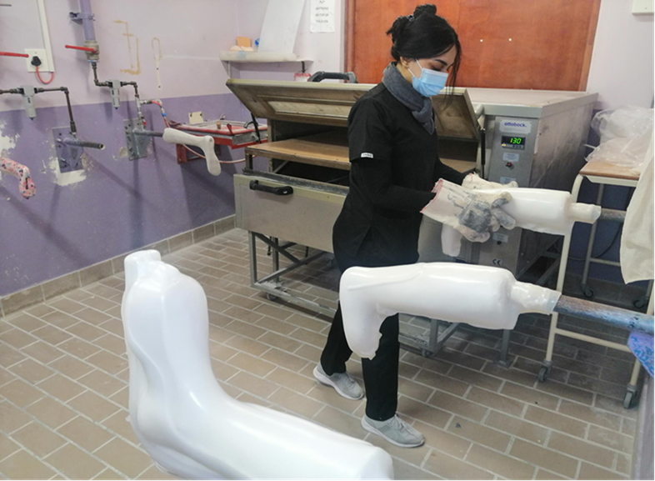
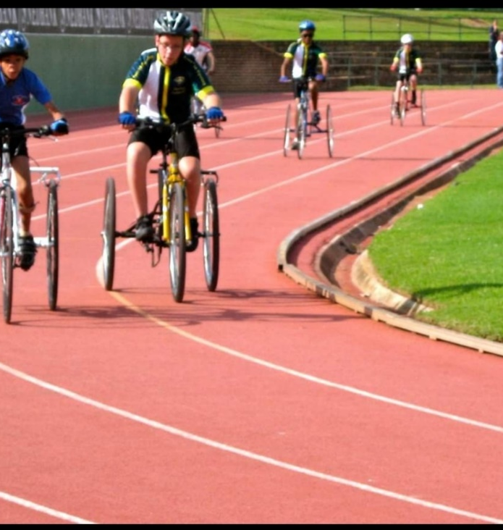
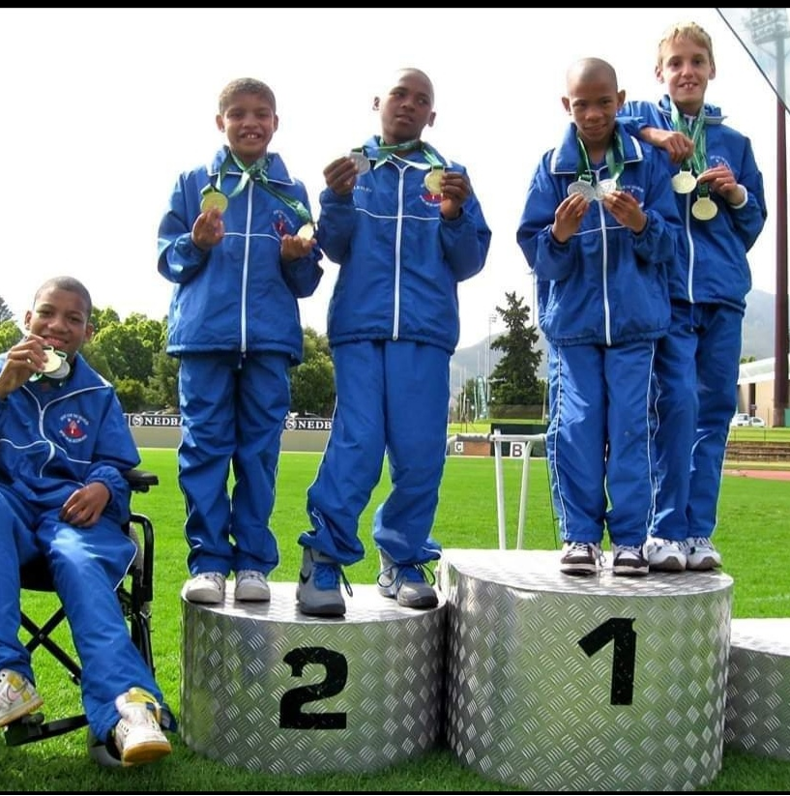
Children in South Africa with disabilities have the right to:
Access to Health Care Services
Equal Education
Be Developed to Their Full Potential
Freedom from Discrimination
Protection Against Violence, Abuse and Neglect

Slide 30
Private Sector
Bradley Beckerleg
Presentation
Private Sector

Slide 31

Pillars of sustainability

Slide 32
Sustainability
for affordable healthcare
Money Bill
Remuneration
Organisation
300+ Professional Fee Codes
102 Material Kits
36,740 Individual Products & Components
Guide was distributed until 2017
How will the NHI reimbursement occur in the future, as there is no current National Reference Model

Slide 33
NHI as Medical Insurance Management
Clarity
Contradictions
Negotiated or fixed prices
Patients needs
OHPP (Office of Health Products Procurement)
SAHPRA device accreditation
Backlog of 16 000: new 8 000, variants 8 000
“Health goods”
Supply chain management
NHI
Role player

Slide 34
Professional Fee - Code description & Time Based on ISO 9999 standards
10502 Trans-tibial prosthesis endoskeletal K1-K2
Summation of code inclusions and descriptions
Consumables are included in the Procedure Fee. Should the prosthetist require the use of a material kit(s), in addition to the kits as noted to be associated with the relevant profession fee tariff code, the kit(s) will be added as a separate item(s) to the total fee charged. See Material Kit list. All components including suspension systems, feet and adaptors are charged separately with relevant Nappi codes.
20046 Fabrication kit included (glass reinforced acrylic)
No | Code inclusions | Professional Time (hrs) | Facility Time (hrs) | No | Code inclusions | Professional Time (hrs) | Facility Time (hrs)
1 | Consultation and assessment. Intake of patient/client problems and functioning | 1 |  | 13 | Final fitting and adjusting of the definitive device |  | 2
2 | Prosthetic assessment of function, ampro/ampnopro or similar | 1 |  | 14 | Prosthetic assessment of patient/client |  | 1
3 | Reports, motivation, quotation and submission for authorization to provide service | 2 |  | 15 | Check out, delivery, user instruction (warranty, maintenance) | 1
4 | Concept/design of the prosthetic device | 2 |  | 16 | Evaluation of patients/client's device with case manager | 1
5 | Measurement and casting/scanning | 2 |  | 17 | Service and maintenance scheme (six months) |  | 2
6 | Selection of device components | 1 |  | 18 | Adjustments (socket and alignment), functional updates (six months) |  | 2
7 | Modification and tracing of cast scan | 2 |  | 19 | Unexpected modifications/repair and adjustments (12 months) |  | 4
8 | Fabrication of device |  | 8 | 20 | Communicating with suppliers, ordering, receiving, storing raw materials, components and pre-fab devices | 1
9 | Bench assembly and alignment |  | 2 | 21 | Product (component) responsibility (warranty issues) | 1
10 | Trial fitting, static and dynamic alignment |  | 3 | 22 | Basic business obligations, accounts administration etc. | 1
11 | Adjustments and functional additions |  | 2 | 23 | Maintaining a patient/client dossier | 1
12 | Finishing definitive device |  | 8 | 24 | Other duties, communications with patient, doctor, and other healthcare workers, funders, case managers etc | 1
Sub Total: Professional Time: 18 Hours - Facility Time: 34 Hours – TOTAL of 52 HOURS

Slide 35
A few trans-tibial residuum types
Every patient is unique

Slide 36
Non accredited Healthcare Service Provider
Referral not followed
Treatment not necessary
Criteria for accreditation process
Funders impact on Private Sector

Slide 37
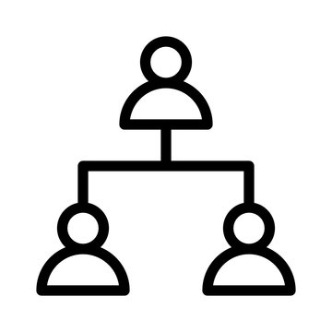


Road Accident Fund (RAF)
Workman’s Compensation Fund (COIDA)
RAF
COIDA

Slide 38
Orthotist Prosthetist are 1st line Practitioners
Referring practitioner details
Delays & additional costs
Vulnerable population
Limitations
Pathways: GPs, Specialists, Physiotherapists, Occupational Therapists & Other Allied Healthcare Providers
Referral
Pathways

Slide 39

CONCLUSION
South African Orthotic & Prosthetic Industry Support the Concept of National Health Insurance
THANK YOU – Questions & Answers

Slide 40
Resources
Department of Social services. White Paper on the Rights of Person with Disabilities, 2016.
Dobson A, Murray K, Manolov N, DaVanzo JE. Economic value of orthotic & prosthetic services among medicare beneficiaries: a claims-based retrospective cohort study. J Neuroeng Rehabil. 2018 Sep 5;15(Suppl 1):55. doi: 10.1186/s12984-018-0406-7. Available: https://jneuroengrehab.biomedcentral.com/track/pdf/10.1186/s12984-018-0406-7.pdf
GROOT, W. & MAASEN VAN DEN BRINK, H. Measuring the effects of education on health and civic engagement. OECD, 2006 Copenhagen. Available: https://www.oecd.org/education/innovation-education/37425763.pdf
Health Market Inquiry (Final Report, Sept 2019)
HOLIDAYS, S. A. 2021. Freemedigital. Available: http://www.southafricanholidays.info/provinces [Accessed 12 June 2021].
International Sociate for Prosthetics and Orthotics (ISPO) 2015-2017 Standards for Prosthetic and Orthotic
Kyte R, Wolfson R, Engelbrecht J. Immediate Postoperative prosthesis (IPOP) utilisation in septic & tumour amputees in government hospital. SA Orthopaedic Journal, 2010
National Department of Health. Framework Strategy for Disability and Rehabilitation Services in South Africa, 2015-2020
National Department of Health. National Health insurance bill, 2019.
National Department of Health. Strategic plan 2020/21-2024/5
National Rehabilitation Policy. Rehabilitation for all, 2000.
National development plan. Vision 2030.
NHS 2015 p 12-13. Available: https://www.england.nhs.uk/commissioning/wp-content/uploads/sites/12/2015/11/orthcs-final-rep.pdf
STATISTA. 2019. Total population of South Africa in 2019, by province [Online]. Statista: :Sars Kamer. Available: https://www.statista.com/statistics/1112169/total-population-of-south-africa-by-province/ [Accessed 12 June 2021].
The Children’s Act No. 38 of 2005
The White Paper on the Rights of Persons with Disabilities Implementation Matrix 2015-2030
WHO, W. H. O. Transforming and scaling up Health Professionals. World Health Organization Guidelines, 2013 Geneva, Switzerland.
WHO, W. H. O. 2016. Priority Assistive Products List [Online]. Available: https://www.who.int/phi/implementation/assistive_technology/low_res_english.pdf [Accessed 7 June 2021].
United Nations Convention on the Rights of Persons with Disabilities (CRPD)
WHO, W. H. O. 2017. Standards for Prosthetics and Orthotics Services Provision Part 1. [Online]. Available: http://apps.who.int/iris/bitstream/handle/10665/259209/9789241512480-part1-eng;jsessionid=C79FA8436B9A92A6828ADB05DF2FCB0F?sequence=1 [Accessed 7 June 2021].
WHO, W. H. O. Opening the GATE for assistive health technology: Shifting the Paradigm. Concept Note. [Accessed 7 June 2021].
World Health Organization (WHO) 2011 World Report on Disability

Slide 41
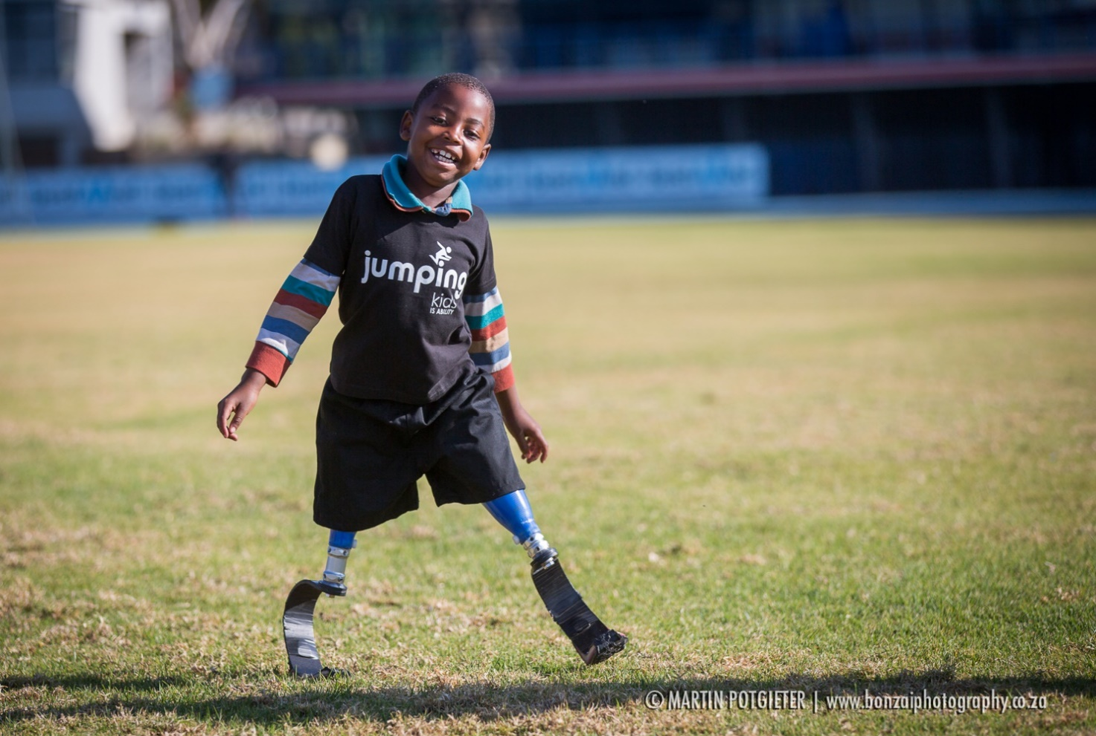
THANK YOU

