Slide 1
National Health Insurance Bill:
Oral Presentation
admin@audiologysa.com

Slide 2
INTRODUCTION
SAAA recognises the need for health care reform in South Africa and is supportive of the concept of a National Health Insurance model.
However, there are aspects that need further clarification, such as below points which have been used to guide our presentation points:
Role of the private practice – accreditation? Role of Office of Health Standards Compliance?
Remuneration – Capitation model? Extent of remuneration?
Multidisciplinary practice concept? HPCSA Rules?

Slide 3
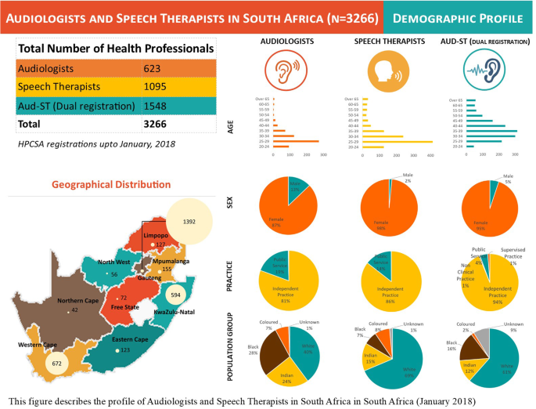
HEARING HEALTH CARE SERVICES
Burden of HL
20.3% of all types HL (12.1 mil)
6.2% moderate and greater HLs (3.6 mil)
8.3 Audiologists/million in SA
Limited multi-disciplinary services - 4.6 ENTs/million in SA
(WRH, 2021; Mulwafu et al. 2017)
Hearing health service providers

Slide 4
HOW WE VIEW NHI
There are three parts to this comment, the first being General, the second pertaining to Hearing Healthcare Services, and the third relating to issues in Leadership and Governance.
General
Healthcare services
Governance
Focuses on doctors and nurses
Limited healthcare coverage
Frozen posts for rehab specialists
Education and medico-legal exclusions
1st line practitioner exclusions
PHC and supply of devices

Slide 5
RECOMMENDED SOLUTIONS
1
2
3
Inclusion of rehab specialists across all levels of service delivery
Universal Health Coverage in line with South African population and Audiologists’ ratios should be considered
Availing of posts, bottom-up, from community service practitioners upwards.
Technology: buying and maintaining of durable equipment and devices for Audiologists and patients, e.g. audiometers, hearing aids

Slide 6
THANK YOU

