Slide 1
Rehabilitation Presentation on NHI Bill to the Parliamentary Committee on Health
15 June 2021

Slide 2
Introductions Mrs Liepollo Ntlhakana

Slide 3
Introductions

Slide 4
What is Rehabilitation?

Slide 5
Definition of Rehabilitation
“Rehabilitation” means a goal-orientated and time-limited process aimed at enabling impaired persons to reach an optimum mental, physical or social functional as defined in section 1 of the National Health Act.”
Rehabilitation is defined as “a set of interventions designed to optimize functioning and reduce disability in individuals with health conditions in interaction with their environment” as defined by the World Health Organisation, 2020.
MDT nature
Quality care
Inter-sectoral nature
Social determines of health care – participation, prevention, promotion – draw line between health & social
The term “allied health professional” as used in the definition of “primary health care” in the NHI Bill needs to be clarified, i.e. to stipulate which practitioners are envisaged as allied health professionals and as such primary care practitioners.
This term implies that practitioners registered at the Allied Health Professions Council of South Africa (AHPCSA) are regarded as primary care providers in addition to general practitioners, dentists and nurses.

Slide 6
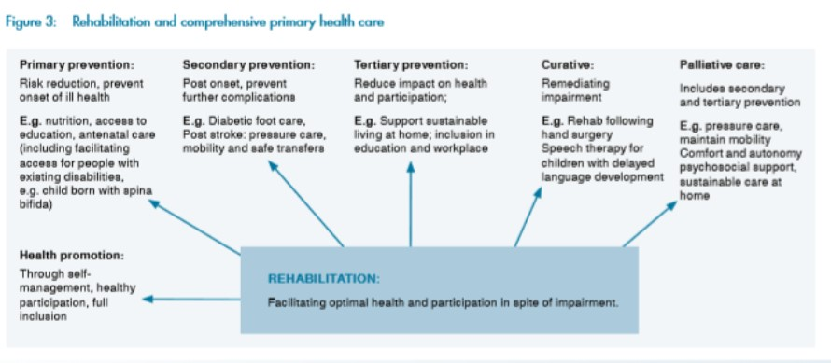

Slide 8
Key Points to remember about Rehabilitation
Rehabilitation practitioners are not allied health professionals. Are health practitioners registered at the Health Professions Council of South Africa (HPCSA).
Lack of opportunities for training and regulatory body MLW
Inter-sectoral collaboration, e.g. Transport, Labour/social grant, housing.
Social determinants – economic activity, physical environment, education, food security – access to healthy life, social integration & community engagement, health care system – quality of care.
Services provided from the acute – chronic phases, including CBR.
Services provided throughout the lifespan of a patient- challenges
Ability of access to services should not be determined by income.
Multi-disciplinary nature of rehab – expert in their own area

Slide 9
Statement
Support in principle the UHC
Willingness to support and work together, improve the health services and quality care
However…
Rehabilitation by definition - Exclusion from the NHI
Concerns raised about the NHI

Slide 10
Specific Discussion Points regarding the NHI Bill

Slide 11
Contents for Discussion
Inequity of Rehabilitation services
Human Resources
Reimbursement models for rehabilitation services
Composition of the Contracting units and inclusion of rehabilitation services on other levels
Criteria included for accreditation with NHI Fund – professional bodies to be included in the decision affecting the profession, e.g. clinical guidelines
NHI Bill

Slide 12
Inequity of and Access to Rehabilitation services Miss Maryke Bezuidenhout

Slide 13
Universal Health Coverage
‘People should be able to access appropriate health services based on need and not ability to pay’
Key principles:
Equity
Financial Risk Protection
Additionally: Progressive realization, restorative justice
: Accessible, affordable, appropriate, acceptable
: Targeted strategies needed for vulnerable groups
experiencing inequities in access and outcomes
For a service which is accessible and acceptable to PwD, access to rehabilitation is critical
Notes:
UHC demands that people access health care based on need, and not ability to pay. Key principles include that of equity and financial risk protection. Health services should be accessible, affordable, appropriate and acceptable, and targeted strategies for vulnerable groups may be needed to ensure the universality of healthcare in South Africa.

Slide 14
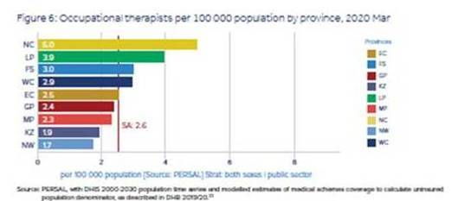
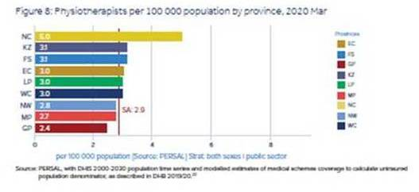
Inequities in Public sector HR (Rehab) per Province
Geographical distribution?
Multi-disciplinary rehab team/area?
Ratio per uninsured population?
Whole system equity assessment?
Coverage of services, gaps?
HR data availability?
Day C, Gray A, Padayachee T and Cois A., 2020. South African health review, Health Systems Trust. Retrieved 4 June 2021
Notes:
Disability and Rehabilitation workforce data is fragmented and difficult to obtain across public and private sectors. Aggregate data, when obtained, is unable to show particular discrepancies in coverage according to rurality or district, and the presence of a multi-disciplinary team at a facility is not captured. This makes a gap analysis particularly challenging, and without disaggregated data we will struggle to identify pockets of inequities to close these gaps.

Slide 15
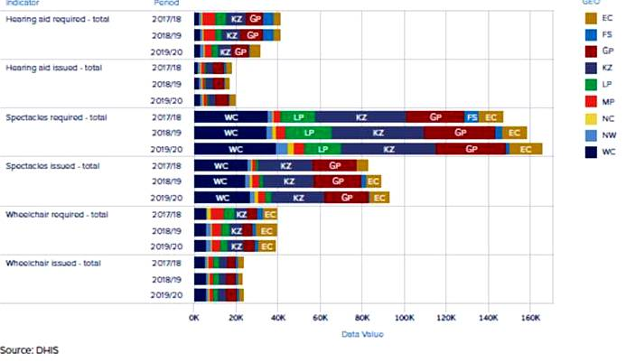
Assistive Device Backlogs per Province
Access
Follow up care
Data quality
Day C, Gray A, Padayachee T and Cois A., 2020. South African health review, Health Systems Trust. Retrieved 4 June 2021
Notes:
The application and issuing rates of the various assistive devices also vary significantly across provinces, with some provinces producing rates as low as 30%. Whilst issuing rate is an acceptable sentinel indicator for service delivery, it fails to take into account inequities in access and elements of quality care such as relevant qualifications of therapists and follow up service rates for training, maintenance and repairs.Deficiencies in data around human resources, budgets and follow up rates raise serious quality concerns.

Slide 16
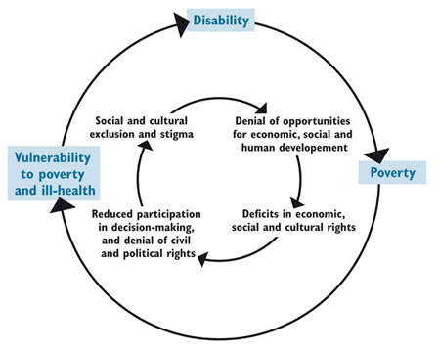
Results of Inequities: A Vicious Cycle
Source: DFID, Poverty, Disability and Development, p.4
Notes:
The perpetuating cycle of disability and poverty is well described, and our health system- together with other systems- is driving this.

Slide 17
Using NHI to address Inequities using good D&R Practice Examples and Piloting
Defining essential disability services: minimum standards, contextualized guidelines, skills mix
Reassess data systems: STATSSA & DHIS
Enforce universal design
Address FRP through decentralised service delivery
Attempt to strengthen inter-sectoral service delivery
Notes:
But all is not lost, and NHI potentially gives us an opportunity to re-imagine and redesign this system to address barriers and inequities. However, this will need coordinated and inclusive planning involving those of us at the coalface as well as end users within the system. Governance and Stewardship- and the political will and commitment to finally make this change happen- lies in your court as much as ours.

Slide 18
Human Resources Associate Prof Mershen Pillay

Slide 19
Population vs HPCSA Registrations
 |  | HPCSA | EC | FS | GP | KZN | Limpopo | Mpum | NC | NW | WC
Population - 59,992,399 |  |  | 6 734 001 | 2 928 903 | 15 488 137 | 11 531 628 | 5 852 553 | 4 679 786 | 1 292 786 | 4 108 816 | 7 005 741
Audiologists |  | 805 | 36 | 14 | 255 | 261 | 21 | 51 | 16 | 9 | 136
Occupational Therapists |  | 5855 | 303 | 331 | 2055 | 723 | 254 | 282 | 119 | 135 | 1588
Orthotists |  | 688 | 75 | 28 | 241 | 161 | 18 | 41 | 8 | 14 | 85
Speech Therapists |  | 1393 | 61 | 37 | 388 | 310 | 15 | 53 | 24 | 22 | 471
Speech Therapists & Audiologists |  | 1632 | 28 | 32 | 956 | 132 | 120 | 88 | 10 | 33 | 195
Physiotherapists |  | 8334 | 463 | 390 | 2858 | 1223 | 355 | 360 | 144 | 217 | 2192
TOTAL REHAB |  | 18707 | 976 | 832 | 6753 | 2800 | 783 | 875 | 321 | 430 | 4667

Slide 20
Human Resources (Cont.)
1. All possible referral pathways to be explored:
2. Current legislation and processes to establish partnerships: cumbersome and time- consuming.
3. Transitional solution:
NDOH to make session posts available
Access to private beds
Explore innovative finance models for MLW and disability workers through service level agreements with NPOs and DPOs and tapping into EPWP
4. Government to demonstrate the commitment to establish a fully integrated health system.
5. Contracting of private sector therapists – available area where there is a need
6. Critical to examine actual staff structures in public sector

Slide 21
Human Resources (Cont.)
7. Other categories of staff to be appointed:
Therapy assistants and technicians
Ward-based Outreach Teams (WBOTs)
8. Changes to the existing regulatory structures to:
facilitate contracting, and
registration and training of additional categories of healthcare workers
essential that adequate numbers of public sector posts are created to ensure that patient care is not compromised.
upskilling of all categories of staff
staff retention, leadership and developing service delivering
governance and leadership skills essential for the delivery of quality care.

Slide 22
Human Resources (Cont.) - Ministerial & Advisory Committees
1. Proposed Ministerial Committees must be Board Committees be appointed and function in terms of mandates provided by the NHI Board.
2. Advisory committees’ sizes: represent all the necessary skills and expertise required as in Government Gazette.
3. Representative: nominated and appointed through transparent processes, published in the Government Gazette.
4. Benefits Advisory Committee: to include representatives of the professional associations and academic institutions.
5. Section 25 (2) to be changed as following:
"The membership of the Benefits Advisory Committee, appointed by the Board Minister, must consist of persons with technical expertise in medicine, public health, health economics, epidemiology, the rights of patients, one member must represent the Minister, medical technology and representatives of health practitioners, including rehabilitation practitioner.“
6. Government Gazette: Outputs of Benefits Advisory and Health Care Benefits Pricing Committees to be published for comment and upon finalisation.

Slide 23
Composition of the Contracting Units and inclusion of Rehabilitation Services on other Levels Miss Maryke Bezuidenhout

Slide 24
General inputs
In theory, contracting has the potential to address issues in coverage and quality of care
Theory to implementation: Type of contract, payment approaches, whether incentives meet health objectives and health indicators selected, whether services are appropriately audited and contracts monitored, length of contract, and whether repercussions to non-compliance or poor performance are implemented determines success… do we have the capacity and the resources???
Welcome transitional arrangements: health systems strengthening and addressing gaps in coverage and quality through interim measures including addressing public sector posts in low resource settings and selective contracting in key areas
Piloting: no piloting has occurred with rehabilitation and disability services that we are aware of- different models of care, aspects of care and types of contract and payment approaches should be trialled in different settings
Concerns around lack of knowledge of D&R at all levels of the healthcare system: including DHMO and CPUs envisaged- potential for inappropriate budgeting and contracting: inclusion/participation of D&R reps in these organizations?
Fragmented inaccessible D&R information systems: without baselines and ability to monitor progress towards UHC, we cannot begin

Slide 25
Transitional Arrangements
1. Data:
Disaggregation of GHS data to sub-district level by disability status
Disability status linked to ICD-10 coding (HPRS), inter-operability
HR distribution data (public and private): HPCSA?
Whole system analysis of inequities in health utilization and access: PwD
2. Gaps:
Identify key gap areas, prioritize according to impact, contract: e.g. PHC level: neurological rehabilitation services, wheelchair seating services, psychosocial (disability) services, O&M services, acute care neurological services (spinal cord injuries - including traumatic, infective and atraumatic, head injury, young strokes), sessional posts in public hospitals: inpatient and outpatient care
3. Pilot contracting of above:
Different settings, outcomes, referral pathways and retention in care, skills mix including MLRWs/SLAs with DPOs, information systems, unbundling key services

Slide 26
Transitional Arrangements
Inclusion in gap analysis and planning: Should involve therapists from various settings and contexts, particularly those at coalface and end users (PwD)
Urgent attention to MLRW deficit: issues in accreditation of training for select cadres, in training opportunities and post creation for all cadres, and in the establishment of a regulatory authority- piggy back CHW developments?
Supporting health information systems are critical- inclusion of ‘experts’ from coalface, as well as academia, IT and data experts is critical. Without this, we run the risk of not knowing what works and what doesn’t.
Urgent attention to Guideline contextualization and development to support contracting and quality of care.
Strengthen the public sector D&R services now- many opportunities have low cost or require organizational reform (including integration of D&R in planning at all levels across health programs and reviewing routine data systems)
Address key issues affecting inter-sectoral collaboration, budgeting and planning at all levels: integration of D&R as cross cutting service and SES and health outcomes dependant on inter-sectoral collaboration
Address infrastructure backlog, PPT and transversal tenders: universal design

Slide 27
Contracting: Particular Considerations
Accessibility: Longstanding access issues largely around OOPE, service structure/content, availability and acceptability of care and community awareness/ stigma
Affordability: High risk of impoverishment through OOPE in accessing care by PwD, need for decentralization and care coordination
Acceptability: High risk of loss to follow up for above reasons, with significant (costly) secondary complications, need for inclusion of PwD in planning and implementation of services
Appropriateness: prioritize services with huge gaps in coverage and significant morbidity (moderate and severe disabilities as well as early identification/intervention)
Cost shifting: should not be onto the patient and their families- vulnerability!
Objectives, outcome measures and indicators: to be determined for different services. Health systems strengthening and community engagement takes time!!!!!
Key aspects affecting quality of care and health outcomes are not currently reimbursable, e.g.: intersectoral collaboration, multi-disciplinary and family meetings, administrative functions associated with coordination of care, community engagement, HCW training

Slide 28
Reimbursement Models for Rehabilitation Services Mrs Anisha Ramlaul

Slide 29
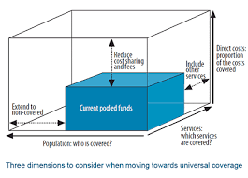
How much Public Money will be enough?
Given the pre-payment & pooling of risk
Given that the social solidarity proposed is to cover income cross subsidization (rich/poor) and risk cross subsidy (sick by healthy)
The NHI Bill is silent to any Financial Risk Protection of taxpayers and other contributing streams, as well as to the ceiling of Funds required to prevent a “bottomless pit” scenario

Slide 30
Access to Quality Health is a Gradient
The reimbursement models for rehabilitation is not clear.
The Final Evaluation Report, Phase 1 (July 2019) found that Provinces supported the capitation model or other outcomes-based reimbursement schemes, but ideally not fee-for-service (FFS) payment models. Rehabilitation was not part of this phase and study.
Empirical evidence suggests that amongst low and middle-income economies, mixed funding models have performed well in terms of health outcomes and have generally achieved this at a lower cost than better- known UHC models, Beveridge (tax) and Bismarck (social insurance) models (Nelson et al, 2012).
With the proposed overhaul of healthcare delivery and funding mechanisms, with little to no evidence-based policy inputs, and virtually no piloting of the proposed reimbursement models & insufficient evidence for their proposed impact, we believe that any meaningful level of fiscal detail is absent
Countries who have used capitation models (secondary, valued driven) show pros and cons: simplified bookkeeping, reduced excessive billing and the avoiding of unnecessary tests & procedures, but also fewer services are incentivized.
Outcomes based value payment models traditionally are performance-related incentive payments for the healthcare providers & generally depends on at least 10% on outcomes of the provided care.

Slide 31
Chapter 10 Financial Matters
No. 51 (1a): The Bill does not stipulate any corrective action and/or accountability if audit and financial records are not submitted timeously.
No. 51 (3): On items included in the Annual Report -we note that there is no health outcome measure reporting to encompass health and disability and impact on economy.
It is not stated/ unclear how civil society and professional bodies will have easy access to Annual Reports.
We note that as recent as March 2021, the Auditor-General has called on government leaders to ensure:
1) sustainable solution to prevent accountability failures;
2) ensure consequences for accountability failures;
3) prioritise improving financial management of auditees;
4) take opportunities for progressive and sustainable change.
No. 54 (e): Fine for theft and fraud: R 100 000 and less than 5 years in prison. Our comments are that this is hardly indicates serious, robust intent to discourage fraud and corruption and needs to be reviewed.

Slide 32
Criteria for Accreditation of Service Providers included for by NHI Fund Mrs Magda Fourie

Slide 33
Timeframe of Accreditation
1. In section 39 (7) of the Bill mention is made of a five-year renewal process for health service providers, which seems to exclude health establishments.
2. Health establishments should be included in the timeframe
3. Should be ten years for stability and commitment to grow the health system

Slide 34
Certification by OHSC
1. Agree that there must be standards to adhere to
2. Working closely with the OHSC and provide inputs of what is required for rehabilitation facilities and providers
3. Greatly concern about:
facilities in public sector (record from OHSC) who are not compliant but is e.g. the only facility in the area? Government must be responsible & step in.
The health provider is certified but the facility fails, can services continue?
4. Emphasis must be on facilities to ensure full accessibility for People with Disabilities
5. Listing and publications of accredited health service providers and health establishments must be published annually
6. Bill should allow the Board and Fund to outsource functions, such as accreditation by OHSC

Slide 35
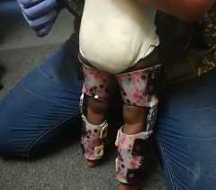
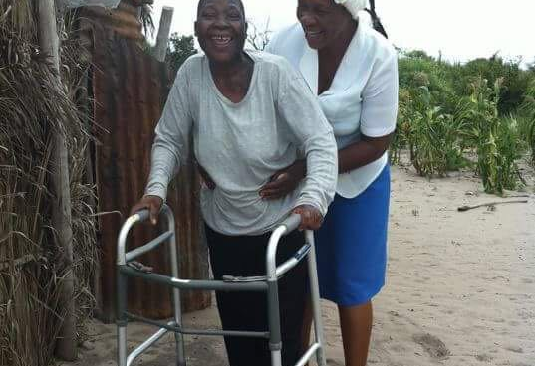
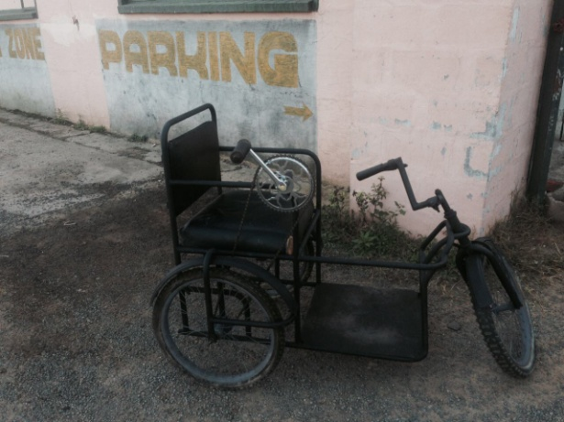
Monitoring & Evaluation
1. Crucial element of the success of universal health coverage and functioning of NHI Fund - Supports the development of a unique robust health information system in SA.
2. Data management in the health system is fragmented which makes it difficult and impossible to monitor and evaluate health services and to facilitate informed decision- making.
3. Performance of rehabilitation accredited service providers be monitored and evaluated by a rehabilitation manager who are familiar with rehabilitation service requirements.
4. Adherence to the provision of information mentioned in section 39 of the Bill must be accompanied by the provision of the necessary electronic equipment, programmes and analytical processes by the NHI Fund.
5. Not clear in the Bill who will determine the criteria for M&E of quality care
6. Rehabilitation services to be included in discussion for criteria required for rehabilitation.
7. Benefit package must include access to and maintenance of appropriate assistive devices at all levels of care, to prolong the life of the device, reduce costs and improve the quality of usage of the devices by the patient.

Slide 36
Clinical guidelines
1. Support quality health care services based on evidence or best practice guidelines
2. Rehab services to be included in the NHI in benefits package on all levels of care and for all age groups.
3. Professional associations must be involved in preparing protocols/treatment guidelines and best practice standards for benefits in the benefits package.
4. Health service providers’ autonomy must not be compromised when it comes to decision-making depending on patient’s condition.

Slide 37
5. Research agenda:
Currently very little academically accepted rehabilitation evidence is available in SA to support quality rehab interventions. As a result, international guidelines must be considered.
Universities and clinicians to be involved
Funding must be made available for development and contextualisation of guidelines and evidence-based or best practice by the NHI Fund.
6. Do not support: the Minister, consultation with Fund can decide on the provision of minimum to specified personal health services, appropriate number and mix of health care professionals, or the guidelines.

Slide 38
Adherence to Referral Pathways
1. Referral pathways must be practical and easy to manage
2. Must include all health providers and establishments and equal opportunity
3. Must include up and down referrals from PHC to tertiary and specialized care
4. Clinicians to be involved in creating these referral pathways

Slide 39
Summary of Recommendations by Rehabilitation Associations Prof Pat de Witt

Slide 40
Governance of structures of the NHI Fund
All NHI governance structures must adhere to standards of best practice -recommend the King IV Report on Corporate Governance in SA 2016 (King IV).
A “no fault provision’’ must be added to the Bill.
An overt percentage cost for the governance structure should specified so that it does not overrun essential funds for service delivery
must be externally audited by reputed independent company.
The range of powers of the politically appointed Minister of Health are a concern
An effective and efficient Board should be in control of key functions of the NHI Fund and service delivery.
Membership of the Board and the Chief Executive Officer of the NHI Fund must be appropriately qualified, open to robust public scrutiny with a transparent process.
At least one of the members should be rehabilitation professional (consultation with the Rehabilitation Professional Associations and Societies)
All proposed Ministerial Advisory Committees must include:
Appropriate number and mix of health care professionals and include rehabilitation professionals to ensure informed decision-making in respect of rehabilitation services.
Also a mix of the contracted and employed HCP.

Slide 41
Civil society should have:
A robust repeal committee and access to a reporting process
Consumer satisfaction for health service must be in place to inform planning and strategies
Centrally manged procurement and suppliers:
Needs to be efficient to prevent long provision details
Yearly reviews are not feasible;
Must include separate spares and repairs policy for assistive devices.
Rehabilitation providers should be consulted about the procurement of professional equipment and assistive devices.

Slide 42
Implementation of the NHI
Support full implementation by 2026 but implementation should not be time based (S 57) but milestone-based to further explain (S 33).
Implementation should not affect continuity of care of patients especially where interruptions of care may cause harm-accountability must be provided for in (S 57- transitional arrangements)
Health service delivery is inter-sectorial and robust responsive relationships between the different departments is lacking in this Bill (Basic education , Higher education, Social Development, Transport [RAF], Employment Labour [CF]

Slide 43
Retention and Skilling of the Rehabilitation Workforce
1. Consideration of a work force retention programme
2. Proposed contracting system is complex:
5 year time frame may not promote buy-in from health care providers to contribute to health service growth and continuous upskilling.
Propose a 10 years option subject to quality assurance
Flexibility is required as HCW are mobile
3. HPCSA to be held more accountable for the regulation of practice and practitioners-do not believe this is a function of the NHI or any structure of the NHI.
4. Clinical training of all levels of students is a cost to service provision which has not been sufficiently considered.
5. Community service is statutory requirement for all rehabilitation professionals: how will this be accommodated and managed.

Slide 44
Closing Remarks
1. Support in principle the objectives of the UHC and the NHI
2. Have concerns:
Checks and balances to prevent fraud and wastage
Establishing trust in the system to deliver quality healthcare to all

Slide 45
Supporting these Recommendation
White Paper on the Rights of People with Disabilities (2015)
- WPRPD Implementation Matrix, Pillar 4
UNCRPD committee report (2018)
- concluding observations and recommendations for South Africa
AU Disability Protocol ratified 2019, submitted to Parliament
Standardization of the Provision of Assistive Devices for South Africa
Framework and Strategy for Disability and Rehabilitation
Notes:
Many recommendations have already been made. The trick is in implementing them.

Slide 46
Additional References
Day C, Gray A, Padayachee T and Cois A., 2020. South African health review, Health Systems Trust. Retrieved 4 June 2021
Hanass-Hancock, J. and McKenzie, T.C., 2017. People with disabilities and income-related social protection measures in South Africa: Where is the gap?. African Journal of Disability (Online), 6, pp.1-11.
Hanass-Hancock, J., Nene, S., Deghaye, N. and Pillay, S., 2017. 'These are not luxuries, it is essential for access to life': Disability related out-of-pocket costs as a driver of economic vulnerability in South Africa. African Journal of Disability (Online), 6, pp.1-10.
Louw, Q.A., Berner, K., Tiwari, R., Ernstzen, D., Bedada, D.T., Coetzee, M. and Chikte, U., 2020. Demographic transformation of the physiotherapy profession in South Africa: A retrospective analysis of HPCSA registrations from 1938 to 2018. Journal of Evaluation in Clinical Practice.
Louw, Q., Grimmer, K., Berner, K., Conradie, T., Bedada, D.T. and Jesus, T.S., 2021. Towards a needs-based design of the physical rehabilitation workforce in South Africa: trend analysis [1990–2017] and a 5-year forecasting for the most impactful health conditions based on global burden of disease estimates. BMC public health, 21(1), pp.1-11.
Moodley, J. and Ross, E., 2015. Inequities in health outcomes and access to health care in South Africa: a comparison between persons with and without disabilities. Disability & Society, 30(4), pp.630-644.
Pillay, M., Tiwari, R., Kathard, H. and Chikte, U., 2020. Sustainable workforce: South African audiologists and speech therapists. Human Resources for Health, 18(1), pp.1-13.
Sherry, K., 2014. Disability and rehabilitation: Essential considerations for equitable, accessible and poverty-reducing health care in South Africa. South African health review, 2014(1), pp.89-99.
Sherry K and Reid S., 2020. South African health review, Health Systems Trust. Retrieved 4 June 2021
Tiwari R, Ned L and Chikte U., 2020. South African health review, Health Systems Trust. Retrieved 4 June 2021
Statistics South Africa. Profiling socio-economic status and living arrangements of persons with disabilities in South Africa. Pretoria: StatsSA; 2016. URL: http://cs2016.statssa. gov.za/wp-content/uploads/2018/07/CS-2016-DisabilityReport_-03-01-232016.pdf
South African National Department of Social Development. White Paper on the Rights of Persons with Disabilities. Pretoria: SANDSD; 2015. URL: https://www. gov.za/documents/white-paper-rights-persons-disabilitiesofficial-publication-and-gazetting-white-paper.
South African Department of Social Development, 2016, Elements of the financial and economic costs of disability to households in South Africa, Results from a Pilot Study, DSD, UNICEF, Johannesburg
World Health Organization, 2011. World report on disability 2011. World Health Organization.

Slide 47
Profession Specific Presentations

Slide 48
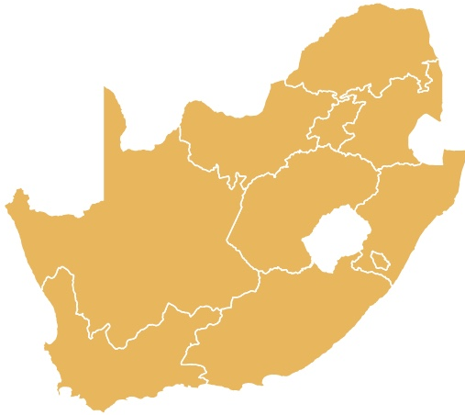
Medical Orthotics and Prosthetics in Public Health
Medical Orthotics and Prosthetics forms an integral part of the multi-disciplinary-team in health care services, rehabilitation and disability management
Nationally we have 25 O&P centres with 129 in level 2 and 3 hospitals
Public/professional ratio 60, 027, 095/129 = 465 326:1
Elaboration of Medical Orthotics and Prosthetic services to be presented by the South African Orthotic and Prosthetic Association at 12:40

Slide 49
Order of Presentations
Audiology – President: Mrs Liepollo Nthakana
Speech therapy-Language & Hearing – CEO: Mrs Annaline Jack
Occupational Therapy – President: Prof Pat de Witt
Physiotherapy – Deputy President: Mrs Lonese Jacobs
Rural and Low Resource settings – Chairperson: Miss Maryke Bezuidenhout

Slide 50
Questions

