Slide 1

STANDING COMMITTEE PRESENTATION
14 June 2021

Slide 2
CONTENT OF PRESENTATION
The presentation will consist of two parts, viz.
Quarterly Performance Reports for the period April – June 2020, July - September 2020, October - December 2020.
Readiness for primary school learners (Grade R to 7) to return to the daily attendance and traditional timetable from 26 July 2021.

Slide 3
Quarterly Performance Review
Quarter 2,3 and 4
Standing Committee on Education

Slide 4
Contents
1
Impact of C-19 on org Performance and Monitoring
2
Quarter 2 Performance
3
Quarter 3 Performance
4
Quarter 4 Performance
5
Pre-audit output against annual targets

Slide 5
Impact of COVID-19 on organizational performance and monitoring

Slide 6
Impact of COVID-19 on organisational performance and monitoring
Alert Level 3: 29 December 2020 – 28 February 2021
Alert Level 1 since 1 March 2021
State of disaster extended to 15 June 2021
Phase 2 of Covid-19 vaccination in progress.
In-year amendment to 40 targets have been tabled

Slide 7
Impact of COVID-19 on organisational performance and monitoring
Alert Level 1: 21 September – 28 December 2020
Most normal activity resumed, with precautions and health guidelines.
Alert Level 3 since 29 December 2020
Schools applied TREPs to manage social distancing
No inhouse in-service training
No diagnostic systemic assessment 3,6,9
Delayed opening of schools in 2021

Slide 8
Quarter 2 Performance Report

Slide 9
Quarter 2: Performance Report

Slide 10
Quarter 3 Performance Report

Slide 11
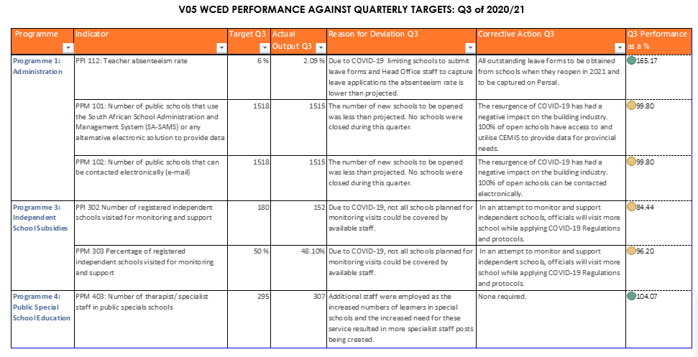
Quarter 3: Performance Report

Slide 12
Quarterly performance: Q3 of 2020/21
The WCED set 6 quarterly targets.
2 targets were achieved (33%) and 4 targets were partially achieved (67%).
Significant over-performance (165.17%) – PPI 112: Teacher absenteeism rate – delay in the submission and capturing of leave application forms. An update will be provided when reporting on Q4 performance.

Slide 13
Quarterly performance: Q3 of 2020/21

Slide 14
Quarter 4 Performance Report

Slide 15
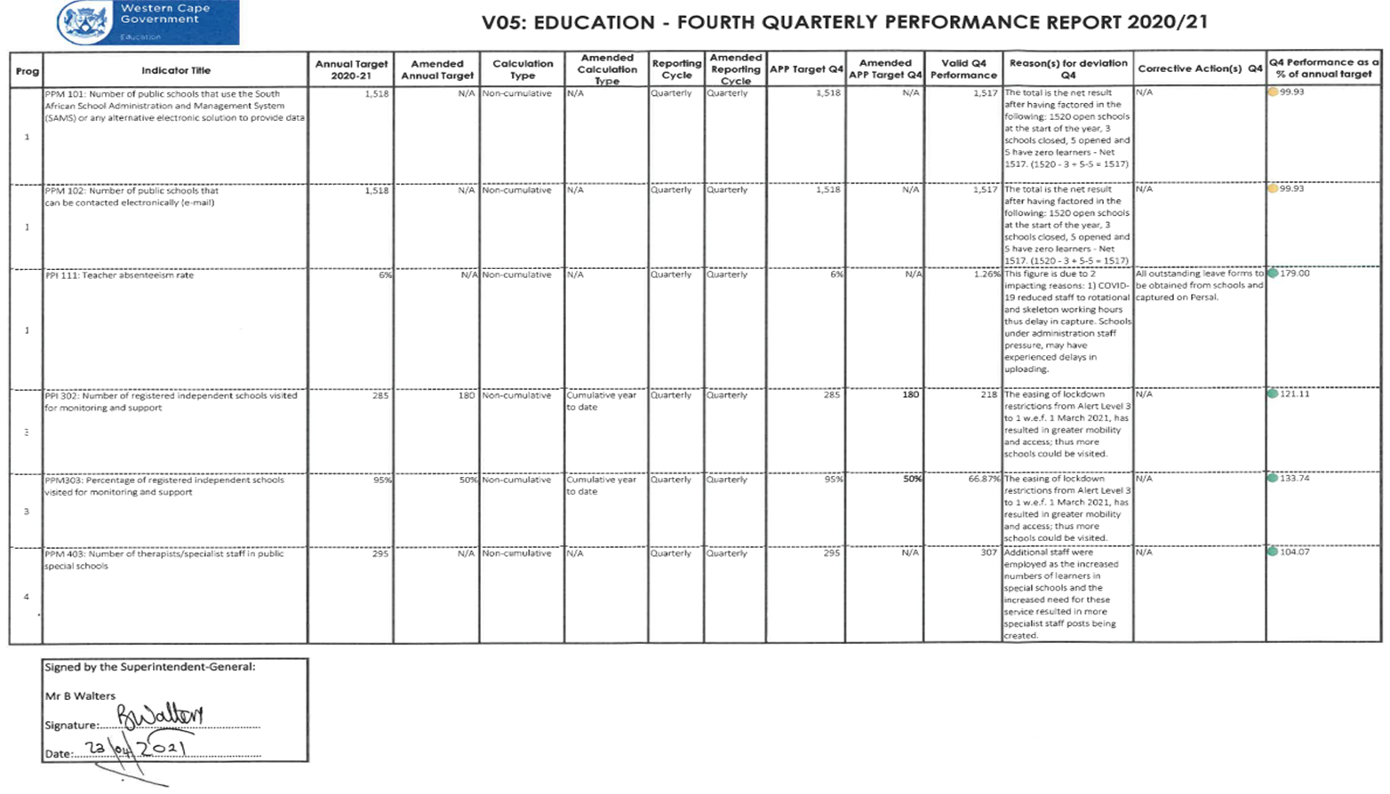
Quarterly Performance Q4 of 2020/21

Slide 16
Quarterly performance: Q4 of 2020/21
The WCED set 6 quarterly targets.
4 targets were achieved (67%) and 2 targets were partially achieved (33%).
Significant over-performance (179%) – PPI 112: Teacher absenteeism rate – delay in the submission and capturing of leave forms.

Slide 17
Quarterly performance: Q4 of 2020/21

Slide 18
Conclusion
The WCED performed admirably given business ‘unprecedented’ due to COVID-19.
Learner retention: 67.8% Up from prior year of 67.33%

Slide 19
Readiness for Primary School (Grade R to 7) and Special School learners (Gr R-12) to return to the daily attendance and traditional timetable from 26 July 2021.

Slide 20
NATIONAL GUIDELINES
Directions
DBE: Government Gazette Nr 44633 (dated 28 May 2021)
DBE Communication
Circular 3/2021: Teachers with comorbidities (dated 3 June 2021)
WCED communication to schools
Letter by SG: return of PS and Special School learners on 26 July 2021 (dated 2 June 2021)
Letter by SG: Management of comorbidities on L2 (dated4 June 2021).

Slide 21
WCED SURVEY
A survey was recently conducted to check on various aspects at schools, amongst other PPEs and readiness to bring back 100% learners.
Outcomes on PPEs
  PPEs: Whilst almost all schools still have PPEs that was delivered in 2020 or procured by the school using N&S funding, the survey indicated that schools will have difficulty in funding further PPEs.
  Consequently, the department has agreed to supply schools with PPEs, but schools must inform the District office of shortages.

Slide 22
WCED SURVEY
Outcome of survey on 100% return
Description | Extent/ Numbers | Comment
Total number of schools with Gr R-7 | 1 100 | Includes all types of schools.
Schools which cannot return 100% | 1195 [PS 867; ELSEN 55] | Space as the reason for less 100% 14 Schools earmarked for additional mobile units (Completion July-Oct ‘21). Procedure to be followed.
Schools that can return 100% | 328 [Gr R-7: 234; LSEN 18] | Can comply with the Covid Requirements.

Slide 23
PROCEDURE WITH DEADLINES
Schools that cannot open, must complete a template providing the following information:
Why the school cannot receive all learners back?
How it will ensure that all learners receive adequate teaching exposure.
The above information must be submitted to the District Office by 30 June 2021.
If the school is open, it must inform the HoD within 72 hours of any Covid cluster breakout.
Minimise learner movement at school. Teachers to rotate.
All contact sport has been suspended.
Application of strict Covid compliance rules for non-contact sport.
WCED will monitor support to ALL learners.

Slide 24
READINESS AND RISKS
The department will get a sense after 30 June 2021 of how many schools will take up the opportunity to return 100% learners.
There could be teacher objections, given the announcement of the third wave of Covid.
Department to closely monitor those schools which cannot return 100% learners.
DBE still needs to clarify the 1 x m physical distancing requirement.
Responsibility stays with the department to support learners, irrespective of attendance mode, as best as it can.

Slide 25
Thank you

