Slide 1
The place where Africa’s Green Economy grows

Slide 2
Atlantis SEZ Standing Committee on Finance, Economic Opportunities & Tourism (SCFEOT)
The place where Africa’s green economy grows
31 May 2021

Slide 3
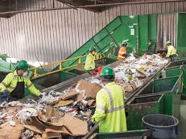
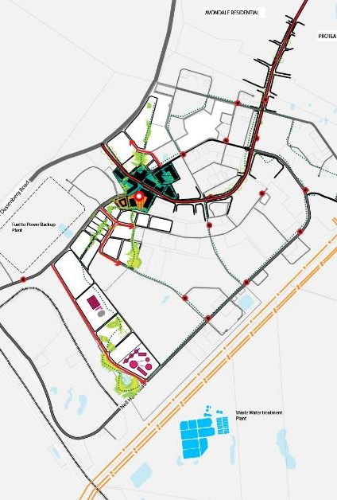
Strategic Objectives
To develop a sustainable, commercially orientated Greentech SEZ in Atlantis
To attract and retain export-focused Greentech investors into the Atlantis SEZ
To establish and maintain a conducive business environment for the Green Economy
To foster local economic growth, employment and revitalization by being integrated within the community
To implement credible, effective resources, business processes and administration which serve and drive the ASEZ strategic objectives

Slide 4
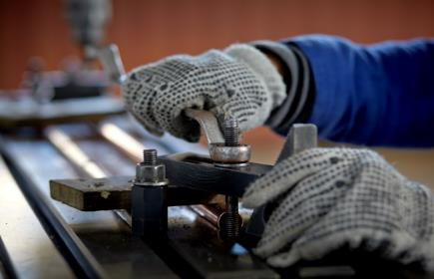
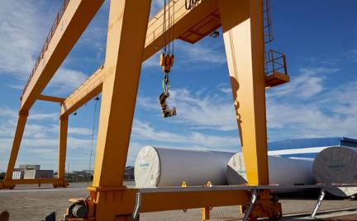
What is Greentech?
Lower Carbon
Resource efficient
Socially inclusive
Notes:
South African Renewable Energy Business Incubator (SAREBI), Atlantis
Employee from iSOLAR learning practical skills in the green economy at SAREBI. iSOLAR is one company receiving incubation support as part of SAREBI's work providing non-financial assistance to entrepreneurs in the renewable energy industry.
Gestamp Renewable Industries (GRI), Atlantis SEZ
This GRI manufacturing facility, which produces steel wind turbine towers, was the first company to set up in the proposed Atlantis Special Economic Zone (SEZ). GRI invested R300m to establish the facility, which has created 200 new permanent jobs.

Slide 5
SKILLS DEVELOPMENT

Slide 6
Identified Skills in Demand
Foundational
Technical
Interpersonal
Management
Supervisory
Specialized
Notes:
Strong industry need for high school students to choose Maths core and Science related subjects- STEM
Welding, boiler services, renewable energy – technical & specialized (renewable energy) skills
Technical skills
Leadership skills
Management skills
Production skills
Basic numeracy and literacy
Technical engineering skills
Supervisory skills
Customer service skills
Communication/interpersonal skills
IT skills
Marketing and sales skill

Slide 7
Skills Development Programs Energy Focus
STEM Education
Ikhamva Youth
Industry Focused
Renewable Energy
Foundational Skills
Project Management
Business Administration
Business Communication
Project implementation
Labour intensive
Water & Waste Management
CSN Capacity

Slide 8
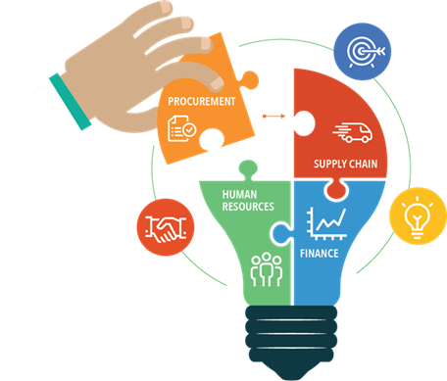
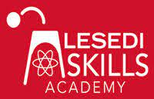
Partners in Skills Development

Slide 9
Atlantis SEZ as a “living lab”
Living Lab
Community
Private Actors
Knowledge Institutions
Multi stakeholder
Public Actors
Natural Setting
Living Lab incorporates and goes beyond the eco-industrial park concept. It develops, manages and contributes towards local ecosystems, thus fostering inclusion within urban and regional context.

Slide 10
New Partners 2021 -2022
Academic Partner for applied research and knowledge transfer
R2million funding for technical skills development

Slide 11
Skills Development
Despite a need for ICT related skills in Atlantis to align for participation in the digital economy, there are no coding/ ICT related skills development initiatives due to budget constrictions.
Skills development impact could be scaled through the introduction of Tech Hub and technology programs into Atlantis. Software and hardware skills development would contribute towards the shortage of technology skills and increase income opportunities.
Project implementation
CSN Capacity

Slide 12
Community Integration & Development
COMMUNITY STAKEHOLDER NETWORK
Community Facilitation Agreement signed between CSN & ASEZ Co.
Quarterly Progress Meetings with DEDAT & City of Cape Town
First of its kind for Special Economic Zones in RSA
Business, Informal traders, Traditional Council, Labour, Education, Faith Based, Civic,
Continuous capacity building and sector focused work plan
Next steps: operationalising and further capacity building
Business Communication
Business Administration
Project Management

Slide 13
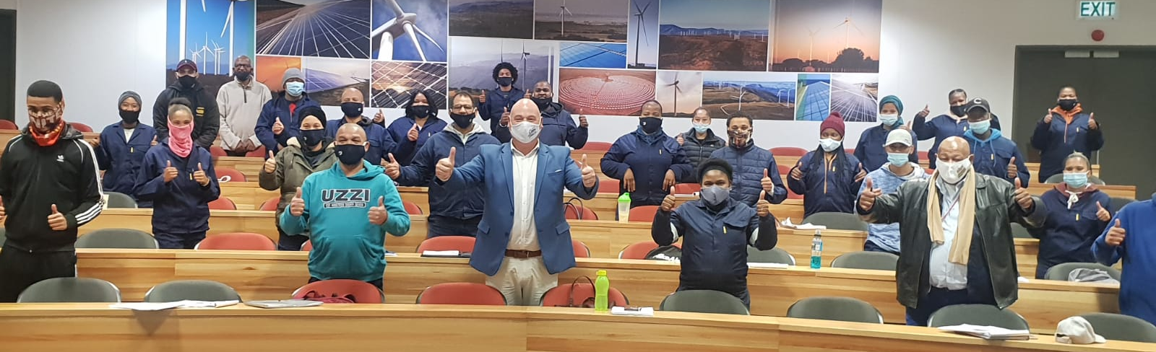
Current skills development initiatives 2021-2022
Water treatment & Waste management (20)
Early Childhood Development (20)
Collaborating with City-funded program supporting green economy skills development (90)
Construction SMME Supplier Development (13)
Basic welding, boiler making and mechanical fitting (54)
SARETEC BTS and BTT training (12 beneficiaries)
Business Administration (10 beneficiaries)
Project Management (15 beneficiaries)
Business Communication (10 beneficiaries)

Slide 14
Other programmatic collaboration
City
Basic Welding
Mechanical fitting
Boilermaking
SARETEC Bolting and Fastening Training
Project implementation
DEDAT
Workplace placement programme
Renewable energy skills training centre?
GREENCAPE
CSN Capacity
Ikamva Youth Programme
Artisan training at SARETEC

Slide 15
Questions?

