Slide 1
SAA Group STATUS UPDATE
PORTFOLIO COMMITTEE ON PUBLIC ENTERPRISES
02 JUNE 2021

Slide 2
Contents
BR Process Update
Status of Subsidiaries
Funding for SAA & Subsidiaries
Subsidiaries Funding requirements
Special Appropriation Bill for funding Subsidiaries
SAA Funding and Actual Expenditure
Market Overview
Resumption of operations
Cargo
Strategic Equity Partner (SEP) update

Slide 3
BR Process Update
The BRPs filed a notice of substantial implementation on 30 April 2021 which resulted in the exit of the BRPs at SAA since the process started in December 2019.
Key areas still requiring strategic focus during the Transition Phase:
Receivership was established to manage the settlement of outstanding liabilities;
The receivership will settle labilities over the next three years. These are concurrent creditors and unflown ticket liability; and
Implementation of the Business Rescue Plan initiatives.

Slide 4
BR Process Update
The BRPs handed over the affairs of the business to the Interim Board and Executive Management Team to focus on the following:
Develop and implement an interim business plan to sustain the operations while a strategic equity partnership (SEP) is being finalized;
Address all residual legal matters including the LRA Section 189s and the legal disputes in the courts with the labour unions and the Pilots association; and
Resumption of flight operations.

Slide 5
Status of Subsidiaries
SAA went into business rescue on 5 December 2019 due to continuous losses over an extended period of time
SAA subsidiaries were not put into business rescue, the impact of SAA being in business rescue exacerbated financial challenges of the subsidiaries
The business rescue plan recognized the deteriorating financial situation
Clause 14.6.10.1 of the business rescue plan recognised the relationship between SAA and its subsidiaries and the requirement for intra-group transactions
Success of business rescue plan is dependent on financial viability of subsidiaries

Slide 6
Funding for SAA & Subsidiaries
 | Urgent Funding to 31 Jan 21 | Remainder over 3 years | Total
 | ZAR Billion | ZAR billion | ZAR billion
Employee Related Payments | 2.80 |  | 2.80
Post-BR Creditors | 0.80 |  | 0.80
Working Capital and Interim Flying | 2.00 |  | 2.00
Recapitalisation of Subsidiary Companies | 2.70 |  | 2.70
Honouring of Unflown liability | 2.20 | 1.20 | 3.40
Dividend Concurrent Creditors) | - | 2.30 | 2.30
Total | 10.50 | 3.50 | 14.00
Funding requirement for SAA and Subsidiaries was approved by Government
R2.7 billion for subsidiaries was part of the request
R3.5 billion required over 3 years needs to be approved by Government

Slide 7
Subsidiaries Funding requirements
Subsidiary | Operational Issues | Financial Issues | Recommendations
South African Airways Technical | Inability to procure spares in advance had a ripple effect on the maintenance of Mango flights Retrenchments – right size business was required | Declining revenue not sufficient to cover fixed monthly costs Deferred payment of PAYE, VAT, pension fund contributions until funding received Partial payment of salaries | Restructuring of SAA Technical required to right size the business
Mango | Mango’s market share had decreased since February 2020 as a result of the impact of the COVID 19. Operational inefficiencies, mainly due to the aircraft on the ground. Inadequate support from SAAT | Cash inflow less than cash outflow therefore deferring of payments to meet critical payments Critical vendors not paid which could ground Mango due to deferred payments Funding required to mainly for pay accumulated debt instead of positioning for future | Funding initially allocated for subsidiaries needs to be re-assessed based on changed market circumstances, future plans of SAA and the subsidiary and available funding

Slide 8
Subsidiaries Funding requirements
Subsidiary | Operational Issues | Financial Issues | Recommendations
Airchefs | Unable to provide any service due to: Majority of Air Chefs business came from SAA Covid Regulations on serving meals in- flight Liquidity challenges resulting in operational inefficiencies New customers lost due to inability to provide services as a result of liquidity challenges | Continued losses as revenue insufficient to cover cost | Urgent review and approval of restructuring plan by Board

Slide 9
Special Appropriation Bill for funding Subsidiaries
Allocation of R10.5 billion in MTBPS to SAA for the implementation of the Business Rescue Plan
Second Adjustments Appropriation Act, 2020 was passed on 20 January 2021 did not provide for transfer of funds to subsidiaries despite DPE including this in the funding request
R7.8 billion has been transferred to the airline to date
Special Appropriation bill tabled in Parliament on 24 February 2021 to enable R2.7 billion to flow to subsidiaries
The R2.7 billion formed part of the R10.5 billion requested for the SAA business rescue plan requirements

Slide 10
SAA Funding and Actual Expenditure
R10.5 billion was allocated in the 2020 Second Adjustments Appropriation
R7.8 billion transferred to SAA for restructuring:
Voluntary settlement packages and employee liabilities paid to date R2 billion.
Post commencement finance creditors paid to date R600 million.
Un-flown ticket liability paid to date R800 million.
The R2.7 billion for subsidiaries remains unpaid to date as this amount couldn’t be allocated as part of funds allocated for SAA business rescue.

Slide 11
Market Overview – Domestic Market
Skylink Airways has announced its intentions start operating in the domestic market as of September 2022. The new airline intends filling the gap left by SAA on the Cape Town and Johannesburg bases;
Cape Town International Airport (CTIA) has announced that it is close to reaching 70% of its 2019 domestic air travel volumes;
The Covid third wave is expected to slightly slow down passenger demand.

Slide 12
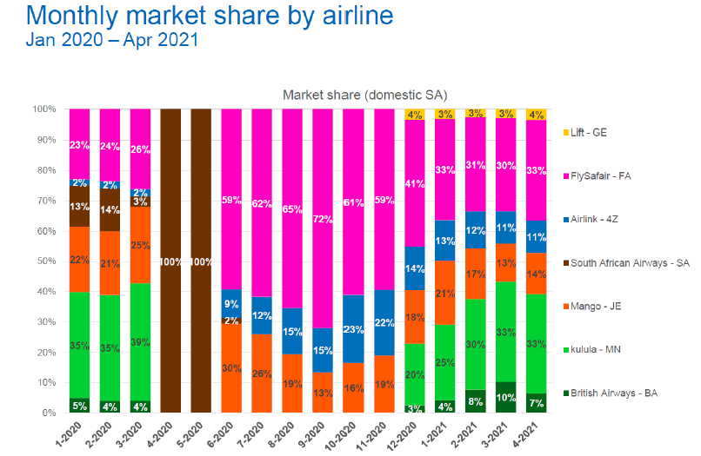
Market Overview – Monthly Flight Market Share
Source: Boeing

Slide 13
Resumption of Operations
SAA currently preparing for resumption of operations and focusing on the following:
Regulatory compliance with Civil Aviation to ensure safety and security requirements are adhered to;
Market re-entry strategy – route network simulation, product development, pricing;
Subsidiaries alignment for resumption of operations; and
Communication strategy geared towards resumption of operations.
Resumption of operations s dependent on the macro factors such as Covid19 pandemic and satisfactory resolution of Pilots matter.

Slide 14
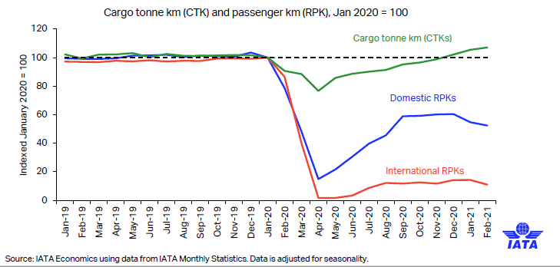
Cargo Update
African airlines’ cargo demand in February 2021 increased by 44.2% compared to Feb 2019
Africa was the strongest of all regions driven by Asia-Africa trade expansion – International Air Transport Association (IATA)
Air Cargo Volumes remain strong and resilient through the pandemic;
According to IATA, Air Cargo faces continue facing capacity shortage.

Slide 15
Cargo Update
The restructuring of SAA, has necessitated the business model review of Cargo due to the reduction in belly space capacity available from SAA;
SAA to review Cargo strategy to align to market changes and Ekurhuleni Aerotropolis advancement;
There is a need to focus on stabilization and expansion of the business using third party capacity suppliers; and
There is a need for investment in infrastructure and IT systems to support the new business model.

Slide 16
SEP Process
The Department is in final discussions with the Strategic Equity Partner.
Both parties are conducting due diligence
The process may be finalised in between 4 to 6 weeks
Once the process is finalised an announcement will be made.

Slide 17
End of Presentation

