Slide 1
MISSION ESTABLISHMENT
Head of Mission: Amb. CT Rubushe
Counsellor Political: Mr VG Kwepile
Counsellor Political (SSA): Vacant
Counsellor Economic: Vacant
Defence Attaché: Col. Lochner
Three First Secretaries: Political, Administration and Immigration & Civic Services
Third Secretary Administration

Slide 2
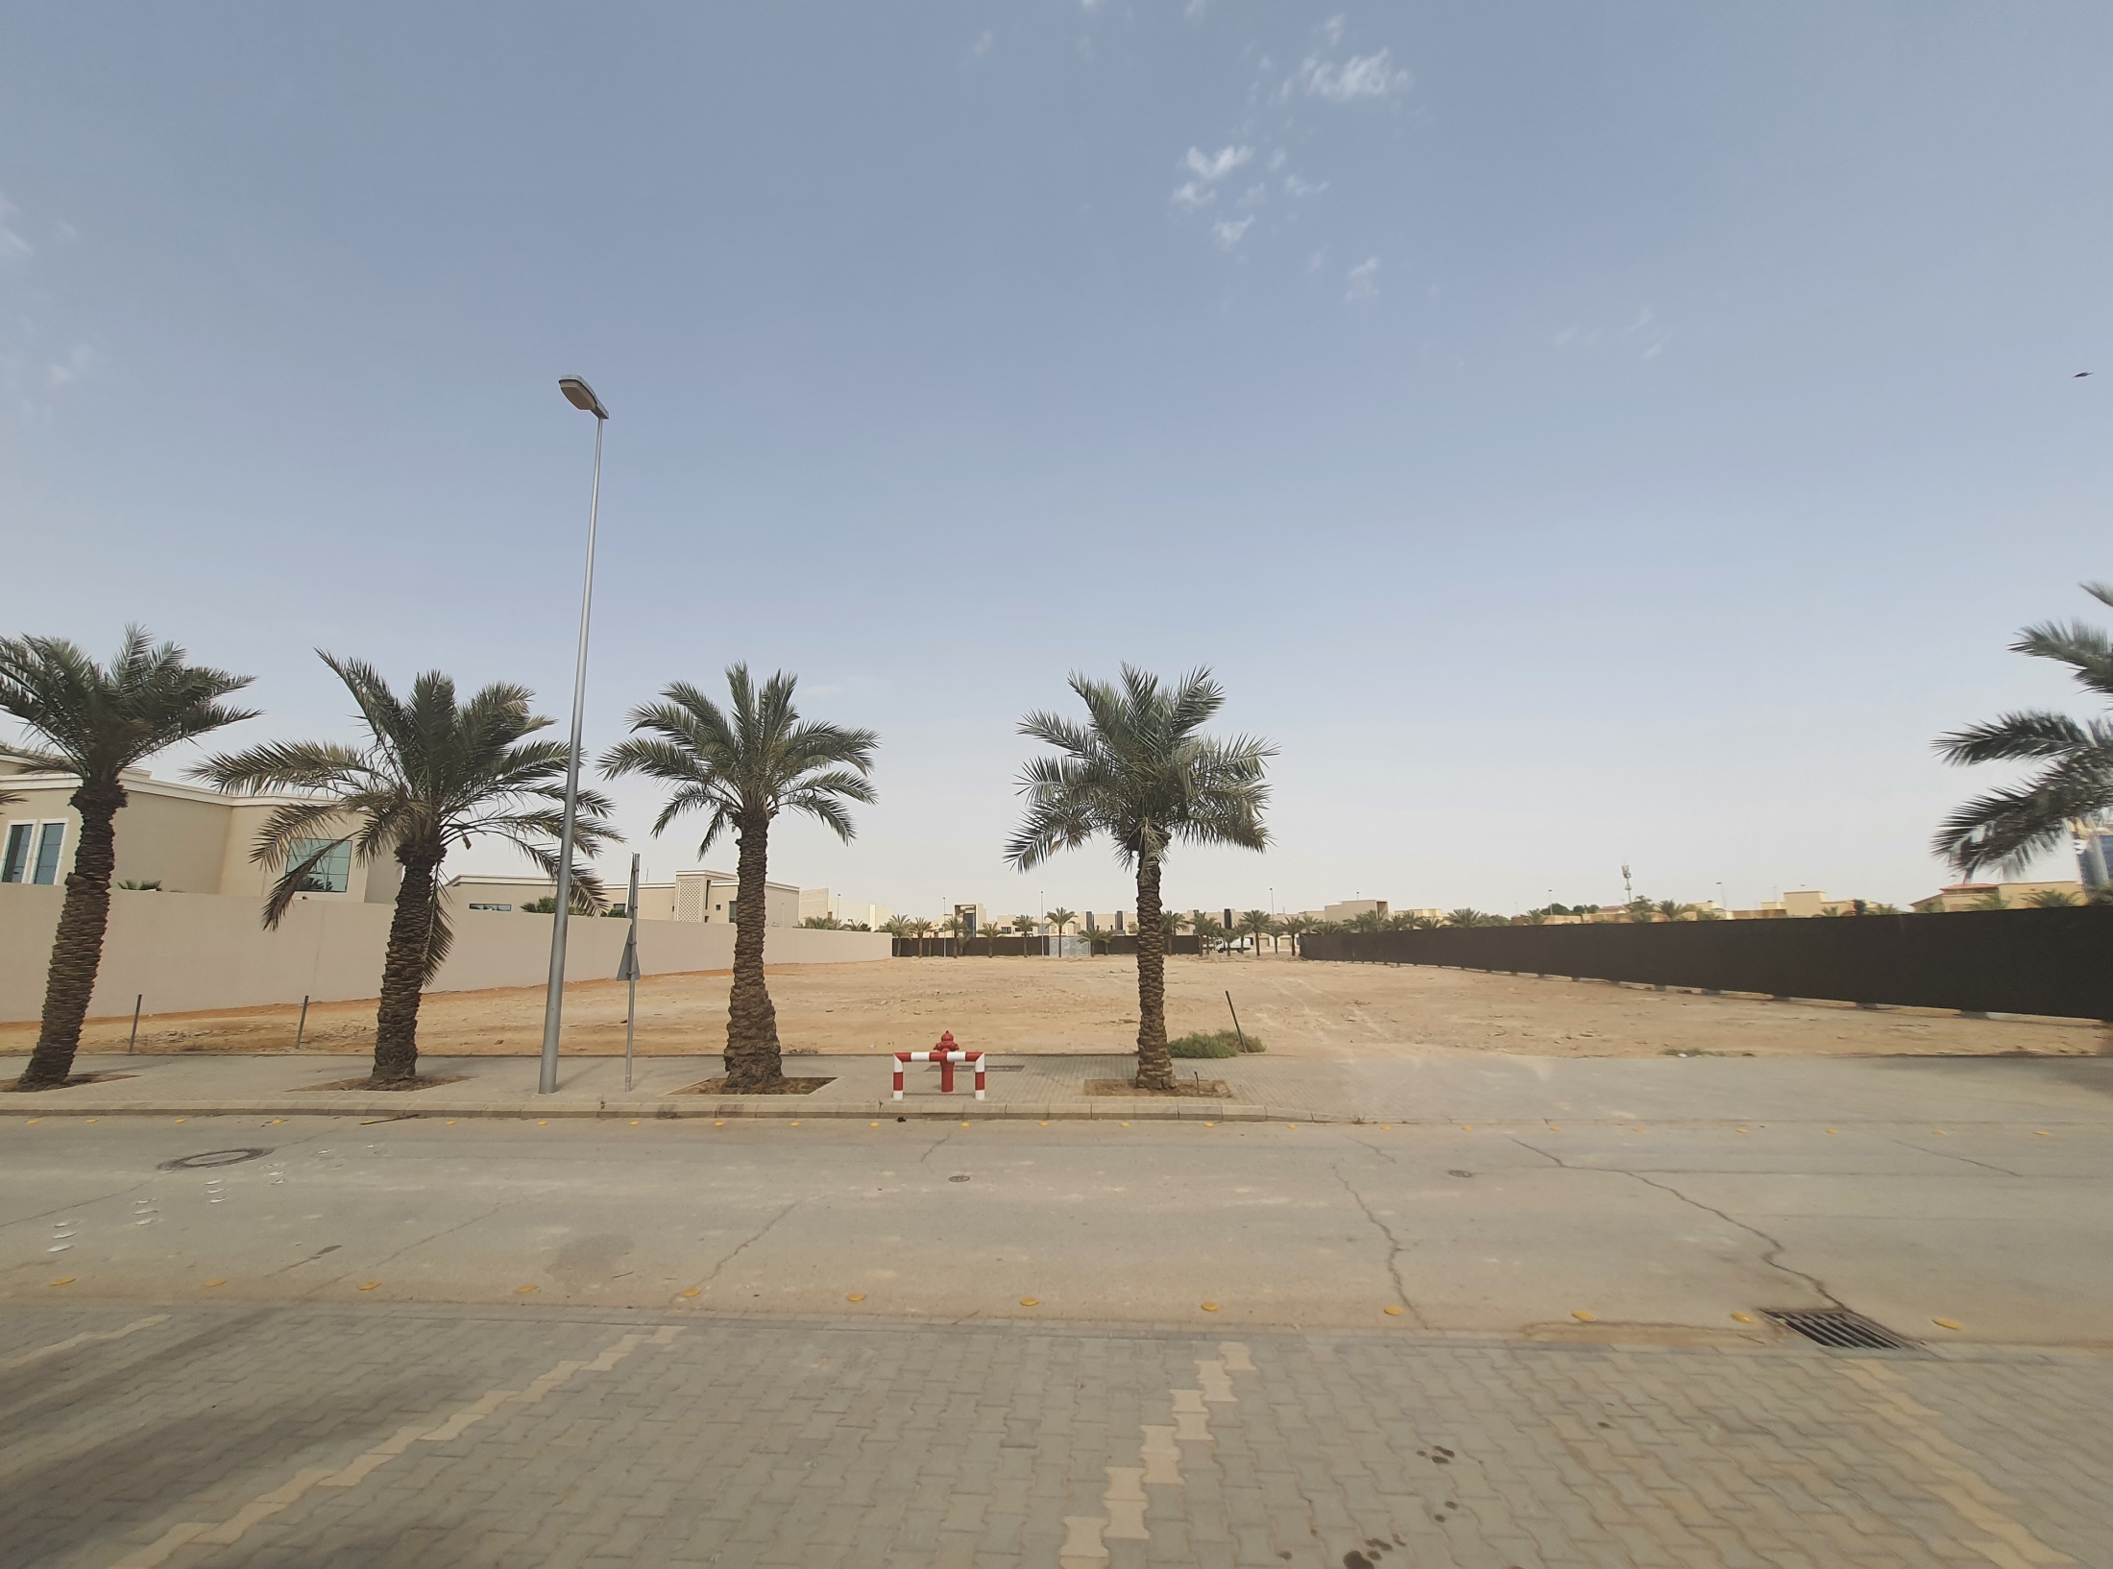

Slide 3
UNDEVELOPED LAND
Address of the land
Plot no 29D, Diplomatic Quarter
Riyadh
Are 6,298 sq.
Date of acquisition
16 February 2008
Amount
SAR 5,668,200
+- 1, 510, 050 USD (rate 3.74797)
The title deed is available

Slide 4
Cont...
There are no running expenses incurred by the mission towards the land.
The land is inside the Diplomatic Quarter where most of diplomatic missions are accommodated and access is controlled by the diplomatic police

Slide 5
Assets Management
Existence: Assets appearing on the register but not on the floor
Reason:
Barcode could have fallen off
Asset is lost/stolen but was never reported
Asset disposed but not removed from the register
Completeness: Asset on the floor but not on the register
Reason:
Asset disposed on paper but never physically removed from the floor
New asset additional form(NAAF) never submitted
Asset transferred from partner department to DIRCO and the asset register not updated as yet.

Slide 6
Continuation assets management
The mission has a total of 820 assets, 648 were verified, that resulted in 79 % achievement.
Reason for not achieving 100%: Upon investigation the following discrepancies were discovered:
34 assets were previously disposed of but not removed from the register,
3 assets duplicated on the register
135 assets were left at the old chancery premises without following the correct asset disposal procedures when the mission was relocating from the old premises to the new Chancery and Official Residence.
This resulted in assets appearing on the register but not on the floor. (Existence)

Slide 7
Disposal of Assets
The mission identified assets to be disposed of including assets that were left at the old chancery without following proper disposal procedures.
The Standing Committee members will meet and recommend the disposal of assets that are redundant and missing.

