Slide 1
INFORMATION REGULATOR’S STATE OF READINESS FOR THE IMPLEMENTATION OF THE PROTECTION OF PERSONAL INFORMATION ACT 4 OF 2013 AND PROMOTION OF ACCESS TO INFORMATION ACT 2 OF 2000
Date: 02 June 2021

Slide 2
TOPICS
INTRODUCTION
COMING INTO EFFECT OF POPIA AND PAIA
REGULATOR’S STATE OF READINESS
RECRUITMENT OF KEY EMPLOYMENT
EDUCATION AND COMMUNICATION OPPORTUNITY
ENFORCEMENT COMMITTEE
CONCLUSION

Slide 3
INTRODUCTION

Slide 4
Introduction (cont…)
Section 14 of the Constitution provides that everyone has the right to privacy. The right to privacy includes the right to protection of personal information. Section 32 of the Constitution enshrines the right of access to information held by both public and private bodies.
The Protection of Personal Information Act 4 of 2013 (POPIA) and Promotion of Access to Information Act 2 of 2000 (PAIA) were enacted in response to the above-mentioned constitutional mandates to privacy and access to information.

Slide 5
Introduction (cont…)
POPIA promotes the protection of personal information processed by public and private bodies. It also prescribes the minimum requirements (8 conditions for lawful processing of personal information) for the processing of personal information.
The right of access to information is one of the most effective ways of upholding the constitutional values of transparency, openness, participation and accountability.
Accordingly, the Regulator performs a dual mandate in terms of POPIA and PAIA.

Slide 6
COMING INTO EFFECT OF POPIA & PAIA, AS AMENDED

Slide 7
Coming into effect of POPIA and PAIA
POPIA came into effect on 1 July 2020, except for sections 110 and 114(4) which will be effective from 30 June 2021.
POPIA provides for a 12 month grace period, in terms of which the responsible parties are required to put measures in place to ensure that all processing of personal information is in compliance with POPIA.
The 100 day countdown to 1 July 2021 commenced on 24 of March 2021. Accordingly, public and private bodies have 28 days left to ensure that all processing of personal information conforms with POPIA.

Slide 8
Coming into effect of POPIA and PAIA
On 1 July 2021 all responsible parties must ensure that all processing of personal information complies with POPIA. The enforcement powers of the Regulator will come into effect on this date.
On 30 June 2021 the Regulator will be responsible for the promotion and enforcement of the rights protected by PAIA. This function is currently performed by the South African Human Rights Commission ( SAHRC).

Slide 9
Coming into effect of POPIA and PAIA
Regulation 5 (Application for issuing codes of conduct) commenced on 1 March 2021, Regulation 4 (Responsibilities of Information Officers) commenced on 1 May 2021 and the residual Regulations will commence on 1 July 2021.
The 1 July 2021 is also the commencement date for section 58(2) of POPIA, which deals with the processing of personal information subject to prior authorisation by the Regulator.

Slide 10
REGULATOR’S STATE OF READINESS

Slide 11
Readiness Plan for POPIA and PAIA
In order to ensure that the operating environment is prepared to effectively promote and protect the right to privacy as well as the right of access to information, the Regulator developed a readiness plan for the implementation of both POPIA and PAIA , which was previously presented to parliament.
The objective of the readiness plan is to critically look at the organisation's capacity to successfully deliver or to perform its functions under POPIA and PAIA, and initiate appropriate actions or measures to bring the current state of readiness to one of confidence in long-term success of the organisation.

Slide 12
PAIA Regulations
Due to the amendment brought by POPIA, the current PAIA regulations has to be repealed.
In preparation for the transfer of PAIA functions to the Regulator, the Department of Justice and Constitutional Development (DOJ & CD), in consultation with the Regulator, published draft regulations relating to the promotion of access to information, 2020. The submission of the public comments closed on 17 May 2021.
The DOJ & CD advised that the regulations will be gazetted on or before 30 June 2021.

Slide 13
PAIA Readiness Plan
The PAIA Readiness plan has been developed, which we are confident will result in the organisation being ready for implementation.
PAIA regulations serve as one of the critical actions identified in the readiness plan, as well as the updating of the PAIA Guide, which was initially compiled by the South African Human Rights Commission.

Slide 14
PAIA Readiness Plan
The translation of the PAIA Guide into 11 official languages is at an advanced stage and the Regulator has included braille as one of the languages in which the PAIA Guide will be available. The Regulator's PAIA Manual is also being translated to three official languages and braille.

Slide 15
PAIA Readiness Plan
Amongst the critical documents developed are the following :
Enforcement Notice;
Information Notice;
PAIA Manual Template- Private Body;
PAIA Manual Template - Public Body;
Private Bodies' Report Form in terms of Section 83(4) of PAIA;
Public Bodies' Report Form in terms of Section 32 of PAIA;
Summons
Subpoena; and
Search and Seizure Warrants.

Slide 16
POPIA Readiness Plan
Amongst the identified performance tasks and deliverables completed in preparation for the 1 July 2021 is the processing of applications for-
Codes of conduct- Guidelines developed and applications currently being processed;
Prior authorisation– Guidance Note issued and applications currently being processed;
Exemption- Guidance Note drafted and to be adopted. Applications to be processed during the month of June 2021 ;
Special Personal Information- Guidance Note drafted and to be adopted. Applications to be processed during the month of June 2021;

Slide 17
POPIA Readiness Plan
Personal information of children- Guidance Note drafted and to be adopted. Applications are to be processed during the month of June 2021;
Direct marketing by means of unsolicited electronic communications is a serious issue, the Regulator will issue a Guidance Note on direct marketing by means of unsolicited electronic communications, directories and automated decision making.
A Guidance Note on what constitutes appropriate , reasonable technical and organisational measures has been drafted and is to be adopted. This guidance note will offer guidance to responsible parties and data subjects.

Slide 18
POPIA Readiness Plan
Registration of Information Officers: a guidance note on the registration of Information Officers has been issued. The portal has been developed and is being refined by DOJ & CD.
Complaints Management System :Complaints will be handled manually until the online complaints form is operative. A fully automated complaints management system is necessary and is yet to be funded.
Rules of Procedure for Complaints Handling have been drafted are to be adopted before the end of June 2021.

Slide 19
RECRUITMENT OF KEY EMPLOYEES

Slide 20
Prioritised core position
The Regulator has prioritised the recruitment of key employees under the core business. The following progress has been made:
DIVISION | NUMBER OF FUNDED POSTS | NUMBER OF FILLED POSTS | ADVERTISED POSITIONS | STATUS
POPIA | 16 | 2 | 14 | Offer letters for ten (10) positions issued on 31 May 2021 One (1) position of Senior Manager waiting for results of competency assessment. One (1) position of Executive at headhunting stage Two (2) positions of PA and Secretary to be shortlisted
PAIA | 16 | 4 | 12 | Offer letters for 9 positions issued on 31 May 2021 Three (3) positions interviewed on 2 June 2021
LEGAL, POLICY, RESEARCH AND TECHNOLOGY ANALYSIS | 11 | 2 | 09 | One (1) position of Senior Manager waiting for results of competency assessment Eight (8) positions to be shortlisted
EDUCATION AND COMMUNICATION | 7 | 3 | 4 | One (1) position of Executive waiting for competency assessment results Three (3) positions to be shortlisted

Slide 21
EDUCATION AND COMMUNICATION OPPORTUNITIES

Slide 22
Public Awareness, Communication and Stakeholder engagement
Key Communication Areas:
Enforcement powers coming into effect 1 July 2021
Information Regulators taking over the functions of PAIA
Publish developed Guidance Notes
Unpack guidance notes and key issues
Promotion of POPIA and PAIA
Stakeholder engagement :
Stakeholder engagement sessions- interact with stakeholders on compliance with POPIA and PAIA
Monthly Information Webinars
Distribution of PAIA and POPIA booklets to Information Officers and Deputy Information Officers
Dissemination of content :guidance notes
Stakeholder enquiries management system
Platforms and Communication approach:
Development of simplified leaflets to be translated in 11 official languages to disseminate during public awareness programmes
Community Radio advertisement in 11 official languages
Website and social media updates and response to enquiries
Education initiatives:
Self training tool (POPIA and PAIA booklets)
One Training for Information Officers – SMME & Civil Society

Slide 23
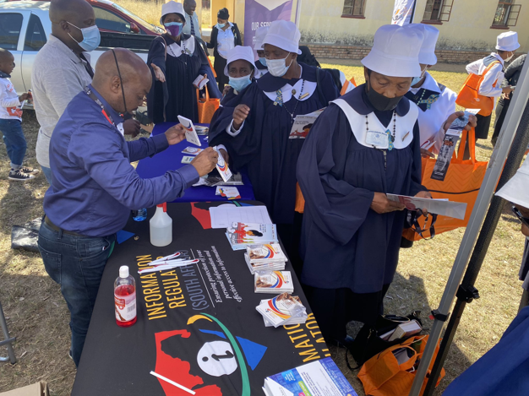
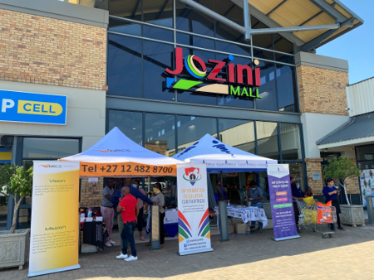
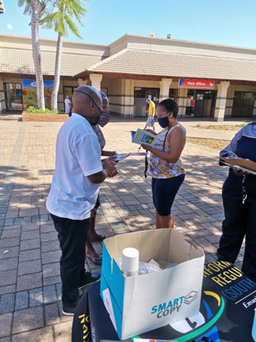
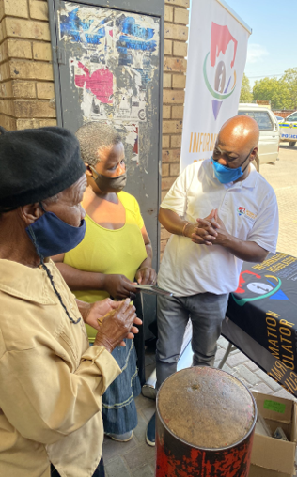
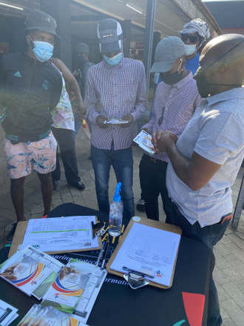
Education and Communication Activities (Jan-May 21)
Impression: 4800, Engagement 350
Followings
570 Twitter 370 Facebook
Updated website with content consistently which saw the growth of the website rise from
15 Public Activation executed in 5 Provinces – North West, Limpopo, Gauteng, Mpumalanga and KZN
Conducted 50 media interviews with community media, mainstream radio, broadcast and online media. Released 7 Media statement
Conducted 48 Stakeholder engagement session on POPIA compliance
Government Departments, Entities, Financial institution, Organised
Structures, Academia

Slide 24
ENFORCEMENT COMMITTEE ENFORCEMENT COMMITTEE

Slide 25
ENFORCEMENT COMMITTEE
Section 50 of POPIA requires that the Regulator to establish an Enforcement Committee, which Committee must consider and make recommendations on all matters referred to it by the Regulator in terms both POPIA and PAIA.
The Enforcement Committee must consist of –
At least one member of the Regulator ;and
Such other persons appointed by the Regulator, as referred to in Section 47(7) , for the period determined by the Regulator.
POPIA requires that the Regulator in consultation with the Chief Justice and Minister of Justice and Correctional Services to appoint a judge of the High Court of South Africa whether in active service or not.

Slide 26
ENFORCEMENT COMMITTEE
A member of the Regulator has been designated as a committee member.
An advert for the additional members of the enforcement committee, in terms of section 47(7) of POPIA, will be published.
In light of the Regulator’s decision for the Chairperson of the Committee to be a Judge of the High Court. The Regulator has written to the Chief Justice and Minister of Justice and Correctional Services requesting a consultation in this regard and is currently awaiting a response. The Regulator has identified possible Judges to serve as Chairperson of the Enforcement Committee.
The Regulator has consulted with National Treasury relating to remuneration rates of proposed members of the Enforcement Committee.

Slide 27
ENFORCEMENT COMMITTEE
The Regulator has consulted with National Treasury relating to remuneration rates of proposed members of the Enforcement Committee.

Slide 28
CONCLUSION

Slide 29
CONCLUSION (cont…)
The Regulator is aware that the journey ahead will have challenges in the implementation of its mandate. As the organisation grows, measures will be put in place to address these challenges.

Slide 30
THANK YOU

