Slide 1
PORTFOLIO COMMITTEE – VIRTUAL OVERSIGHT:
Embassy of the Republic of South Africa
Berlin: Germany

Slide 2
Berlin: Mission Staff Complement
Transferred Officials: Total of 14 (Including Ambassador)
Nine (9) DIRCO
Two (2) Department of Home Affairs
One Defence
One SSA
One DTI (Currently Vacant)
Locally Recruited Personnel: 31
28 DIRCO (including: Ambassador and Minister Pleni: 3 Domestic Helpers and 2 Chauffeurs) - 2 vacancies currently
1 Defence Secretary + 1 driver (currently vacant)
1 Marketing Officer (currently vacant)

Slide 3
Head of Mission: Amb. Stone P. Sizani
Minister Plenipotentiary: Vacant
3rd Secretary admin (Amb PA): Mr Molokomme
Counsellor Political: Ms Ramalho-Murteira
Counsellor Political: Ms Joyce
First secretary Political: Ms Mabuza
First secretary Political: Mr Kemp
First secretary Admin Ms Mkoroana
Counsellor Admin: Mr Teka
First secretary (DHA): Mr Xabendlini
Second Secretary (DHA): Mr Tshete
Counsellor (SAA): Ms Mtshali
Defence Attache: Capt. Mkhwanazi
Minister Trade (DTI): Vacant

Slide 4
SA State Owned Properties
South Africa has 4 State Owned Properties in Germany.
BERLIN
Occupied Chancery at: Teirgatenstrasse 18
Occupied Official Residence Occupied: Taunusstr.8
BONN (Unoccupied Properties)
Former Official Residence building
Former Chancery building

Slide 5
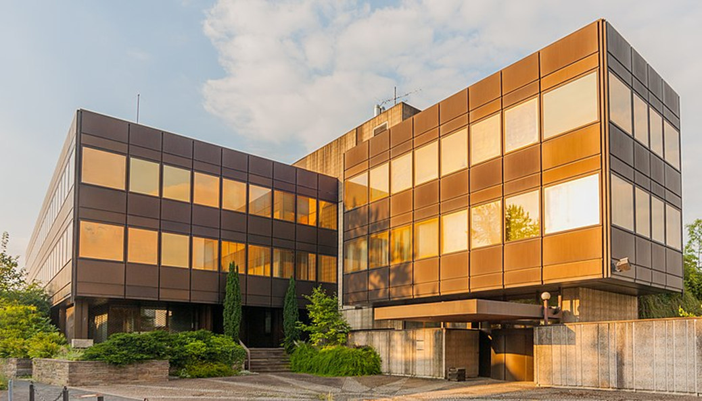
FORMER CHANCERY BONN-GERMANY

Slide 6
FORMER CHANCERY BONN-GERMANY
Address: Auf der Hostert 3, 53173 Bonn
Property conveyed on 20th January 1970 and occupied on 9th June 1970.
Purchase prise or costs unknown.
The property is 51 years old.
It was vacated when Embassy moved to Berlin in 1999.
Total size on the building: 3 337 sqm
Total size of the plot: 4767 sqm.
Title deed is available

Slide 7
FORMER CHANCERY BONN-GERMANY
The property is in an extremely bad condition.
Maintenance challenges:
it is very difficult to maintain the property because Bonn is very far from Berlin. Mission does not have funds to visit frequently or to hire a fulltime caretaker.
Mission’s view on continued ownership of the property:
The two properties be sold to the highest bidder (disposed) and the sale revenue be used to buy Chancery for Munich Consulate General and 2 or 3 residential properties (houses) for Transferred Officials in Berlin.

Slide 8
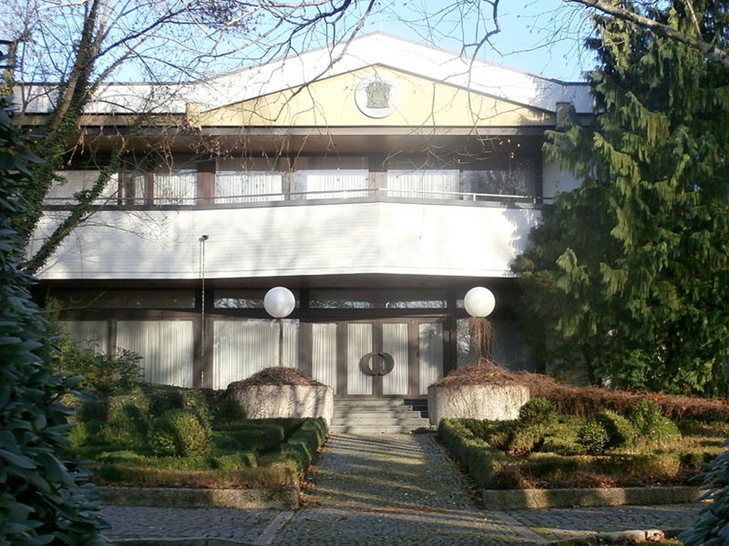
FORMER OFFICIAL RESIDENCE BONN-GERMANY

Slide 9
FORMER OFFICIAL RESIDENCE BONN-GERMANY
Address: Rudigerstr. 20-22, 53179 Bonn
Property conveyed 24 April 1970 and Occupied on 11 January 1971.
Purchase prise or costs unknown.
The property is 50 years old
It was vacated when Embassy moved to Berlin in 1999.
Total Plot size: 4728 sqm
Title deed is available

Slide 10
The property is in bad condition,
Maintenance challenges:
it is very difficult to maintain the property because Bonn is very far from Berlin (about 600 km). Mission does not have funds to visit frequently or to hire a fulltime caretaker.
Mission’s view on continued ownership of the property:
Two properties should be sold to the highest bidder and the sale revenue be used to buy Chancery for Munich Consulate General and 2 or 3 residential properties (houses) for Transferred Officials in Berlin.

Slide 11
Assets Management
Total of 3220 Assets
Assets locations: Chancery; Official Residence; Residences of all Transferred Officials.
Verification done twice per-year: 1st April to August - 2nd October to February.
2020/21 last verification: over 50% assets where physically verifies mainly at the Chancery. Verification was not completed due to COVID lockdown / restrictions.
2021/2022 first Varication started in April and continuing.
Most of the assets (mainly household furnisher) are very old.
Obsolete assets are identified during verification and listed for disposal approval.

