Slide 1
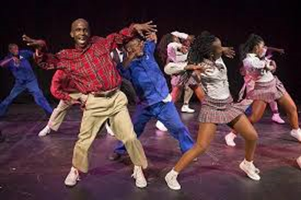
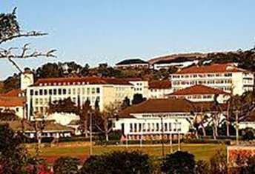
Contents
Introduction | Financial Management
Background | Addressing Water Sewer
Challenges | Sound Financial Management
Strategic focus areas – 2016 to current | Audit Outcomes
Organisational Stability | Reasons for Regression
Stability Administration | 2020 AG Disclaimer
Investigations Litigation | Actions implemented to address Disclaimer
Addressing Waste Management | Addressing Capacity Constraints:

Slide 2
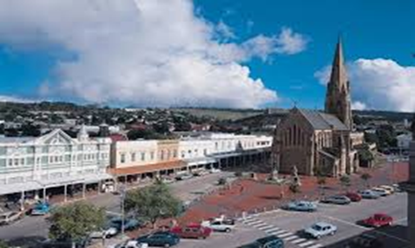
Introduction
Makana Municipality - category B municipality under the Sarah Baartman District Municipality, EC.
Consists of Makhanda, Riebeek East, Alicedale, Fort Brown, Seven Fountains, Sidbury and Salem.
14 wards, including 3 rural wards
Home of the National Arts Festival; Rhodes University and other prominent and internationally acclaimed primary and high schools.

Slide 3
Background
Makana Municipality used to be one of the best Municipalities in the Country.
It has received so many accolades due to its holistic performance.
The situation started to change in the past 12-15 years of governance.
The resulting effect of that was, inter alia:
  All systems failed in Makana;
  The services dropped;
  The inability to service its debt;
  Adopted three organisational structures;

Slide 4
Challenges
Absorbed about 112 contract workers in 2016 as determined by the Basic Conditions of Employment Act
Discrepancies in terms of salaries;
Organisational structure top heavy;
Water and sewer leakages became the order of the day (sewer challenges described in detail in slide dealing with sewer)
Collection of waste was not done regularly;
Litigation, investigations and consequence management
Key staff members left the institution;
Staff morale was at it lowest ebb;
Reputational damage – residents do not have confidence in municipality.
Fleet was abused by staff;
Operations and maintenance were not done;
Illegal dumping
Adverse Audit Opinions and Financial Management (detailed discussion of challenges and remedies at the end of the presentation)

Slide 5
Challenges/cont
Dam Levels: Glen Melville – 87%; Howiesonspoort- 10% ; Settlers – 5%
Currently relying on JKWTW for the entire Makhanda area, as raw water feed to Waainek WTW, is almost depleted.
JKWTW's daily production is 10ML per day and the average demand is 18ML per day.
Although every effort is made to communicate water issues on various platform such as facebook, website, what’s app groups, radio, media, some residents are still not informed when challenges are experienced with water
Theft and vandalism

Slide 6
Strategic focus areas – 2016 to current
The Council elected in 2016 resolved to focus on these key strategic matters, to regain the thrust of the governance:
  Stability in the administration;
  Addressing poor service delivery;
  Increase revenue through revenue enhancement strategies;
  Stability of the workforce;
  Correct the organisational structure;
  Paying of the debtors;
  Prepare reputational damages and address the trust relationship with residents.

Slide 7
Addressing trust relationship
Kagiso trust, Rhodes University and the Mayor collaborated to establish the Makana Circle of Unity.
The University appointed personnel to drive the program.
There are related initiatives to enhance training and cooperation by all parties involved.
Civic Organisations, Rate Payers, Business Sector, Education Sector, and Grahamstown Foundation (NAF) are involved in this initiative
Sessions are held on various topics for debate to enhance the municipal plans (economy, community, etc).

Slide 8
Organisational Stability
The Council approved an Organisational Structure in 2019.
Cogta was instrumental in the project.
The municipality is busy with JD/JE and the placement of staff.
The salary discrepancies was dealt with in 98% of the cases.
SBDM is finalising the appointment of the Service Provider and personnel for the process of Job Evaluation.
There is no more sporadic strikes occurring except the challenge of workforce that needs to realise the culture of the current leadership.

Slide 9
Stability Administration
All Senior Management positions are filled (should be noted from 2012 to 2018, 13 Acting Municipal Managers and during the period of Section 139 – 3 Administrators
Makana is now managing grants from National Government due to administrative stability (previously grants were managed by SBDM on behalf of Municipality)
Working with Kagiso Trust to enhance ethical leadership among senior managers.

Slide 10
Investigations Litigation
Kabuso and Morar investigation (statements were taken by a Hawks rep from various employees).
In respect to Ghost employees, 2 prosecutions were concluded successfully against former HR practitioner who pleaded guilty and was sentenced in terms of s300 of the CPA (to payback money to Makana ) he has done so for one case and also sentenced in terms of s276 of the CPA suspended sentence with conditions.
The matter of Former Dir. Mlenzana is also being investigated by the Hawks and this one is at an advanced stage.
Council recently requested that allegations into Former Dir. Mazwayi also be forwarded to law enforcements

Slide 11
Addressing Waste Management
Household waste is collected regularly and according to a schedule
Many initiatives were launched to upgrade the municipal landfill site
Provision is made on the SDF for a new Landfill site – decommissioning of old landfill site still to take place and establishing of new site to take place

Slide 12
Addressing Water
Equitable distribution is achieved through transfer of water from Botha’s Hill reservoir into the Western reservoirs.
Water is supplied on alternate days, to enable more time for production, transfer and filling up of reservoirs.
In the process of procuring a loud hailer to improve communication

Slide 13
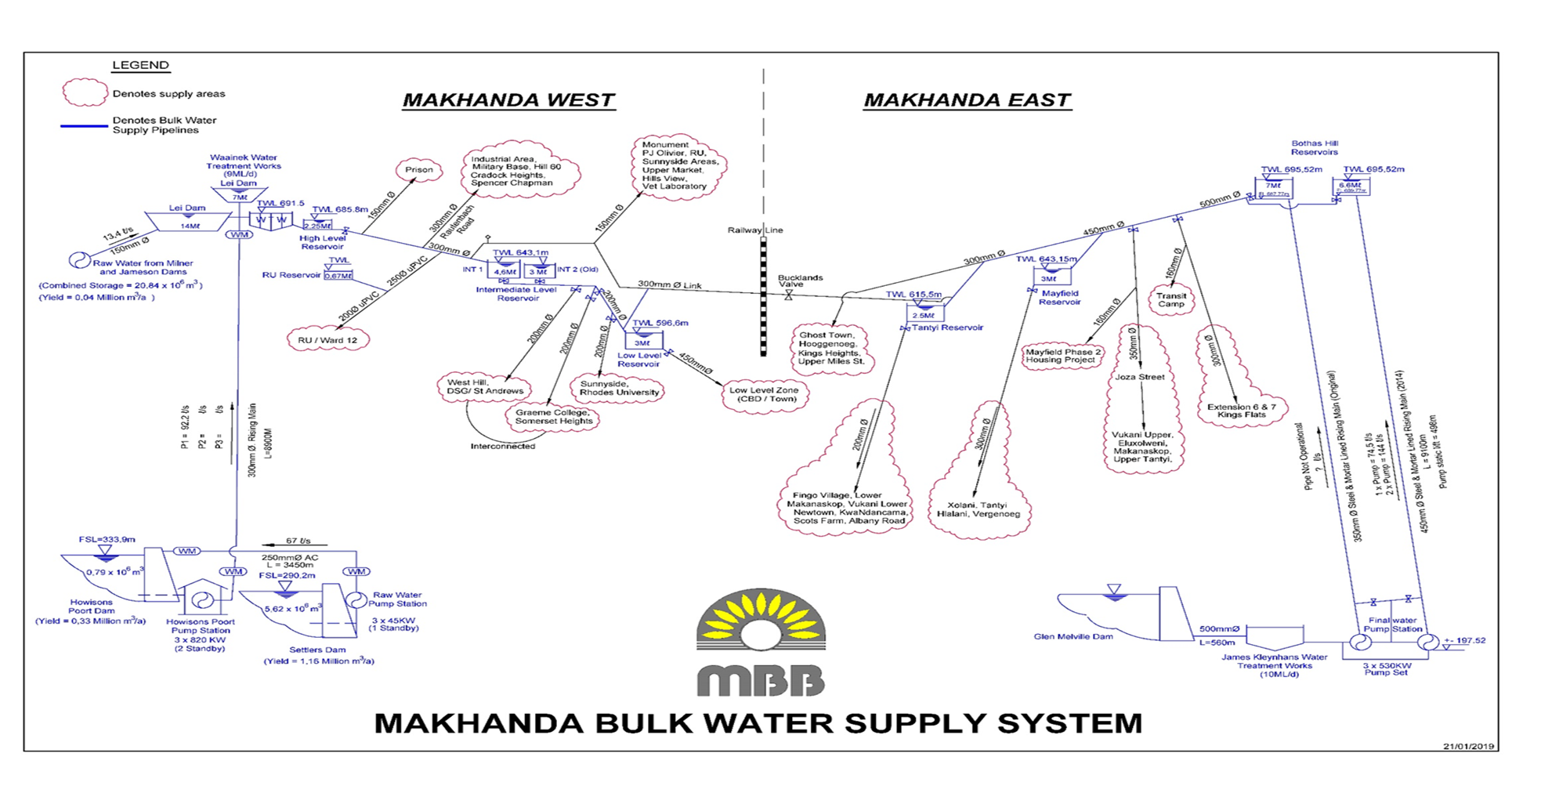

Slide 14
Upgrading James Kleynhans Bulk Water Supply
PROJECT DESCRIPTION | PROGRESS AND ACHIEVEMENTS | CHALLENGES & RISKS | PROPOSED ACTIONS
Augmentation of the existing 10 Mℓ/day James Kleynhans WTW with additional 10 Mℓ/day, with associated works in order to meet the bulk potable water demands in Makhanda Budget: R237m Expenditure: R101,5m 21/22 allocation: R70m | PHASE 1: Refurbishment to the existing Water Treatment Works (WTW), Electrical Improvement interconnecting pipework as well as Sludge disposal: (100% completed) PHASE 2: Augmentation of the Water Treatment Works from 10Ml/d to 20Ml/d and associated Storage, Pipelines, ME&I, upgrading of existing pipelines and refurbishing existing 10Ml/d WTW (35% Construction) Phase 3&4: Upgrading and refurbishment of existing Pumping Main. (Preliminary Design) | Delays in payment process Inability to complete the project as planned (September 2021) | Payment processes to be fast-tracked, in order to avoid excessive delays. Application for extension of time has been made. Anticipated completion is December 2021

Slide 15
Sewerage situation
2 Waste Water Treatment Works: Belmont Valley (5,4ML/d) and Mayfield (2,5ML/d).
Both plants are operating above design capacity
Belmont Valley is mainly dysfunctional and is operated manually.
Sewer main lines have dilapidated beyond maintenance.
Overflow and contamination into raw water sources
Human Settlements and other developments withheld due to WWTWs’ treatment capacity
Capital funding required for major upgrades, on both plants, to mitigate health hazard and non-compliance

Slide 16
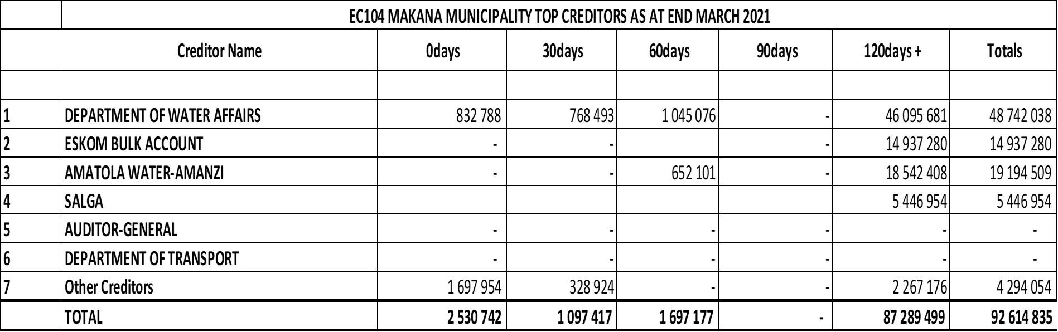
Financial Management
Creditors Balance as at 31 March 2021

Slide 17
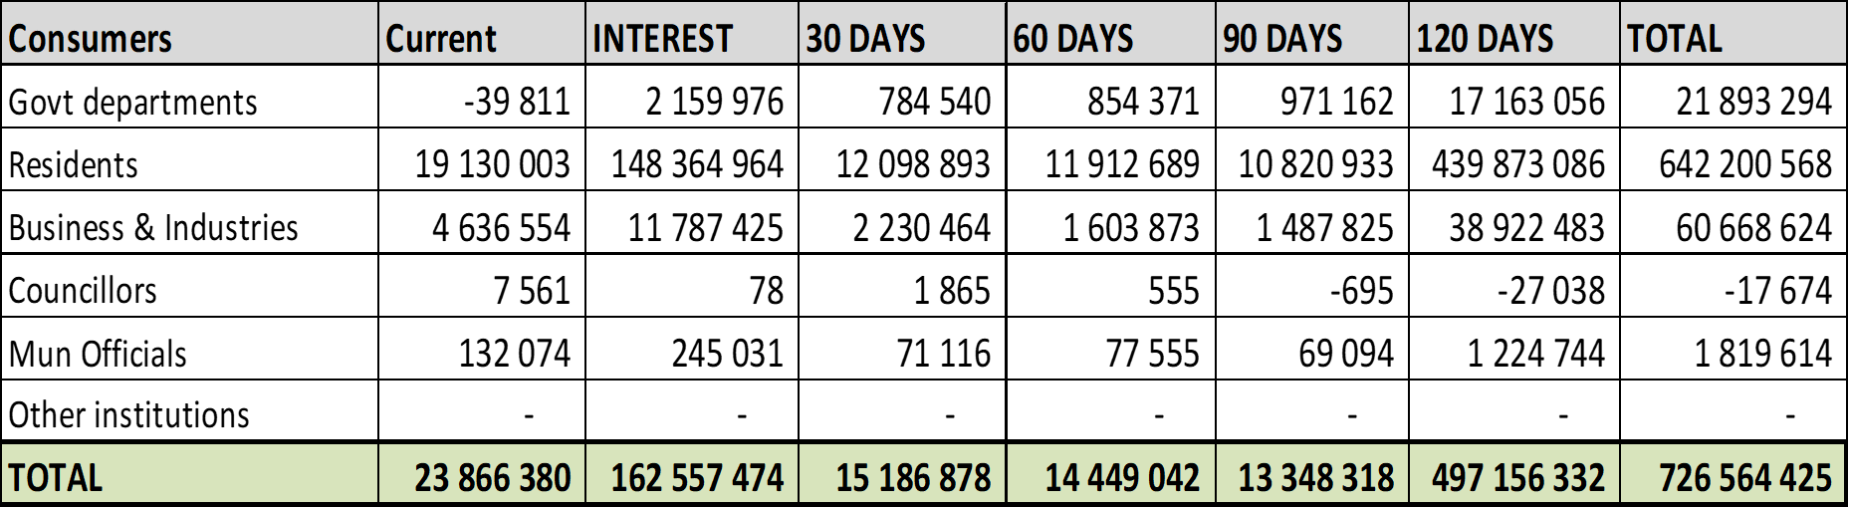
Debtors Balance as at 31 March 2021

Slide 18
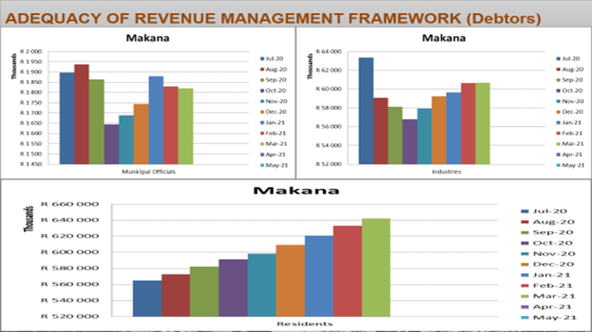

Slide 19
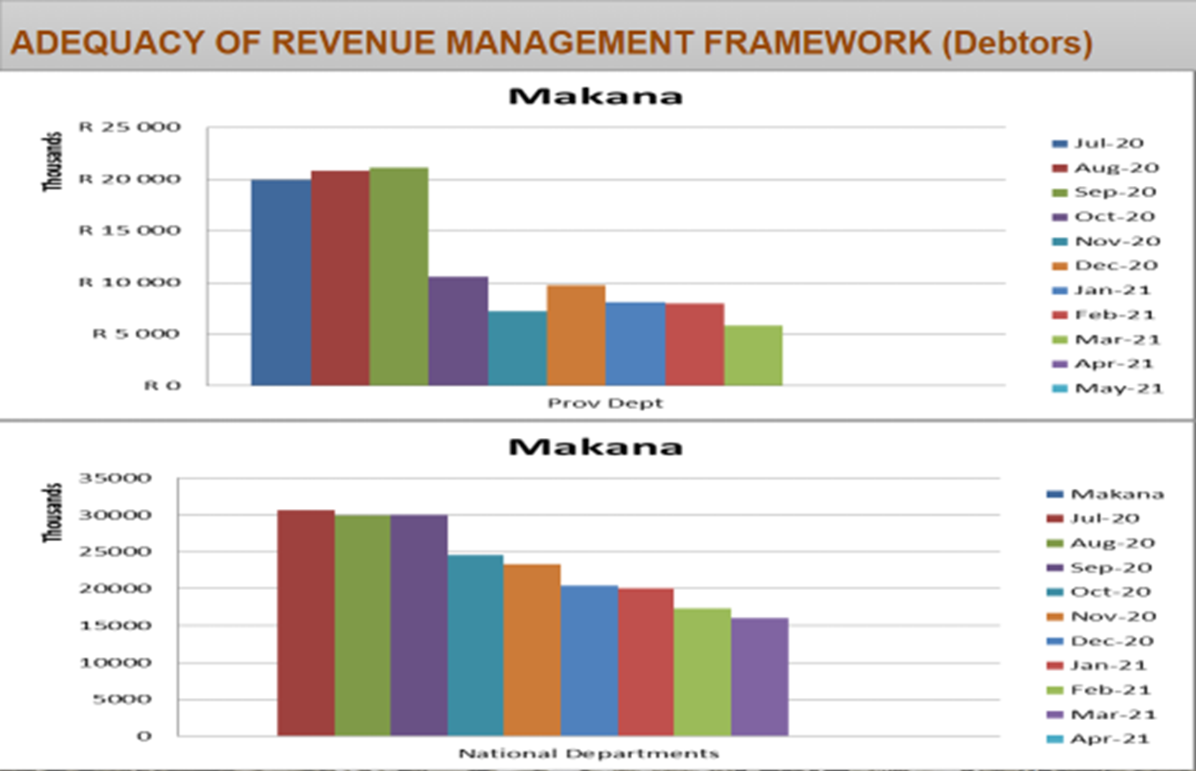

Slide 20
Sound Financial Management
Reduced Arrear Creditors from R190million in 2018 to R92 million as at 31 March 2021
Debt book has however grown from R500million to R726 million, this is due to averaging between 80% and 90% collection rates and not writing off irrecoverable debt.
Cash Management has improved with Cash Coverage of one month as at 30 June 2019, however ratio decreased to 0,45 months as at end June 2020 after COVID19 pandemic. Currently still around 0,4 months
2021/22 Tabled Budget is confirmed as funded – 2nd year in a row after numerous unfunded budgets;
Reporting is up to date and Makana remains compliant with Treasury Milestones, including mSCOA compliance.

Slide 21
Audit Outcomes
The Auditor-General’s Reports for the 2016, 2017 and 2018 financial years have all reflected a qualified audit opinion
The audit opinion regressed to a disclaimer opinion in 2019 mainly attributed to limitations caused by a lack of supporting documents for journals and missing or non-submission of documents.
The audit process improved in 2020 where almost all documents were submitted to AG, but there were still findings in Assets; Revenue; Leave; and Provisions, amongst others that could not be resolved and ended up with Disclaimer. AG stated that we were close to a qualified opinion and must continue with actions implemented in 2020.

Slide 22
2019 AG Disclaimer
The areas of disclaimer include that the municipality:
  did not have processes in place to verify that the electricity consumption billed by ESKOM was duly consumed by the municipality (Bulk Purchases);
  did not have adequate revenue management systems in place to ensure that all meters were read in the municipality at least once in the financial year;
  did not have management systems in place to verify the accuracy of its debt book as there are consumers who have not made a payment during the 12 months being audited;
  Property plant and equipment included assets that were not proved to be under the municipality’s ownership;
  There was a lack of adequate supporting documentation to support adjustments made to the revenue from exchange transactions; payables from exchange transactions; as well as Cash and Cash equivalents;

Slide 23
Reasons for Regression
Municipality is found to lack an adequate system of records management as this was evidenced by the non-submission of requested information for audit purposes, and where information was submitted, there were delays in the submission of information.
Lack of Workflow & Access Controls as Payment vouchers and supporting documentation for Payroll was often lost within the municipality and provided a limitation of scope for the auditors to continue.
In the revenue section, discrepancies were found between what is billed for services versus the services actually provided to properties within the municipality and this was due to the records not being updated as properties are being developed over time.
Meter readings not done regularly and inadequate collection of arrear debts.
The exodus of institutional memory and lack of adequate capacity and succession planning within the Municipality and in particular the Finance Department.
It was found that the Chief Financial Officer was vacant for 5 months in the 2018/19 year; Manager Revenue was vacant since February 2018; the municipality also lacked a lower management structure as there is no are no Accountants appointed at the municipality and a lack of suitable positions within the staff structure to support the segregation of duties and implementation of internal control environment.

Slide 24
Reasons for Regression/cont
The Manager: Budget & Reporting responsible for compilation of Annual Financial Statements (AFS) & Budgets resigned in February 2019 at a critical time of the year after being with the municipality for 15 years.
Efforts to persuade the individual was not successful as the candidate had personal reasons requiring relocation. The incumbent’s only subordinate resigned in 2018 and that positioned has not been filled yet due to changes being made to the organogram.
Although the Municipality swiftly appointed a Chief Financial Officer by 01 December 2018 and a new Manager: Budget & Reporting by 01 June 2019, the incumbents had insufficient time and resources to successfully take over the roles due to lack of a proper handover of processes and information.
The Manager Revenue position remained vacant after two unsuccessful recruitment drives. The post was advertised for a third time and the incumbent commenced duty 03 May 2021.
A lack of coordination, correlation and cohesion between the different directorates of the municipality as it appeared that departments were working in isolation or in silos which had a negative impact on efficient operations and service delivery.
With a full complement of Senior Management, more frequent SMT Meetings are held and working relations are improving between directorates.

Slide 25
2020 AG Disclaimer
The areas of disclaimer include that the municipality:
  PPE - Asset register did not agree to General Ledger & Existence of certain material assets could not be verified;
  did not have adequate revenue management systems in place to ensure that all meters were read in the municipality at least once in the financial year;
  did not have management systems in place to verify the accuracy of its debt book as there are consumers who have not made a payment during the 12 months being audited;
  Did not disclose Impairment losses as per GRAP 104 and therefore incorrectly accounted for VAT on Impairment.
  There was a lack of adequate detail documentation to support the basis of assumptions and discounted rates used to determine and value of the employee benefit obligation;

Slide 26
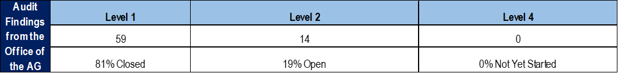
Actions implemented to address Disclaimer
The major issues not addressed to date is the area of Revenue Management (8 findings) to which there are actions and timeframes attached up to 30 June 2021 in the audit action plan.
1 Compliance finding for the late tabling of the Oversight Report remained;
1 finding relating to Investigation of Unauthorised; Irregular; Fruitless & Wasteful Expenditure remains as there were no cases finalized during 2019/20 financial year – we are currently tabling reports to MPAC & Sec 32 Committee;
The last finding that cannot be solved now is the Payment of Creditors within 30 days as the municipality has insufficient cash flow to settle debts immediately and entered into payment plans on arrear debts that will only expire in 2023.

Slide 27
Actions implemented to address Disclaimer
Audit report was issued late - received 16 April 2021
Audit Action Plan is being drafted and plans to workshop with Mayoral Committee and Audit Committee on 07 May 2021.
Door-to door municipal meters and services verification is underway to address material revenue findings
Consultants have already been appointed to fix 2018/19; 2019/20 AFS and findings and then prepare 2020/21 AFS.
Have agreed with AG to conclude 2018/19 and 2019/20 restatements by July 2021 and have it audited during July and August 2021 so that findings can be addressed before final submission on 31 August 2021.
PPE / Assets have been awarded to consultants for a full review to address the AG findings

Slide 28
Addressing Capacity Constraints
CFO and All Managers have now been appointed
Reviewing Job Descriptions to enable filling of Accountant Vacancies.
In Short-term have appointed qualified graduates with 6 Finance Interns; 2 Internal Audit Interns and 2 IT Interns to boost capacity where we face critical vacancies
Provincial Treasury providing support in SCM and Accounting advice
SBDM providing support with Revenue Completeness through door-to-door verification exercise / data cleansing
COGTA providing support with Risk management and audit outcomes.

