Slide 1
PORTFOLIO COMMITTEE REPORT ON SARAH BAARTMAN AND ITS LOCAL MUNICIPALITIES
01 JUNE 2021

Slide 2
PRESENTATION OUTLINE
Purpose
Overview of the District
Governance
Service Delivery
Financial Management
COVID-19 Interventions
DDM: Implementation
Recommendations

Slide 3
Purpose
To brief the Portfolio Committee on Cooperative Governance and Traditional Affairs (CoGTA) on the state of the Amathole District and its Local municipalities; for the Portfolio Committee to note progress to date;
Makana Local Municipality
Sunday River Valley Local Municipality
Ndlambe Local Municipality
Dr Beyers Naude Local Municipality
Blue Crane Local Municipality
Kouga Local Municipality and
Koukama Local Municipality

Slide 4
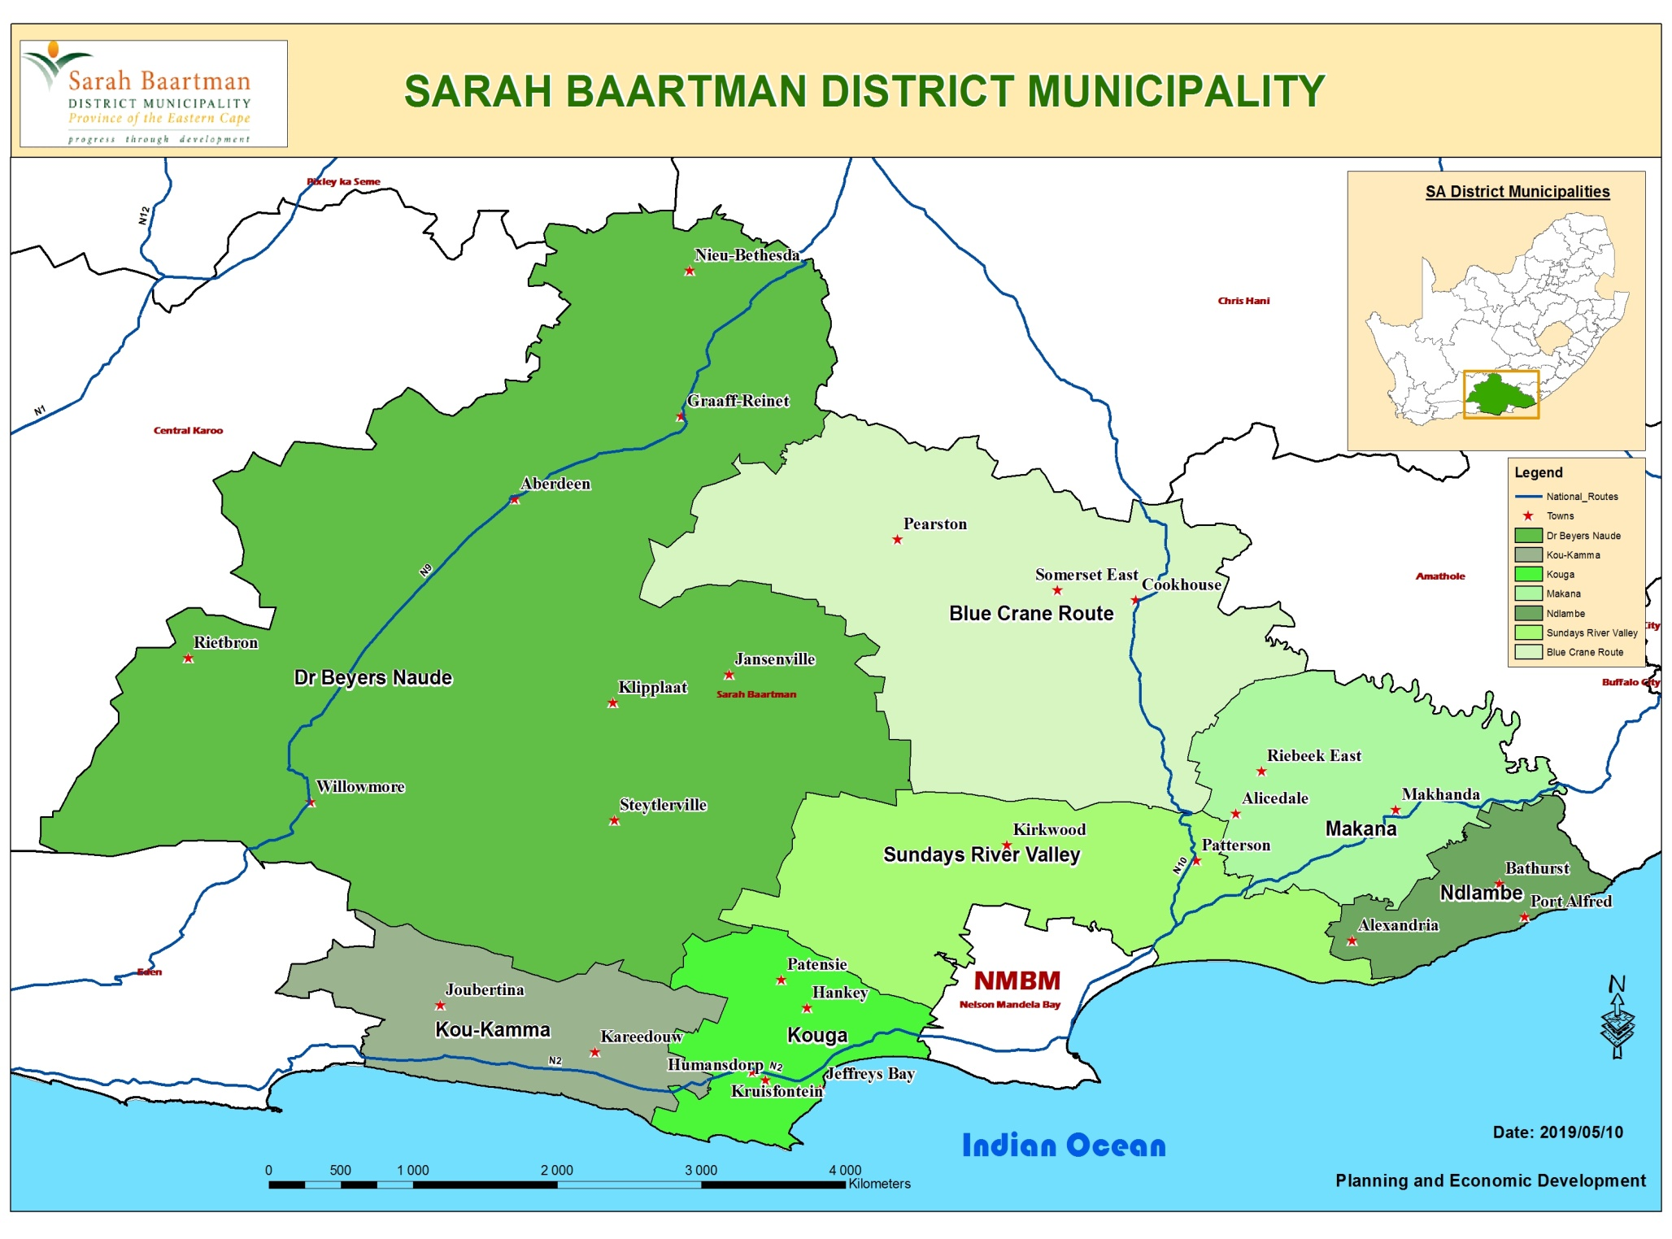

Slide 5
BACKGROUND
SBDM is the largest District Municipality in the Eastern Cape Province geographically and has an estimated population of 520 000 (2018)
The District consists of seven (7) Local Municipalities:
Makana Local Municipality
Sunday River Valley Local Municipality
Ndlambe Local Municipality
Dr Beyers Naude Local Municipality
Blue Crane Local Municipality
Kouga Local Municipality and
Koukama Local Municipality
Out of the seven Locals, Dr. Beyers Naudé Local Municipality was established by merging the Camdeboo, Ikwezi and Baviaans Local Municipalities. The Municipality was officially established on 6 August 2016 after the Local Government Elections.

Slide 6
STATE OF GOVERNANCE
STATE OF GOVERNANCE

Slide 7
STATE OF GOVERNANCE and administration
The Administration is fairly stable in Sarah Baartman District Municipality and its locals and the details are as follows:
SBDM, Makana, Ndlambe, Blue Crane Route and Koukamma LMs - all positions of Senior Management are filled
Sundays River Valley LM - Municipal Manager suspended, SBDM Municipal Manager acting in the position
Dr Beyers Naude LM - CFO suspended other Senior Management positions filled
Kouga - Director Technical Services post vacant all other Senior Management posts filled
SBDM and constituent Local Municipal Councils are sitting virtually per municipal calendar.
There are IGR structures in place in the DM and all LM’s and are fully functional.
Local Municipal Technical and Political JOC meetings are held regularly Information is shared with SBDM District JOC.
All Local Municipalities and SBDM have tabled the DRAFT IDP and Budget for 2021/2022 financial year.
The District is developing District Development Plan with stakeholders and its locals.

Slide 8
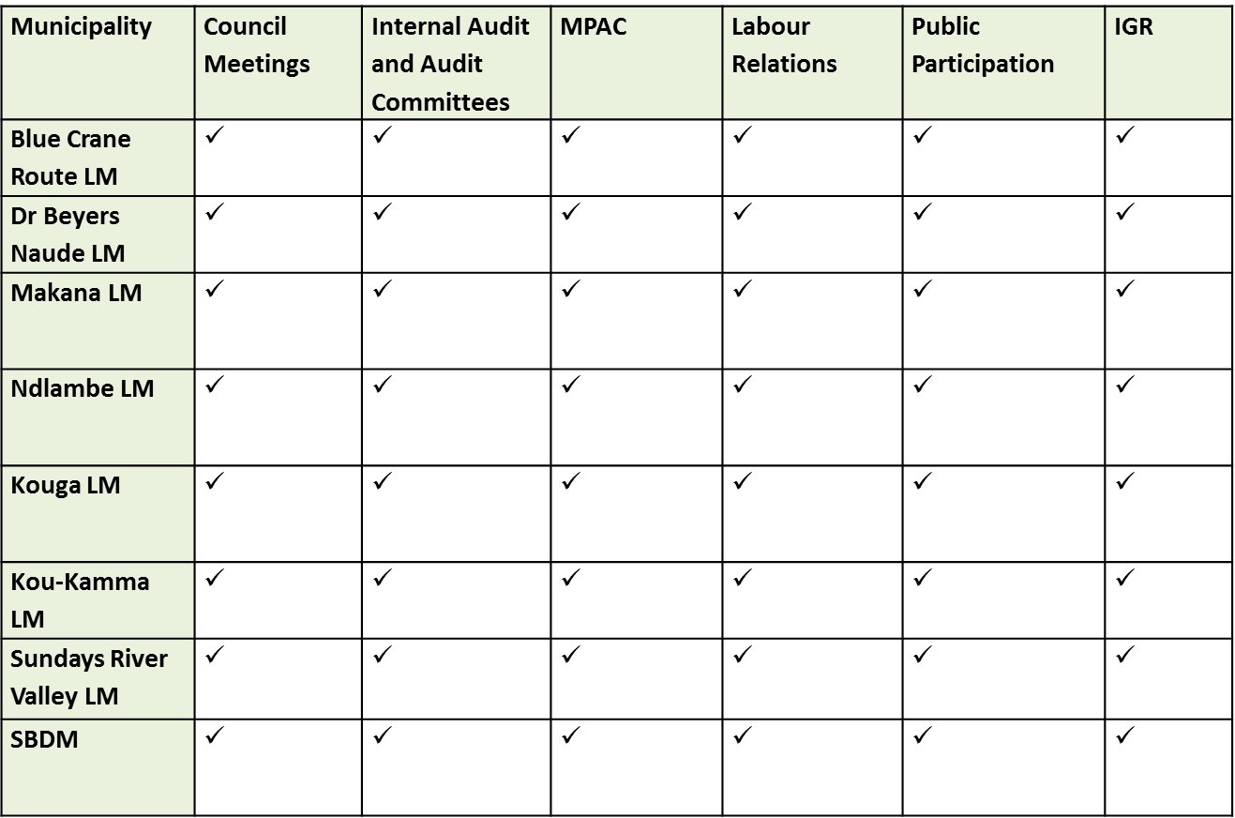
State of governance
The table below illustrate the establishment and functionality of committees in all municipalities:

Slide 9
State of Governance
Audit outcomes for the period of 2016/17 to 2019/20
Municipality | 2016/17 | 2017/18 | 2018/19 | 2019/20
Blue Crane | Unqualified | Unqualified | Unqualified | Unqualified
Dr. Beyers Naude | Disclaimer | Disclaimer | Disclaimer | Qualified
Kouga | Unqualified | Unqualified | Unqualified | Unqualified
KouKamma | Unqualified | Unqualified | Unqualified | Unqualified
Makana | Qualified | Qualified | Disclaimer | Disclaimer
Ndlambe | Qualified | Qualified | Qualified | Qualified
Sundays River Valley | Qualified | Qualified | Disclaimer | Disclaimer
Sarah Baartman DM | Unqualified | Unqualified | Unqualified | Unqualified

Slide 10
State of governance
Makana LM had disclaimers for two consecutive years, the Municipality is currently experiencing financial difficulties in its cash flow. The operating revenue and expenditure to date are however within the budget limits. This was due to the equitable share that was transferred during the second quarter.
The municipal performance was unsatisfactory in the 2019/20 financial year due to a system change to be able to successfully implement mSCOA.
The municipality has not been able to address systemic challenges and processes related to the functioning of the AOPO (Audit of predetermine objective) and Internal Audit. The following areas still require responsiveness and mitigation measures to improve the audit outcome of the municipality in 2019/20 (audit still underway) and 2020/21:
Improved Internal Controls;
Strong Leadership; and
Consistency with regards to performance management and record keeping.
Makana Municipality has not yet received its final audit opinion for the 2019/20 financial year as there was a two-month extension granted by the Minister of Finance to submit AFS due to the impact of the Covid19 Pandemic.
Provincial Treasury together with Cogta are assisting the municipality. An action plan will be compiled based on the draft findings and implementation and progress will be regularly monitored.

Slide 11
State of governance
Sunday River Valley municipality had disclaimer for two consecutive years the financial instability of the municipality has been questioned by Auditor-General. The decline is the consequences of unfunded budgets in a number of years.
Cash flow and outflow is significantly lower, than the inflated budgeted revenue and expenditure.
Proper financial administration of debtor accounts over the past years is a serious challenge and it also contributed to consumer’s querying their accounts and resulted in non-payment because of disputes.
Dr Beyers Naude- Audit outcomes –The municipality received a disclaimer audit opinion for three consecutive years 2016/17, 2017/18 and 2018/19. There are litigations by and against the municipality.
DBNLM has inherited outstanding creditors amounting to R65.3 million. These are debts owed to Eskom, SALGA, AG, among others
The municipality is utilizing the Promun Financial System and implemented mSCOA.
One of the main areas of concern relates to the financial resources available to deliver services and address historical financial challenges of the erstwhile municipalities.
Unspent conditional grants as at June 2019 relates mostly to the drought grants for which roll over was approved.
Public participation / communication
SBDM and the Local Municipalities have had to think out the box to deal with the “new normal” and have embraced the use of social media platforms and community radio etc. to reach communities and engage with them on the Draft IDP and Budget.

Slide 12
State of Governance

Slide 13
Service delivery
SERVICE DELIVERY

Slide 14
Service delivery cHALLENGES
MUNICIPALITY | CHALLENGES | ACTION PLAN
Dr Beyers Naude | No Water Meters for bulk supply and household metering | Funding required from DWS
 | Lack of Water Conservation and Demand Management | Funding and support required from DWS
 | Insufficient capacity for existing infrastructure, reticulation system in poor state (Incl. Ageing Infrastructure | Support required from COGTA and funding from DWS and NT
 | Require Water tanks for households and Water Trucks | Funding required from DWS
 | Drilling and equipping of additional boreholes | Funding and support required from DWS
 | Lack of Electricity meters to cater for bulk supply measurement from Eskom | Funding required from DOE
 | No Yellow Plant to improve service delivery | Support required from Dept. of Road & Transport and COGTA
 | Poor Operations and Maintenance Planning | Support required from MISA
 | Poor Asset Management | Support required from COGTA
 | Lack of infrastructure funding | Support required from COGTA
 | Rapidly filling up of space at LM cemeteries and limited land available for new cemeteries | Support required from DEDEA and DRDAR
 | Vandalism (theft, damage and electricity theft) | Ward Committees with Ward Councilors to conduct education and awareness
 | Community Based Works Programme (CBWP) - appointed service provider does not adhere to deadlines | SBDM to be appointed as an Implementing Agent
 | Assistance to required in negotiating with ESKOM on historical debt owed. | Support required from COGTA

Slide 15
Service delivery cHALLENGES
MUNICIPALITY | CHALLENGES | ACTION PLAN
Koukamma | Drilling and equipping of additional boreholes | Funding required from DWS
 | New waster water treatment works | Funding required from DWS
 | No Water Meters for bulk supply and household metering | Funding required from DWS
 | Lack of infrastructure funding (Incl. ageing Infrastructure) | Support required from COGTA and funding from DWS and NT
 | Lack of Water Conservation and Demand Management | Funding and support required from DWS
 | Require Water tanks for households and Water Trucks | Funding required from DWS
 | Poor Operations and Maintenance Planning | Support required from MISA
 | No Yellow Plant to improve service delivery | Support required from Dept. of Road & Transport and COGTA
 | Poor Asset Management | Support required from COGTA
 | Rapidly filling up of space at LM cemeteries and limited land available for new cemeteries | Support required from DEDEA and DRDAR
 | Roads for the Dairy farms in Koukamma require upgrades | Funding required from Dept. of Road & Transport
 | Street lighting urgently required as will also assist in crime reduction
 | Vandalism (theft, damage and electricity theft) | Ward Committees with Ward Councilors to conduct education and awareness
 | Shortage of service delivery vehicles

Slide 16
Service delivery challenges
MUNICIPALITY | CHALLENGES | ACTION PLAN
Kouga | No Water Meters for bulk supply and household metering | Funding required from DWS
 | Lack of Water Conservation and Demand Management | Funding and support required from DWS
 | Drilling and equipping of additional boreholes | Funding required from DWS
 | Require Water tanks for households and Water Trucks | Funding required from DWS
 | Lack of infrastructure funding | Support required from COGTA and funding from NT
 | Climate change - water diversify mix (ground water, reuse, recycle desalination due to drought) | Support required from Dept. of Road and Transport
 | R331 Road between Patensie, Hankey, Loerie to N2 - require upgrade | Support and funding required from Dept. of Road & Transport and NT
 | R330 between Hankey to Humansdorp - require upgrade | Support and funding required from Dept. of Road & Transport and NT
 | MR00389 Da Gama Road in Jeffrey's Bay - require upgrade | Support and funding required from Dept. of Road & Transport and NT
 | Roads for the Dairy farms in Kouga require upgrades | Funding required from Dept. of Road & Transport

Slide 17
Service delivery challenges
MUNICIPALITY | CHALLENGES | ACTION PLAN
Makana | Drilling and equipping of additional boreholes | Funding required from DWS
 | No Water Meters for bulk supply and household metering | Funding required from DWS
 | Lack of Water Conservation and Demand Management | Funding and support required from DWS
 | Require Water tanks for households and Water Trucks | Funding required from DWS
 | Insufficient capacity for existing infrastructure, reticulation system in poor state (Incl. Ageing Infrastructure | Support required from COGTA and funding from DWS and NT
 | Upgrading of Belmont Valley Water and Sanitation Works to enable Rhodes University to expand its campus and increase the number of students enrolled | Support and funding required from DWS and NT
 | Upgrading of Taxi Routes in Makhanda | Support and funding required from Dept. of Road & Transport and NT
 | R67 Makhanda (Grahamstown) to Port Alfred | The Road to be given to SANRAL to manage
 | Road to Nature’s Valley - to be re-opened Alicedale to N2 | Support and funding required from Dept. of Road & Transport and NT
 | Poor Operations and Maintenance Planning | Support required from MISA
 | Poor Asset Management | Support required from COGTA
 | Vandalism (theft, damage and electricity theft) | Ward Committees with Ward Councilors to conduct education and awareness campaigns
 | No Yellow Plant to improve service delivery | Support required from Dept. of Road and Transport and COGTA
 | Street lighting urgently required as will also assist in crime reduction
 | Shortage of service delivery vehicles

Slide 18
Service delivery challenges
MUNICIPALITY | CHALLENGES | ACTION PLAN
Ndlambe | Drilling and equipping of additional boreholes | Funding and support required from DWS
 | No Water Meters for bulk supply and household metering | Funding required from DWS
 | Lack of Water Conservation and Demand Management | Funding and support required from DWS
 | Insufficient capacity for existing infrastructure, reticulation system in poor state (Incl. Ageing Infrastructure | Support required from COGTA and funding from DWS and NT
 | Require Water tanks for households and Water Trucks | Funding required from DWS
 | Climate change - water diversify mix (ground water, reuse, recycle desalination due to drought to improve water supply in Ndlambe urgently | Support required from COGTA and funding required from DWS and NT
 | Lack of Operations and Maintenance Planning | Support required from MISA
 | Lack of infrastructure funding | Support required from COGTA and funding from NT
 | Roads in the pineapple belt in Ndlambe require upgrade | Support and funding required from Dept. of Road & Transport and NT
 | No Yellow Plant to improve service delivery | Support required from Dept. of Road & Transport and COGTA
 | Street lighting urgently required as will also assist in crime reduction
 | Vandalism (theft, damage and electricity theft) | Ward Committees with Ward Councilors to conduct education and awareness campaigns

Slide 19
Service delivery challenges
MUNICIPALITY | CHALLENGES | ACTION PLAN
Sundays River Valley | Drilling and equipping of additional boreholes | Funding and support required from DWS
 | No Water Meters for bulk supply and household metering | Funding required from DWS
 | Lack of Water Conservation and Demand Management | Funding and support required from DWS
 | Require Water tanks for households and Water Trucks | Funding required from DWS
 | Lack of water in informal settlements in SRV area (Addo). | Funding and support required from DWS
 | Reconstruction of R335 Motherwell to Addo and R75 from Uitenhage to Kirkwood: | Support and funding required from Dept. of Road & Transport and NT
 | Lack of Electricity meters to cater for bulk supply measurement from Eskom | Funding required from DOE
 | Poor Operations and Maintenance Planning | Support required from MISA
 | Poor Asset Management | Support required from COGTA
 | Lack of infrastructure funding | Support required from COGTA and funding from NT
 | Building of Integrated Emergency Response Centre in Paterson (N10) for the District Municipality | Funding Support and Partnership required from COGTA and Dept. of Road & Transport
 | No Yellow Plant to improve service delivery | Support required from Dept. of Road & Transport and COGTA
 | Shortage of service delivery vehicles
 | Vandalism (theft, damage and electricity theft) | Ward Committees with Ward Councilors to conduct education and awareness campaigns

Slide 20
Service delivery challenges
MUNICIPALITY | CHALLENGES | ACTION PLAN
Blue Crane Route | Drilling and equipping of additional boreholes | Funding and support required from DWS
 | Lack of Water Conservation and Demand Management | Funding and support required from DWS
 | Require Water tanks for households and Water Trucks | Funding required from DWS
 | No Yellow Plant to improve service delivery | Support required from Dept. of Road and Transport and COGTA
 | Lack of Electricity meters to cater for bulk supply measurement from Eskom | Funding required from DOE
 | Poor Operations and Maintenance Planning | Support required from MISA
 | Poor Asset Management | Support required from COGTA
 | Lack of infrastructure funding, reticulation system in poor state (Incl. Ageing Infrastructure | Support required from COGTA and funding from NT
 | Vandalism (theft, damage and electricity theft) | Ward Committees with Ward Councilors to conduct education and awareness campaigns

Slide 21
MIG ALLOCATION
The Sarah Baartman District Municipalities are allocated a total MIG of R167 907 in the 2020/21 financial year and the amount was reduced to R172 674. An expenditure of R 114 024 (66%) has been reported as at end of April 2021. A balance of R53 883 is still to be spent by end June 2021.
2020/21 MIG Allocation
Total Allocation: R 167,907 million
Revised Allocation : R 172,674 million
Expenditure as at end April 2021: R 114,024 million (66%)
Number of MIG Receiving Municipalities: 7
Municipalities in Green Rating (> 82%): 2
Municipalities in Umber Rating (60 - 82%): 2
Municipalities in Red Rating (< 60%): 3

Slide 22
4. SERVICE DELIVERY
Municipality | Challenges | Action plan
Dr Beyers Naude | Delays in the appointment of service providers on time for project implementation Slow performance during execution of projects by contractors Late reporting on MIG Performance | COGTA & MISA Engineers to closely support the Municipality to ensure planned projects are implemented on time and within budget One on One engagements by COGTA/MISA support with reporting Municipality received additional funds in 2020/21 of R 5 million to augment funding for water and sanitation
Blue Crane | Delays in the appointment of service providers on time for project implementation Slow performance during execution of projects by contractors – (Roads project are implemented using internal / municipal plant which is old and breakdown often) Late project registration | COGTA & MISA Engineers to closely support the Municipality to ensure planned projects are implemented on time and within budget One on One engagements by COGTA/MISA support with reporting and project registration Municipality to revise their project implementation strategy and consider utilising also external PSPs Municipality received additional funds in 2020/21 of R 5 million to augment funding for water and sanitation
Makana | Slow start in project implementation due to late appointment of service providers and litigation challenges Late appointment of service providers due to non sitting of Bid Committees | COGTA & MISA Engineers to closely support the Municipality to ensure planned projects are implemented on time and within budget PT, COGTA to engage with municipality to resolve the procurement challenges the municipality has to minimize the risk of litigations A schedule to be developed for the sitting of bid committees in order to fast track procurement

Slide 23
4. SERVICE DELIVERY
Municipality | Challenges | Action plan
Ndlambe | Slow start in project implementation due to late appointment of service providers | COGTA to support the municipality on overall project planning and packaging and IDP processes and project monitoring to ensure projects are implemented as per the approved project implementation plan and budget
Sundays River Valley | Delays in the appointment of service providers on time for project implementation Poor reporting on MIG MIS Late project registration | COGTA to closely support the municipality on project planning, packaging and monitoring. Also to facilitate project registration process for un-registered projects A schedule to be developed for the sitting of bid committees in order to fast track procurement
Kouga | Incapacity in the Technical Department of the Municipality. The technical director resigned and PMU manager is suspended Delays in the appointment of service providers on time for project implementation Slow performance during execution of projects by contractors | COGTA/ PT/ District / MISA to closely support the municipality on project planning, packaging and monitoring whilst the municipality finalizes the disciplinary and recruitment processes. Provincial Treasury to monitor procurement plan of the municipality

Slide 24
4. SERVICE DELIVERY
Municipality | Challenges | Action plan
Koukamma | Slow performance during execution of projects by contractors Poor planning leading to late execution of projects and appointment of service providers which in turn delay project progress The Project Management Unit is under capacitated as currently there is only one Project Manager for all the MIG projects | The Municipality is supported through COGTA / MISA / District in order to address the capacity challenges in the PMU and Technical Services as a whole to ensure projects are implemented as per the approved scope and within budget and also address forward planning of the municipality In order to safeguard the funds and closely monitor the projects, the Municipality is placed under cost reimbursement, this means invoices are verified against work done and before payment can be granted by COGTA, PT & MISA

Slide 25
Financial management
FINANCIAL MANAGEMENT

Slide 26
Financial management
LM’s have high Debtors balances. The recoverability of these debts is questionable
Revenue collection is poor in Sunday’s River Valley and KouKamm LMs
High Creditors balances
High employee costs
Heavy reliance on Government Grants
Economy not growing – unemployment increasing – revenue limited
Enforcing payment by consumers
Support and Intervention required in DRBNLM, Makana and SRVM to improve audit outcomes as well as financial sustainability

Slide 27
Covid 19 intervention
COVID-19 INTERVENTIONS

Slide 28
COVID-19
Since the outbreak of coronavirus in Wuhan in the City of Bhuei China in December 2019, it was recognised as a pandemic by the World Health Organisation on the 11th of March 2020.
On the 5th of March, the first confirmed case was reported in South Africa by the Minister of Health, Dr Zweli Mkhize. The President of South Africa, President Cyril Ramaphosa declared the National State of Disaster in terms of the Disaster Management Act on the 15th March.
The Minister of Local Government and Traditional Affairs, Dr Nkosazana Dlamini Zuma anchored the President’s declaration as a result it was gazetted as such on the 18th of March 2020. Regulations were developed and distributed.
The District municipality with the Dept. of Health established a District outbreak response team with was made up of Disaster Management Unit, Environmental Health Services and Dept. of Health.
Sarah Baartman District municipality established JOC (Joint Operations Committee) which was made up of various stakeholders. These were established at the District Level and Local Level. JOC was then divided into two sections, the Political Command Council where political leadership was being briefed and the Technical Command Council which was made up of administration officials from the municipality and sector departments.

Slide 29
COVID-19
In coordinating the pandemic, the District Municipality in consultation with its seven Local Municipalities ensured that the following were in place:
Establishing a District Joint Operation Committee.
Co-ordination of support to district response agencies
Issuing of public information with regards to the suspected cases and confirmed cases
Provider of the political link between the disaster management system and the community
Provision of emergency relief aid. This was issued when necessary to victims in quarantine sites
Co-operation with PDMCs and NDMC in the identification of hazards, risk and vulnerability within their geographical area.
Disaster management coordination and information sharing.
Joint co-operation in ensuring emergency preparedness.
Coordination and implementation of prevention and mitigation strategies.
Implement disaster response, provision of relief and immediate recovery to communities.

Slide 30
COVID-19
Mobilisation of resources to ensure immediate response to disasters and incidents.
Evacuation to temporary shelters of all or part of the population from the disaster-stricken areas if such action is necessary for saving lives.
Provision of the 24-hour control room (communication centre)
Conducting health education, awareness-raising and health promotion by Environmental Health Practitioner (EHPs)
Investigation of suspected cases and contact tracing by EHPs.
Environmental Health and Disaster Management participate in Outbreak Response Teams (ORT) activated at Provincial and District Level
Assessment of municipal building to be utilized as quarantine sites.
Submit reports to PDMCs and NDMC.
Establishments within the District are following the guidelines and protocols when there is a suspected case, the staff is not in contact with guests

Slide 31
COVID-19
The District and Local municipalities in conjunction with various sector departments e.g. Dept. of Health, Dept. of Social Development, Dept. of Public Works, DEDEA, SAPS, Dept. of Correctional Services, Dept. of Basic Education, SASSA, Dept. Sport, Culture and Recreation, Dept. of Labour, Dept. EC Liquor Board, and Business Sector all participated in the following programs:
Conduct awareness campaigns in the form of loud hailing,
Distribution of pamphlets and posters.
Development of COVID-19 Contingency Response Plan,
Development of Occupational Workplace Plan,
Activation of Disaster Management Volunteers to assist as que marshals to manage social distancing during SASSA days.
Training of Funeral Parlours in the handling of Covid-19 bodies and management of human remains.
Procurement of PPE and Fumigation equipment.
Donation and distribution of PPEs (including fumigation equipment) to Sector Departments, Schools, Old Ages Homes, NGOs

Slide 32
COVID-19
Ward Based Rapid Response Teams were established in all 7 Local Municipalities led by Local Municipality Mayors.
Other stakeholders which played a significant role were, Dept. of Health, Dept. of Social Development.
These structures played a prominent role in ensuring that education and awareness campaigns were conducted. Compliance with regulations was adhered to and enforced.
The Dept. of Health continued with testing even when cases were dropping.
The District municipality in collaboration with its local municipalities, GCIS, Department of Health and Word Health Organisation (WHO) developed a resurgence communications plan which incorporated a district-wide roadshow.
The roadshows included community awareness and stakeholder engagement. Media engagement and social media posts were used to reach a wider audience.

Slide 33
DDM IMPLEMENTATION
DDM IMPLEMENTATION

Slide 34
DDM IMPLEMENTATION
SBDM has been allocated the Honourable Deputy Minister Capa as the National DDM champion and MEC Bayeni and Mvoko as the Provincial Champions and DDM Political Committee meetings have been held.
Presentations have also been made to the Honourable Minister of COGTA Ms N Dlamini Zuma and Eastern Cape MEC for COGTA Honourable Nqata.
Consultation with local municipalities in SBDM have been held with Mayors and municipal managers as well as sector departments.
Progress in terms of developing the DDM One plan are as follows:
First Draft of District Profile
Key Development trends identified
List of projects from LM’s collated and possible catalytic projects identified

Slide 35
DDM IMPLEMENTATION
The Sarah Baartman District Development Model provides a detailed profile with the intention to show case the Districts economic, demographic and socio-economic environment. The analysis of data is broken down in the context of the District vis-a-vis neighbouring districts in the province and South Africa.
Understanding the changes in the composition of the population with respect to population group, age and gender is vital in the face of growing pressure on food, energy, water, jobs and social support on the country's citizens.

Slide 36
DDM IMPLEMENTATION
SBDM has engaged with EC COGTA and ECSECC and discussions were held for ECSECC to support SBDM in the Development of its DDP.
ECSECC has been supporting OR Tambo the Pilot site in the Eastern Cape so their contributions will be invaluable in moving the SBDM DDM forward
SBDM would need support in reviewing the existing One Plan template and profile to assess:
Institutionalization of the DDP - engagement with EC COGTA as to roles and responsibilities on the following:
Profiles and Gap Analysis
Access to National and Provincial Budgets
Quick Interventions
Rethinking approaches

Slide 37
8. recommendations
The Portfolio Committee on Cooperative Governance and Traditional Affairs (CoGTA) to note the contents of the presentation.

