Slide 1
Tuesday, 1 June 2021, from 19:00 – 22:00, on the Zoom Virtual Platform. Portfolio Committee on Co-operative Governance and Traditional Affairs

Slide 2
INDEX
PURPOSE OF PRESENTATION
AUDIT ACTION PLAN
COVID-19
FINANCIAL SUSTAINIBILITY
ROOT CAUSES & CHALLENGES
OPERATING REVENUE
OPERATING EXPENDITURE
CAPITAL EXPENDITURE
ACCUMALATED FIGURES
INSTITUTIONAL CAPACITY

Slide 3
PURPOSE OF PRESENTATION
Local municipalities in the SBDM is requested to brief the committee on the state of the municipality. This is part of the Committee’s initiative to intensify oversight in municipalities, particularly in the wake of the recent municipal audit outcomes. The information required cover the section 72 report of Council - December 2020.

Slide 4
AUDIT ACTION PLAN
2018/2019 as well as 2019/2020 Audit outcome – Disclaimer
An audit action plan for 2018/2019 was developed with the assistance of Provincial Cogta but is was not implemented or monitored
A new Audit action plan for 2019/2020 have been developed in March 2021. This plan is inclusive of the findings of 2018/2019
Disclaimer based on significant core issues namely, Limitation of scope, and Receivables
The limitations of scope is mainly attributable to a dysfunctional Financial Management System

Slide 5
COVID-19
All grants received in respect of Covid-19 have been spent 100%

Slide 6
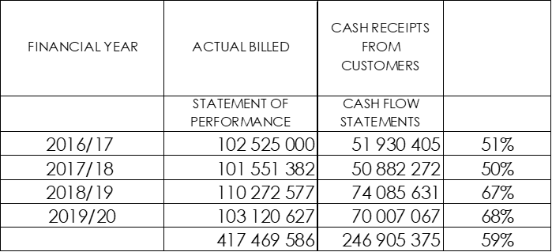
SRVM FINANCIAL SUSTAINIBILITY
Financial sustainability been questioned by AG over years
The decline in sustainability is the consequence of years of unfunded budgets (Unrealistic income projections)
Actual revenue collected/billed revenue ratio varies from 51% to 68%

Slide 7
The following table reflects the cash flow statements and operating budgeted revenue and expenditure as per schedules.
Actual cash revenue and expenditure are significantly lower than the inflated budgeted revenue and expenditure.
Expenditure budget provision was made for to pay with revenue that would not be realised.
This challenge that was created over years manifested in serious cash flow challenges for the municipality.

Slide 8
ROOT CAUSES & CHALLANGES
All water meters in the towns expect Kirkwood are not functioning anymore.
Kirkwood has 330 residential and 85 business properties as per valuation role.
The income the municipality generates comes solely from Kirkwood.
In Kirkwood 101 meters are faulty and actual billings are not possible
No meter readings can be taken and all properties are billed a minimum average units per month.
No motivation for the consumers to limit consumption which reflects in the bulk purchase cost monthly.
This also created a total resistance in paying for services over years.
Infrastructure suffers from lack of maintenance and the most visible are streets that are beyond repair.
All this contribute to a significant resistance towards paying for services developed over the past years across all the consumer categories in Kirkwood.
Proper financial administration of debtor accounts over the past years is a serious challenge and it also contributed to consumer’s querying their accounts and resulted in non-payment because of disputes.
Services delivery also suffers from the lack of equipment and tools.

Slide 9
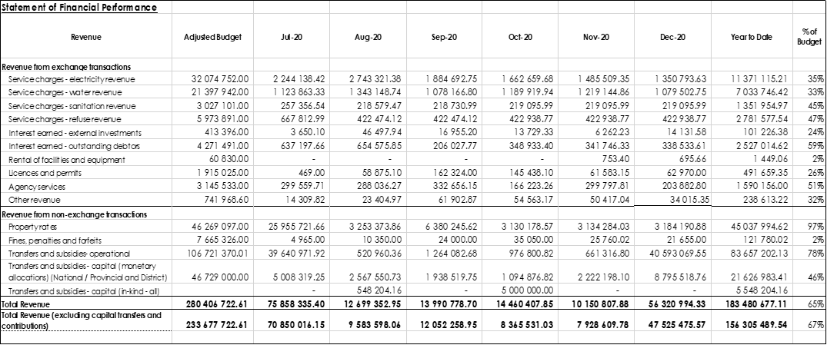
OPERATING REVENUE
The accrued billings from services reflect that SRVM will not meet its targets with major consequences for cash flow. Another indication of an inflated budget.
The billings for rates reflects serious problems with a target of 97%

Slide 10
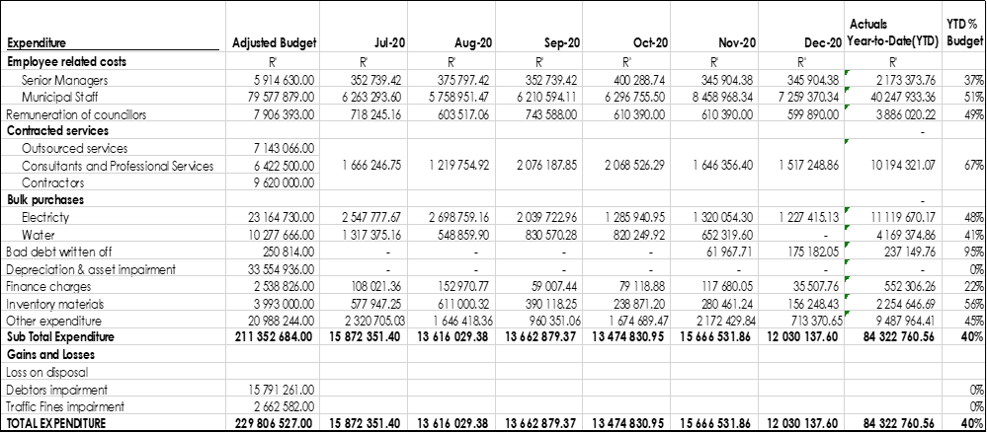
OPERATING EXPENDITURE
Total operating expenditure for the period amounts to 40% of the Adjustment budget

Slide 11
CAPITAL EXPENDITURE
Capital spending is 36% as at end December 2020

Slide 12
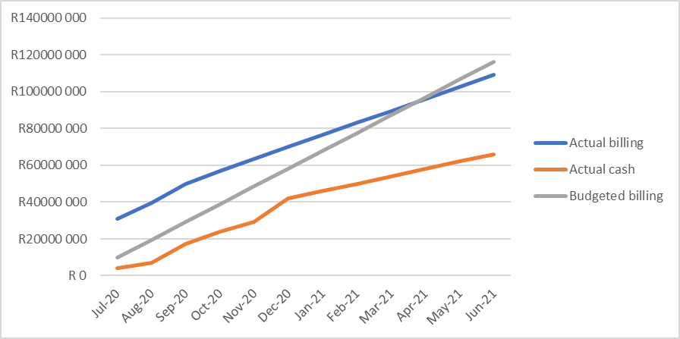
ACCUMALATED ACTUAL BILLING/ACTUAL CASH/BUDGETED BILLING
Actual cash (orange line) up to December 2020 and projected to June 2021 is significant lower. Also an indication of blown up budget. Eventually lead to serious cash flow shortages

Slide 13
INSTITUTIONAL CAPACITY
Municipal Manager - Suspended since June 2020
Since November 2020 MM of SBDM is seconded to SRVM
CFO Appointed from November 2020 for a 2 year contract
Dir Corporate Services Currently vacant
Appointment approved by Council – 27 May 2021
Dir Technical Services Appointed since May 2020 for a 5 year contract
Dir Community Services Resigned end May 2021
Recruitment process commenced

Slide 14
OTHER
Internal Audit Committee is functioning
MPAC is functioning
Sec 32 Committee established

Slide 15
THANK YOU

