Slide 1


DWS and SALGA
JOINT PORTFOLIO COMMITTEE BRIEFING ON
2021/22
WATER BOARD TARIFFS
1 JUNE 2021

Slide 2
Table of Content
Purpose of the presentation
Background and reflection on the legislative process
Sources of Funding for the sector
Water Value Chain
Reflection on the Water Provision costs, 2021/22 tariffs, consultation and status
SALGA and National Treasury comments
Approved 2021/22 bulk water tariffs
Municipal tariff process
Management of Debt in the Water Sector and finding sustainable solutions
Way forward and Recommendations

Slide 3
Purpose of the Presentation
To brief PC on the factors that influenced the individual Water Boards proposed tariffs
For PC to note the bulk tariff approval process and relevant legislative requirements.
    Section 42 of the MFMA
    Circular 23 of the MFMA
For PC to note the approved tariff by the Minister of Water and Sanitation for financial year 2021/22 for Water Boards as well as the proposed municipal tariffs as part of the value chain
To brief PC on management of debt in the water sector and finding sustainable solutions

Slide 4
Background
Water Boards are Schedule 3B entities of PFMA, (National Government Business Enterprises) which are financed from sources other than the National Revenue Fund, or other statutory money
As organs of state established by the Water Services Act, Section 34 requires that water boards, in their operation, must strive to be financially viable.
Tariffs must be cost reflective, and based on prudent budget processes
The MFMA and Circular 23 governs the tariff consultation process and the approvals thereof, where national or provincial organs of state providing a bulk resource to a municipality, make submissions to their executive authorities for any intention to increase the price of such resource.

Slide 5
Sources of Funding for the sector
Taxes
(property rates)
Tariffs
Transfers
(Capex)
Financial
Markets
Water Boards
Water Boards
Municipalities
Municipalities
Municipalities
Municipalities

Slide 6
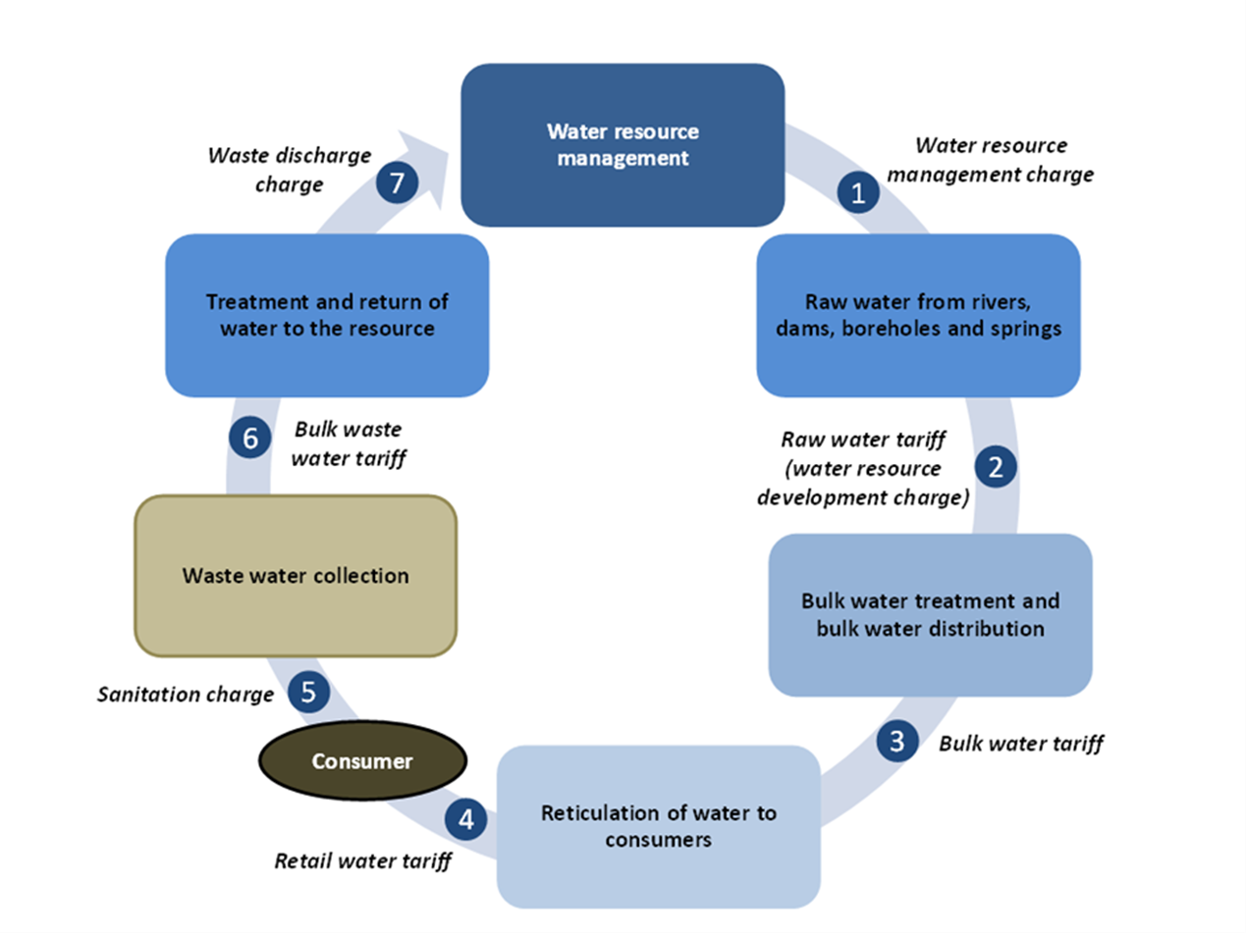
Tariffs in the water value chain

Slide 7
CONTEXT: Institutional Delivery and Tariff Approval in the water value chain
Mandated by National Water Act 38 of 1998
Tariffs determined through: Pricing Strategy
Approver: Minister
DEPARTMENT HUMAN SETTLEMENTS, WATER AND SANITATION
1st Tier
National security of supply
Approved Tariffs to be tabled in Parliament in terms of section 42 MFMA
2nd Tier
Regional supply to WSA’s (municipalities)
Mandated by the Water Services Act 108 of 1997
Tariff: Norms and Standards
Approver: Board and Minister
BULK PROVIDERS
(Water Boards)
3rd Tier
Local service delivery and customer management
Mandated by the Constitution, Water Services Act, Municipal Systems Act and Municipal Structures Act
Tariff: Norms and Standards
Approver: Council
MUNICIPALITIES
(Water Services Authorities)
7

Slide 8
Reflection on the legislative process governing the tariff process and the approvals
  The 2021/22 bulk water tariff process began in October 2020 with preliminary consultation between DWS and Water boards, followed by customer consultation during October and November 2020 as per Sec 42 MFMA and circular 23.
WB requested written comments from both SALGA and NT on the proposed amendment before the 40 day period required before submitting to the executive authority (MFMA s42(2)).
  MFMA s42(3)(d) requires the WB to include in its submission to the executive authority to explain how SALGA & NT comments were taken into account. The current legislative framework does not provide for a deadlock breaking mechanism in the event there is disagreement between a water board and SALGA or NT or both on the basis of the comments.
  ,

Slide 9
Reflection on the legislative process governing the tariff process and the approvals (2)
  SALGA and NT made comments and engaged with water boards to have the comments sufficiently responded to.
  The tariffs are approved once in a year (MFMA s42(5)) for it to apply on that same year if tabled on or before 15 March, any failure to table on the stipulated time will defer the implementation of the tariff to the following year.
  The Executive Authority to water boards as per s28 of the Water Services Act made a determination and tabled the approved bulk water tariffs in Parliament on 15 March 2021.
  The legislative framework further does not spell out any further Parliamentary processes after tabling on or before the 15th of March each year. But to communicate the approved tariffs to Municipalities.
Notes:
Point 1 – DWS initiated a meeting with NT and SALGA in February 2021 to discuss the comments raised by the two organizations and to establish a common ground going forward

Slide 10
Water Provision Costs
Throughout the water value chain water - Entities generally incur costs from the same cost factors;
Raw Water, Electricity, Labour; Depreciation and Chemicals are the 5 major cost drivers ranked from highest to lowest to a water board
  These costs together constitute almost 60% of the total costs of water boards.
  Raw Water purchases are demand driven and the natural resource that is to be transformed. Inaccurate demand forecasting has cost implications.
Eskom tariff increases and subsequent litigation leading to increased Eskom Tariff reinstatement
Bloem Water receives electricity from Centlec and Mhlathuze Water also receives from City of uMhlathuze at tariffs higher than Eskom’s

Slide 11
Water Provision Costs (2)
Labour increases are determined in bargaining councils through agreements between the organised labour and the industry. Default in the implementation is a high risk for the delivery of water.
  Chemicals are mostly imported from international markets directly or indirectly through a local supplier, the local price is highly influenced by the Exchange Rates that are always fluctuating.
  Depreciation depends on the amount and condition of the infrastructure that the water board operates
  Over the past 3 years, the above cost factors increased by above inflation rates
  Though the pricing might be aimed at cost recovery and cost recovery tariffs are charged all the time, without sufficient revenue collection the objective is defeated.
  Individual WB’s cost drivers and additional consideration that informs the potable bulk water tariff setting is discussed hereafter
Notes:
Bullet 1 e.g Bloem Water receives electricity from ESKOM and Centlec (a municipal entity)

Slide 12
Amatola Water Board
Factors influencing tariff increase
0% increase led to under-recovery in the 20/21 FY in operating costs and need to recover in the 21/22 FY
Specific issues raised by SALGA
Concern that Amathole DM does not want to enter into a long term agreement WB which places the security of the revenue stream at risk
Need to indicate how unit cost increases were calculated as well as staff cost
Specific issues raised by NT
Rising staff costs needs to be managed

Slide 13

Amatola Water Board
Specific findings by Economic and Social Regulation (ESR)
Proposed Tariff
    Higher tariffs are due to fewer volumes for sale due to low demand while costs are increasing,
    In a financial distress and requires intervention.
    Have no borrowing limits to raise funds
    The tariff/s have been recommended as proposed
proved Tariff
Amatola WB | 2019/20 and 2020/21 Tariff (0% Increase) | 2021/22 Proposed, and approved % Increase | 2021/22 Approved Tariff
Potable | R 12.99 | 7.085% | R 13.91
Raw | R2.85 | 7.085% | R3.05

Slide 14
Bloem Water Board
Factors that lead to proposed increase
Reverting back to the 2003 SLA with Mangaung Metropolitan Municipality
Inclusion of the Impairment of Trade Receivables as an input cost to address the non-payment by municipalities.
Specific challenges experience during the tariff consultation process for Bloem Water Board – elaborated on next slide

Slide 15
Bloem Water Board
Circular 23 and Section 42 of the MFMA require water boards to consult with municipalities on the proposed tariffs between October and November and submit written proposals to NT and SALGA by 1 December.
Bloem Water sent invitations for the tariff consultation meetings to all the customers timeously, but the municipality did not avail themselves even after follow up requests.
Bloem Water then resorted to submitting written tariff proposal to the municipalities to solicit inputs.
Bloem Water submitted their tariff proposals to NT and SALGA on 30 November 2020.
Further deliberations ensued in December which resulted in Mangaung MM and Bloem Water reverting back to the conditions of the 2003 SLA which stipulates that the water board will supply the municipality with 5.9 million KL of raw water at no charge.
This resolution had a material effect on the tariff structure of Bloem Water which required the water board to revise and re-submit a tariff proposal to NT and SALGA on 15 December 2020.
The revised tariff proposal arrived at the period when NT and SALGA concluded the process of assessing and providing comments on the proposal received on 30 November 2020, thus resulting in NT and SALGA being unable to provide written comments based on the revised tariff proposal.

Slide 16

Bloem Water Board
Specific findings by Economic and Social Regulation (ESR)
    In a financial distress and requires intervention
    Dependant on Mangaung Metro for the survival of the water board but experiencing challenges in the relationship as can be seen on detail included above
    Huge CAPEX plan but unable to fund since the water board is not credit worthy.
    Outstanding debt owed by MMM who as the main customer and the biggest of all the debts is over R1. billion.
    The tariff/s has not been recommended as proposed, the recommended tariff increase is 10% for raw water.
Bloem WB | 2019/20 and 2020/21 Tariff (0% Increase) | 2021/22 Proposed, % Increase | 2021/22 Proposed Tariff | 2021/22 Recommended and approved % Increase | 2021/22 Approved Tariff
Potable | R 9.01 | 11% | R 10.01 | 10% | R 9.910
Raw | R 6.62 | 33% | R 8.80 | 11% | R 7.350

Slide 17
Lepelle Northern Water Board
Factors that lead to proposed increase
2020/21 zero rated tariff and the electricity tariff increase
Specific issues raised by SALGA
The cash flow problem of the water board is due to non payment by municipalities
Specific issues raised by NT
Insufficient information provided in the tariff proposal
Concern over a double digit increase in tariffs
Liquidity is threatened as the cash balance is decreasing over the years

Slide 18

Lepelle Northern Water Board
Specific findings by ESR:
    In financial distress and requires intervention
    Business model require to be reviewed to allow for cross-subsidy since the water board serves poorer communities.
    Highest rate of tariff increase for one scheme at 16%
    CAPEX cannot be effectively funded.
Water Board | 2019/20 and 2020/21 Tariff (0% Increase) | 2021/22 Proposed and approved % Increase | 2021/22 Approved Tariff
Lepelle Northern | R 7.49 | 11% | R 8.28

Slide 19
Magalies Water Board
Factors that lead to proposed increase
2020/21 zero rated tariff increase and the model to achieve uniform tariff by 2024/25 financial year
Specific issues raised by SALGA
Concerns over the methodology used achieve the uniform tariff and drought tariff.
Revenue projection is unrealistic considering slow growth in water volume sales
Specific issues raised by NT
Labour Cost increase is excessively high
Expedite the process of developing a tariff policy to include uniform tariff

Slide 20

Magalies Water Board
Specific issues raised by ESR:
    Striving for a uniform tariff across all the operating schemes but little interest to fund for the convergence,
    If achieved it will allow for cross-subsidisation among the schemes
    The tariff/s have been recommended as proposed
Water Board | 2019/20 and 2020/21 Tariff (0% Increase) | 2021/22 Proposed and approved % Increase | 2021/22 Approved Tariff
Magalies | R 8.71 | 8.24% | R 9.43

Slide 21
Mhlathuze Water Board
Factors that lead to proposed increase
Under-recovery due to 0% increase. Planned systems upgrades and increase in new infrastructure to deliver water.
Specific issues raised by SALGA
Concern about the general expense together with staff that is the biggest item of expenditure with no explanation on what is covered
Specific issues raised by NT
NT supports the full cost recovery tariff however concerned with the high labour costs

Slide 22

Mhlathuze Water Board
Specific issues raised by ESR:
    Highest tariff rate in percentage increase (15.2%) when comparing to other water boards
    Project year on year high water sales volumes relative to what they sell each year
    Huge CAPEX plan but mainly not directed towards capacity of the infrastructure as it is for overheads.
    Bigger challenge is inability to spend the full CAPEX budget over the past financial years.
    Controversial costing model for the water board,
    The tariff/s has not been recommended as proposed, the recommended tariff increase is 9% for bulk water.
MhlathuzeWater Board | 2019/20 and 2020/21 Tariff (0% Increase) | 2021/22 Proposed, % Increase | 2021/22 Proposed Tariff | 2021/22 Recommended and approved % increase | 2021/22 Approved Tariff
Potable | R 5.08 | 15.2% | R 5.85 | 9% | R 5.540
Raw | R 2.16 | 9% | R 2.35 | 9% | R 2.350

Slide 23
Overberg Water Board
Factors that lead to proposed increase
0% increase led to under-recovery in the 20/21 FY in operating costs and need to recover in the 21/22 FY
Specific issues raised by SALGA
Expressed concern that both the drought and penalty charge are determined on the allocation.
Specific issues raised by NT
Concern regarding under recovery tariff proposed by water board as this will negatively affect the entity’s sustainability.

Slide 24

Overberg Water Board
Specific issues raised by ESR:
    The water board has the lowest volumes for sale which makes it the smallest.
    Dependant on Industrial/agricultural client for the survival of the water board.
    The water board charges under recovery tariff
    The tariff/s have been recommended as proposed
Water Board | 2019/20 and 2020/21 Tariff (0% Increase) | 2021/22 Proposed, and approved % Increase | 2021/22 Approved Tariff
Overberg | R 7.66 | 8% | R 8.27

Slide 25
Rand Water Board
Factors that lead to proposed increase
2020/21 zero rated tariff, significant increase in the electricity tariff and depreciation due to capitalization of assets.
Specific issues raised by SALGA
Disputes the need to increase the size of the personnel given that the water demand is not increasing
Specific issues raised by NT
Revenue increase is as a result of tariff increase and not increasing demand

Slide 26

Rand Water Board
Specific findings raised by ESR
    High profit margin of more than 20%
    Planned operational cost are consistently below budget over last 4 years
    Planned revenue exceeded resulting in high income surplus
    Tariff recovering all cost and generating surplus.
    CAPEX worth R27.6 billion over the next 5 years
    Bigger challenge of inability to spend the full CAPEX budget over the past final years.
    The revenue growth dependant on the price increases while volume sales remain constant.
    The tariff/s have not been recommended as proposed, the recommended tariff increase was 4.6% (inflation based)
Water Board | 2019/20 and 2020/21 Tariff (0% Increase) | 2021/22 Proposed, % Increase | 2021/22 Proposed Tariff | 2021/22 Approved % Increase | 2021/22 Approved Tariff
Rand | R 10.09 | 5.8% | R 10.68 | 5,8% | R 10.674

Slide 27

Sedibeng Water Board
Factors that lead to proposed increase
Current deficit of (18%) due to 0% increase, provision of 6.5% provision on vacancies.
Tariff proposal caters for 6.9% increase in energy costs forecast
Specific issues raised by SALGA
Require alignment between tariff application and corporate plan.
Correct level of capital expenditure
Specific issues raised by NT
Implement measures to curtail its rapidly rising staff costs and make provisions for the Vaal Gamagara project and other projects planned

Slide 28
Sedibeng Water Board
Specific findings raised by ESR
  Geographically the largest water board in the country having taken over 3 disestablished water poor water boards. (Botshelo; Pelladrift & Namakwa)
  Huge CAPEX but unable to secure funding for such.
  The most owed water board in the country about R4 billion with almost R2 billion owed by Matjhabeng LM in the FS, hence the substantial amount of impairments.
  The tariff/s have been recommended as proposed
Water Board | 2019/20 and 2020/21 Tariff (0% Increase) | 2021/22 Proposed, recommended and approved % Increase | 2021/22 Approved Tariff
Sedibeng | R 9.81 | 6% | R10.40

Slide 29

Umgeni Water Board
Factors that lead to proposed increase
Total operating costs are increasing at an alarming rate compared to the sales volumes increase (consistently at 20.90% in average for three consecutive years.
Specific issues raised by SALGA
Discrepancy between UW’s expansion and low water sales volumes
Staff costs needed to be clarified and level of capital expenditure need to be corrected
Specific issues raised by NT
The water board must implement cost curtailment measures

Slide 30
Umgeni Water Board
Specific findings raised by ESR:
    A strong balance sheet with a strategy to further build on lower debt funding and better equity
    High profit margin of more than 20%
    CAPEX worth R15.1 billion over the next 6 years
    Budgeting and forecasting is excessive for administrative expenses and labour costs
    The tariff/s have not been recommended as proposed
Water Board | 2019/20 and 2020/21 Tariff (0% Increase) | 2021/22 Proposed, % Increase | 2021/22 Proposed Tariff | 2021/22 Recommended and approved % Increase | 2021/22 Approved Tariff
Umgeni | R 8.37 | 7% | R 8.96 | 5% | R 8.784

Slide 31
Municipal Tariff Processes
Local Government is mandated by the Constitution, Water Services Act, Municipal Systems Act and Municipal Structures Act to deliver basic services to communities and to levy tariffs as guided in the norms and standards. The approver of tariffs is the Municipal Council
The Constitution S151 provides that:.
2. The executive and legislative authority of a municipality is vested in its Municipal Council.
3. A municipality has the right to govern, on its own initiative, the local government affairs of its community, subject to national and provincial legislation, as provided for in the Constitution.
4. The national or a provincial government may not compromise or impede a municipality's ability or right to exercise its powers or perform its functions.

Slide 32
Municipal Tariff Processes
Municipal tariffs are approved together with the budget prior to the beginning of a financial year. The Council determines tariffs when approving its budget for a budget year. Council may determine tariffs during the course of the financial year only when:
• A new service is introduced.
• No tariff for an existing service has previously been imposed.
In terms of section 28 (6) of the MFMA Council may not increase tariffs during a financial year, except when required in terms of a financial recovery plan.

Slide 33

Management of debt in the water sector and finding sustainable solutions

Slide 34
Purpose
To outline:
The crisis facing DWS in terms of the financial status of Water Boards and proposed solution
Impact of non-payment by municipalities on WTE and water boards
Impact of the zero tariff increase on water boards and proposed solution
Status of debt owed to municipalities and financial viability of top owing municipalities
What is being done and addressing the bigger problem
Proposed short, medium and long term solutions to the debt
  Single and Integrated Revenue Management Framework
  Multi-disciplinary Revenue Committee (MdRC)
  Strategy to address escalating debt:
    Deal with current account payments
    Restructure the debt owed by municipalities
    Target the top 12 municipalities owing Water Boards
  Installation of smart prepaid solution
  Rollout of a National Campaign on the culture of payment

Slide 35

We are facing a crisis
The financial vulnerability of water services (including bulk) is such that if we don’t act immediately, we face the risk of not being able to ensure access to water in certain water board areas
Ongoing deteriorating and deficient infrastructure is stalling SDG progress
Already the impact of COVID-19 on the water and sanitation sector has raised the alarm in terms of our capacity to deliver services during critical times
Now we are under severe stress, with an operating deficit in the sector as a whole which requires urgent attention.

Slide 36
We are facing a crisis
The financial crunch means the following
    Revenue and tariffs that cannot sustain the business
    Water Trading Entity owed R14,7 billion as at 30 April 2021 and rising due to non payment by Municipalities
    Water Boards owed almost R12,6 billion as at 31 March 2021 and rising due to non payment by municipalities ) this includes R2,4 billion under current account
    Declining credit ratings and borrowing capacity
    Stringent rules on state guarantees
    Inadequate investments in infrastructure which will have an adverse impact in meeting the current and future increased demand for water services
    Inadequate money allocated to operations and maintenance with high risk of unreliable services negatively impacting on water quality and quantity, and also health and hygiene, and critically on the environment
    Revenue loss of about 7% (R1,9 billion) due to 0% tariff increase during 2020/21 financial year
    Looming labour unrest over moratorium on conditions of service
    Potential loss of skills from the sector
    Potential collapse of our institutions

Slide 37
Water Board municipal debt continues to grow

Slide 38
The impact of non payment by the municipalities
As at 31 March 2021, municipalities owed water boards over R12,6 billion of which R2,4 billion is under current account (see Annexure 1)
The debt owed by some individual municipalities is considerable where it will not be possible for the municipality to pay it off in the foreseeable future. For example Matjhabeng LM owes Sedibeng Water more than R4 bn as of end of January 2021 where R3,7 bn debt is more than 120 days. (see Annexure 2 for top 12 municipalities with largest arrears amounts)
Emfuleni LM owes Rand Water more than R1,3 billion inclusive of current account and R937 million over 120 days
Sedibeng Water total debtors book is R5,1 billion owing by the municipalities as at Jan 2021
4 water boards are facing a financial crisis (Amatole Water, Bloem Water, Lepelle Northern Water, and Sedibeng Water)
Others such as Rand Water (RW) and Umgeni Water are seeing their debtors book growing as a result of non-payment but are still able to operate and maintain infrastructure and pay salaries
Water Boards are entering into payment arrangements with municipalities but there are challenges (See Annexure 3 for efforts by Water Boards to recover the debt and Annexure 3A for challenges when Water Boards implement credit control measures)

Slide 39
4 Water Boards need urgent financial support in order to keep afloat between March and June 2021 with operations, maintenance and payment of salaries.
Water Board | Requested funding | Recommend funding | Variance
 | R’000 | R’000 | R’000
Amatola Water | 61 000 | 61 000 | 0
Bloem Water | 162 000 | 162 000 | 0
Lepelle Northern Water | 94 000 | 94 000 | 0
Sedibeng Water Board | 600 000 | 267 000 | 333 000
Total | 917 000 | 584 000 | 333 000
DWS proposed a Temporary Relief Facility of R600 million to assist these Water Boards through internal re-prioritization from RBIG within DWS budget allocation. Legal advice from NT (on the 26 January 2021) was that this is not possible as the purpose of the RBIG allocation cannot be changed to bail out Water Boards.

Slide 40

Extent of impact on water boards – Example of Sedibeng Water
The consequence of non payment by municipalities are such that Sedibeng Water won’t be able to pay their salaries, operations, creditors, etc. As of 23 March 2021 Sedibeng Water’s cash bank balance was only R350 000.
Sedibeng Water is a major institution. It is the third largest water utility in the country with assets of R4.9 billion, and revenue from bulk potable supply of water of R1,6 per annum. The staff compliment is over 800.
Sedibeng Water serves 12 municipalities in the Free State, North West and Norther Cape, where it supplies over 90 million (kl) of water per annum.
It is unthinkable that an institution such as Sedibeng Water is to collapse
To address this crisis DWS requested to transfer R139 million from the funds appropriated to Umgeni Water to Sedibeng Water for operational purposes. This was granted by NT on 17 March 2021 in terms of TR 6.3.1(a) and Section 5(1)(c) of the Appropriation Act. DWS has processed this transfer by early April 2021. This was a once off transaction due the delays in a Umgeni Water project and there is no more appropriated funds available for re-allocation.
Basically funds are being taken from one Water Boards to pay another. This clearly is not sustainable.

Slide 41
The challenge facing DWS
If Sedibeng, Amatole, Bloem, Lepelle Northern Water Boards do not receive the financial support requested between March and June 2021, they cannot continue operating
Given that DWS does not have residual budget under goods and services to provide support to the water boards, the challenge facing DWS is to either:
  Do nothing whereby these water boards will collapse
  Incur irregular expenditure to bail them out
The sector departments and its stakeholders cannot stand by and let our water boards collapse
Water is a basic human right, we have to resolve the problem
If we are not proactive in finding a solution, water will stop.
ONLY POSSIBLE SOLUTION
Minister of Human Settlements and Water and Sanitation to engage Cabinet to request funding for water boards until end of June 2021, outlining the dire consequences if they are not bailed out
Budget Forum allocates sufficient funds to WBs within DORA for the next financial year (DWS to indicate amount)

Slide 42
Water boards are also losing approximately 7% or R1.9 billion of their revenue as a result of 0% tariff increase during 2020/21
Water Boards | Audited 18/19 (R'm) | WB Revenue Projection (R'm) |  |  |  | % 2019/20 vs 2020/21 | % 2020/21 vs 2021/22 | % 2021/22 vs 2022/23
 |  |  |  |  |  |  |  |  | Revenue loss due to tariff reduction 20/21 R'm
 |  | 2019/20 Draft AFS | 2020/21 | 2021/22 | 2022/23
Amatola Water | 423 | 419 | 419 | 474 | 528 | 0% | 13% | 11% | 39
Bloem Water | 752 | 818 | 812 | 968 | 1 066 | -1% | 19% | 10% | 74
Lepelle Northern Water | 591 | 602 | 602 | 701 | 769 | 0% | 16% | 10% | 31
Magalies Water | 979 | 789 | 693 | 896 | 1 000 | -12% | 29% | 12% | 78
Mhlatuze Water | 402 | 664 | 540 | 560 | 691 | -19% | 5% | 23% | 126
Overberg Water | 56 | 63 | 63 | 81 | 80 | 0% | 29% | -1% | 14
Rand Water | 15 539 | 16 423 | 16 678 | 19 507 | 21 082 | 2% | 17% | 8% | 1 084
Sedibeng Water | 1 648 | 1 680 | 1 423 | 2 135 | 2 551 | -15% | 50% | 19% | 100
Umgeni Water | 3 538 | 4 118 | 4 222 | 4 512 | 5 123 | 3% | 7% | 14% | 376
Total | 23 928 | 25 576 | 25 347 | 30 063 | 33 060 | -1% | 19% | 10% | 1 922
The revenue loss analysis above only considers the bulk water potable tariff not secondary activity revenue and other income. There has been no funding injected to assist water boards to cope with the stress of no tariff increase for the 2020/21 financial year except to the 5 water boards who are in deficit already

Slide 43
Addressing Water Boards Tariffs
Water Boards are currently rendering a service, but at a reduced rate in consideration of COVID
If water boards are not allowed to increase their tariffs to cover their costs, what is the solution to cover the gap?
The potential solutions are to:
  Reverse the decision so that water boards can impose the correct tariffs
  Top slice local government and water related grants to cover the gap in the next Division of Revenue
  Achieve cost reflective tariffs through a phased approach to close the gap
Big bang approach will cause more debt on the side of municipalities and further impact on their inability to pay water boards
SOLUTION
Water Boards address their inefficiencies where relevant, and charge cost reflective tariffs in a phased approach
Interim gap to be addressed through top slicing grants in the next DORA

Slide 44
GROWTH IN WTE MUNICIPAL DEBTORS
R’000s

Slide 45
The impact of non payment by the municipalities on the WTE
As at 30 April 2021, municipalities owed WTE over R7,6 billion inclusive of R139 million under current account
Water boards owed WTE more than R7,1 billion as at 30 April 2021 inclusive of current account
Non-payment by the municipalities also affects WTE payments to TCTA. The WTE has to pay the TCTA the full amount billed whether the revenue has been received or not. This is to enable TCTA to pay the funders of the loans on time, as defaulting on a loan repayment is not an option. To fund this shortfall, less is spent on operations and maintenance of infrastructure
The entire value chain (from source to tap ) is thus affected. As long as there is non-collection from the municipal customers there will be a negative impact on the whole value chain
The DWS has held numerous engagements with sector departments and its stakeholders in an attempt to resolve the growing debt owed to water boards by municipalities (See Annexure 5 for engagements)

Slide 46
At the same time municipalities are owed – R230.5 billion
As of 31 December 2020 aggregate municipal consumer debts amounted to R230.5 billion
The largest component of municipal debt relates to the households which represents 72.2 per cent or R166.5 billion, while organs of state accounts for 9.0 per cent or R20.7 billion (R13.2 billion reported in the second quarter of 2019/20) of the total outstanding debtors. The businesses sector owes 16.9 per cent or R39 billion of the total outstanding debt.
Not all the outstanding debt of R230.5 billion is realistically collectable, as these amounts are inclusive of debt older than 90 days (historic debt that has accumulated over an extended period), interest on arrears and other recoveries.
If consumer debt is limited to below 90 days, then the actual realistically collectable amount is estimated at R37.8 billion.
Municipalities owed their creditors R67.3 billion as at 31 December 2020
The total balance on borrowing for all municipalities equates to R70.9 billion as at 31 December 2020

Slide 47
The current state of municipal finances
A snapshot of selected LG financial performance indicators:
Indicator | Performance | Perf. Trend*
Financial Distress | 163 municipalities (64%) | 15% increase
Unfunded Budgets | 106 municipalities (41%) | 4% increase
Outstanding debtors (total) | R230 billion (R191 billion) | 20% increase
Outstanding creditors (total) | R65 billion (R41.4 billion) | 57% increase
Unqualified audit opinions | 114 municipalities (44%) | 3.5% increase
Qualified Audit opinions (2018/19) | 85 municipalities (33%) | 0.8% decrease
Adverse/Disclaimer audit opinions (2018/19) | 40 municipalities (16%) | 1.2% decrease
Outstanding Audits (2018/19) | 18 municipalities (7%) | 5.5% increase
* Performance trend against previous financial year

Slide 48
What is being done?
  Some of the top 20 defaulters’ have been placed under section 139 interventions where DCoG in collaboration with sector departments supported the municipalities with the development and implementation of financial recovery plans.
  To enforce compliance, stringent measures were put in place by National Treasury whereby prior to release of equitable share (of December 2020) municipalities were required to show proof that they have ‘paid its creditors as required in terms of section 65(2)(e) of the MFMA’.
  Where the municipality has a repayment plan with Eskom and /or a water board, it had to submit a copy thereof to National and Provincial Treasuries and show proof that the current accounts have been paid.
  BUT, the problem is not simply about enforcing payment, it is much bigger than that

Slide 49
The bigger problem
Underlying the ballooning debt there is:
a lack of coordination and integration of support to municipalities (a systematized approach)
a lack of institutional and people capacity
a lack of revenue management effort threatening financial sustainability in most of the municipalities in South Africa, which then impacts on bulk providers and other creditors
The lack of revenue management impacts negatively on the ability and capacity of municipalities to fulfil their constitutional and legislative mandate, in particular the delivery of services
Poor or failing service delivery results in non payment, thus a vicious circle
We need to break this circle
How?
What are the solutions?

Slide 50
The bigger problem (continued)
On 29 December 2020 the Supreme Court of Appeal (“SCA”) handed down a written judgment which set aside Eskom’s decision to interrupt the supply of electricity to the two municipalities who repeatedly defaulted in making their payments to Eskom for the electricity supplied to them.
Although the SCA decision was concerned with the lawfulness of the reduction by a state organ creditor of the provision of basic services to another state organ debtor tasked with delivering basic municipal services for purposes of recovering debt, and should ordinarily not be applicable to Water board’s conduct to reduce water services for purposes other than debt recovery.
Water Provision by Water Boards impacts another organ of state like a municipality
The implications of the above to the water boards:
The legal effect of non-compliance with Inter-Governmental Relations Act and section 4 of Promotion of Administrative Justice Act, 3 of 2000 (“PAJA”) steps would result in an order declaring Water Board’s decision to reduce the water services unconstitutional.
Though the SCA was not called upon to decide whether a state organ is bound to follow the same steps where it elects to institute legal proceedings for the recovery of debt, the provisions of sections 40(1)(b) and 41(1) of IRFA impose the exact similar obligations on Water Boards.
Other Courts are likely to follow the same trend against water boards in the future ( Reference: Govan Mbeki vs. Rand Water)
Civil Society is also interdicting the current credit control measures

Slide 51
Steps we propose should be adopted by Water boards to ensure compliance with the judgment of the SCA in its attempts to recover overdue debt.
section 44(1) and (2)(a) and (b) of the MFMA and section 40 - 42 of IRFA and compliance with section 4(5) of WSA
STEP 1
Upon non-payment of an account issued by the Water board for the supply of bulk water services to a municipality when it falls due, either in terms of the Bulk Water Supply Agreement, or in terms of section 65(2)(e) of the MFMA, a letter must be addressed to the municipality in question with regard to the non-payment and notifying the municipality of the intentions to reduce water flow and grant the municipality an opportunity to make representations not later than the specified date .
STEP 2
Compliance with section 44 (1) and (2) and (a) and (b) of the MFMA and section 40(1) and 41(2) of IRFA
If the Municipality is cooperative in response to the notification letter, Water board ought to endeavour that engagements are held as soon as its circumstances require, after receipt of the municipality’s response.
If agreement is reached and the municipality abides, the engagements come to an end, the parties having complied with the provisions of sections section 40(1) and 41(2) of IRFA.
STEP 3
Compliance with the provisions of section 41(2) - declaration of a dispute
If the agreement contemplated in paragraph above is not reached or is breached, Water board must declare a dispute in writing with the municipality, as required by the provisions of section 41(1) of IRFA

Slide 52
Steps we propose should be adopted by Water boards to ensure compliance with the judgment of the SCA in its attempts to recover overdue debt.
section 44(1) and (2)(a) and (b) of the MFMA and section 40 - 42 of IRFA and compliance with section 4(5) of WSA
STEP 4
Compliance with section 42 of IRFA
In its written declaration of a dispute, the Water board must give effect to the dispute resolution mechanism that may have been agreed to as part of the agreement contemplated and referred in paragraphs in step 2 above, by invoking its terms.
STEP 5
Water board decides on court action or compel water restrictions
Only in the event that the Water board elects to reduce bulk water supply, must it, in addition to the above, first comply with the provisions of sections 3 and 4 of PAJA read with section 4(3)(b) of the WSA, which mandates that:
  ahead of taking a decision to reduce the supply of bulk water, Water board must issue a public notification in the local and print and broadcasting media of Water board’s intention to exercise its powers to reduce the supply of bulk water;
  that notice must provide residents adequate notice of the nature and purpose of the proposed administrative action;
a reasonable opportunity to make representations
The SCA decision impels Water boards, when it seeks to exercise its powers in terms of section 31(3) read with section 4 of the WSA by reducing water services for debt collection purposes, to comply with the provisions of:
  section 44 of the MFMA;
  sections 40 – 43 of IRFA read with section 41 of the Constitution; and
  section 139 of the Constitution read with section 139 of the MFMA.
in the manner described above.

Slide 53
Steps we propose should be adopted by Water boards to ensure compliance with the judgment of the SCA in its attempts to recover overdue debt.
section 44(1) and (2)(a) and (b) of the MFMA and section 40 - 42 of IRFA and compliance with section 4(5) of WSA
Enforcement processes
”Intervention by the Minister”.
(1) Section 63 of the WSA - If a water services authority has not effectively performed any function imposed on it by or under this Act, the Minister may, in consultation with the Minister for Provincial Affairs and Constitutional Development, request the relevant Province to intervene in terms of section 139 of the Constitution.
(2) In terms of sections 64 and 65 of the WSA, The Minister may on application and after consultation with a Province, make grants and loans and give subsidies to a water services institution from funds appropriated by Parliament; contributed by individuals or nongovernmental organizations; or contributed by other governments and governmental institutions and in doing so must consider the requirements of equity and transparency; the purpose of the grant, loan or subsidy; the main objects of the WSA; and the financial position of the applicant.
Save where it is stated otherwise, the sequence of and suggested steps are, for all intents and purposes, imposed by the Constitution and legislation. The timelines are however self-imposed and not prescribed by legislation

Slide 54
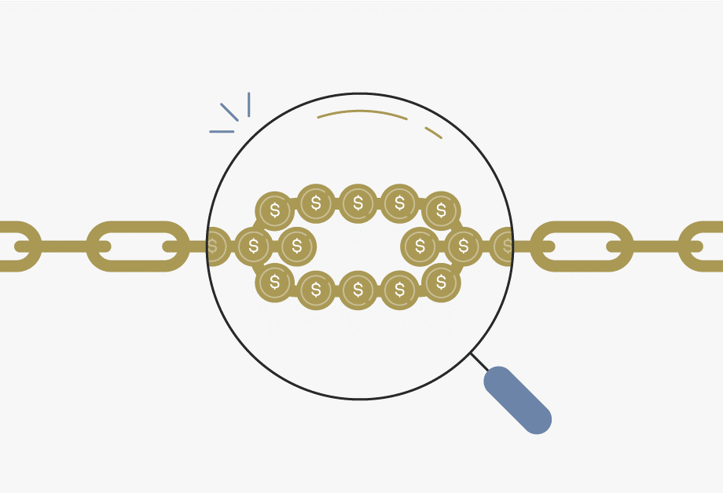
SOLUTION: A holistic approach to stop the increasing debt
If municipalities are not financially sustainable, the sustainability of all institutions in the value chain, including water boards are negatively impacted
Thus we are taking a holistic approach which addresses all the dependencies that are integral to effective municipal revenue management
The aim is to stop the increasing debts owed to Eskom, municipalities, water boards and the Water Trading Entity
We will do this through a Single and Integrated Revenue Management Approach (SIRMA)

Slide 55
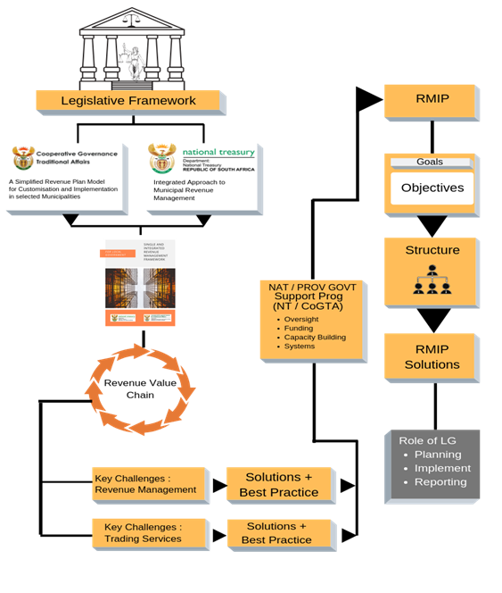
What is the Single and Integrated Revenue Management Approach (SIRMF)?
A framework setting out the action that municipalities, together with government and key stakeholders must develop and implement, to address the revenue management challenges in a manner that produces sustainable results
The financial sustainability of municipalities is a shared responsibility
The SIRMF creates a framework within which these responsibilities are expressed
The single and integrated approach is underpinned by
  joint programme planning and budgeting,
  joint programme design, and
  joint implementation of programmes.
In practice this means pooling of funding and resources for joint enabling programmes

Slide 56

SOLUTION: Establishment of the Multidisciplinary Revenue Committee (MdRC)
  The overall objective of the MdRC is to implement the holistic approach
    To address areas of shortcoming with the revenue value chain that primarily contributes to increased inefficiencies in the municipality
    Transform financially distressed municipalities into “Smart and Financially Sustainable Municipalities” and use technology as a critical enabler for change
  A MdRC is established at the national level and will be replicated at the provincial level to address municipal financial sustainability (See Annexure 5 for the Institutional Structure of the MdRC)
  The MdRC is underpinned by a Single and Integrated Revenue Management Framework (SIRMF) to ensure better management of their revenue for financial sustainability and improved service delivery

Slide 57
SOLUTION: Strategy to deal with defaulting municipalities
Short Term
1
At the heart of this problem is that municipal councils adopt unfunded budgets – indicating that they plan to spend more than their revenue intake
Thus the strategy is to ‘force’ municipalities to adopt funded budgets where cash surpluses pay arrear obligations (See Annexure 6 for detailed process)
With funded budgets municipalities can pay their current accounts
This is the first step towards sustainability
Restructure the arrear debt owing to Water Boards and WTE
Ring fence the debt and suspend interest
Revising payment arrangements in line with affordability based on assessments
Provide incentives to incrementally write off arrear debt, e.g. paying current account on time
Pay Current Accounts
Medium Term
2
Restructure Arrear debt

Slide 58
SOLUTION: Strategy to deal with defaulting municipalities
Longer Term
Build on National Treasury financial assessments of the top 12 owing municipalities
For each municipalities a deep dive assessment will be undertaken to identify the structural and systemic issues underlying the debt. For example: lack of billing, dilapidated infrastructure, lack of maintenance, outdated indigent registers, inadequate skills and capacity, poor systems, etc. (MISA)
A Cost of Supply Study (CoS) will supplement the deep dive assessment to determine tariffs that recover costs
The assessments will give a better understanding of the state of the water services function and what must be done in the short, medium and longer term to ensure sustainability
Based on the assessments a plan of action will be developed for each municipality which assigns responsibility to different stakeholders (e.g. sector departments, COGTA, NT, MISA, SALGA, etc) where support is pooled and integrated
Where the assessment and Cost of Supply Study finds that the internal mechanism is not sustainable, consideration will be given to alternative mechanisms to resolve the debt crisis
3
Target top 12 owing municipalities

Slide 59
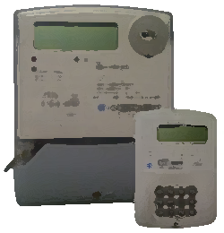
SOLUTION: Installation of a SMART Prepaid Solution -
Strategic Objectives of SMART Prepaid Solution
To transform financially distressed municipalities into “Smart and Financially Sustainable Municipalities” using technology as a critical enabler for change.
Piloting this solution will test a business case, proof of concept; standardized technology, systems, processes, structure, policies in pre-paid rollout for the future and wider implementation
Programme Overall Objectives
Eliminate municipal water and electricity losses and reduce the outstanding debt owed , while improving effectiveness and efficiency
To improve the Revenue Management of municipalities

Slide 60
SOLUTION: Rollout of a National Campaign on the Culture of Payment
  COGTA, is championing the Responsible Citizenry Campaign to educate, mobilise and reinforce the payment for services rendered by municipalities
  Media engagement platforms are used to rollout the campaign, including community radio stations, commercial radio stations and print media, etc.
  The campaign is currently implemented by national government for one year (2020/21FY)
  Municipalities are expected to institutionalize the campaign from 2021/22 FY onwards
  Stakeholders including municipalities are being continuously engaged to ensure support on the rollout of the campaign
  An outreach will be undertaken to raise awareness on meter tempering, illegal connections and ghost vending

Slide 61

In addition – Consolidation of Efforts
Efforts to support municipalities and to resolve the debt are being consolidated across government.
These efforts include a whole range of initiatives including:
  B2B, DDM, Interventions, MISA support, Tariff Setting, Cost of Supply Studies
  Regulating service provision arrangements through SDA, which includes support
  Addressing Organs of State Debt and related ownership issues
  IMTT – Panel report recommendations
The intention is not to reinvent the wheel but to strengthen existing efforts to improve the situation

Slide 62
Recommendations
It is recommended that PC:
Note the factors that influenced the individual Water Boards proposed tariffs
Note the bulk tariff approval process and relevant legislative requirements as well as the approved tariff by the Minister of Water and Sanitation for FY2021/22 for Water Boards
Notes the recommendation that the Minister of Human Settlements and Water and Sanitation engage Cabinet to request funding for water boards until end of June 2021
Notes the recommendation that the Budget Forum allocates sufficient funds to WBs within DORA for the next financial year (DWS to indicate amount)
Request MEC’s and DDM Ambassadors to assist at municipal level to unblock challenges and disputes between water boards and municipalities. Unresolved disputes to be referred to the COGTA established Facilitators
Note the Solutions outlined in this presentation including:
  Single and Integrated Revenue Management Framework (SIRMF) as the approach to dealing with the debt with the focus on the revenue management value chain and its related dependencies
  The establishment of the Water leg of the Multi-disciplinary Revenue Committee (MdRC)
  The Strategy to address the escalating debt
  The implementation of the IMTT recommendations with respect to SMART solutions, and payment campaign

Slide 63
Recommendations
It is recommended that PC:
Note the implementation of the Strategy to address the escalating debt
Water boards to implement credit control measures including waters supply limitations that is in line with the Constitution of the RSA, Water Services Act, and PFMA as agreed between DWS , SALGA, COGTA and National Treasury
Water Boards to address their inefficiencies where relevant, and to charge cost reflective tariffs in a phased approach
Mandate CoGTA, DWS, and SALGA to investigate how water services can be professionalized to ensure better management of the retail business as this affects the entire water value chain.
Mandate COGTA and DWS to determine how the District Development Model can contribute to ensuring an integrated approach to manage the entire water value chain

Slide 64
THANK YOU

