Slide 1
PORTFOLIO COMMITTEE ON CO-OPERATIVE GOVERNANCE AND TRADITIONAL AFFAIRS
BLUE CRANE ROUTE MUNICIPALITY
Cllr: BA Manxoweni
1 June 2021

Slide 2
Index
1) Implementation of the Post Audit Action plan
2) State of finance (Breakdown of Covid 19 expenditure)
3) Revenue Collection from March 2020 to December 2020
4) Unauthorised, Irregular and Fruitless and Wasteful expenditure
5) Consequence management
6) Institutional Capacity
7) Audit committee & Internal Audit
8) MPAC
9) Disaster management plans

Slide 3
1) Implementation of the Post Audit Action Plan
 | Status
1 | 2019/20 annual financial statements and annual performance reports were submitted to the office of the AG within the required timeframes as legislated by the National Minister of Finance. Audit report were issued to BCRM on 28 February 2021
2 | BCRM obtained a unqualified audit opinion for the 2019/20 financial year. 6th in a row Unqualified for both AFS and PMS Certain compliance matters to be addressed in order to obtain clean audit opinion
3 | Post audit action plan was prepared by management, and approved by Council Included in the approved 2019/20 annual report
4 | Emphases matters includes the following: Material losses (Electricity R 12,6 m (20%) Irregular expenditure (R 6,7m) Unauthorised expenditure (R 24,2m) Debt impairment R 23,3 m
5 | Action plans are included to address the above, which includes: Submission of business plans to upgrade and refurbish old electricity infrastructure, preplacement of of old and faulty electricity meters Implementing “war on electricity theft” – in process Implementing a web based integrated SCM module by 1 July 2021, to curb irregular expenditure Ongoing training of SCM unit and Bid committee members – on going Implementing more effective measures to recover outstanding municipal bills, by way of hand-overs to legal firms

Slide 4
2) State of Finance (Breakdown of the COVID – 19 Expenditure
 | Grant | Status
1 | Covid relief grant – R 983,000.00 | This grant was received on 8 May 2020 100 % expenditure were reported as at end of October 2020 AG audited these expenditure. No finding was raised.
2 | R8 066 000 additional Equitable share for the 2020/21 financial year was received | financed the non-payment of consumer accounts because of the loss of income during the Covid period. Debtor payment rate dropped significantly

Slide 5
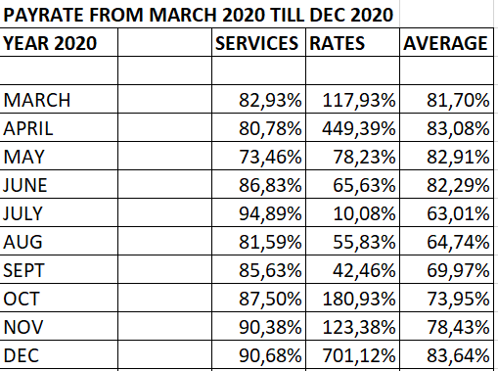
3) Revenue Collection from March 2020– December 2020

Slide 6
4) Unauthorized, Irregular, Fruitless & Wasteful Expenditure
 | Type | 2017/18 – opening balance | 2018/19 | 2019/20 | Total
1 | Irregular Expenditure | R 2,6 m | R 16, 3 m | R 6,6 m | R 25,5 m
2 | Unauthorised Expenditure | R 3,9 m | R 7,1 m | R 24 m | R 35 m
3 | Fruitless and Wasteful | R 845,535 | R 10,684 | R 0 | R 845,535

Slide 7
5) Consequence Management
 | Status | Frequency
1 | All irregular, Fruitless and wasteful expenditure are referred to Council as per MFMA | On a quarterly basis
2 | MPAC and Disciplinary Board are functional | These two structures are currently investigation all irregular, fruitless and wasteful expenditure as at 30 June 2020 as well as up until March 2021. Recommendations will be tabled to council at it next ordinary meeting scheduled for June 2021
3 | Performance management systems | Council and management is currently implementing systems of control to cascade performance management to the lower levels of staff

Slide 8
6) Institutional Capacity
 | Status
1 | Council is functional and meet regularly
2 | All top management positions are filled, including MM, CFO, Director Technical Services, Director Community Services and Director Corporate Services
3 | Other key critical positions that are not filled within the Technical Services department, due to budget constrain include: Land use unit ISD officer electrical artisans Civil work Manager
4 | Other critical positions not filled to due budget constrain: LED manager

Slide 9
7) Audit committee and Internal audit
 | Status
1 | The Audit committee is functional and has the necessary capacity
2 | The Internal audit unit is functional and has the necessary capacity
3 | Audit committee meetings are scheduled regularly, in terms of their annual plan
4 | Activities of the AC for the year under review included the following: Review of the 2019/20 AFS and performance annual reports Review of section 52 d in year reports Review performance management reporting
5 | Activities of the internal audit unit for the year under review included the following: Various of internal audit reviews, including SCM, contract management, HR and leave management, Asset management Assisting in reviewing the Risk register Facilitation of the implementation of the audit improvement plans

Slide 10
8) MPAC
 | Status
1 | MPAC is functional and has the necessary capacity
2 | Meetings are scheduled regularly
3 | MPAC dealt with the following within the current book – year 2019/20 – Oversight report 2019/20 – Annual report Irregular, Unauthorised and fruitless and wasteful expenditure up until 30 June 2020 Section 52 (d) reports – 2020/21

Slide 11
9) Status of the Disaster Management Plans
 | Status | Frequency
1 | BCRM disaster management plan to be tabled at SBDM for adoption. | To be determined by SBDM
2 | Administrative and Political JOC in place, dealing with matters of COVID regulation implementation | Weekly
3 | COVID risk manager appointed | Daily
4 | COVID disinfection team established and performance their work regularly | Daily

Slide 12
Questions / Answers

