Slide 1
CSIR Shareholder’s
Compact 2021/22
A presentation to Parliament
Friday, 7 May 2021

Slide 2

Contextual consideration
CSIR continues to conduct cutting-edge multidisciplinary research that improves the quality of life of our citizens.
The organisation is cognisant of external challenges. Our work is driven to respond to the triple challenge of poverty, unemployment, inequality and opportunities presented by technology, including the 4IR.
Our research programmes are guided by various government strategies and frameworks, e.g. NDP, MTSF and White Paper on STI.
The CSIR strategy emphasises balancing our contribution to industrial development with our efforts in the creation of a capable state. In its second year of implementation, the industrial focus is taking root with increasing support to the private sector (SMMEs and established companies), and aggressive growth targets.

Slide 3

Contextual consideration
The COVID-19 pandemic has had a negative impact on the implementation of our strategy and the future sustainability of the CSIR.
Despite this, the CSIR has made a significant contribution in supporting the national and private sector response to COVID-19. The CSIR’s planned programmes will support the country’s economic and recovery plan.
Reductions in parliamentary grant have curtailed our ability to invest in the sustainability and development of new capabilities.
Concerned about possible cuts in investment by the DoD in the CSIR, which is a significant contributor to the sustainability of our defence capabilities.
The 2021/22 operational plan for the CSIR is based on an aggressive growth of collaboration with the private sector in the face of declining public sector income, in order to sustain the organisation going forward.

Slide 4
Contents
> About us
  Our mandate
  Our vision and mission
  Our values
  CSIR strategic objectives
> Key performance indicators
> Delivery on strategic objectives
> Conclusion

Slide 5

CSIR mandate
^{CSIR MANDATE}
“The objects of the CSIR are, through directed and particularly multi-disciplinary research and technological innovation, to foster, in the national interest and in fields which in its opinion should receive preference, industrial and scientific development, either by itself or in co-operation with principals from the private or public sectors, and thereby to contribute to the improvement of the quality of life of the people of the Republic, and to perform any other functions that may be assigned to the CSIR by or under this Act.”
(Scientific Research Council Act 46 of 1988, amended by Act 27 of 2014)

Slide 6

Vision and mission
VISION
We are accelerators of socio-economic prosperity in South Africa through leading innovation
MISSION
Collaboratively innovating and localising technologies while providing knowledge solutions for the inclusive and sustainable advancement of industry and society

Slide 7

Our values
Excellence
People-centred
Integrity
Collaboration
We excel at R&D and industrial innovation solutions that address South Africa’s challenges. We are unashamedly passionate about the impact we make and pursue excellence in every facet of CSIR life.
We care about people – our impact through innovation aims to improve lives. We respect each other’s diversity, and uphold the dignity of every person, regardless of culture or belief system. We treat our stakeholders the way we like to be treated.
We value integrity – in ourselves and in others. We are honest and fair in how we work and how we engage the world around us. We respect the trust that our colleagues and our stakeholders place in us and commit to ethical decision-making, delivery and governance.
We are keen to learn from one another and collaborate across the organisation and with external partners, to ensure our work has the best chance to innovate a better future for South Africans.

Slide 8

The CSIR strategic intent
Growth
Refers to inclusive and dual growth for the country and the CSIR. The CSIR will use its capabilities in e.g skilled human capital and infrastructure to assist in growing the economy; but will also grow to become a world-class organisation.
Sustainability
Focuses on CSIR-developed technologies that lead to the advancement and sustainability of SA enterprises and the financial sustainability of the organisation in a resource-constrained environment.
Impact
Focuses on the commercialisation of our technologies and innovations for industrial development, as well as technology and knowledge transfer that enable a capable state.
Relevance
Addresses the CSIR’s role in driving the relevance of innovation in inclusive sustainable industrial development and the creation of a capable state.

Slide 9






Strategic objectives
  Conduct research and development of transformative technologies
  and accelerate their diffusion.
  Improve the competitiveness of high-impact industries to support South Africa's re-industrialisation by collaboratively developing, localising and implementing technology.
  Drive socioeconomic transformation through RD&I that supports the development of a capable state.
  Build and transform human capital and infrastructure.
  Diversify income and maintain financial sustainability and good governance.

Slide 10
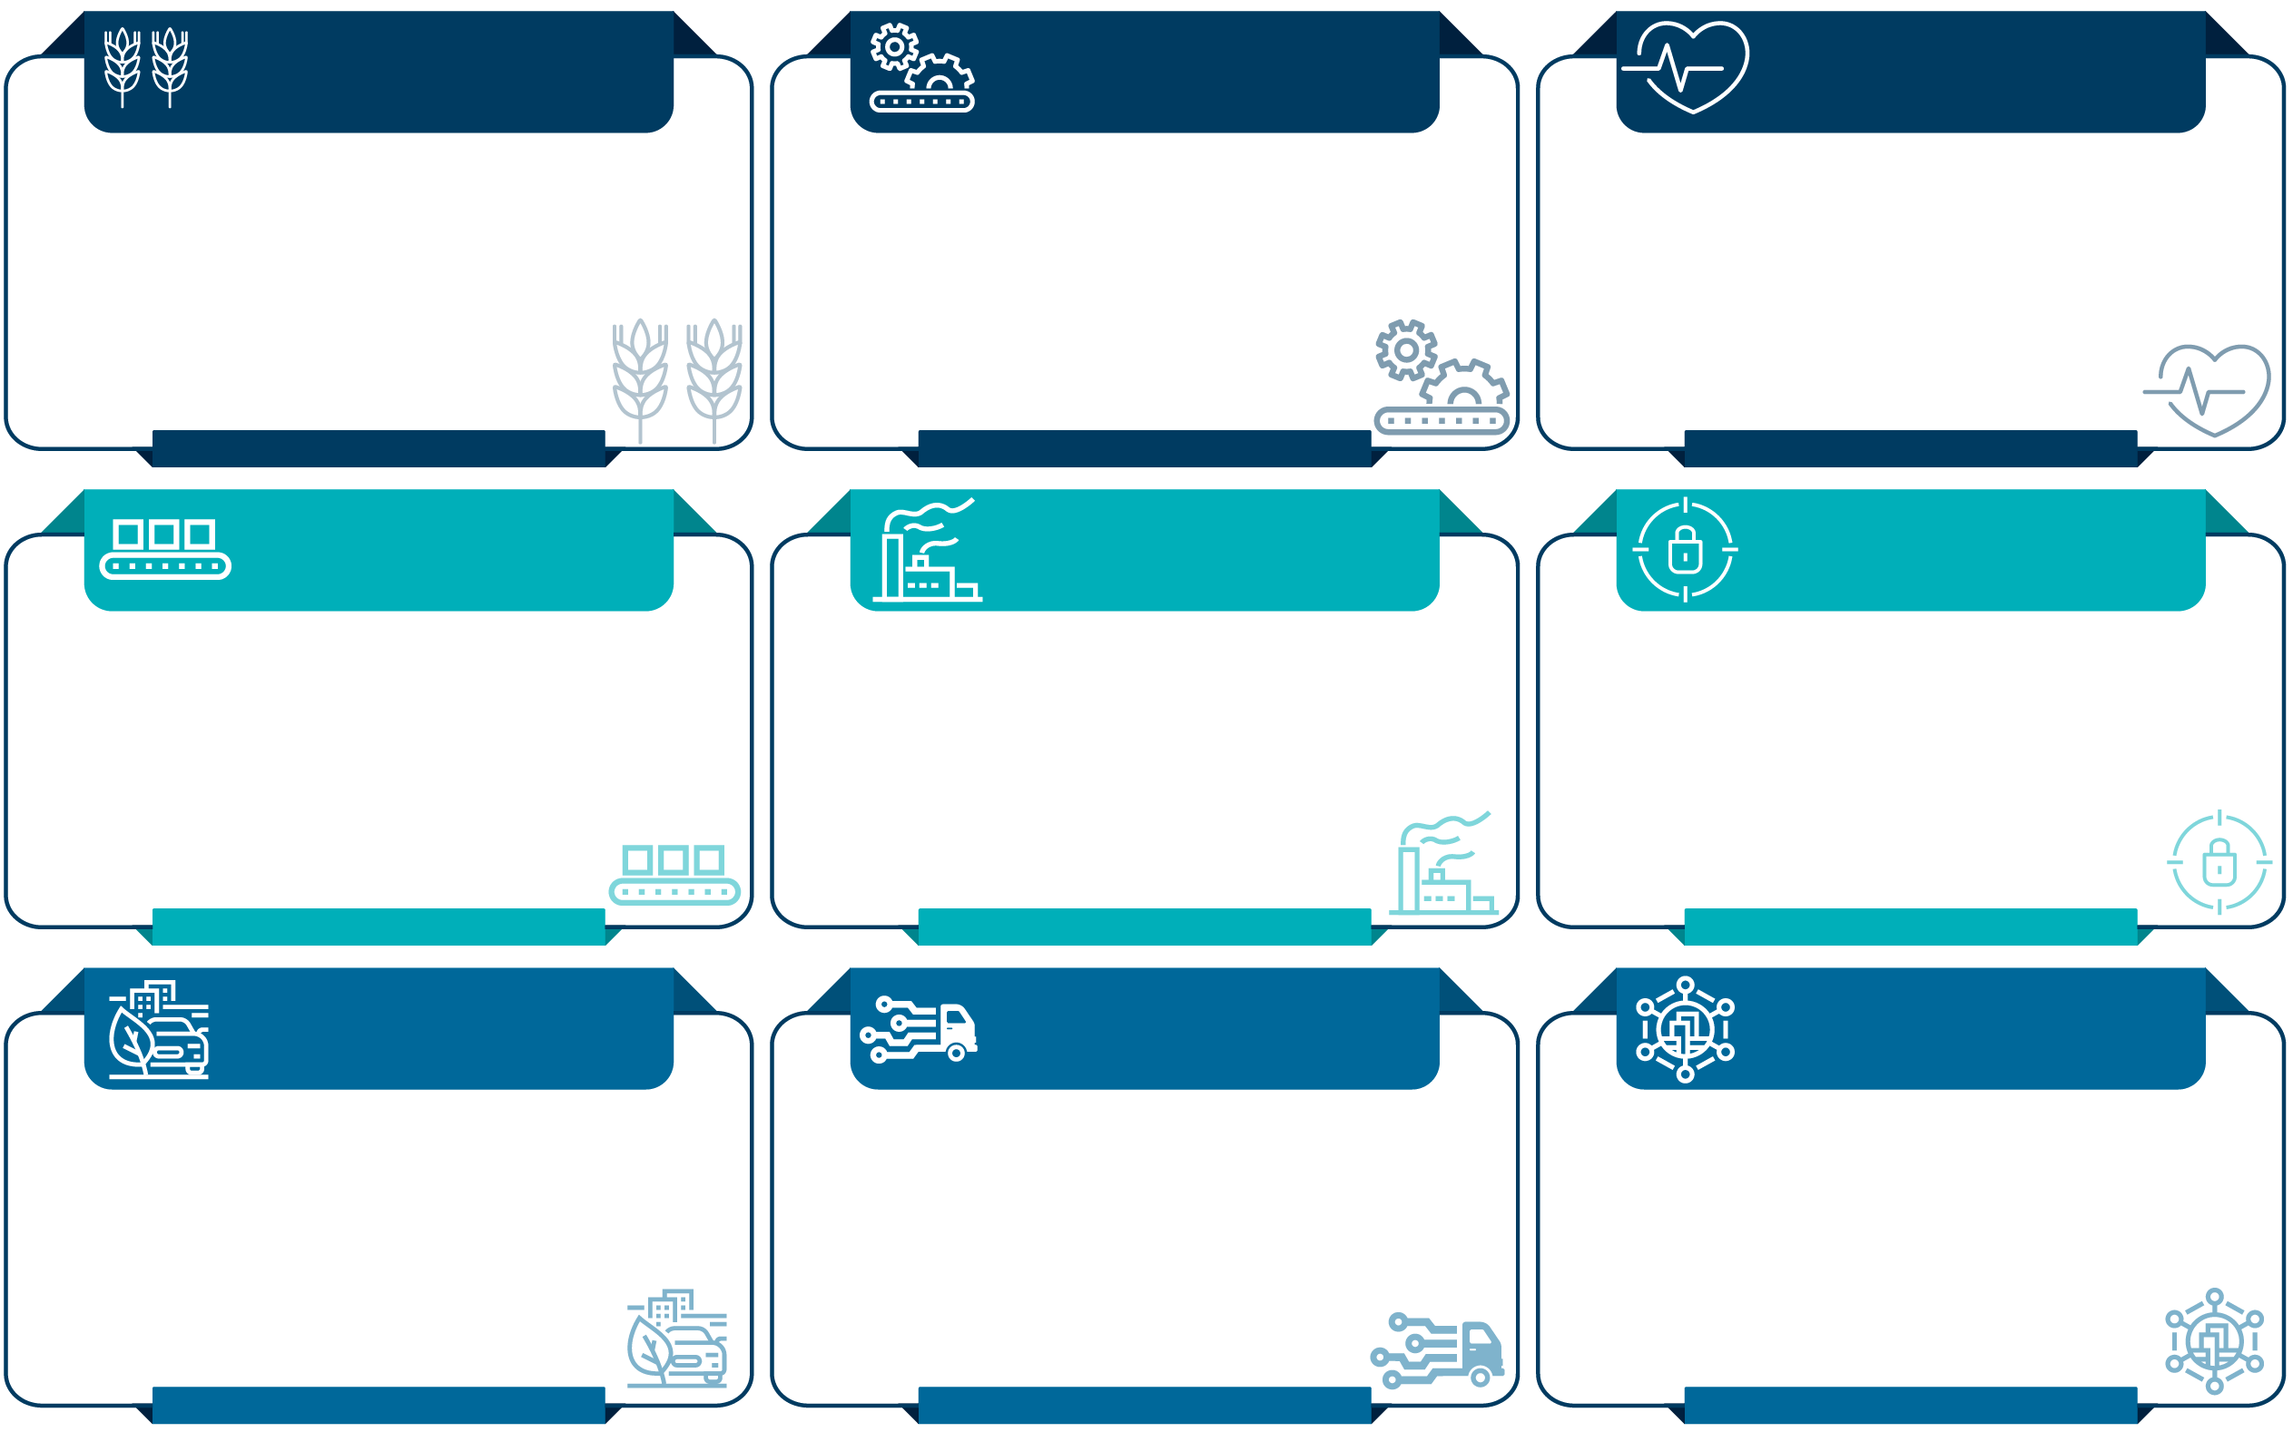
The pillars of the CSIR Strategy
Positioned to drive SA’s industrialisation
Advanced Agri & Food
FUTURE PRODUCTION
Chemicals
NextGen Health
Innovate to strengthen primary production, agro-processing and advance rural economies
Establish state-of-the-art (bio)-chemistry to drive local pharmaceutical and the broader chemical industries
Develop technologies to drive improved health outcomes and patient-centric healthcare delivery
Industry advancement clusters
FUTURE PRODUCTION
Manufacturing
FUTURE PRODUCTION
Mining
Defence & Security
Strengthen manufacturing value chain to enhance Industry Competitiveness
Support the growth and revitalisation of the mining industry
Build resilient defence and security capabilities to strengthen national security technology capacity
SMART Places
SMART Mobility
NextGen Enterprises
& Institutions
Effect smarter resource use, sustainable economic growth and smart infrastructure and service developments
Enable South Africa to have an efficient, effective and integrated logistics sector
Support the digitalisation of government, public institutions and private sectors
Industry and society enabling clusters
The clusters are technology industry convergences that represent the CSIR’s strategic focus.
They have been selected based on national priorities, potential for socioeconomic impact and the fourth industrial revolution.

Slide 11
CSIR alignment to MTSF priorities and
STI Domains
Economic transformation and job creation
Education, skills and health
Consolidating the social wage through reliable and quality basic services
Spatial integration, human settlements and local government
Social cohesion and safe communities
A capable, ethical and developmental state
Advanced Agri & Food
Manufacturing
Mining
Chemicals
NextGen Health and Enterprises
NextGen Health and Enterprises
Smart Places
Smart Mobility
NextGen Enterprises
Smart Places
Smart Mobility
Defence & Security
NextGen Enterprises
Smart Places
Smart Mobility
A better Africa and world
The circular economy
Education of the future
Sustainable
energy
The future
of society
Health innovation
High-tech industrialisation
ICT and
smart
systems
Nutrition security
Water security
Smart
Places
Chemicals
NextGen Enterprises
NextGen Enterprises
Smart Places
NextGen Health
NextGen Enterprises
NextGen Enterprises
Smart Places
Manufacturing
Defence and Security
Advanced
Agri & Food
Smart Places
MTSF Priorities
SAForSTI Domains
CSIR Clusters

Slide 12
CSIR alignment to the South African Economic
Reconstruction and Recovery Plan post COVID-19
Infrastructure rollout throughout the country
Rapid expansion
of energy
generation capacity
Employment stimulus to create jobs and support livelihoods
Drive for industrial growth (including localisation in manufacturing)
Advanced Agri & Food
Provision of infrastructure for the development of products and processes for agroprocessing.
Chemicals
Hosting of National Nano Micro Manufacturing Facility node with management hub.
Development of a Pilot-Scale Supercritical CO2 Encapsulation Facility.
Smart Places
Sustainable energy futures: developing energy planning frameworks for application at the national, municipal and enterprise level to address the present electricity crisis.
Renewable energy integration: provide support to Eskom and municipalities on the integration of renewable energy technologies to the grid.
Chemicals
SMME support from facilities in development and scale-up: BIDF (Durban), BIDC and NIDF (Pretoria).
Consolidating Port Elizabeth non-woven facility’s role in supporting the nascent cannabis industry.
Advanced Agri & Food
Support the development of products and processes based on indigenous knowledge.
The development of cannabis-based products and processes to stimulate the growth of the cannabis industry.
NextGen Health
Digital precision medicine to support one health concept and advance the health solutions in the country.
Smart Places
Green cement pilot plant
CSIR’s support of the industrialisation drive
Create economic opportunities, increased competitiveness through innovation and technological support
ERRP Priorities
CSIR Clusters

Slide 13
CSIR alignment to the South African Economic
Reconstruction and Recovery Plan post COVID-19
Infrastructure rollout throughout the country
Rapid expansion
of energy
generation capacity
Employment stimulus to create jobs and support livelihoods
Drive for industrial growth (including localisation in manufacturing)
NextGen Health
In collaboration with Diplomics, provision of infrastructure for proteomics applications.
Infrastructure for COVID-19 testing services.
Smart Places
Strategic Infrastructure Management; Policy and guidance for Green Building.
Order of Magnitude Cost Estimating Tool for Student Housing Infrastructure Planning.
Smart Places
Solar PV reliability support: accelerated deployment and performance improvement of solar PV systems.
Energy storage: testing, development and commercialisation of local energy storage solutions to beneficiate SA resources.
Thermal energy storage and waste heat recovery: improving the energy efficiency and demand response of SA’s energy system.
Advanced Agri & Food
SMME support from facilities in development and scale-up: BIDC, Enterprise Creation and Development.
Production of Food Safety Standards to ensure food security.
Use of satellite imaging to support small-scale farmers’ productivity.
Chemicals
Develop and/or localise biological and chemical conversion technologies and products using sustainable feedstocks to support commercially competitive green chemical production.
NextGen Enterprises
Hosting and technically supporting a world-class network modernisation and automation laboratory that supports research in emerging technologies and will enable collaboration with industry to experiment with digital infrastructure deployment models.
CSIR’s support of the industrialisation drive
Create economic opportunities, increased competitiveness through innovation and technological support
ERRP Priorities
CSIR Clusters

Slide 14
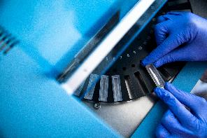

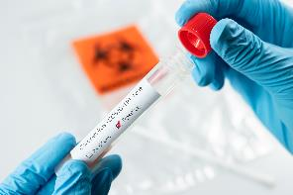
CSIR COVID-19 solutions and interventions
The CSIR has been able to leverage its capabilities to respond to the COVID-19 pandemic.
This highlights the importance of investing in R&D capability development in dealing with future crises and opportunities.
There are ongoing R&D activities which include developing relevant capabilities in order to fully support the state.
Some of the ongoing R&D activities are:
  The Electronic Vaccination Data System is owned by the National Department of Health and developed (in part) by the CSIR
  The National Ventilator Project (100% local manufacture)
  COVID-19 testing labs in support of the National Health Laboratory Service
  Information and Decision Support Centre

Slide 15




A sample of CSIR engagements with private sector
COMMERCIAL EXPLOITATION
C-Search radar
3D naval and ground based surveillance radars
HIGH QUALITY
GERMAN CLIENTS
FOREIGN DIRECT INVESTMENT
ENERGY
WATER
INFRASTRUCTURE
EMERGING AND SMALL-FARMER SUPPORT
BIOETHANOL AND D-LABS
SA Ventilator Project
COVID-19 TESTING FACILITY
C4IR SA
TVET COLLEGES
CYBERSECURITY
ADDITIVE MANUFACTURING
INCUBATION
SMART FACTORY PLATFORM
SMART CITIES
PRODUCT LIFECYCLE MANAGEMENT
R&D INFRASTRUCTURE
CSIR IP licenses
Black Umbrellas to support qualifying businesses recommended by the CSIR
SMART FARMING INNOVATIONS
PEPSICO DEVELOPMENT FUND

Slide 16
KEY PERFORMANCE INDICATORS

Slide 17
SO1: Conduct RD&I of transformative technologies and accelerate their diffusion
Key performance indicator | Forecast 2020/21 | Target 2021/22 | % Increase / Decrease | Target 2025/26
1. Publication equivalents | 278 | 300 | 8% | 415
2. New priority patent applications filed | 4 | 9 | 125% | 18
3. New patents granted | 11 | 8 | -27% | 20
4. New technology demonstrators | 38 | 46 | 21% | 61
5. Number of technology licence agreements signed | 16 | 19 | 19% | 27

Slide 18
SO2: Improve the competitiveness of high-impact industries to support SA’s re-industrialisation
Key performance indicator | Forecast 2020/21 | Target 2021/22 | % Increase / Decrease | Target 2025/26
6. Number of localised technologies | 10 | 11 | 10% | 19
7. Number of joint technology agreements being implemented for industry | 20 | 22 | 10% | 32
8. Number of SMMEs supported | 68 | 75 | 10% | 110

Slide 19
SO3: Drive the socioeconomic transformation through RD&I which supports the development
of a capable state
Key performance indicator | Forecast 2020/21 | Target 2021/22 | % Increase / Decrease | Target 2025/26
9. Number of reports contributing to national policy development | 17 | 17 | 0% | 22
10. Number of standards delivered or contributed in support of the state | 9 | 9 | 0% | 11
11. Number of projects implemented to increase the capability of the state | 36 | 40 | 11% | 46

Slide 20
SO4: Build and transform human capital and infrastructure
Key performance indicator | Forecast 2020/21 | Target 2021/22 | % Increase / Decrease | Target 2025/26
12. Total SET staff | 1 426 | 1 497 | 5% | 1 820
13. % of Black SET staff | 65% | 66% | 1% | 68%
14. % of Female SET staff | 36% | 37% | 2% | 41%
15. % of SET staff with a PhD | 22% | 23% | 1% | 25%
16. Total Chief Researchers | 13 | 17 | 31% | 23
17. % of Black Chief Researchers | 15% | 17% | 2% | 30%
18. % of Female Chief Researchers | 23% | 24% | 1% | 33%

Slide 21
SO4: Build and transform human capital and infrastructure
Key performance indicator | Forecast 2020/21 | Target 2021/22 | % Increase / Decrease | Target 2025/26
19. Total Principal Researchers | 178 | 193 | 8% | 235
20. % of Black Principal Researchers | 29% | 35% | 6% | 45%
21. % of Female Principal Researchers | 19% | 22% | 3% | 27%
22. Number of exchange programmes with industry | 11 | 15 | 36% | 26
23. PPE Investment (Rm)* | 55 | 100 | 82% | 120

Slide 22
SO5: Diversify income, maintain financial sustainability and good governance
Key performance indicator | Forecast 2020/21 | Target 2021/22 | % Increase / Decrease | Target 2025/26
24. Total income (Rm) | 2 630 | 2 869 | 9% | 3 817
25. Net profit (Rm) | -50 | -96 | 92% | 23
26. SA Public sector income (% Total income) | 55% | 56% | 1% | 38%
27. SA Private sector income (% Total income) | 9% | 9% | 0% | 24%
28. International contract income (% Total income) | 5% | 6% | 1% | 12%
29. B-BBEE Rating* | 2 | 2 | N/A | 2
30. Recordable incident rate* | <2 | 1.8 | 0% | 1
31. Audit opinion | Unqualified audit opinion | Unqualified audit opinion | N/A | Unqualified audit opinion

Slide 23
DELIVERY ON STRATEGIC OBJECTIVES

Slide 24
SO1:
Conduct RD&I of transformative technologies and accelerate their diffusion

Slide 25
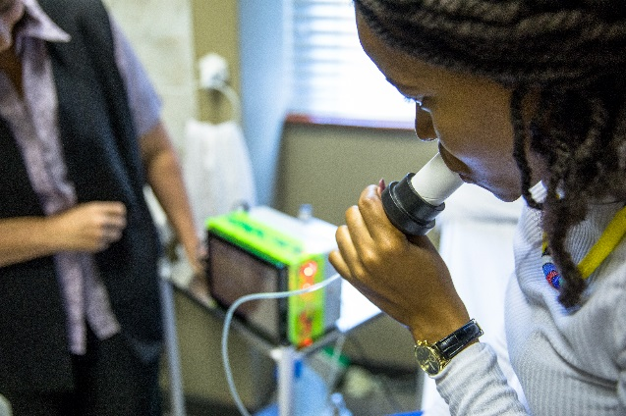
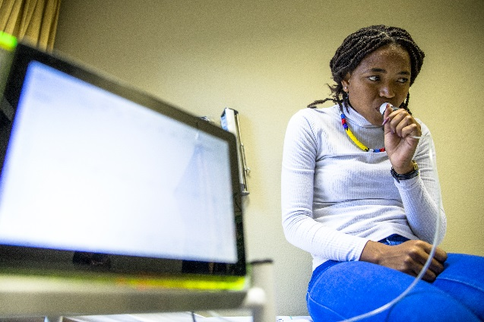
Chemicals, agriculture, food and health
Breath analyser
Challenge/opportunity
The need for non-invasive diagnosis – breath analysis advantages over traditional blood analysis for diabetes include: being painless and non-invasive, easy to perform, inexpensive, results available immediately for therapeutic assessments
Technology
CSIR sensor detects acetone in the breath of diabetic patients
Technology patents granted UP
Clinical trials undertaken with the University of Pretoria
Opportunity
4.5 million cases of diabetes in South Africa – up 137% from 2017
South Africa has highest proportion of adults with diabetes in Africa
> R30 billion spent by diabetic patients in South Africa
Over 69% of people with diabetes are undiagnosed in Africa
77% of deaths due to diabetes occur in individuals younger than 60
Status
Kiara Health (Pty) Ltd commercialisation partner

Slide 26
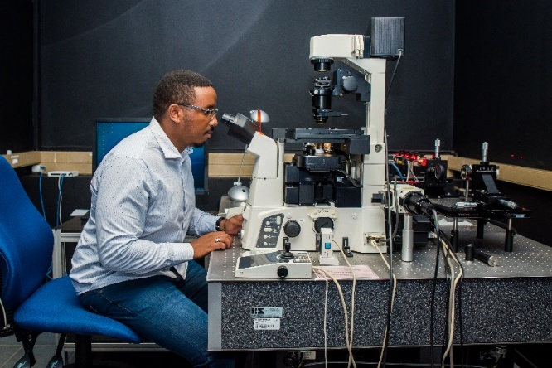
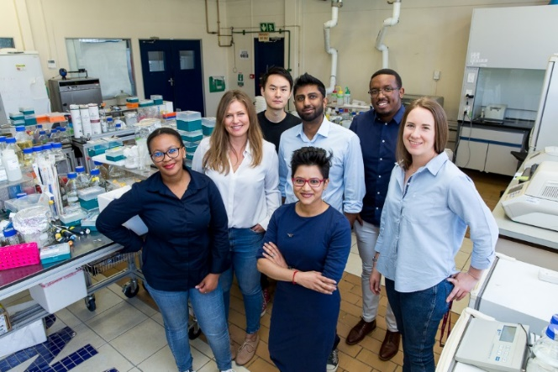
Chemicals, agriculture, food and health
Digital Precision Medicine
Challenge/opportunity
High costs of hospitalisation due to adverse drug reactions, poor health outcomes due to ineffective drugs, lack of pharmacovigilance capability to track safety of drugs that are approved for our markets
Technology concept
The South African Digital Precision Medicine Platform: Combining big data and bioengineering of liver organoids to provide precision medicine based healthcare to all South Africans based on genetic background
Opportunity
Industry sector: pharmaceutical companies would buy aggregated data (local market value at R45 bn) on drug performance
Regulatory sector: SAHPRA would have access to the ONLY pharmacovigilence reporting system in the region/ continent
Private clients: Medical schemes would pay for tests to minimise cost of the wrong treatment (local market value R160 bn)
State clients: DoH could incorporate this into their ‘Track’ lab system to democratise health care (Annual budget for SA of R150 bn)
Status
Secured partnerships with Diplomics, IBM and Jembi Health to ensure we coordinate best digital/ data practise
Proof-of-concept project proposal requested by the Gates Foundation
Technology could be market ready in one year

Slide 27
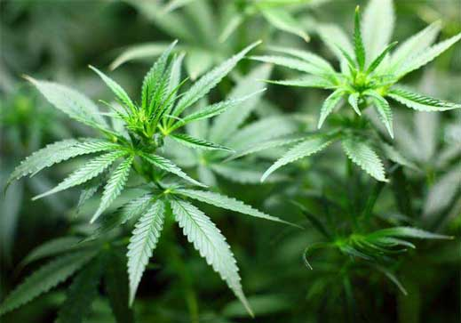
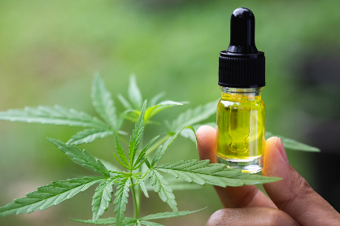

Chemicals, agriculture, food and health
Agroprocessing Cannabis
The problem
Legislation is paving the way for the declassification of hemp as an illegal crop, and potentially cannabis (dagga) as well, but current bulk production is illegal, and farmers do not have access to value adding technology
The opportunity
Cannabis production in Africa is estimated to be 38,000 tons per year despite the fact that it is illegal in most countries.
South Africa is the third largest producer of cannabis in the world (2,500 tons per year). 900,000 farmers who grow cannabis; 350,000 traditional healers who grow their own cannabis for medical reasons
CSIR intervention/contribution
Facilitate farmer participation in main stream economy once licensed
Infrastructure for fibre processing in Port Elizabeth
Cannabis oil extraction capabilities, including analytical capabilities
Enhancing water solubilisation of cannabinoids
Encapsulation of cannabinoids
Current Status
Fibre processing facility business plan developed in partnership with Coega IDZ for dtic and National Treasury consideration
Successful cannabinoid-based products at lab scale
Ready for piloting and testing

Slide 28
SO2:
Improve the competitiveness of high-impact industries to support SA’s re-industrialisation, by collaboratively localising, developing and implementing technology

Slide 29
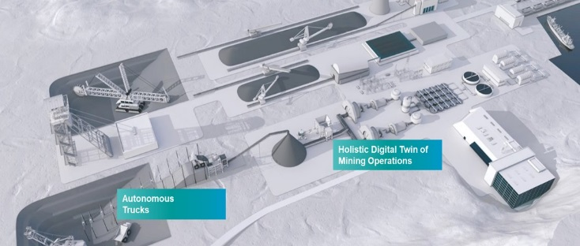
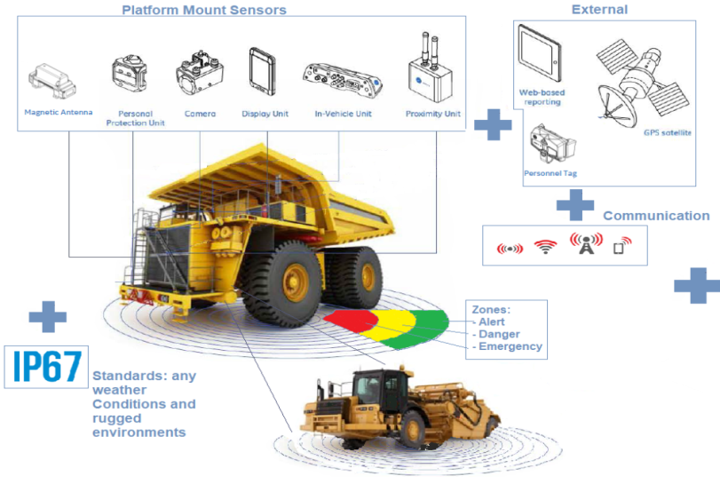
Mining, manufacturing, defence and security
Collision avoidance technologies and modernisation in mining
The challenge
Transport fatalities and inefficient operations of trackless mobile machinery in mining
Technology intervention
The Minerals Council and the CSIR are investigating locally produced collision-avoidance systems to address this problem
The modernisation of SA’s mining operations has the potential to unlock R153 bn in value by 2026, which would translate to an increase of 2% to SA GDP
The CSIR has mobilised capabilities to:
  Develop and demonstrate digital simulation technologies for cost-effective collision-avoidance systems
  Maximise local content in collision-avoidance system development, manufacturing and deployment
  Build technical capability for full product life cycle that is locally produced in SA

Slide 30
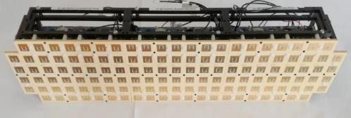
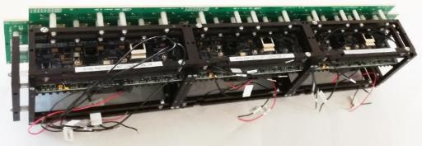
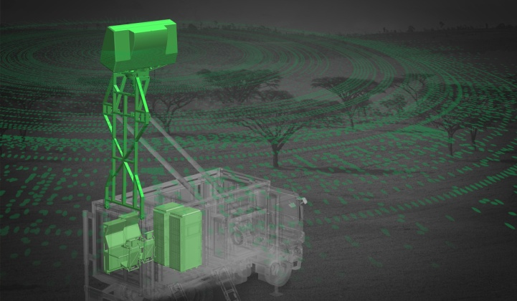
Mining, manufacturing, defence and security
CSIR partners with Hensoldt, a world-class global radar company
The challenge
Harnessing a traditionally strong in-country advanced electronics capability to grow radar industry and exports. Industry has struggled to significantly access the global defence markets and has been declining due to diminishing local opportunities
CSIR intervention
Partner with Hensoldt GmbH (Germany), a strong international player, utilising CSIR’s technology and radar capability to jointly develop a next generation 3D search radar to replace Hensoldt’s successful existing TMRL 3D/TRS 3D products in their portfolio.
Hensoldt Germany is utilising this as the vehicle to establish an RSA radar business unit under its existing Hensoldt SA company that will manufacture and export the product, utilising Hensoldt’s global sales force.
Status
The CSIR and Hensoldt SA have signed:
  A development agreement to jointly develop the radar using foreign direct investment from Hensoldt Germany.
  A licensing agreement to enable Hensoldt South Africa to commercialise the product, resulting in royalties to the CSIR.
In parallel, a joint CSIR-Hensoldt SA product team has in 2020 completed the System Requirements and Preliminary Design phases of the development.
CSIR low-cost phased array technology, one of the key CSIR technologies enabling this radar
Design of radar product resulting from joint preliminary design in 2020

Slide 31
SO3:
Drive the socioeconomic transformation through RD&I which supports the development of a capable state

Slide 32
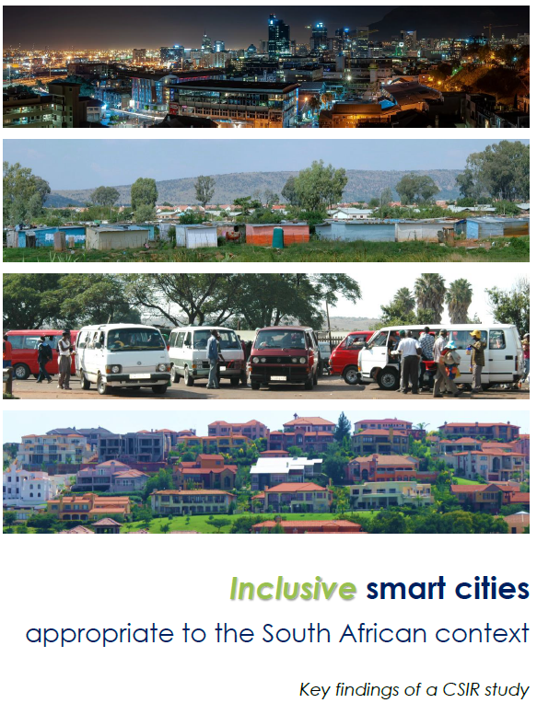
Natural resources, enabling infrastructure, public and professional services division
Inclusive smart cities appropriate to the South African context
The challenge:
Municipalities are under increasing pressure to become ‘smarter’, but it is not always possible to access impartial, factual information about smart cities and technologies. Many private companies have vested interests and don’t provide reliable advice.
Intervention:
The CSIR is assisting CoGTA with the development of 'A South African Smart Cities Framework: A decision-making framework to guide the development of smart cities in South Africa”.
The CSIR team is developing a smart-readiness assessment tool.
This will help municipalities to prioritise interventions and reduce the possibility of fruitless expenditure on smart technologies that may not be appropriate.

Slide 33
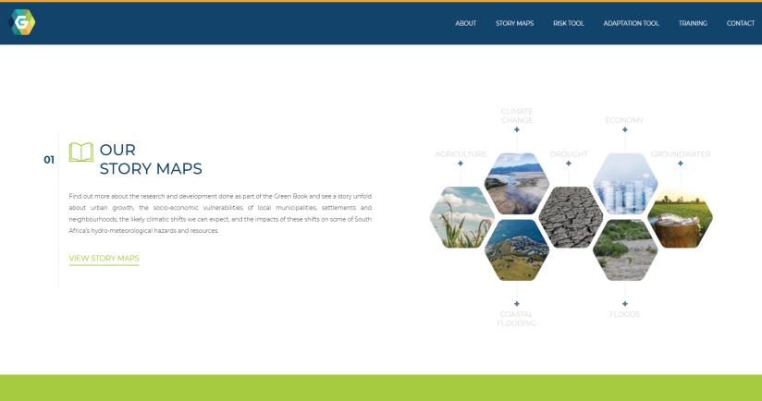
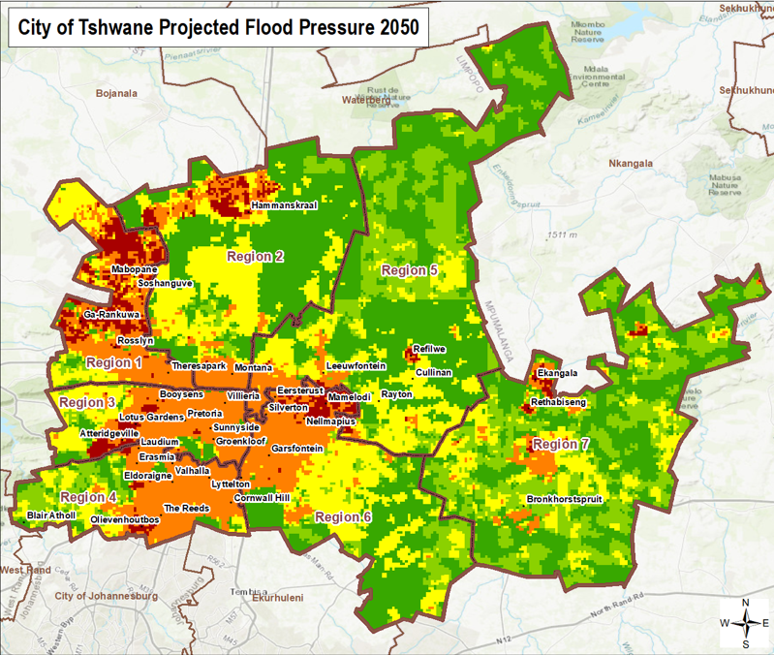
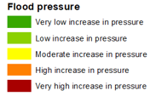
Natural resources, enabling infrastructure, public and professional services division
GreenBook: Advanced spatial analysis and modelling
www.greenbook.co.za
The focus is to provide planning support to municipalities on climate adaptation.
The goal is to develop the capability to support local government in evaluating risks to and vulnerabilities of human settlements given climate change and to adapt planning practices to be more climate resilient.
Climate change and the resultant extreme climate events are recognised as a major risk to human settlements. When municipalities do planning as it relates to long-term land-use planning, as well as shorter-term capital investments, it is increasingly important to consider the implications of climate change on built-up areas and determine what cities can do now to see to it that they are (more) climate resilient in future.

Slide 34
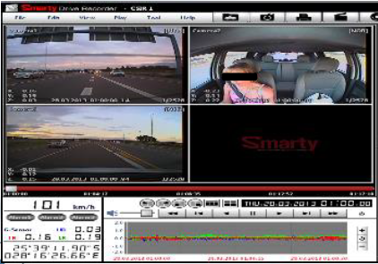
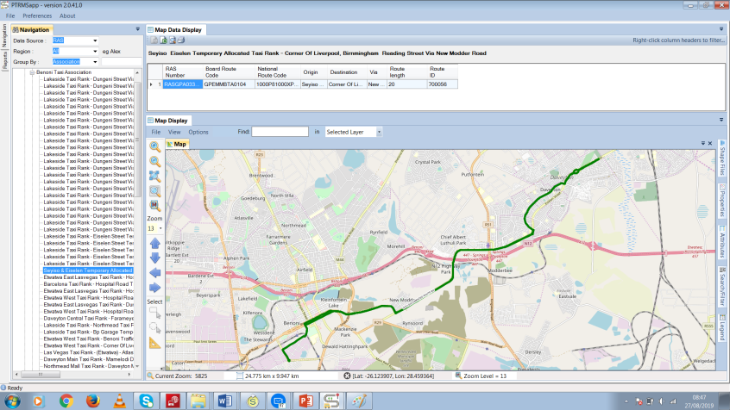
Natural resources, enabling infrastructure, public and professional services division
Crash risk modelling and public transport data portal
Naturalistic Driving Studies
Improved modelling of crash risk, from a driver perspective to improve road safety
Driver behaviour is a leading cause of crashes.
Installing equipment in vehicles enables the study of hazard perception, distracted driving, handling skills, etc.
Public Transport Data Portal
Creation of a relational public transport database with value-added data analytics
All public transport data sets collated include:
  Minibus taxi routes, facilities
  Gauteng Subsidised Bus Routes
  Household Travel Survey
Enables integrated public transport planning

Slide 35
SO4:
Build and transform human capital

Slide 36
Build and transform human capital
Strategic Initiative
Focus and impact
Targeted at undergraduate and postgraduate students to increase the pool of highly qualified individuals in STEM fields.
CSIR partnership with DSI, NRF and merSETA.
580 students sponsored
Bursary Programmes
Holistic development of recent graduates to attain professional registration in their areas of expertise.
Currently have 46 graduates on board who are mentored by CSIR experts.
Graduates-in-Training Programme
CSIR and merSETA partnership
Develop a Learning Factory to facilitate the development of skills through learnerships and internships
There are currently 40 interns supported within the CSIR.
Technical skills development through Learnerships and Internships

Slide 37
Build and transform human capital
Strategic Initiative
Focus and impact
Develop and impart skills, as well as create job opportunities for unemployed youth.
The CSIR is the first SOE to participate in this programme and has 66 youth onboard that provide STEM services to schools and municipalities.
Youth Employment Service Initiative
Develop a pool of African SA chief researchers to become internationally recognised experts in their field of research.
The CSIR has invested in 10 researchers, (50% females) to equip and qualify as Chief researchers in the next 5 years.
Accelerated Researcher Development Programme
Training of junior, middle and senior leaders in key competencies that will assist the organisation to deliver on its strategy and values.
Leadership and Management Development Programme

Slide 38
Build and transform human capital
Build and transform human capital
Risk
The ability to remain competitive in the market because of restrictions from National Treasury in terms of remuneration-related matters.
Effects on the wellbeing and productivity of staff.
Pandemic’s rapid spread and the negative impact on the local and global economies, as well as threat to human life.
National and global lockdown of economic activity due to the coronavirus.
COVID-19

Slide 39
SO4:
Infrastructure Investment

Slide 40

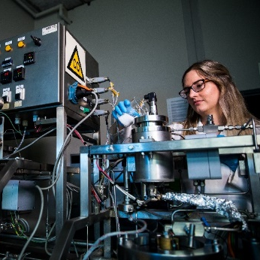
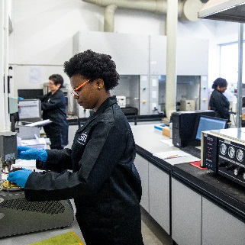
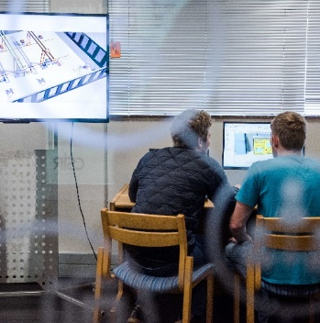
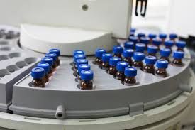
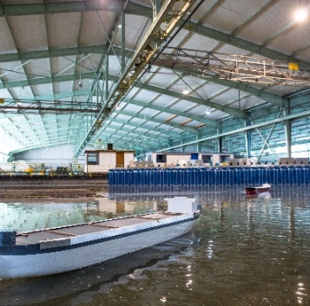
National Treasury and DSI-funded infrastructure
The Supercritical Carbon Dioxide Encapsulation Facility
Advanced Material (Road) Testing Laboratories
The Learning Factory
Pharmaceutical Innovation Platform
Coastal and Hydraulics Laboratory

Slide 41
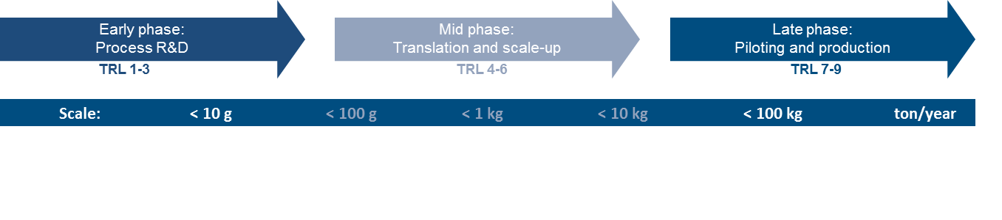
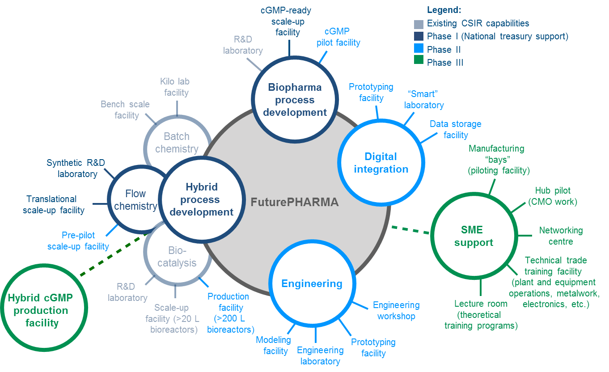
Strategic infrastructure to support local pharmaceutical production
Synthesis 4.0 manufacturing hub: Pharmaceutical technologies
The problem
Lack of local production capacity for pharmaceuticals
Pharmaceuticals 5th largest contributor to trade deficit
Linked security of supply risk for the country
The technology intervention
An integrated open access facility that focuses on research translation and the production of clinical grade materials for early clinical development
The opportunity
Combined batch, biocatalytic and flow processing, full continuous flow processing
Fermentation technology and bio-production of enzymes/proteins/antibodies
Plant-based expression systems for vaccines and antibodies
Improve performance by blurring the lines between the physical and digital to make production processing more automated, modular and responsive
Current status
The CSIR has integrated relevant capability in the BIDC: Batch processing (lab -> kilo lab -> pilot chemical / bioreactors), CNSM: Analytical characterisation and nano-formulation
R75 million National Treasury investment in the current MTEF

Slide 42
SO5:
Diversify income, maintain financial sustainability and good governance

Slide 43



Maintain financial sustainability
Diversification opportunities
Commercialisation strategy – generate more revenue out of IP and technology
R&D partner of choice for SOEs, government departments and municipalities
Optimal space utilisation on CSIR campus
Maintain financial sustainability
Diversify income (via commercialisation of technology, engagement with private sector and participation in international endeavours to strengthen other funding streams
Continue to implement stringent cost-containment measures
Optimise the debtors collection function
Good Governance
Maintain clean Audit Report
Maintain compliance with PFMA and other legislation

Slide 44

Maintain financial sustainability
Support from Shareholder
Investment requirements for implementation of strategy – R5 billion to support strategic infrastructure and modernisation
Continued support to the CSIR to be preferred supplier for strategic solutions to state in line with mandate
Additional guarantees for foreign revenue generation – R200 million
See R&D as investment in future competitiveness and not as an expense
Increase % of R&D spending as a proportion of GDP
Risks
Declining PG in both nominal and real terms
Increasing debtors and doubtful debts
Reduced liquidity
Current state of the economy

Slide 45
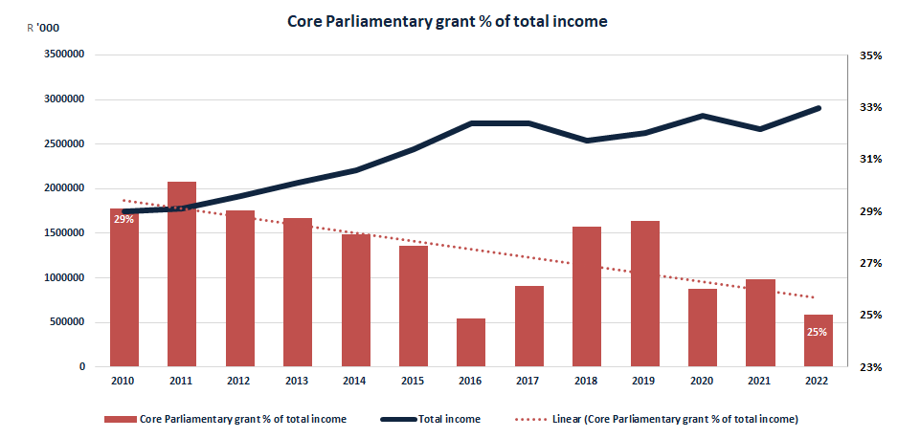
Maintain financial sustainability

Slide 46



Maintain good governance
SHEQ focus remains on safe operation conditions due to continued impact of COVID-19
SHEQ functionality and model continued focus on enhanced maturity and responsiveness to risks
  COVID-19
  Increasing industrialisation
CSIR launched an initiative to measure National Greenhouse Gas Emission Reporting Regulations
  Continued improvement of data integrity and emission reduction
RIR target reduced from 2 to 1.8
SHEQ
B-BBEE audit achieved a Level 2 B-BBEE certification
YES Programme significant contributor
On target to maintain Level 2
B-BBEE

Slide 47
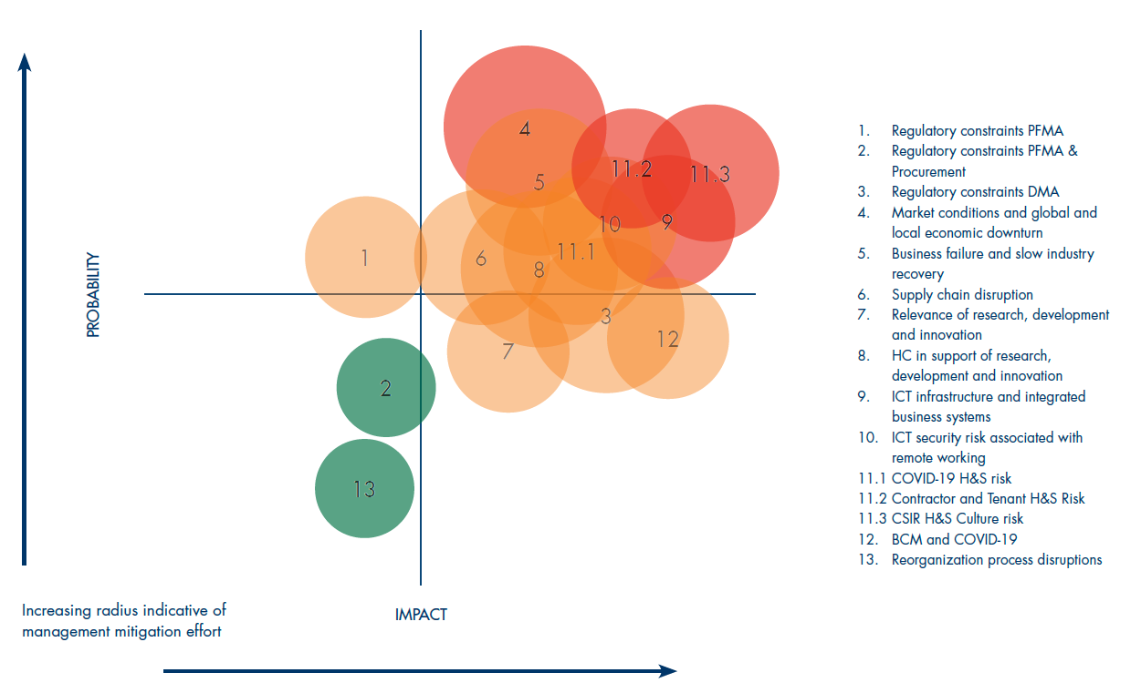
Maintain good governance
Risks
Bottom up and top down risk identification and mitigation
Benchmark WEF/IRMSA top economic risks mapped for organisations post COVID-19 onset

Slide 48
THANK YOU

