Slide 1

State of Provincial Finances: North West Province
National Treasury | 31 May 2021

Slide 2
Overview
Budget and Expenditure
  Spending per department and economic classifications
  Conditional Grant spending
Procurement Irregularities
  Irregular, Fruitless and Wasteful as well as Unauthorised Expenditure
Conclusion

Slide 3
Budget and expenditure per department: 2018/19 to 2020/21

Slide 4
Budget and expenditure per economic classification, 2018/19 – 2020/21

Slide 5
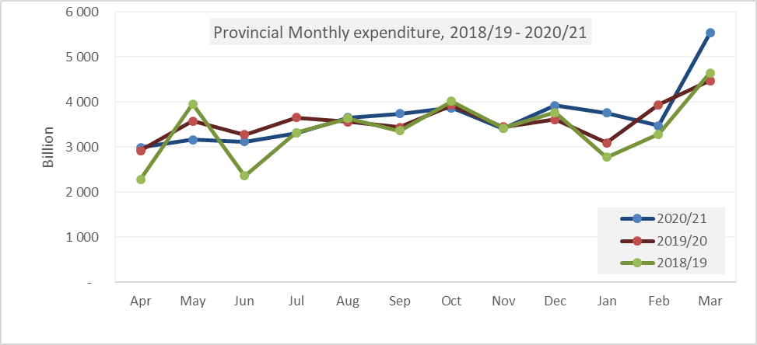
PROVINCIAL MONTHLY EXPENDITURE, 2018/19 – 2020/21

Slide 6
Budget and expenditure for health department: 2018/19 to 2020/21
  Department received additional R1.7 billion for COVID-19 response;
  Spending on COVID-19 has been quite slow
  Health records preliminary expenditure of R14.052 billion or 98.99 per cent, underspending by R143.977 million against the allocation of R14.196 billion. With COE overspending and payments of capital assets underspending.
  The initial additional beds planned at West Vaal, Duff Scott and Maseve Hopsital were not reached given the staffing challenges. However, the current assessment revealed that there were enough beds based on the demands over the past 6 months.

Slide 7
Budget and expenditure for EDUCATION department: 2018/19 to 2020/21
  Learner Teacher Support Material(LTSM) expenditure started to pick during last month of financial year due to slow purchasing processes during the year.
  COVID-19 response was allocated an amount of R435.011 million, of which 82.8 per cent has been recorded as expenditure.
  Sanitary Dignity Project spending is at R7.288 million against the allocation of R16.427 million, registered under expenditure of R9.139 million.
  Presidential Employment Initiative had allocation R445.251 million, of which R427.081 million have been spend.
  Procurement of laptops, office furniture, sports and recreation equipment for schools that were placed on hold are being revived;

Slide 8
Budget and expenditure for Office of the PREMIER: 2018/19 to 2020/21
  OTP budget was reduced by approximately R231.438 million since tabling of the 2020/21 Main Appropriation and this resulted in reduction in underspending when compared to last financial year.
  Budget reduction affected the ITC transformation projects which are now deferred to the next financial year;
  The training as per the workplace skills plan is pended to the 2021/22 financial year. The HRM unit will arrange free online training for officials who urgently need training.
  Delayed filling of identified critical posts

Slide 9
Budget and expenditure for COMMUNITY SAFETY AND TRASNPORT MANAGEMENT department: 2018/19 to 2020/21
  The spending on Scholar Transport as at end March 2021 amounts to R274.347 million or 94.10 per cent, worth-noting is that the department still has outstanding accruals for scholar transport service providers.
  Scholar Transport expenditure for the current year was restricted given that not all grades were granted permission for schooling;

Slide 10
Budget and expenditure for PUBLIC WORKS AND ROADS department: 2018/19 to 2020/21
  Public Works and Roads records preliminary expenditure of R3.282 billion or 97.88 per cent, underspending by R70.936 million against the allocation of R3.353 billion.
  Provincial Roads Maintenance Grant registered a significant increase in spending from the low spending over the preceding months to 99.93 per cent or R1.264 billion from the allocated R1.265 billion.

Slide 11
Conditional grant expenditure, 2018/19 – 2020/21

Slide 12
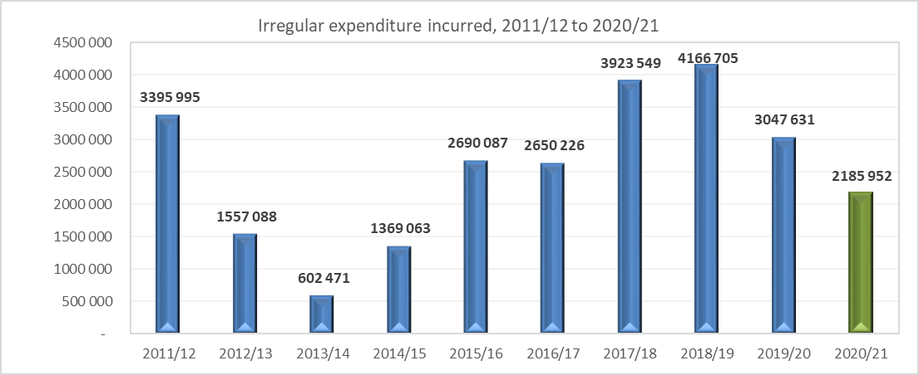
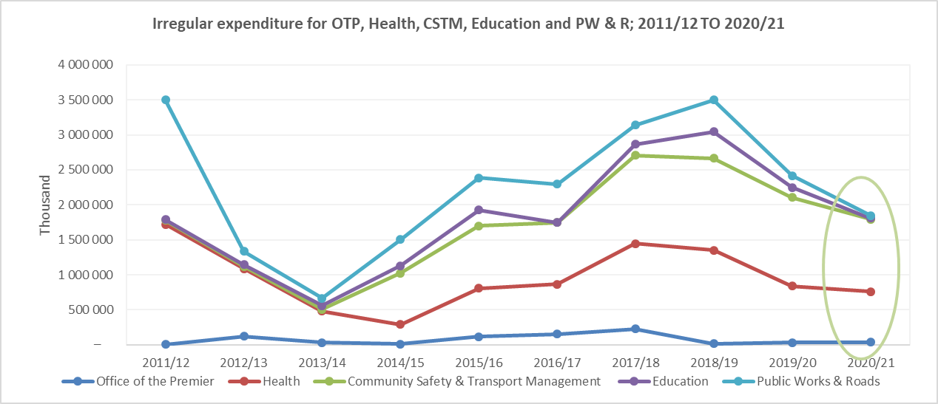
Irregular expenditure, from 2011/12 to 2020/21

Slide 13
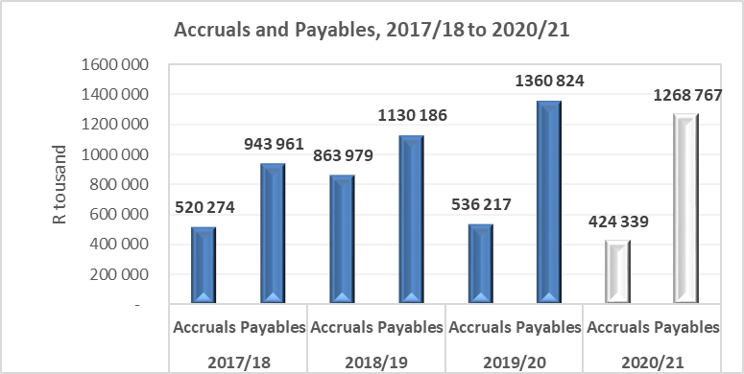
Accruals and Payables, 2017/18 – 2020/21

Slide 14
CONCLUSION
It is recommended that the Committee notes:
The North West Province Financial position remains healthy even after some budget cuts to cater for COVID19 and improved spending as at end of 2021/21 financial year;
Improvements towards achieving budget credibility and increased funding for social sector departments like Health;
Slight reductions in annual recording of Irregular, Unauthorised, Fruitless and wasteful expenditure by departments under Section100(1)(b) of the Constitution of South Africa;
That the National Treasury is concerned about poor performance on Conditional Grant spending by departments like Education, Public Works and Roads and Human Settlements;
Departments need to improve infrastructure (IDMS) governance structures and capacitate the SCM units;

Slide 15
.
THANK YOU

