Slide 1



FIRST & SECOND SPECIAL REPORT
28 May 2021

Slide 2



MISSION
“The Auditor-General of South Africa has a constitutional mandate and, as the Supreme Audit Institution (SAI) of South Africa, it exists to strengthen our country’s democracy by enabling oversight, accountability and governance in the public sector through auditing, thereby building public confidence.”
VISION
“To be recognised by all our stakeholders as a relevant Supreme Audit Institution (SAI) that enhances public sector accountability.”
VALUES

Slide 3
INTRODUCTION

Slide 4
The role of the Auditor-General of South Africa
We have undertaken a comprehensive, multifaceted and risk-based audit of the key initiatives introduced by government and the management of the multibillion rand in funds made available. Our objective with this Covid audit is not to disrupt or stand in the way of the good work that is being done; our role will be to enhance the public confidence that government funds and interventions have reached its intended targets.

Slide 5
The Covid-19 audit is a real-time audit with 3 components
Prevention
Detection (audit)
Reporting
Building on our strong stakeholder relationships and processes, we had engagements with accounting officers/authorities and executive authorities on the need for preventative controls to be implemented or strengthened to address the increased risks and significant changes in operations.
We are testing the implementation of the preventative controls (including automated controls) and report any remaining risks to accounting officers/authorities, with recommendations on closing the gaps.
We identify high risk transactions, payments, procurement and processes using a risk identification process enabled through data analytics and a deep understanding of the environment.
We audit the high risk items – the procedures are dependant on the nature of the matter being audited (e.g. emergency procurement or grant payments).
We report any findings to the accounting officers/authorities as soon as they are identified so that they can address the finding and fix any control weaknesses identified before additional payments or distributions are made.
We will be reporting on our work and the outcome thereof as well as the responses by the accounting officers/authorities to any weaknesses identified in special reports tabled in Parliament.

Slide 6
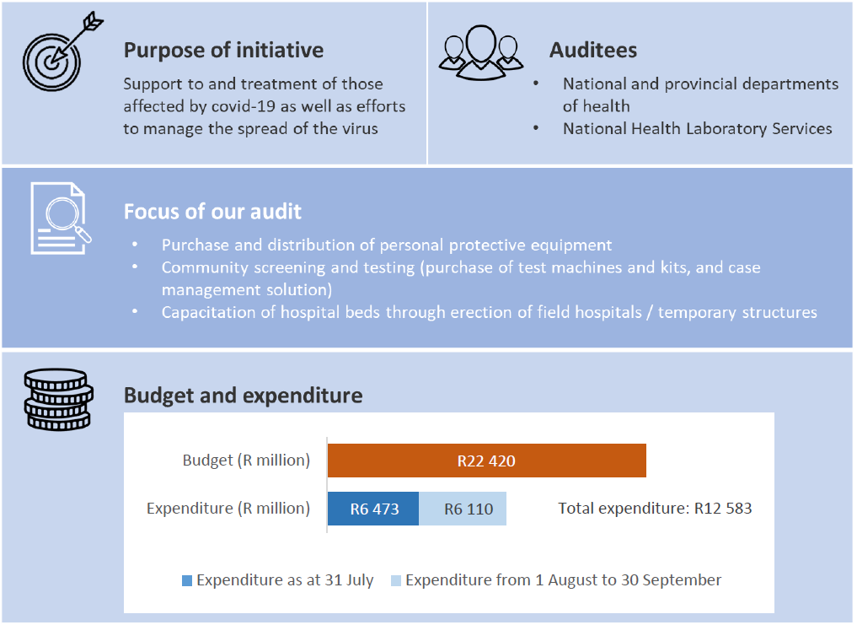
Healthcare Services

Slide 7
The role of the Auditor-General of South Africa
Main focus areas
Sub-focus area
Purchase and distribution of PPE
Procurement Process
Recording
Storage
Distribution
Community screening and testing
Community Testing
Case management solution
Capacitation of hospital beds through erection of field hospitals
Procurement Process
Construction and Commissioning
Decommissioning
Other Expenditure
Procurement Process

Slide 8
KEY AUDIT OBSERVATIONS

Slide 9
SECTION A:
Procurement and contract management

Slide 10
Personal Protective Equipment (PPE) for Healthcare workers
A few examples from Special Report (SR) 1
Finding No. in SR 1 | Detailed audit findings | Province
1 | PPE items not ordered at prices regarded by the National Treasury as market related Seven of the nine provinces ordered PPE items from suppliers at prices in excess of the maximum prices prescribed by National Treasury. | EC, GP, KZN, MP, NW, NC, WC
3.1 | Specifications not indicated on awards and submissions When we assessed the awards, submissions and delivery notes in relation to goods delivered, we noticed that no mention was made of the actual specifications that had to be complied with for the goods to be delivered, as required by instruction note 8 of 2019-20 paragraph 3.7.6. | KZN, GP
3.3 | Goods received and accepted other than those ordered: PPE of inferior quality accepted other than those ordered and paid for (KZN). Goods were received and paid for by the department that were not the same as the ones specified in the original order documents (GP). same price paid for smaller units delivered and accepted than those ordered (KZN) | KZN, GP
3.4 | Transactions noted with tax-related discrepancies transactions entered into with suppliers who are not tax compliant at order date (KZN) transactions entered into with suppliers who are not tax compliant at order date (GP) | KZN, GP

Slide 11
Personal Protective Equipment (PPE) for Healthcare workers
A few examples from Special Report (SR) 2
Finding No SR 2 | Description of finding | Province
1.1 | Reasons for deviation from supply chain management prescripts, not recorded and/ or approved as per the approved delegation of authority, as required by treasury regulation 16A6.4 | EC, GP, NC, NW
1.3 | Goods procured at prices higher than National Treasury Instruction Notes As reported in the first special report, departments did not always adhere to the instruction notes issued by the National Treasury, as they continued to order PPE items at prices in excess of the maximum prices prescribed by the National Treasury. | GP, KZN, NW, WC
1.4 | Non-compliance with local content requirements The winning service providers did not submit a declaration on local content | KZN, MP, NC
1.5 | Specifications not indicated on quotations and submissions As reported in the first special report, when we assessed the awards, submissions and delivery notes in relation to goods delivered, we noticed that no mention was made of the actual specifications that had to be complied with for the goods to be delivered, as required by instruction note 8 of 2019-20 paragraph 3.7.6 | EC,GP, KZN
1.9 | Limitation of scope – procurement information requested not submitted for audit | FS, GP, KZN, MP

Slide 12
Temporary quarantine facilities & field hospitals
A few examples from Special Report (SR) 2
Finding on SR 1 | Detailed audit findings | Province
1 | Needs assessments and evaluation of major capital projects not performed Proper needs assessment, including a proper evaluation of major capital projects prior to a final decision, was not performed on some projects | KZN
2 | Declaration of interest (SBD 4) not included in procurement documents Declaration of interest forms were not included in the procurement documents, resulting in a limitation in the testing of compliance | KZN
An example from Special Report (SR) 2
Finding on SR 2 | Description of finding | Province
8.1 | Standard bid documentation was not included in procurement documents provided The required declarations of interest (SBD 4). Documentation to support that the awarded suppliers had not failed to perform in any previous contracts (SBD 8). Documents indicating whether the awarded suppliers committed corruption or fraud in competing for any previous awards (SBD 9). | DOH – KZN, DPW - GP

Slide 13
SECTION B:
Focus Areas

Slide 14
FOCUS AREA 1:
Personal Protective Equipment (PPE) for Healthcare workers

Slide 15
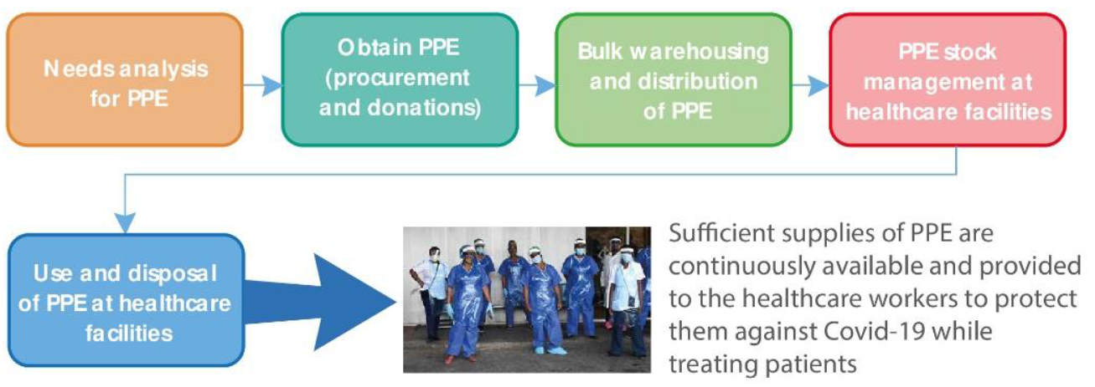
Value Chain- PPE
The value chain below includes the ideal chain of events from when the healthcare sector determines the need for PPE during the pandemic up to the time when sufficient supplies of PPE are continuously available at healthcare facilities and provided to healthcare workers to protect them against the Covid-19 virus while treating patients.

Slide 16
Key audit observations - Recording, storage and/or distribution of PPE
Finding on SR 2 | Description of finding | Province
4.1 | Systems and/or controls to account for PPE not in place or not effectively used at bulk storage and healthcare facilities We identified that, at nine bulk storage facilities and nine healthcare facilities in five of the nine provinces, systems and/or controls to account for PPE were not in place or, where they were in place, were not used effectively based on the requirements of the respective departments. | EC, KZN, MP, NC, NW
4.2 | PPE not distributed in a complete and/or timely manner to healthcare facilities Ten of the bulk storage facilities in eight of the nine provinces fulfilled some of the requests for PPE from the healthcare facilities in reduced quantities or not at all. | EC, FS, GP, KZN, LP, NW
4.3 | Poor storage practices at bulk storage and health care facilities PPE stock was not always stored according to the respective departments’ requirements to ensure efficient and effective storage. We found poor storage practices at 12 bulk storage facilities and 23 healthcare facilities in eight of the nine provinces | EC, FS, GP, KZN, LP, MP, NC, NW
4.4 | Limited security controls at bulk storage facilities At seven of the bulk storage facilities in four of the nine provinces, PPE stock was not always stored securely | EC, FS, NC, NW
4.5 | Ineffective quality assurance over PPE during receipt Some items of PPE received by the healthcare facilities in seven of the nine provinces did not meet the minimum required standards and/or specifications. | EC, FS, GP, KZN, MP, NC, NW

Slide 17
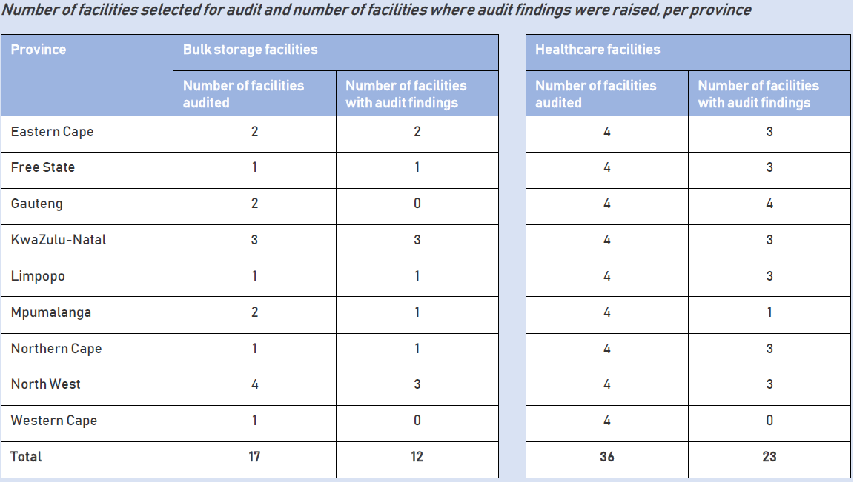
Poor storage practices at bulk storage and health care facilities
The table below shows the number of bulk storage and healthcare facilities selected for audit per province as well as the number of facilities where audit findings were raised:

Slide 18
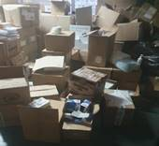
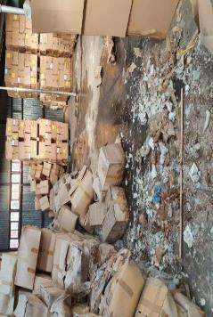
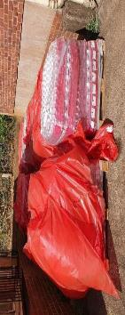
Poor storage practices at bulk storage and health care facilities - Examples
Picture 1: PPE stored in the walkways, outside the boxes and on top of each other in a disorderly manner.
Picture 2: PPE stock was stored at a temporary bulk storage facility and some healthcare facilities where the infrastructure was not well maintained and therefore in a poor condition. Instances were identified where the ceilings were not in a good condition due to water damage. Some of the PPE was damaged by water as indicated in picture 2.
Some PPE stock was stored outside a temporary bulk storage facility. Picture 3 shows sanitisers that were stored outside the facility that were exposed to the sun and rain. Some of these items were damaged due to exposure to direct sunlight, therefore its integrity/quality was compromised.

Slide 19
FOCUS AREA 2:
Community testing and case management solution

Slide 20
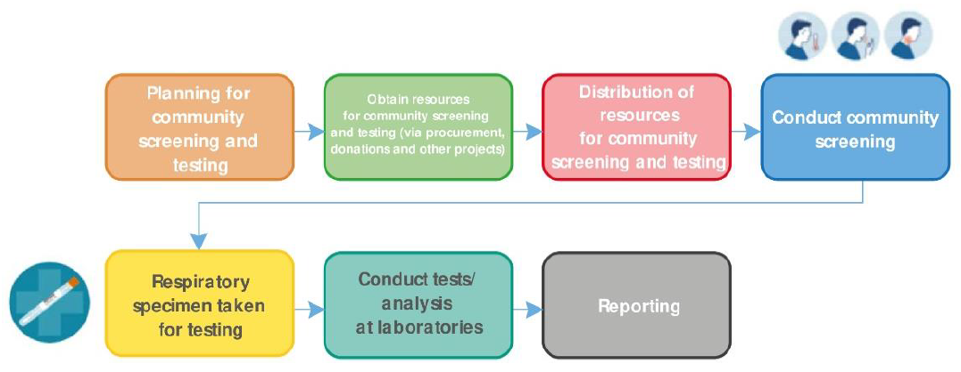
Value Chain- Community testing and case management solution
The diagram below summarises the process flow that we had planned to focus on:

Slide 21
Key audit observations
Special Report (SR) 1
Finding on SR 1 | Detailed audit findings | Auditee
2 | No provision for data backup management process in the service level agreement | NDoH
3 | No provision for change management process in the Service level agreement | NDoH
Special Report (SR) 2
Finding on SR 2 | Description of finding | Auditee
6 | PPE procured at prices higher than National Treasury instruction notes The NHLS procured some PPE items at prices in excess of the prices regarded by the National Treasury as market related | NHLS
7 | IT project management governance and system implementation controls deficiencies resulted in incomplete and inaccurate data Systems were implemented without clearly defined business and functional requirements. Project governance was not adequate for overall oversight and monitoring, including managing risks as they arose We were not provided with any evidence that some form of systems testing was performed before systems went live. | NDoH

Slide 22
FOCUS AREA 3:
Temporary quarantine facilities and field hospitals

Slide 23
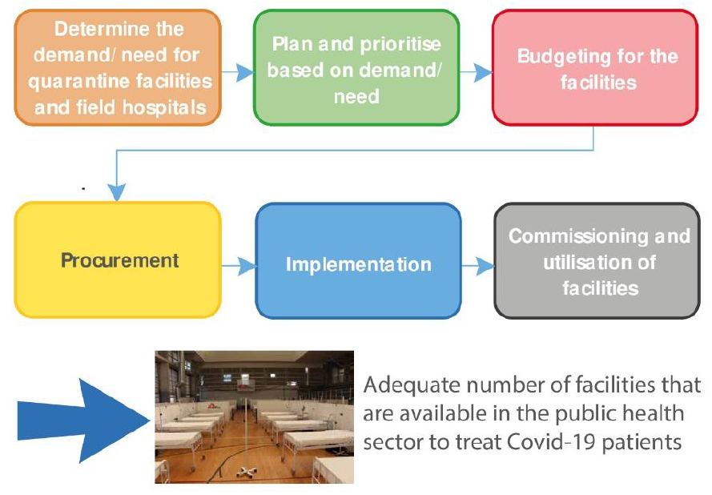
Value Chain - Temporary quarantine facilities and field hospitals
The value chain includes the ideal chain of events from when the public sector determines the needs for temporary quarantine facilities and field hospitals during the Covid-19 pandemic up to utilisation of these facilities.

Slide 24
Key audit observations
The following key audit observations were noted relating to implementation and commissioning
Finding on SR 2 | Description of finding | Province
9.1 | Free State: Bloemfontein Show Grounds | FS
9.2 | KZN: Clairwood Temporary Field Hospital | KZN
Notes:
9.1 Free State: Bloemfontein Show Grounds - Delay in completion of the field hospital
9.2 KZN: Clairwood Temporary Field Hospital:
9.2.1. Project cost – no evidence provided for approval and breakdown of project costs
9.2.2. Request for proposals invited from a limited number of suppliers
9.2.3. Project delays
9.2.4. Project snags/poor project quality

Slide 25
RECOMMENDATIONS & FOLLOW UP FROM SR1

Slide 26
Recommendations
PPE
Accounting officers must focus on the implementation of robust preventative controls. These preventative controls must be enforced and there should be zero tolerance for transgressions and consequence management in order to affirm accountability.
Departments must investigate unjustifiable awards of contracts fully and hold transgressors accountable. They should also fully disclose such instances as it relates to irregular expenditure and recover potential losses.
Community testing and screening, Case management
The accounting officer should ensure that governance and contract management of the case management system is strengthened.
Temporary quarantine sites and field hospitals
The accounting officer should ensure that there is more accountability with regards to the temporary quarantine sites and field hospitals.

Slide 27

SR 1 Findings, key commitments and follow up in SR 2
# | Province | Key commitments received
 |  | Implemented | In progress/ Not implemented
1 | Eastern Cape | The Eastern Cape DoH established a provincial contract specifically for covid-19 PPE to ensure that PPE was ordered at prices regarded by the National Treasury as market related. Long-outstanding orders with suppliers were cancelled and more recent orders were followed up frequently to ensure timely delivery. Also, a provincial pharmaceutical procurement unit was being established to, among others, centrally manage the procurement of PPE. | The department did not agree with all the identified control weaknesses in relation to the possible fraud risks, but has started improving some controls. In some instances, the control weaknesses have led to actual transactions, therefore, the CFO instructed that manual orders may longer be used. The completeness and accuracy of the asset register, as well as the appropriate classification of covid-19 expenditure, will be audited as part of the 2020-21 financial audit.
2 | Free State | N/A – commitments were in progress | The Free State DoH followed up on outstanding PPE orders on a weekly basis. If the delivery has been outstanding for more than 60 days, the orders placed with the suppliers were cancelled.
3 | Gauteng | The Gauteng DoH charged the procurement committees with the responsibility to ensure compliance with the National Treasury Instruction Notes. The supplier appointment letters were updated to reflect the agreed delivery dates. The accounting officer committed to institute disciplinary actions against implicated officials, which resulted in the suspension of the chief director: SCM and the acting chief director: SCM shortly afterwards. The accounting officer also subsequently tendered his resignation after being suspended by the premier of the province. | The acting HoD requested an extension to the end of November 2020 to provide commitments in addressing the issues noted. The accounting officer indicated that the department agrees with the control weaknesses identified in relation to the possible fraud risks reported, and is in the process of developing a response plan to address the control weaknesses. The plan will be made available to the AGSA by the end of November 2020, after which the adequacy and effectiveness of the control improvements can be evaluated.

Slide 28
SR 1 Findings, key commitments and follow up in SR 2
# | Province | Key commitments received
 |  | Implemented | In progress/ Not implemented
4 | KwaZulu-Natal | The KwaZulu-Natal DoH ordered PPE from suppliers with existing contracts, as far as possible, to ensure that PPE was ordered at prices regarded by the National Treasury as market related. To avoid extended lead times, the department also made it mandatory that suppliers confirm that they had PPE stock on hand when they submitted quotations. | The accounting officer indicated that potential fraud risks to the department's operations are viewed in a serious light and that detailed improvement plans will be developed by the end November 2020, after which the adequacy and effectiveness of the control improvements can be evaluated.
5 | Limpopo | Where a supplier could not deliver the required PPE within the agreed lead time, the order was automatically cancelled unless extension of the delivery period was specifically granted. | N/A – Commitments were implemented
6 | Mpumalanga & Western Cape | N/A - commitments were in progress | The Mpumalanga and Western Cape DoH continued to ensure compliance with the National Treasury Instruction Notes and they also continued to follow up on long-outstanding orders with suppliers.

Slide 29
SR 1 Findings, key commitments and follow up in SR 2
# | Province | Key commitments received
 |  | Implemented | In progress/ Not implemented
7 | Northern Cape | Since the previous report, the Northern Cape DoH had provided us with their corrective actions. | The department committed to ensure compliance with the national treasury instruction notes and their system relating to the management of PPE orders was strengthened.
8 | North West | The North West DoH ordered, as far as possible, PPE by using existing contracts to ensure that PPE is ordered at prices regarded by the National Treasury as market related. The department also reported suppliers that charged them inflated prices and those who were defaulting in terms of lead times to the provincial treasury. This department also followed up on long-outstanding orders and classified some suppliers as dormant once they did not supply PPE on time. | Although the department's risk register was updated to include covid-19-specific risks, the monitoring of preventative controls was still lacking. This, coupled with late payment of suppliers, resulted in some repeat findings in a number of areas, as reported later in the report.
9 | National Department | For the national DoH, the previous special report included findings without management commitments. A follow-up was performed on the findings from the review of the service-level agreement as reported, which revealed that the cost associated with software licences beyond 30 September 2020 was not clearly defined. Communication between the department and the service provider confirmed that although the service provider's services were extended beyond 30 September 2020, this was done at no extra cost to the department; therefore, addressing the risk of any potential additional system implementation costs. | N/A – Commitments were implemented

Slide 30
CONCLUSION

Slide 31
Conclusion
Overall, we have identified several control weaknesses and related findings throughout the health sector that materially impacted the quality and value for money of the services or products delivered, and communicated these to management. These had a significant impact on whether the funds allocated had actually been spent for the intended purpose, by the institutions involved.
A majority of the findings reported in the second report, were in progress at the time of tabling the first report. Repeat findings noted, were as a result of the slow response by management to implement the recommendations and commitments made, with appreciation that management were occupied with responding to the pandemic.
The accounting officers have committed to implementing a number of internal controls to address the significant deficiencies identified, with most accounting officers committing to suspending emergency procurement and reverting back to normal procurement processes, as well as ensuring that matters reported are followed up. These follow up actions should include investigations and consequence management, where applicable, for transgressions.

Slide 32
Conclusion
‘Even in the midst of a crisis, transparency and accountability for government spending to the benefit of citizens cannot take a backseat.’
The late auditor-general Kimi Makwetu

Slide 33
Our social media platforms

