Slide 1











COVID-19 Presentation
28 May 2021

Slide 2
Introduction
There has been sustained increase in the daily new cases for the three consecutive weeks in all provinces
As of 26th May
  Cumulatively of 1,645, 555 cases, recoveries 1,546, 583 (94.0%).
  There are 56,077 deaths (CFR 3.4%)
  There are currently 42 895 active cases (12% hospitalized)
  Test positivity rate is tending towards 10,1 %
Lessons from our second wave response highlighted the importance of early response to sustained increase in new cases.
Lessons from other countries underline the need to slow down transmission, facilitate vaccine penetration, and thus allow for the benefits to take effect – to avoid overwhelming the health system.

Slide 3
Average daily tests & proportion of positive tests
Lighter shade is an incomplete week
Cumulative number tests 4 Mar 2020 – 27 May 2021 = 11,495,627

Slide 4
Confirmed SARS-Cov-2 cases by province
(7-day moving average cases per 100,000 population – up to 27 May 2021)
5/100,000
Data source: Department of Health; Analysis: Cheryl Baxter

Slide 5
Confirmed SARS-Cov-2 cases by province
(7-day moving average cases per 100,000 population – up to 27 May 2021)
Gauteng
North West
National
Mpumalanga
Western Cape
Data source: Department of Health; Analysis: Cheryl Baxter

Slide 6
Temporal provincial trends in Covid-19 cases
GP
2.4
LP
0.4
GP
3.8
LP
0.6
GP
6.2
LP
0.6
GP
9.0
LP
1.0
MP
3.0
MP
1.3
MP
2.9
MP
3.8
NW
3.3
NW
4.8
NW
6.6
NW
7.7
FS
8.9
KZN
0.6
FS
12.0
KZN
0.8
FS
14.4
KZN
0.9
FS
14.6
KZN
1.1
NC
12.4
NC
20.8
NC
29.6
NC
33.8
EC
0.3
EC
0.4
EC
0.6
EC
1.1
WC
1.9
WC
2.6
WC
3.3
WC
3.6
10 May
17 May
24 May
3 May
Cases /100,000 /day
0-4.99
5 - 9.99
10 - 14.99
>15
Data source: SA DoH; Analysis: Cheryl Baxter

Slide 7
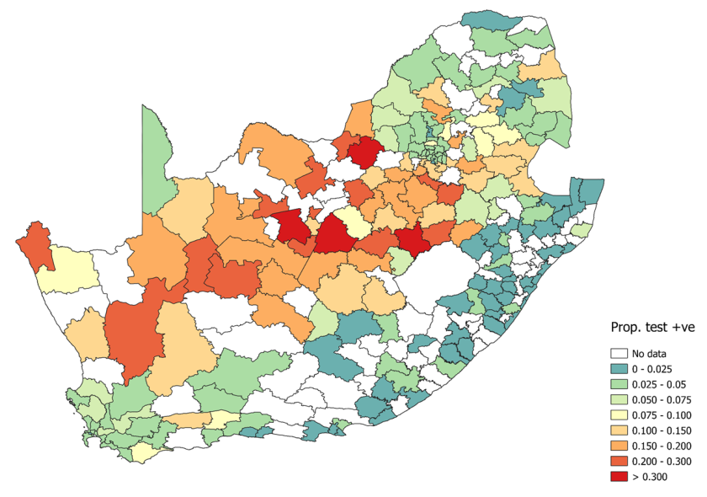
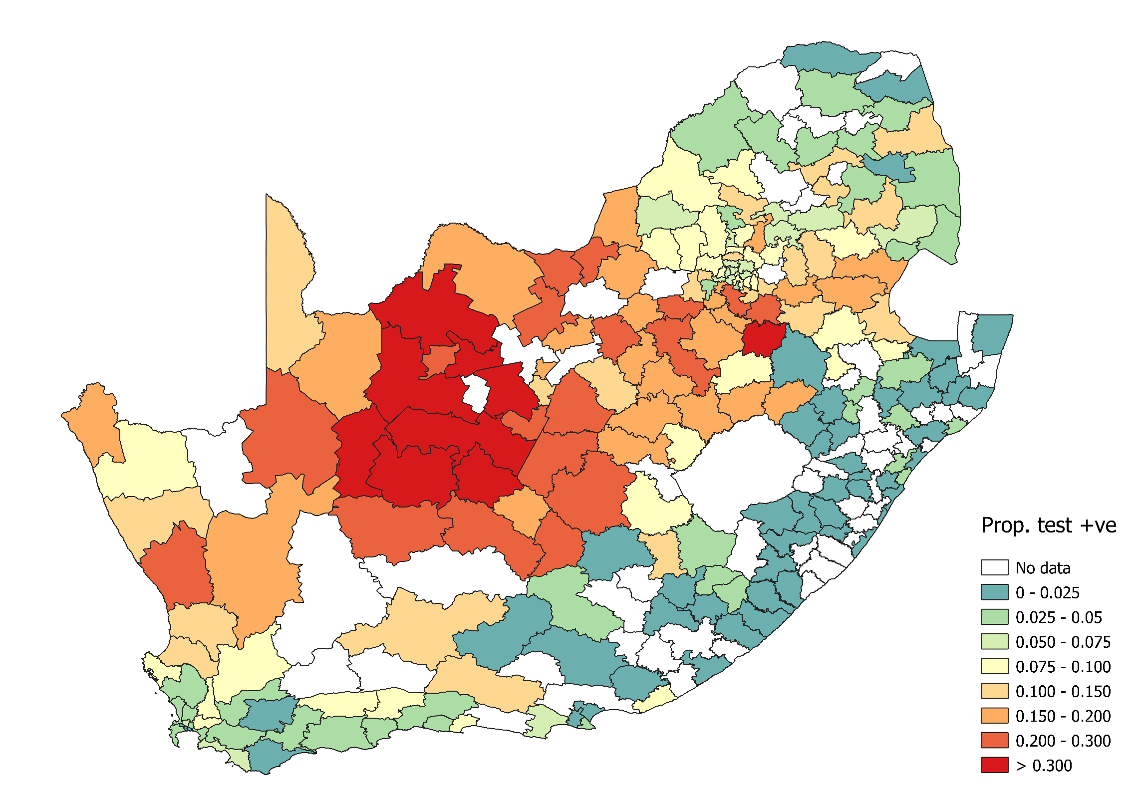
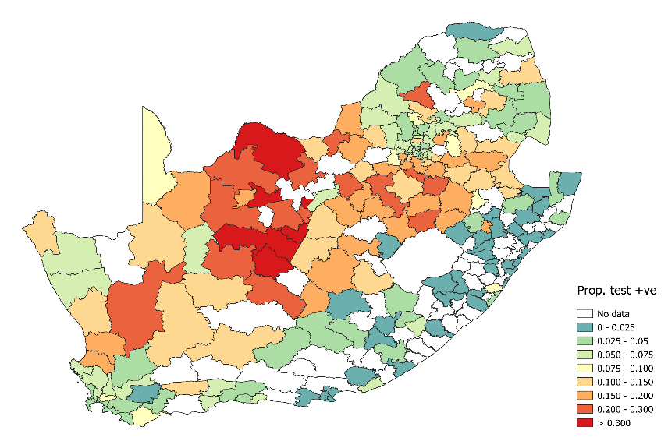
Proportion testing positive by health sub-district in South Africa for the week ending 15 May 2021 (week 19)
Week 17
Over the past weeks, districts with high proportion testing positive has been increasing
Week 19
Week 18

Slide 8
Status of resurgence indicators and triggers

Slide 9
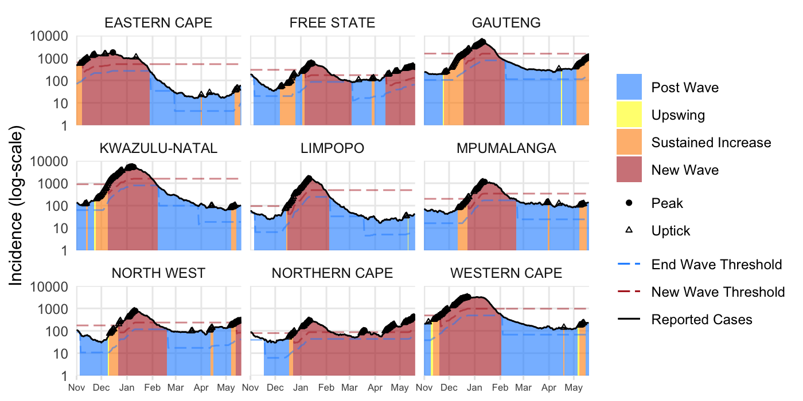
Provincial Overview of Sustained Increase & Wave Monitoring

Slide 10
Triggers for New COVID-19 Restrictions:
7 to 14 days advance warning
Metric under consideration: Test positivity ≥5% for ≥7 days
Nationally, as of the 21st May, the new test positivity rate has remained above the 5 % mark for 20 days (using the 7-day moving average) and daily positivity rate is almost 10%

Slide 11
Hospitalisation & Death Trends per province
As of 21 May 2021
In last 7-day Hospitalizations increased in all provinces except KZN & WC
Hospitalizations in the NC have surpassed the peaks of both the first and second waves in the province.
Hospitalizations in FS and NW are steeply trending upwards, with GP beginning to show similar trends
Hospitalizations are gradually increasing in EC, LP and MP
Deaths increased in 6 provinces in last 7 days

Slide 12
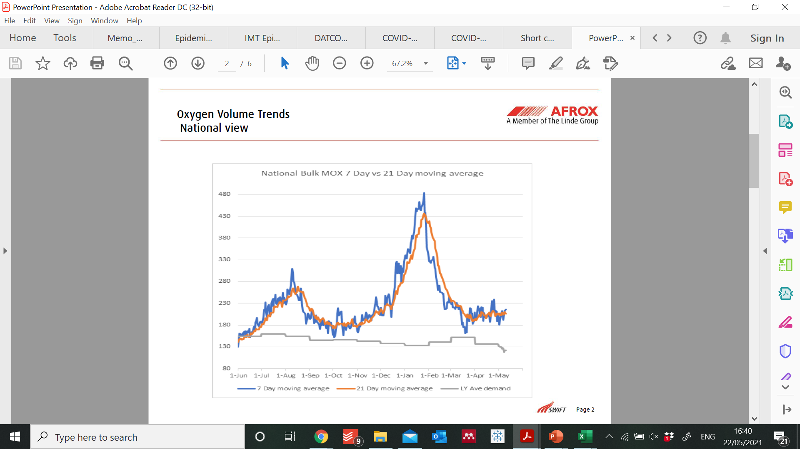
National Oxygen Volume Trends
At the national level: Oxygen demand is increasing both on the 7 day moving average and the 21 days moving average
Source:

Slide 13
Justification for urgent change in the restrictions
Epidemiological rationale
Sustained increase in new cases in last 14 days
Increased admissions
Increased positivity rate ( almost 10% at national level)
Drivers of the recent spike in cases transmission
Social gatherings without NPIs or following guidelines on numbers
Funerals and after tears parties
Clusters in schools( Matric Camps, sport camps)

Slide 14
Justification for urgent change in the restrictions
Health system capacity
Increasing admissions in 8 provinces
Behavioural and social
Increased complacency( low risk perception)
Increasing demand for Oxygen in the hospital
ICU capacity in NC already at stress levels
No adherence to NPIs( Not wearing mask, increased crowding)

Slide 15
Vaccine EVDS Registration and Roll-out Update

Slide 16
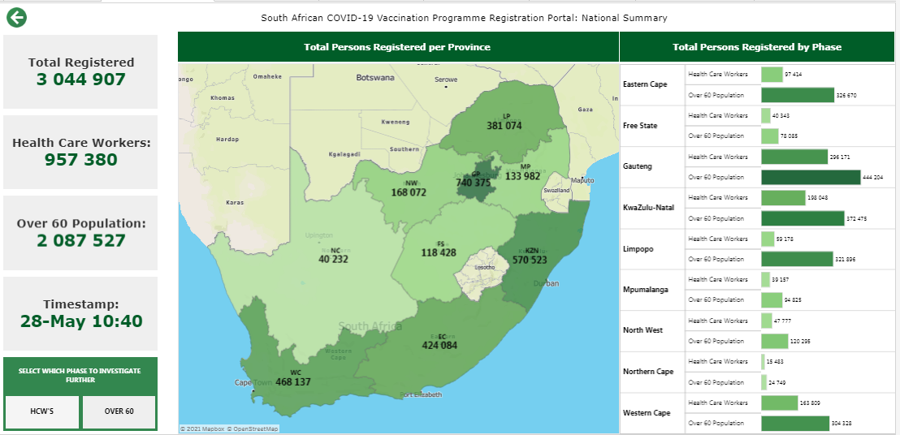
Registrations as at 28 May at 10h40

Slide 17
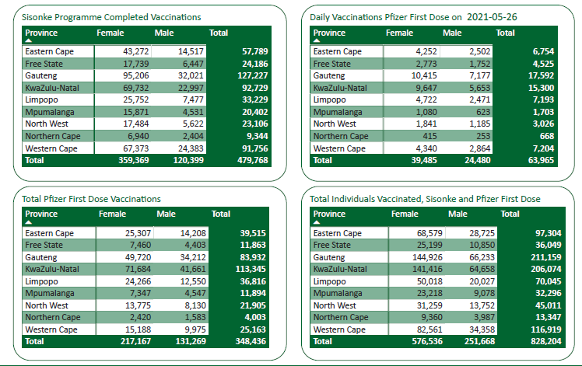
Vaccinations – As at Midnight on 26 May 2021
Disclaimer:
Data displayed in this Dashboard only contains vaccination records captured in the Electronic Vaccination Data System (EVDS) and excludes vaccination records captured on paper. Totals will be adjusted as back-capturing and data validation is done.

Slide 18
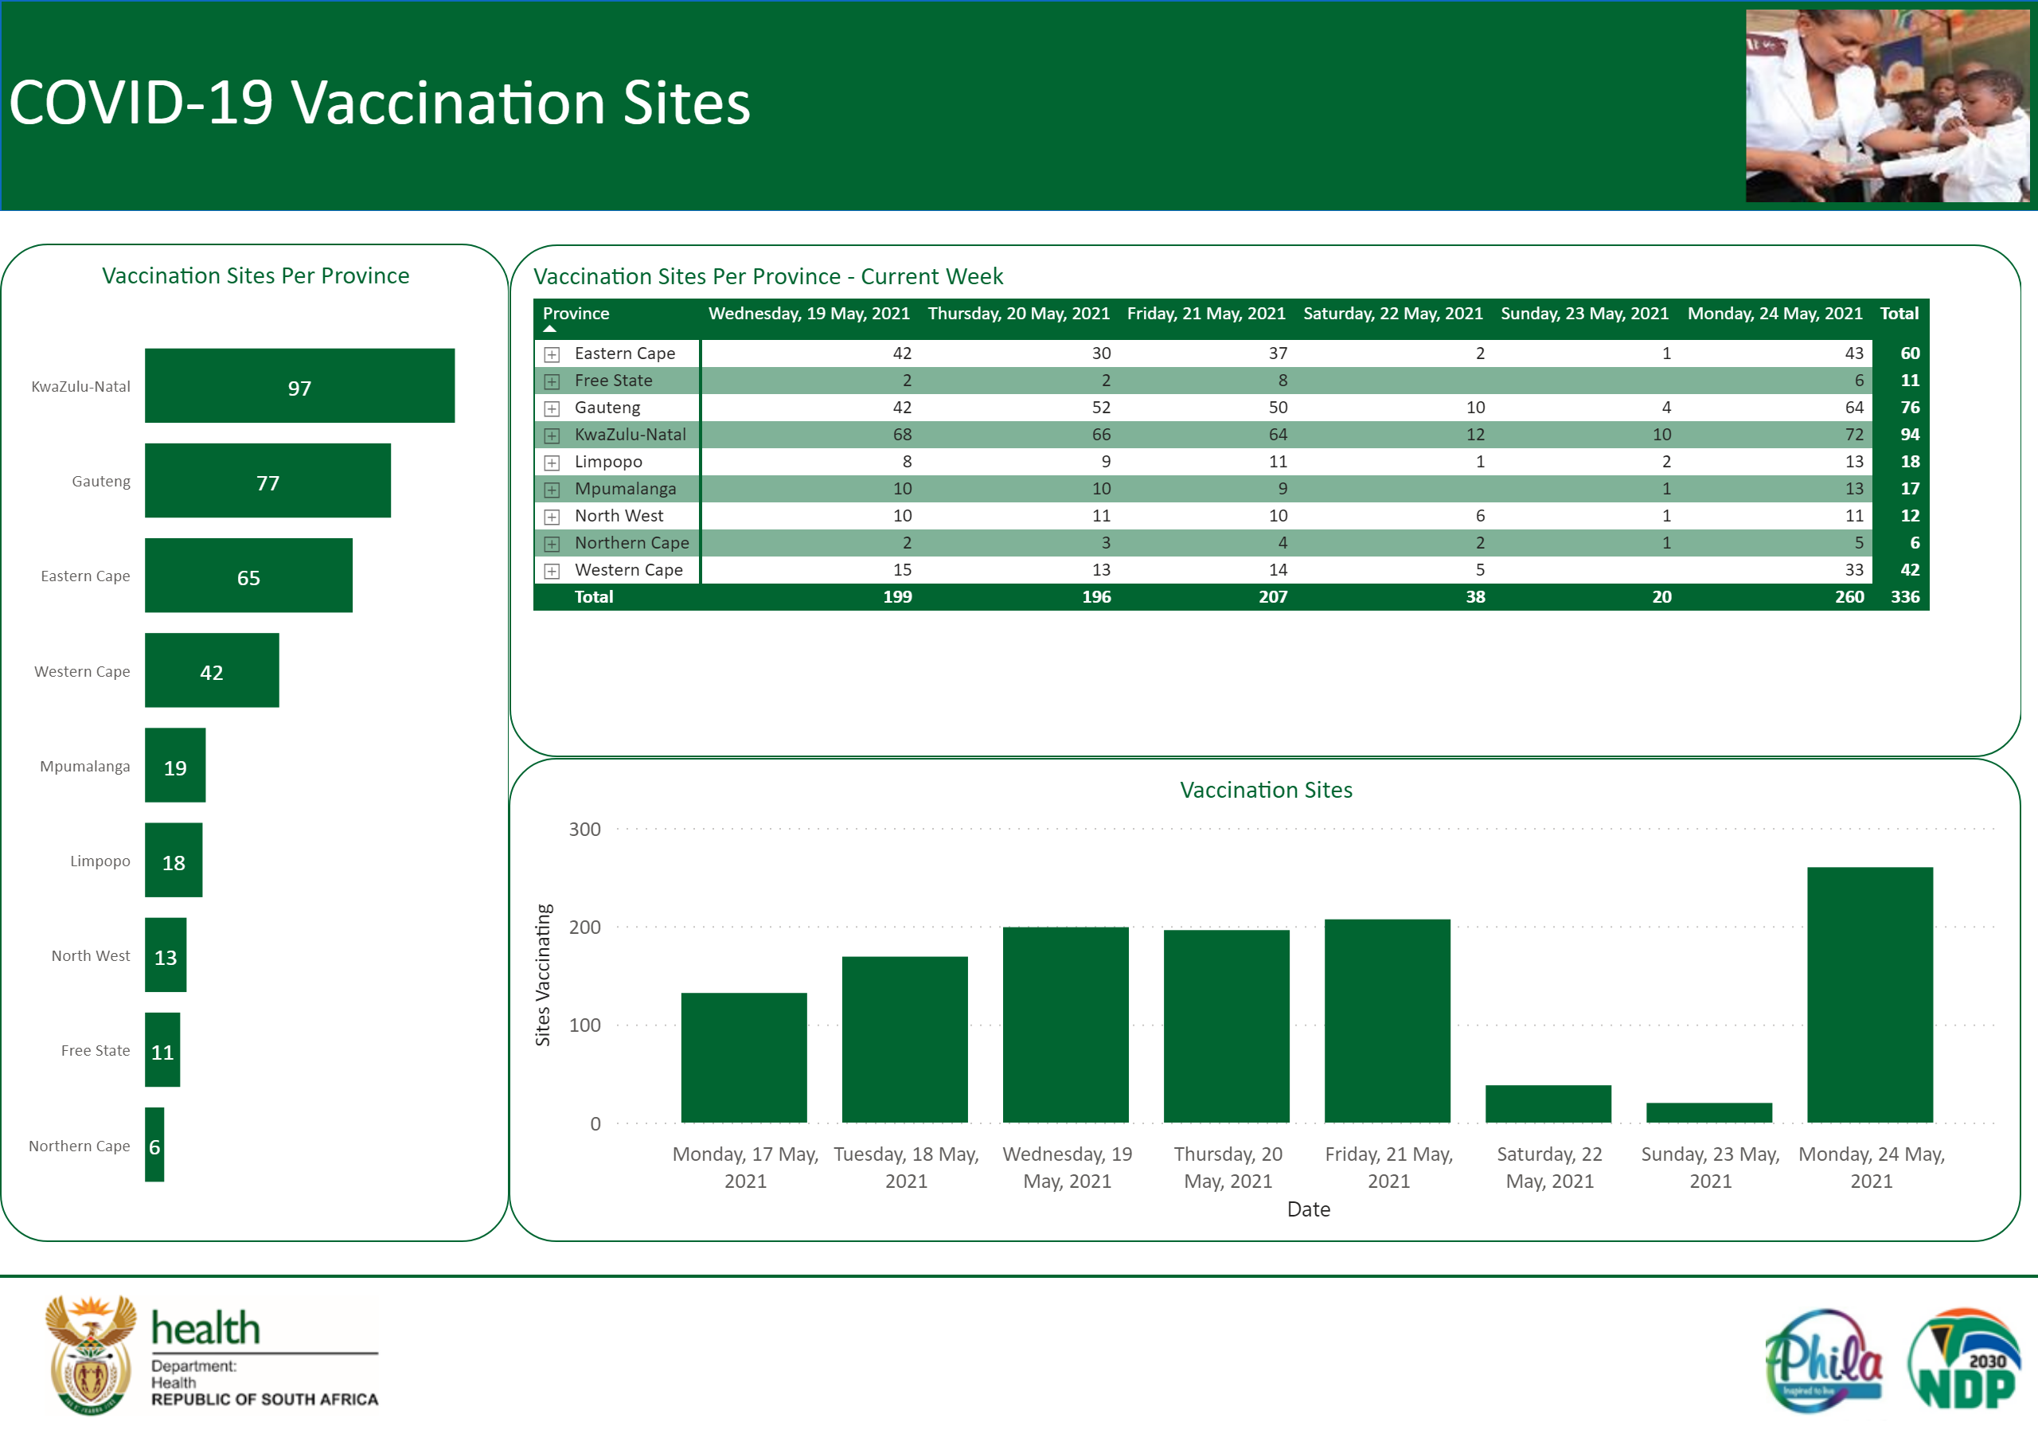
COVID-19 Vaccination Sites

Slide 19
Thank you

