Slide 1
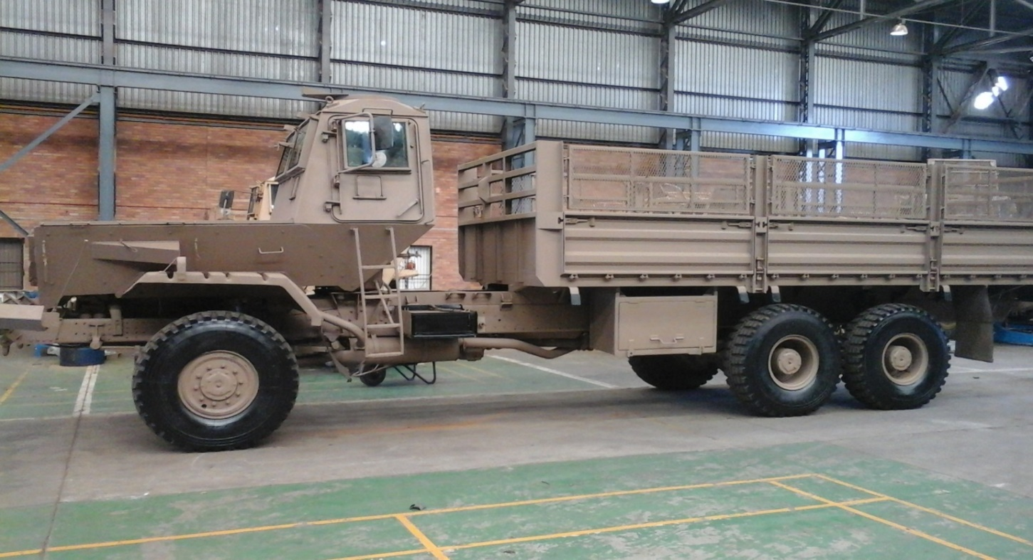
PROJECT THUSANO COMPREHENSIVE REPORT
1
PRESENTED BY: R ADM (JG) O.B. MTHETHWA DATE: 24 MAY 2021

Slide 2
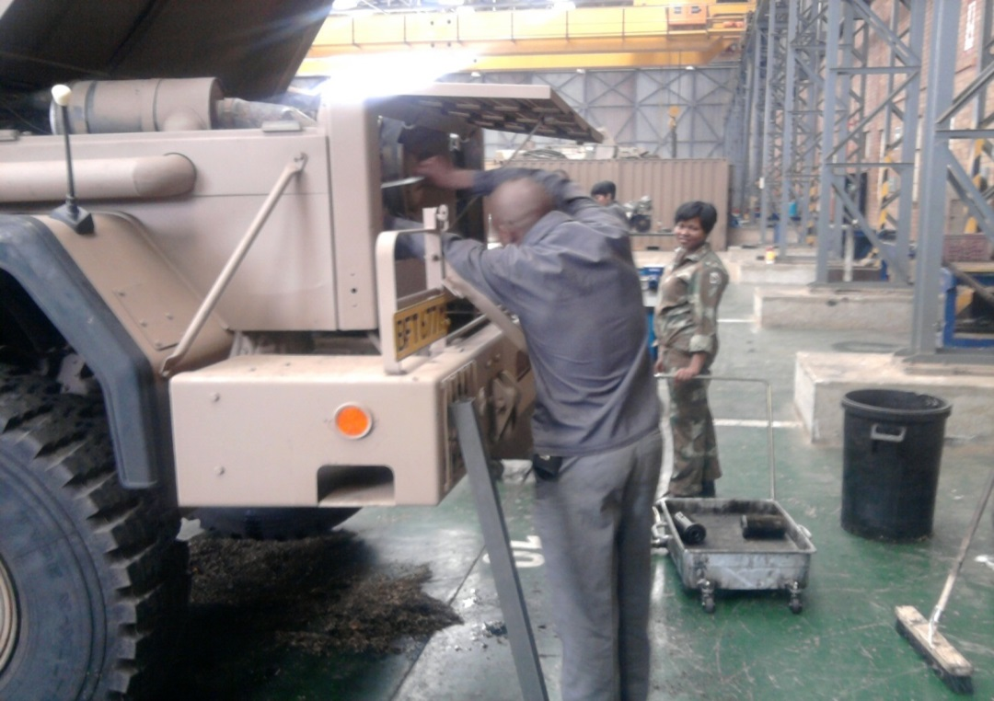
AIM
2
Is to provide a comprehensive status report on Project THUSANO to the Joint Standing Committee on Defence and Military Veterans
Notes:
2

Slide 3
SCOPE
3
Background
Contracts
Skills Transfer
Capability Building
Achievements
Expenditure
Conclusion
Discussion

Slide 4
BACKGROUND
4
Since the year 2000, the South African National Defence Force (SANDF) just like any other state Department, started experiencing huge budget cuts which was due to the declining Gross Domestic Products (GDP) and current economic climate. This affected the SANDF’s ability to ensure that Prime Mission Equipment (PME) is maintained optimally. As a result this had an adverse impact on the SANDF to fulfil its mandate since it negatively impacted force readiness
The decline in serviceability of PME because of budget cuts led to the exodus of scares skills. Most of the SANDF’s skilled members were poached by the private sector who enticed them with lucrative packages. As a result the Department of Defence Leadership had to device new initiatives intended at improving the declining serviceability of PME
Project THUSANO was then established in terms of the Memorandum of Understanding between the government of South Africa and the government of the Republic of Cuba on 10 January 2012. In light of the age of the SANDF’s PME which most is obsolete and without any projected allocation of budget for replacement, it was deemed important that initiatives that were to be employed had to be structured in such a manner that will allow the resuscitation of the current fleet of vehicles and machinery that the SANDF is operating with, to fulfilling its mandate

Slide 5
BACKGROUND (2/2)
5
South Africa as part of a multi-international community enjoys diplomatic ties with multiple countries. As one of the main role players in Africa, South Africa is engaging in bilateral with multiple countries Cuba included. The bilateral that took place between the Cuba and South Africa was based on developmental needs, and sharing of expertise. This was motivated by the fact that Cuba has a unique maintenance and preservation system of old PME dating back to 1954
Furthermore this was aimed at reducing expenditure of repairing PME at private industries that were billing the SANDF exorbitant prices during these prevailing National Budget cuts. The SANDF opted to procure own vehicle components and with the assistance of Cuba, repair own vehicles whilst ensuring there was adequate skills transfer between the two countries
To date this relationship has ensured that the SANDF covers wide strides at ensuring that old and obsolete PME are restored to their prime

Slide 6
CONTRACTS
6
As part of the MOU between SANDF and The Cuban Revolutionary Armed Forces, the two participants entered into contractual obligations. the following contracts were agreed upon:
Contract T1 17-001: This contract entails:
- The provision of Professional and Technical Services
- The Cuban Technicians who are in South Africa for the establishment of the Technical capability within the Department of Defence
- The Cubans provide technical assistance for the technical material supply in the Tank and Transport services. They repair Armoured vehicles
- They provide technical assistance in the deactivation of war material
- Repair and maintenance service of the transport technology
- Training of technicians in the organisation of transport technique
- Technical assistance in the organisation of the system of technical security
- Technical assistance in the organisation of the maintenance system, repair and maintenance of aviation equipment

Slide 7
CONTRACTS T1 17-001 (2/2)
7
As part of the MOU between SANDF and The Cuban Liberation Army , the two participants entered into contractual obligations. the following contracts were agreed upon:
- Technical assistance in the preservation of aviation armament
- Repair and maintenance of medical equipment
- Offering advice to learners identified to begin military medical training Cuba
- Advice for the selection of personnel to carry out pilot courses in military aviation

Slide 8
CONTRACTS T1 17-002 (2/2)
8
SA MILITARY HEALTH SERVICES
- Military medical training (Medicine)
- Training course in Social Science
- Military Medicine (Biomedical)
SENIOR COURSES FOR THE SANDF
- Strategic Defence and Security Programme
- Joint Senior Command and Staff Programme

Slide 9
CONTRACTS TI 17-002
9
Contract T1 17-002: This contract entails the provision of vocational learning of South African students in Cuba. The following are courses offered by Cuba to the South African learners:
SA ARMY COURSES
- Middle level on Transport and Tank Technicians
- Mechanical Engineering on Transport and Tanks
SA AIR FORCE COURSES
- General Military training for future pilots
- Aviation Technicians
- Aviation Engineers
- Air Traffic Control
If a new requirement from a Service is request it will be forwarded to Director Thusano. A needs assessment will then be carried out and a request will then be forwarded to the Military Attache in Cuba, who will then be a pivotal part to ensure that a supplement to the contract is drafted and agreed upon by both parties.

Slide 10
SKILLS TRANSFER AND QUALIFICATIONS TO SANDF MEMBERS THROUGH PROJECT THUSANO
SKILLS TRANSFER: OVERALL
 | SA ARMY | SAAF | SA NAVY | SAMHS
 | 1009 | 154 | 25 | 204
Total Skills Transfer |  |  |  | 1386

Slide 11
SKILLS TRANSFER AND QUALIFICATIONS TO SANDF MEMBERS IN DETAIL
11
Trades | SA Army | SAAF | SA NAVY | SAMHS
Motor Mechanic | 557 |  | 5 | 36
Auto Electricians | 109 |  | 1 | 6
Spray Painter | 18 |  |  | 6
Bio medical electrician |  |  |  | 33
Welders |  |  |  | 6
Workshop Planners | 75 |  |  | 6
Medical Clinic |  |  |  | 1
Aircraft Mechanic |  | 18
Avionics |  | 15
Armorer | 4
Veh Preservation | 18 | 4 |  | 8
Aircraft Preservation
Corrosion Management
Aircraft Radar |  | 13
Aircraft Instrument |  | 8

Slide 12
SKILLS TRANSFER AND QUALIFICATIONS TO SANDF MEMBERS IN DETAIL (2/3)
12
Trades | SA Army | SAAF | SA NAVY | SAMHS
Aircraft Radio |  | 8
Aircraft Mechanics |  | 18
Avionics Systems |  | 8
Engineers | 32 | 7
Technicians | 56 | 14
Aviation Technicians |  | 13
Pilots |  | 3
ENSP | 40 |  | 9 | 12
JSCSP | 40 | 4
Aircraft Electrician |  | 10
Cadet | 60
Aircraft Electrical |  | 11

Slide 13
SKILLS TRANSFER AND QUALIFICATIONS TO SANDF MEMBERS IN DETAIL (3/3)
13
Trades | SA Army | SAAF | SA NAVY | SAMHS
Doctors |  |  |  | 57
Bio Medical Engineering |  |  |  | 3
Air Traffic Control |  |  |  | 15
Psychologists |  |  |  | 15
TOTAL | 1009 | 154 | 19 | 204
GRAND TOTAL |  |  |  | 1392

Slide 14
CAPABILITY BUILDING
14
Training and skills transfer of the aforementioned members of the South African National Defence Force is done with the hospices of creating own capability within the SANDF
This capability will enhance the formation of the DOD Workshop which will be situated in Tek Base (Lyttleton) and Regional Workshops in all 9 provinces
These workshops will be self reliant in terms of expertise, skills and knowledge as they will be depending of training acquired from the Cubans

Slide 15
CAPABILITY BUILDING (2/5)
15
The envisaged Workshops will be structured as follows:
DOD Workshop
This workshop will execute third and forth line repairs and this entails;
- Components repair
- Body works (Panel beating and spray painting)
- Dismantling
- Refrigeration
- Engine Overhaul
- Armament fitters

Slide 16
CAPABILITY (3/5)
16
The staff compartment of the DOD workshop will consist out of the following skilled specialists:
Motor Mechanics:
(Artisan, Military Artisan, Senior Military Artisan, Artificer)
Auto Electricians:
(Artisan, Military Artisan, Senior Military Artisan, Artificer)
Amorous:
(Artisan, Military Artisan, Senior Military Artisan, Artificer)
Refrigerators:
(Artisan, Military Artisan, Senior Military Artisan, Artificer)
Panel Beaters:
(Artisan, Military Artisan, Senior Military Artisan, Artificer)
Recovery:
(Artisan, Military Artisan, Senior Military Artisan, Artificer)

Slide 17
CAPABILITY BUILDING (4/5)
17
Regional Workshop
This workshop will be staged in all 9 provinces with the aim to execute First and Second Line repairs. This entails;
- Maintenance and repair section
- Industrial repair
- Refrigeration
- Armament fitters
- Second Line Recovery

Slide 18
CAPABILITY BUILDING (5/5)
18
The staff compartment of this workshop will consist out of the following skilled specialists:
Motor Mechanics:
(Apprentice, Artisan, Military Artisan, Senior Military Artisan)
Auto Electricians:
(Apprentice, Artisan, Military Artisan, Senior Military Artisan)
Amorous:
(Apprentice, Artisan, Military Artisan, Senior Military Artisan)
Refrigerators:
(Apprentice, Artisan, Military Artisan, Senior Military Artisan)
Recovery:
(Apprentice, Artisan, Military Artisan, Senior Military Artisan)

Slide 19
ACHIEVEMENTS SA ARMY
19
Inspected vehicles: 14 257
Vehicles with maintenance and repairs: 13 092
Completed vehicles: 11 623
Repaired components: 12 691
Restored 30 workshops and 168 work stations
The workshop equipment, such as battery chargers, compressors, test benches, lathes, drills, hoists and cargo handling equipment have been repaired
10 technical training workshops have been carried out
A total of 10 overhead cranes repaired in workshops

Slide 20
ACHIEVEMENTS SA ARMY (2/4)
20
These figures include the work performed in the Army, Special Forces and B-Vehicles maintenance and repair teams under SAMHS and the Navy. The project has furthermore rendered services to the Military Police
Also, in the SA Army and SAMHS, A and B vehicles preservation has been carried out. So far, 1683 works are in this field, distributed as follows:
855 preserved vehicles
609 de-preserved vehicles
123 technical diagnoses
96 prophylactic works
The THUSANO team has carried out maintenance and preservation of 243 aviation bombs. 600 788 infantry weapons

Slide 21
ACHIEVEMENTS SA ARMY (3/4)
21
During 2020, many of the preserved vehicles were de-preserved, because SANDF needed to use them to support Operations Corona and Notlela. For this reason, at this moment there are only 246 preserved vehicles in the hangars
Maintenance and repair has been provided to different kinds of vehicles: Samils, recoveries, water and fuel bunkers, SAMAGs, Trailers, Ratels, Mambas, Mfezi, Casspirs, D-vehicles, and C-Vehicles
To date 34 Rooikat armoured vehicles have been repaired. 91 tanks: 84 Oliphant Mk1 and 7 Oliphant Mk2 have been repaired. Preservation of 51 tanks, 32 Oliphant Mk1 and 19 Oliphant Mk2 has been achieved
6 Oliphant Mk1 power packs, and one Rooikat power pack were repaired. A test bench for testing the tanks´ electrical components was manufactured , and the stabilizer. More the Cubans also manufactured a device for cleaning the air filters, and repaired the test bench for the Rooikat power pack

Slide 22
ACHIEVEMENTS SA ARMY (4/4)
22
In 81 Depot, a general physical stocktaking continues to be carried out by a Cuban and the SANDF team. The team has counted 31 211 ledgers and 6 971 712 parts. Besides, many of them have been reorganized and relocated. It includes 1420 bins and 73 202 items. In total, our team has reorganized 17 warehouses
Project THUSANO has developed a methodological guide for making the stocktaking at 81 Depot , as well as a computer program for facilitating the process of searching for parts by car brand. A proposal of modification to 3 documents involved in the counting process was drafted, and the storage standards for the SANDF was developed
The THUSANO Team drafted and submitted for approval the policies for Integrated Technical Support System and its Structure, as well as the policies for Preservation and Deactivation. They have also developed the standards for SA Army workshops. Meanwhile, they are transferring skills in the repair, maintenance and preservation of Armour vehicles through Pilot Project

Slide 23
ACHIEVEMENTS SA AIR FORCE
23
In the SAAF the THUSANO teams carried out 19 814 works. They include, among others:
440 support activities to periodic aircraft maintenance
94 aircraft operative maintenances
129 major repairs
2 172 light repairs 274 parts and components preserved
52 test benches repaired
Developed and manufactured 20 test benches for different components and parameters
Developed 202 methodologies for the test benches
3 831 circuit inspections
2 444 calibrating and testing activities
5 488 trainings in testing and repairs
85 completed aircrafts
The THUSANO team has carried out maintenance and preservation of 243 aviation bombs.

Slide 24
ACHIEVEMENTS SA MILITARY HEALTH SERVICES
24
The electro-medical team has inspected 4 136 medical equipment, repaired 2 458 and rendered maintenance to 3 544. Meanwhile, the Military Health advisor drafted a proposal for training military doctors in South Africa
As part of Op. Notlela, our specialists repaired and recovered 31 ambulances earmarked for disposal. Although the operation finished, we continue working in this field
On the other hand, since their arrival in April 2020, the medical doctors and nurses have rendered support in fighting Covid-19 in the 3 main military hospitals, and in military units with troops. They have obtained the following results:

Slide 25
ACHIEVEMENTS SA MILITARY HEALTH SERVICES (MILITARY DOCTORS)
25
Health actions carried out | Quantity
Total of patients treated. | 18985
Blood extractions | 2048
Medical forms prepared | 15830
Imaging studies | 8
Patients resuscitation | 7
Lab studies processing | 211
Extraction of lab samples | 923
Participation in ward passes and medical discussions. | 875
PCR tests | 5456
Nursing procedures | 17835
Health education activities. | 8525
Drug administration by oral way. | 1230
Drug administration by oral way | 2355
Vein channeling | 366
Cures | 811
Patients feeding | 299
Patients bathing | 129
13

Slide 26
ACHIEVEMENTS SA MILITARY HEALTH SERVICES (MILITARY DOCTORS) (2/3)
26
Patients transfer | 225
Sutures | 14
Screenings | 1121
Care of pregnant women | 314
Treatment of HIV patients. | 170
HIV Tests | 51
Joint surgeries and medical procedures | 6
Updating of vaccination programs | 279
Medical forms revision | 250
Total of actions carried out. | 79298
14

Slide 27
39 patients have been included in the project so far. 27 have completed the treatment with good results, 7 are under treatment, 3 abandoned the treatment, and 2 had a bad evolution
27
HEBERPROT-P (3/3)

Slide 28
SIMULATORS
28
Sim SAMIL 20 PC combat driving simulator has been developed. It is in the mass production stage. 7 have been finished and 17 are in process. By the end of this year, the 24 driving simulators agreed in contract must be manufactured
The deployment phase has started. Currently, there are 4 simulators deployed: 2 in the SA Army Infantry School, 1 in SA Army Engineering School and 1 in SA Army Technical Training Center
Special skills have been transferred to 28 South African specialists
An infantry shooting demonstration was carried out in SA Army Infantry School, following Cuban experiences and standards. There were displayed: an R4 rifle simulator prototype and an automated shooting range
We are working on finishing the development of the R4 rifle simulator and adapting the automated shooting range to the South African climate and electro-magnetic conditions
16

Slide 29
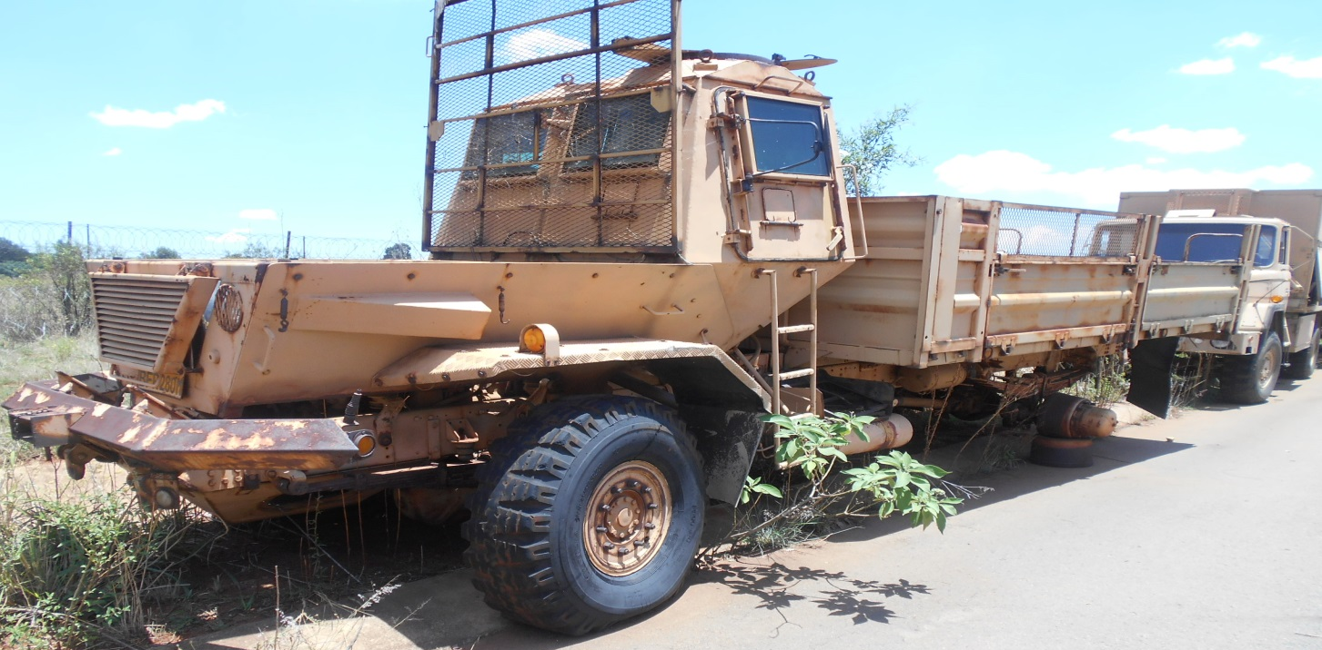
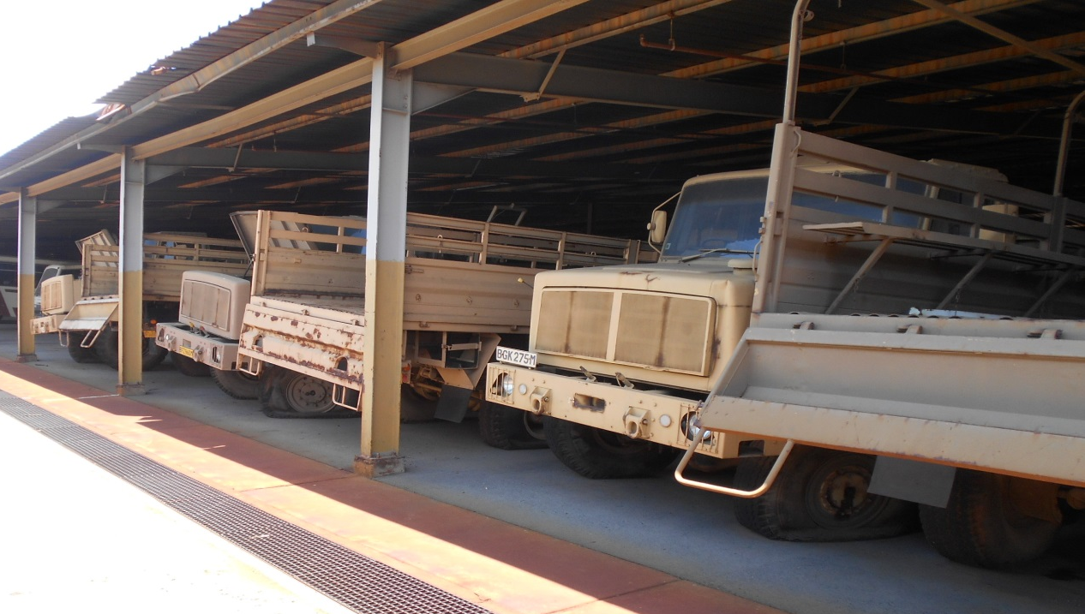
29
REPAIR OF SAMILS
BEFORE

Slide 30
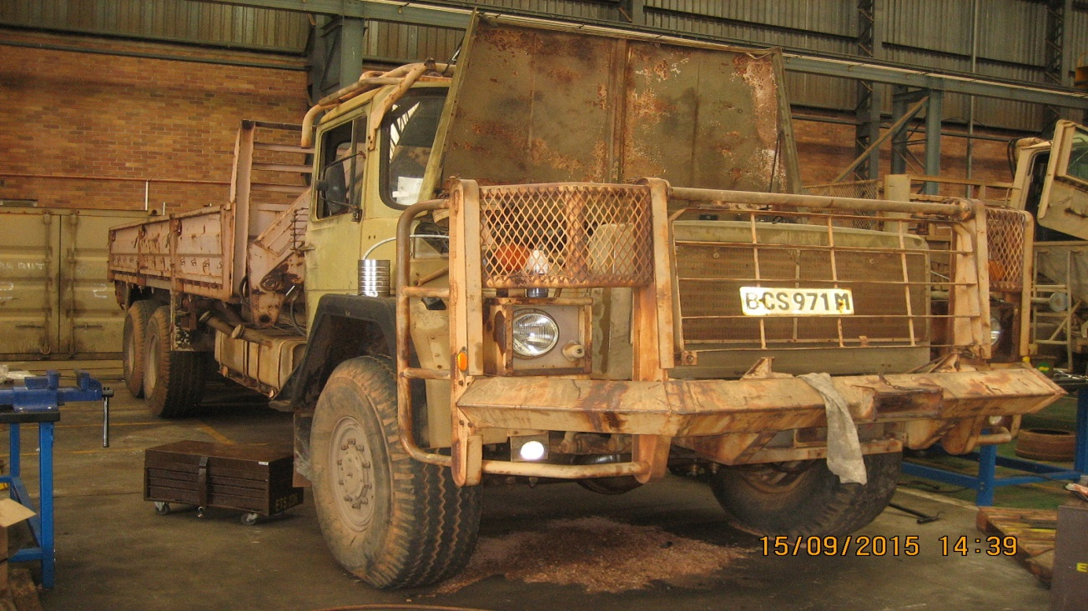
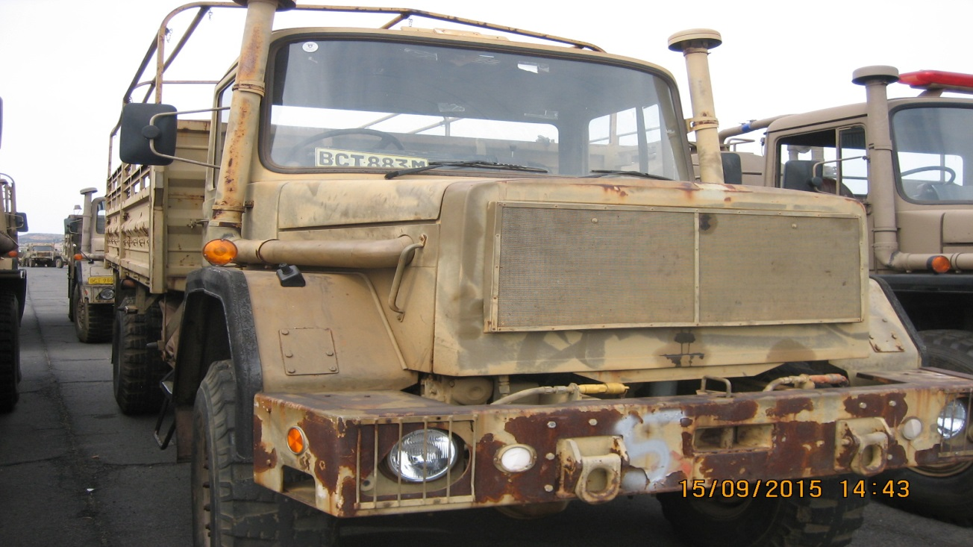
30
REPAIR OF SAMILS
BEFORE

Slide 31
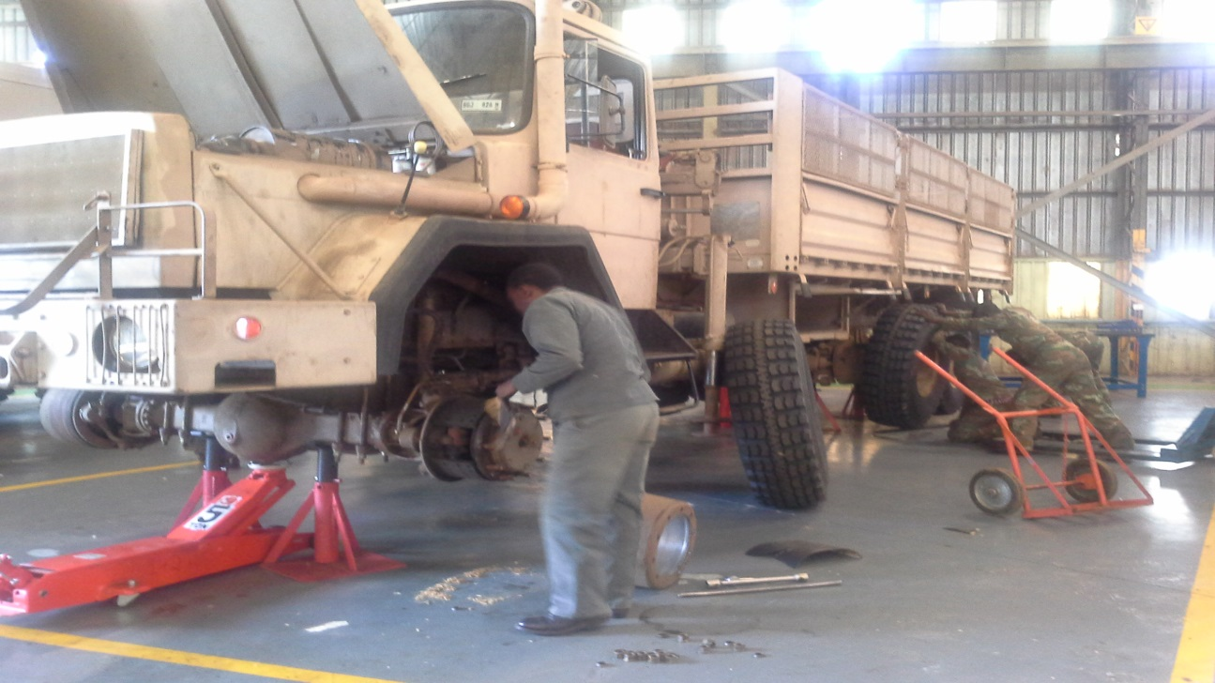
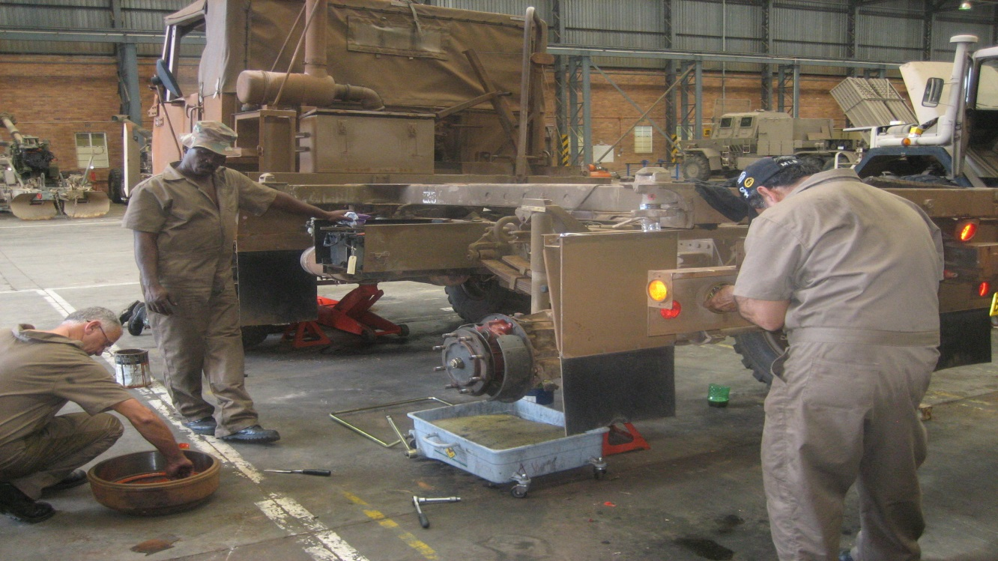
31
REPAIR OF SAMILS
IN PROCESS

Slide 32
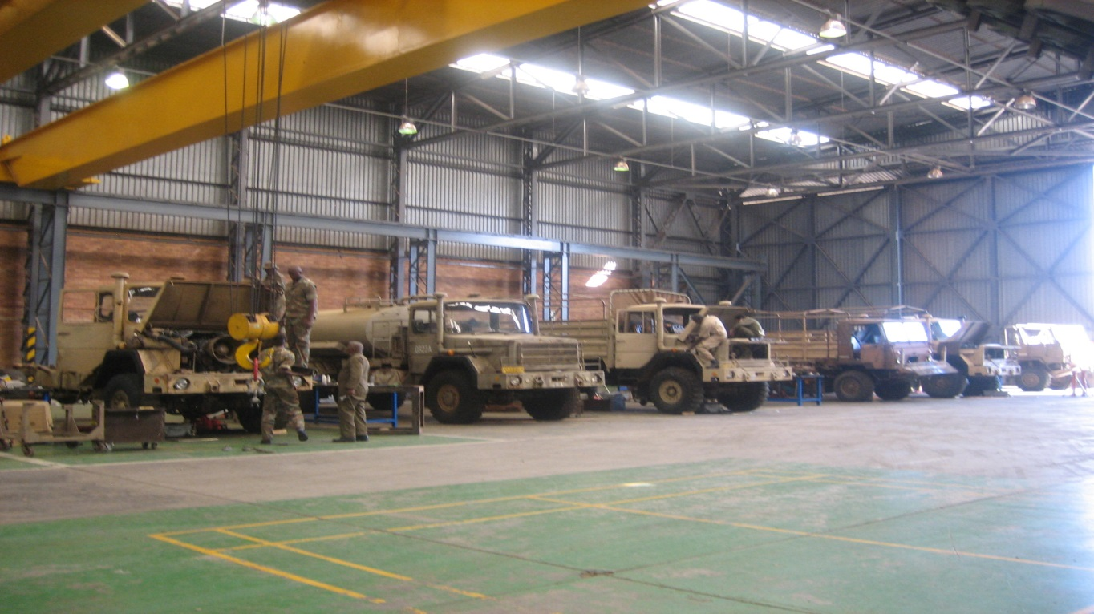
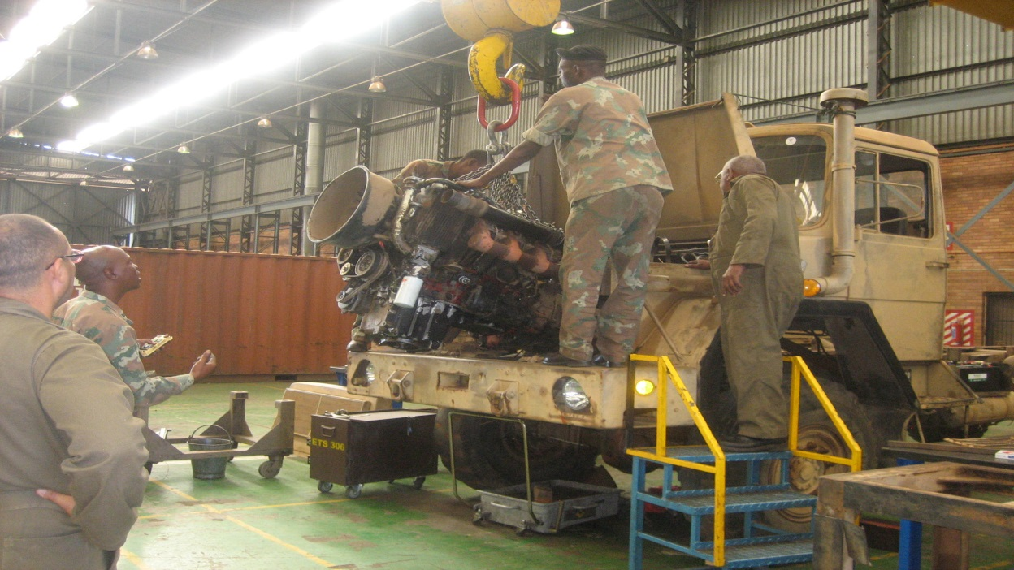
32
REPAIR OF SAMILS
IN PROCESS

Slide 33
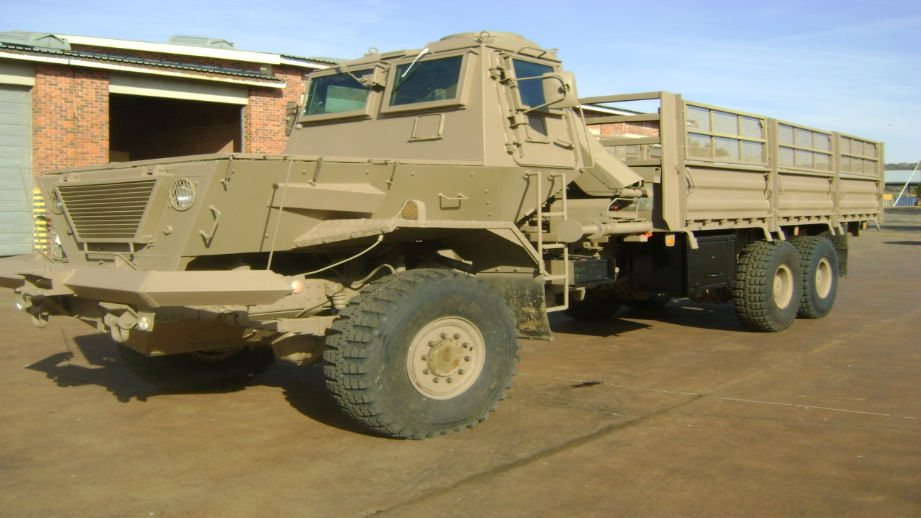
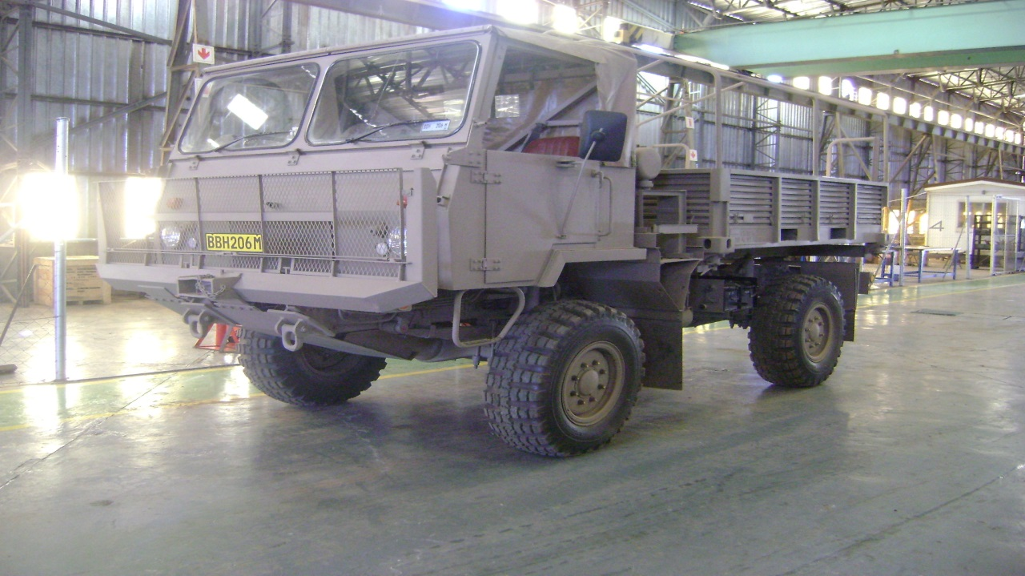
33
REPAIR OF SAMILS
AFTER

Slide 34
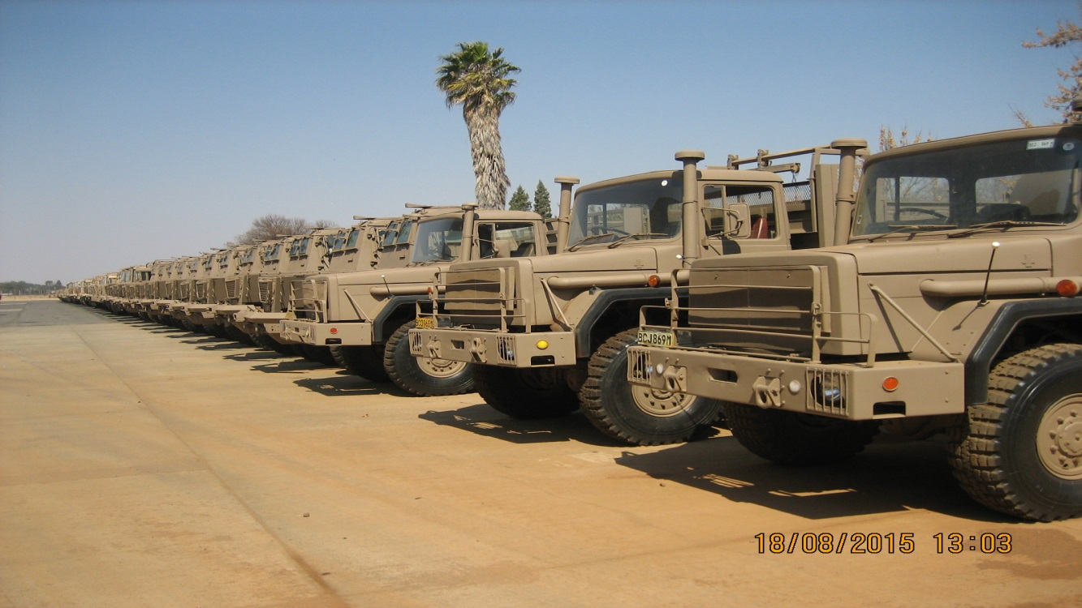
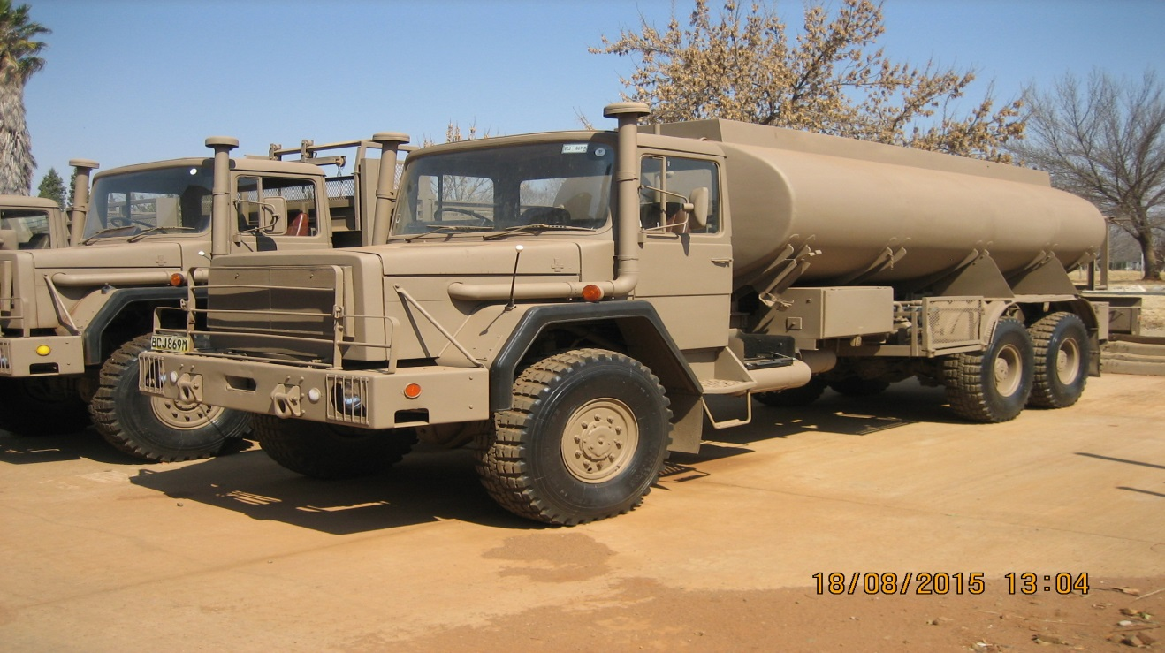
34
REPAIR OF SAMILS
AFTER

Slide 35
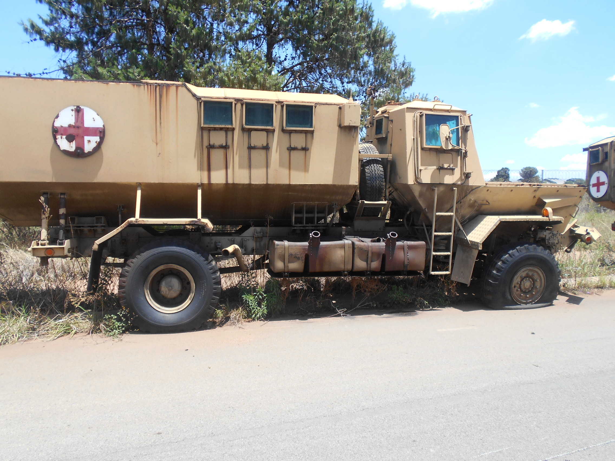
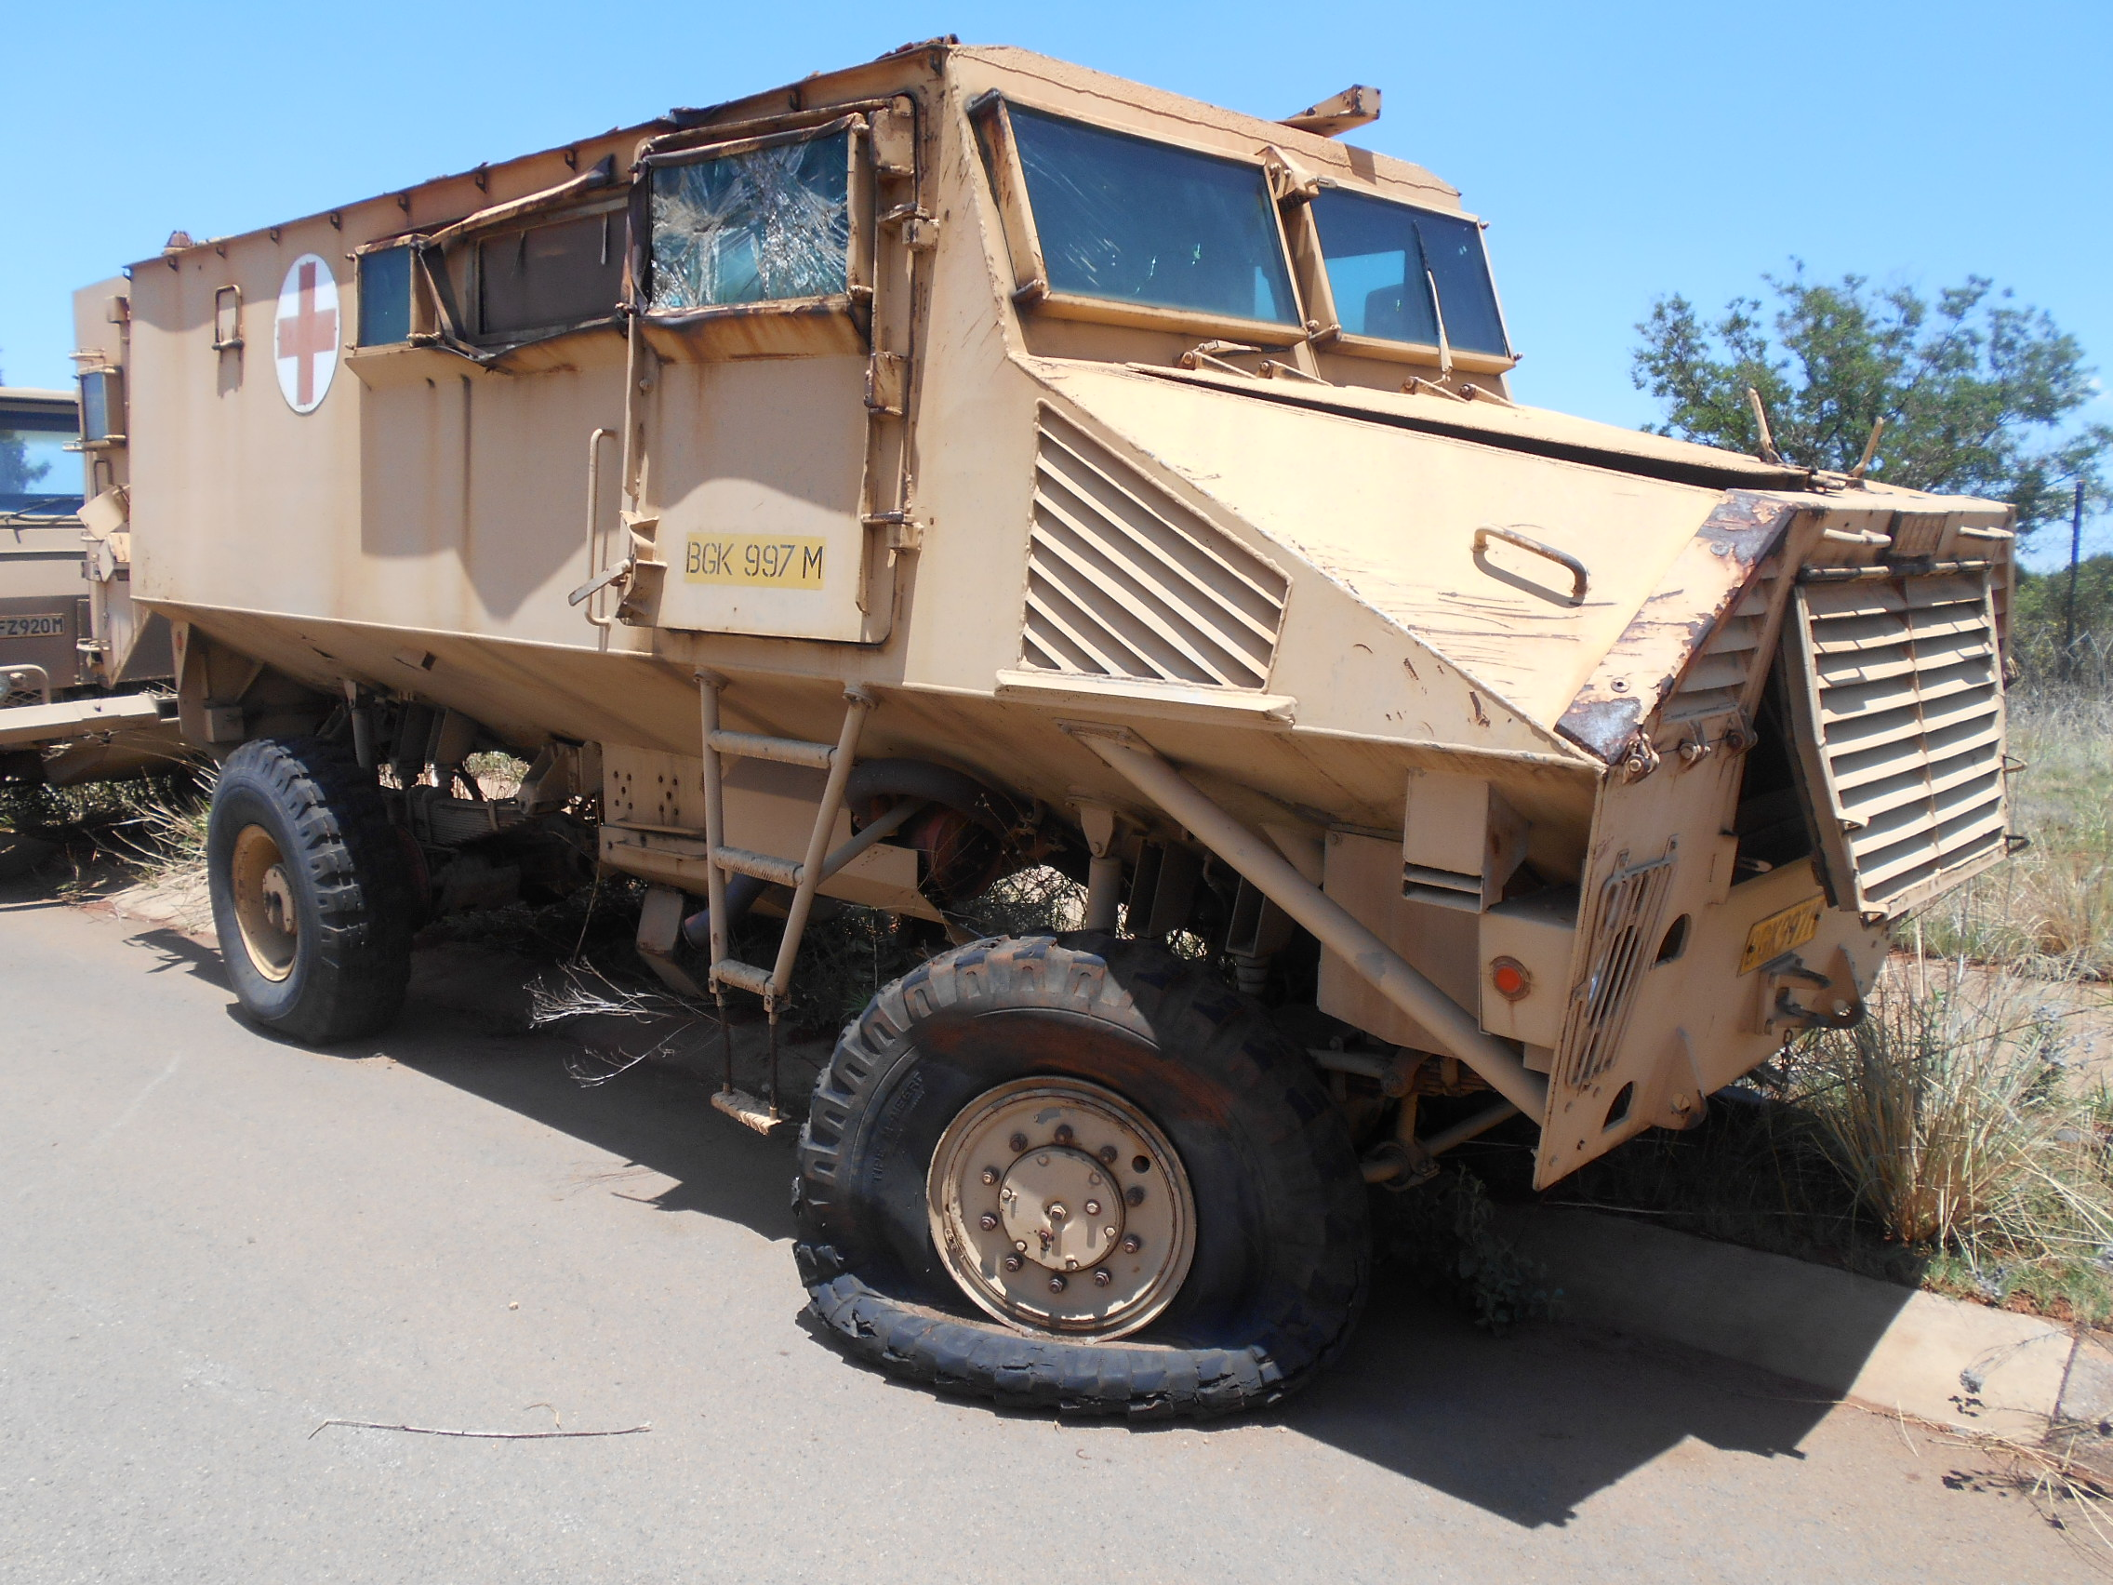
35
SAHMS VEHICLES
BEFORE

Slide 36
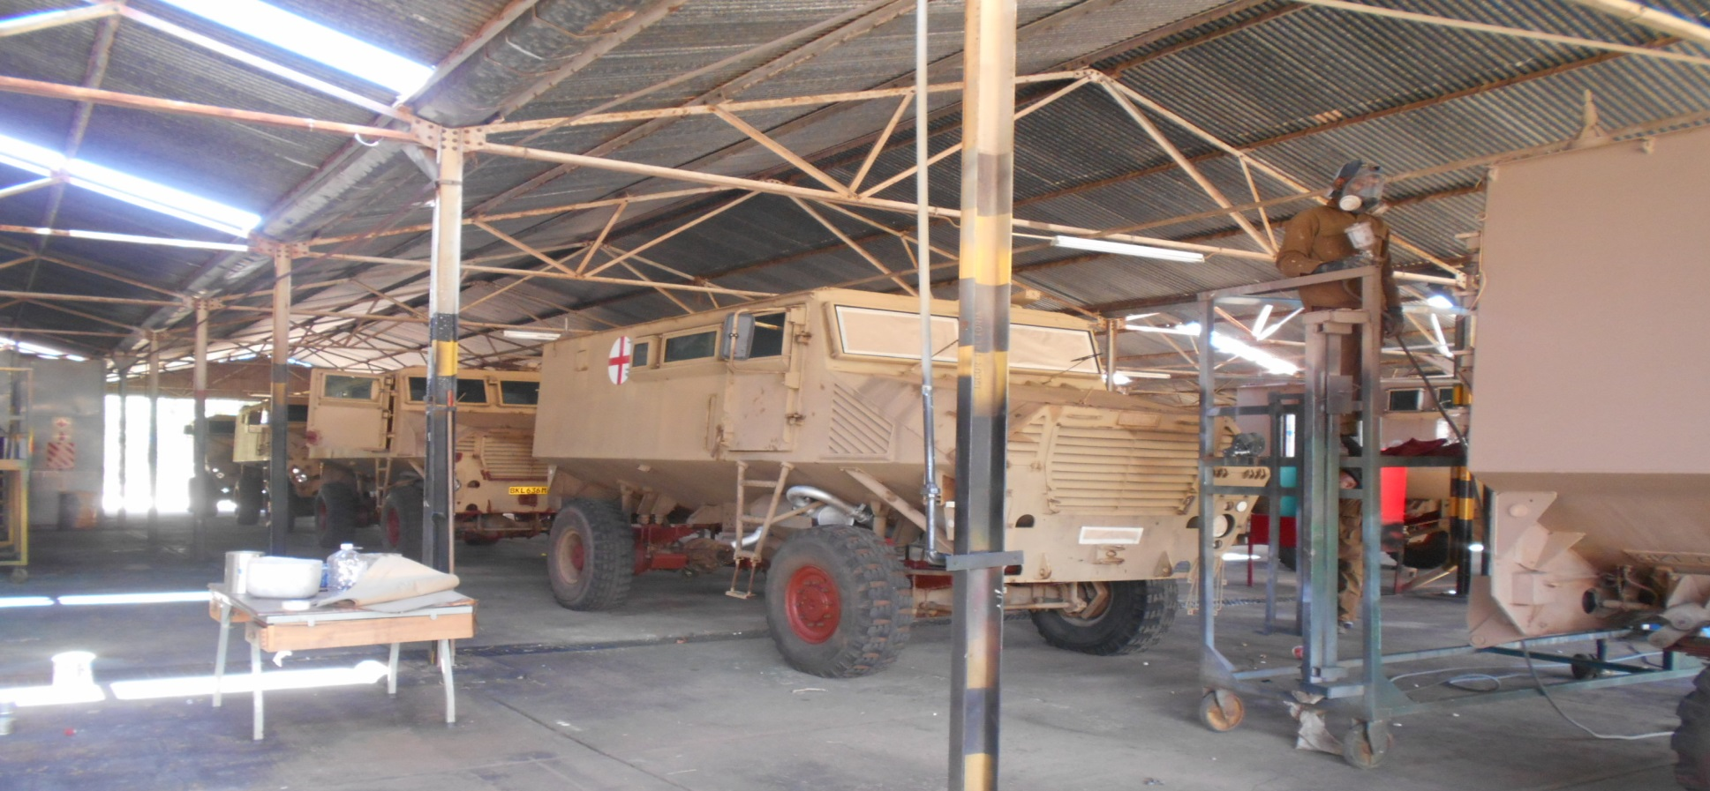
36
SAHMS VEHICLES
IN PROCESS

Slide 37
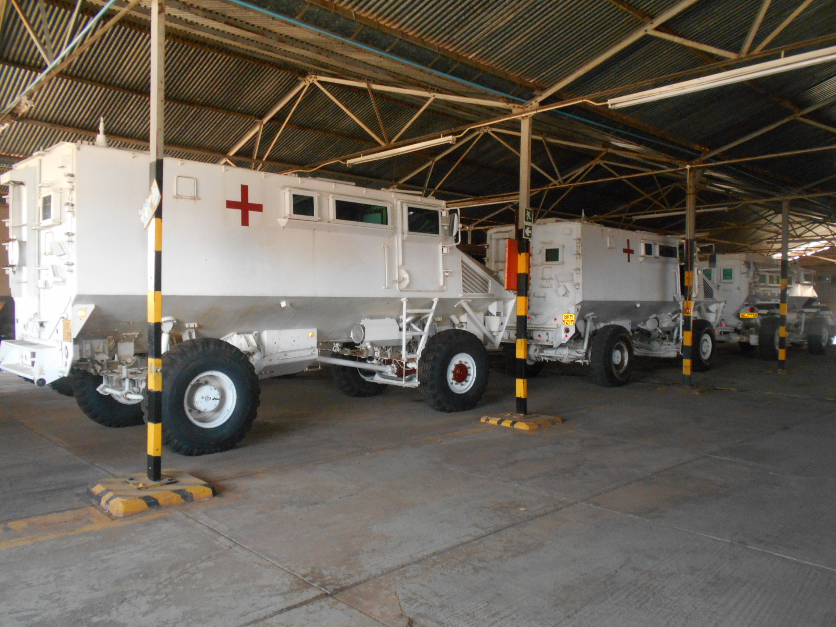
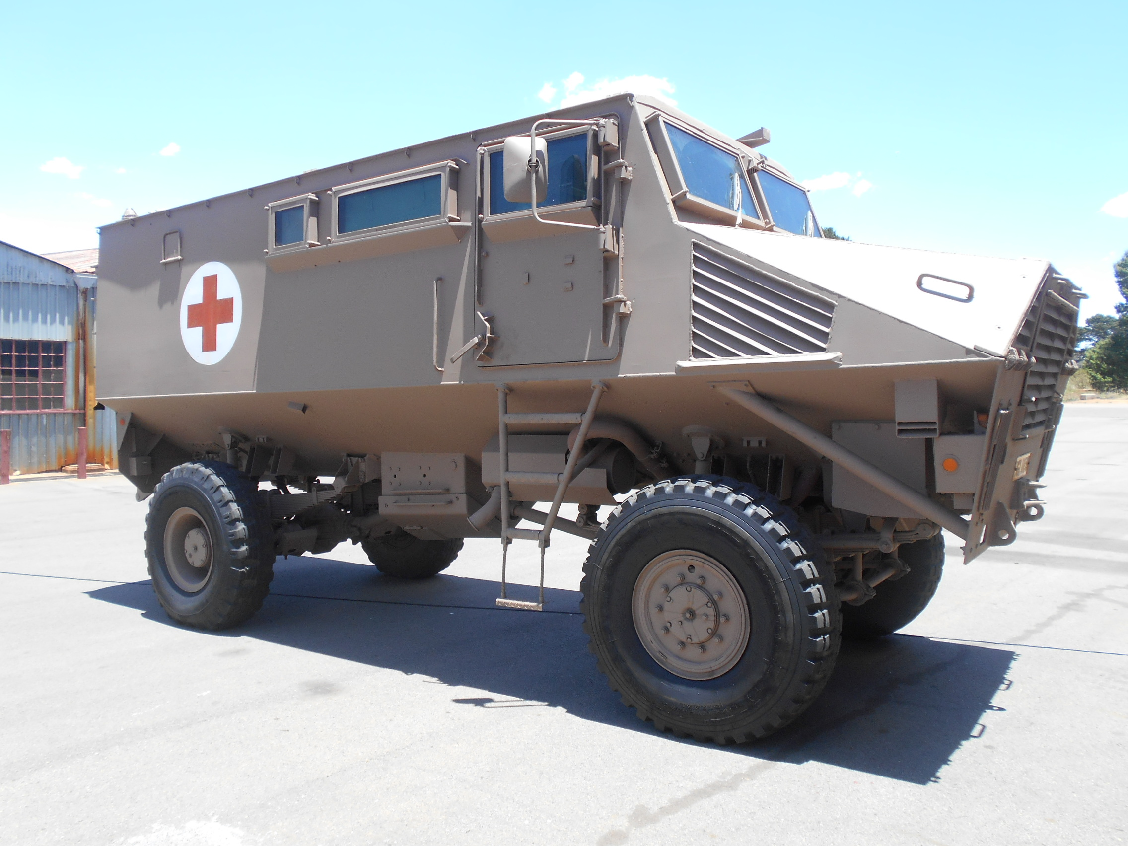
37
SAHMS VEHICLES
AFTER

Slide 38
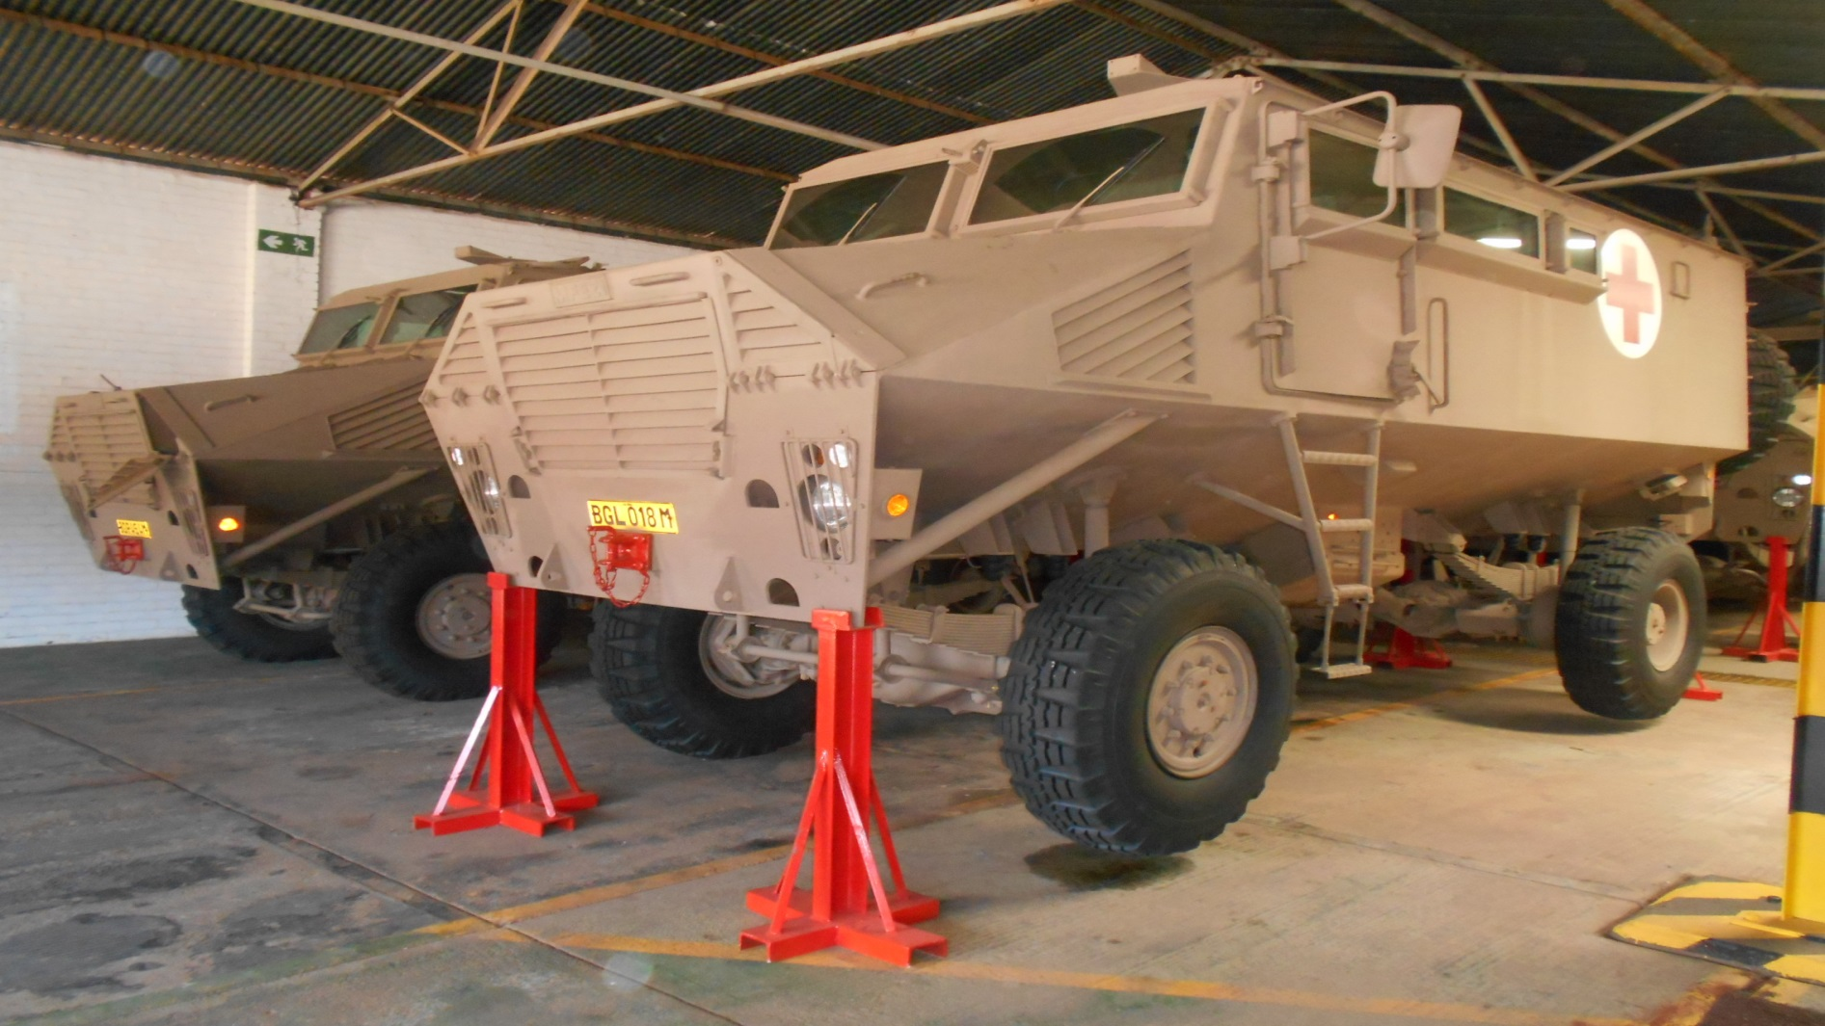
38
SAHMS VEHICLES
AFTER

Slide 39
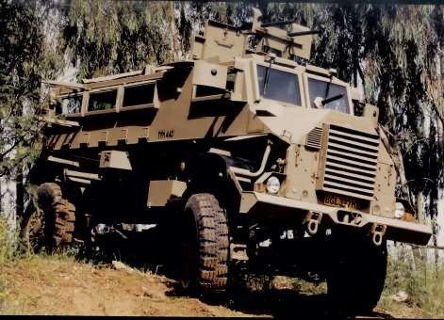
PICTURES OF OTHER CAPABILITIES PROJECT THUSANO HAS RESTORED
39
Casspir Mklll

Slide 40
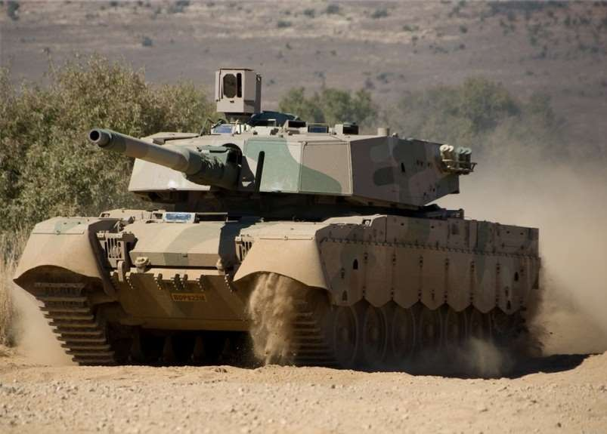
PICTURES OF OTHER CAPABILITIES PROJECT THUSANO HAS RESTORED
40
Olifant Mkl & Mkll Tank

Slide 41
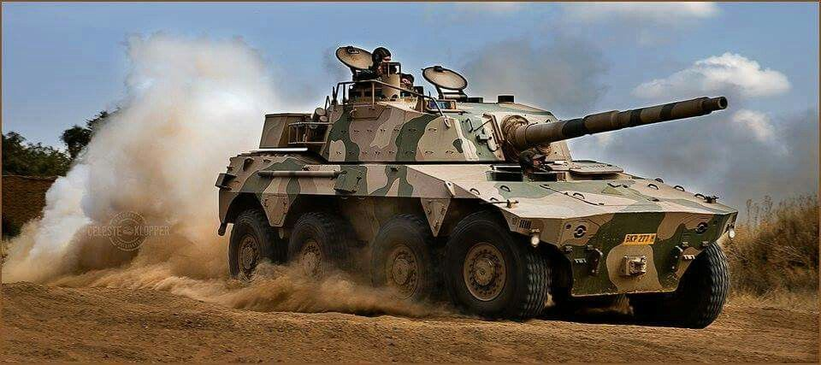
PICTURES OF OTHER CAPABILITIES PROJECT THUSANO HAS RESTORED
41
Rooikat Armored Vehicle

Slide 42
CUBAN DELEGATION
Cuban professionals that are key to the abovementioned achievements in conjunction with members of the South African National Defence Force are based at the following regions:
Regional Works Gauteng: 06
DOD Main Ordnance Depot: 12
35 Field Engineering: 06
43 Bde: 06
8 Medical Depot: 07
DOD Mob Cen: 08
101 Fd Wksp: 06
102 Fd Wksp: 06
ASB Kby: 05
ASB WC: 05

Slide 43
CUBAN DELEGATION (2/2)
ADA School: 06
SAAF Base Ysterplaat: 04
SAAF Base Langebaan: 05
SAAF Bloemspruit: 05
SAAF Waterkloof: 08
SA Navy Simon’s Town: 09
Simulator Project Team: 12
Head of Delegation: 04
TOTAL 172

Slide 44
EXPENDITURE
The following reflect expenditure of maintenance and repair of B vehicle (Samils and Mambas by private entities before the inception of Project THUSANO
44
S/NO | CLIENT | COMMODITY | F/Y 2010-2011 | F/Y2011-2012 | F/Y2012-2013
 | a | b | c | d | e
1 | Client: SA ARMY | M&R of B-Vehicles at Organizational & Intermediate (O&I) level | R70,9M | R84.0M | R86.0M
2 | Client SA ARMY | M&R of B-Vehicles at Depot level | R60.0M | R80.0M | R85.0M
3 | Client SA ARMY | Procurement of spares at O&I level | R4.0M | R4.0M | R4.0M
4 | CJ OPS | Operation Cordite: Support of B-Vehicle fleet in mission area | R10.8M
5 | CJ OPS | Operation Corona: Procurement of Spares/Components for B-Vehicles | R1.2M
6 | CJ OPS | Operation Corona: M&R of B-Vehicles at Depot level | R22M
7 | CJ OPS | Operation Corona: M&R of B-Vehicles at O&I leve | R14.0M
8 | Special Forces | M&R of B-Vehicles and components | R3.11M | R3.43M | R3.73M
9 | Special Forces | B-Vehicle Spares and Components | R 756,820 | R 806,515 | R 913,682
10 | SAAF | M&R of Mamba Vehicles | R 152,020 | R 173,302 | R 197,564
11 | SAAF | M&R of Samil Vehicles | R 370,000
12 | Special Forces | M&R of B-Vehicles and components | R 3.11M | R3.43M | R3.73M
TOTAL |  |  | R 187. 28M | R 172 409 817 | R 179 841 246

Slide 45
Expenditure for Project THUSANO is hyperlinked
45
EXPENDITURE

Slide 46
CONCLUSION
46
Project THUSANO continues its development, following the elements agreed in the contract signed between both parties. Its objectives are being fulfilled, and we continue moving forward despite the challenges imposed by the current pandemic situation
Invitation is forwarded to the Parliamentary Portfolio Committee on Defence to visit The DOD Mob Centre and Walmansthal to physically view the inroads of Project THUSANO

Slide 47
DISCUSSION

