Slide 1
investigation CONCERNING AN ICCV found smuggling cigarettes into a Correctional Centre during lockdown alert level 3

Slide 2
briefing
It was brought to the attention of a Senior Manager at the Krugersdorp Correctional Centre (CC) by an inmate that an Independent Correctional Centre Visitor (ICCV) of JICS was smuggling contraband cigarettes into the CC.
With reference, the Senior Manager (accompanied by another Correctional Services official) conducted a search at the office of the ICCV, Mr T G Nkwanyana.
Before the search could be conducted, Mr Nkwanyana disclosed 6 packets of cigarettes.
At the time of the incident (August 2020) the country was under National Lockdown, Alert Level 3, in line with the Disaster Management Act, 2002.
As a result of the actions of the ICCV, he was charged with three counts of misconduct:
  Failure to comply with, or contravention of an Act, Regulation or legal obligation;
  Being in possession of an illegal, unauthorised, habit-forming and/or stupefying drug on departmental premises; and
  Contravention of the Correctional Services Act, Act 111 of 1998.

Slide 3
Briefing (cont.)
Pending the disciplinary enquiry process, Mr Nkwanyana was temporarily transferred to JICS Northern Management Regional Office (NMR), Centurion.
During the disciplinary hearing (which commenced and was finalised on 3 November 2020), Mr Nkwanyana chose not to be represented by a union representative or a fellow employee. He pleaded guilty to all the charges levelled against him.
Mr Nkwanyana tendered his resignation at the commencement of the disciplinary hearing. The Chairperson of the enquiry explained that the service termination (resignation) and disciplinary hearing are two separate processes and that he, as the Chairperson, does not have any jurisdiction on the resignation process and therefore the disciplinary hearing should proceed.
Mr Nkwanyana did not contest the testimony of the employer witness presented during the disciplinary hearing.
Witnesses from the Department of Correctional Services testified that the trust relationship with this particular ICCV had irretrievably broken down.

Slide 4
Briefing (cont.)
Mr Nkwanyana was found guilty of misconduct by the appointed Chairperson.
As mitigating factors the ICCV, Mr Nkwanyana, submitted that he has shown remorse and that he will not repeat the transgression. The ICCV submitted that he should not be dismissed from employment and further indicated that his employment contract with JICS will expire on 20 November 2020.
The Chairperson took cognisance of the remorse shown by the ICCV and recommended that although Mr Nkwanyana is dismissed, he should be allowed to continue to serve the remainder of his employment contract (13 working days) at the NMR.
The above recommendation and sanction were accepted by the delegated authority and the ICCV’s services were terminated with effect from 20 November 2020.

Slide 5
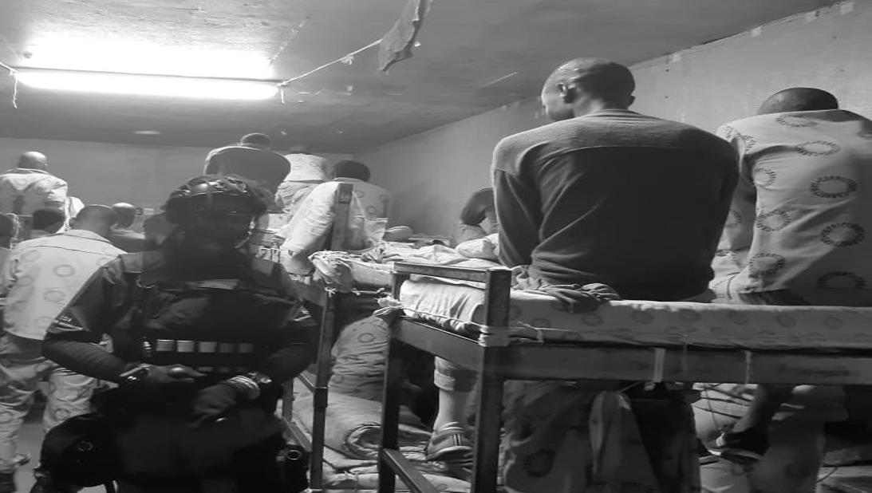
THANK YOU

