Slide 1
O.R. TAMBO DISTRICT MUNICIPALITY (ORTDM)
PC Cogta Engagement on the construction of Ventilated Improved Pit (VIP) latrines
20 May 2021

Slide 2
PRESENTATION OUTLINE
2
2. BACKGROUND AND CONTEXT
3. WATER SERVICES PLANNING AND IMPLEMENTATION
4. SANITATION SERVICES PLANNING AND IMPLEMENTATION
5. CHALLENGES
1. INTRODUCTION

Slide 3
3
INTRODUCTION

Slide 4
Introduction
This report is prepared for parliamentary portfolio committee of Copoerative Governance and Traditional affairs Engagement, on the construction of Ventilated Improved Pit (VIP) latrines in the OR Tambo District Municipality
The report makes reflection on the efforts undertaken by the district in accelerating the provision of the VIP sanitation.
It also deliberate on current approach and proposed implementation strategies for the future
The report further lift the challenges that are faced by the district in its endeavor of providing universal access to sanitation across all communities

Slide 5
5
BACKGROUND & CONTEXT

Slide 6
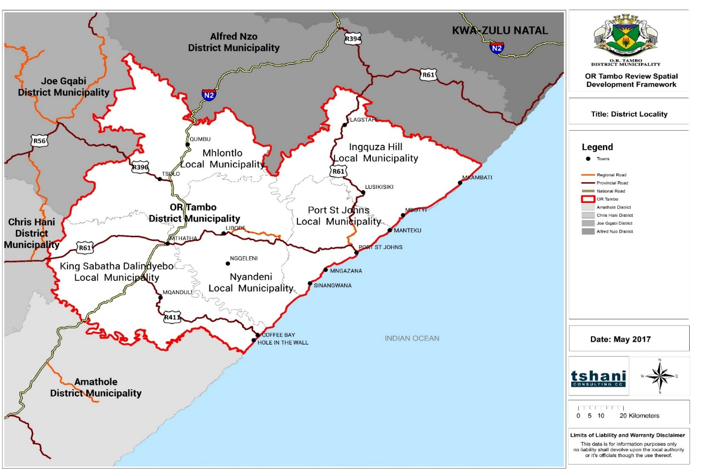
Locality
OR Tambo District Municipality is one of 6 District Municipalities in Eastern Cape Province
Classified as a C2 municipality the district:
Is largely a rural municipality – approx. 93% of residents live in rural settlement areas
Comprises 5 Local Municipalities
King Sabata Dalindyebo
Mhlontlo
Nyandeni
Port St Johns
Ingquza Hill

Slide 7
Water Services Background
ORTDM is the water service Authority and the Provider for its area of jurisdiction.
The district municipality institutionalized the water services function in such that it renders both the Authority, Project implementation and provisioning function.
The table below illustrate the district Water Services structural arrangement as per functional areas in order to deliver water services.
For the purpose of this report the district will account on the acceleration of sanitation services, particulary dry sanitation.

Slide 8
Structural Overview of the Department
Director: Water & Sanitation Services
Head of Department
Senior Admin
Admin Coordinator
General Manager: WSP, CC & ERU
Head Planning & Implem
General Manager: WSA, PMU & ES
Head Water Services Prov

Slide 9
9
WATER SERVICES PLANNING & IMPLEMENTATION

Slide 10
Planning & Project Management Unit
The Water Services Planning and Project Management solely deals with the planning and execution of various project in the district.
The project implementation is guided by the District Water and Sanitation Master Plan, which was adopted as early as 2012.
The intention of the Master plan is to serve the communities of the district with optimum water supply and whilst it also intends to provide sustainable sanitation (both dry and water-borne sewer system to all the district towns). .
It is safely to note that the District Water Master Plan is fairly aligned to the District Spatial Development Framework and the identified nodal / regional centers of development.
For the purpose of this report progress on the implementation of the Water Master Plan will be provided with a focus on sanitation.

Slide 11
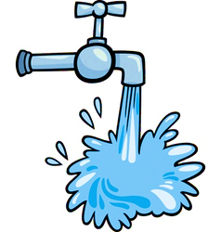
Basic Service Delivery Backlog
11
Piped water inside dwelling = 33 746
Piped water in yard = 37 561
Communal piped water (At RDP‑level) = 37 949
Communal piped water (below RDP-level) = 12 923
No formal piped water = 226 066
Flush toilet = 66 791
VIP = 205 923
Pit Toilet = 49 855
Bucket System (not serviced ) = 2 330
No toilet = 23 338
Human settlements is a provincial competence.
Housing backlog
= + 158 000
Energy for lighting = 50 262
Energy for lighting and other purposes = 250 566
Not using electricity = 47 417

Slide 12
Pertinent Issues for Consideration
Backlogs:
On water borne sanitation huge backlogs are on waste water treatment plants and bulk sewers.
Only Mthatha that has full blown water sanitation and the master plan to deal with upgrading the system to carter for current and future developments
The other eight towns do have rudimental sanitation systems mainly composed of sceptic tanks, interconnecting sewers disposing into the sewer ponds requiring maintenance.
The improvement of the sewer borne system to all towns is currently underway, progress will be provided in the next slides.
Sanitation backlogs last estimate is about 96 thousand households that don’t have basic level of service.
The 96 000 consist of 30 000 dry sanitation with the remainder being urban areas that will be connected to diffent towns water borne sanitation system.
The current dry sanitation backlog will be eradicated in 10 years with the current rate of 3000 VIP delivered on annual basis.

Slide 13
SANITATION SERVICES PLANNING & IMPLEMENTATION

Slide 14
OVERVIEW OF SANITATION DELIVERY
The ORTDM master plan committed to ensure that all towns of the district have water-borne sewer.
This has been based on the fact that only Mthatha town had full water borne system.
The approach serve to create economic opportunities across the small towns and further developments in order to ease Mthatha.
Also the district had committed to provide dry sanitation to the rural communities in the form of VIPs.
The district had accelerated the delivery of dry sanitation in such that only around 30 000 households are remaining. This means that in the current delivery rate the municipality can eradicate its backlog within 10 years.
NB The key challenge faced by the municipality is that VIPs are getting full and there are no maintenance funds.

Slide 15
OVERVIEW OF SANITATION DELIVERY
The ORTDM master plan committed to ensure that all towns of the district have water-borne sewer.
This has been based on the fact that only Mthatha town had full water borne system.
The approach serve to create economic opportunities across the small towns and further developments in order to ease Mthatha.
Also the district had committed to provide dry sanitation to the rural communities in the form of VIPs.
The district had accelerated the delivery of dry sanitation in such that only around 30 000 households are remaining. This means that in the current delivery rate the municipality can eradicate its backlog within 10 years.
NB The key challenge faced by the municipality is that VIPs are getting full and there are no maintenance funds.

Slide 16
SANITATION LEVEL OF PER LOCAL MUNICIPALITY
LOCAL MUNICIPALITY | ABOVE & MINIMUM SERVICE LEVEL |  | BELOW MINIMUM SERVICE LEVEL |  |  | TOTAL
 | FLUSH TOILET | VIP | PIT TOILET | INFORMAL SYSTEM | NO TOILET
King Sabata Dalindyebo | 34 000 | 63 800 | 16 600 | 606 | 6 660 | 122 000
Mhlontlo | 4 720 | 25 700 | 11 800 | 156 | 3 730 | 46 100
Ingquza Hill | 6 870 | 41 200 | 11 200 | 1 100 | 2 800 | 63 200
Nyandeni | 6 380 | 51 300 | 6 900 | 313 | 4 200 | 69 100
Port St Johns | 8 530 | 14 500 | 6 100 | 590 | 5 200 | 34 900
Total | 60 527 | 196 540 | 52 666 | 2 768 | 22 590 | 335 091
Sub Total Above/ Below Minimum Service Level | 257 067 |  | 78 024

Slide 17
SANITATION LEVEL OF PER LOCAL MUNICIPALITY

Slide 18
DISTRICT APROACH FOR DRY SANITATION IMPLEMENTATION
1. Current Approach
As part of implementing the sanitation master plan, the district had broken down its projects into wards.
The wards are divided into projects of approximately 500 units depending to the extent of the ward. The units are ordered as panels and are mainly manufactured in Durban in KZN.
The Implementation is done through Technical Consultant appointed through panel of consultants and with accompanying subconsultants such as ISD and health & Safety
The consultants compile a business plan that is submitted to Cogta Technical Committees for allocation of funds through Municipal Infrastructure Grant.
The procurement strategy for construction is the conversional one that is public tender which tend to benefit from CIDB Grading 6 to 7 leaving large sector of contractor of grade 1 to 5 which are mainly local base outside of beneficiation.

Slide 19
Overview of Construction Procurement Strategy
the Employer intends to enter into identical framework agreements with two or more Principal Contractors that have demonstrated the requisite capacity, qualification and experience to undertake the design, manufacture, supply, delivery and installation of precast concrete VIP toilets and perform related maintenance and community focused services and functions, within the geographical boundaries of the OR Tambo District Municipality (the "district"), on an 'as instructed' basis, over 36 months.
the Principal Contractor shall then form framework agreements with small, medium and micro-enterprises (have a CIDB grading of less than or equal to 4CE/GB) that have registered offices within the district to participate in the programme as subcontractors. Each local municipality will have equal representation in the database.
Local Municipality | CIDB 1‑2 | CIDB 3 | CIDB 4
King Sabata Dalindyebo | 4 | 2 | 1
Nyandeni | 4 | 2 | 1
Mhlontlo | 4 | 2 | 1
Ingquza Hill | 4 | 2 | 1
Port St Johns | 4 | 2 | 1
no work assigned to a Principal Contractor may be subcontracted to another party outside of the panel of subcontractors
The ultimate objective of the establishment of the panel of subcontractors is that within 12 months from their appointment and annually after that, to graduate each Subcontractor up two CIDB Grades. Any entity that has a grading greater than 4CE shall be graduated out of the panel of subcontractors, and the Principal Contractor shall, through a competitive bidding process, replace them with an eligible enterprise

Slide 20
Overview of Construction Procurement Strategy
the targeted areas for subcontracting are as follows:
material transport;
labour transport;
labour-hire;
supply of personal protective equipment (PPE);
plant hire;
security; and
maintenance activities, such as emptying toilet pits, replacing doors and roofs etc.
the Principal Contractors shall be required to meet the following targets for local participation for the respective job bands for each project issued to them.
Job Type | Year 1 - Target | Year 2 - Target | Year 3 – Target
General Labour | 100% | 100% | 100%
Safety Officers | 40% | 100% | 100%
Code 14 Drivers | 40% | 100% | 100%
Entry‑Level Fabrication | 40% | 50% | 100%
Quality Control Inspector | 80% | 100% | 100%
Production Technician | 20% | 50% | 100%
Site Foreman | 40% | 100% | 100%

Slide 21
SUMMARY OF WATERBORNE SANITATION PER TOWN
TOWN | SEWER PROJECT | PROJECT STATUS
Mthatha | Upgrade of Mthatha Sewer | The project has been completed. The municipality is doing refurbishment at Ngangelizwe and Ncembedlana
Mqanduli | Mqanduli Sewer | Reticulation almost complete (95%) with outstanding work being mainline connection to the treatment works. This is due to land dispute with the owner.
Libode | Libode Sewer | Treatment works phase 1 is 98% complete and regulation is currently on design
Tsolo | Tsolo Sewer | Treatment works is 98% complete and reticulation is at ECTAC for funding approval

Slide 22
SUMMARY OF WATERBORNE SANITATION PER TOWN
TOWN | SEWER PROJECT | PROJECT STATUS
Qumbu | Qumbu Sewer | Feasibility complete and Business plan has been submitted to ECTAC for funding approval
Port St Johns | PSJ Sewer | The project is at the detailed design. The progress is withheld by final decision for land availability.
Flagstaff | Flagstaff Sewer | Phase I of the treatment works is complete and phase II and reticulation is in the ECTAc for funding approval.
Lusikisiki | Lusikisiki Sewer | Phase I is complete and operational. Phase under construction and reticulation on procurement
Nqgeleni | Nqgeleni Sewer | The projects is in the ECTAC for funding approval.

Slide 23
PROJECTS UNDER IMPLEMENTATION
Ingquza Hill Ward 8 Sanitation | R 13 977 081,83 |  | Construction | 7 176 597,36
Ingquza Hill Ward 15 Sanitation | R 17 946 086,94 |  | Construction | 9 692 276,39
Ingquza Hill Ward 29 Sanitation | R 20 830 697,50 |  | Construction | 15 335 758,69
KSD Ward 18 Sanitation | R 17 826 873,01 |  | Construction | 11 602 768,22
Mhlontlo Ward 21 Sanitation | R 16 015 902,00 |  | Construction | 10 516 742,26
Mhlontlo Ward 22 Sanitation | R 12 246 127,00 |  | Construction | 11 377 253,38
Port St Johns Ward 5 Sanitation | R 21 846 499,00 |  | Construction | 2 461 906,28
Port St Johns Ward 18 | R 8 183 929,00 |  | Construction | 6 147 966,71
Port St Johns Ward 8 | R 16 281 787,40 |  | Construction | 7 408 330,31

Slide 24
24
CHALLENGES FACED BY THE DISTRICT

Slide 25
CHALLENGES
Declining budgets for operation and maintenance of sanitation infrastructure;
Unable to employ competent and experience staff to operate complex waste water treatment works, the competent Senior Superintend retired five years ago and our HR section has been unable to replace him
Theft and vandalism of water equipment such as pumps and generators including electricity cables
Disruption of power due to load shedding resulting to sewer spillages of the pump stations
Foreign objects deposited into municipal sewers result in repetitive blockages especially in low income townships
Inability of the Local Municipalities to administer properly building regulations resulting in building over midblock sewers

Slide 26
THANK YOU

