Slide 1
Health Insurance (NHI) Bill Presentation: Parliamentary Portfolio Committee
National Health Laboratory Service (NHLS)

Slide 2
About the NHLS
The National Health Laboratory Service (NHLS) is a schedule 3A Public Entity which was established in 2001 by an Act of Parliament to -
provide cost-effective and efficient health diagnostic health laboratory services to:
all public sector health care providers;
any other government institution inside and outside of the Republic that may require such services; and
any private health care provider that requests such services;
support health research; and
support training for health science education

Slide 3
The NHLS has Three Statutory Functions
SERVICE
RESEARCH
TRAINING

Slide 4
The National Health Laboratory Service (NHLS) is a schedule 3A Public Entity which was established in 2001 by an Act of Parliament (Act 37 of 2000 as amended) to provide diagnostic pathology laboratory services to the National and Provincial Health Departments of Health.
National Institute of Communicable Diseases(NICD)
Diagnostic Media Products
(DMP)
NHLS
National Institute of Occupational Health(NIOH)
South African Vaccine producers
(SAVP)

Slide 5
NHLS Service Delivery Model
56 Million Patients
In the public sector
International
(WHO+ US CDC)
Continental
(Africa CDC)
Regional
(SADC)
Central/reference
Tertiary
Regional
District
Primary
3841 Public Clinics
422 Public hospitals
9 Provinces in RSA
National
Provincial
District
Local
233 NHLS clinical laboratories
*https://www.rcpath.org/discover-pathology/news/fact-sheets/pathology-facts-and-figures-.html
95 % of clinical pathways rely on access to pathology services*

Slide 6
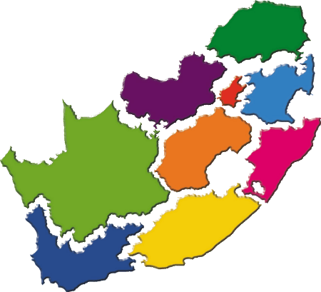
NHLS Diagnostic Services by Province
Province | Limpopo
Total Test Volumes | 6,15 million
2018/2019 financial year
233 NHLS labs in 9 provinces
97 million tests to hospitals and clinics
Province | Gauteng
Total Test Volumes | 27,07 million
Province | Mpumalanga
Total Test Volumes | 5,17 million
Province | North West
Total Test Volume | 4,85 million
Province | Free State
Total Test Volumes | 4,53 million
Province | Northern Cape
Total Test Volume | 1,75 million
Province | KwaZulu-Natal
Total Test Volumes | 25,94 million
Province | Western Cape
Total Test Volumes | 11,69 million
Province | Eastern Cape
Total test Volumes | 10,38 million

Slide 7
Universal Health Coverage (UHC)
The NHLS is committed to the principle of providing universal access to quality health care services for all South Africans.
Key aspects of Universal Health Coverage (UHC) include:
Communities receiving the needed health services without any financial hardship.
Providing a full spectrum of essential, quality health services ranging from health promotion to prevention, treatment, rehabilitation, and palliative care.
Enabling communities to access essential health care services that address the most significant causes of disease and mortality.

Slide 8
Universal Health Coverage (UHC)
The introduction of the National Health Insurance (NHI) will ensure that everyone has access to appropriate, efficient, and quality health services in line with UHC principles.
NHI intends to bring about reforms that will improve service to ensure that all South Africans can use affordable, quality healthcare services regardless of their socioeconomic status.
The National Laboratory Service (NHLS) is confident that the NHI will open up access to health services and achieve UHC.

Slide 9
The NHLS Strategic Objectives Linked to UHC
Improving quality across the spectrum from analytical quality, quality assurance to quality management to laboratory accreditation.
Improving clinical effectiveness by targeting the use of laboratory medicine to improve clinical outcomes. This entails timeous results, clinical interpretation and advisory service and patient-focused medicine.
Improving cost-effectiveness by doing more at equal or higher quality for a lower total cost. This requires the appropriate use of laboratory services, and demonstrating value for money.

Slide 10
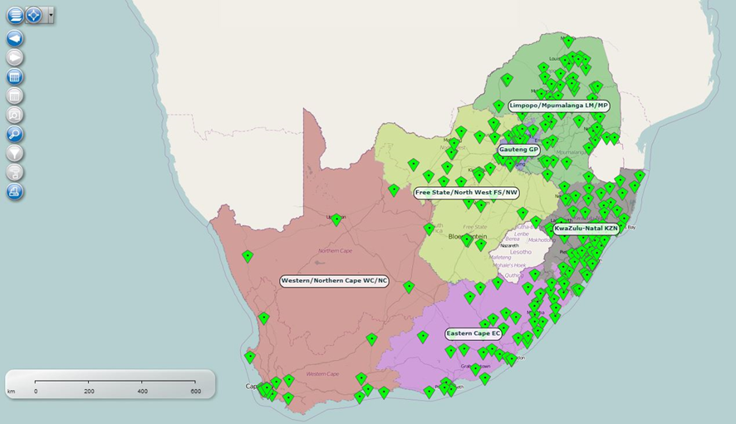
Role of the NHLS under NHI
The NHLS has a mandate to ensure that teaching, research and service is seamlessly delivered across South Africa.
This is confirmed by mandate to provide high quality, efficient and cost-effective services.
The NHLS Act 37 of 2000, Section 15(1) states that the public health sector services must purchase laboratory services from the NHLS.

Slide 11
Role of the NHLS under NHI
The NHLS is the only pathology service provider that could currently ensure adequate coverage and equitable access across the country through its national network of 233 laboratories
No other pathology service is in this a position to deliver such a service, more especially to the rural areas.
The NHLS would be able to quickly and easily provide coverage and access to the private sector by extending the existing laboratory network.

Slide 12
UHC Principle
Migrating from a two-tier to a single-tier health system;
Before the advent of democracy is South Africa, a fragmented and racially biased health system was in place that predominantly benefitted the white minority;
Post democracy, the development of a single non-discriminatory health-care system was proposed; however a two-tier system based on social and class determinants was perpetuated;
The two tier public and private health care system continues to exist in the laboratory and diagnostic sector
A two-tier system is deemed to be unsustainable and very costly

Slide 13
UHC Cube for Laboratory Services
Pathology service | Population Served (%) | Pathology Costs (ZAR) | Services Covered*
Public-sector (NHLS) | 80% | 7 094 905 000 | 99% of testing needs
Private-sector practices | 20% | 8 160 000 000 | 90% of testing needs$
*NHLS has a mandate to provide all the required testing in South Africa. $Low-volume esoteric tests required for patient care is referred to the NHLS by private practices. 90% is an estimate.
The public-sector laboratory services cater for 80% of the population, with similar annual pathology costs for 20% coverage in the private sector.
Furthermore, it provides 99% of national testing needs that include esoteric and specialised assays.
Similar pathology costs are reported by both public and private sector.
Competition Commission (2019) Competition Commission Market Inquiry (CCMI)
Council of Medical Schemes () Council of Medical Schemes Report.

Slide 14
Burden of Disease in South Africa
The population of South Africa is growing rapidly with figures estimating 56,52 million who require health compared to 53,7 million estimated in 2014.
HIV and TB epidemics remains the priority diseases in South Africa and require significant volumes of testing to support the management.
With increase pressure of the 90:90:90 targets and END TB strategies, this is likely to remain an important mandate of the NHLS.
The recent mortality reports, (prior to COVID-19 pandemic), reflects that tuberculosis remains the leading cause of natural deaths, followed by diabetes and cardiovascular diseases.
Non-communicable diseases now contribute to 60% of the top ten causes of death.

Slide 15
Burden of Disease in South Africa
This will require significant strategic planning for supportive laboratory services.
A wave of non-communicable diseases is likely to add further requirements to the laboratory services with Cancer predicted to increase by at least 30% by 2030.
In recent survey in rural South Africa, high rates of stroke, cardiovascular diseases, hypertension and dyslipidaemia were noted in a addition to HIV, with at least 56% of individuals having two or more of these diseases.
In addition, occupational, environmental and safety risk factors, including workplace exposures and injuries, are significant contributors to the global burden of diseases and to morbidity and mortality.
The above demonstrates the increasing need and greater investment in precision laboratory medicine to facilitate greater prevention in public health.

Slide 16
Analysis of laboratory services in South Africa
Category | Public Sector | Private Sector | South Africa
Annual test volumes | 91 302 409 | 53 000 000 | 144 302 409
Annual expenditure | R 7 094 905 000 | R 8 160 000 000 | R 15 254 905 000
Average expenditure per/test | R 78 | R 154 | R 106
Total population served | 46 499 860 | 11 624 966 | 58 124 826
Per capita expenditure | R 153 | R702 | R 262
Competition Commission (2019) Competition Commission Market Inquiry (CCMI)
Council of Medical Schemes () Council of Medical Schemes Report.

Slide 17
Analysis of laboratory services in South Africa (cont.)
We used the NHLS expenditure, Competition Commission Market Inquiry (CCMI) and the Council of Medical Schemes Report data.
There were 91 million tests performed in the public sector compared to 53 million by the private sector. This results in an average expenditure per test of R78 and R154 for the public and private sectors respectively. Using population estimates, the per capita expenditure was R153 in the public sector compared to R702 for the private sector (4.5-fold difference).
This highlights the much higher costs in the private sector, with the potential for costs savings under NHI.
Competition Commission (2019) Competition Commission Market Inquiry (CCMI)
Council of Medical Schemes () Council of Medical Schemes Report.

Slide 18
NHLS Comments on the NHI Bill
Single purchaser and single payer principle
The NHLS is fully supportive of the introduction of the NHI Bill. The NHLS endorses the principles of universal health coverage, efficiency, cost-effectiveness, quality, and equity. We believe that the NHI offers a strategic advantage in the form of monopsony power by creating a market with only one buyer. We believe that the NHI fund will be in a position to pre-dictate prices and set the standard for health care services. The single purchaser and single payer principle are a good funding mechanisms to achieve the UHC objectives.

Slide 19
NHLS Comments on the NHI Bill(cont.)
NHLS as Designated Service Provider
The NHLS recommends that the NHI Fund contracts with the NHLS as a designated service provider for all pathology services. The NHLS has been designated as the service provider for the transition phase. This should be the case beyond the transition period. One of the advantages would be that the NHI can streamline both service provision as well as, pathology payment. The benefits of the NHLS as a designated provided include: The burden of monitoring provision and payments of pathology services can be taken away from the Fund as the NHLS can perform this and report to the NHI Fund

Slide 20
NHLS Comments on the NHI Bill (cont.)
NHLS as Designated Service Provider (cont.)
It would serve as the repository of all laboratory data using systems that have already been established such as the corporate data warehouse and laboratory information system (LIS). These systems could be used to provide national patterns of test utilisation. This would take the burden of monitoring the pathology service from the fund. Laboratory data could also be interfaced with NHI patient record system for bi-directional communication. The NHLS could implement electronic order entry to facilitate paperless tests ordering.

Slide 21
NHLS Comments on the NHI Bill
Composition of the board
In principle, we agree to the concept of technical representation. The experience from the NHLS Board shows that having organisational representatives has the advantage that these organisational representatives provide important feedback on the services and the end user experience. The NHI Board will need to implement mechanisms to obtain feedback from organisations and stakeholders, if the Board only has technical representatives. Consideration should be given to the costs of setting up and running Boards and Committees, which could be substantial. The Fund could be run as a government component/agency and therefore reduce the expenditure on setting up a Board.

Slide 22
NHLS Comments on the NHI Bill
Financing mechanisms
The NHI Bill does not contain much detail on the financing mechanism for different providers. Contracting with the NHLS as the designated service provider has the advantage that the NHI only has to determine the financing mechanism with the NHLS and the same mechanism can then be used by the NHLS to sub-contract with the private laboratories. This mechanism can also be used to cap utilisation and prevent over-servicing. The NHLS has experience in contracting out to the private sector and reimbursing the private sector for services rendered.

Slide 23
NHLS Comments on the NHI Bill
Benefits design
The Bill should state whether the benefit package will be implicit (i.e. name what will be in the package) or explicit (what will be excluded). The Bill should also state how benefits will be paid for if it is not in the benefit package. The NHI Fund should also allow for duplicative health insurance i.e. everyone should be compelled to contribute to mandatory pre-payment. However, for those who want to buy a similar package through voluntary insurance should be able to do so. This will reduce the burden from the NHI Fund. The disadvantage of this however, is that it could lead to a two tier system. This risk can be mitigated by the Fund prescribing administered prices for the voluntary packages.

Slide 24
Conclusion
The NHLS is fully supportive of the initiative to deliver UHC through the NHI.
The role of pathology services is pivotal to the delivery of health care services. The implementation of the NHI will require pathology services to play its role to facilitate improvement of access to health care.
With UHC, more citizens will be able to access health care services that will result in an increased demand for diagnostic testing, both for clinical diagnosis in disease states and for screening of healthy people.
This would require regular data on test utilisation and costs to efficiently manage pathology expenses for the NHI fund.

Slide 25
Conclusion
The NHLS is uniquely placed to fulfil both the mandates of access and coverage as well using existing data systems to provide pathology utilisation data.
In addition, the NHLS has unique pathology expertise to define evidence based best practices for ordering tests to improve the appropriateness of test utilisation.
The combination of our national platform for coverage, lower unit costs, existing data systems and pathologist expertise places the NHLS at a unique position to fulfil a public health mandate.
The NHLS is positioned as the only unified, fully integrated, national public sector pathology organisation to deliver on the NHI mandate.
It is uniquely already well positioned to deliver pathology services for NHI.

Slide 26
THANK YOU

