Slide 1
AMATHOLE DISTRICT MUNICIPALITY (DC12) PRESENTATION ON CONSTRUCTION OF VENTILATED IMPROVED PIT (VIP) LATRINES
PORTFOLIO COMMITTEE ON COOPERATIVE GOVERNANCE AND TRADITIONAL AFFAIRS
20 MAY 2021
EXECUTIVE MAYOR
CLLR. K.C. MANELI

Slide 2
CONTENT
BACKGROUND
SIYENZA CONTRACT TIMELINE
PROGRESS ON PUBLIC PROTECTOR RECOMMENDATIONS IMPLEMENTATION

Slide 3
BACKGROUND: POWERS AND FUNCTION
WATER AND SANITATION;
Municipal Health Services;
Integrated Development Planning for the district as a whole;
Fire Fighting Services;
Solid waste disposal sites;
Regulation of passenger transport services;
Promotion of local tourism for the area of the district municipality;
Municipal public works in respect of any of the above functions

Slide 4
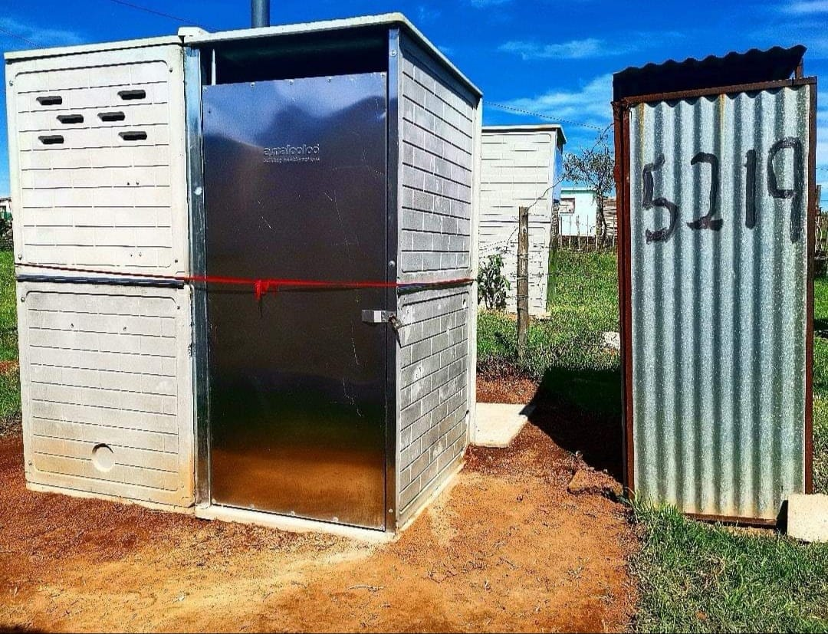
BACKGROUND: SANITATION FUNCTION
Ventilated Improved Pit (VIP) Latrine are a minimum basic level of sanitation service as per the National Standard by Department of Water and Sanitation.
ADM undertakes the installation of VIP latrines through the Accelerated Sanitation Program which is funded through the Municipal Infrastructure Grant (MIG)

Slide 5
SIYENZA CONTRACT TIMELINE
2014
2016
2018
Procurement Process
Regulation 32
Contra Intra Parties
NT commissioned a forensic investigation
Criminal Case Opened
2019
Public Protector Report
ADM Council noted the Public Protector Report with clear resolutions
Arrests and court appearance of the accused
2015
2017
.
Tabling of the Forensic Report by Former MEC of COGTA
Allegations
Court Case

Slide 6
PROCUREMENT PROCESS
ADM initially went out on tender for the supply and installation of latrine pit toilets.
August 2014, ADM notified Rocla, Concretex & Izwelwethu Cemforce that they had been successful in their bids to supply the above-mentioned toilets.
Despite this notice, no contracts were entered into between the ADM and the said tenderers.

Slide 7
REGULATION 32 CONTRACT
12 September 2014, the ADM concluded a contract with Siyenza for the supply and installation of 66 000 toilets at a contract value of R631m, in terms of Regulation 32 of the SCM Regulations with MISA, as MISA had a similar toilet project running and Siyenza was its implementing agent in Northern Cape.
17 September 2014, ADM introduced Siyenza to Rocla, Concretex and Izwelwethu Cemforce as the ADM’s installation/implementing agent of the 66 000 toilets.

Slide 8
CONTRACT INTER PARTIES
Rocla, Concretex & Izwelwethu Cemforce then entered into agreements with Siyenza for the supply of the latrine pit toilets, and Siyenza would appoint local contractors for the installation of the said toilets.
During December 2014, ADM paid Siyenza an amount of around R94m in advance allegedly in lieu of site establishment.

Slide 9
ALLEGATIONS
During early 2015, allegations surfaced that Siyenza was irregularly appointed, and upon further investigation, found that the contract between MISA and Siyenza was not properly concluded, therefore the contract between ADM and Siyenza was by automation also not properly concluded.
When Siyenza was informed about this by ADM, Siyenza brought legal action against ADM in order to retain the contract.

Slide 10
COURT CASE
At the time of the matter going to court, Siyenza was already paid an amount of around R215m for the supply and installation of toilets.
24 November 2015, the High Court ruled, in the matter of Blue Nightingale 397 (Pty) Ltd T/A Siyenza v ADM, that the contract entered into between Siyenza and ADM on 12 September 2014 was unconstitutional, invalid and void ab initio.

Slide 11
FORENSIC INVESTIGATION
NT commissioned a forensic investigation in 2016, which found that ADM received value for money; meaning, they received the actual amount of physical toilets build based on the amount paid to Siyenza.
However, there is a claim of R110m by Rocla, Concretex and Izwelwethu Cemforce & for the supply of toilets and the installation of the said toilets.
The Forensic Report was tabled by former MEC Xasa to ADM Council in 2017
A criminal case was subsequently registered in 2018

Slide 12
PUBLIC PROTECTOR REPORT
The Public Protector Report was tabled to ADM Council in June 2019.
The Public Protector Report recommended, albeit irregularly, that ADM must quantify and pay the service providers their outstanding amounts due, where necessary.
ADM Council resolved that:
Council notes the report of the Public Protector and the Action Plan for remedial action,
Council instructs the Municipal Manager to ensure that the remedial action is implemented as per the Public Protectors’ report, save for those findings that will be taken on review to the High Court;
The Municipal Manager is authorized to institute legal proceedings to review paragraphs 7(ee) and (ff) of the Public Protectors’ report.

Slide 13
PROGRESS TO DATE
The ADM has taken the aforementioned PP remedial action on review, which matter will be heard later this year, given that the ADM does not owe the service providers any monies as no contract was entered into between ADM and the service providers, and based on the fact that Siyenza entered into separate contracts with the different service providers; and given the fact that the ADM received value for money.
Review of SCM policy to ensure the future procurement in terms of Regulation 32 are done within regulations and compliance requirements.
All relevant officials were workshopped on the reviewed SCM policy

Slide 14
PROGRESS TO DATE
Consequence Management:
Senior Manager Legal Services was suspended and subsequently resigned
General Manager Supply Chain was suspended and subsequently resigned
Matter was reported to the Directorate for Priority Crime Investigation and Asset Forfeiture.
Arrest were made of the former Municipal Manager, former CFO, former Director for Enginnering Services and former Director of Corporate Services
The Court Case is currently underway, with two sessions already held.

Slide 15
PROGRESS TO DATE
Rocla, Concretex and Izwelwethu Cemforce have lodged a court process on the claim of R110m by for the supply of toilets and the installation of the said toilets against ADM:
Having obtained legal advice, ADM is not liable for the outstanding debt of the abovementioned service providers as there was no contractual obligation between ADM and the service providers.
In addition, ADM had received value for money in the number of toilets built and supplied by Siyenza

Slide 16
“Bringing ADM Back To Its Former Glory”

