Slide 1
Integrated Database Management System for the Department of Military Veterans 19th May 2021

Slide 2
Contents
SITA Engagement Model
Projects :
- DMV Call Centre
- IDMS Project
IDMS Project Background
IDMS Project Scope
IDMS Solution Benefits
IDMS Project Approach
IDMS Project Delivery Progress
IDMS Costing/Financials

Slide 3
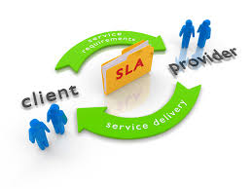
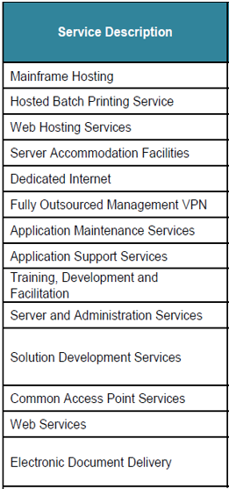
SITA Engagement Model
BUSINESS AGREEMENT (BA)
SITA entered into a BA with DMV in 2012.
The aim of the Business Agreement is for SITA to offer mandatory services as per SITA Amendment Act,2002
SLA ANNEX(ES) - AS PER SITA SERVICE CATALOGUE
Service category and definition
Service Value proposition
Service elements
Service performance metrics
Service roles and responsibilities
Service costing and pricing
Service management conditions (penalties, dependencies, escalations)
PRIMARY SERVICE LEVEL AGREEMENT (SLA)
General service conditions
Special (client specific) conditions
Service Governance

Slide 4
DMV Call Centre
Benefit Statement
SITA provides all technology for DMV with regards to ITSM and Aspect Telephony services. This includes Professional Services to guide the DMV on how to make use of the technology and how to establish a Call Centre Service aligned to the best practice frameworks.
The scope of support from SITA includes guidance on the following areas: Process and Policy requirements Operations of a Call Centre Risk Management Security Management Reporting Mechanisms Maintenance and support of systems IT Service Desk Allow the Customer to use SITA technology to manage and control their own Service Desk Functions
DMV ROLE AND RESPONSIBILITY
The Department is responsible for the management of their own service to their customers
Report all system and telephony related support calls via the SITA Toll free number (0800 11 55 75)
Provide approval within time frames for change control
Inform SITA in writing in the event of decommissioning a service
SITA ROLE ROLES AND RESP0NSIBILITY
SITA supports and maintains the systems.
Provides technical and functional support on SITA’s Service Desk systems
Monthly reporting

Slide 5
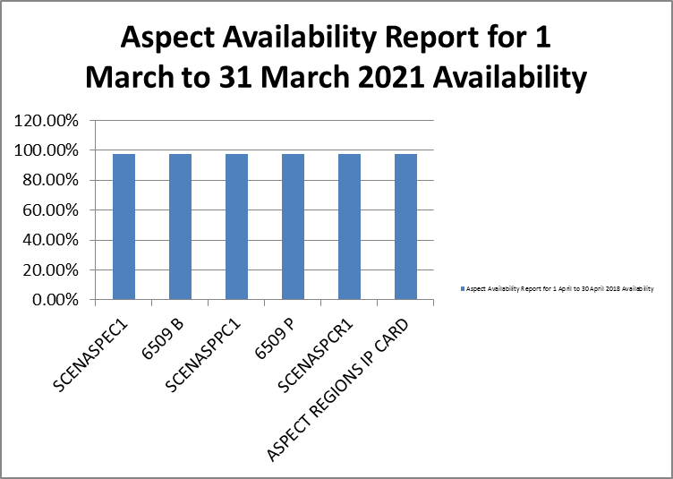
DMV Call Centre Performance
Aspect Servers, ITSM Servers & SMC Reporting Servers are used by DMV to provide call centre services. These servers are constantly monitored by SITA to ensure zero downtime.
The server availability YTD % is as follows:
Aspect: 97.80 % ITSM Servers: 99.38 % SMC Servers: 99.41 %
Aspect Availability Report for 1 April to 30 April 2021
Device Name | Device Role | Availability
SCENASPEC1 | Telephony Integration Server | 97.80%
6509 B | ACD (Automatic Call Distributor) Backup Server | 97.80%
SCENASPPC1 | Telephony Proxy Config Server | 97.80.%
6509 P | ACD (Automatic Call Distributor) Primary Server | 97.80%
SCENASPCR1 | Crystal Reporting Server | 97.80.%
ASPECT REGIONS IP CARD | Telephony IP (Internet Protocol) Card | 97.80%
Average |  | 97.80.%

Slide 6
IDMS Project Background
The Department of Military Veterans (DMV) requested SITA to develop a credible, secure and reliable National Military Veterans database/system (e-DMV) in order to ensure efficient and effective service delivery.
The e-DMV System consists of 14 e-Services to be developed: (e-Registrations and 13 e-Benefits) and integration with internal and external systems.
The project was established in June 2017 and since then the project experienced numerous challenges before it was put on hold in January 2019. It was then resuscitated on the 21st September 2020.
SITA & DMV held a project kick off session during September 2020 to resuscitate the project, a project team was allocated and new project timelines were developed and the project scope was reaffirmed.
In October 2020 a follow up workshop session was held to confirm project artefacts with all key stakeholders, the following was agreed: Governance Sign-off of User Requirements Specification, Technical Solution Design, Project Plans, Timelines, Confirmation of technical resources.
The project team has now established project weekly governance meetings to track progress.

Slide 7
IDMS Project Scope & Integrated Database Management Platform
Counselling Benefit
Migration
Health Care Benefit
Housing Benefit
Training and Skills Benefit
Basic Education Benefit
Employment Placement Benefit
Tertiary Education Benefit
Business Opportunities Benefit
Burial Support Benefit
Rreports
Compensation Benefit
Honouring and Memorialisation
Integration
Registrations
Payment
Social Relief Benefit
DMV Profile
Notifications
Master Data
Military Veteran Benefit Management
Workflow
User Management
Integration
Reporting
Integrated Database Management System
Common components
Secure connection
In Progress
Not Started

Slide 8
IDMS Project : Solution Benefits
The DMV will have a central digital system to keep all IDMS records and it will have the ability to communicate with beneficiaries online.
Central Source of data repository will be ensured.
Only clean data will be migrated to the new solution ensuring data integrity and accurate transactions.
The Integrated Military Database System will be enhanced with intelligence by integrating with external systems and implementation of DMV business process and rules.
DMV will have the ability to fully automate its business processes by establishing MOU’s for data sharing with key partners.
Maintenance of a credible and secure national military veterans database will be ensured.

Slide 9
IDMS Project Approach
Critical modules will be delivered first.
Weekly project governance meetings between SITA and DMV have been established.
Subject Matter Expects are concurrently being engaged to fast track solution development process.
Gap Analysis activity has started for the updated requirements and the existing system,
The previous engagements delivered modules ready for deployment.
A decision was made that requirements be updated to align with the current business needs.
The already developed modules will then be updated, to cater for the revised requirements.
The aim is to deliver critical Modules this financial year.

Slide 10
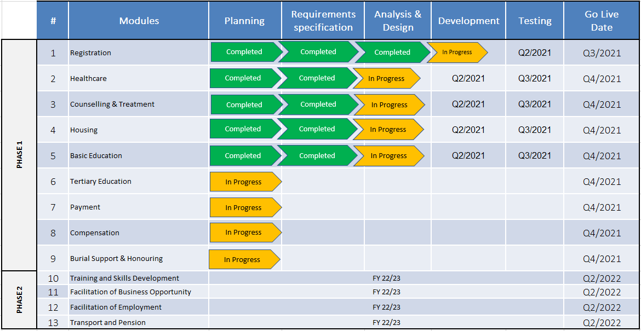
IDMS Project Delivery Progress

Slide 11
IDMS - Costing/Financials
SITA will Invest in the development of the solution for DMV with an understanding that a SLA will be in place post solution Go Live.
Services will be Software as a Service (SaaS). SaaS refers to a software that is centrally hosted in SITA and is used on a subscription basis.

