Slide 1
Contents
THE DSI 2021/22 APP
Select Committee
19 May 2021
Chapter 01
Chapter 01
Chapter 01
Chapter 01
Chapter 01
Chapter 01
Chapter 01

Slide 2
The DSI 2021/22 Annual Performance Plan Cover Page

Slide 3
Table of Contents-1
Mission, vision, values and brand
DSI’s mandate
Context of the 2021/22 Annual Performance Plan
Science, Technology and Innovation in the NDP
2019-2024 Medium-Term Strategic Framework
The 2019 White Paper on Science, Technology and Innovation

Slide 4
Table of Contents-2
Planned initiatives to support the Department’s institutional outcomes
The Department’s contribution to the national COVID-19 response and the ERRP
Medium-Term Expenditure Framework (MTEF) for the Department and its entities
Geographic Footprint of the DSI_STI Projects
Infrastructure projects

Slide 5
Mission, vision, values and brand
Mission
To provide leadership, an enabling environment and resources for STI in support of South Africa’s inclusive and sustainable development.
Vision
Increase well being and prosperity through science, technology and innovation.
Values
Innovation
Knowledge-sharing
Professionalism
Brand
Making sure “its” possible…
Ethical behavior
4

Slide 6
Mandate
Internationalisation/ Regional integration
Knowledge
Generation
Publications
Students
Knowledge to inform dec.making
Knowledge
Utilisation for: Economic development
Knowledge utilisation for: Social (inclusive) development
R & D led industrialisation
Knowledge transfer to society
High tech SMMEs
Prototypes
Patents
Demonstrators
Infrastructure
Human Capital Development
Notes:
Still need to debate whether we combine SO2 and SO4

Slide 7
DSI’s Programmes
Administration
Technology Innovation
White Paper on
S&T, National Research & Development Strategy, Ten-Year Innovation Plan
International Cooperation and Resources
Research Development and Support
Socio-Economic Innovation Partnerships

Slide 8
Context
The 2021/22 Annual Performance Plan is guided by:
The National Development Plan (NDP) – Vision 2030
The 2019-2024 Medium Term Strategic Framework (which is the second five-year phase of the NDP)
The 2019 White Paper on Science, Technology and Innovation which will be further elaborated in the recently Cabinet approved Decadal Plan
The national COVID-19 response and the Economic Reconstruction and Recovery Plan
The Decadal Plan is expected to be approved during the 2021/22 financial year

Slide 9
Landscape for the 2020-2025 DSI Strategic Plan Horizon
NDP Pillars / Drivers
Driving a Strong
& Inclusive Economy
Building & Strengthening the Capabilities of South Africans
Achieving a
more Capable State
2019-24 MTSF
7 APEX PRIORITIES – DSI COMMITMENTS ARE:
Apex Priority 2: Economic Transformation and Job Creation
Apex Priority 3: Education, Skills and Health
Coherent & Inclusive Governance
Expand & Transform HCD
Increase
STI Investment
Expand &
Transform Research Enterprise
Enable Innovation
2019 WP on STI Goals
A transformed inclusive, responsive and coherent NSI
Human capabilities and skills for the economy and for development.
Increased knowledge generation and innovation output
Knowledge utilisation for inclusive development
Knowledge utilisation 4 Eco dev. (a) revitalising existing industries
(b) stimulating R&D-led industrial dev.
Innovation in support of a capable & develop- mental State
2020-2025 Strategic Plan
Decadal Plan
WP Policy Intents; SA Foresight Study on STI; NRDS and TYIP incl. HESTIIL Reviews

Slide 10
THE NATIONAL DEVELOPMENT PLAN
VISION 2030

Slide 11
Science, Technology and Innovation in the NDP…(1)
The National Development Plan (NDP) is a long-term vision for the country, which provides a broad strategic framework to guide key government choices and actions, and focuses on the critical capabilities needed to transform the economy and society.
The NDP highlights the centrality of science technology and innovation (STI) in creating sustainable socio-economic development and addressing societal challenges such as education, health, food security, water shortages and climate change in accelerating economic transformation.
As such the NDP proposed a phased approach in entrenching the contribution of STI to economic growth namely:

Slide 12
Science, Technology and Innovation in the NDP…(2)
Phase 1
(2012-2017)
Phase 2 (2018-2023)
Phase 3 (2023-2030)
Focus on intensifying research and development (R&D) spending, emphasising opportunities linked to existing industries.
Lay the foundations for more intensive improvements in productivity’ where ‘innovation across state, business and social sectors become pervasive.
Emphasis on consolidating the gains on phase 2 with ‘greater emphasis on innovation, improved productivity, more intensive pursuit of a knowledge economy and better exploitation of comparative and competitive advantages in an integrated continent’.

Slide 13
THE MEDIUM-TERM STRATEGIC FRAMEWORK (2019-2024)

Slide 14
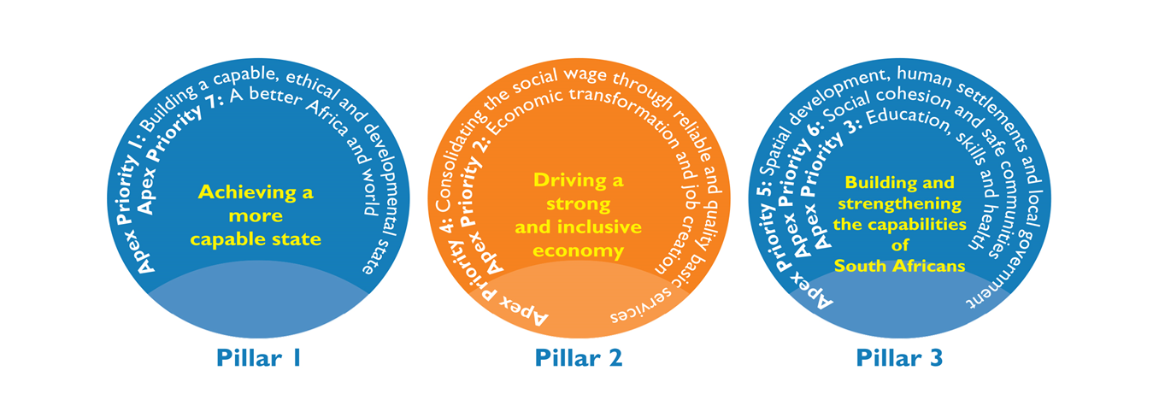
2019-2024 Medium-Term Strategic Framework – MTSF
The 2019-2024 MTSF is premised on three pillars with seven associate apex priorities over the medium-term in addressing the triple challenges of unemployment, inequality and poverty as well as playing a catalytic role in achieving the NDP targets:

Slide 15
The Department’s contribution to the MTSF priorities
Priority 1- A Capable, Ethical and Developmental State
Innovation in support of a capable and developmental state
District- Metro Coordination Model to Improve the Coherence and Impact of Government Service Delivery and Development
Provide timely, accurate and independent data and information for mega projects monitoring and evaluation.
14

Slide 16
Supporting other priorities of the 2019-2024 MTSF…(1)
Priority 2: Increase the contribution of digital economy to GDP through 4IR
Achieving 100% universal broadband by aligning and contributing to the DoC Satellite Communication Strategy.
Priority 3: Education, Skills and Health
TB treatment research success rate
Better diagnostics
TB therapies
Local manufacturing of TB drugs
Development of treatment and prevention technologies for HIV, NCD and maternal health care.
Priority 4: Consolidating the social wage through reliable and quality basic services
Innovative technology approaches for the delivery of basic services (energy, water, sanitation, roads).
15

Slide 17
Supporting other priorities of the 2019-2024 MTSF…(2)
Priority 6: Spatial integration, human settlements and local government
Provision of applications and products for precision agriculture, human settlement and water bodies information layers.
Demonstrations in partnership with the Department of Mineral Resources and Energy to assess the appropriateness of new technologies such as hydrogen fuel cells to improve service delivery.
Provision of information for air quality information system, land cover and land use mapping, frequent information on weather patterns, and human activity on critical resources such as water, land and air.
Provision of decision support tools, human settlements layer, water bodies information layer.
16

Slide 18
THE 2019 WHITE PAPER ON SCIENCE, TECHNOLOGY AND INNOVATION

Slide 19
2019 STI White Paper
The 2019 White Paper on Science, Technology and Innovation vision is “enabling sustainable inclusive SA development in a changing world”.
The White Paper policy intents are aimed at significantly growing the contribution of STI to South Africa’s national priorities.
The 2020 Decadal Plan will serve as the implementation plan for the 2019 STI White Paper.

Slide 20
Objectives of the 2019 STI White Paper
Adopt a whole-of-government/society approach to innovation.
Instil a culture of valuing STI, and integrate STI into government planning and budgeting at the highest levels.
Create an enabling and inclusive governance environment.
Create a more innovation-enabling environment.
Increase and transform NSI human capabilities.
Expand and transform the research system.
Expand and transform the institutional landscape.
Increase funding and funding efficiencies.

Slide 21
INSTITUTIONAL OUTCOMES OF THE DEPARTMENT – PLANNED INITIATIVES

Slide 22
The DSI Six Outcomes
A transformed, inclusive, responsive and coherent NSI
Knowledge utilisation for economic development (a)
revitalising existing industries
(b) stimulating R & D led industrial development
Human capabilities and skills for the economy and for development
Innovation in support of a capable and develop- mental State
Increased knowledge generation and innovation output
Knowledge utilisation for inclusive development
Partnerships
Internationalisation
Transformation

Slide 23
OUTCOME 1: A transformed, inclusive, responsive and coherent NSI
Outcome Statement: Over the next 5 years expand, transform and enhance the responsiveness of the NSI.
# of missions introduced and adopted by Cabinet that crowd in resources and capabilities across the NSI;
% increase in the investment support by government that advances GERD towards 1,1% of GDP; and
OUTCOME INDICATORS:
% increase in the number of formalised partnerships between different category actors of the NSI that advance Decadal Plan priorities;
# of approved strategies that give effect to the agreed dimensions of transformation to be effected in the NSI

Slide 24
Implementing Outcome 1
Outcome 1: A transformed, inclusive, responsive and coherent NSI
Planned policy initiatives/ targeted interventions:
Finalise Transformation Framework to strengthen the Department’s transformation agenda
Finalise the Decadal Plan which will be the implementation plan 2019 WP for STI, and define critical missions that will be attend to between 2021-2031; [coherent]

Slide 25
Cont…
Support grassroots innovators and support new entrants into the economy, via targeted RDI instruments; [inclusive]
Example: support 200 black emerging farmers with innovation support
Modernisation of sectors of the economy such as manufacturing, agriculture and mining to ensure that these sectors are competitive and can contribute to higher GDP growth; [responsive]
Finalise the Decadal Plan which will be the 2019 WP for STI implementation plan and define critical missions that will be attend to between 2021-2031; [coherence]

Slide 26
OUTCOME 2: Human capabilities and skills for the economy and for development
Outcome Statement: Over the next five years improve the representivity of high end skills and increase the development of technical and vocational skills for the economy.
# of artisans and technicians trained in high-tech industries and absorbed into the economy;
% increase of women and black researchers in South African research workforce;
# increase of PhD-qualified teaching and research staff; and
Improved knowledge of science among citizens
OUTCOME INDICATORS:
# of DSI- funded PhDs graduating annually as a contribution to the NDP target of 100 PhDs per million population by 2030;

Slide 27
Implementing Outcome 2
Outcome 2: Human capabilities and skills for the economy and for development
Planned policy initiatives/ targeted interventions
Support more than 8 200 Honours, Master’s and PhD students across programmes by 31 March 2022;
Place at least 975 graduates in DSI- funded work preparation programmes (the internship programme) (750 from programme 4 and 225 programme 2);
Support 20 artisans;
Provide 250 research infrastructure grants; and

Slide 28
Cont…
Support the development of critical high-end skills in selected technology areas such as the bioeconomy, space science and technology, energy, intellectual property management nanotechnology, robotics, photonics and areas of technology convergence that are important in building a knowledge society by providing 580 postgraduate bursaries (390 programme 5 and 190 programme 2) in the areas mentioned above.

Slide 29
OUTCOME 3: Increased knowledge generation and innovation output
Outcome Statement: Over the next five years increase the relative contribution of South African researchers and public research institutions to global scientific and innovation output.
Increase South Africa's share (percentage) of global publication outputs;
% increase in prototypes, technology demonstrators and pilot plants that advance industrialisation through innovation; and
# of patents, plant breeders' rights, trademarks and/or designs from publicly financed R&D registered with formal examination offices (as applicable).
OUTCOME INDICATORS:

Slide 30
Implementing Outcome 3
Outcome 3: Increase knowledge generation and innovation outputs
Planned policy initiatives/ targeted interventions
7 000 Internationally accredited research articles from researchers
Award 3 000 research grants through NRF-managed programmes
fast-tracking interventions aimed at PhD qualification among non- PhD-qualified staff;
Interventions to improve the publishing rate of academics at HDIs to increase research outputs per capita;
70 demonstrators, prototypes and others innovation outputs (10 programme 2 and 60 in programme 5); and
258 disclosures from publicly-funded research.

Slide 31
Cont…
The department will measure and track the number of outputs commercialised as a result of support provided in designated areas; e.g. licenses, assignments, options of varying nature (such as directed research, joint ventures and the like), start-ups, spin outs, new companies etc.;
Expand the roll-out of the South African National Research Network (SANReN) to TVETs and increase the total available broadband capacity to 5 800Gbps; and
Establish IK-Based Bio-Innovation Institute to interface and mainstream African wisdoms for applied integral research, inclusive innovation, local technology transfer, holistic enterprise development and conscious commercialisation.

Slide 32
OUTCOME 4: Knowledge utilisation for economic development - a) in revitalising existing industries (b) in stimulating R&D led industrial development
Outcome Statement: Over the next 5 years improve the sustainability and competitiveness of traditional sectors of the economy and initiate/ continue RDI in emerging and/or nascent technology areas that could enable the development of non-traditional economic sectors.
OUTCOME INDICATORS:
Rand value of RDI investment attracted to support RDI needs identified through the sector masterplans process;
% increase in SMMEs/co-operatives whose performance has improved or who secured new opportunities through support provided by the DSI and its entities;

Slide 33
OUTCOME 4: Cont…
% increase in the commercialisation of granted intellectual property rights from publicly funded R&D; and
# of new R&D-led industrial development opportunities initiated by the DSI.
OUTCOME INDICATORS:
Outcome Statement: Over the next 5 years improve the sustainability and competitiveness of traditional sectors of the economy and initiate/ continue RDI in emerging and/or nascent technology areas that could enable the development of non-traditional economic sectors.

Slide 34
Implementing Outcome 4
Outcome 4: knowledge utilisation for economic development in
revitalising existing industries and
stimulating R&D led industrial development.
Planned policy initiatives/ targeted interventions
Introduction of the Sovereign Innovation Fund (SoIF), which will serve as a new financing instrument in partnership between the public and private sectors with the sole purpose of harvesting and commercialising the South African technology innovations for deployment in national and international markets;
Participate in the development of sectoral master plans i.e. agriculture, the oceans economy, energy, mining and health;

Slide 35
Cont…
Implement common flagship programmes in support of priority sectors as reflected in the national reimagined/revitalised industrial strategy;
Partnering with the DMRE in deploying fuel cells at government buildings and critical infrastructure such as airports, as well as rural formal and urban informal settlements to reduce the impact of rolling blackouts; and
Using industrial ports as the nerve centres for scaling up the use of clean hydrogen towards building a Hydrogen Economy in SA.

Slide 36
Cont…
The DSI leads the RDI aspect of the national master plan programme on medicinal cannabis and hemp in developing medicines, nutraceuticals and cosmeceuticals from cannabis in collaboration with other government departments, civil society, academia and business grounded on the principles of socio-economic transformation, i.e. inclusion of women and youth.
The DSI will continue managing a portfolio of projects with a potential of creating new industries or rejuvenating existing industries.

Slide 37
OUTCOME 5: Knowledge utilisation for inclusive development
Outcome Statement: Over the next five years, expand the use of scientific knowledge (as evidence) in support of innovation for societal benefit and public good.
OUTCOME INDICATORS:
Grassroots innovations whose commercialisation has been facilitated by the support/access of the multi-tiered support package provided by the DSI and its entities; and
Publicly financed IP made available (accessible) in support of grassroots innovators

Slide 38
Implementing Outcome 5
Outcome 5: knowledge utilisation for inclusive development
Planned policy initiatives/ targeted interventions
In line with the national development profile and social dynamics and ensuring knowledge for inclusive development enable innovation deployment, the department will expand the multi-tiered package to support commercialisation of grassroots innovations, through technology development, compliance with industry standards where applicable, and protection of IP and mentorship;

Slide 39
Cont…
More deliberate focus on IP related solutions that will enable and improve access to basic services, strengthening the capacity of the state in service delivery and promote the inclusion of women, youth and people living with disabilities; and
Facilitate commercialisation of grassroots innovation and its access to publicly available IP in line with the commitment for the deployment of locally developed technology solutions, using instruments such as technology demonstrations, agroprocessing facilities and support for entrepreneurs.

Slide 40
OUTCOME 6: Innovation in support of a capable and developmental State
Outcome Statement: Over the next 5 years, improve the adoption of innovation and technology in service delivery and efficiency of government programmes and services.
Increase in the number of use cases of decision-support systems;
# of demonstrators that have successfully introduced a new way of delivering a service;
# of district/metropolitan municipalities supported with technology-based applications as part of the District Development Model for service delivery improvement; and
Evidence of informed integration of innovation in service delivery.
OUTCOME INDICATORS:

Slide 41
Implementing Outcome 6
Outcome 6: Innovation in support of a capable and developmental state
Planned policy initiatives/ targeted interventions
The Department will be more deliberate in promoting the expansion of piloted solutions that enable and improve access to basic services such as waste and water management, housing, sanitation and energy provision and that strengthen the capacity of the state in service delivery.
Locally developed technology deployment in support of the use of innovation in implementing State policies in Basic Education, e-Health, infrastructure project scoping etc.

Slide 42
CONTRIBUTION TO THE NATIONAL COVID-19 RESPONSE AND THE ERRP

Slide 43
Innovation in support of COVID-19:
Analytics and modelling-1
The DSI has coordinated a package of responses across the NSI to address South Africa’s readiness for the impact of COVID-19. The response has been centred on the following four pillars:
Analytics and modelling.
Research and innovation.
Manufacturing.
International cooperation initiatives in support of the global response to the pandemic.
3

Slide 44
Innovation in support of COVID-19:
Analytics and modelling-2
Analytics and modelling:
Models for predicting the spread of the virus.
Data visualisation dashboard.
Response strategy modelling/integration platform – CMORE.
Epidemiological and response strategy modelling.
COVID-19 vulnerability assessment – Gauteng City Region.
Infection data, including recovery and mortalities.
Research coordination with relevant HEIs and science councils.
Survey to assess the understanding and attitudes of South Africans.
3

Slide 45
Innovation in support of COVID-19:
Research and innovation
Rapid tool development
Targeted surveillance
Sentinel, surveillance of adults hospitalised for severe acute respiratory infection.
Covid Diagnosis & Surveillance
For treatment and prophylaxis for highly exposed individuals.
Repurposing of drugs for treatment of mild cases
For R&D for candidate vaccines.
Therapeutic trials
Establishing a repository of whole blood samples for possible genetic markers
predisposing to severe COVID-19 disease.
Serological and genomic investigations of SARS-CoV-2 among HIV-infected and HIV-uninfected individuals and those with TB.
Monoclonal antibodies, immunoglobulins and molecular epidemiology.
Analytics and modelling
4

Slide 46
Innovation in support of COVID-19: Research and innovation
Centre for Proteomic and Genomic Research (“CPGR”) provided 20 018 tests to support NHLS.
CSIR Biosciences Lab has conducted
16 986 SARS-CoV-2 diagnostic tests for eight different entities to date.
Universities testing support: the KwaZulu-Natal Research Innovation and Sequencing Platform (KRISP)
Sequencing the SARS Cov 2.
Training for hospital frontline staff
Data Centre, CHPC,
Centres of Centre for and
Excellence (SA Epidemiological
Modelling
Analysis-SACEMA)
5

Slide 47
Innovation in support of COVID-19:
High-tech manufacturing-1
STI in support and as a lever and enabler of industrialisation in the National Ventilator Project (NVP) for COVID-19 in SA and potential export to SADC.
The National Ventilator Project harnesses the capabilities of SA industry.
The systems engineering methodology and procurement practices used by SARAO to realise the MeerKAT were recognised as appropriate to this task.
Minister Ebrahim Patel, Department of Trade, Industry and Competition (DTIC), established the NVP.
6

Slide 48
Innovation in support of COVID-19:
High-tech manufacturing-2
SARAO, a facility of DSI entity the National Research Foundation (NRF),
was mandated to run the project together with the CSIR
By end of September, 20 000 ventilators will be delivered.
6

Slide 49
National Ventilator Project – project execution plan
Wed 1 April
Fri 3 April
Sat 4 April
Fri 12 June
9
5
9 e
⁵ Jun
12
6
l SAH
Apri ^{PRA}
Fun
¹⁷ din
g
6
Fri 17 April
SAHPR
A
Funding
20,000 Units by end of September
O2/air blenders
7

Slide 50
International cooperation initiatives in support of the global response to the pandemic-1
Part of the Solidarity core protocol, an international study of COVID-19 treatments for hospitalised patients (a treatment clinical trial where diagnosed patients receive treatment with drug regimens, e.g. ARVs, believed to have an effect).
OECD debate: STI readiness and response in times of global emergencies – the COVID-19 pandemic
Engagement with the South African diplomatic community – views and ideas regarding cooperation on COVID-19.
Collaborative request from China for vaccines, diagnostics, therapy and IKS.
8

Slide 51
International cooperation initiatives in support of the global response to the pandemic-2
Collaborative request from China for vaccines, diagnostics, therapy and IKS.
SA (DSI-funded) companies partnering with SADC countries for diagnostics reagents development (TokaBio, CapeBio). Reducing morbidity and mortality in health care workers exposed to COVID-19 through BCG vaccination.
Biopharming – partnerships by CSIR and Cape Bio Pharms for plant-based production of highly potent anti-viral antibodies approach to COVID-19 vaccine development with BAT via their subsidiary Kentucky Bioprocessing (KBP) and Merck (Geneva).
8

Slide 52
STI Contributions to ERRP (1)
Key sub-outcomes of relevance | Current DSI Investments contributing to the priority or one or more of the key sub-outcomes
PRIORITY 1: ENSURING ENERGY SECURITY
1.5 - Diversification of energy sources within just transition context. 1.7 - Continuation of the implementation of the IRP to ensure diversification of resources | Hydrogen South Africa
PRIORITY 2: INDUSTRIALIZATION / GROWING THE PRODUCTIVE ECONOMY
2.1 - Strategic localisation to repurpose SA’s manufacturing sector 2.2 - Maximise localisation to cover supplier development and also increase the number of designated projects 2.4 - Improve efficiencies of local producers | Sector Innovation Funds Mandela Mining Precinct Technology Localisation Strategy Technology Stations Programme Smart Factory Programme (CSIR)

Slide 53
STI Contributions to ERRP (2)
PRIORITY 2: INDUSTRIALIZATION / GROWING THE PRODUCTIVE ECONOMY (cont.)
2.7 - Develop local supplier industries for infrastructure delivery 2.8 - Support for local manufacturing as well as firms and households in distress 2.9 - Strengthen SMMEs and cooperatives on the back of localisation and support for badly affected labour intensive industries 2.10 - Export promotion and regional integration, support for township and village economies 2.11 - Implement the digital economy master plan | Industry Development Centres Aeroswift Fluorochemicals Expansion Initiative Maritime Domain Awareness Satellite Constellation in support of Operation Phakisa (Oceans Economy) Space: Local launch capability in South Africa Biomanufacturing Industry Development Centre (BIDC), Biorefinery Development Facility (BDF(, Nanomaterials Industrial Development Facility (NIDF) Photonics Prototyping Facility (PPF) Green Economy for Development

Slide 54
STI Contributions to ERRP (3)
PRIORITY 2: INDUSTRIALIZATION / GROWING THE PRODUCTIVE ECONOMY (cont.)
2.12 - Enable emergence of an industrial and medicinal hemp and cannabis industry 2.18 - Deepen localisation including innovation and financial inclusion | mLab (Codetribe Academy) DSIDE Tech. Acquisition and Deployment Fund
PRIORITY 3: MASS PUBLIC EMPLOYMENT
3.2 - Implement environment and circular economy programme 3.4 - Support ECD and community health 3.6 - Invest in creative and cultural sectors 3.8 - Skills development, intensify the interventions in the arts and cultural sector in the context of mass employment 3.9 - Environmental restoration and ecological services programme as well as war on waste. | Health Promotion Agents Water graduate programme Envirochamps Experiential Training Programme Imvelisi Grassroots Innovation Programme Community Journalist Programme SmartStart IT platform

Slide 55
STI Contributions to ERRP (4)
PRIORITY 4: INFRASTRUCTURE (NDP 2030 PRIORITIES)
4.1 - Accelerate implementation of shovel ready projects and those identified through the SIDS process as well as regulatory reforms aimed at building broad-based public-private partnerships 4.6 - Rebuild SA construction sector 4.13 - Broadband rollout 4.14 - Bulk Water infrastructure 4.15 - Energy sector reforms (Legislative amendments and regulations to enable the implementation of the IRP and renewable energy programme) | Space Infrastructure Hub SANREN Sustainable Human Settlements STI roadmap South African Sanitation Technology Demonstration Programme (SASTEP) Water Technologies Demonstration Programme (WADER) EcoSun demonstrator project
PRIORITY 5: Macro-economic interventions and enablers for ec. growth
5.4 - End wastage including enhanced productivity 5.8 - Review and integrate government support for formal and informal SMMEs, start-ups and cooperatives 5.13 - Skills strategy reorientation to respond to demands

Slide 56
STI Contributions to ERRP (5)
PRIORITY 6: GREEN ECONOMY
6.1 - Waste recycling, beneficiation and transition to circular economy 6.2 - Market tools, local beneficiation and export potential ash, gypsum, slag and biomass 6.3 - Waste picker integration and revitalisation of buy-back centres and improved management of landfill sites. 6.5 – Diversion of waste from landfills to industries (batteries, lighting, e-waste, tyres, paper and packaging). | Waste RDI Water RDI Green Economy for Development SASTEP 3D printing of houses
PRIORITY 7: AGRICULTURE AND FOOD SECURITY
7.2 - Ensuring more support to emerging and small- scale farmers. 7.8 - Intensify agricultural research and introduce new smart agriculture technologies | Various crop improvement programmes Agriculture Sector Innovation Funds (SIF’s) Animal health cluster for the development of animal vaccines

Slide 57
2021/22 Output Performance Indicator Analysis Programme

Slide 58
MTEF Allocations per Programme
Programme | Adjusted Appropriation 2020/21 | MTEF ALLOCATION
 |  | 2021/22 R’000 | 2022/23 R’000 | 2023/24 R’000
Administration | 294 416 | 328 196 | 332 550 | 333 293
Technology Innovation | 1 397 065 | 1 780 222 | 1 783 283 | 1 793 320
International Cooperation and Resources | 119 302 | 146 625 | 149 090 | 149 466
Research Development and Support | 3 735 718 | 4 949 244 | 5 093 259 | 5 192 081
Socio-economic Innovation Partnerships | 1 731 786 | 1 729 028 | 1 769 794 | 1 776 421
Total | 7 278 287 | 8 933 315 | 9 127 976 | 9 244 581

Slide 59
2021/22 Budget Analysis per Programme

Slide 60
MTEF Allocations per Economic Classification
Economic Classification | Adjusted Appropriation 2020/21 | MTEF ALLOCATION
 |  | 2021/22 R’000 | 2022/23 R’000 | 2023/24 R’000
Compensation of employees | 361 993 | 358 003 | 358 364 | 358 376
Goods and services | 119 869 | 208 465 | 213 906 | 214 717
Transfers and subsidies | 6 789 431 | 8 363 994 | 8 552 691 | 8 668 340
Payments for capital assets | 6 994 | 2 853 | 3 015 | 3 148
Total | 7 278 287 | 8 933 315 | 9 127 976 | 9 244 581

Slide 61
2021/22 Analysis per Economic Classification

Slide 62
ALLOCATIONS TO DSI PUBLIC ENTITIES

Slide 63
MTEF Allocation to Public Entities
Public Entities | 2021/22 R’000 | 2022/23 R’000 | 2023/24 R’000
Technology Innovation Agency | 447 703 | 458 370 | 460 131
South African National Space Agency | 202 193 | 162 439 | 163 063
Academy of Science of South Africa | 33 210 | 33 839 | 33 970
National Research Foundation | 962 587 | 986 202 | 989 991
Council for Scientific and Industrial Research | 978 449 | 1 002 269 | 1 006 119
Human Sciences Research Council | 314 394 | 321 098 | 322 332
Total | 2 938 536 | 2 964 217 | 2 975 606
NB: MTEF allocation to public entities comprises of parliamentary grants only.

Slide 64
2021/22 Budget Allocation Analysis per Entity

Slide 65
MTEF Allocations per Programme
Programme | Adjusted Appropriation 2020/21 | MTEF ALLOCATION
 |  | 2021/22 R’000 | 2022/23 R’000 | 2023/24 R’000
Administration | 304 107 | 328 196 | 332 550 | 333 293
Technology Innovation | 1 378 321 | 1 780 222 | 1 783 283 | 1 793 320
International Cooperation and Resources | 116 802 | 146 625 | 149 090 | 149 466
Research Development and Support | 3 745 248 | 4 949 244 | 5 093 259 | 5 192 081
Socio-economic Innovation Partnerships | 1 733 809 | 1 729 028 | 1 769 794 | 1 776 421

Slide 66
2021/22 Budget Analysis per Programme

Slide 67
DSI INFRASTRUCTURE PROJECTS

Slide 68
DSI 2021/22 Infrastructure Projects
Infrastructure Projects | Programme | Outputs | 2021/22 Allocation
Square Kilometer Array (SKA) | Research Development and Support | Installation of 2 of the 3 science modes (UHF and LSP). | R802 407 000
South African Research Infrastructure Roadmap (SARIR) |  | The 4 RIs to be initiated: South African Marine and Antarctic Research Facility; 2. Nano Manufacturing facility; 3. Solar Research Facility; and 4. Materials Characterisation Facility. | R346 666 000

Slide 69
DSI 2021/22 Infrastructure Projects
Infrastructure Projects | Programme | Outputs | 2021/22 Allocation
National Integrated Cyberinfrastructure System (NICIS) | Research Development and Support | 1. Increase the total available broadband capacity provided by SANReN annually. 2. Increase the data storage capability through DIRISA Projects. 3. Conduct a feasibility study to increase the compute capability to 10 Pflops. 4. Graduate master’s students in e-science through the National e-Science Postgraduate Teaching and Training Platform. | R272 121 000

Slide 70
Geographic Footprint of DSI_STI Projects

Slide 71
DSI STI Interventions Footprint
Name of the Province | Name of the Project | Project in brief
Northern Cape | Construction of the SKA Science Tourism Centre in Carnavon | To develop and construct the SKA science tourism centre aligned to the MeerKAT and SKA telescopes. The construction of the centre will bring about short-term construction-related jobs, opportunities for local suppliers; a limited number of longer-term jobs in running the centre, and increased tourism with all its attendant benefits.
All provinces | Structured school-based science engagement initiative | Build and enhance the culture of science in South African schools

Slide 72
DSI STI Interventions Footprint
Name of the Province | Name of the Project | Project in brief
Free State KwaZulu-Natal Gauteng Limpopo Mpumalanga Northern Cape Western Cape | The National Recordal System (NRS) Initiative. | The ultimate aim is to create opportunities for benefits to flow back to the communities. The project is implemented through Indigenous Knowledge Systems Documentation Centres (IKSDCs) in nine provinces. One of the objectives of the initiative is to develop human resources and institutional support to enable communities to record their indigenous knowledge. Although the positions created are temporary, the impact it has on the lives of the people cannot be underestimated.

Slide 73
DSI STI Interventions Footprint
Name of the Province | Name of the Project | Project in brief
North West Western Cape Gauteng | Hydrogen South Africa (HySA) | Aimed at developing South African intellectual property, knowledge, human resources, products, components and processes to support the South African participation in the nascent, but rapidly developing Hydrogen and Fuel Cell Technologies. HySA focusses on harnessing South Africa's mineral endowments to promote the development of a hydrogen economy and use of renewable energy resources. Ultimately the objective is to find alternative applications for the platinum group metals (PGMs) in cleaner energy sources, in order to mitigate the potential decline in the use of PGMs in internal combustion engines.

Slide 74
DSI STI Interventions Footprint
Name of the Province | Name of the Project | Project in brief
All provinces | IP Wise™ awareness sessions | The IPWise initiative was developed specifically with researchers/ students in mind who develop intellectual property as they conduct their research and development. These one-day workshops are designed to raise awareness about what intellectual property is, what to do when it intellectual property is created, what precautions should be taken during the research process and before protecting the intellectual property.

Slide 75
DSI STI Interventions Footprint
Name of the Province | Name of the Project | Project in brief
Cont… | Cont… | Furthermore, the commercialisation pathways are explained so that researchers/ students have a clear understanding of the journey that lies ahead in the technology transfer process. In line with the DSI vision -NIPMO extended the reach of its IP Wise™ awareness sessions to Technical and Vocational Education and Training (TVET) colleges around the country! During 2020/21, IP Wise™sessions were completed at Gert Sibande TVET college (Mpumalanga) with many more planned for the future.

Slide 76
DSI STI Interventions Footprint
Name of the Province | Name of the Project | Project in brief
North West Western Cape Gauteng | Hydrogen South Africa (HySA) | Aimed at developing South African intellectual property, knowledge, human resources, products, components and processes to support the South African participation in the nascent, but rapidly developing Hydrogen and Fuel Cell Technologies. HySA focusses on harnessing South Africa's mineral endowments to promote the development of a hydrogen economy and use of renewable energy resources. Ultimately the objective is to find alternative applications for the platinum group metals (PGMs) in

Slide 77
DSI STI Interventions Footprint
Name of the Province | Name of the Project | Project in brief
Cont… | Cont… | cleaner energy sources, in order to mitigate the potential decline in the use of PGMs in internal combustion engines.
Kwazulu-Natal | Biorefinery | Many opportunities for socio-economic development exist across the biomass value chain that can be unlocked through biorefineries, from biomass production, energy production, production of primary and commodity outputs (polymers and bulk chemicals), food and feed production as well as high value speciality products such as pharmaceuticals and cosmetics.

Slide 78
DSI STI Interventions Footprint
Name of the Province | Name of the Project | Project in brief
Limpopo And in negotiations with the Eastern Cape | Precision Agriculture Information System (PAIS) | The project focuses on developing a PAIS that will provide near real-time farm scale information to small scale farmers in South Africa to address issues of food security in the country, and government’s agricultural policies. Over and above developing PAIS, the CSIR will also invest in awareness, encouraging youth involvement in agriculture, empowering farmers to use data at farm level for decision making.
Limpopo And in negotiations with the Eastern Cape | Precision Agriculture Information System (PAIS) | The project focuses on developing a PAIS that will provide near real-time farm scale information to small scale farmers in South Africa to address issues of food security in the country, and government’s agricultural policies. Over and above developing PAIS, the CSIR will also invest in awareness, encouraging youth involvement in agriculture, empowering farmers to use data at farm level for decision making.

Slide 79
DSI STI Interventions Footprint
Name of the Province | Name of the Project | Project in brief
All Provinces | Agricultural Bio-innovation Partnership Programme (ABIPP) Projects | Provides access to new technologies such as improved drought tolerant cultivars (wheat, maize), technology support for climate resilience and pest and disease management, as well as animal improvement (breed selection, vaccine development and wet carcass improvement). Other projects include technology support for agroprocessing (marula, honeybush, cape aloe) and farmer development support (technology transfer). Food and Nutrition projects include Soy products, Nixtamalisation and

Slide 80
DSI STI Interventions Footprint
Name of the Province | Name of the Project | Project in brief
Cont… | Cont… | Commercialisation of Nutrient-Dense and Drought Tolerant Traditional and indigenous Crops (Amadumbe, Bambara groundnut and leafy vegetables). Feasibility studies and value chain development for canola, cassava, sorghum and dryland are also in progress.
All provinces except the Northern Cape | Indigenous Knowledge-Based Bio-Innovation Programme | The Indigenous Knowledge-Based Bio-Innovation Programme has six Platforms in African Medicines, Cosmeceuticals, Nutraceuticals, Health Infusions, Technology Transfer and Commercialisation. This is a consortium of science councils, universities, government and indigenous knowledge organisation.

Slide 81
DSI STI Interventions Footprint
Name of the Province | Name of the Project | Project in brief
All Provinces | Strategic Health Initiatives Partnership | The DSI is supporting a number of research and innovation projects with the aim of facilitating the development of locally appropriate tools to address the burden of disease in South Africa. To date, the focus has been on communicable and non-communicable diseases, including interventions aimed at addressing maternal and child health. Amongst the projects being supported is the development/use of Umbiflow to screen low risk pregnancies for placental abnormalities that could lead to still births.

Slide 82
DSI STI Interventions Footprint
Name of the Province | Name of the Project | Project in brief
Cont… | Cont… | The project involves a joint collaboration between the Council for Scientific and Industrial Research (CSIR - Gauteng), the South African Medical Research Council (SAMRC – Western Cape) and the University of Pretoria. Umbiflow, designed for use in resource-limited settings, has demonstrated significant potential in reducing premature births and child mortality. Furthermore, strategic investments have been made to enable the development of affordable, effective and locally appropriate solutions such as vaccines, therapeutics, medical

Slide 83
DSI STI Interventions Footprint
Name of the Province | Name of the Project | Project in brief
Cont… | Cont… | devices, diagnostics and other prevention strategies to address HIV/AIDS, TB, malaria and COVID-19. While these initiatives are coordinated and managed by the SAMRC on behalf of the DSI, the recipients of the research grants are located at a number of academic and research institutions across the nine provinces in South Africa, and the outputs of these investments will be implemented nationally.

Slide 84
Maps of DSI Projects in Districts
Maps presented below are indicative of the spatial footprint of DSI’s interventions in provinces;
Not all projects are reflected on the map due to the scale of the map;
DSI has embarked on mapping all initiatives as part of the DDM journey, this is work is in progress;
The maps below indicate a spatial footprint of DSI interventions across districts, but some projects have not be indicated at this scale.
The DSI’s DDM approach is likely to crowd in projects that are responsive to the district profiles and challenges and have been
83

Slide 85
Maps of DSI Projects in Districts
selected as high impact projects to support the districts.
An accurate spatial footprint of DSI’s initiatives and the number of interventions at each district will be presented through mapping DSI’s initiatives at each district rather than at a national scale;
Mapping of DSIs DDM interventions is an on- going process, running parallel to the DSI’s process of packaging and selecting the most responsive projects to support the Districts.
84

Slide 86
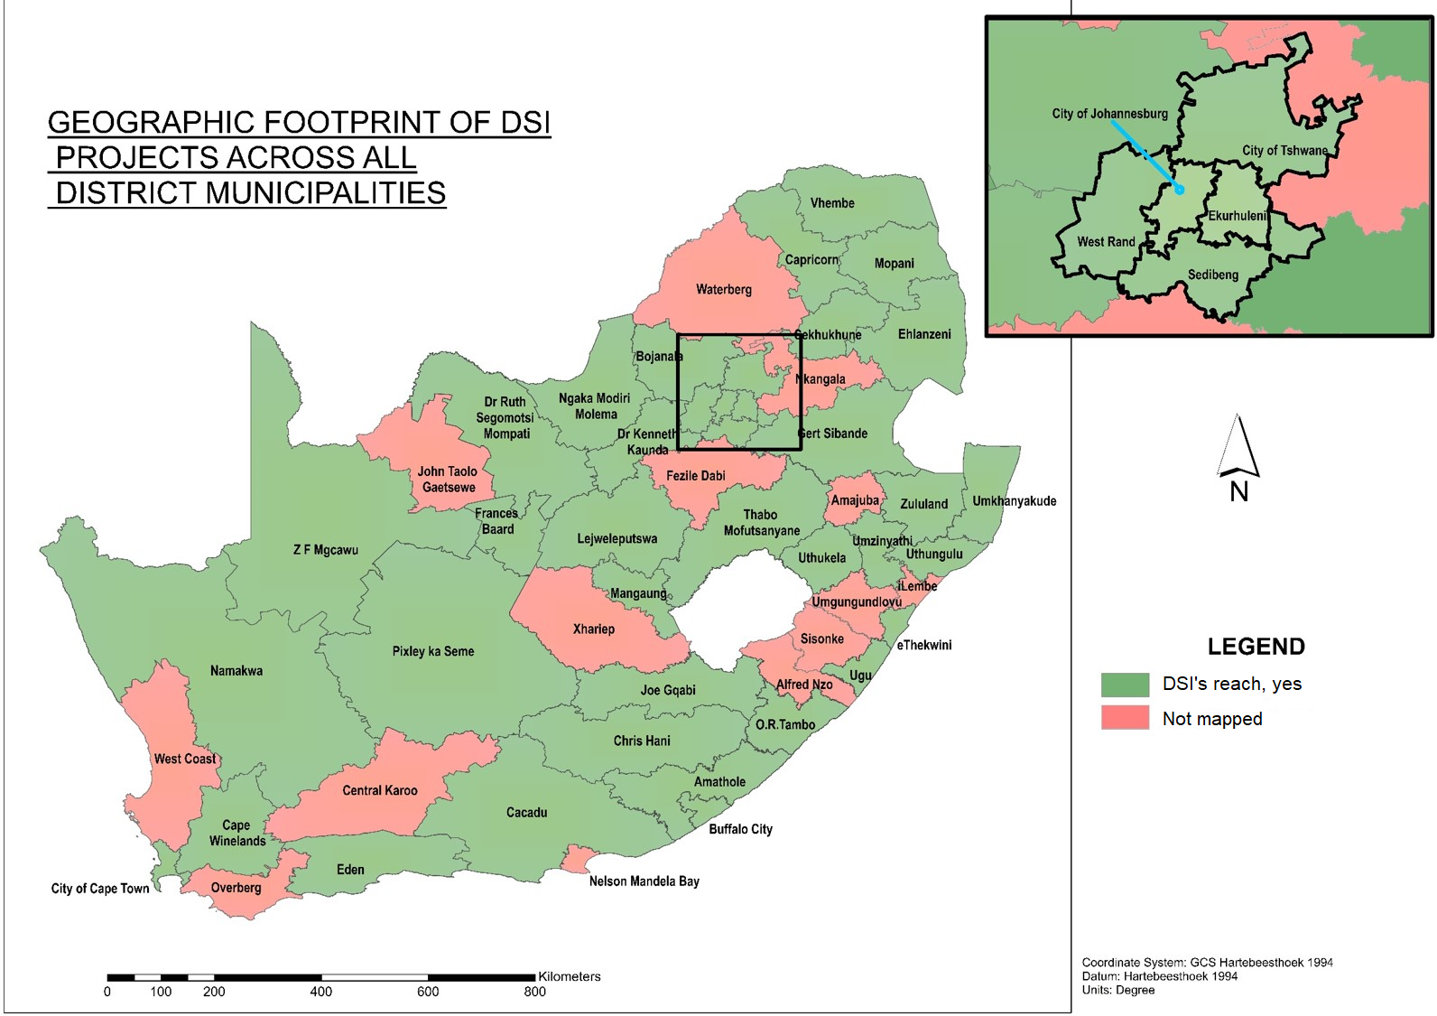
Geographic Footprint of DSI Projects Across District Municipalities
85

Slide 87
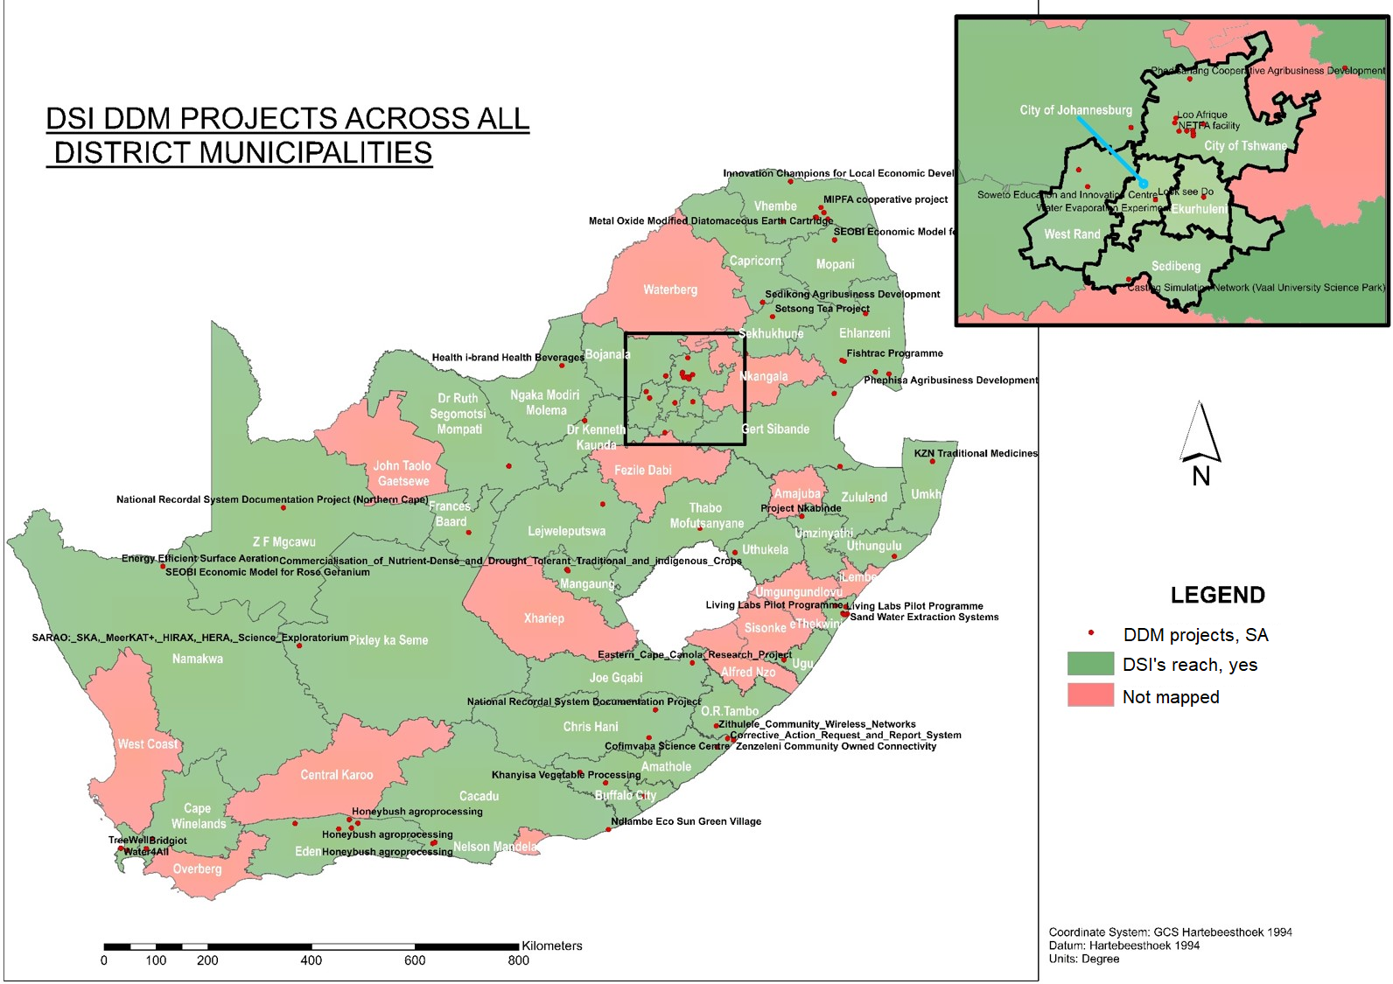
DSI’s DDM Projects Across District Municipalities
86

Slide 88
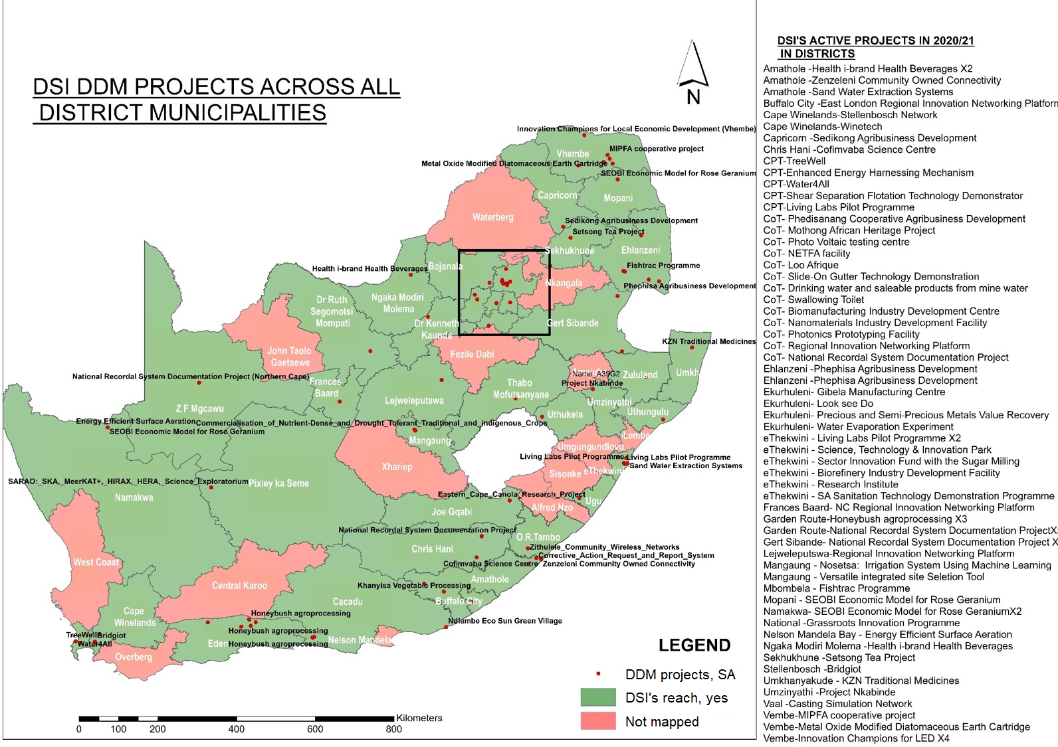
DSI’s High Impact and Most Response DDM Projects
87

Slide 89
DSI’s DDM Impact Areas
Impact Area (1)
Life Changing Opportunities
-skills development;
-training, innovation leadership skills;
-entrepreneurship support;
-digital skills;
-incentives and support for tech start ups, innovation SMME’s, cooperatives;
-support for unemployed youth, women
-youth innovation incentive schemes
Impact Area (2)
Economic Competitiveness and Recovery
-local systems of innovation and production;
-circular economy;
-innovation for local economic development;
-innovation support for existing economic sectors such as mining, agriculture, tourism and manufacturing;
-support for new sources of growth;
Impact Area (3)
Access to Basic Services and Infrastructure
-basic service delivery such as water, energy, human settlements, education, waste management, health and sanitation;
-innovation infrastructure;
-community innovation, science support centres;
-community broadband connectivity;
Research infrastructure;
-support for new sources of growth;
-smart cities, smart settlements and neighbourhoods
Impact Area (4)
Societal Problems, Challenges and Decision Support
-youth in drugs;
-environmental pollution and degradation;
-climate change and drought;
-safer cities and communities;
-social development;
-decision support tools;
-policy research
88

Slide 90
Dankie Enkosi
Ha khensa Re a leboga
Ro livhuwa Siyabonga
Siyathokoza Thank you

