Slide 1
NATIONAL HEALTH INSURANCE BILL
Submission by the HPCSA to Parliament
18th May 2021

Slide 2
CONTENT
GUIDING THE PROFESSIONS, PROTECTING THE PUBLIC
CONVERGENCE IN PURPOSE: NHI & HPCSA
HPCSA AS PARTNER TO THE NHI
HPCSA’S VIEWS ABOUT NHI
JURISDICTION OF RELEVANT STATUTORY
JURISDICTION OF STATUTORY BODIES EVEN AFTER THE NHI
PROPOSED SPECIFIC AMENDMENTS TO THE BILL

Slide 3
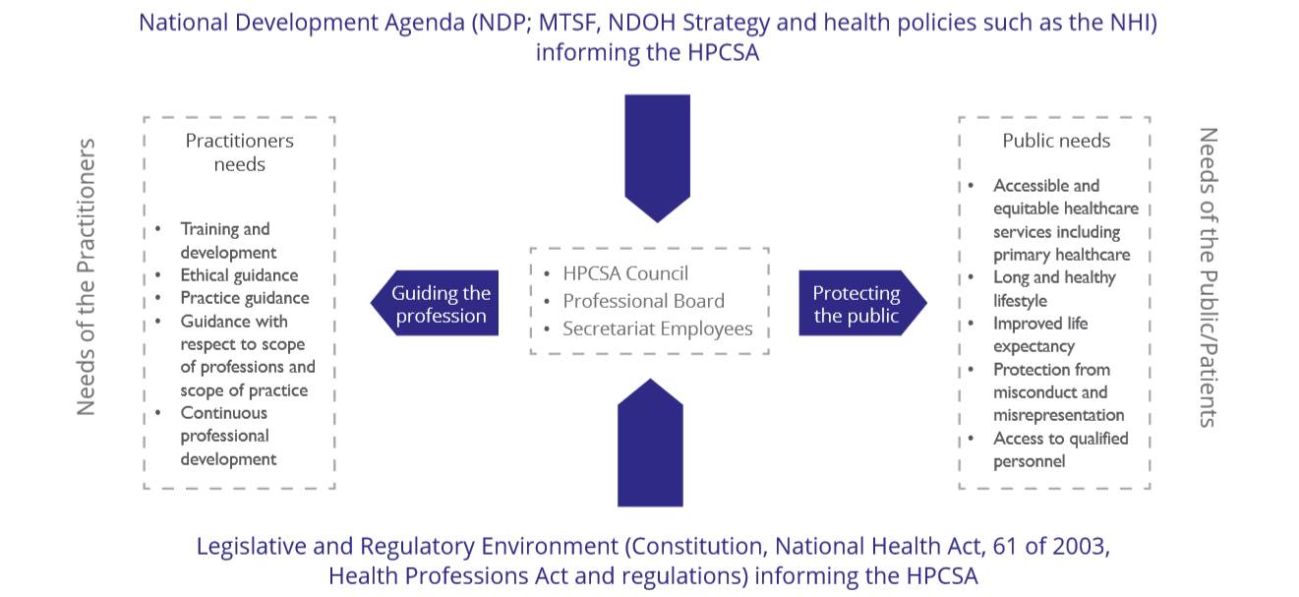
GUIDING THE PROFESSIONS, PROTECTING THE PUBLIC

Slide 4
CONVERGENCE IN PURPOSE: NHI & HPCSA
The Council welcomes the National Health Insurance for the following reasons:
Health equity and social justice
Reducing inequalities between the public and private sectors
Ensuring quality assurance for universal health coverage
Enforcing Professional Codes of Conduct and Ethics
Enhancing the Human Resources for Health as the key component and driver of universal coverage for health by ensuring that there are adequately qualified professionals trained and registered that meet the needs of the country by effectively carrying out its mandate of providing for control over the education, training and registration for and practising of health professions registered under the Act.

Slide 5
HPCSA AS PARTNER TO THE NHI
Experience in engagement with communities, professional associations and other regulators:
SANC
Pharmacy Council
SAHPRA
Etc
Experience in managing registrations of over 200,000 practitioners in any one year through its registers
Managing accreditations of training and internship programmes and their evaluations

Slide 6
HPCSA’S VIEWS ABOUT NHI
The National Health Insurance (NHI) should be the only funding mechanism for health in the Republic.
NHI should be funded through tax of all employed South Africans
Private medical aid schemes may continue to exists but funded separately over and above tax paid for the NHI
For NHI to succeed health must be an exclusive national competence and that any section(s) of the Constitution that militate against this view must be amended.
The Medical Schemes Act must be amended to ensure alignment with the NHI.
NHI should be about funding and contracting while service provision is left to other entities, public and private

Slide 7
JURISDICTION OF RELEVANT STATUTORY
BODIES EVEN AFTER THE NHI
Accreditation of professionals and their practices under relevant statutory bodies
Accreditation of facilities by the Office of Health Standards Compliance;
Standards setting for professions;
Conduct of professionals
Registration of professionals by the amongst others, the HPCSA
Treatment protocols

Slide 8
PROPOSED SPECIFIC AMENDMENTS TO THE BILL
Section | Clause | Challenge with current formulation | Proposed Amendment / New formulation
Rights of Users | 6 (o) | This clause creates a duplicative coverage by medical schemes and undermines the single-payer model of NHI | To pay through out-of-pocket means, health care services that are not covered by Fund
Cost Coverage | 8 | This clause creates a duplicative coverage by medical schemes and undermines the single-payer model of NHI | A person or user as the case may be must pay for health care services of that person or user:
Cost Coverage | 8(b) | This clause will encourage non-adherence to the referral pathway and will create a parallel system by undermining referral pathways | Delete Clause 8 (b)
Powers of the Fund | 11(h) | The Fund must not be seen to be the player and the referee | Investigate complaints against Fund, health care providers, health establishment and suppliers in collaboration with law enforcement agencies, statutory councils and regulatory authorities
Constitution and Composition of Board | 13(6) | There needs to be active participation of strategic members in the Board | The CEO, CFO and Chief Actuarial Officer are ex-officio members of the Board but may not vote at Board Meetings

Slide 9
PROPOSED SPECIFIC AMENDMENTS TO THE BILL …CONTINUED
Section | Clause | Challenge with current formulation | Proposed Amendment / New formulation
Role of Medical Schemes | 33 | NHI may never be fully implemented | The future role of medical schemes will be to offer complementary coverage to services not covered by NHI as determined by the Benefits Advisory Committee. The Minister will determine through regulations in a gazette when this phase will ensue
National Health Information System | 34 (3) | This clause must be strengthened to ensure that in addition to provisions of the NHA, it must also comply with requirements of this Act | Health Workers, health care service providers and persons in charge of health establishments must comply with provisions of the National Health Act and provisions of Section 40 of this Act relating to access to health records and the protection of health records
Appeal Tribunal | 44 (a) | May be misinterpreted as Chairperson of Board of NHI Fund | Remove the word Board at the end of sentence

