Slide 1
Amendment of Regulations in terms of the Legal Aid South Africa Act, 2014
Briefing to the Portfolio Committee on Justice and Correctional Services
12 May 2021

Slide 2
Presentation Outline
Introduction
Enabling Provisions
General
Details of the Proposed Amendments to the Regulations
4.1 Regulation 9: Civil matters
4.2 Regulation 11: Limitation and exclusion of civil legal aid
4.3 Regulation 13: Maintenance, domestic violence and harassment cases
4.4 Regulation 14: Labour cases
4.5 Regulation 15: Divorce and family law cases
4.6 Regulation 23: Other legislation requiring legal representation for children
4.7 Regulation 27: Qualifying for legal aid and means test
4.8 Regulation 31: Partially subsidized legal aid
4.9 Regulation 32: Contributions by legal aid recipient
5. Conclusion
Amendment of Regulations: Legal Aid SA Act, 2014

Slide 3
1. Introduction
Amendment of Regulations: Legal Aid SA Act, 2014

Slide 4
1. Introduction
The Legal Aid South Africa Act, 2014 (Act No. 39 of 2014) (the Act) came into operation with effect from 1 March 2015.
The first Regulations in terms of the Act were published by Government Notice No. R. 745 of 26 July 2017.
The Regulations were amended by Government Notice No. R. 498 of 29 March 2019 to increase the amounts of the means test.
The Board of Legal Aid South Africa, consequent to a resolution dated 8 July 2020, recommended to the Minister in terms of Section 23(1) specific amendments to the Regulations.
Amendment of Regulations: Legal Aid SA Act, 2014

Slide 5
2. Enabling Provisions
Amendment of Regulations: Legal Aid SA Act, 2014

Slide 6
2. Enabling Provisions
Section 23(1) and (2) of the Act provides as follows:
The Minister must, after receipt of recommendations of the Board, make regulations relating to—
the types of matters, both civil and criminal, in respect of which Legal Aid South Africa—
(i) provides legal aid;
(ii) does not provide legal aid; and
(iii) provides limited legal aid and the circumstances in which it does so;
the requirements or criteria that an applicant must comply with in order to qualify for legal aid, as well as the terms and conditions on which such legal aid is made available to the applicant;
the policy relating to the approval or refusal of legal aid, the termination of legal aid and appeals against such refusal or termination of legal aid; and
any matter which it is necessary or expedient to prescribe for the proper implementation or administration of this Act.
Any regulations made under subsection (1) must, before publication thereof in the Gazette, be tabled in Parliament by the Minister for approval.
Amendment of Regulations: Legal Aid SA Act, 2014

Slide 7
3. General
Amendment of Regulations: Legal Aid SA Act, 2014

Slide 8
3. General
The Department of Justice and Constitutional Development e-mailed a request for comments to several stakeholders on the proposed amendments to the Regulations on 29 September 2020.
Stakeholder were given until 30 October 2020 to provide comments.
No comments were received.
The proposed amendments to the Regulations do not result in any significant policy change.
The Presidency: Policy and Research exempted the DoJ from conducting a Socio-Economic Impact Assessment on the amendment of the Regulations as there were no significant policy changes.
Amendment of Regulations: Legal Aid SA Act, 2014

Slide 9
4. Details of the Proposed Amendments to the Regulations
Amendment of Regulations: Legal Aid SA Act, 2014

Slide 10
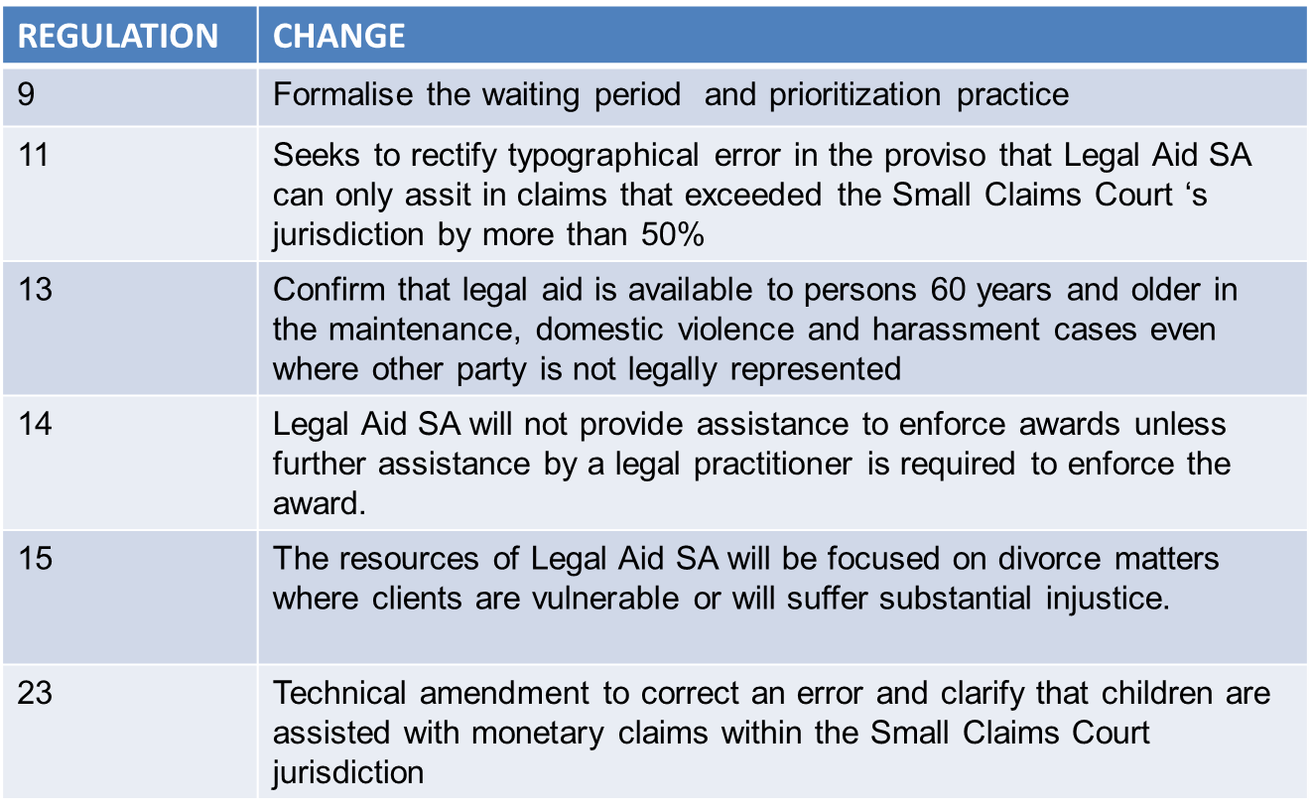
4. Summary of Changes
Amendment of Regulations: Legal Aid SA Act, 2014

Slide 11
4. Summary of Changes continued
Amendment of Regulations: Legal Aid SA Act, 2014

Slide 12
4. Discussion of the Amendment of Regulations
4.1 Regulation 9
Regulation 9 of the Regulations is amended—
by the substitution of the following words in sub regulation (1) for the words preceding paragraph (a):
“(1) Legal Aid South Africa may grant legal aid to a litigant in any civil matter, with or without a waiting period, where—”
by the addition after sub regulation (5) of the following sub regulation:
“(6) In the event that a waiting period referred to in sub regulation (1) is applied, Legal Aid South Africa must prioritise civil matters which have a significant impact on clients’ lives, including, but not limited to, the following matters:
(a) Civil proceedings involving children;
(b) evictions;
(c) social security matters;
(d) educational matters; and
(e) income related matters, such as employment or dismissals, pension and related funds and maintenance.”
Amendment of Regulations: Legal Aid SA Act, 2014

Slide 13
4. Discussion of the Amendment of Regulations
4.1 Regulation 9 Continued
The amendment of Regulation 9 provides clarity that:
a waiting period can be allowed in civil matters to manage demand for civil legal services. In practice, the waiting period is already used and the amendment seeks to confirm this practice; and
The new sub regulation 6 provides for matters which must be prioritised when such a waiting period is applied. These criteria are already used in practice.
Amendment of Regulations: Legal Aid SA Act, 2014

Slide 14
4. Discussion of the Amendment of Regulations
4.2 Regulation 11
Regulation 11 of the Regulations is amended by the substitution for sub regulation (3) of the following sub regulation:
“(3) Subject to regulation 23(8), legal aid may not be granted for any action that can be brought in a small claims court in terms of the Small Claims Courts Act, 1984 (Act No. 61 of 1984): Provided that Legal Aid South Africa may grant legal aid for a claim that exceeds the monetary jurisdiction of the small claims court by more than 50 percent.”
This amendment seeks to correct a technical error to the existing Regulation 11(3) to rectify a typographical error in the proviso to ensure that Legal Aid SA can only assist in claims that exceed the Small Claims Court’s jurisdiction by more than 50%.
Amendment of Regulations: Legal Aid SA Act, 2014

Slide 15
4. Discussion of the Amendment of Regulations
4.3 Regulation 13
Regulation 13 of the Regulations is amended—
by the substitution for sub regulation (1) of the following sub regulation:
“(1) In a maintenance case in terms of the Maintenance Act, 1998 (Act No. 99 of 1998), a domestic violence case in terms of the Domestic Violence Act, 1998 (Act No. 116 of 1998), or a matter brought in terms of the Protection from Harassment Act, 2011 (Act No. 17 of 2011), Legal Aid South Africa may grant legal aid to a legal aid applicant for an initial consultation to advise him or her on his or her rights, the procedure he or she can follow and his or her prospects of success.”
Amendment of Regulations: Legal Aid SA Act, 2014

Slide 16
4. Discussion of the Amendment of Regulations
4.3 Regulation 13 continued
Regulation 13 of the Regulations is amended—
by the substitution for sub regulation (2) of the following sub regulation:
“(2) Legal aid may be granted for legal representation in a court hearing for matters referred to in sub regulation (1), if—
(a) in the opinion of Legal Aid South Africa, the legal aid applicant's claim or defence has good prospects of success; and
(b) the—
opposing party is represented by a legal practitioner or is a legal practitioner; or
(ii) the legal aid applicant is over 60 years of age or disabled.”
Amendment of Regulations: Legal Aid SA Act, 2014

Slide 17
4. Discussion of the Amendment of Regulations
4.3 Regulation 13 continued
The proposed amendments to sub regulations (1) and (2)(b) are aimed at clarifying that legal aid in these types of matters is available to persons aged 60 years and older, even where the opposing party does not have legal representation.
This will make it easier for disabled and elderly applicants to qualify for legal aid and will increase access for vulnerable groups.
Amendment of Regulations: Legal Aid SA Act, 2014

Slide 18
4. Discussion of the Amendment of Regulations
4.4 Regulation 14
Regulation 14 of the Regulations is amended by the substitution in sub regulation (1) for paragraph (c) of the following paragraph:
“(c) assistance to enforce an award by the Commission for Conciliation, Mediation and Arbitration established in terms of the Labour Relations Act, 1995, where the Commission for Conciliation, Mediation and Arbitration has already instructed a sheriff at its own cost and a sheriff has been unable to successfully execute, except where there is no prospect of recovery.”
Amendment of Regulations: Legal Aid SA Act, 2014

Slide 19
4. Discussion of the Amendment of Regulations
4.4 Regulation 14 Continued
The Commission for Conciliation, Mediation and Arbitration (CCMA) provides assistance to enforce their awards and therefore Legal Aid SA should only provide assistance where further assistance by a legal practitioner is required to enforce the award.
A proposed amendment to Regulation 14(1)(c) will ensure that assistance to enforce CCMA awards is provided, where clients cannot proceed without the intervention of a legal practitioner.
Amendment of Regulations: Legal Aid SA Act, 2014

Slide 20
4. Discussion of the Amendment of Regulations
4.5 Regulation 15
Regulation 15 of the Regulations is amended by the substitution for sub regulation (2) of the following sub regulation:
“(2) Legal Aid South Africa may not grant legal aid for the following matters:
(a) A divorce appeal;
(b) a divorce action if the legal aid applicant married a foreigner to enable that foreigner to obtain South African citizenship; and
(c) a divorce action where there is—
(i) no allegation of domestic abuse;
(ii) no child, including a disabled or intellectually challenged child;
(iii) no immovable property as part of the joint estate;
(iv) no pension interest as part of the joint assets; or
(v) any other substantial benefit in the joint estate.”
Amendment of Regulations: Legal Aid SA Act, 2014

Slide 21
4. Discussion of the Amendment of Regulations
4.5 Regulation 15 Continued
The proposed substitution of Regulation 15(2)(c) will bring clarity and address any misinterpretation regarding the merits of a client’s divorce claim as opposed to whether a divorce order will be granted.
The proposed rewording of Regulation 15(2)(c) will focus the resources of Legal Aid SA on matters where clients are vulnerable or will suffer substantial injustice.
The other divorces will mostly be uncontested ones. Self-help assistance for clients will be available on Legal Aid SA’s website and clients will be assisted with legal advice by Legal Aid SA paralegals. The Registrars of the Regional Courts will also be able to assist in uncontested divorces.
Amendment of Regulations: Legal Aid SA Act, 2014

Slide 22
4. Discussion of the Amendment of Regulations
4.6 Regulation 23
Regulation 23 of the Regulations is amended by the substitution for sub regulation (8) of the following sub regulation:
“(8) Legal aid may be granted to a child for a monetary claim that falls within the small claims court monetary jurisdiction where it is required to protect the best interests of that child and if substantial injustice would otherwise result.”
This Technical amendment to Regulation 23(8) is proposed to correct an error and to clarify that children are assisted with monetary claims, even when they fall within the Small Claims Court jurisdiction.
This is a formalisation of how the matter is dealt with in practice.
Amendment of Regulations: Legal Aid SA Act, 2014

Slide 23
4. Discussion of the Amendment of Regulations
4.7 Regulation 27
Regulation 27 of the Regulations is amended by the addition after sub regulation (6) of the following sub regulation:
“(7) The amounts contemplated in sub regulations (2), (3), (4), (5) and (6) will increase annually on 1 April on the basis of the Consumer Price Index, rounded off to the next 100.”
The proposed amendment seeks to make provision for an automatic annual increase in the means test threshold by the Consumer Price Index (CPI), without requiring Legal Aid SA to go through the formal and rigorous process of amending the Regulations.
Amendment of Regulations: Legal Aid SA Act, 2014

Slide 24
4. Discussion of the Amendment of Regulations
4.8 Regulation 31
Regulation 31 of the Regulations is amended—
by the substitution for sub regulation (1) of the following sub regulation:
“(1) If a legal aid applicant does not qualify for legal aid in terms of the means test, Legal Aid South Africa may provide partially subsidised legal aid and require from the legal aid applicant to contribute to the cost of the legal aid.”
by the substitution in sub regulation (2) for the full stop at the end of paragraph (c) of the expression “; and”
by the addition in sub regulation (2) after paragraph (c) of the following paragraph:
“(d) whether the requirements of regulation 9(1) are met, in civil matters.”
Amendment of Regulations: Legal Aid SA Act, 2014

Slide 25
4. Discussion of the Amendment of Regulations
4.8 Regulation 31 Continued
The substitution of Regulation 31(1) with the new provision seeks to remove the reference to “criminal matter” and thereby include civil matters as matters for which partially subsidised legal aid can be granted.
The insertion of sub regulation (2)(d) is a consequential amendment to include civil matters that meet the Regulation 9(1) criteria in the scheme for subsidised legal aid.
Amendment of Regulations: Legal Aid SA Act, 2014

Slide 26
4. Discussion of the Amendment of Regulations
4.9 Regulation 32
Regulation 32 of the Regulations is amended—
by the substitution in sub regulation (1) for paragraphs (b) and (c) of the following paragraphs:
“(b) cessation of the criminal trial;
(c) the accused is convicted and sentenced to direct imprisonment; or”
by the addition after paragraph (c) of the following paragraph:
“(d) the finalisation of a civil matter,”
Amendment of Regulations: Legal Aid SA Act, 2014

Slide 27
4. Discussion of the Amendment of Regulations
4.9 Regulation 32 Continued
The proposed amendment to Regulation 32(1) now makes provision for contributions to also be levied in civil matters where the means test is exceeded.
This is a consequential amendment to Regulation 32 to give effect to the inclusion of civil matters in Regulation 31, as discussed above.
Amendment of Regulations: Legal Aid SA Act, 2014

Slide 28
5. Conclusion
The proposed amendments to the Regulations do not result in any significant policy change;
The technical corrections will align the policy to the actual position;
The limited and decreasing civil resources of Legal Aid SA will be directed to the most vulnerable;
There will not be duplication of services between the CCMA and Legal Aid SA;
The Means Test will keep pace with inflation without requiring annual revisions to the Regulations;
The Regulations will come into effect once approved by both houses of Parliament and duly gazetted by the Minister.
Amendment of Regulations: Legal Aid SA Act, 2014

Slide 29
NGIYABONGA
THANK YOU
KE A LEBOGA
DANKIE
www.legal-aid.co.za

Slide 30
Follow us on social media
@LegalAidSA1
Legal Aid South Africa
www.legal-aid.co.za

