Slide 2

FILM & PUBLICATION BOARD
ANNUAL PERFORMANCE PLAN 2021/2022
PRESENTATION TO THE PC OF COMMUNICATIONS
11 MAY 2021

Slide 3
PRESENTATION OUTLINE
FPB MANDATE
FPB STRATEGIC PLAN 2021 – 2025
ANNUAL PERFORMANCE PLAN 2021/22
ALIGNMENT TO PERFORMANCE AGREEMENT OF MINISTER
HUMAN RESOURCES
TOP 10 STRATEGIC RISKS
BUDGET 2021/22

Slide 4
MANDATE

Slide 5


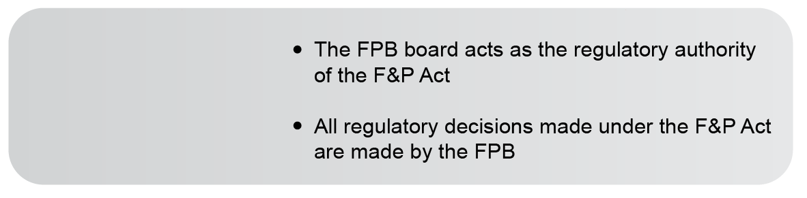




THE FPB HAS BEEN ESTABLISHED AS A REGULATORY AUTHORITY AND AN ORGAN OF THE STATE TO ACT IN THE FOLLOWING WAYS

Slide 6




THE FPB’S MANDATE

Slide 7
FPB STRATEGIC PLAN 2021 - 2025

Slide 8
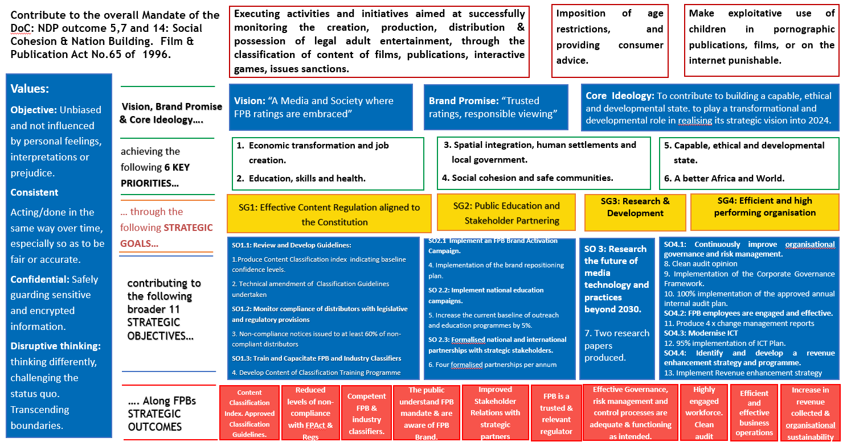
STRATEGIC DIRECTION 2021 - 2025

Slide 9
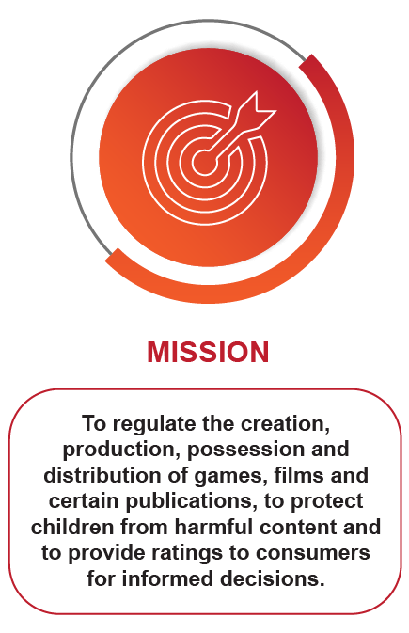
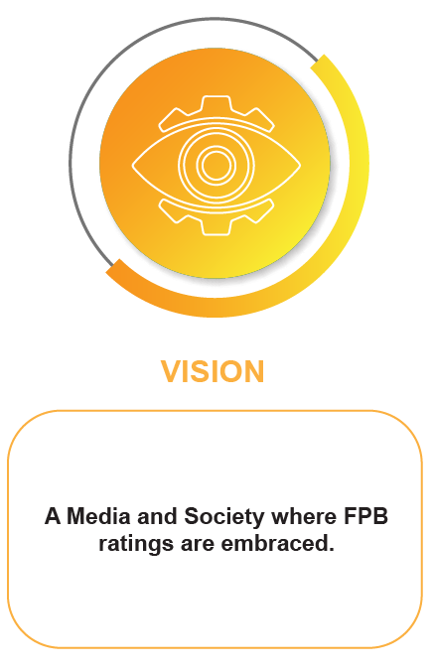
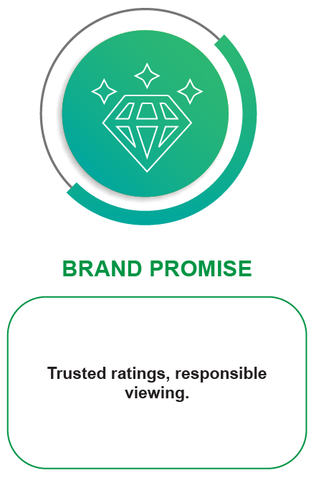
OUR MISSION, VISION AND
BRAND PROMISE

Slide 10
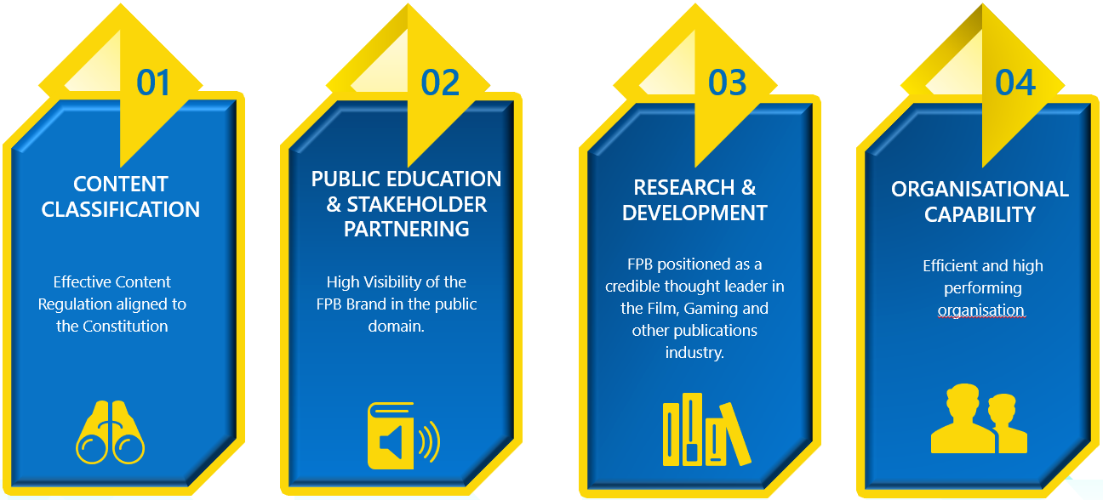
STRATEGIC OBJECTIVES
2021 - 2025

Slide 11




STRATEGIC OUTCOMES:
Content Classification Index. Approved Classification Guidelines.
Reduced levels of non-compliance with FPAct & Regs
Competent FPB & industry classifiers.
The public understand FPB mandate & are aware of FPB Brand.
Improved Stakeholder Relations with strategic partners
FPB is a trusted & relevant regulator
Effective Governance, risk management & control processes
Highly engaged workforce. Clean audit
Efficient and effective business operations
Increase revenue collected & organisational sustainability

Slide 12
ANNUAL PERFORMANCE PLAN 2021 - 2022

Slide 13
STRATEGIC GOAL 1:
EFFECTIVE CONTENT REGULATION ALIGNED TO THE CONSTITUTION

Slide 14

Strategic Goal 1: Effective Content Regulation aligned to the Constitution
Strategic Objective 1.1: Review & Develop Guidelines.
Indicators, Annual and Quarterly Targets
Output Indicators* | Annual Target (measures) | Q1 | Q2 | Q3 | Q4
Content Classification Index (reports) | Produce Content Classification index (CCI) indicating baseline confidence levels. | Conduct research on the CCI on 6 SADC countries. | Conduct research on the CCI on 6 SADC countries. | Conduct research on the CCI on 6 SADC countries. | Produce Research Report. Update the CCI, publish a report and distribute.
Approved Classification Guidelines | Technical amendment of Classification Guidelines undertaken | Develop the classification review plan. | Conduct consultations with stakeholders across the country. | Draft findings document and revise the guidelines. | Submit amended Classification Guidelines to Council and Executive Authority.

Slide 15
Strategic Goal 1: Effective Content Regulation aligned to the Constitution
Strategic Objective 1.2: Monitor compliance of distributors with legislative and regulatory provisions
Indicators, Annual and Quarterly Targets
Output Indicators* | Annual Target (measures) | Q1 | Q2 | Q3 | Q4
Number of Non-compliance notices issued. | Non-compliance notices issued to at least 60% of non-compliant distributors | Number of Non-compliance notices issued. | Number of Non-compliance notices issued. | Number of Non-compliance notices issued. | Number of Non-compliance notices issued.
Approved Enforcement Committee Concept Paper. Appointment of the Chairperson the Enforcement Committee. | Benchmark enforcement models in different institutions. Council approved concept paper. Appoint Chairperson of the Enforcement Committee | Develop a research proposal and conduct the benchmark study (research). | Draft Benchmark report (research) and business case produced (legal). | Table the benchmark report to Council for approval. Nomination of the Chairperson of the Enforcement Committee. | Council appoints chairperson of the Enforcement Committee.

Slide 16
Strategic Goal 1: Effective Content Regulation aligned to the Constitution
Strategic Objective 1.3: Train and Capacitate FPB and Industry Classifiers
Indicators, Annual and Quarterly Targets
Output Indicators* | Annual Target (measures) | Q1 | Q2 | Q3 | Q4
Approved Classifier Training Programme | Design Content Classification Training Programme | Develop Business Case and project documentation for the classification Training programme. | Implement the project plan and submit project reports on a quarterly basis. | Implement the project plan and submit project reports on a quarterly basis. | Draft Classification Training Programme.

Slide 17
STRATEGIC GOAL 2:
PUBLIC EDUCATION AND STAKEHOLDER PARTNERING

Slide 18
Strategic Goal 2: Public Education and Stakeholder Partnering
Strategic Objective 2.1: Implement an FPB Brand Activation Campaign
Indicators, Annual and Quarterly Targets
Output Indicators* | Annual Target (measures) | Q1 | Q2 | Q3 | Q4
100% Implementation of the Brand repositioning strategy | Implementation of the Brand Repositioning Strategy | Brand repositioning strategy tabled to EXCO. | Design of the repositioned brand based on approved Brand Strategy. Tabling of repositioned Brand for approval at Council, | Launch of the repositioned FPB brand. | Implement a training programme on the repositioned FPB brand to Key stakeholders.
Strategic Objective 2.2: Implement national education campaigns.
Outreach and Education reports, Evaluation reports as well as focus group reports. Monitoring and evaluation system to be developed. | 100% achievement of the approved Outreach and Education Plan | 100% completion of the planned implementation activities due for Q1. | 100% completion of the planned implementation activities due for Q2. | 100% completion of the planned implementation activities due for Q3. | 100% completion of the planned implementation activities due for Q4. Conduct an Impact Assessment of the Outreach Programme 2021/22

Slide 19
Strategic Goal 2: Public Education and Stakeholder Partnering
Strategic Objective 2.3: Formalised national and international partnerships with strategic stakeholders
Indicators, Annual and Quarterly Targets
Output Indicators* | Annual Target (measures) | Q1 | Q2 | Q3 | Q4
Formalised partnership agreements | 4 x formalised partnerships per annum | Approval of an Annual Stakeholder Engagement Plan aligned to the priorities of an Organisational and Unit Stakeholder Ecosystem Map | 2 x formalised partnership developed with a strategic partner per quarter. | 1 x formalised partnership developed with a strategic partner per quarter. | 1 x formalised partnership developed with a strategic partner per quarter.

Slide 20
STRATEGIC GOAL 3:
RESEARCH AND DEVELOPMENT

Slide 21
Strategic Goal 3: Research & Development
Strategic Objective 3.1: Research the future of media technology and practices beyond 2030
Indicators, Annual and Quarterly Targets
Output Indicators* | Annual Target (measures) | Q1 | Q2 | Q3 | Q4
Workshop on dissemination of Convergence Survey findings | Disseminate the findings of the 2019/20 convergence survey | Identify platforms for a conference and workshop Develop abstracts for two research papers Develop concept notes for the workshop and conference | Presentb a paper on the Convergecne survey results at one identified natioinal conference. Convene workshop with FPB stakeholders Identifty journals for publication | Draft research papers for publication. | Two research papers submitted for publication.
Comparative analysis report on games classification systems and processes | Conduct benchmarking on games classification systems internationally | Develop Terms of Reference and appoint a service provider. | Research instrument developed. Data collection commences | Data collection finalised | Research report finalised and presented to EXCO and MANCO approved by council

Slide 22
STRATEGIC GOAL 4:
EFFICIENT AND HIGH PERFORMING ORGANISATION

Slide 23
Strategic Goal 4: Efficient and high performing
Strategic Objective 4.1: Continuously improve organisational governance and risk management.
Indicators, Annual and Quarterly Targets
Output Indicators* | Annual Target 2021/22 (measures) | Q1 | Q2 | Q3 | Q4
External audit report with a clean audit opinion | Clean audit opinion | Complete annual financial statements on time and in accordance with GRAP. | Information for audit purposes submitted to AG on time. National Treasury framework for strategic and Annual performance plans complied with. | Compliance with the PFMA and relevant legislation. | Compliance with the PFMA and relevant legislation.
Implementation of the Corporate Governance Framework | 100% implementation of the Corporate Governance Framework. | Develop Annual Council plan and table to council for approval. Implement the Corporate Governance framework. | Implement the Corporate Governance framework against the approved Annual Council plan. | Implement the Corporate Governance framework against the approved Annual Council plan. | Implement the Corporate Governance framework against the approved Annual Council plan.

Slide 24
Strategic Goal 4: Efficient and high performing
Strategic Objective 4.1: Continuously improve organisational governance and risk management.
Indicators, Annual and Quarterly Targets
Output Indicators* | Annual Target (measures) | Q1 | Q2 | Q3 | Q4
Percentage implementation of the Annual Internal Audit Plan | Implementation of the Annual Internal Audit Plan | Develop and approve the Annual Internal Audit Plan. 15% implementation of the Annual Internal Audit Plan. | 40% implementation of the Annual Internal Audit plan | 70% implementation of the Annual Internal Audit plan | 100% implementation of the Annual Internal Audit plan
Report on the Implementation of the Enterprise Risk Management Strategy and plan. | 100% Implementation of the Enterprise Risk Management Strategy and plan. | Implementation of the Enterprise Risk Management Strategy and plan. 100% Completion of the planned implementation activities due for quarter. | Implementation of the Enterprise Risk Management Strategy and plan. 100% Completion of the planned implementation activities due for quarter. | Implementation of the Enterprise Risk Management Strategy and plan. 100% Completion of the planned implementation activities due for quarter. | Implementation of the Enterprise Risk Management Strategy and plan. 100% Completion of the planned implementation activities due for quarter.

Slide 25
Strategic Goal 4: Efficient and high performing
Strategic Objective 4.2: FPB employees are engaged and effective
Indicators, Annual and Quarterly Targets
Output Indicators* | Annual Target (measures) | Q1 | Q2 | Q3 | Q4
Change management reports | Implement the change management project phase ii and phase iii. | Implement phase ii of the Change management programme Not Applicable | Complete phase ii of the Change. management programme Collate all the necessary data and information | Implement phase iii of the Change Management programme Workshop the draft EVP with Staff | Complete phase iii of the Change Management programme Submit finalised EVP to Exco, Manco and HR REMCO

Slide 26
Strategic Goal 4: Efficient and high performing
Strategic Objective 4.3: Modernise ICT capability
Indicators, Annual and Quarterly Targets
Output Indicators* | Annual Target (measures) | Q1 | Q2 | Q3 | Q4
Quarterly progess reports indicating % achievement against the ICT Plan. | % Delivery against annual approved ICT Plan | Approved Annual ICT plan. 20% completion of the planned implementation activities against the annual ICT plan. | 50% completion of the planned implementation activities against the annual ICT plan. | 70% completion of the planned implementation activities against the annual ICT plan. | 95% completion of the planned implementation activities against the annual ICT plan. Review of the Annual ICT Plan.

Slide 27
Strategic Goal 4: Efficient and high performing
Strategic Objective 4.4: Identify and develop a revenue enhancement strategy and programme
Indicators, Annual and Quarterly Targets
Output Indicators* | Annual Target (measures) | Q1 | Q2 | Q3 | Q4
Approved revenue enhancement strategy. Quarterly progress reports on the approved revenue enhancement implementation plan. | Approved Revenue enhancement Strategy and implementation plan. | Workshop the strategy with management. | Develop an implementation plan. | 100% completion of the planned implementation activities for the quarter. | 100% completion of the planned implementation activities for the quarter.

Slide 28
ALIGNMENT TO MINISTERS PERFORMANCE AGREEMENT

Slide 29
SOE Targets for 2021/22 (Only key targets aligned to the DCDT priorities) | Alignment with DCDT 2021/22 targets (as appearing in draft DCDT 2021/22 APP) | Confirmation of available resources to deliver target (Financial & HR) | Required institutional mechanisms & partnerships to deliver on target | Required support from DCDT
FPB Strategic Goal 1: Effective Content Regulation aligned to the Constitution
Produce Content Classification index (CCI) indicating baseline confidence levels. | Priority 6: Social Cohesion and safe communities Target: Fostering Constitutional Identity Annual targets 10 activations utilised to promote constitutional awareness 16 Marketing platforms utilised to promote constitutional awareness per annum. | Human resources not available – require a Research Manager. Financial resources available and committed. | Outsourced to a 3rd party via procurement. University of Pretoria appointed. | Support from the research team.
Technical amendment of Classification Guidelines undertaken | Priority 6: Social Cohesion and safe communities Target: Fostering Constitutional Identity Annual targets 10 activations utilised to promote constitutional awareness 16 Marketing platforms utilised to promote constitutional awareness per annum. | Human and Financial resources available | Strategic partners with whom we have SLAs signed SLAs and MOUs in place as well s informal working partnerships: SABC Brand SA CGE SAAYF GFC Soul City Love Life Tshimologong INHOPE Molo Songololo Schools Film and gaming industry players – regular workshops with industry (Facebook and Google); Webrangers NFVF National Film commissions KZN, WESGRO Gauteng etc. | Support required from Entities oversight, research and Collin Mashile unit.

Slide 30
SOE Targets for 2021/22 (Only key targets aligned to the DCDT priorities) | Alignment with DCDT 2021/22 targets (as appearing in draft DCDT 2021/22 APP) | Confirmation of available resources to deliver target (Financial & HR) | Required institutional mechanisms & partnerships to deliver on target | Required support from DCDT
FPB SO 2: Public Education and Stakeholder Partnering Strategic Objective 2.2: Implement national education campaigns.
100% achievement of the approved Outreach and Education Plan. Safer Internet Day Feb2022 (international campaign) - targeting this as a Ministerial led campaign. 16 days of activism against violence against women (25 Nov to 10 Dec) Child protection week (May/June) Women’s month Billboard and or street pole campaigns 4 x Digital activations per campaign 4 opinion pieces and op-eds per annum and 12 press releases on FPB work Radio (community radio) activations and plans to implement an MDDA radio programming project. Assist SADC and DCDT to roll out, implement and advertise the 116-child protection hotline. | Priority 6: Social Cohesion and safe communities Target: Promoting social cohesion through increased interaction across space and class. Annual Targets 12 Digital campaigns showcasing the significance of national days; 12 interviews radio and television 1 digital media campaign Target: Promoting active citizenry and leadership Annual Target 9 x PYP provincial activities Target: Equal opportunities inclusion and redress Annual Target 100% implementation of National Strategic Plan (NSP) to end gender-based violence by 2024. | Human resources available and committed. Require additional financial resources for a national Billboard campaign | Strategic partners with whom we have SLAs signed SLAs and MOUs in place as well s informal working partnerships: Brand SA SABC CGE SAAYF GFC Soul City Love Life Molo Songololo Schools INHOPE CHILDLINE SA, Tanzania and Rwanda GIZ/UN Women research reference group Tshimologong Film and arts schools Universities NGOs and CBOs supporting people with disabilities Department of Social Development Industry bodies WASPAS; Facebook Google Webrangers | Require Minister to lead on the SID campaign as a departmental FLAGSHIP programme. DCDTResearch Department Minister to lead on this flagship 116 roll out programme – (continent wide). DCDT: Petronella Linders and ICASA

Slide 31
SOE Targets for 2021/22 (Only key targets aligned to the DCDT priorities) | Alignment with DCDT 2021/22 targets (as appearing in draft DCDT 2021/22 APP) | Confirmation of available resources to deliver target (Financial & HR) | Required institutional mechanisms & partnerships to deliver on target |  | Required support from DCDT
FPB Strategic Objective 2.3: Efficient and High Performing Organisation
Clean audit opinion Drive 4IR readiness in terms of upskilling and acquisition of appropriate talent within FPB - Talent Management | Priority 1: Build a capable, ethical and developmental state Targeted Impact: Public Value and Trust; Active citizenry and partnerships in society. Target: 100% elimination of wasteful and fruitless expenditure against baseline by 2024. | Human and Financial resources available and committed. | Internal employees Loss committee set up and well-functioning. Internal audit unit well function. | Critical: appointment of a new FPB Council. Support through Entities oversight department. | Clean audit opinion Drive 4IR readiness in terms of upskilling and acquisition of appropriate talent within FPB - Talent Management

Slide 32
HUMAN RESOURCES

Slide 33
Human Resources
The FPB had undergone an etensive OD process during 2019 to 2020, with a goal to ensure that the organisation is aligned to critical operational imperatives, remain relevant and is 4IR ready as we face massive technological changes and an evolution of content distribution.
The revised and approved Organisational structure has 97 posts (fig 1 above).
Vacancy rate as at March 2021 is 8%; headcount is 88.
There are regular culture and or engagement studies undertaken showing a continues low employee morale. This is due to the ongoing moratorium on salary increments, lack of CEO post and communication;
On a positive note: employees cite that the FPB is a learning organisation and that we run an excellent training and development programme for employees;
High vacancy (employee churn) rate during 2019 resulted in burn out and low staff morale; a many staff were fulfilling dual roles.
Changes in leadership over the past 5 years resulted in uncertainty for some employees;
•Recently reviewed organisational structure that augments the revised strategy – plans underway to review the organisational structure every two years. The structure was last reviewed in 2012).

Slide 34
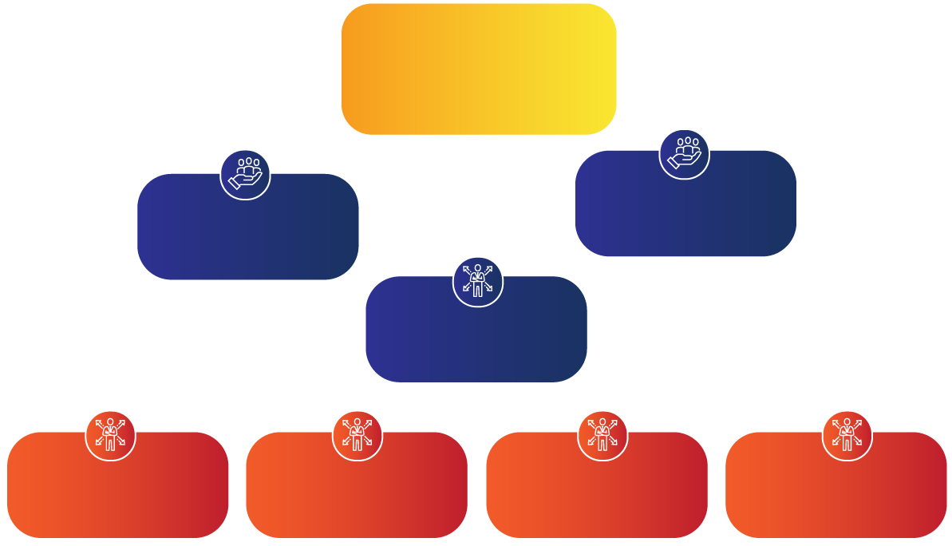

OUR CURRENT STRUCTURE
Department of Communications
and
Digital Technologies
Appeals Tribunal
FPB Council
Chief Executive Officer
Shared Services Executive (SSE)
Chief Operations Officer (COO)
Chief Financial Officer (CFO)
Chief Information Officer (CIO)

Slide 35
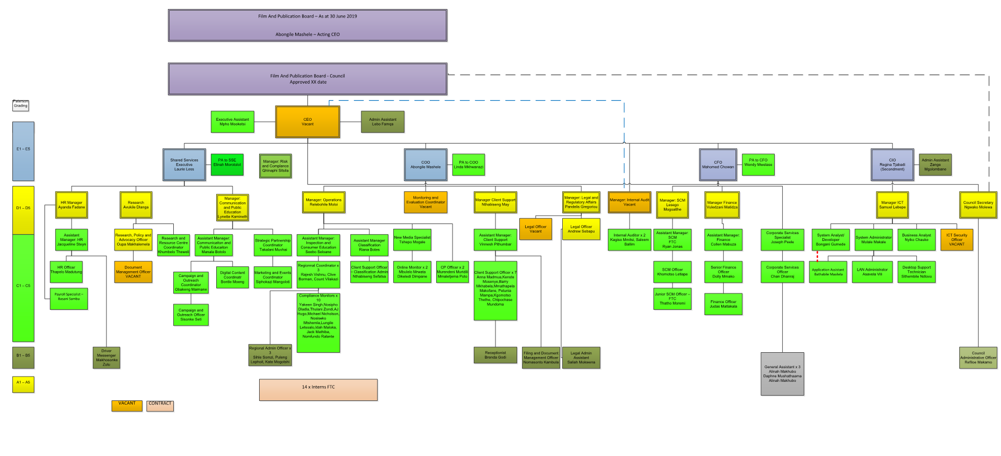

DETAILED STRUCTURE INDICATING VACANCIES

Slide 36
RISK MANAGEMENT

Slide 37
TOP 10 STRATEGIC RISKS 2021/22
Strategic Risk number: SR# | Risk Name | Risk Type/Category | Residual Likelihood | Residual Consequence | Residual Risk Score
SR8 | Inadequate ICT support. | Information Technology | 4 - Likely | 5 - Caterstrophic | High
SR11 | Non-compliance with the Protection of Personal Information Act ("POPIA") | Compliance \ Regulatory | 4 - Likely | 4 – Significant | High
SR9 | Institutional Sustainability Risk | Disaster Recovery / Business Continuity | 4 - Likely | 4 – Significant | High
SR7 | Organisational Culture Risk | Cultural | 4 - Likely | 4 – Significant | High
SR2 | Industry and public non-compliance with the Films and Publications Act (FP Act) and Regulations | Compliance \ Regulatory | 3 - Moderate | 4 – Significant | Moderate
SR6 | Non-compliance to Corporate Governance Framework | Compliance \ Regulatory | 4 - Likely | 3 - Moderate | Moderate
SR4 | Education and awareness campaigns not reaching all demographics of society. | Education and Awareness | 3 - Moderate | 4 – Significant | Moderate
SR3 | Ineffective management of stakeholder relations | Reputation | 4 - Likely | 3 – Moderate | Moderate
SR10 | Inadequate Project Management | Financial | 3 - Moderate | 4 – Significant | Moderate
SR5 | Regression in the audit opinion from the AGSA | Compliance \ Regulatory | 3 - Moderate | 3 – Moderate | Moderate

Slide 38
BUDGET 2021/2022

Slide 39
Revenue Budget 2021/22
Revenue | Budget 2021/22
Operational Grant | 100 937 000
Classification Fees | 3 391 456
Registration Fees | 315 502
Annual Renewal Fees | 323 837
Internet SP Registration | 97 693
License Fees | 10 335 000
Interest revenue | 1 374 685
Grand Total | 116 775 173

Slide 40
Expenditure Budget 2021/22
Operational Expenditure | Budget 2021/22
Personnel | 69 985 830
Administrative | 46 234 530
Capital Expenditure | 554 813
Total Expenditure | 116 775 173

Slide 41
Expenditure Budget Per Program
Expenditure Per Program | Budget 2021/22
SO1: Effective Content Regulation aligned to the Constitution | 11 384 189
SO2: Public Education and Stakeholder Partnering | 5 977 362
SO3: Research & Development | 835 589
SO4: Efficient and high performing organisation | 98 578 034
Grand Total | 116 775 173

Slide 42
Expenditure Budget Per Program
SO1 – Effective Content Regulation
Effective Content regulation is the core mandate of the FPB, ensuring that through its regulatory mechanisms, children and sensitive viewers are not exposed to harmful content.
The budget allocation for this SO will be used for training of classifiers, industry and distributors, classifiers fees, content classification training program, design content classification index, production of content classification index, Legal fees and inspection at all identified distributors of content to ensure compliance to FP Act.
SO2 – Public Education and Stakeholder Partnering
The allocated budget will be used to develop a Brand Repositioning plan based on the perception studies,Implementation of an approved Annual Outreach & Education Plan and improve the stakeholder relations

Slide 43
Expenditure Budget
SO3 – Research & Development
The allocated budget for this SO will be used to launch the results of the convergence survey, conduct focus groups and produce two research papers
SO4 – Efficient and high performing organisation
The allocated budget will be used increase will be used to continuously improve organisational governance and risk management, Compliance with relevant legislation, regulations and policies, implementation of the approved ICT Plan and creating high performing organisation
The bulk amount in this budget include salaries, rental of
office space, maintenance of the vehicles , audit fees, lease
of copy machines, data costs etc and this is in line with the
consumer price index

Slide 44
THANK YOU

