Slide 1
2021 LEARNER ADMISSIONS REPORT
PRESENTATION TO THE PORTFOLIO COMMITTEE ON BASIC EDUCATION
11 MAY 2021

Slide 2
OUTLINE OF THE PRESENTATION
Purpose
Legislative framework
Importance of early registration
Admission Business Process
Effect of COVID-19 on admissions
2020/21 preparations
Admission periods
Circulars
Number of placed learners
Number of unplaced numbers
Migration of learners
Challenges leading to late placement and mitigation strategies
Admission of undocumented learners
Milestones
Recommendation
2

Slide 3
PURPOSE
To present to the Portfolio Committee on Basic Education the updated status report on learner admission and placement.
3

Slide 4
LEGISLATIVE FRAMEWORK
The admission of learners to public schools is governed by the provisions of the South African Schools Act, 1996 (Act No.84 of 1996) (SASA).
The Admission Policy for Ordinary Public Schools (the Admission Policy), determined in terms of section 3(4) of the National Education Policy Act, 1996 (Act No. 27 of 1996), and published in Government Notice No. 2432 of 1998, Government Gazette No.19377, on 19 October 1998.
Approved HEDCOM and CEM Business Process for Admissions.
4

Slide 5
IMPORTANCE OF EARLY REGISTRATION
It is the responsibility of every parent and guardian to ensure that their children are registered for the following year, well before the end of the current school year.
Early admission assists Provincial Education Departments in the determination of:
Post provision;
Learner teacher support materials;
Learner furniture;
Additional classrooms; and
Ensuring that teaching and learning commence on the first day of the schooling calendar.
5

Slide 6
ADMISSION BUSINESS PROCESS
Determine admission period with a comprehensive management plan (timeframes) mapping out:
Application Period – distribution of admission forms, when parents return forms, information on documentation needed;
Management of registration – clear criteria for waiting lists and process to rank applications using feeder schools and residential information as examples, depending on provincial Regulation;
The period to inform parents on the status of their children’s application; and
Period of placement of learners with information on period to lodge appeals, where to find support if a learner is not placed with contact details of provincial and district officials responsible admissions.
6

Slide 7
ADMISSION BUSINESS PROCESS
No. | DBE | PROVINCE | DISTRICTS | SCHOOL
1 | Advice on PED Regulations on learner admissions and give feedback. | Develop learner admissions regulations and circulars. | Ensure proper implementation of learner admission regulations and circulars. | Develop learner admission policy.
2 | Consolidate data on learner admissions. | Generate a management plan for learner admissions. | Generate a management plan for learner admissions. | Implement management plan.
3 | Inform members of the public on information regarding learner admissions. | Put required information on PED website. | Inform public of learner admission matters. | Inform public on learner admissions through news letters.
4 | Monitor and support the implementation of learner admissions. | Monitor and support learner admissions in Districts. | Monitor and support learner admissions in schools. | Administer registration of learners.
5 | Direct learner admission appeals to provinces. | Investigate learner admission appeals. | . Address learner admissions appeals | Administer registration of learners.
7

Slide 8
EFFECT OF COVID-19 ON ADMISSIONS
The advent of the COVID-19 pandemic has led to:
The late opening of the registration and admission process;
The extension of the closing dates;
Different provincial admission periods as COVID-19 affected provinces differently; limited advocacy campaigns conducted due to restricted travel and gatherings; and
Delayed finalisation of placement.
8

Slide 9
2020/21 PREPARATIONS
ADMISSION ASPECT | YES | NO
Made the Provincial Regulations on admissions available?
2. Made Circulars on admissions available?
3. Appointed a District Admission Coordinator?
4. Established a District Admission Team?
5. Developed an Admission Management Plan?
6. Developed an admission advocacy campaign?
7. Determined a clear admission period? (start & end date)
8. Established appeal teams
9. Advocacy
9

Slide 10
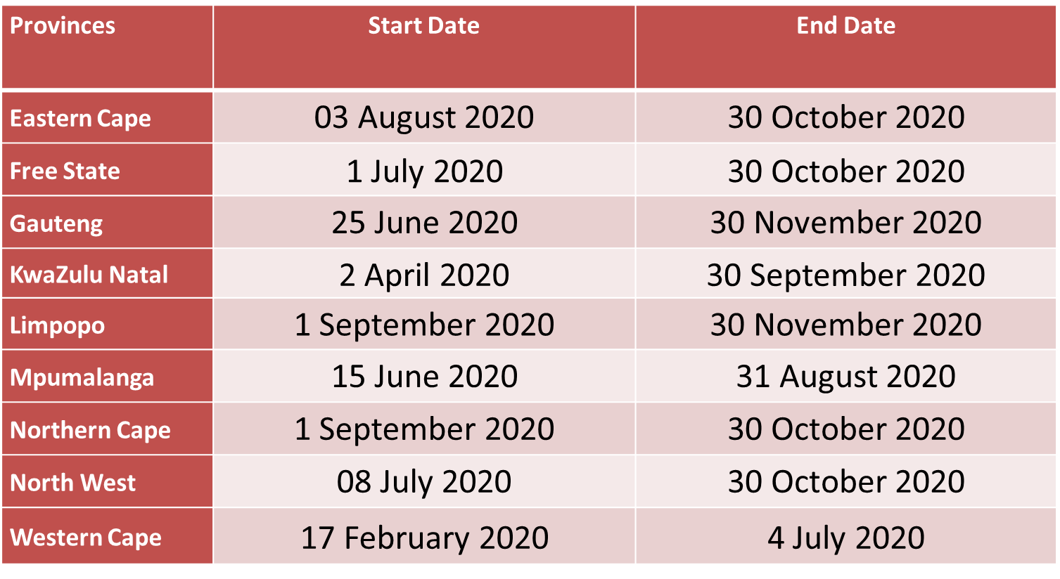
2021 APPLICATIONS
10

Slide 11
CIRCULARS
Province | Circulars | Admissions Teams | Information on the Provincial Website
EC | Circular 5 of 2019 | Was in Place | Assisted applicants
FS | Circular MG 12 of 2020 | Was in Place | Assisted applicants
GP | GN 4138, 13 July 2013, as amended | Was in Place | Assisted applicants
KZN | Circular 2 of 2020 | Was in Place | Assisted applicants
LP | Circular 71 of 2020 | Was in Place | Assisted applicants
MP | Circular 28 of 2020 | Was in Place | Assisted applicants
NW | Circular 30 of 2020 | Was in Place | Assisted applicants
NC | Circular 24 of 2020 | Was in Place | Assisted applicants
WC | Circular 44 of 2018 | Was in Place | Assisted applicants
11

Slide 12
NUMBER OF PLACED LEARNERS
Provinces | Grade 1 | Grade 8
Eastern Cape | 138 392 | 125 686
Free State | 56 972 | 63 566
Gauteng | 131 995 | 141 176
KwaZulu-Natal | 371 164 | 226 509
Limpopo | 136 516 | 139 660
Mpumalanga | 91 306 | 91 090
Northern Cape | 6 544 | 12 318
North West | 14 244 | 17 931
Western Cape | 105 532 | 90 409
Total | 1 052 655 | 908 345
12

Slide 13
NUMBER OF UNPLACED LEARNERS
Only the Western Cape still have outstanding learners to place.
There were over 5 000 learners to be placed in March 2021.
The number was reduced to 3 786 by 13 April 2021.
The remaining unplaced learners was 1 228 as of 24 April 2021.
Updated information received on 10 May 2021 indicates that the figure of unplaced learners was at 109.
The 109 remaining unplaced learners have been allocated to schools but are yet to physically report there. The Western Cape is in the process of getting in touch with parents of the affected learners to confirm placements.
The WCED released more than 400 additional posts in March and an additional 179 posts were added in April to relieve pressure and place learners.
43 classrooms were opened after the appointment of additional teachers.
129 mobile classrooms were procured and delivery has commenced.
13

Slide 14
MIGRATION OF LEARNERS
ORIGIN | WESTERN CAPE | GAUTENG
Eastern Cape | 22 195 | 12 236
Free State | 410 | 5 651
Gauteng | 1 707
KwaZulu-Natal | 455 | 20 074
Limpopo | 203 | 21 573
Mpumalanga | 195 | 7 265
North West | 209 | 7 691
Northern Cape | 649 | 1 476
Western Cape (internal movement) | 1 232 | 1 670
Not in school | 877
Other countries | 1 805 | 25 517
Unknown | 18
Total | 29 955 | 103 153
14

Slide 15
CHALLENGES LEADING TO LATE PLACEMENTS
Delayed opening of school;
English medium schools and schools in informal settlements received more applications than the available spaces, as well as schools in fast growing areas;
Good performing schools attracted more applications than poor performing schools (parents move learners to good schools);
More learners sought admission in public schools after their removal from independent schools due to the parents’ inability to pay fees owing to job loses;
Migration of learners from one area to another increased due to varied family reasons;
Late applications;
Provinces such as Gauteng, Western Cape, Free State (Bloemfontein) and Northern Cape (Kimberly) experience high numbers of admission seekers;
The WC and the EC were the only provinces who still had unplaced entry grade learners as at 19 April 2021.
15

Slide 16
MITIGATION STRATEGIES
Cleaning up of data to remove duplicates.
Opening of walk in centres across districts.
Negotiating on increased class size.
Purchasing of mobile classes (GP 161, WC 129).
Building of additional classroom (408 in GP).
Appointment of additional teachers.
16

Slide 17
ADMISSION OF UNDOCUMENTED LEARNERS
The Department of Basic Education in collaboration with the Department of Home Affairs, has released Circular 1 of 2020 aimed at simplifying the registration and admission of undocumented learners following the 2019 Court Judgement.
17

Slide 18
MILESTONES
Three provinces, Gauteng, Northern Cape and Western Cape have online registration systems for grade 1 and grade 8.
18

Slide 19
NEXT STEPS
The sector has commenced with plans for the 2022 admission process.
19

Slide 20
RECOMMENDATION
It is recommended that the Portfolio Committee on Basic Education notes and discusses the updated status report on learner admission and placement.
20

Slide 21
21

